Slide 1
Large Language Models Energize Geographic Information Science: A Survey
——Explore the boundaries of capability, imagine the impossible
Presenter: Sakura
Department: School of Earth Science, Zhejiang University
Date: 2024/4/7

Slide 2
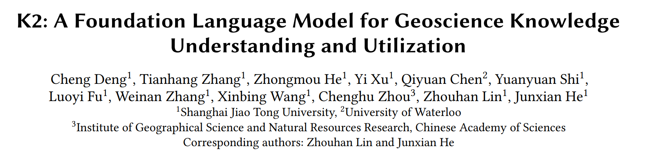
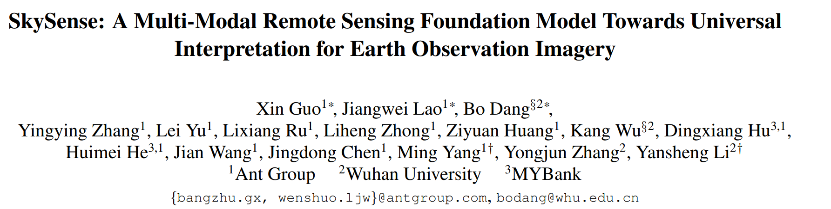
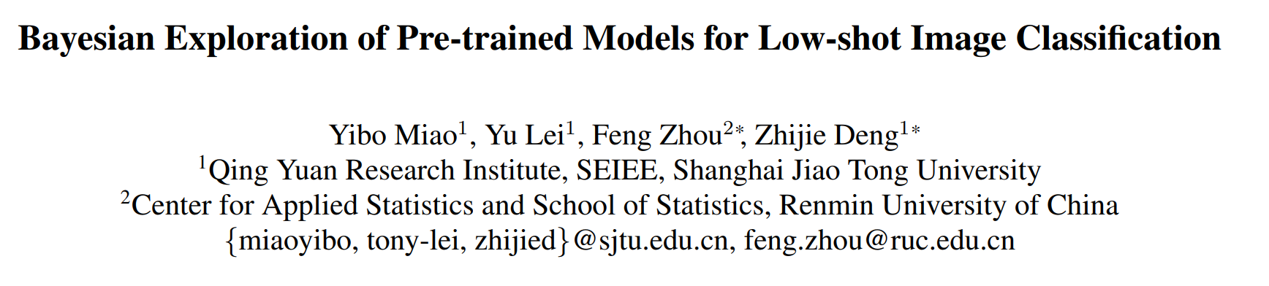
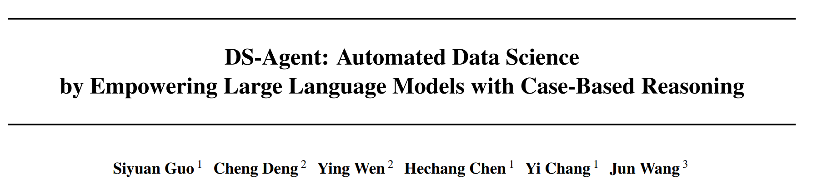
WSDM’24
CVPR’24
CVPR’24
ICML’24

Slide 3
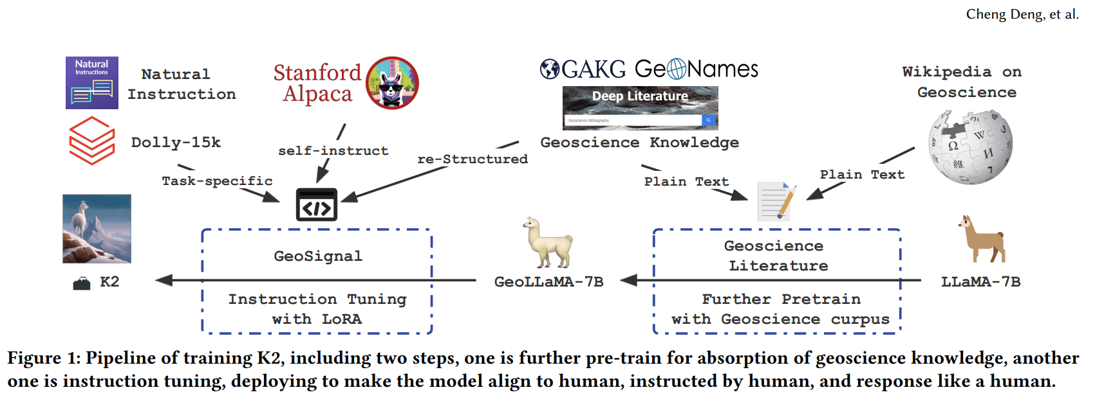
K2: The Pioneer in Integrating Large Language Models with GeoScience
K2: A Foundation Language Model for Geoscience Knowledge Understanding and Utilization
(Deng, C., et al., 2023)/(WSDM’24)
Notes:
CS/ 领域/完整工作溜（数据预处理、预训练、微调）/成熟Demo

Slide 4
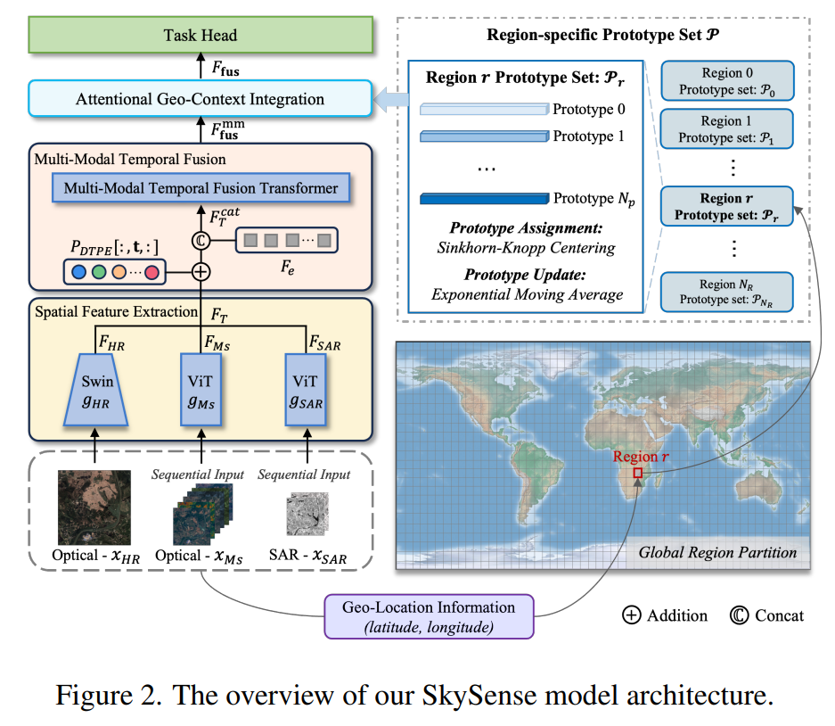
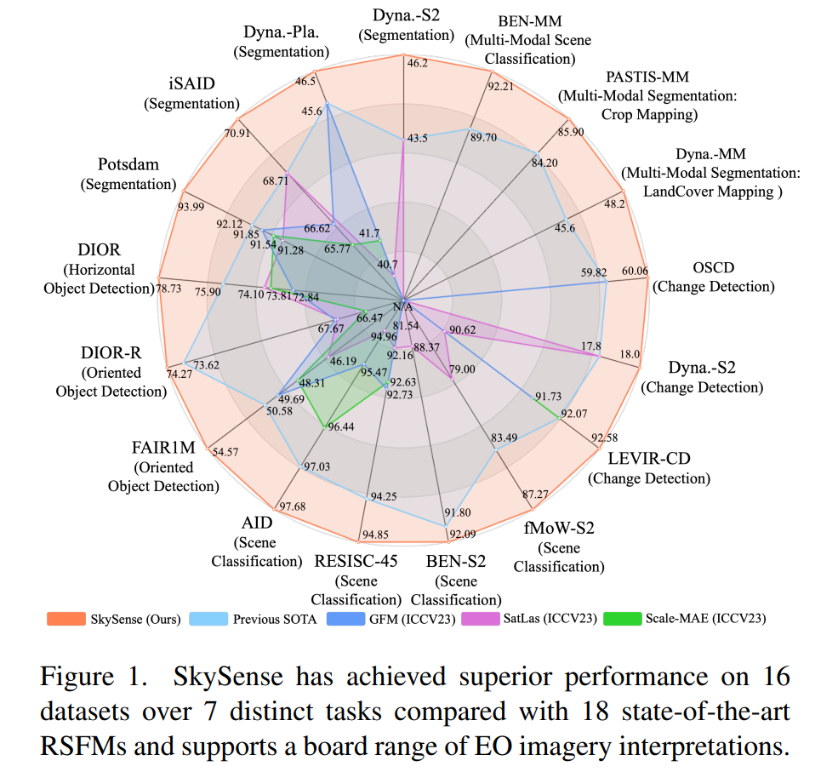
Skysense: A Foundation Model in RS
Skysense: A multi-modal remote sensing foundation model towards universal interpretation for earth observation imagery (Ant Group & Wuhan University & MYBank,2024) /(CVPR2024)
Notes:
地学

Slide 5
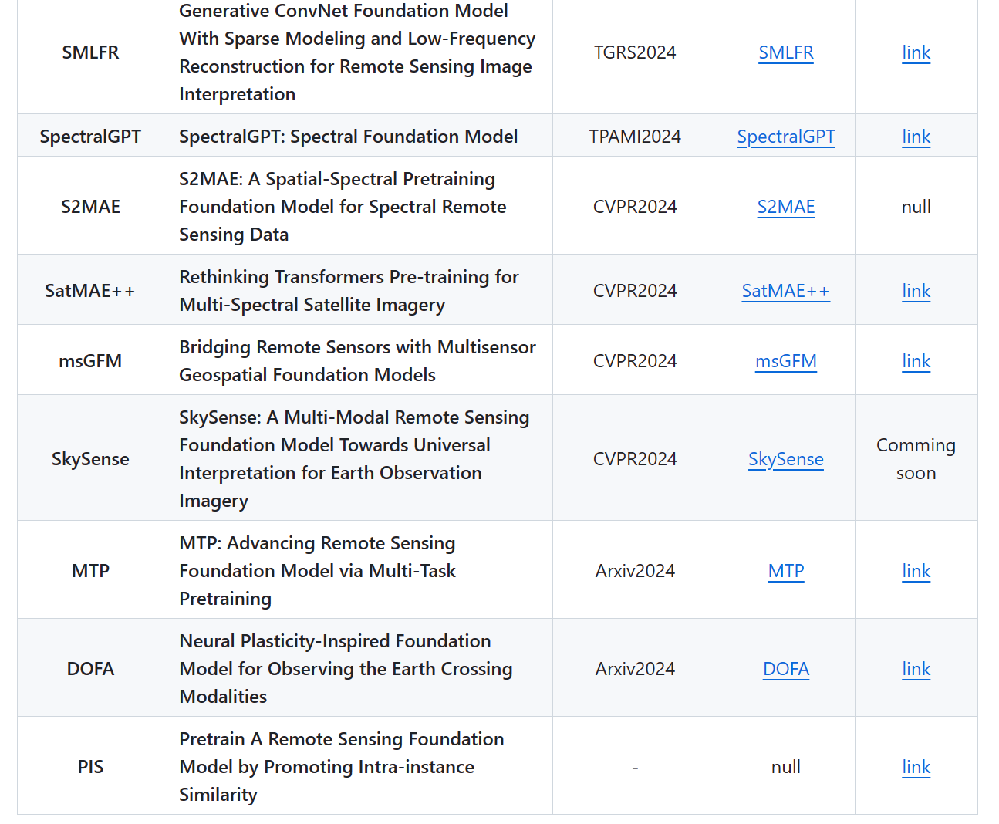
Awesome Remote Sensing Foundation Models
https://github.com/Jack-bo1220/Awesome-Remote-Sensing-Foundation-Models

Slide 6
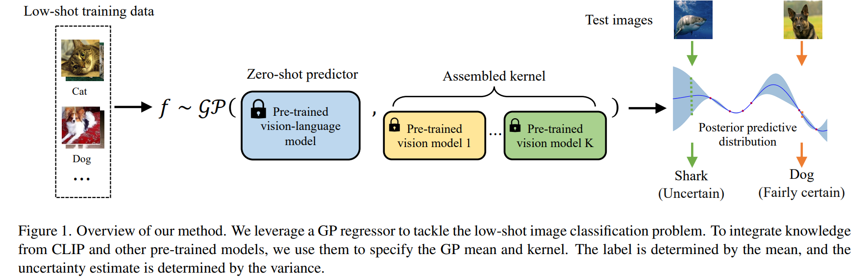
State-of-the-art Models & Modality Bridging
Bayesian Exploration of Pre-trained Models for Low-shot Image Classification
(Yibo Miao, Yu Lei, Feng Zhou, Zhijie Deng, 2024)/(CVPR2024)

Slide 7
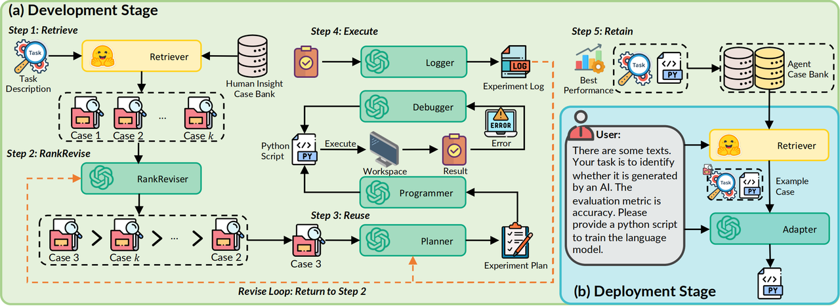
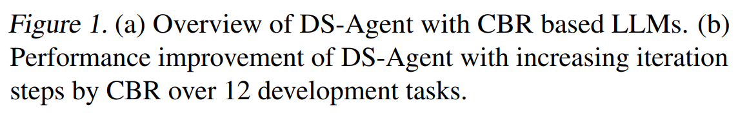
DS-Agent: A Self-Improvement Agent Specialized for Machine Learning Tasks
DS-Agent: Automated Data Science by Empowering Large Language Models with Case-Based Reasoning (Guo, S., Deng, C., et al., 2024) /(ICML2024)

Slide 8
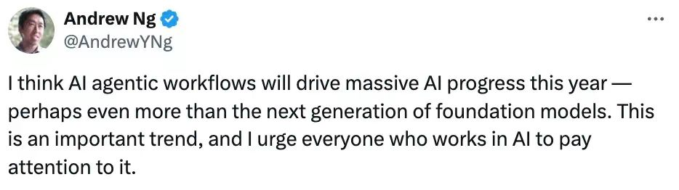
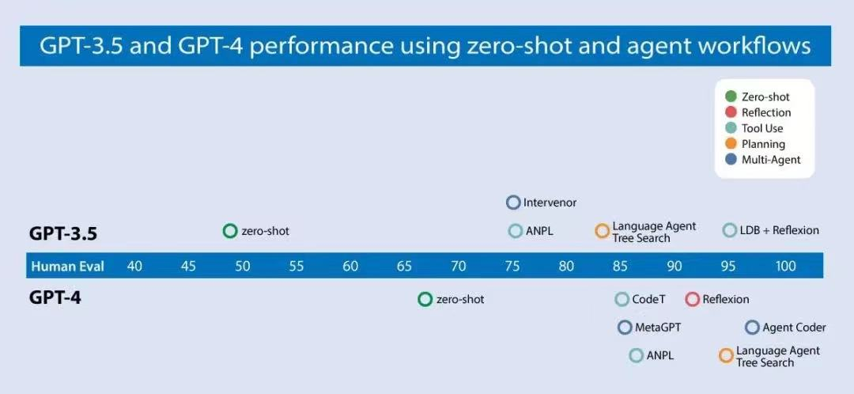
Prospects: Agent is Future!
LLMs serve as all-powerful experts to revolutionize all the traditional paradigms with high-level automation!

