Slide 1

Awesome Tools for AI Researchers
Presentor: Sakura (bilibili@Sa神带你学AI)
Contact me: bili_sakura@zju.edu.cn

Slide 2
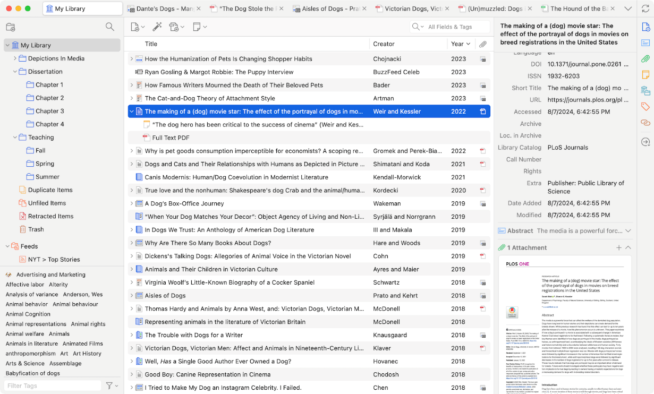
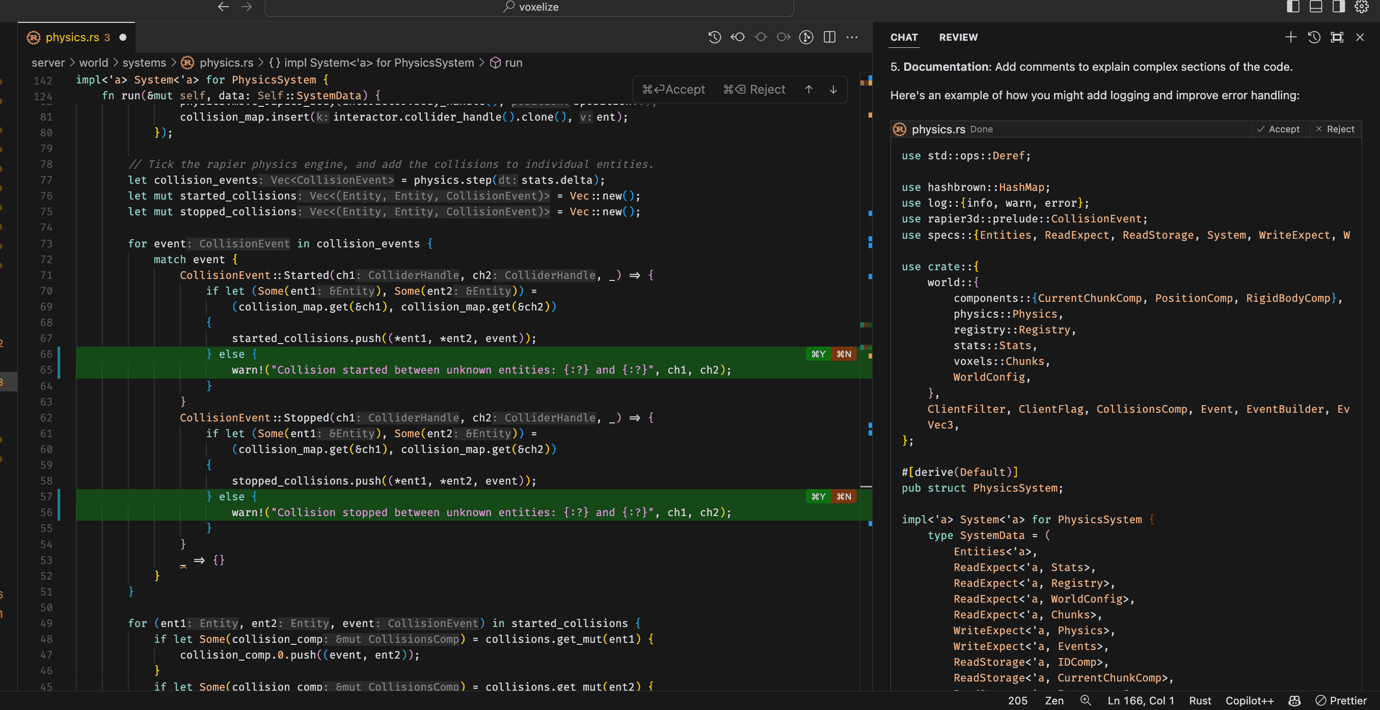
Outline
Literature Assistant
AI Code Editor
Zotero 7
Cursor
https://www.zotero.org/blog/zotero-7/
https://www.cursor.com/features

Slide 3
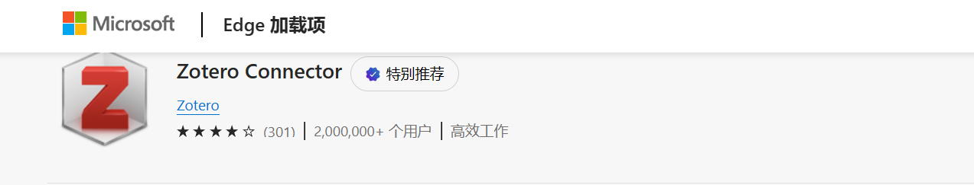
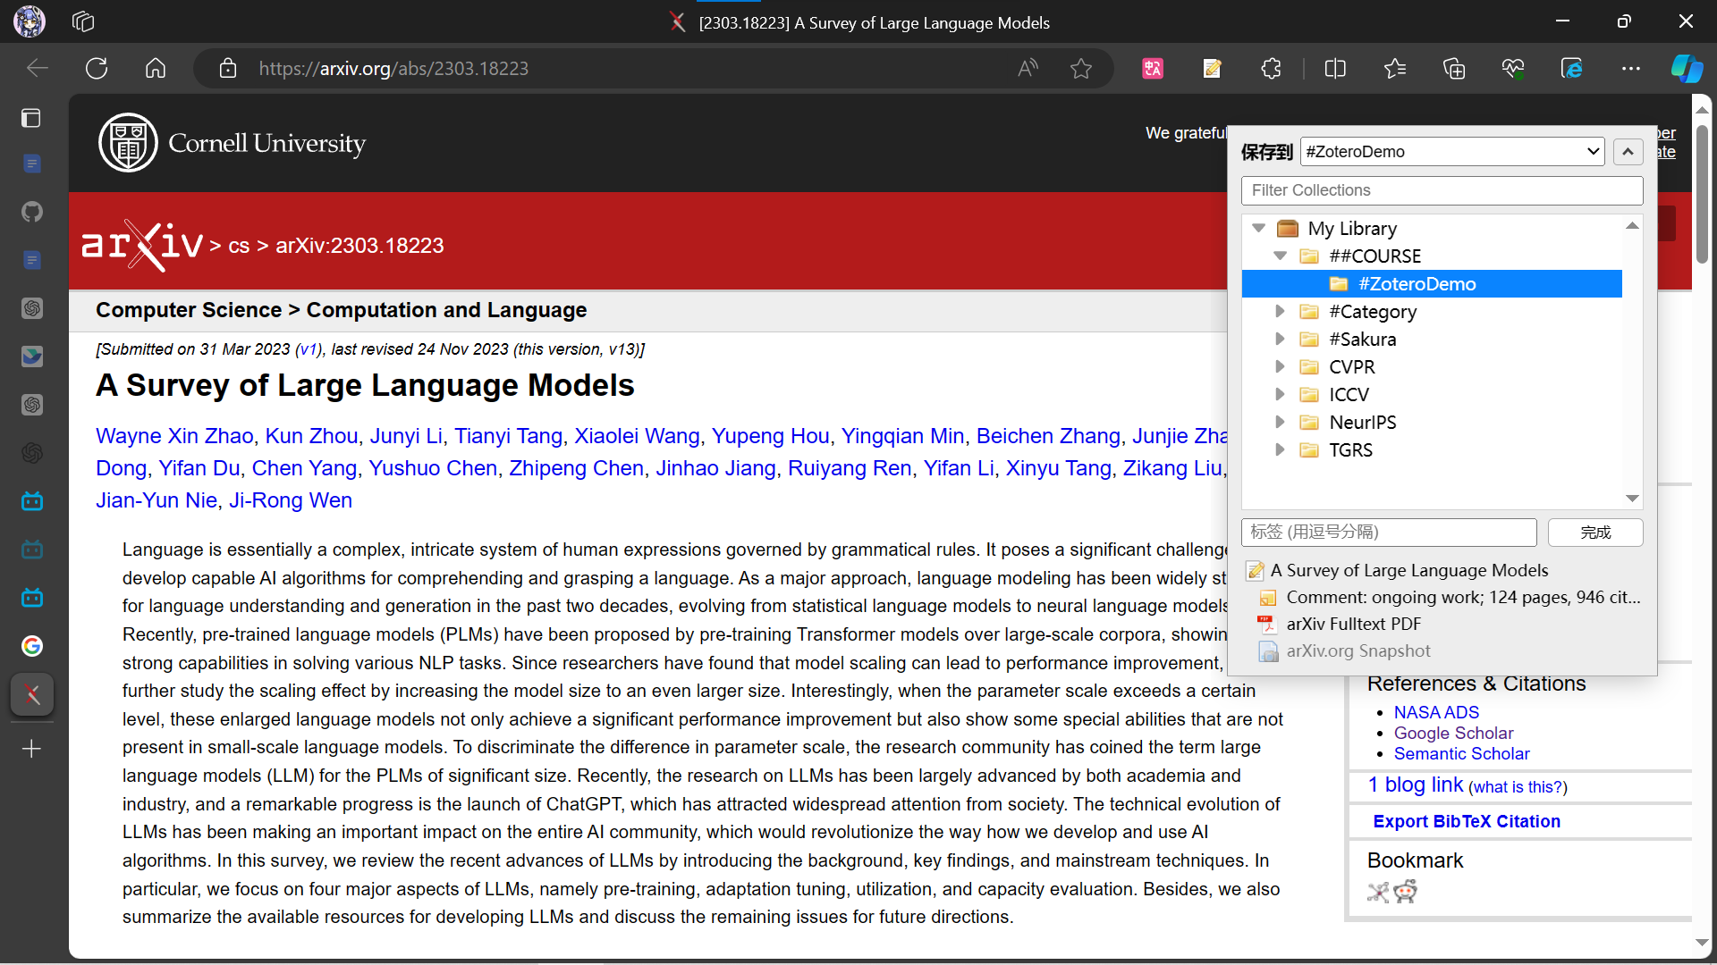
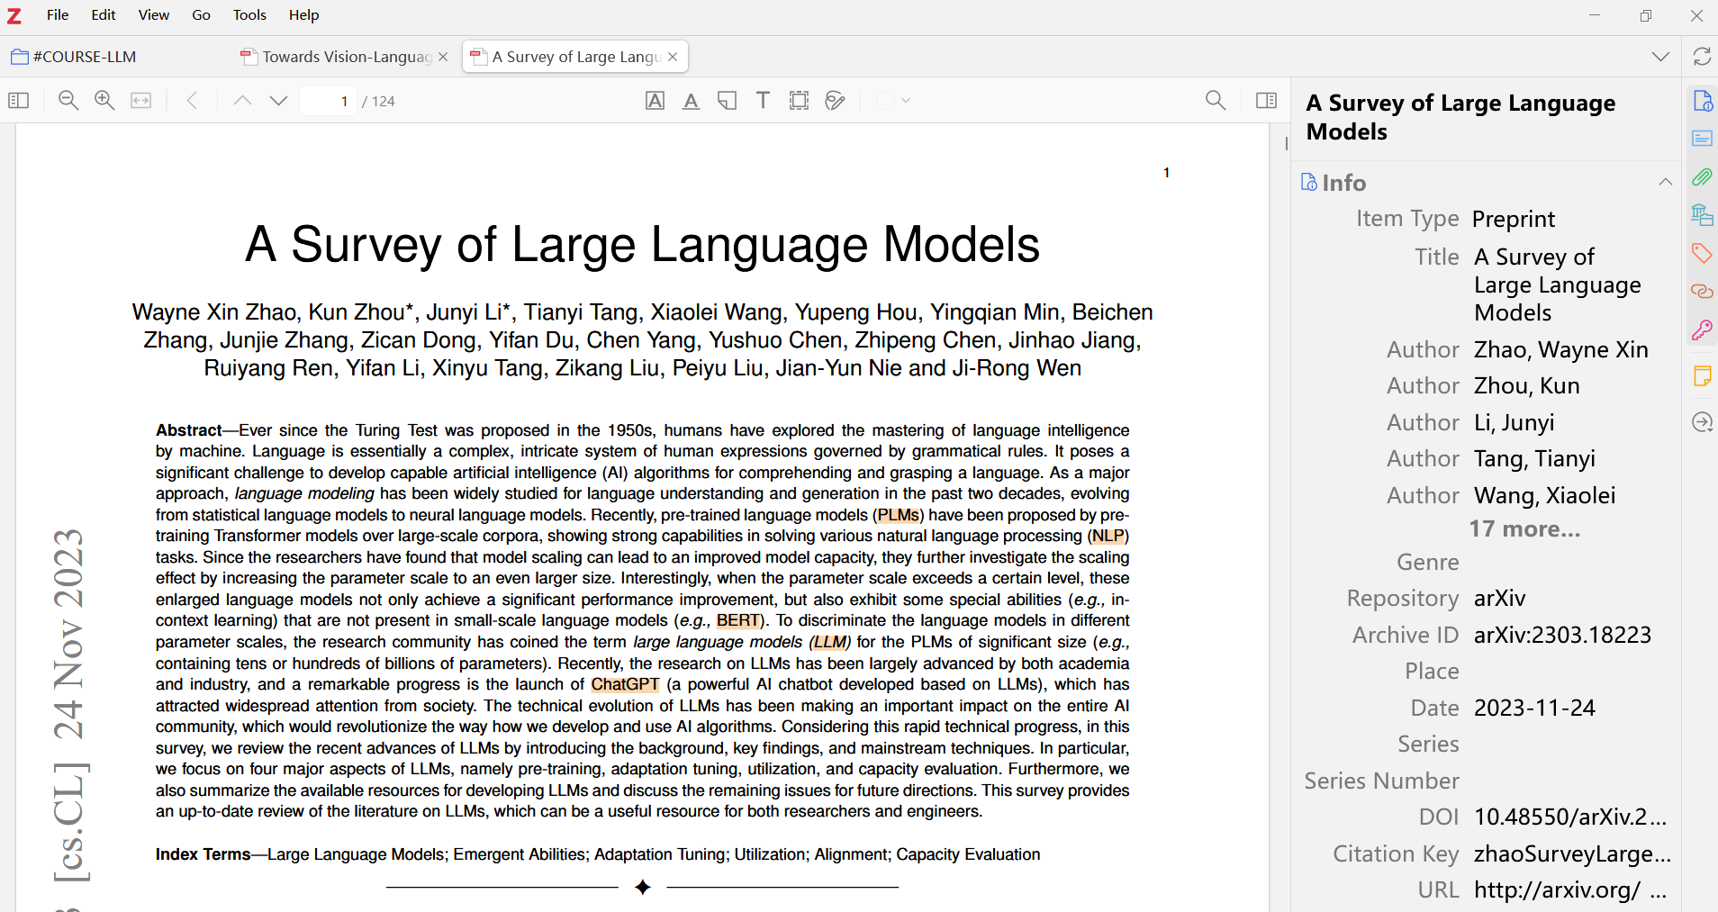
Zotero: Literature Assistant
Collect with a click
Get Paper from arXiv
Entry in Zotero 7
https://www.zotero.org/blog/zotero-7/
https://microsoftedge.microsoft.com/addons/detail/zotero-connector/nmhdhpibnnopknkmonacoephklnflpho

Slide 4
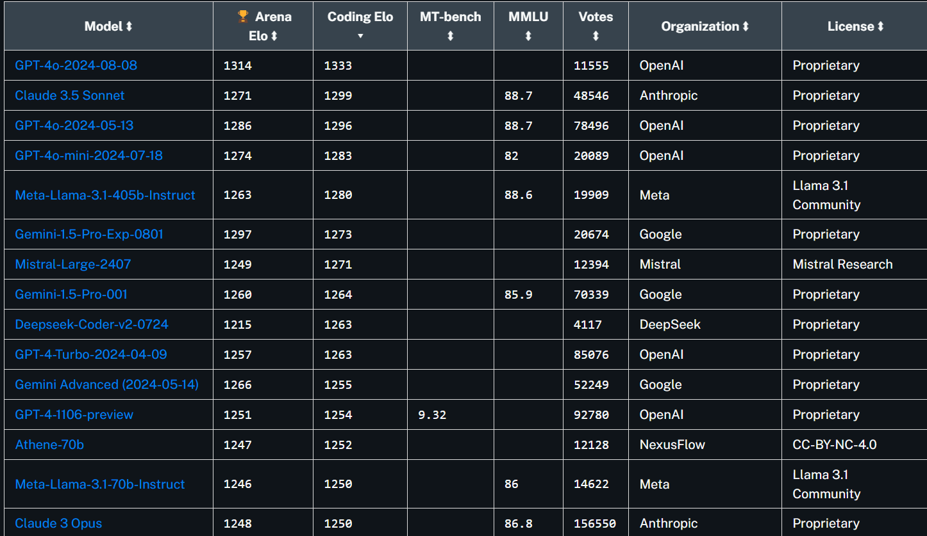
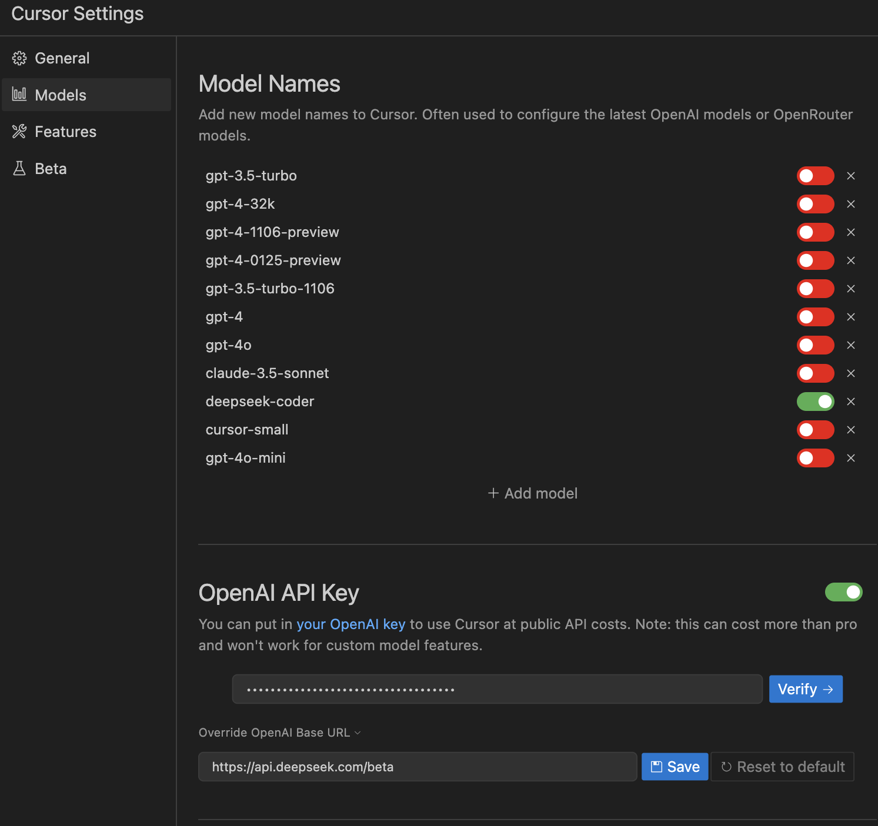
Cursor: AI Code Editor
Chat seamlessly
Coding Elo
Use Deepseek API ($2/1M tokens)
(integrated with OpenAI API format)
https://github.com/getcursor/cursor/issues/1509
https://platform.deepseek.com/api_keys
https://openlm.ai/chatbot-arena/

Slide 5
Cursor: AI Code Editor
API Recommendation
Coding Elo
Use Deepseek API ($2/1M tokens)
(integrated with OpenAI API format)
https://github.com/getcursor/cursor/issues/1509
https://platform.deepseek.com/api_keys
https://openlm.ai/chatbot-arena/

Slide 6
Model | Provider | Context | Input$/1M | Output$/1M
gpt-4o | OpenAI | 128k | $5 | $15
gpt-4o-mini | OpenAI | 128k | $0.15 | $0.6
gpt-4-turbo | OpenAI | 128k | $10 | $30
Gemini 1.5 Pro | Google | 128k | $7 | $21
Claude 3 Opus | Anthropic | 200k | $15 | $75
Claude 3 Sonnet | Anthropic | 200k | $3 | $15
Claude 3 Haiku | Anthropic | 200k | $0.25 | $1.25
Mixtral 8×22B | Mistral AI |  | $2 | $6
ERNIE-4.0 | Baidu
GLM-4 | Zhipu AI
Moonshot-v1 | Moonshot
Qwen | Alibaba
deepseek-v2 (236B) | Deepseek | 32k | $0.14 | $0.28

