Slide 1


The Evolution of GPT Models: Insights from OpenAI
Presentor: Sakura (bilibili@Sa神带你学AI)
Contact me: bili_sakura@zju.edu.cn

Slide 2
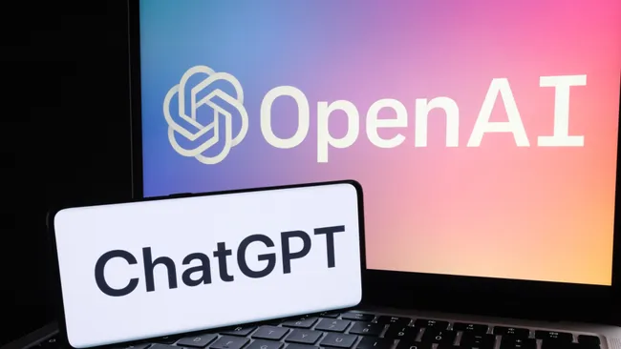
Outline
Background
Introduction to OpenAI
Evolution of GPT-series Models
Early Exploration
Before GPT (2016-2018)
GPT-1 (2018)
GPT-2 (2019)
Capacity Leap & Enhancement
GPT-3 (2020)
Codex (2021)
IntructGPT (March 2022)
The Milestones of Language Models
ChantGPT (November 2022)
GPT-4V & GPT-4-Turbo (2023)
Future
GPT-4o (May 2024)
AGI/Superintelligence (before 2030)
ChatGPT Conception¹
(Image credit: Shutterstock)
1. https://www.tomsguide.com/news/chatgpt

Slide 3
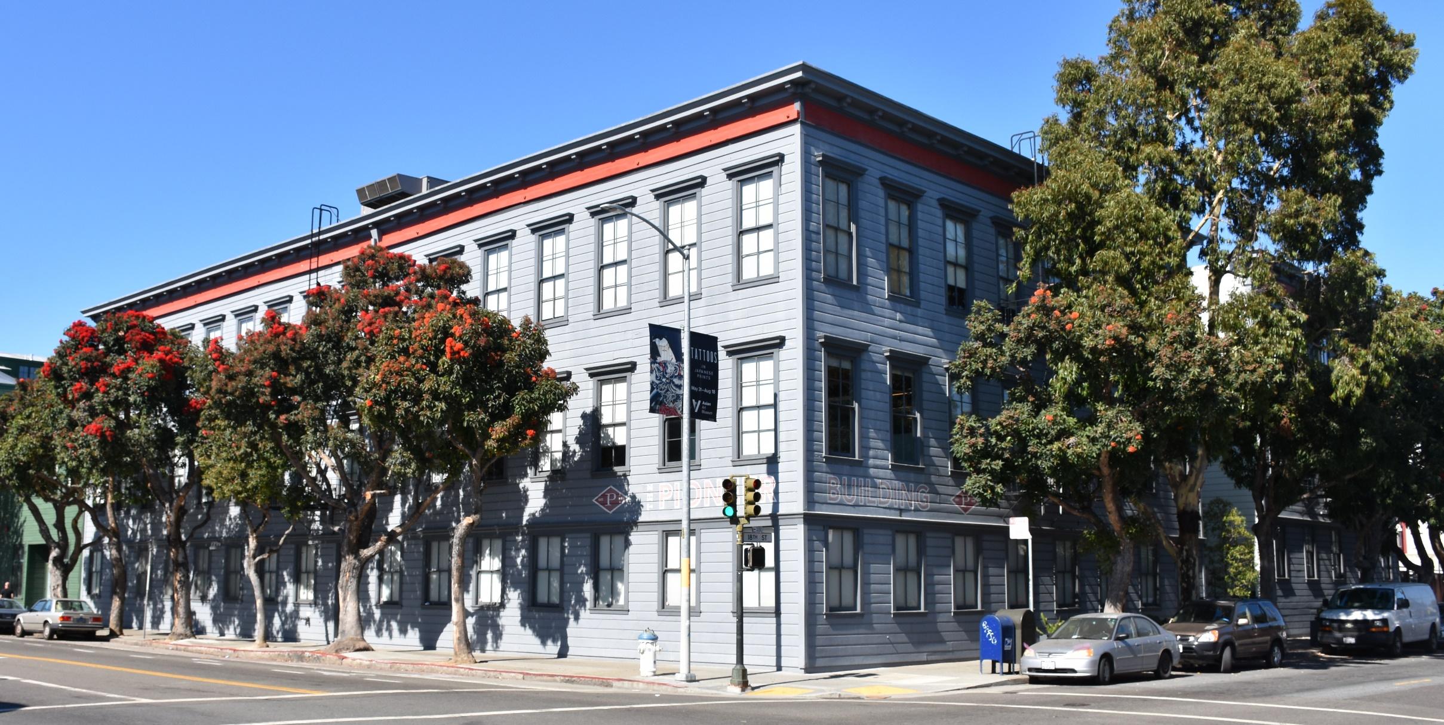
Background
Introduction to OpenAI
OpenAI is a non-profit artificial intelligence research company. Our goal is to advance digital intelligence in the way that is most likely to benefit humanity as a whole, unconstrained by a need to generate financial return. Since our research is free from financial obligations, we can better focus on a positive human impact.
We believe AI should be an extension of individual human wills and, in the spirit of liberty, as broadly and evenly distributed as possible. The outcome of this venture is uncertain and the work is difficult, but we believe the goal and the structure are right. We hope this is what matters most to the best in the field (OpenAI, 2015).
Former headquarters at the Pioneer Building in San Francisco.

Slide 4

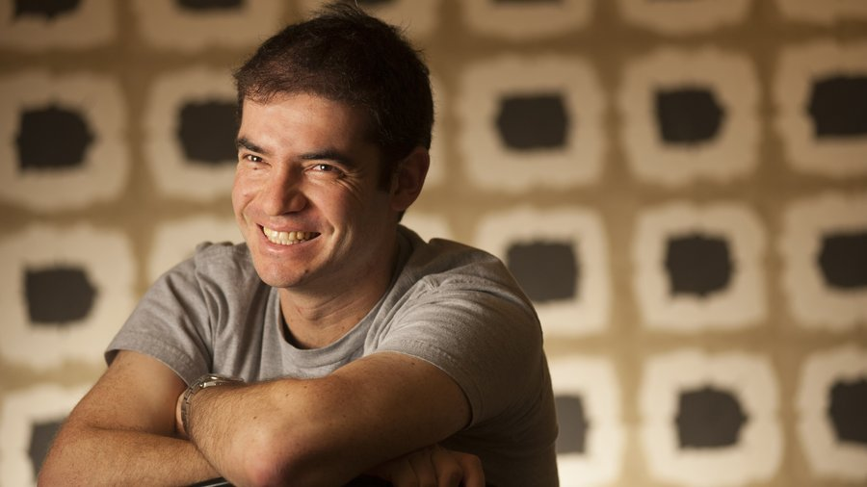
Background
Introduction to OpenAI
Founded Date: December 11, 2015
Headquarters Location: San Francisco, California, USA
Co-founder (with their age in 2015)
Research Director: Ilya Sutskever (29)
CTO: Greg Brockman (27)
Founding Members: Trevor Blackwell (46), Vicki Cheung, Andrej Karpathy (29), Durk Kingma, John Schulman (29), Pamela Vagata, Wojciech Zaremba (29).
Advisors: Pieter Abbeel (38), Yoshua Bengio (51), Alan Kay (75), Sergey Levine, Vishal Sikka (48).
Co-Chairs: Sam Altman (30), Elon Musk (44).
OpenAI Chief Scientist Ilya Sutskever².
(PAOLO VESCIA 2016)
2. https://www.bizjournals.com/sanfrancisco/inno/stories/news/2024/05/14/openai-cofounder-ilya-sutskever-resigns.html

Slide 5
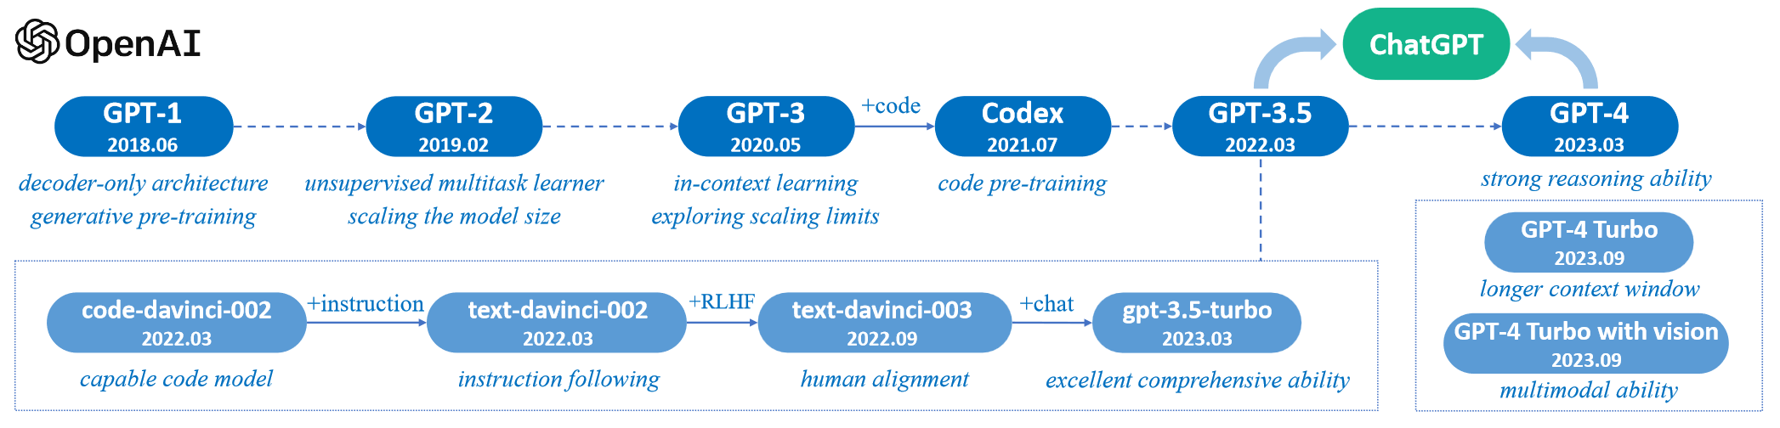
Background
Evolution of GPT-series Models
A brief illustration for the technical evolution of GPT-series models. We plot this figure mainly based on the papers, blog articles and official APIs from OpenAI. Here, solid lines denote that there exists an explicit evidence (e.g., the official statement that a new model is developed based on a base model) on the evolution path between two models, while dashed lines denote a relatively weaker evolution relation (Zhao et al., 2023).

Slide 6
Early Exploration
Before GPT (2016-2018)
A brief illustration for the technical evolution of GPT-series models. We plot this figure mainly based on the papers, blog articles and official APIs from OpenAI. Here, solid lines denote that there exists an explicit evidence (e.g., the official statement that a new model is developed based on a base model) on the evolution path between two models, while dashed lines denote a relatively weaker evolution relation (Zhao et al., 2023).

