Slide 1


The Evolution of GPT Models
Presentor: Sakura

Slide 2
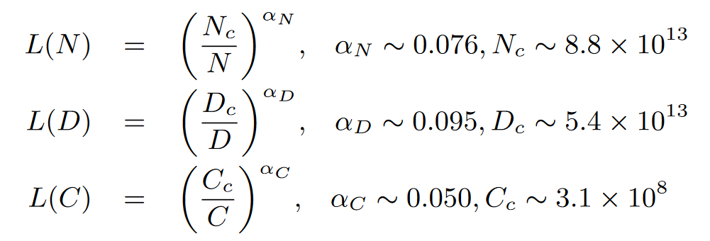
Scaling Law
In 2020, Kaplan et al. [1] (the OpenAI team) firstly proposed to model the power-law relationship of model performance with respective to three major factors, namely model size (N), dataset size (D), and the amount of training compute (C), for neural language models, and L(·) denotes the cross entropy loss in nats.¹
Figure. Three basic formulas for the scaling law¹.
1. The statement and figure are adapted from Zhao et al. (2023) ’s work entitled A Survey of Large Language Models.

