Slide 1
Large Language Models Energize Geographic Information Science: A Survey
——Explore the boundaries of capability, imagine the impossible
Presenter: Chen Zhenyuan (MSC 1)
Department: School of Earth Science, Zhejiang University
Date: 2024/4/7

Slide 2
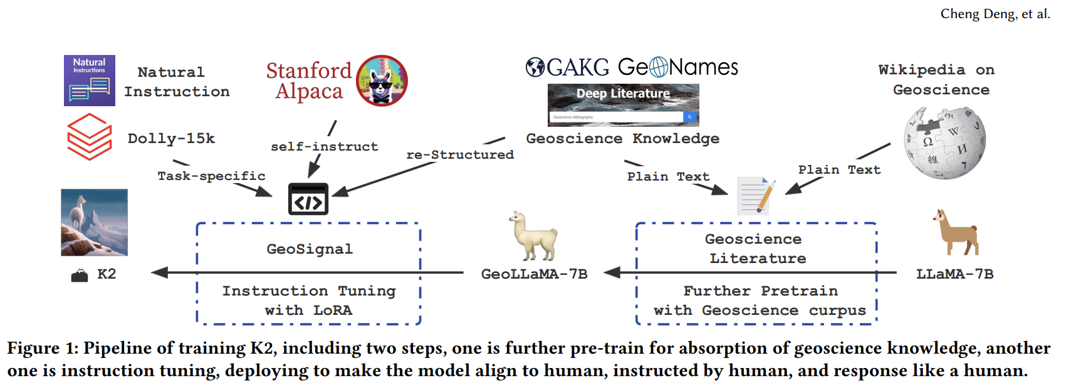
K2: The Pioneer in Integrating Large Language Models with GeoScience
K2: A Foundation Language Model for Geoscience Knowledge Understanding and Utilization
(Deng, C., et al., 2023)/(WSDM’24)

Slide 3
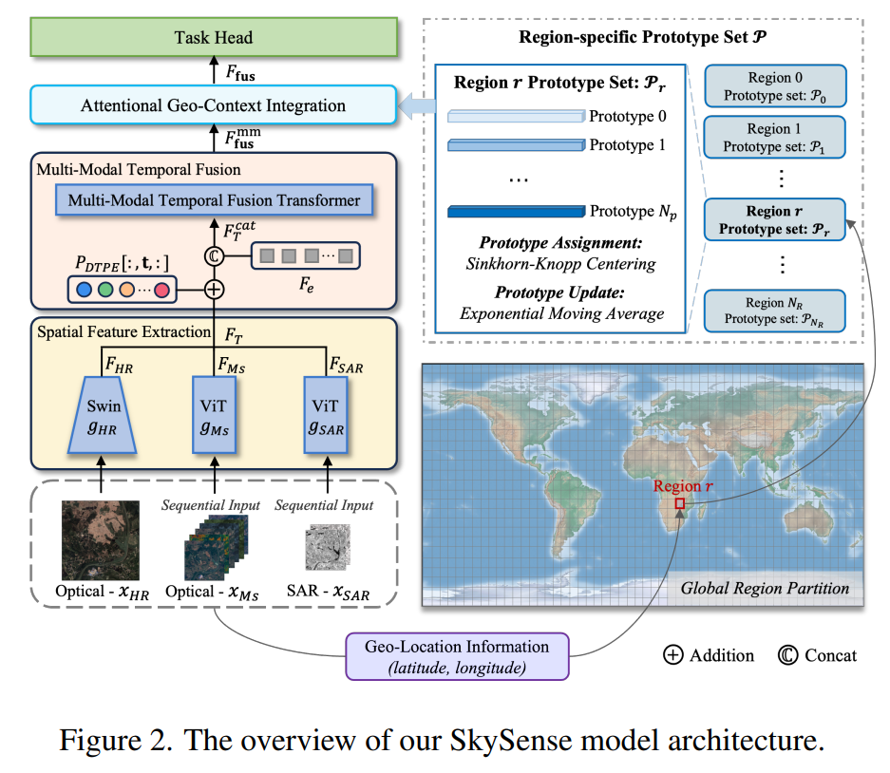
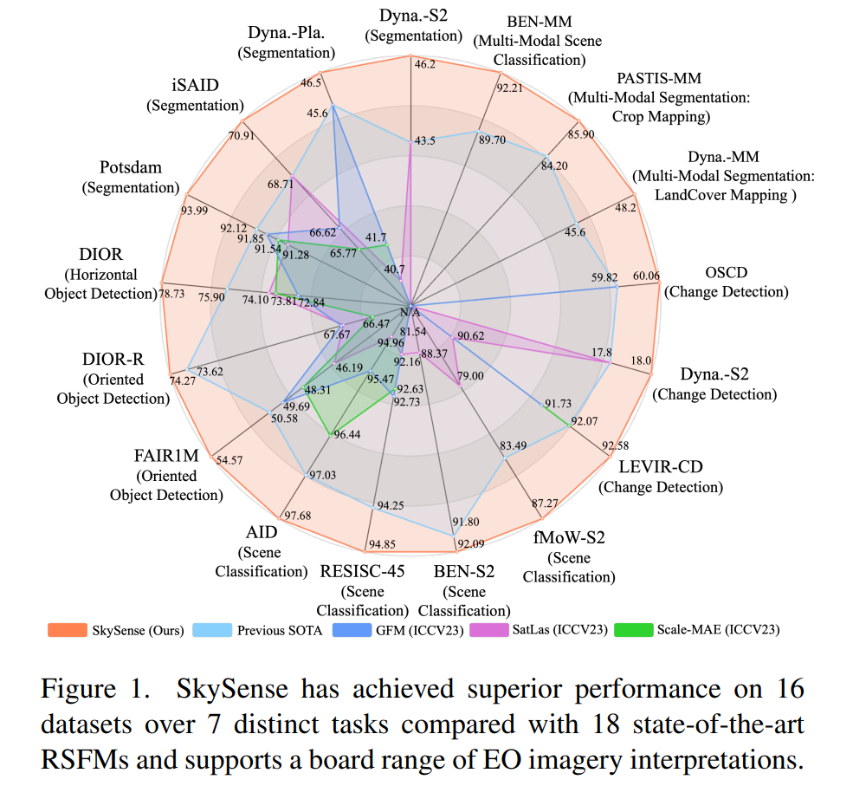
Skysense: A Foundation Model in RS
Skysense: A multi-modal remote sensing foundation model towards universal interpretation for earth observation imagery (Ant Group & Wuhan University & MYBank,2024) /(CVPR2024)

Slide 4
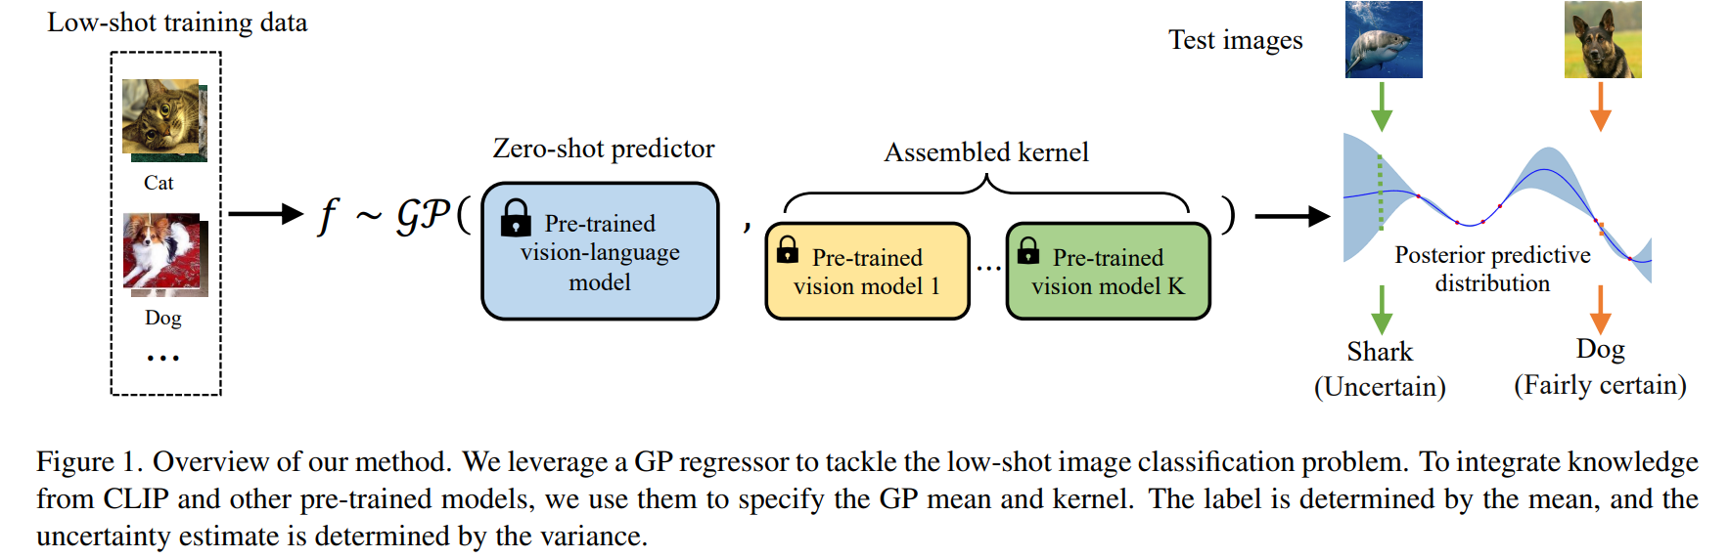
Mixture of Experts & Modality Bridging
Bayesian Exploration of Pre-trained Models for Low-shot Image Classification
(Yibo Miao, Yu Lei, Feng Zhou, Zhijie Deng, 2024)/(CVPR2024)

Slide 5
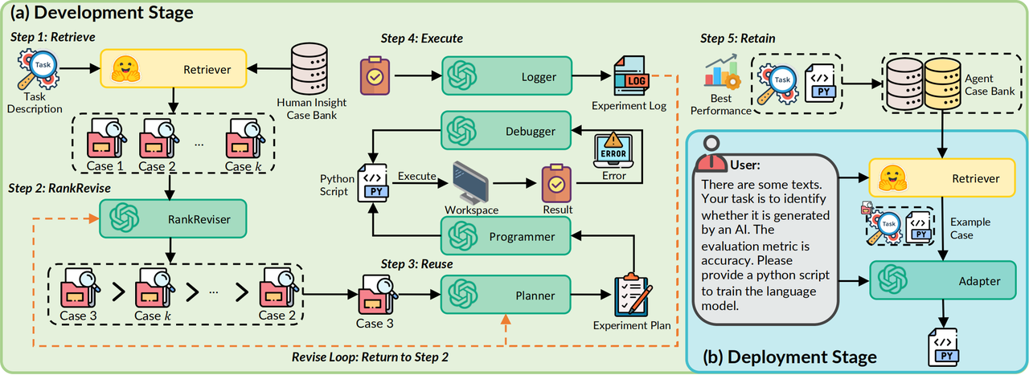
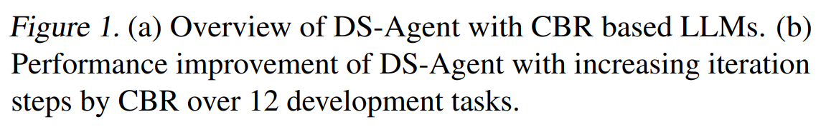
DS-Agent: A Self-Reflection Agent Specialized for Machine Learning Tasks
DS-Agent: Automated Data Science by Empowering Large Language Models with Case-Based Reasoning (Guo, S., Deng, C., et al., 2024)

Slide 6
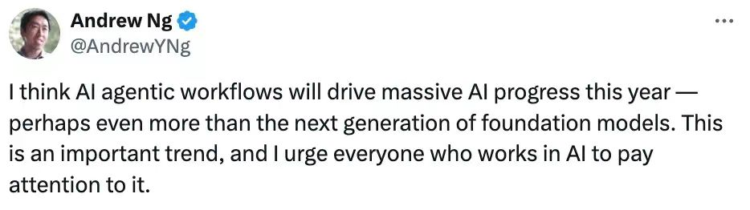
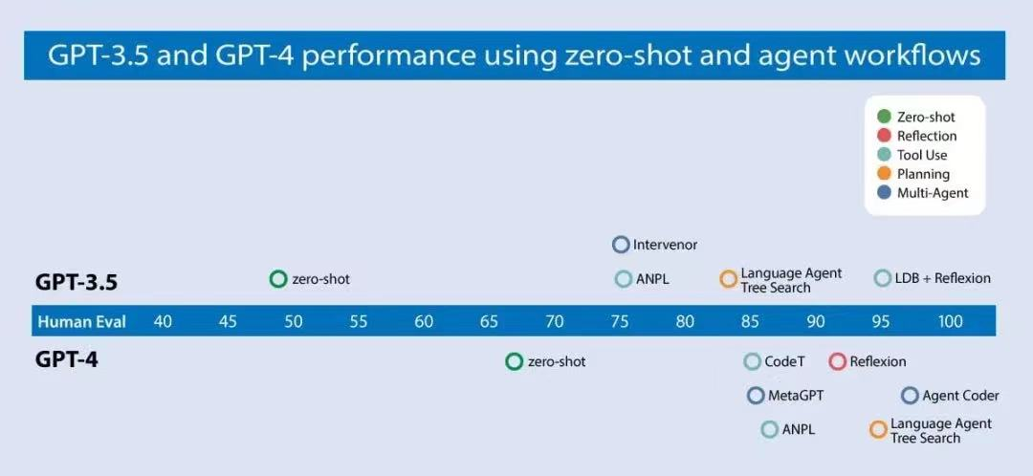
Prospects: Agent is Future!
Using LLM to revolutionize all the traditional paradigm of research with high-level automation

