Slide 1


An Introduction to Large Language Models
—— Await an Era of Artificial General Intelligence
@Sakura

Slide 2
Profile
📖 Pursuing PhD in Data Science & Engineering
@ Zhejiang University
🎓 Focusing on Large Language Models(LLMs) and Remote Sensing Images(RSIs)

Slide 3
Foreword
What is Large Language Model?
Why are LLMs important?
How can we utilize LLMs?

Slide 4
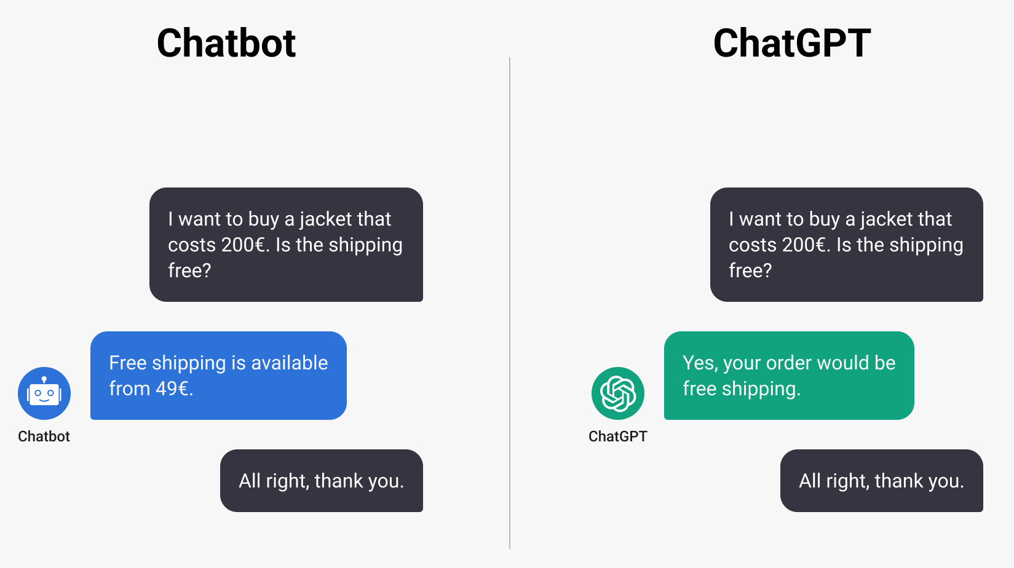
ChatGPT: Run into a Sensation
> Chatbot vs. ChatGPT¹
1. https://micoope.com.gt/?o=chatgpt-the-tech-behind-the-hype-and-what-it-nn-n7AYnRsk

Slide 5
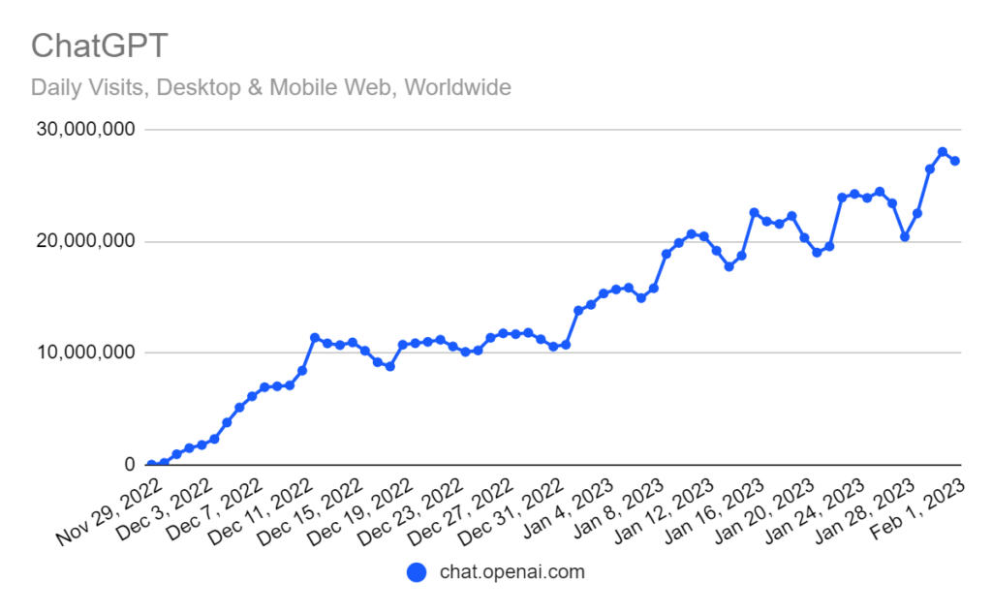
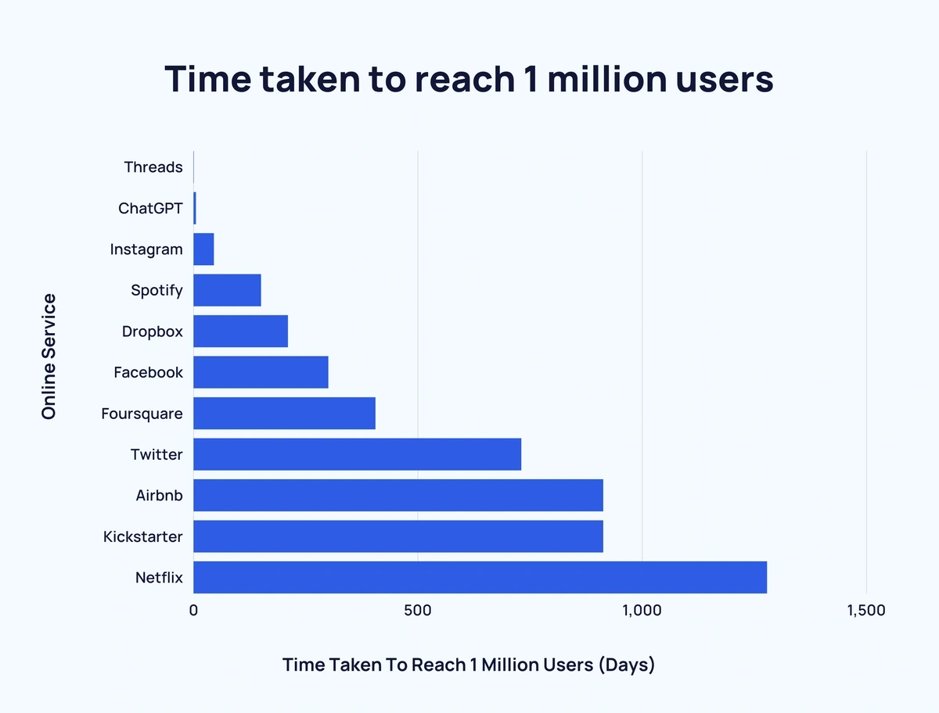
ChatGPT: Run into a Sensation
> ChatGPT Achieves Fastest Ever User Growth^{1,2}
https://influencermarketinghub.com/ai-marketing-benchmark-report
https://explodingtopics.com/blog/chatgpt-users

Slide 6
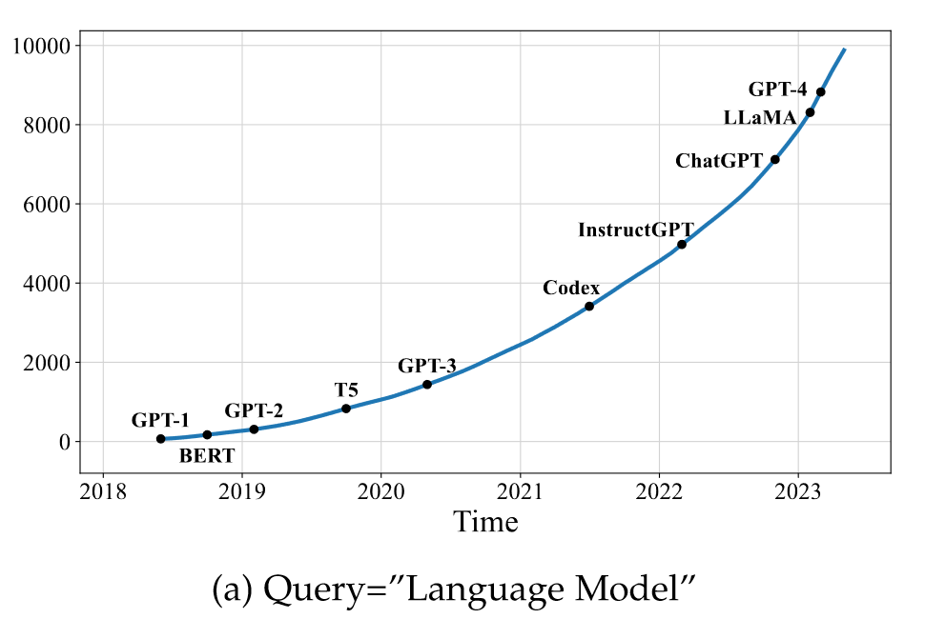
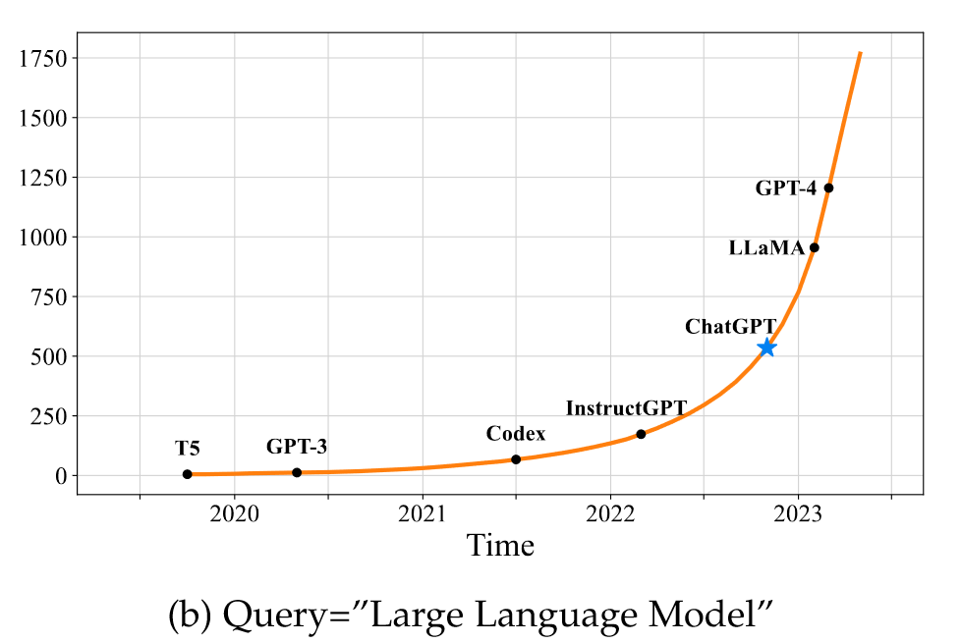
Language Model (LM)
> Introduction to Language Model
Language modeling (LM) is one of the major approaches to advancing language intelligence of machines. In general, LM aims to model the generative likelihood of word sequences, so as to predict the probabilities of future (or missing) tokens.
Figure. The trends of the cumulative numbers of arXiv papers that contain the keyphrases “language model” (since June 2018) and “large language model” (since October 2019), respectively.

Slide 7
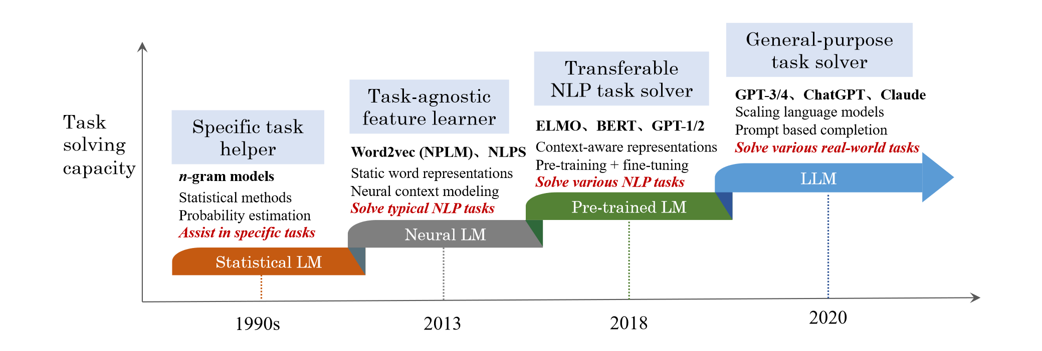
A Story from LM to“Large”LM
> Timeline of Language Model
Figure. An evolution process of the four generations of language models (LM) from the perspective of task solving capacity.

Slide 8
LLM by Definition
> LLM: Large-sized PLM
Researchers find that scaling PLM often leads to an improved model capacity on downstream tasks.
Although scaling is mainly conducted in model size, these large-sized PLMs display different behaviors from smaller PLMs and show surprising abilities (called emergent abilities) in solving a series of complex tasks.
Thus, the research community coins the term large language models (LLM)¹ for these large-sized PLMs, which attract increasing research attention.
A remarkable application of LLMs is ChatGPT that adapts the LLMs from the GPT series for dialogue, which presents an amazing conversation ability with humans.
Note that a LLM is not necessarily more capable than a small PLM, and emergent abilities may not occur in some LLMs.

Slide 9







An Overview on LLM Market
> Common Large Language Models
ChatGPT
gpt-3.5-turbo/gpt-4
LLaMA
OpenAI
Meta AI
PALM
GLM
Google
Zhipu AI
Figure. Mainstream LLM with their AI companies

Slide 10
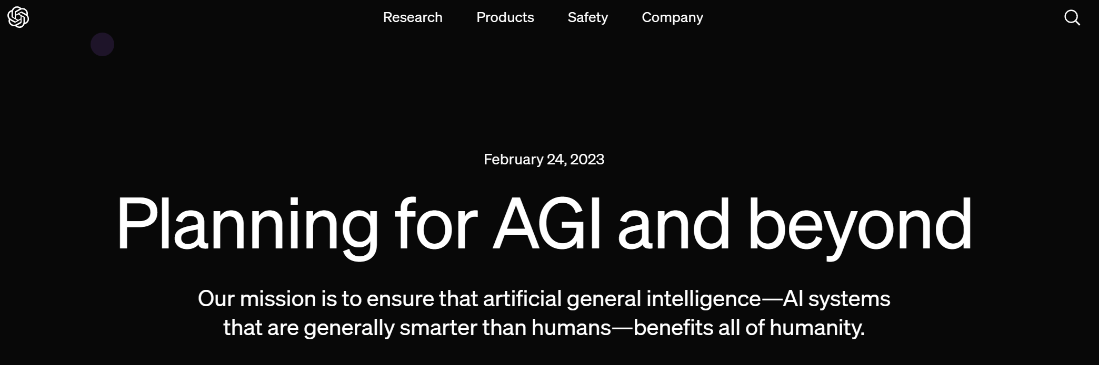
LLM: Aim at Approaching AGI!
- We can imagine a world in which humanity flourishes to a degree that is probably impossible for any of us to fully visualize yet.
- We hope to contribute to the world an AGI aligned with such flourishing.¹
https://openai.com/index/planning-for-agi-and-beyond?ref=hir.harvard.edu

Slide 11
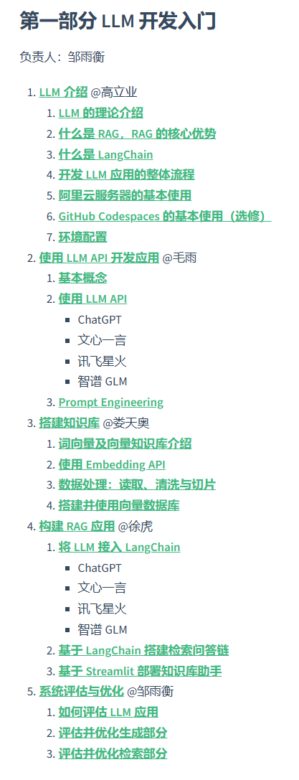
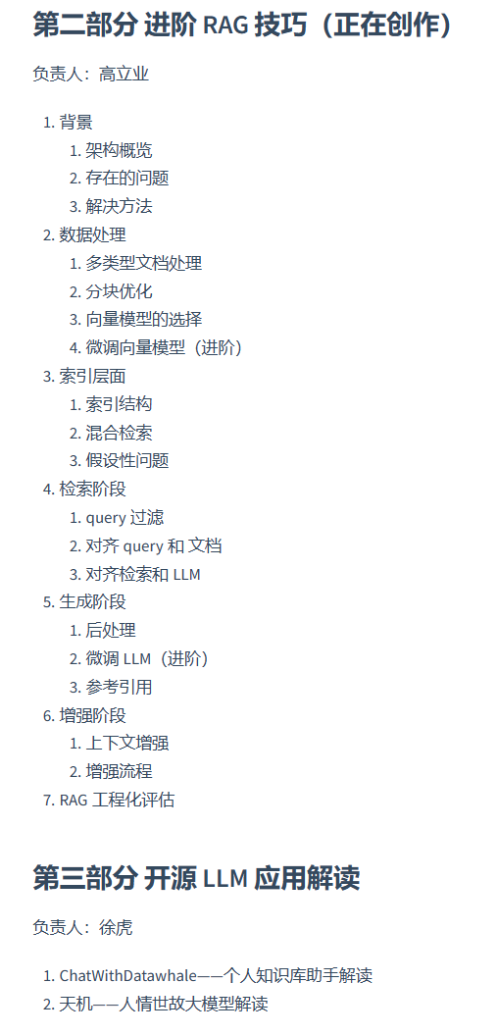
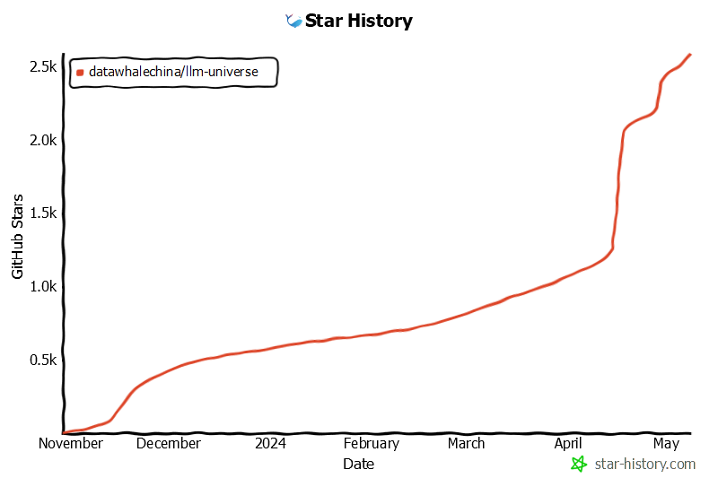

Guidance for AI Researchers
> Choose Your Favorite LLM Projects on GitHub
LLM-UNIVERSE(动手学大模型应用开发)¹
Figure. LLM-UNIVERSE Logo and Star History Figure. LLM-UNIVERSE Outline
https://github.com/datawhalechina/llm-universe

Slide 12
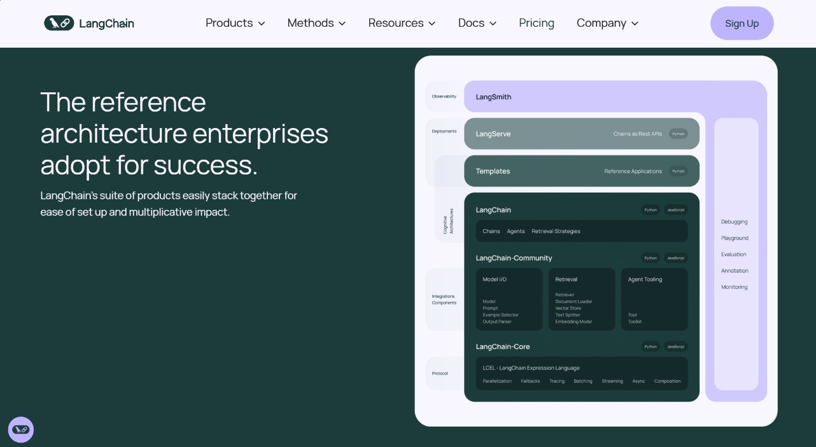
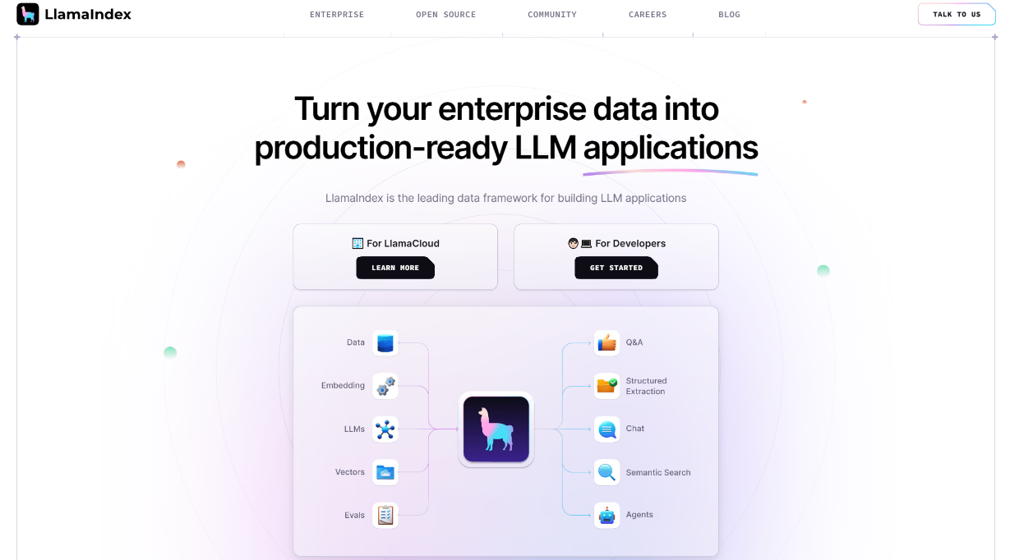
Guidance for AI Researchers
> Get Started to Deploy a Personalized LLM
Well-Organized Python Packages for LLM-based Project Development^{1,2}
Figure. LangChain Home Page
Figure. LlamaIndex Home Page
https://www.langchain.com
https://www.llamaindex.ai

Slide 13

Guidance for AI Researchers
> Get Started to Deploy a Personalized LLM
Software Application: Ollama¹
Figure. Ollama Home Page
https://ollama.com

Slide 14
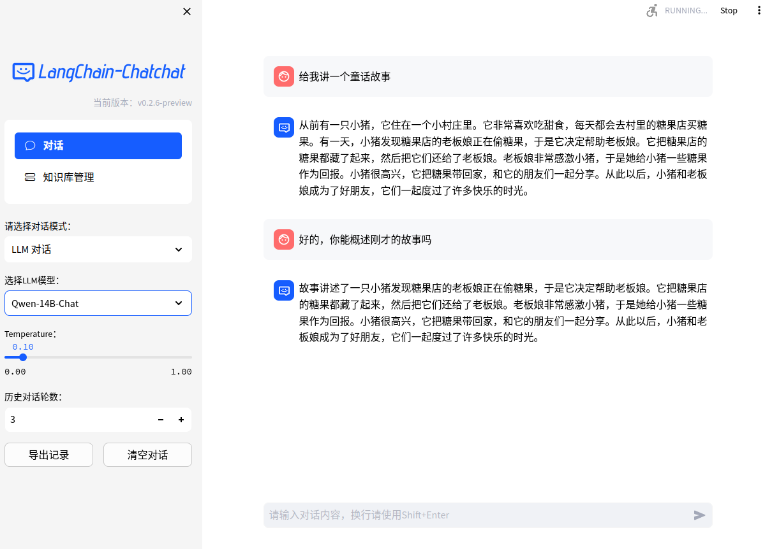
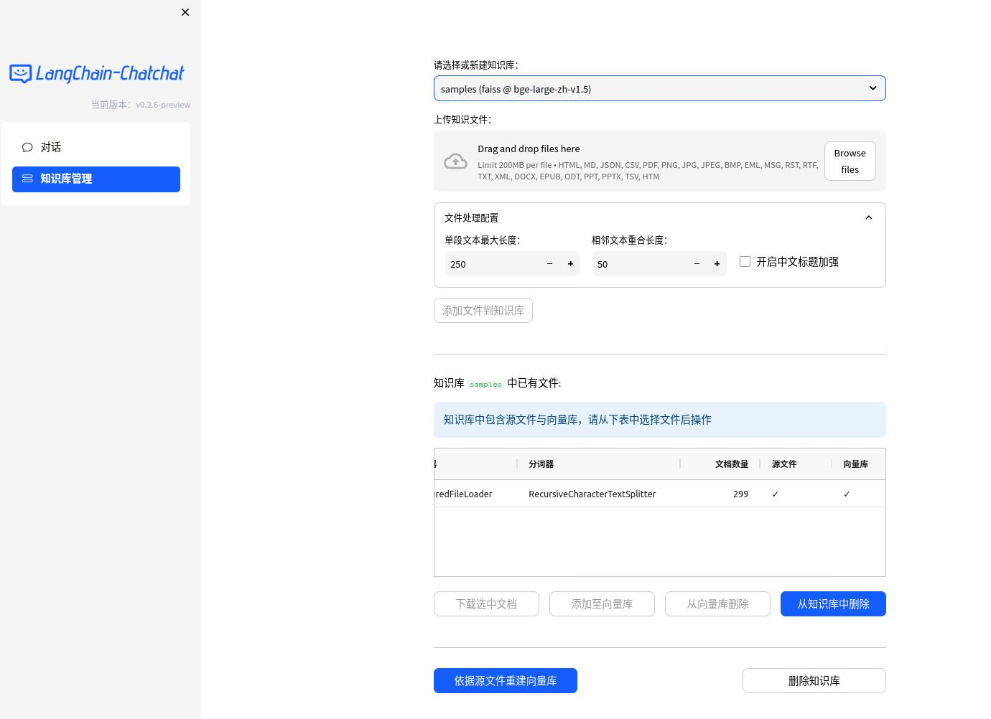

Guidance for AI Researchers
> User-friendly LLM-based Chatbot Project
Langchain-Chatchat¹: A Local Knowledge-based Q&A LLM Application
Figure. LangChain-Chatchat Web UI Demo
https://github.com/chatchat-space/Langchain-Chatchat

Slide 15
Summary
> Recall the Previous Questions
What is Large Language Model?
Why are LLMs important?
How can we utilize LLMs?

Slide 16
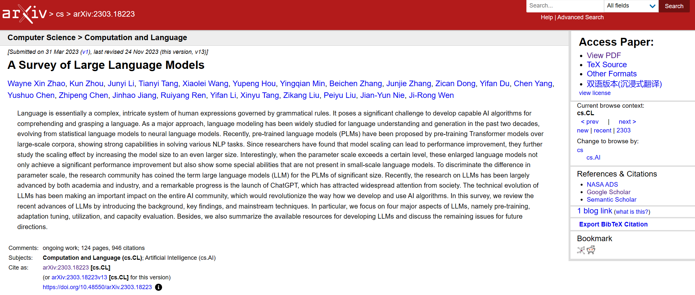
Reference
> First Survey on LLM
This presentation is mainly referred to paper “A survey of large language models” (Zhao et al., 2023).
Zhao, W. X., Zhou, K., Li, J., Tang, T., Wang, X., Hou, Y., ... & Wen, J. R. (2023). A survey of large language models. arXiv preprint arXiv:2303.18223.

