Slide 1

The Larger the Model Size, the Better the Performance?

Slide 2
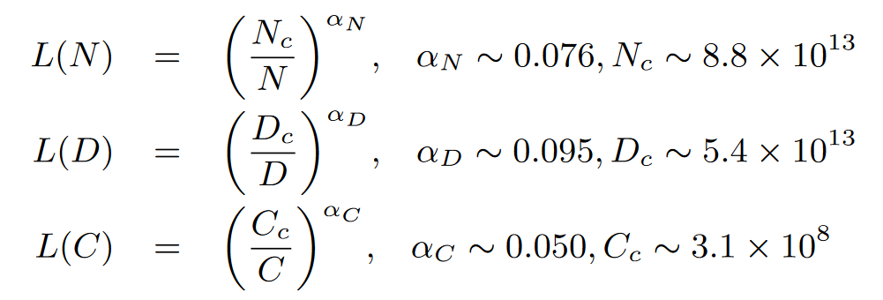
Scaling Law [1]

Slide 3
References
[1] J. Kaplan, S. McCandlish, T. Henighan, T. B. Brown, B. Chess, R. Child, S. Gray, A. Radford, J. Wu, and D. Amodei, “Scaling laws for neural language models,” CoRR, vol. abs/2001.08361, 2020.
[2] J. Kaplan et al., ‘Scaling Laws for Neural Language Models’, ArXiv, Jan. 2020, Accessed: Apr. 20, 2024. [Online]. Available: https://www.semanticscholar.org/paper/Scaling-Laws-for-Neural-Language-Models-Kaplan-McCandlish/e6c561d02500b2596a230b341a8eb8b921ca5bf2

