Slide 1

Diffusion Model Track
- Latest Backbone in Image Synthesis
Sakura 2025/05/13
bili_sakura@zju.edu.cn
© Sakura, 2025. All rights reserved.

Slide 2
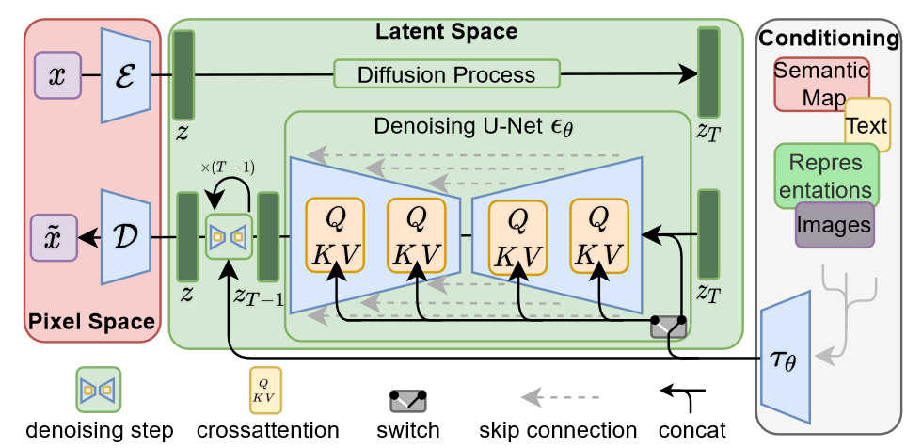
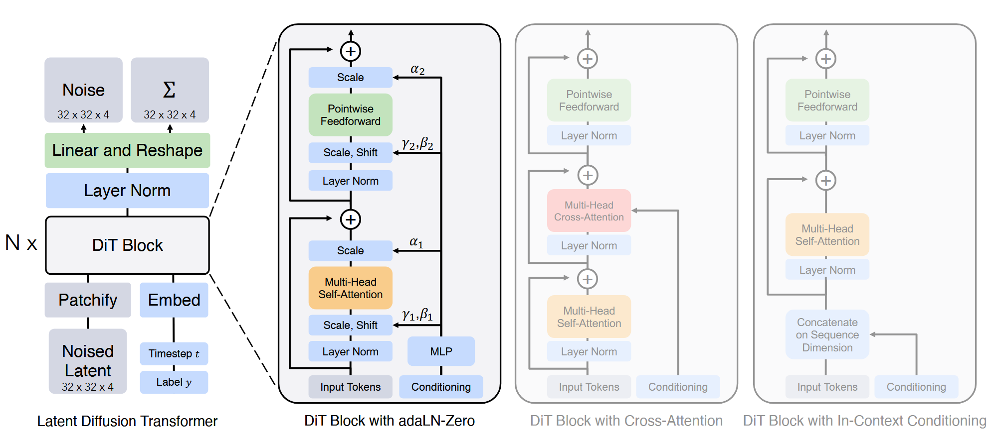
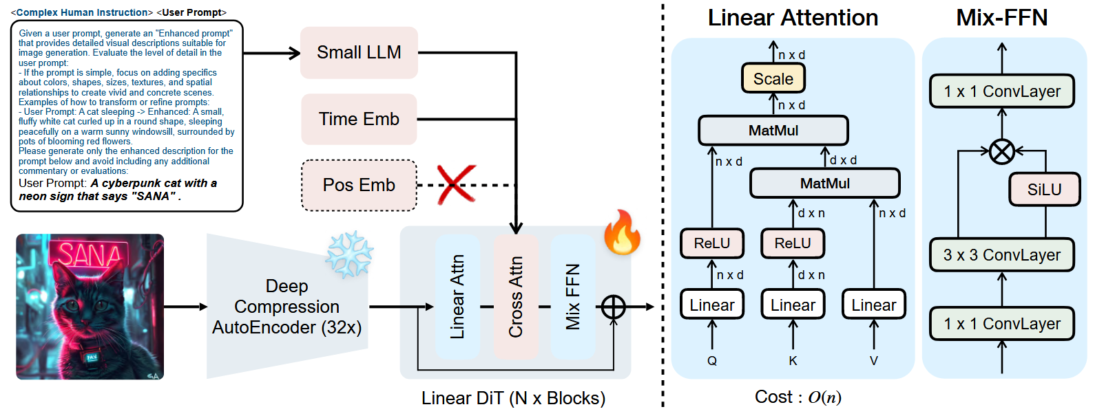
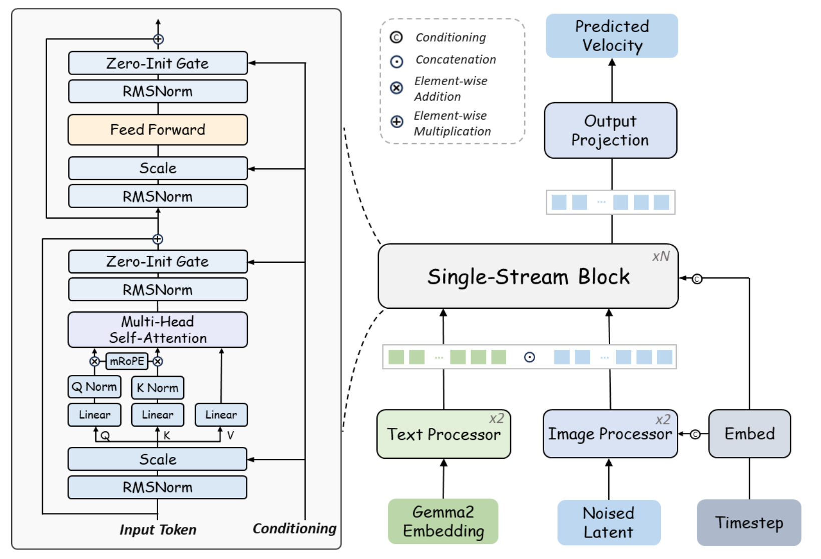
Checkpoint Released Timeline
【Stability AI】Stable Diffusion 2.1: 2022/12/06
【Meta AI】DiT: 2023/01/08
【Stability AI】Stable Diffusion XL 1.0: 2023/07/26
【Huawei】PixArt-α: 2023/10/06
【Huawei】PixArt-δ: 2024/01/10
【Shanghai AI Lab】Lumina-T2I: 2024/04/01
【Huawei】PixArt-Σ: 2024/04/11
【Shanghai AI Lab】Lumina-Next-T2I: 2024/05/12
【Stability AI】Stable Diffusion 3: 2024/06/12
【Black Forest Lab】Flux.1
【Stability AI】Stable Diffusion 3.5: 2024/10/22
【NVIDIA】SANA: 2025/01/11
【Shanghai AI Lab】Lumina-Image-2.0: 2025/01/22
【NVIDIA】SANA 1.5: 2025/03/21
a
b
2023
c
2024
d
2025
a) Unet b) DiTs c) Linear DiTs d) Next-DiTs
© Sakura, 2025. All rights reserved.

Slide 3
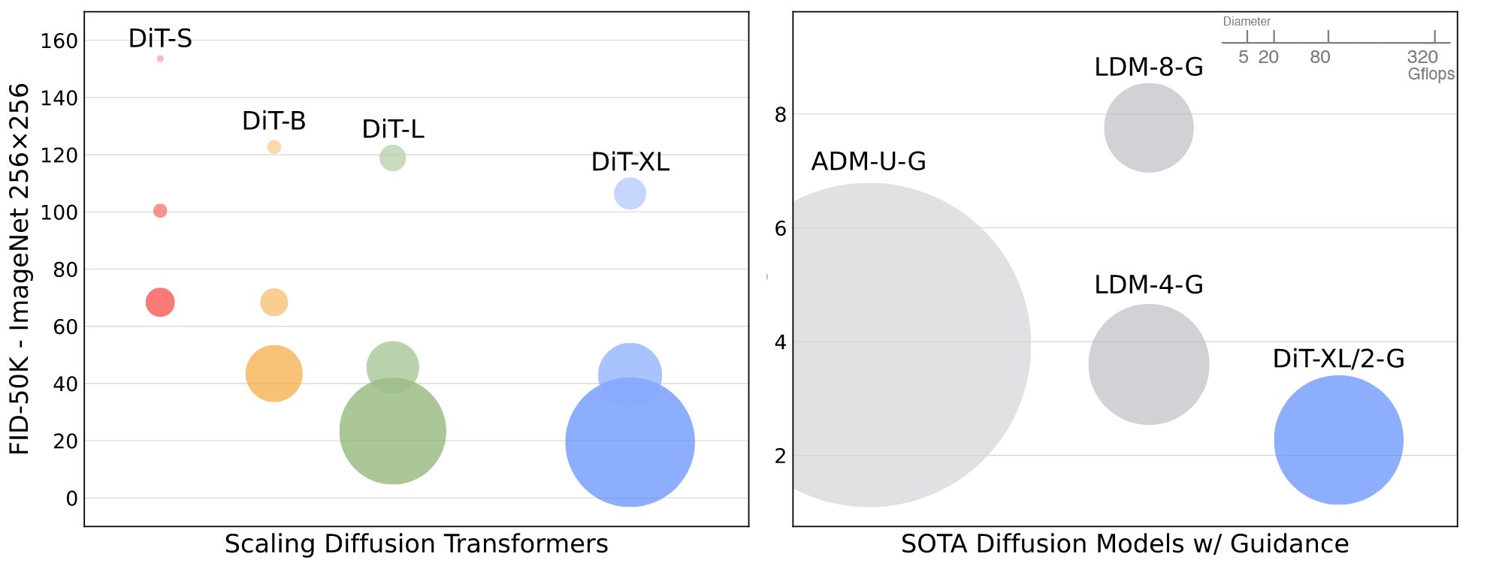
Diffusion Transformer (DiT)
ImageNet generation with Diffusion Transformers (DiTs). Bubble area indicates the flops of the diffusion model. Left: FID-50K (lower is better) of our DiT models at 400K training iterations. Performance steadily improves in FID as model flops increase. Right: Our best model, DiT-XL/2, is compute-efficient and outperforms all prior U-Net-based diffusion models, like ADM and LDM.
Peebles & Xie, Scalable Diffusion Models with Transformers, ICCV 2023

Slide 4
Diffusion Transformer (DiT)
The Diffusion Transformer (DiT) architecture. Left: We train conditional latent DiT models. The input latent is decomposed into patches and processed by several DiT blocks. Right: Details of our DiT blocks. We experiment with variants of standard transformer blocks that incorporate conditioning via adaptive layer norm, cross-attention and extra input tokens. Adaptive layer norm works best.
Peebles & Xie, Scalable Diffusion Models with Transformers, ICCV 2023

Slide 5
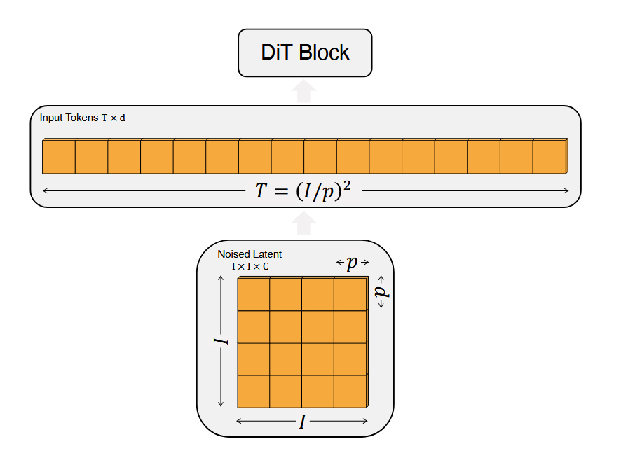
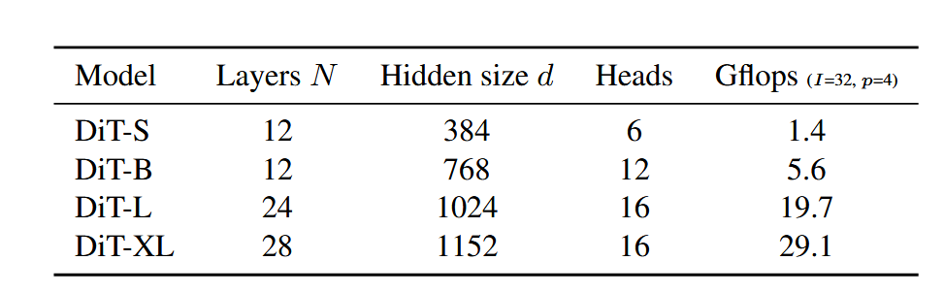
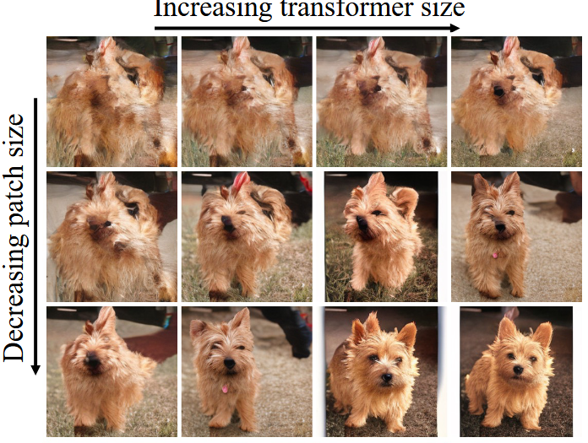
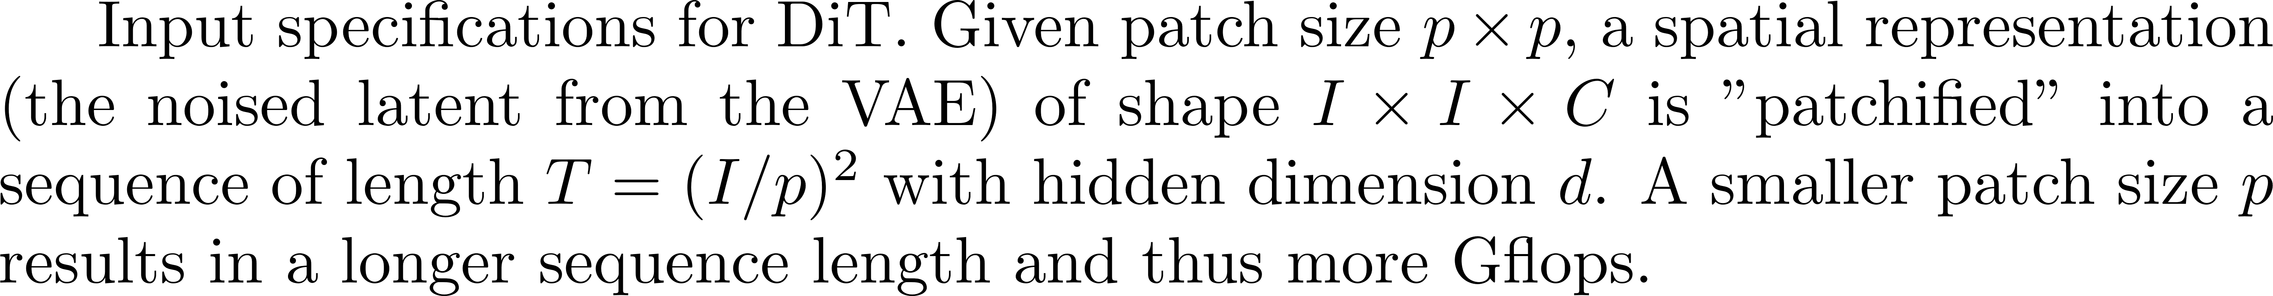
Diffusion Transformer (DiT)
Peebles & Xie, Scalable Diffusion Models with Transformers, ICCV 2023

Slide 6
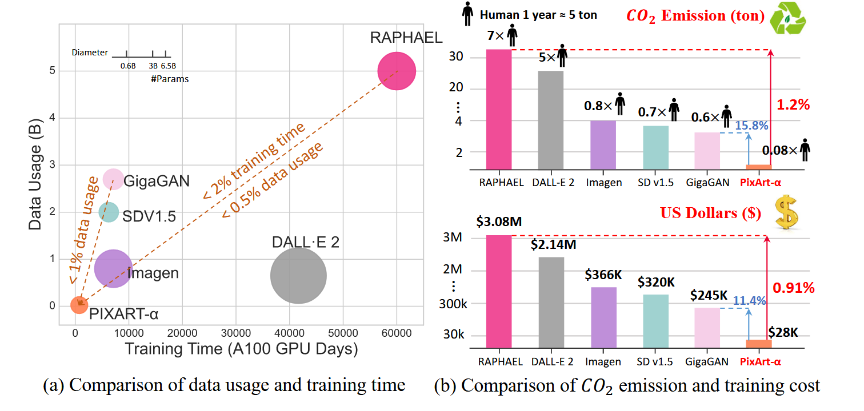
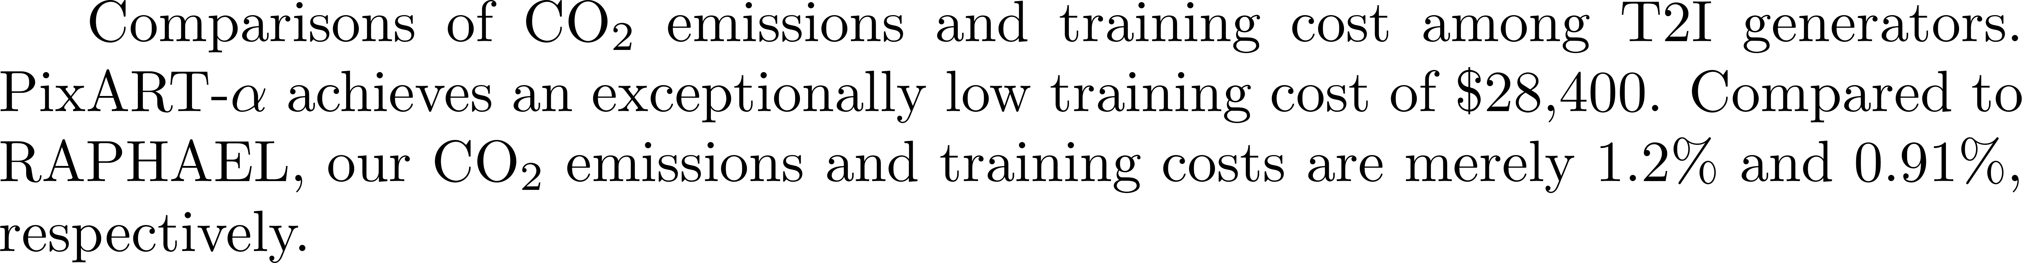
PixArt-α
Chen et al., PixArt-α: Fast Training of Diffusion Transformer for Photorealistic Text-to-Image Synthesis, ICLR 2024

Slide 7
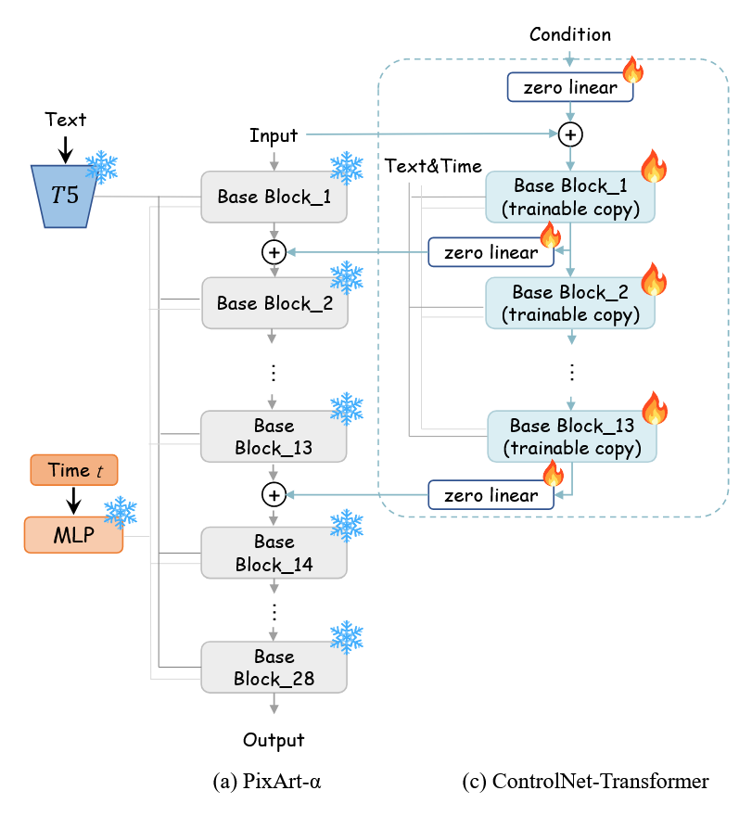
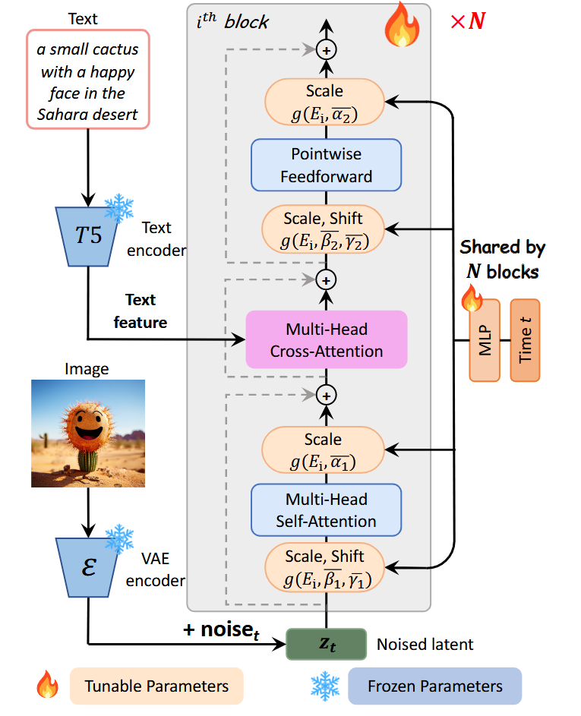
PixArt-α & PixArt-δ
Model architecture of PIXART-α. To optimize efficiency, all blocks share the same adaLN-single parameters for time conditions.
PIXART-δ integrated with ControlNetTransformer.
Chen et al., PixArt-α: Fast Training of Diffusion Transformer for Photorealistic Text-to-Image Synthesis, ICLR 2024
Chen et al., PIXART-δ: Fast and Controllable Image Generation with Latent Consistency Models, arXiv 2025

Slide 8
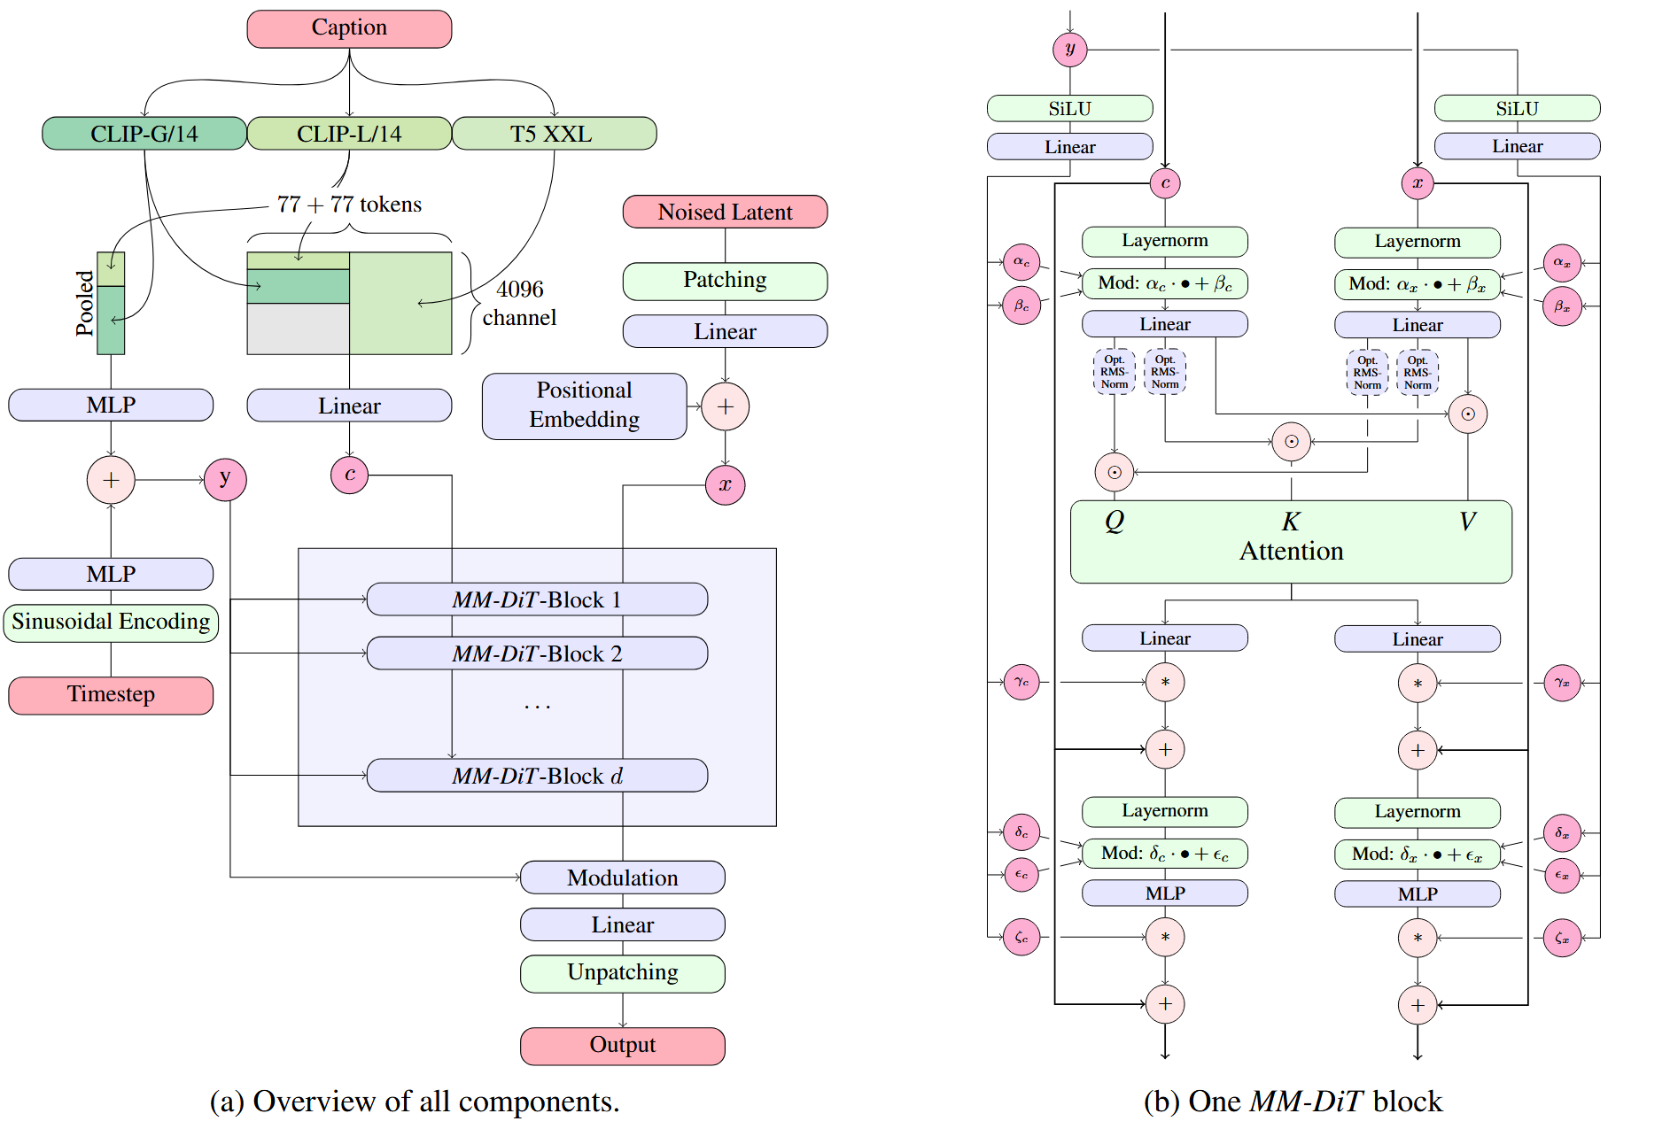
Stable Diffusion 3
Our model architecture. Concatenation is indicated by ⊙ and element-wise multiplication by ∗. The RMS-Norm for Q and K can be added to stabilize training runs.
Esser et al., Scaling Rectified Flow Transformers for High-Resolution Image Synthesis, ICML 2024

Slide 9
SANA
Overview of Sana: Fig. (a) describes the high-level training pipeline, containing our 32× deep compression Autoencoder, Linear DiT, and complex human instruction. Note that Positional embedding is not required in our framework. Fig. (b) describes the detailed design of the Linear Attention and Mix-FFN in Linear DiTs.
Xie et al., SANA: Efficient High-Resolution Text-to-Image Synthesis with Linear Diffusion Transformers, ICLR 2025

Slide 10
Lumina-Image 2.0
Overview of Lumina-Image 2.0, which consists of Unified Captioner and Unified Next-DiT. The Unified Captioner re-captions web-crawled and synthetic images to construct hierarchical text-image pairs, which are then used to optimize Unified Next-DiT with our efficient training strategy.
Qin et al., Lumina-Image 2.0: A Unified and Efficient Image Generative Framework, arXiv 2025

