Slide 1


The Larger the Model Size, the Better the Performance?
Presentor: Sakura

Slide 2
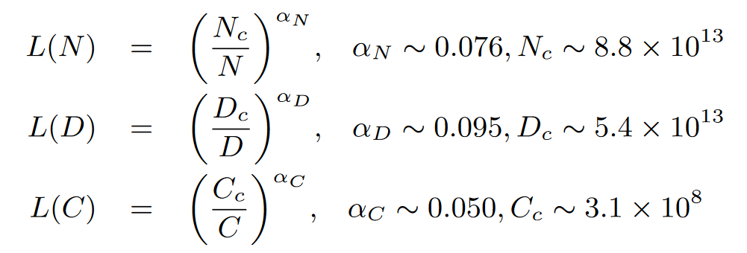
Scaling Law
In 2020, Kaplan et al. [1] (the OpenAI team) firstly proposed to model the power-law relationship of model performance with respective to three major factors, namely model size (N), dataset size (D), and the amount of training compute (C), for neural language models, and L(·) denotes the cross entropy loss in nats.¹
Figure. Three basic formulas for the scaling law¹.
1. The statement and figure are adapted from Zhao et al. (2023) ’s work entitled A Survey of Large Language Models.

Slide 3

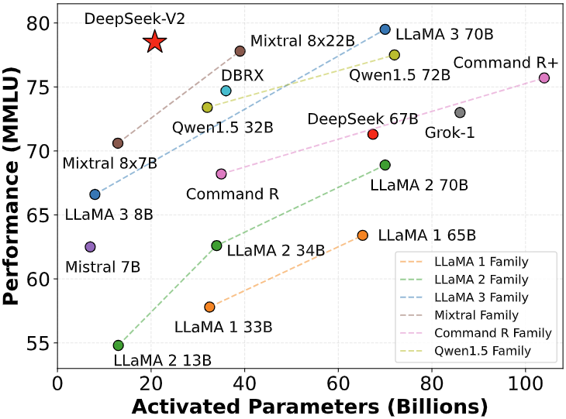
An Analogy: Restaurant vs. LLM
Average Cost → Model Size
Dished Taste → Performance
Figure. A cozy restaurant vs. A luxurious restaurant.
Figure. Performance vs. Parameters
(from Deepseek-v2 [2]).

Slide 4
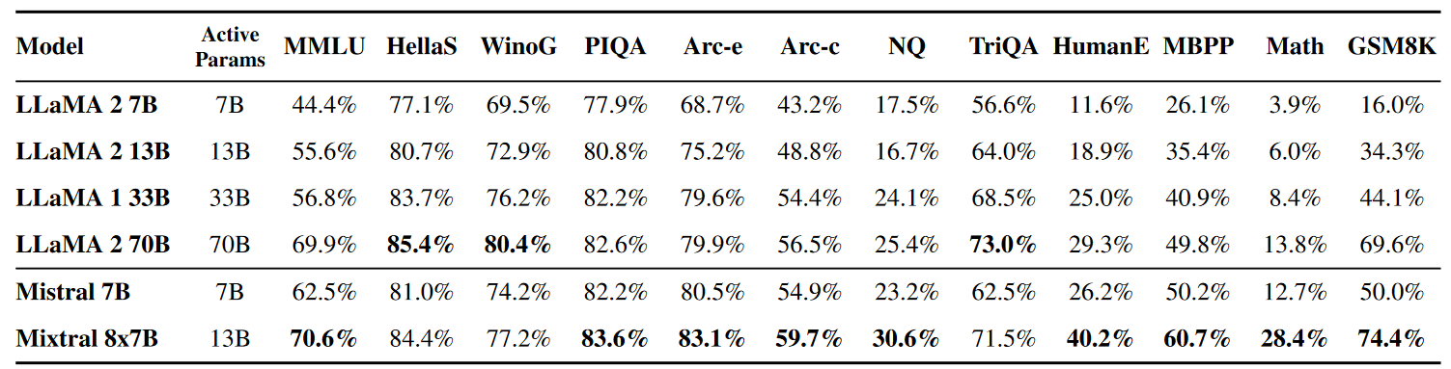
Mixtral(46.7B) Outperforms LLaMA-2(70B)
Table. Comparison of Mixtral with Llama
(from Mixtral of Experts [3]).
Small Models CAN Outperform Large Ones!

Slide 5
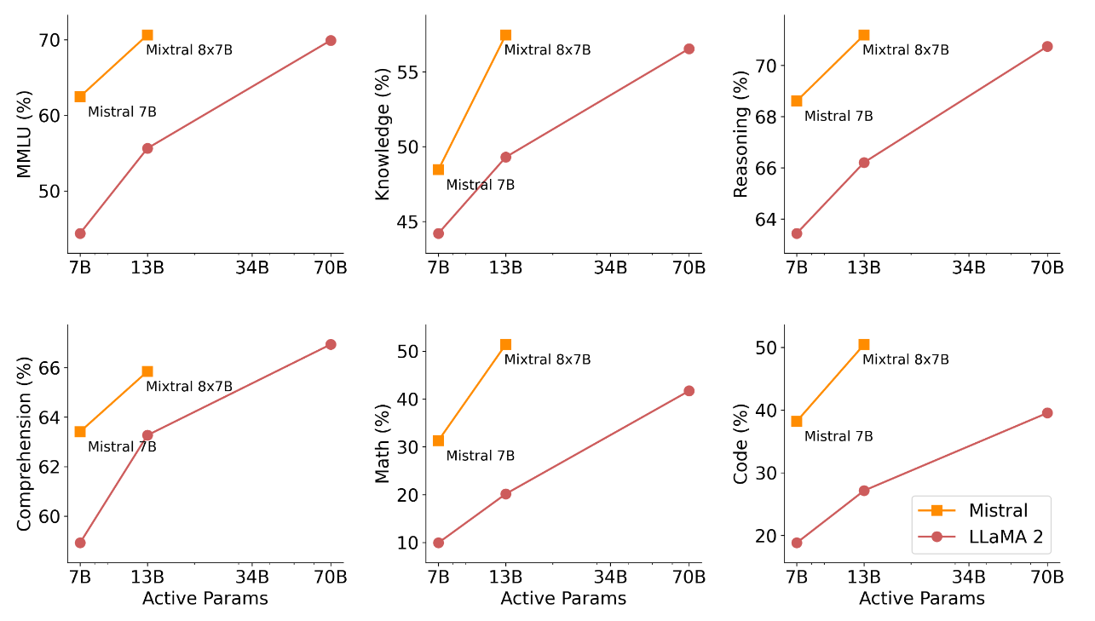
Mixtral(46.7B) Outperforms LLaMA-2(70B)
Figure. Results on 6 benchmarks that Mistral (7B/8x7B) outperforms Llama 2 (7B/13B/70B) (from Mixtral of Experts [3]).

Slide 6
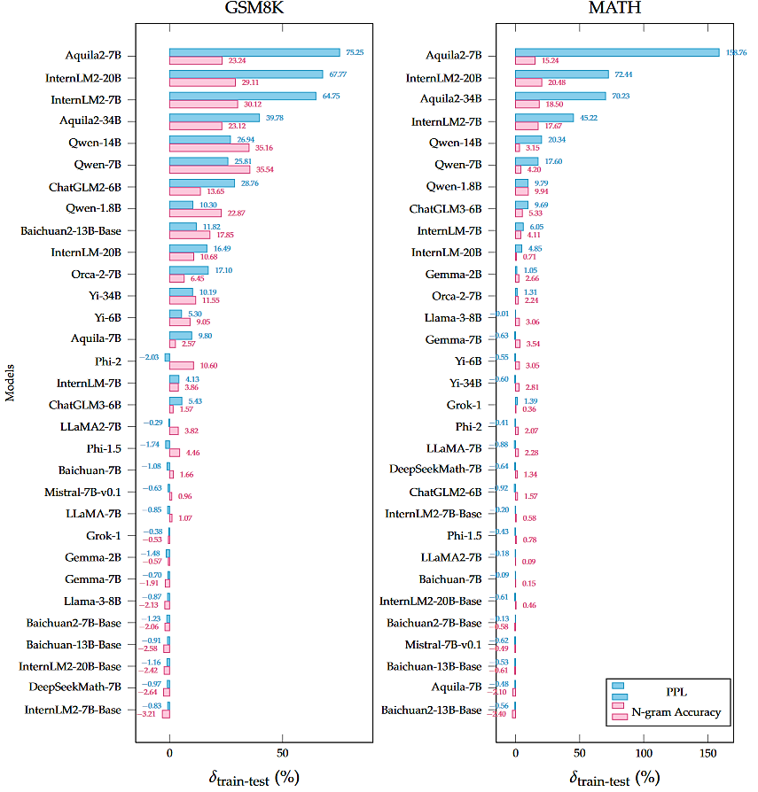
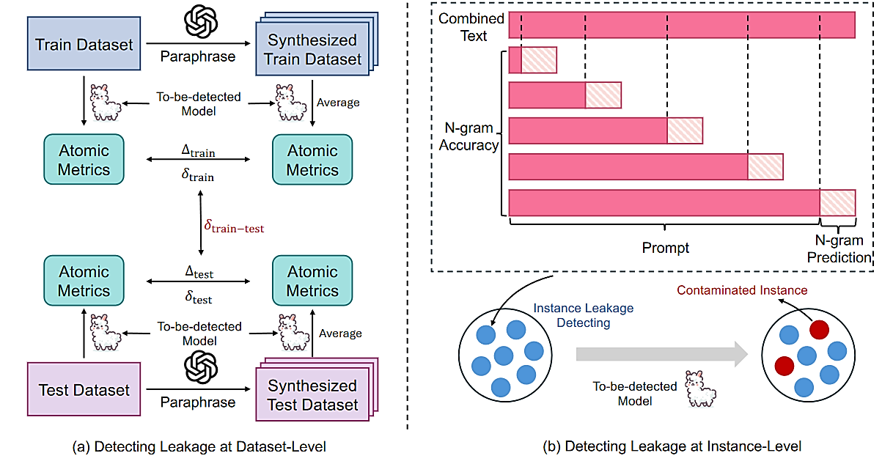
Contamination on Benchmark
⚠ ⚠ ⚠ This metric does not imply cheating, but rather indicates the potential use of the benchmark data during the pre-training phase; while using benchmarks to enhance capabilities is acceptable, the lack of relevant documentation can reduce transparency, potentially resulting in unfair comparisons and hindering the field’s healthy development [4].
Figure. Contamination Ranking [4]
Figure. An overview of detecting approach [4]

Slide 7
References
[1] J. Kaplan, S. McCandlish, T. Henighan, T. B. Brown, B. Chess, R. Child, S. Gray, A. Radford, J. Wu, and D. Amodei, “Scaling laws for neural language models,” CoRR, vol. abs/2001.08361, 2020.
[2] DeepSeek-AI et al., ‘DeepSeek-V2: A Strong, Economical, and Efficient Mixture-of-Experts Language Model’. arXiv, May 24, 2024. doi: 10.48550/arXiv.2405.04434.
[3] A. Q. Jiang et al., ‘Mixtral of Experts’. arXiv, Jan. 08, 2024. Accessed: Apr. 15, 2024. [Online]. Available: http://arxiv.org/abs/2401.04088
[4] R. Xu, Z. Wang, R.-Z. Fan, and P. Liu, ‘Benchmarking Benchmark Leakage in Large Language Models’. arXiv, Apr. 29, 2024. doi: 10.48550/arXiv.2404.18824.

