Slide 1
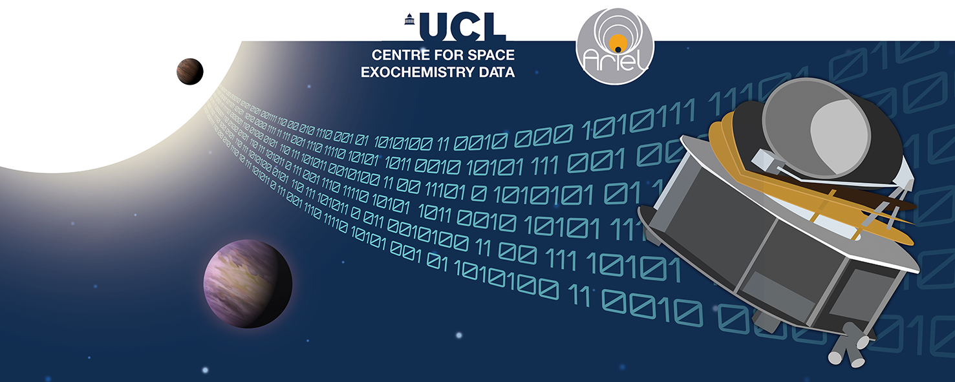
Lecture 2: Official Solution Walkthrough
Tutorials: NeurIPS - Ariel Data Challenge 2024
Presenter: kaggle君-sakura（bili_sakura@zju.edu.cn）
Date: October 9, 2024
Image Credit: NeurIPS - Ariel Data Challenge 2024 | Kaggle
© kaggle君-sakura, 2024. All rights reserved.

Slide 2
Outline
Recall the Task for Ariel Data Challenge
Calibration Details
Explanation on Official Baseline Solution
Data Preparation
1D-CNN for mean transit depth
2D CNN for atmospheric features
Combine 1D and 2D CNN output for FINAL SPECTRA
Insights
Possible Tricks for Baseline Improvement
DL-Tech1 : End-to-End Transformer-Based Solution
DL-Tech2 : Consider 3D Convolutional Module
© kaggle君-sakura, 2024. All rights reserved.

Slide 3
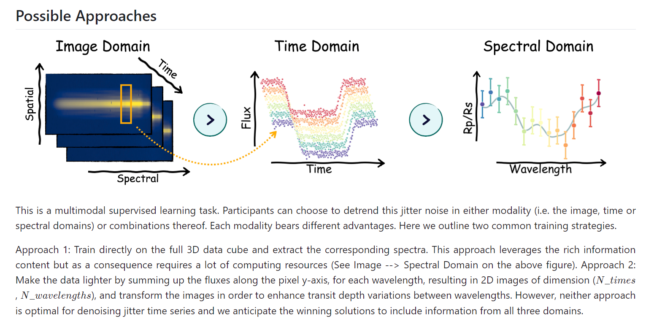
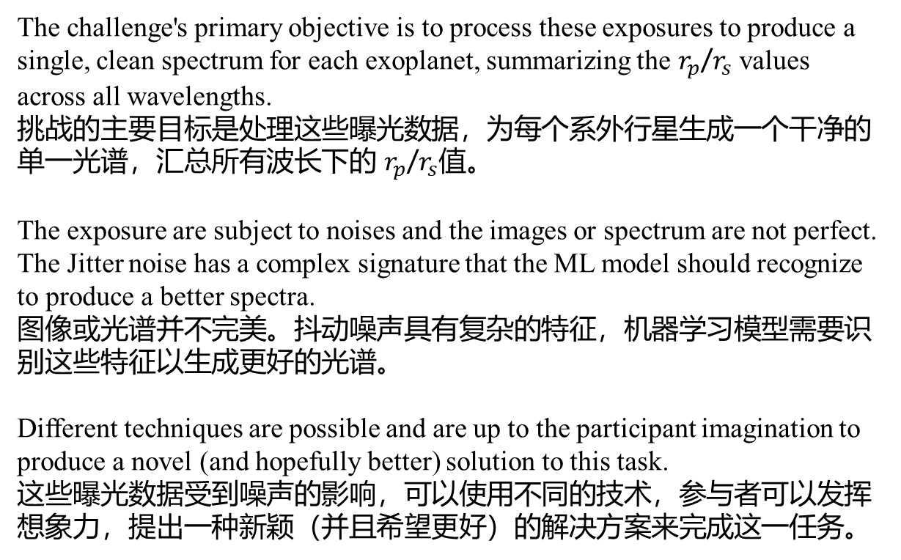
Recall the Task for Ariel Data Challenge
The challenge's primary objective is to process these exposures to produce a single, clean spectrum for each exoplanet, summarizing the $r_{p}$/$r_{s}$ values across all wavelengths.
挑战的主要目标是处理这些曝光数据，为每个系外行星生成一个干净的单一光谱，汇总所有波长下的 $r_{p}$/$r_{s}$值。
The exposure are subject to noises and the images or spectrum are not perfect. The Jitter noise has a complex signature that the ML model should recognize to produce a better spectra.
图像或光谱并不完美。抖动噪声具有复杂的特征，机器学习模型需要识别这些特征以生成更好的光谱。
Different techniques are possible and are up to the participant imagination to produce a novel (and hopefully better) solution to this task.
这些曝光数据受到噪声的影响，可以使用不同的技术，参与者可以发挥想象力，提出一种新颖（并且希望更好）的解决方案来完成这一任务。
© kaggle君-sakura, 2024. All rights reserved.

Slide 4
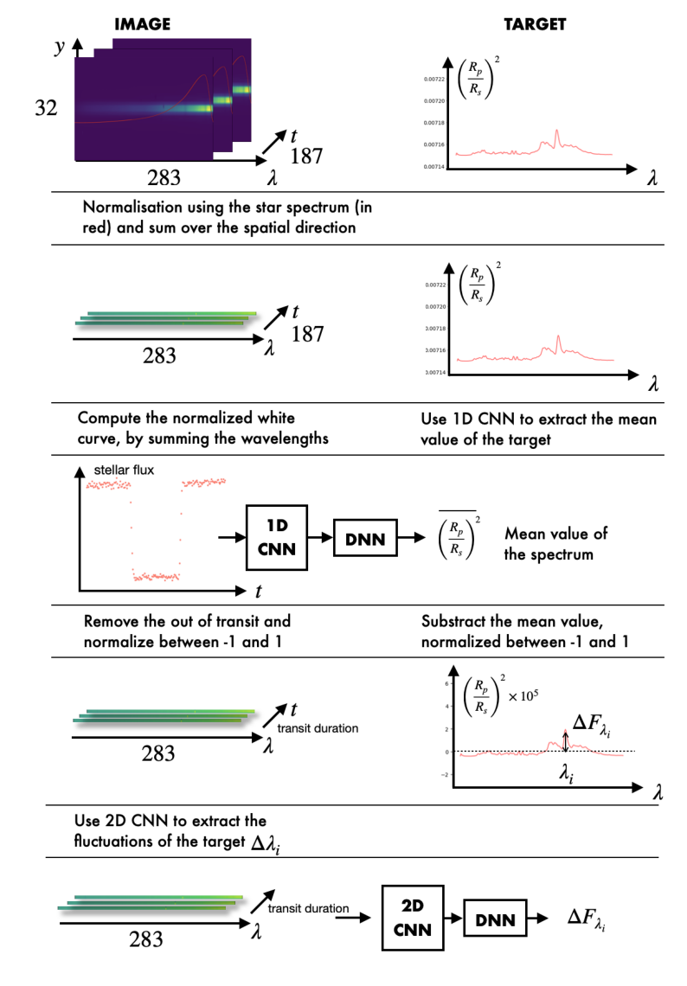
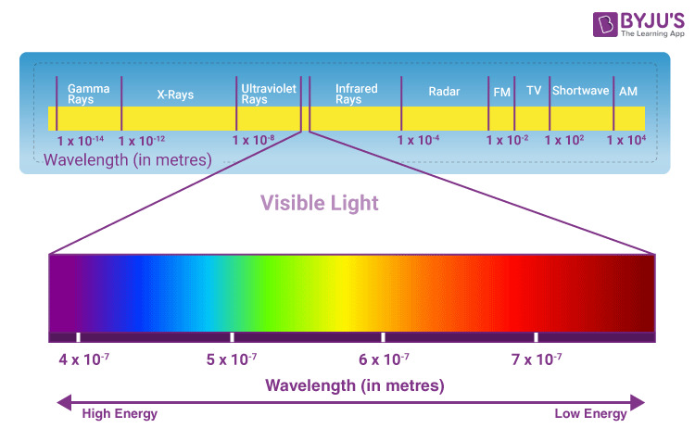
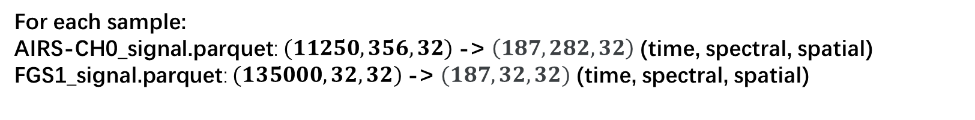
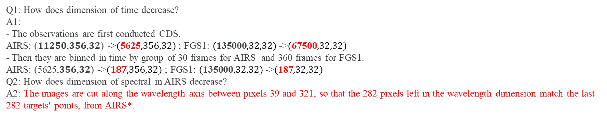
Calibration
For each sample:
AIRS-CH0_signal.parquet: $(11250,356,32)$-> $\left(187, 282, 32\right)$ (time, spectral, spatial)
FGS1_signal.parquet: $(135000,32,32)$-> $(187, 32, 32)$ (time, spectral, spatial)
Calibrating and Time Binning Astronomical Data 校准和时间分箱天文数据
Step 1: Analog-to-Digital Conversion 模拟到数字转换
Step 2: Mask hot/dead Pixel 屏蔽热像素/坏像素
Step 2: Linearity Correction 线性校正
Step 3: Dark Current Subtraction 暗电流扣除
Step 4: Get Correlated Double Sampling (CDS) 获取相关双重采样
Step 5 (Optional): Time Binning 时间分箱
Step 6: Flat Field Correction 平场校正
AIRS-CH0: 1.95 - 3.90 µm
FGS1: 0.60 – 0.80 µm
Q1: How does dimension of time decrease?
A1:
- The observations are first conducted CDS.
AIRS: (𝟏𝟏𝟐𝟓𝟎,𝟑𝟓𝟔,𝟑𝟐) ->$(\text{5625},356,32)$; FGS1: $(\text{135000},32,32)$->$(\text{67500},32,32)$
- Then they are binned in time by group of 30 frames for AIRS and 360 frames for FGS1.
AIRS: (5625,𝟑𝟓𝟔,𝟑𝟐) ->$(\text{187},356,32)$; FGS1: $(\text{135000},32,32)$->$(\text{187},32,32)$
Q2: How does dimension of spectral in AIRS decrease?
A2: The images are cut along the wavelength axis between pixels 39 and 321, so that the 282 pixels left in the wavelength dimension match the last 282 targets' points, from AIRS*.
I think this mapping by cropping is confusing. We would find a way to match $N_{spectral}=356 →N_{spectral}=282$
* https://www.kaggle.com/code/gordonyip/update-calibrating-and-binning-astronomical-data/comments#2953798
Image Credit: https://byjus.com/physics/visible-light/
© kaggle君-sakura, 2024. All rights reserved.

Slide 5
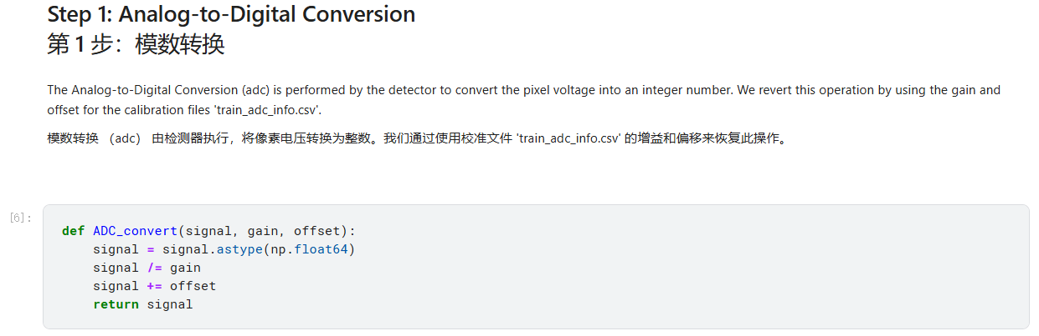
Calibration
There are some things you should pay attention to/modify in official calibration notebook:
Note we divide gain as the gain provided is an inversion factor of a standard gain.
See * for more explanation.
*https://www.kaggle.com/code/gordonyip/update-calibrating-and-binning-astronomical-data/comments#2951175
© kaggle君-sakura, 2024. All rights reserved.

Slide 6
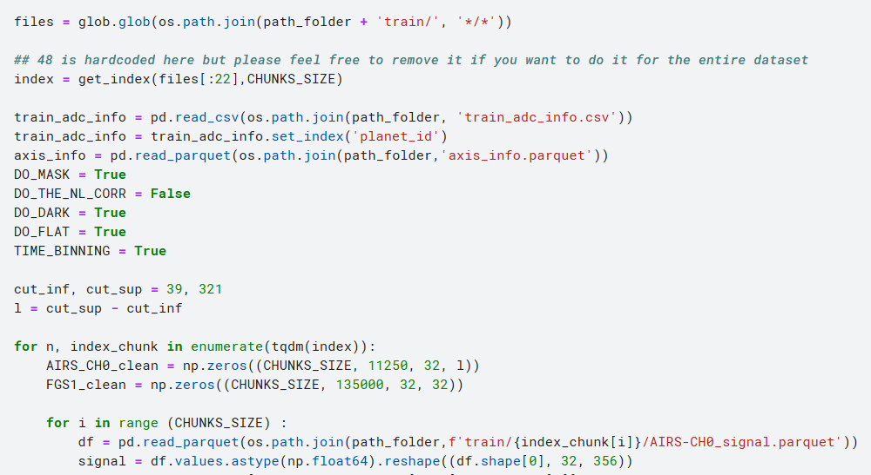
Calibration
There are some things you should pay attention to/modify in official calibration notebook:
1. Default CHUNKS_SIZE=1, enlarge it for acceleration.
2. Replace “[:22]” with “[:]” to process all data in “train” folder. If you want to do a subset, the index number should be 4 × sample_number. In other words, “[:]” works the same as “[:4*673]” where 673 is the number of samples in “train” folder.
3. As mentioned previously, this cropping for AIRS_CH0 data in spectrum dimension is confusing. Use other way instead.
https://www.kaggle.com/code/gordonyip/update-calibrating-and-binning-astronomical-data/comments#2948491
https://www.kaggle.com/code/gordonyip/update-calibrating-and-binning-astronomical-data/comments#2957303
© kaggle君-sakura, 2024. All rights reserved.

Slide 7
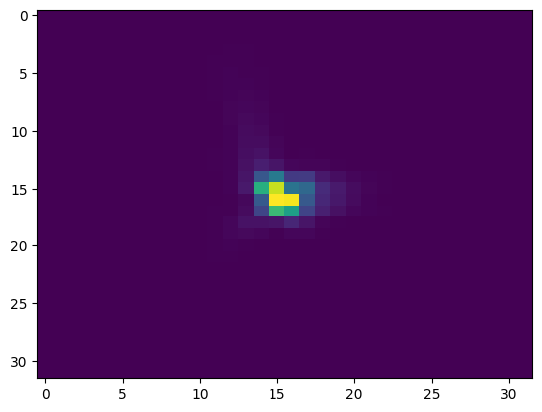
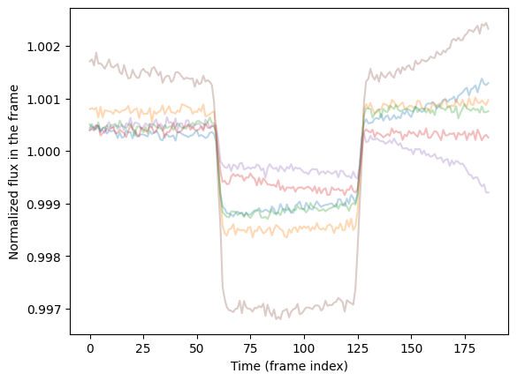
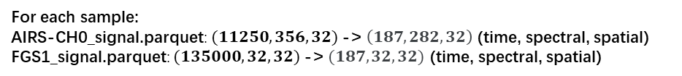
Calibration
For each sample:
AIRS-CH0_signal.parquet: $(11250,356,32)$-> $\left(187, 282, 32\right)$ (time, spectral, spatial)
FGS1_signal.parquet: $(135000,32,32)$-> $(187, 32, 32)$ (time, spectral, spatial)
plt.imshow(data_train_FGS[-1,50,:,:].T, aspect = 'auto')
6 samples of AIRS-CH0 are displayed.
An image-like slice from FGS1 sample data, where time_frame=50. X-axis denotes spectral dimension while Y-axis denotes spatial dimension.
Visualization of calibrated data.
© kaggle君-sakura, 2024. All rights reserved.

Slide 8

Data Preparation
For each sample:
AIRS-CH0_signal.parquet: $(11250,356,32)$-> $\left(187, 282, 32\right)$ (time, spectral, spatial)
FGS1_signal.parquet: $(135000,32,32)$-> $(187, 32, 32)$ (time, spectral, spatial)
$(187, 1, 32)$
Concatenate by spectral dimension
© kaggle君-sakura, 2024. All rights reserved.

Slide 9
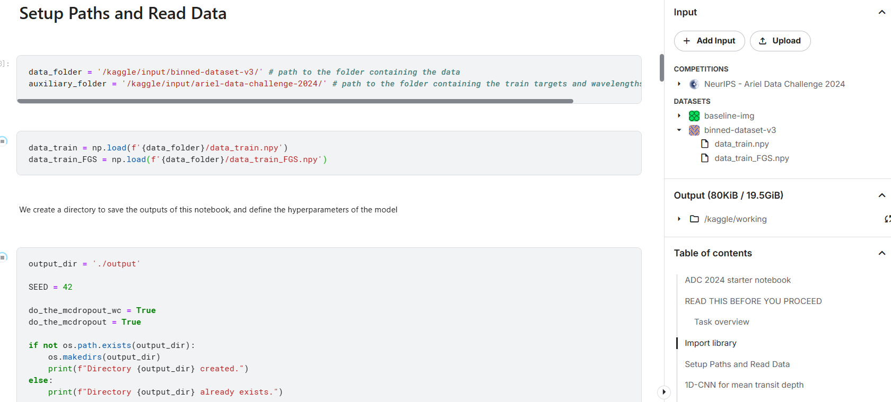
Data Preparation
© kaggle君-sakura, 2024. All rights reserved.

Slide 10
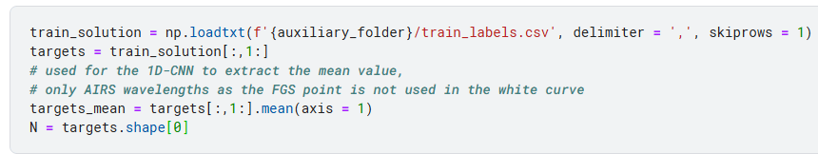
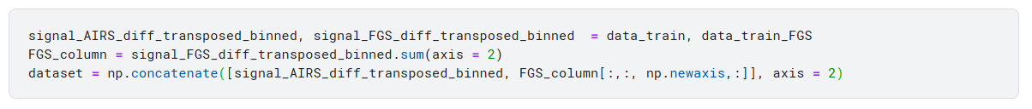
Data Preparation
1D-CNN for mean transit depth
We create the dataset by adding the FGS frame, crushed in one column, at the end of the AIRS data cube.
The images are normalized using the star spectrum extracted from the images themselves.
we sum up the pixels on the y-axis to transform the data into 2D images
© kaggle君-sakura, 2024. All rights reserved.

Slide 11
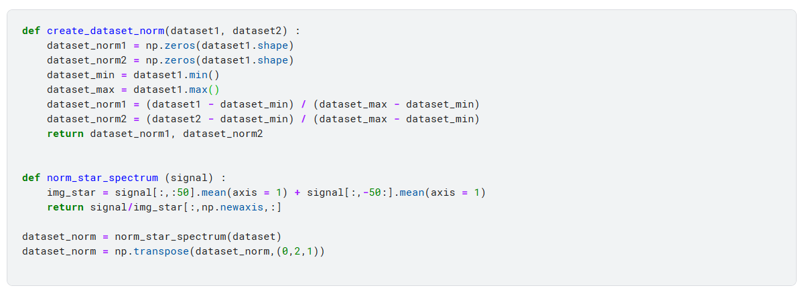
Data Preparation
We divide the images by the star flux assuming the first and last 50 instants belong to the out of transit.
© kaggle君-sakura, 2024. All rights reserved.

Slide 12
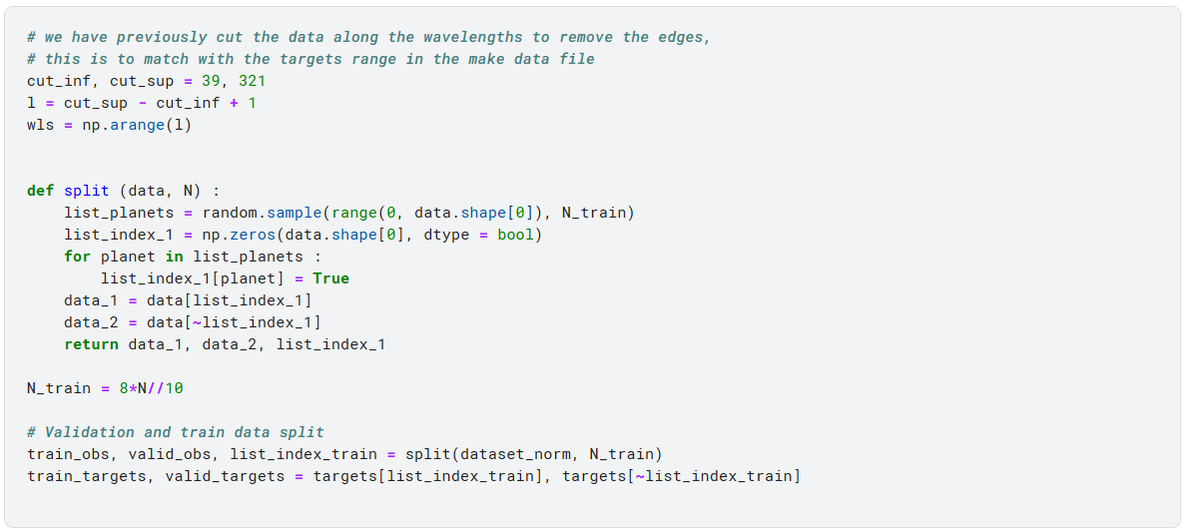
Data Preparation
We start by computing a "white curve", that is actually the sum of the signal over the all image, as a function of time. We split the data and normalize the train/valid/test data.
© kaggle君-sakura, 2024. All rights reserved.

Slide 13
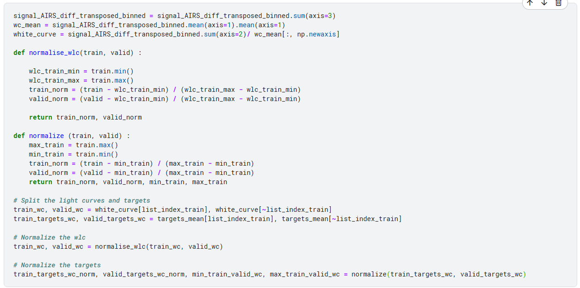
Data Preparation
© kaggle君-sakura, 2024. All rights reserved.

Slide 14
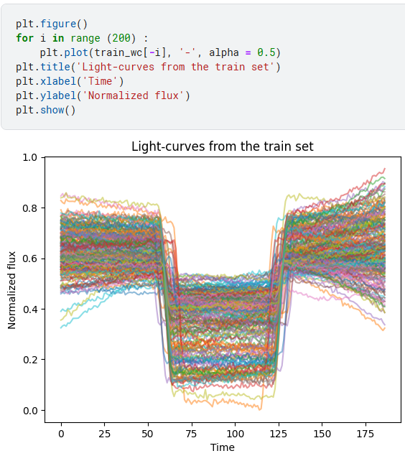
Data Preparation
© kaggle君-sakura, 2024. All rights reserved.

Slide 15
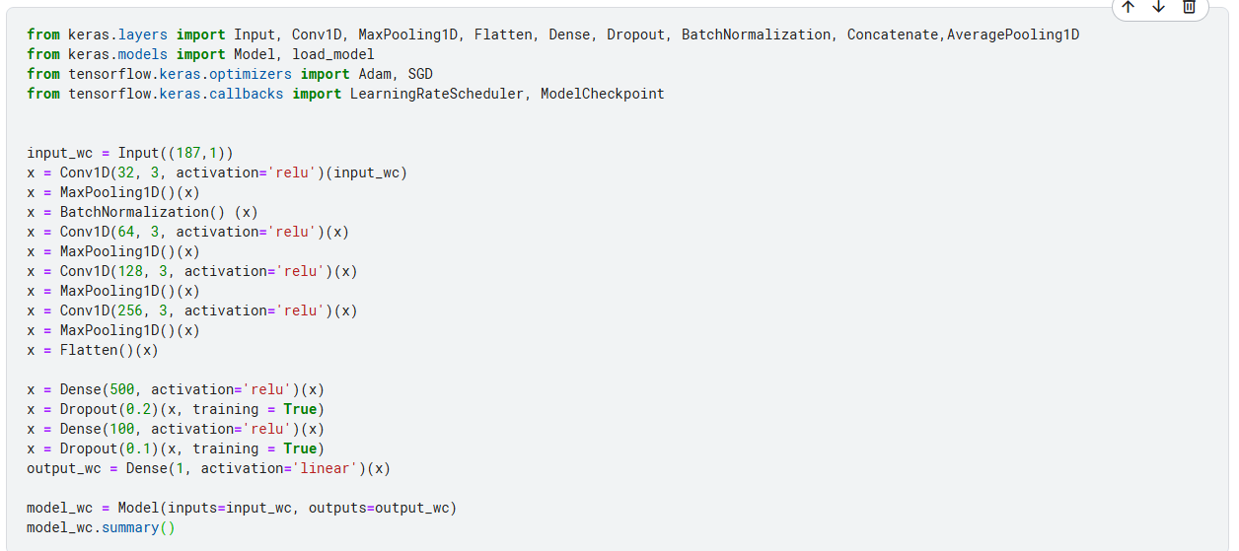
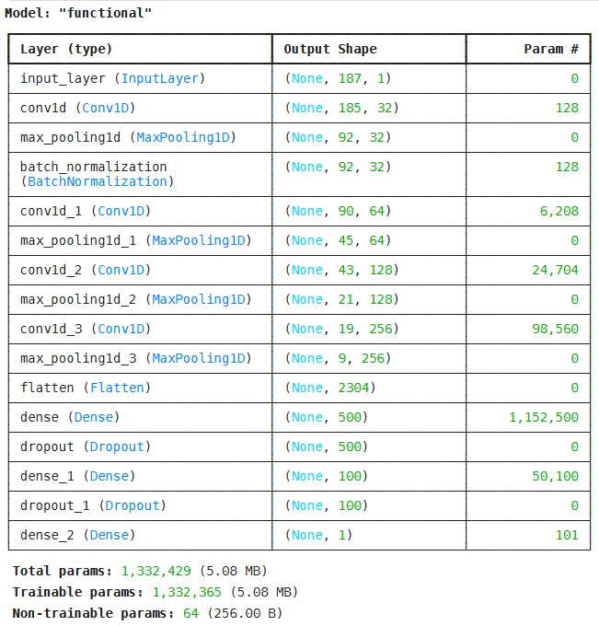
Train 1D CNN
© kaggle君-sakura, 2024. All rights reserved.

Slide 16
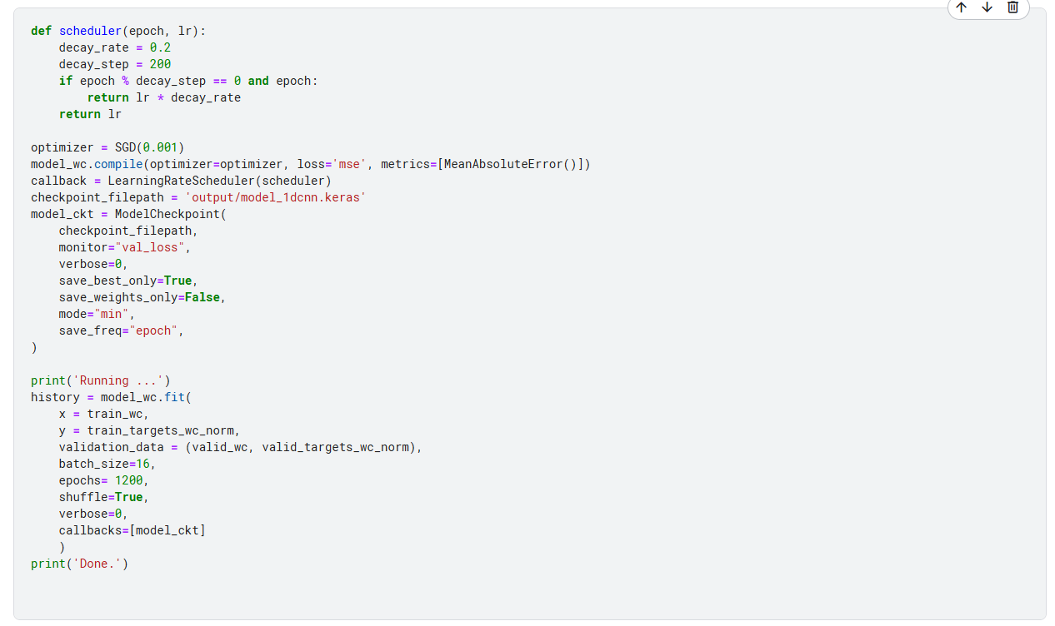
Train 1D CNN
© kaggle君-sakura, 2024. All rights reserved.

Slide 17
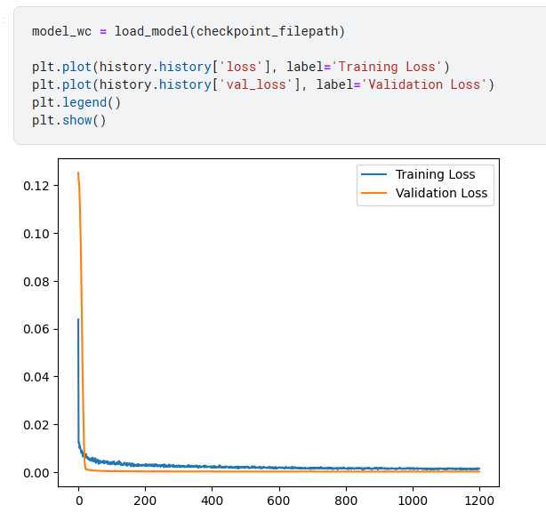
1D CNN Inference
© kaggle君-sakura, 2024. All rights reserved.

Slide 18
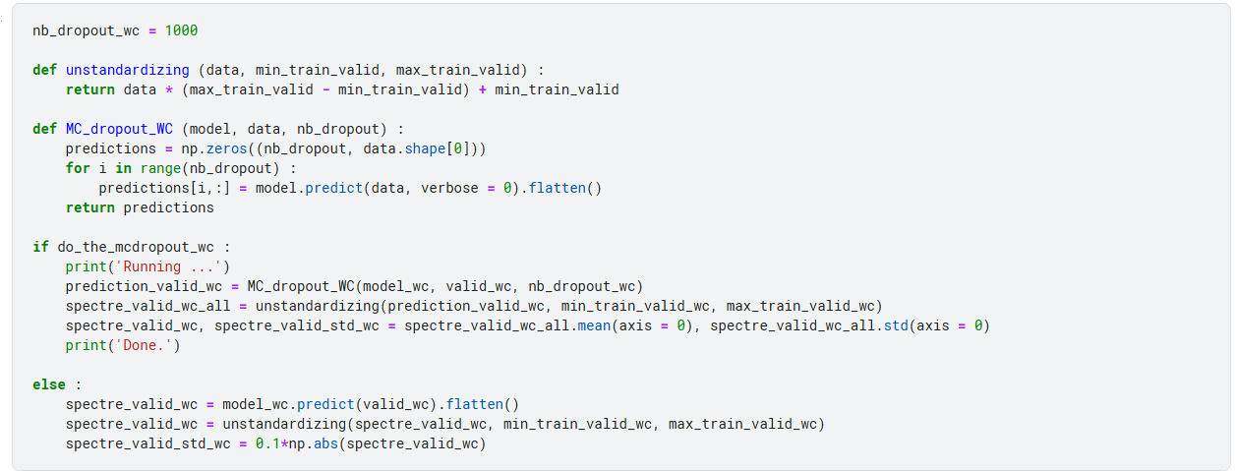
1D CNN Inference
Then, we perform the MC Dropout to obtain the mean prediction and the uncertainty associated. We choose to compute 1000 instances.
© kaggle君-sakura, 2024. All rights reserved.

Slide 19
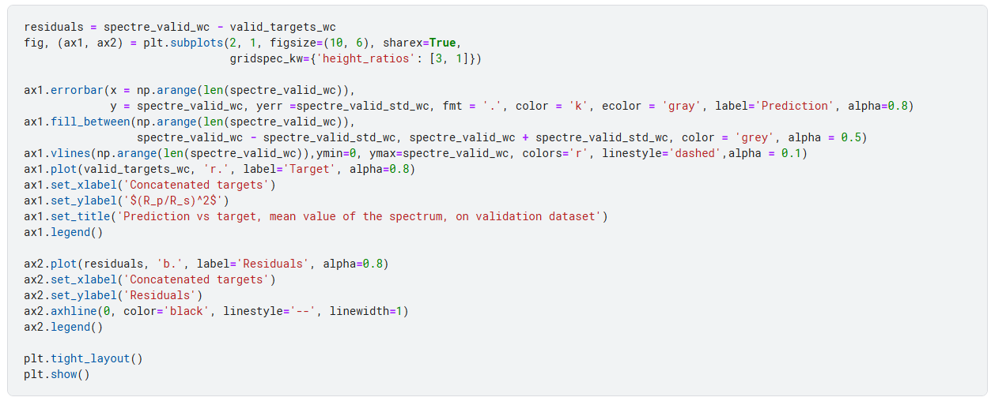
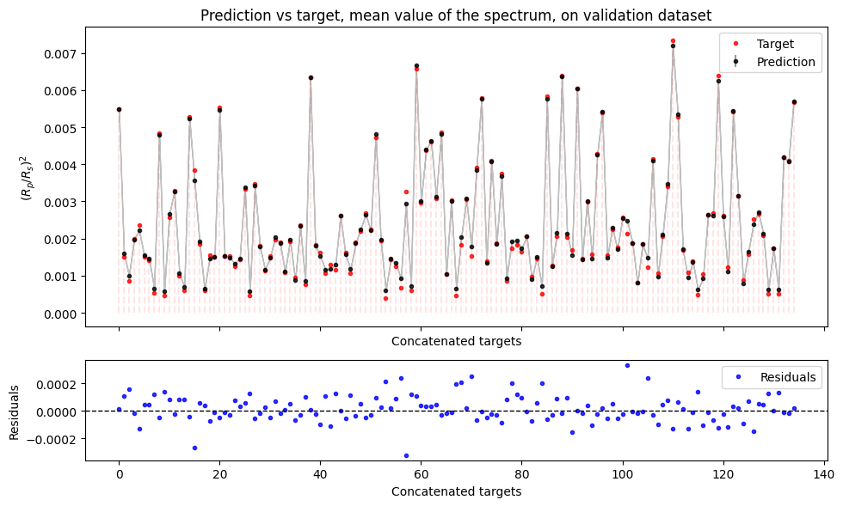
1D CNN Inference
© kaggle君-sakura, 2024. All rights reserved.

Slide 20
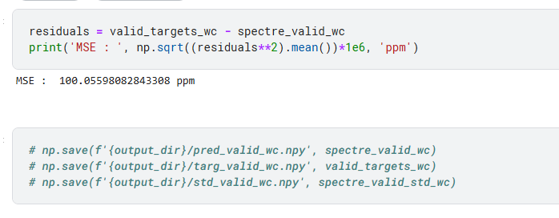
1D CNN Inference
© kaggle君-sakura, 2024. All rights reserved.

Slide 21
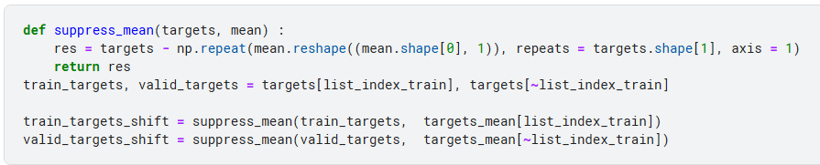
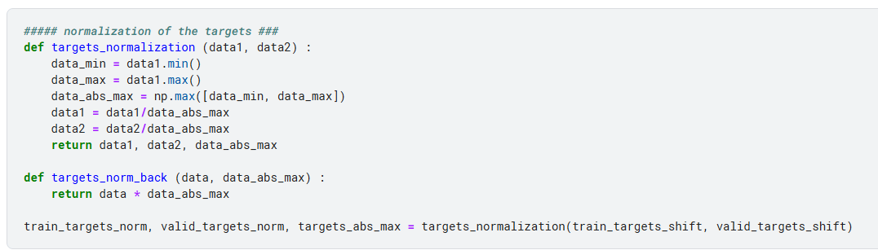
Preprocessing for 2D CNN
2D CNN for atmospheric features
We now remove the mean value (transit depth) of the spectra to keep the atmospheric features only
We normalize the targets so that they range between -1 and 1, centered on zero
© kaggle君-sakura, 2024. All rights reserved.

Slide 22
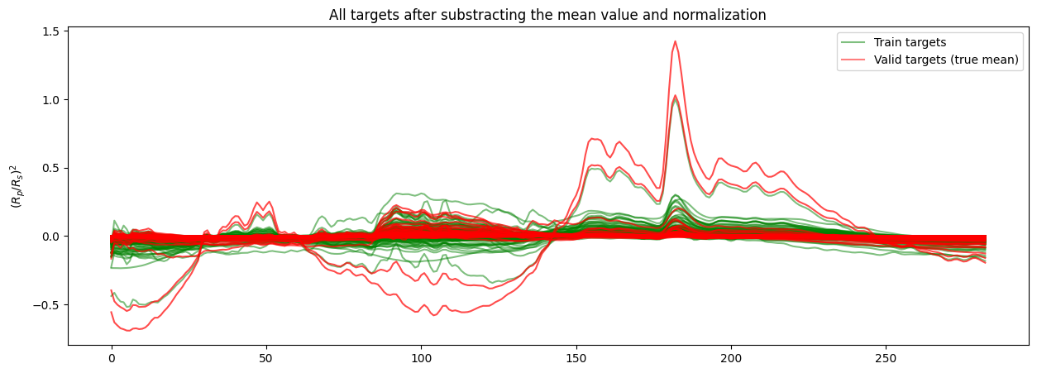
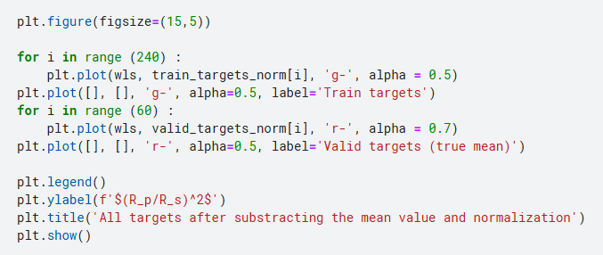
Preprocessing for 2D CNN
© kaggle君-sakura, 2024. All rights reserved.

Slide 23
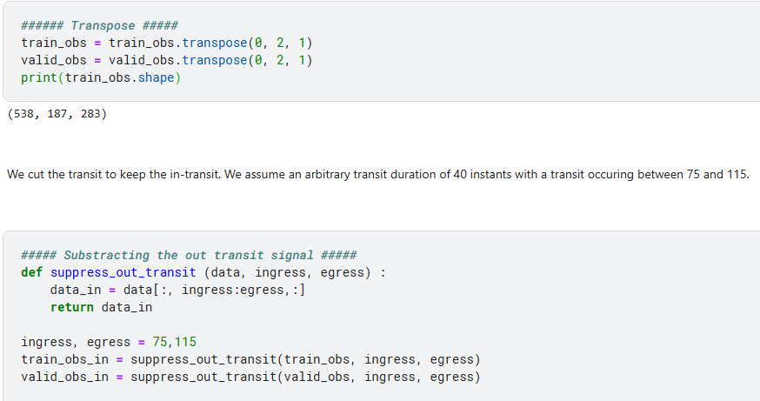
Preprocessing for 2D CNN
© kaggle君-sakura, 2024. All rights reserved.

Slide 24
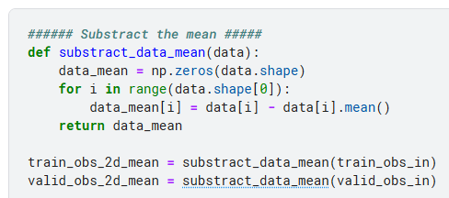
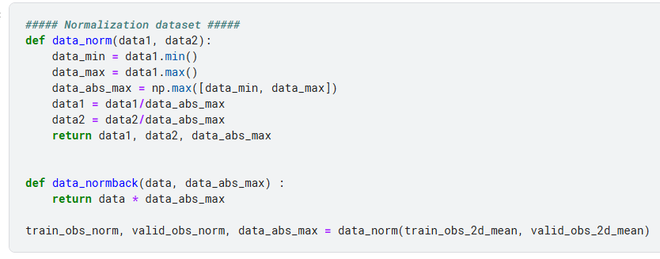
Preprocessing for 2D CNN
We remove the mean value of the in-transit to get relative data like the targets
We use the same normalization as for the targets, i.e. between -1 and 1 centered on zero
© kaggle君-sakura, 2024. All rights reserved.

Slide 25
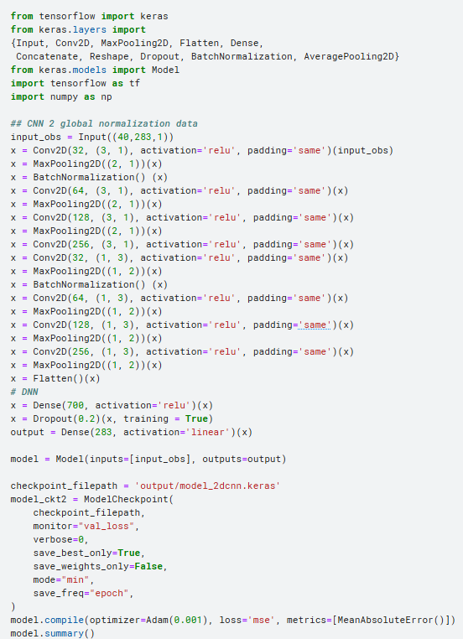
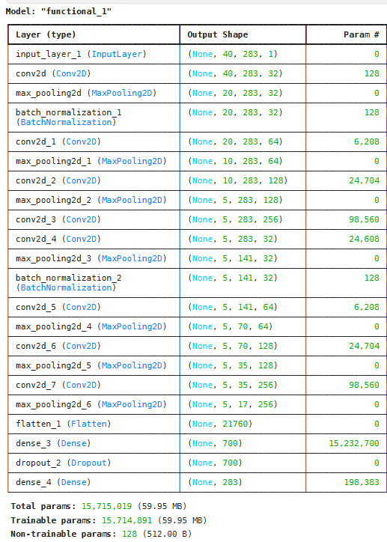
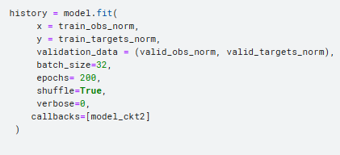
Train 2D CNN
© kaggle君-sakura, 2024. All rights reserved.

