Slide 1


Workflow of Image Captioning for Disaster Remote Sensing Images
Presenter: Sakura
Contact me: bili_sakura@zju.edu.cn
Date: August 19, 2024
© Sakura, 2024. All rights reserved.

Slide 2
Outline
Problem Definition
Image Captioning
Modern Image Captioning Models
General VLM
Remote Sensing VLM
Image Captioning for Disaster RSIs
Building Damage Assessment & Metrics
© Sakura, 2024. All rights reserved.

Slide 3
Problem Definition
© Sakura, 2024. All rights reserved.

Slide 4
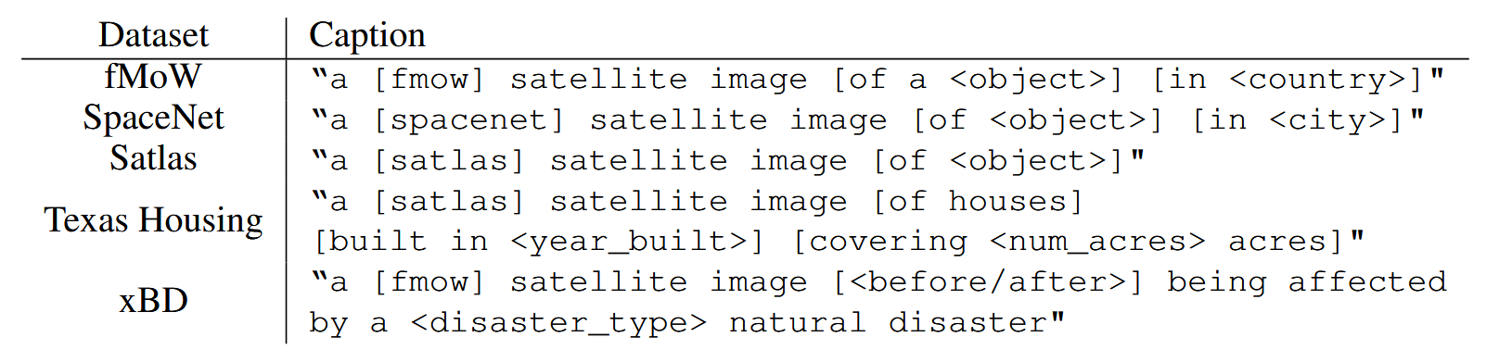
Generate High Quality Descriptions for Disaster RSIs
Imagen [4] showcases the effectiveness of frozen large pretrained language models as text encoders for the text-to-image generation using diffusion models. Inspired by this idea, DALL-E 3 [5] shows that prompt following abilities of text-to-image models can be substantially improved by training on highly descriptive generated image captions. Stable Diffusion 3 [6] follows previous findings, adopt 3 different text encoder for better image synthesis.
In terms of remote sensing images (RSIs), high-quality descriptive captions for RSIs are scarce. Even for inspiring work as DiffusionSat [7], the caption of training dataset is quite short and less informative.
Therefore, there is a strong need for high-quality informative text-image RSIs dataset.
Captions created for each dataset type based on available label information from DiffusionSat [7].
…
© Sakura, 2024. All rights reserved.

Slide 5
Image Captioning
© Sakura, 2024. All rights reserved.

Slide 6
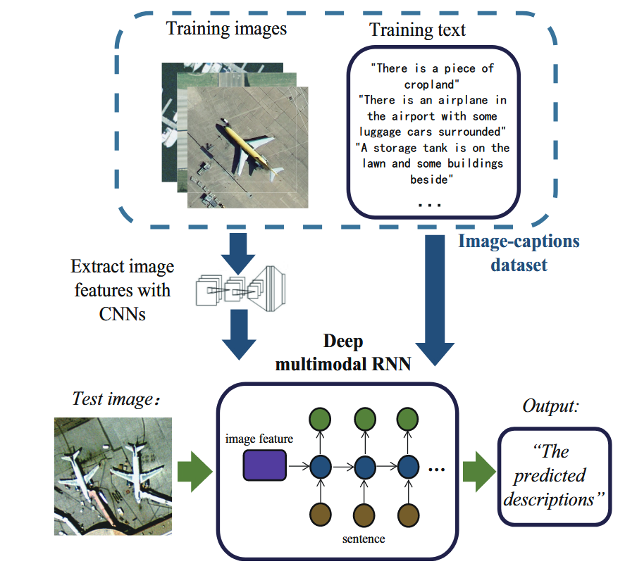
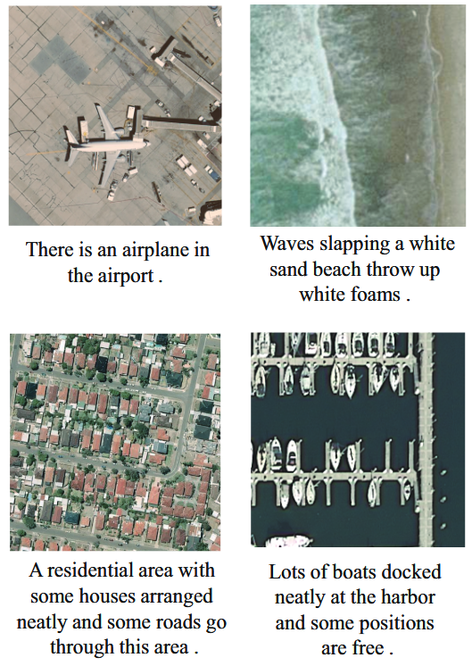
Classic Image Captioning Method
Left: Overview of model proposed in [8]. Right: The result of HSR image caption generation.
[8] B. Qu, X. Li, D. Tao, and X. Lu, ‘Deep semantic understanding of high resolution remote sensing image’, in 2016 International Conference on Computer, Information and Telecommunication Systems (CITS), Jul. 2016, pp. 1–5. doi: 10.1109/CITS.2016.7546397.
© Sakura, 2024. All rights reserved.

Slide 7
Image Captioning Models
© Sakura, 2024. All rights reserved.

Slide 8
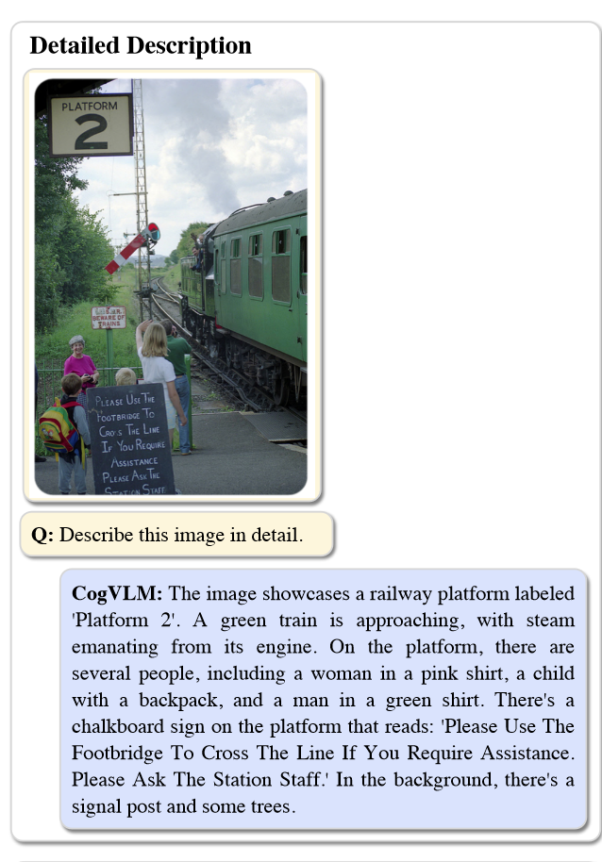
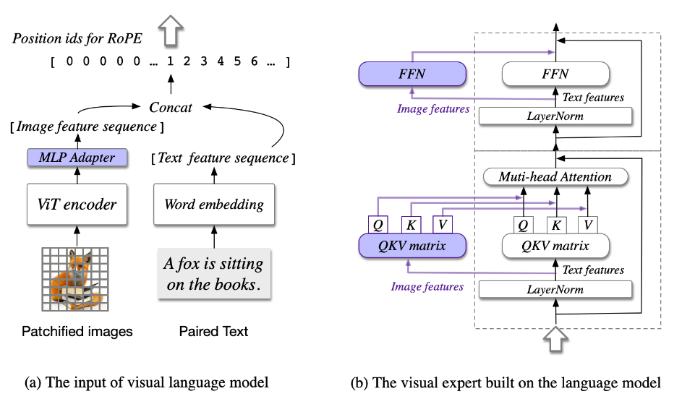
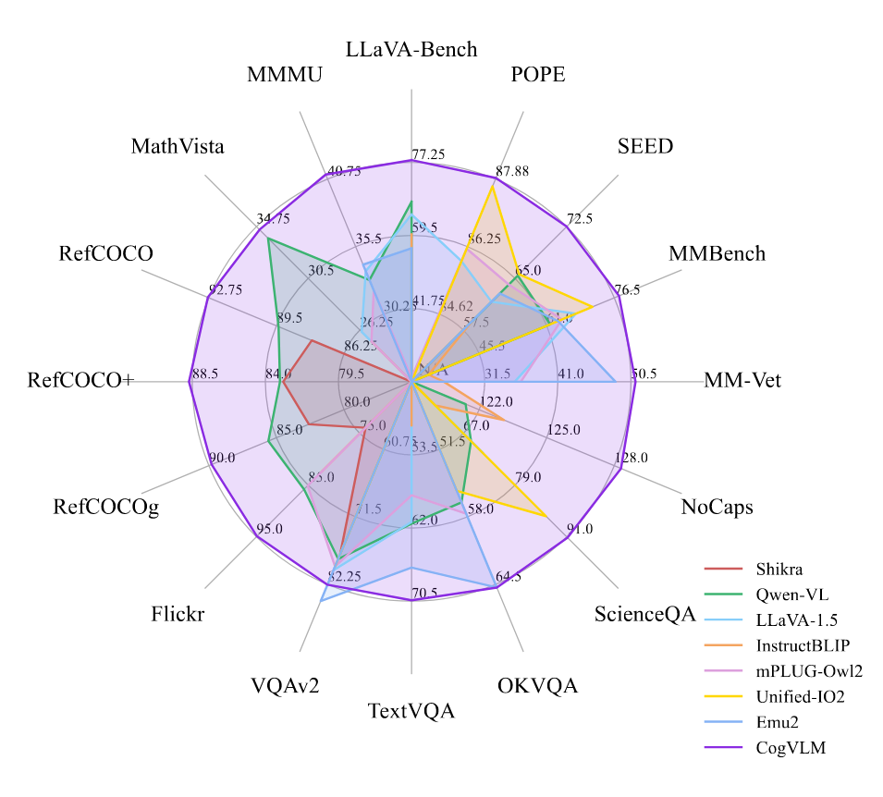
CogVLM 2
Developed by Tsinghua University and Zhipu AI
Checkpoint accessed here
Left: CogVLM image captioning example. Mid: Architecture of CogVLM. Right: Evaluation of CogVLM.
[1] W. Wang et al., ‘CogVLM: Visual Expert for Pretrained Language Models’, Feb. 04, 2024, arXiv: arXiv:2311.03079. doi: 10.48550/arXiv.2311.03079.
© Sakura, 2024. All rights reserved.

Slide 9
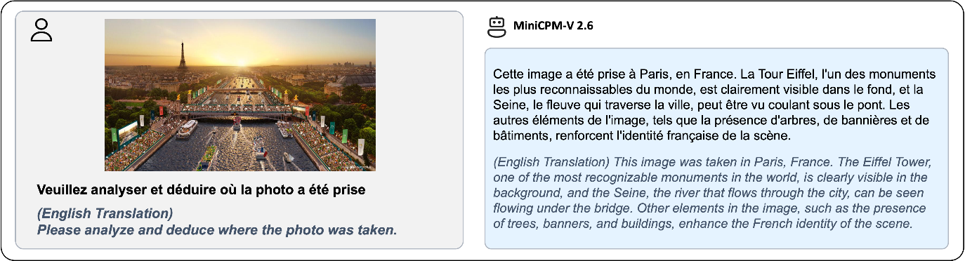
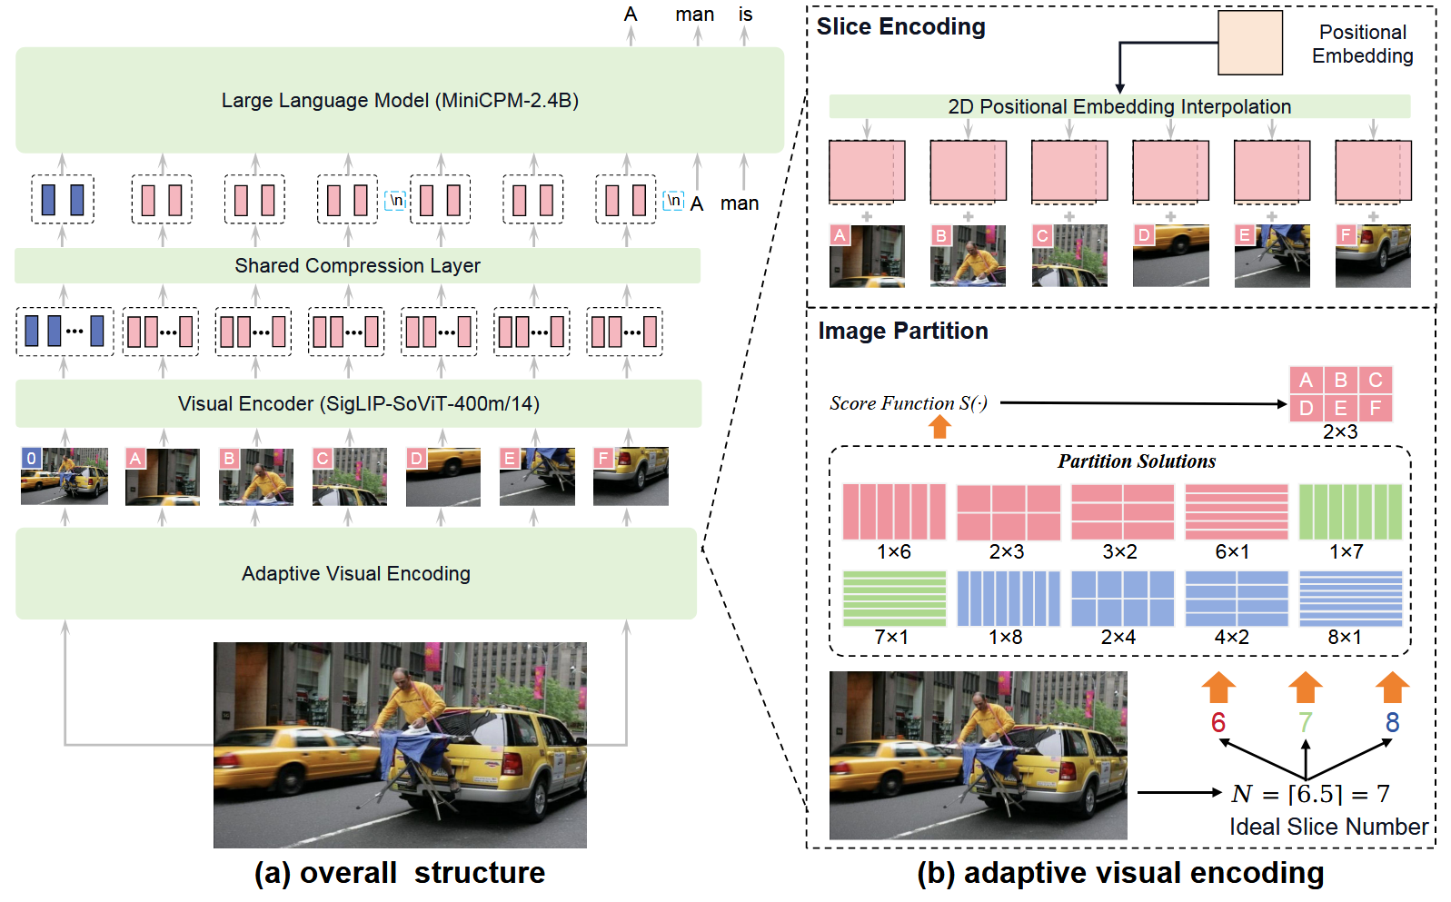
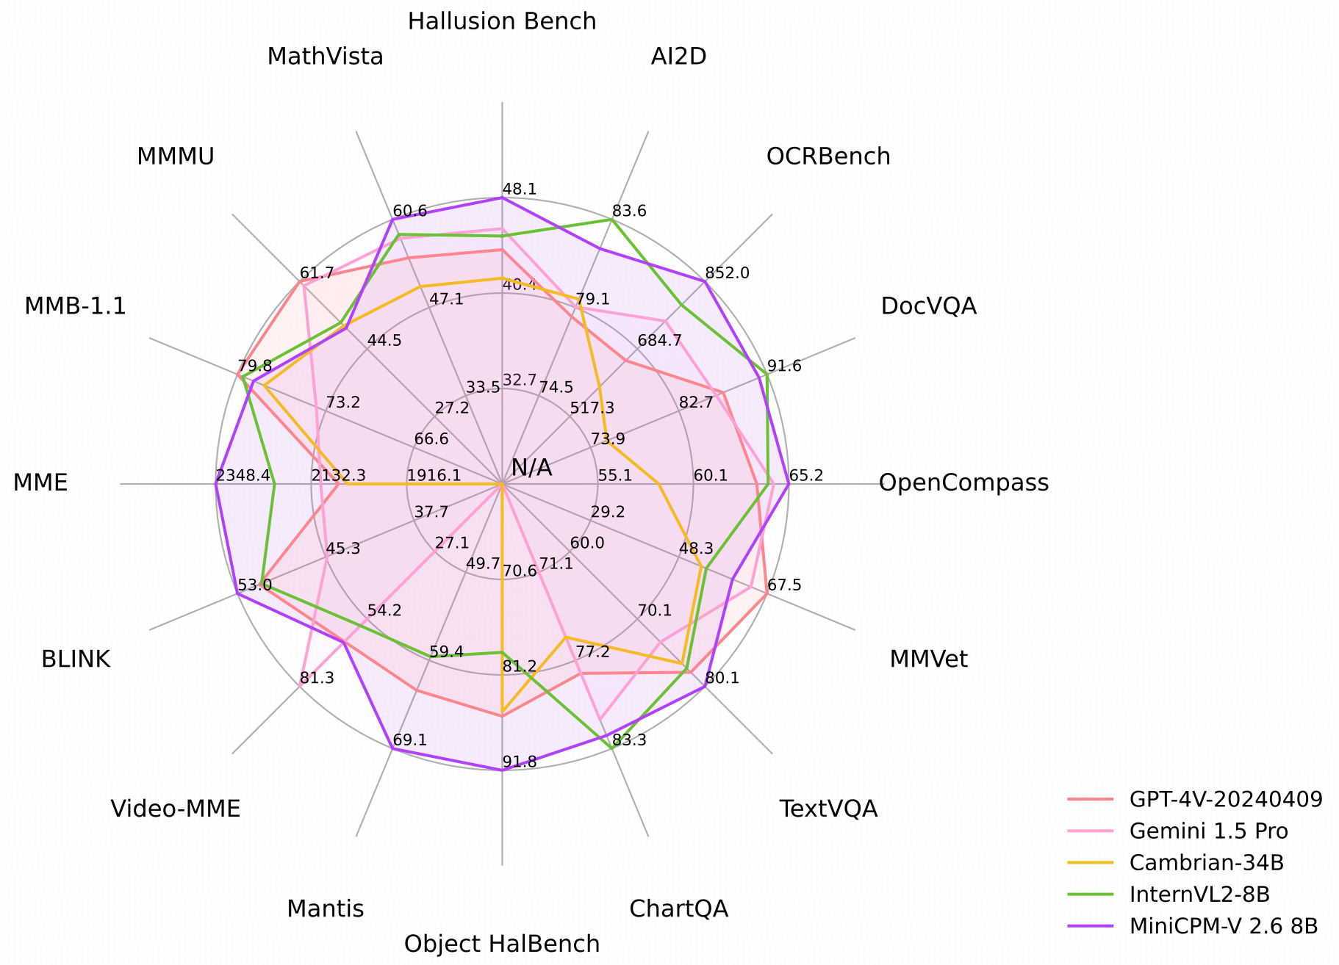
MiniCPM-V 2.6
Developed by OpenBMB
Checkpoint accessed here
Left: MiniCPM-V 2.6 image captioning example. Mid: Architecture of MiniCPM-V. Right: Evaluation of MiniCPM-V 2.6.
[2] Y. Yao et al., ‘MiniCPM-V: A GPT-4V Level MLLM on Your Phone’, Aug. 03, 2024, arXiv: arXiv:2408.01800. doi: 10.48550/arXiv.2408.01800.
© Sakura, 2024. All rights reserved.

Slide 10
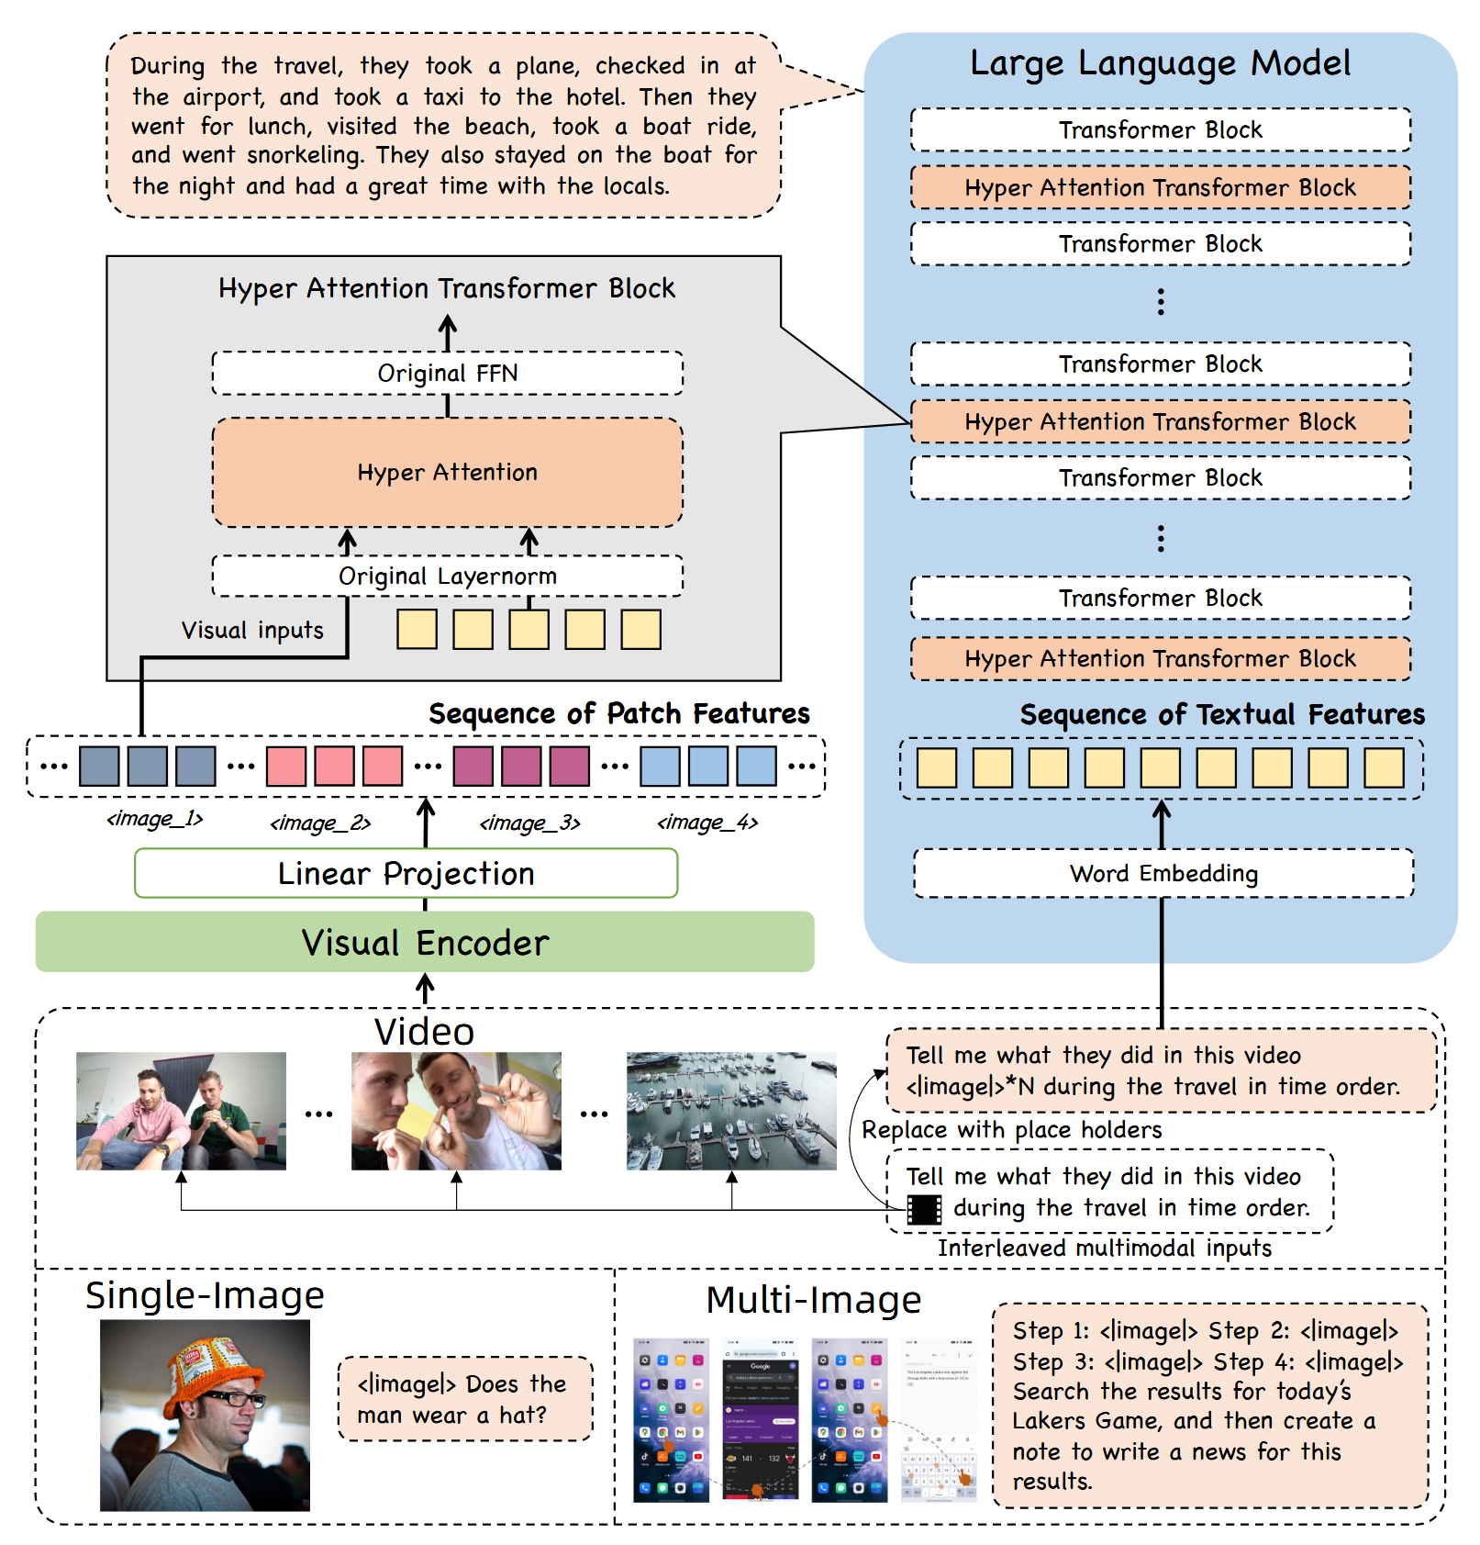
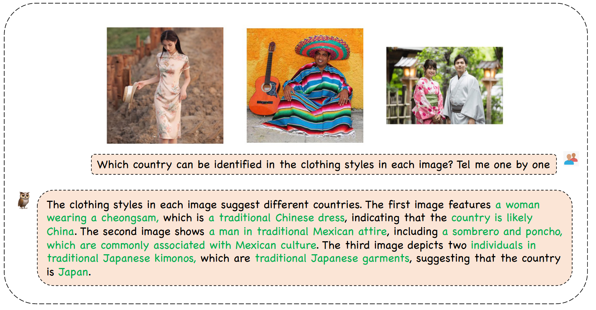
mPLUG-Owl3
Developed by Alibaba Group
Checkpoint accessed here
Left: mPLUG-Owl3 multi-images understanding example. Right: Architecture of mPLUG-Owl3.
[3] J. Ye et al., ‘mPLUG-Owl3: Towards Long Image-Sequence Understanding in Multi-Modal Large Language Models’, Aug. 13, 2024, arXiv: arXiv:2408.04840.
© Sakura, 2024. All rights reserved.

Slide 11
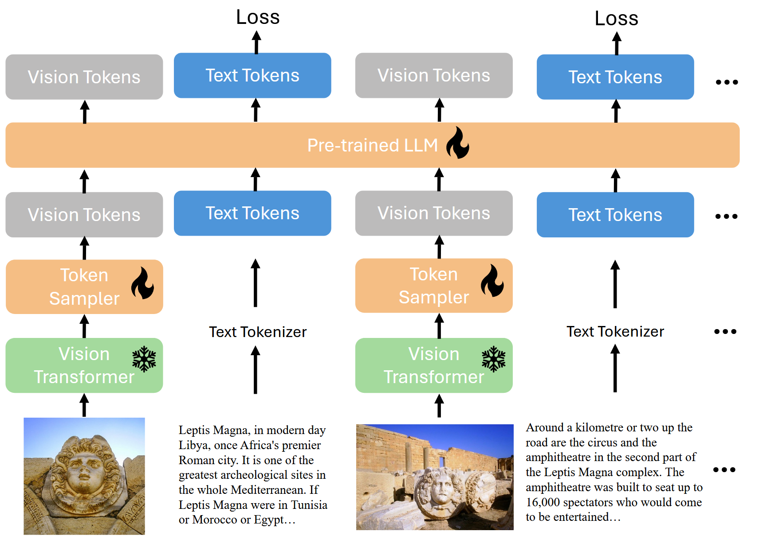
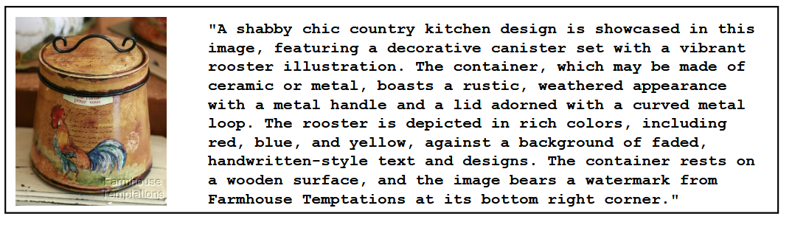
xGen-MM (BLIP-3)
Developed by Salesforce Research
Checkpoint accessed here
Left: BLIP-3 image captioning example. Right: Architecture of BLIP-3.
[12] L. Xue et al., “xGen-MM (BLIP-3): A Family of Open Large Multimodal Models,” Aug. 16, 2024, arXiv:2408.08872. doi: 10.48550/arXiv.2408.08872.
© Sakura, 2024. All rights reserved.

Slide 12
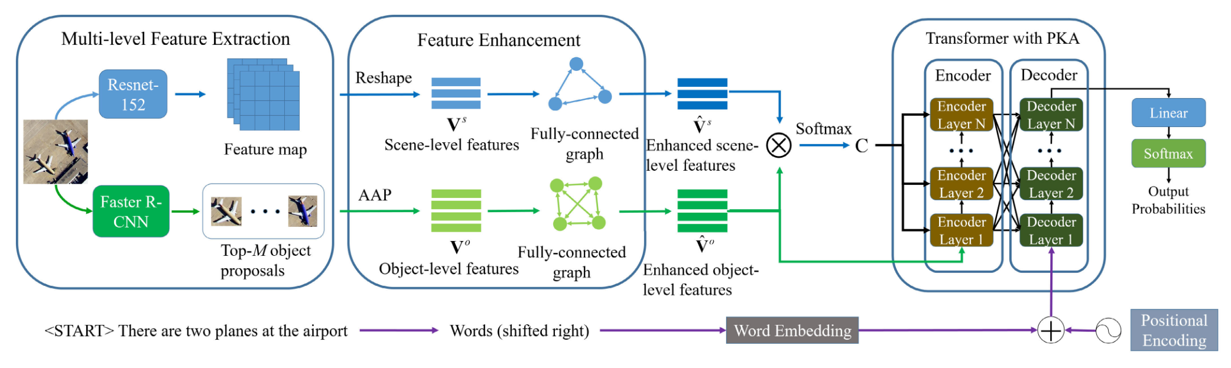
PKG-Transformer & MG-Transformer
PKG-Transformer (TGRS 2023) checkpoint accessed here
MG-Transformer (TGRS 2024) checkpoint accessed here
Framework of PKG-Transformer [9].
[9] L. Meng, J. Wang, Y. Yang, and L. Xiao, ‘Prior Knowledge-Guided Transformer for Remote Sensing Image Captioning’, IEEE Transactions on Geoscience and Remote Sensing, vol. 61, pp. 1–13, Aug. 2023, doi: 10.1109/TGRS.2023.3328181.
© Sakura, 2024. All rights reserved.

Slide 13
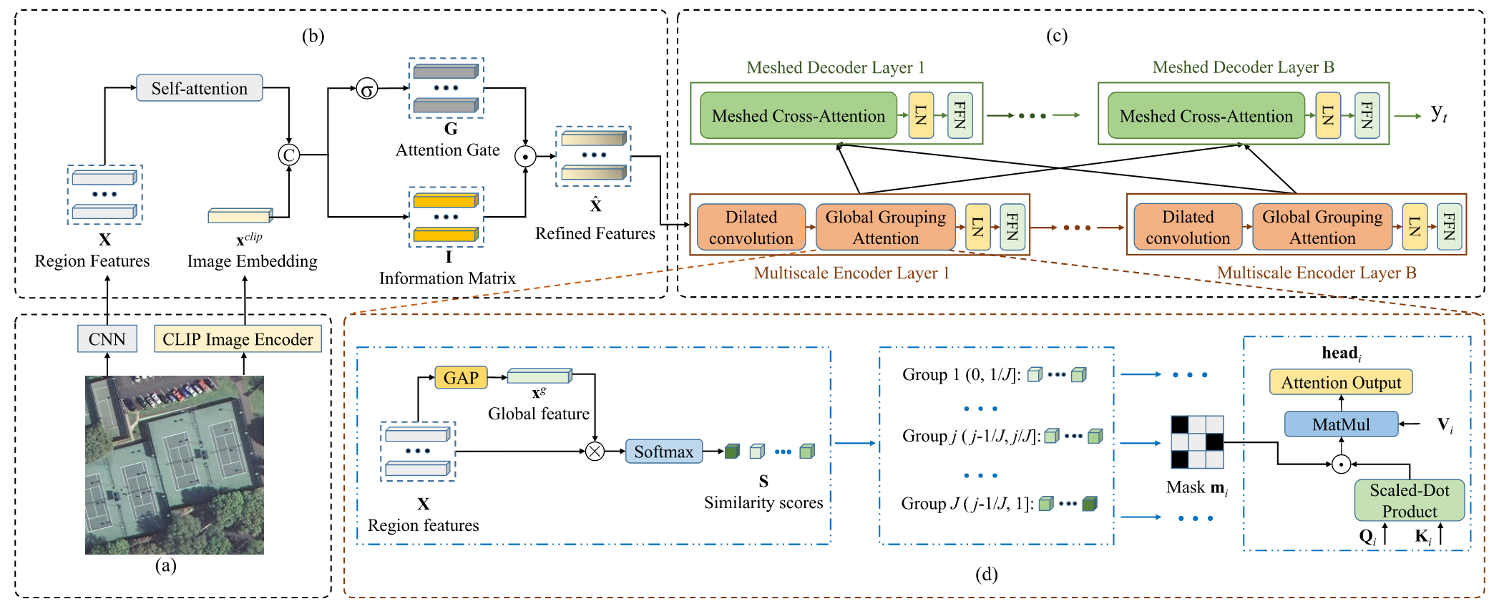
PKG-Transformer & MG-Transformer
PKG-Transformer (TGRS 2023) checkpoint accessed here
MG-Transformer (TGRS 2024) checkpoint accessed here
Framework of MG-Transformer [10].
[10] L. Meng, J. Wang, R. Meng, Y. Yang, and L. Xiao, ‘A Multiscale Grouping Transformer With CLIP Latents for Remote Sensing Image Captioning’, IEEE Transactions on Geoscience and Remote Sensing, vol. 62, pp. 1–15, Apr. 2024, doi: 10.1109/TGRS.2024.3385500.
© Sakura, 2024. All rights reserved.

Slide 14
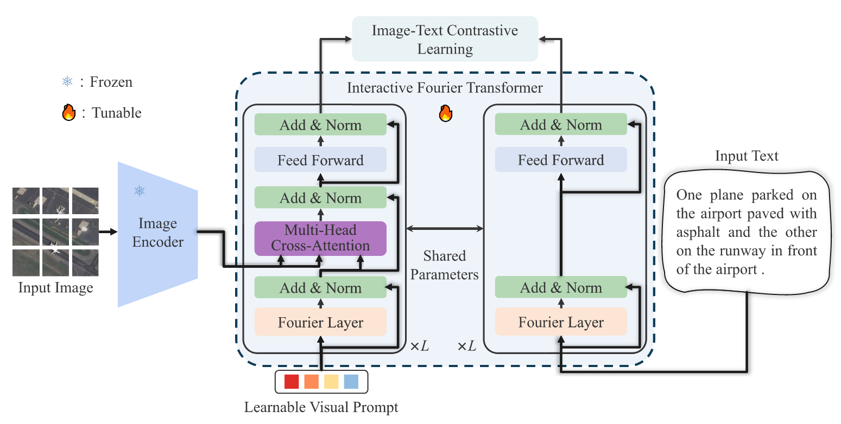
Bootstrapping Interactive Image–Text Alignment
for Remote Sensing Image Captioning
BITA checkpoint accessed here
Framework of BITA [11].
[11] C. Yang, Z. Li, and L. Zhang, ‘Bootstrapping Interactive Image–Text Alignment for Remote Sensing Image Captioning’, TGRS 2024, vol. 62, pp. 1–12, Jan. 2024, doi: 10.1109/TGRS.2024.3359316.
© Sakura, 2024. All rights reserved.

Slide 15
References and Related Works
[1] W. Wang et al., ‘CogVLM: Visual Expert for Pretrained Language Models’, Feb. 04, 2024, arXiv: arXiv:2311.03079. doi: 10.48550/arXiv.2311.03079.
[2] Y. Yao et al., ‘MiniCPM-V: A GPT-4V Level MLLM on Your Phone’, Aug. 03, 2024, arXiv: arXiv:2408.01800. doi: 10.48550/arXiv.2408.01800.
[3] J. Ye et al., ‘mPLUG-Owl3: Towards Long Image-Sequence Understanding in Multi-Modal Large Language Models’, Aug. 13, 2024, arXiv: arXiv:2408.04840.
[4] C. Saharia et al., ‘Photorealistic Text-to-Image Diffusion Models with Deep Language Understanding’, in Advances in Neural Information Processing Systems, Dec. 2022, pp. 36479–36494.
[5] J. Betker et al., ‘Improving Image Generation with Better Captions’, 2023.
[6] P. Esser et al., ‘Scaling Rectified Flow Transformers for High-Resolution Image Synthesis’, presented at the Forty-first International Conference on Machine Learning, Jun. 2024.
[7] S. Khanna et al., ‘DiffusionSat: A Generative Foundation Model for Satellite Imagery’, presented at the The Twelfth International Conference on Learning Representations, Oct. 2023.
[8] B. Qu, X. Li, D. Tao, and X. Lu, ‘Deep semantic understanding of high resolution remote sensing image’, in 2016 International Conference on Computer, Information and Telecommunication Systems (CITS), Jul. 2016, pp. 1–5. doi: 10.1109/CITS.2016.7546397.
[9] L. Meng, J. Wang, Y. Yang, and L. Xiao, ‘Prior Knowledge-Guided Transformer for Remote Sensing Image Captioning’, IEEE Transactions on Geoscience and Remote Sensing, vol. 61, pp. 1–13, Aug. 2023, doi: 10.1109/TGRS.2023.3328181.
[10] L. Meng, J. Wang, R. Meng, Y. Yang, and L. Xiao, ‘A Multiscale Grouping Transformer With CLIP Latents for Remote Sensing Image Captioning’, IEEE Transactions on Geoscience and Remote Sensing, vol. 62, pp. 1–15, Apr. 2024, doi: 10.1109/TGRS.2024.3385500.
[11] C. Yang, Z. Li, and L. Zhang, ‘Bootstrapping Interactive Image–Text Alignment for Remote Sensing Image Captioning’, TGRS 2024, vol. 62, pp. 1–12, Jan. 2024, doi: 10.1109/TGRS.2024.3359316.
[12] L. Xue et al., “xGen-MM (BLIP-3): A Family of Open Large Multimodal Models,” Aug. 16, 2024, arXiv:2408.08872. doi: 10.48550/arXiv.2408.08872.
© Sakura, 2024. All rights reserved.

