Slide 1
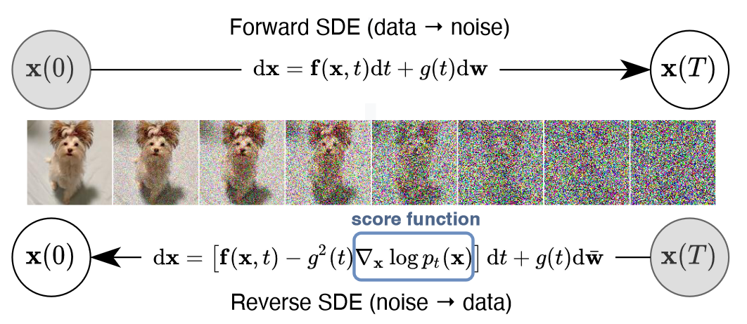
扩散模型天生缺少对空间约束提示词的理解
经典的扩散模型的图像生成的过程是每个像素同时进行去噪，不存在空间约束信息
[1] R. Rombach, A. Blattmann, D. Lorenz, P. Esser, and B. Ommer, ‘High-Resolution Image Synthesis With Latent Diffusion Models’, presented at the Proceedings of the IEEE/CVF Conference on Computer Vision and Pattern Recognition, 2022, pp. 10684–10695.

Slide 2
空间约束能力训练：前瞻
使以Stable Diffusion为首text-to-image模型获得空间约束能力，最简单的方法是直接对模型本身进行继续训练或者直接微调, 然而基座扩散模型(Stable Diffusion)的预训练数据集数量 （e.g. LAION-5B）远大于微调数据集(~100K)，直接微调往往导致过拟合、灾难性遗忘和模式崩塌的问题，因此设置精致的策略十分必要[2]。
Fine-tuning Strategies for Diffusion Models [2]
1. HyperNetwork
Function: Trains a small recurrent neural network to influence the weights of a larger one.
Applications: Image generation with GANs and Stable Diffusion to alter artistic styles.
2. Adapter Methods
NLP Use: Embeds new module layers in pretrained transformers.
Computer Vision Use: Incremental learning and domain adaptation, often with CLIP.
Success: Vision transformers and ViT-Adapter.
3. Additive Learning
Mechanism: Freezes original model weights, adds new parameters through: Learned weight masks, pruning, hard attention
4. Side-Tuning
Approach: Adds a side branch model to learn extra functionality.
Blending: Linearly blends outputs of a frozen model and the new network with a predefined weight schedule.
5. Low-Rank Adaptation (LoRA)
Concept: Learns parameter offsets using low-rank matrices.
Purpose: Prevents catastrophic forgetting by leveraging low intrinsic dimension subspaces.
6. Zero-Initialized Layers
Usage: ControlNet.
[1] R. Rombach, A. Blattmann, D. Lorenz, P. Esser, and B. Ommer, ‘High-Resolution Image Synthesis With Latent Diffusion Models’, presented at the Proceedings of the IEEE/CVF Conference on Computer Vision and Pattern Recognition, 2022, pp. 10684–10695.
[2] L. Zhang, A. Rao, and M. Agrawala, ‘Adding Conditional Control to Text-to-Image Diffusion Models’, in 2023 IEEE/CVF International Conference on Computer Vision (ICCV), Oct. 2023, pp. 3813–3824. doi: 10.1109/ICCV51070.2023.00355.

Slide 3
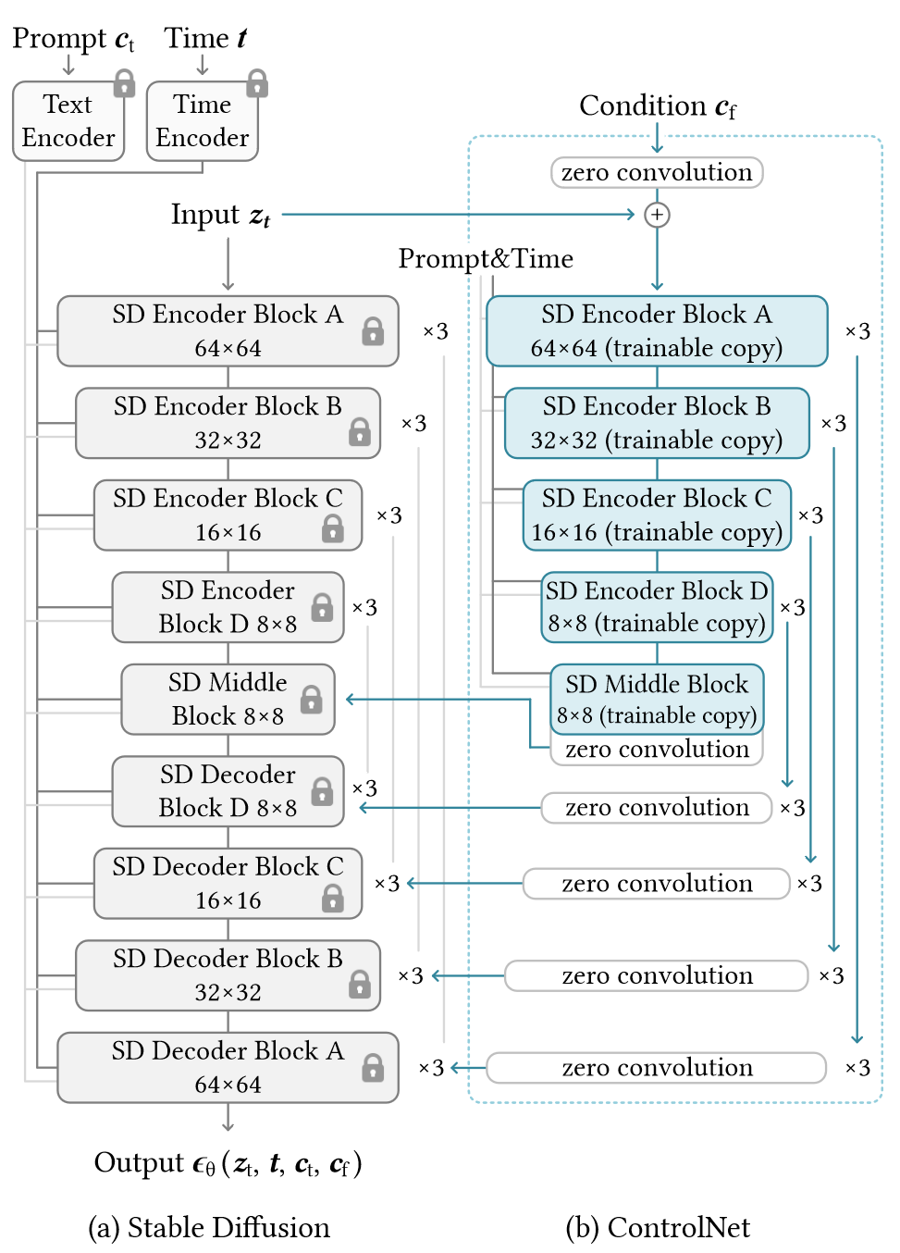
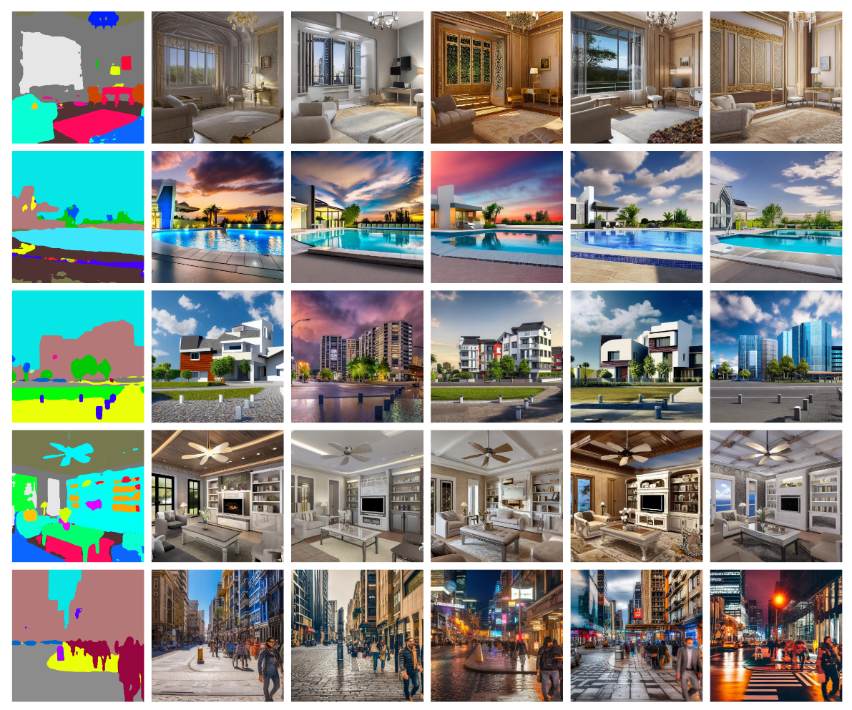
空间约束（一）：SD+ControlNet
Segmentation Map as Spatial Condition with fancy output
ControlNet冻结Stable Diffusion的权重，同时复制Stable Diffusion的Encoder权重在此基础上进行训练，通过ControlNet网络实现空间约束能力 [2]
[2] L. Zhang, A. Rao, and M. Agrawala, ‘Adding Conditional Control to Text-to-Image Diffusion Models’, in 2023 IEEE/CVF International Conference on Computer Vision (ICCV), Oct. 2023, pp. 3813–3824. doi: 10.1109/ICCV51070.2023.00355.

Slide 4
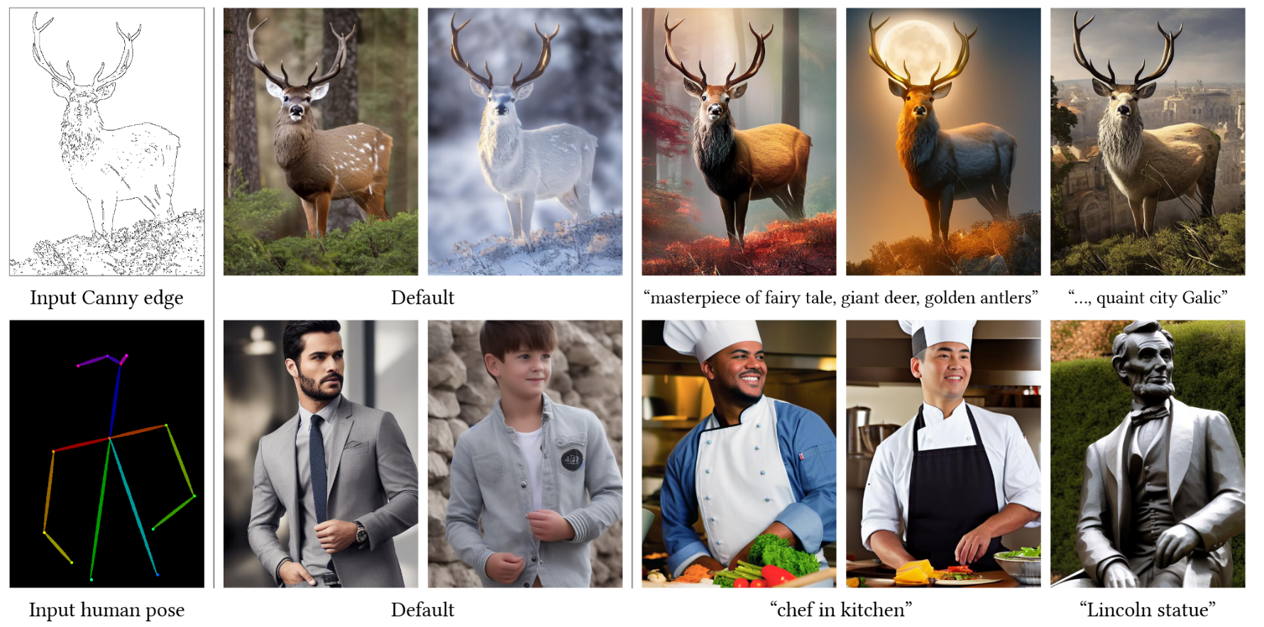
空间约束（一）：SD+ControlNet
缺陷：训练数据是一张图像文本对，不包含同一张图像的前后变化信息，仍然是一个text-to-image模型 [2]
[2] L. Zhang, A. Rao, and M. Agrawala, ‘Adding Conditional Control to Text-to-Image Diffusion Models’, in 2023 IEEE/CVF International Conference on Computer Vision (ICCV), Oct. 2023, pp. 3813–3824. doi: 10.1109/ICCV51070.2023.00355.

Slide 5
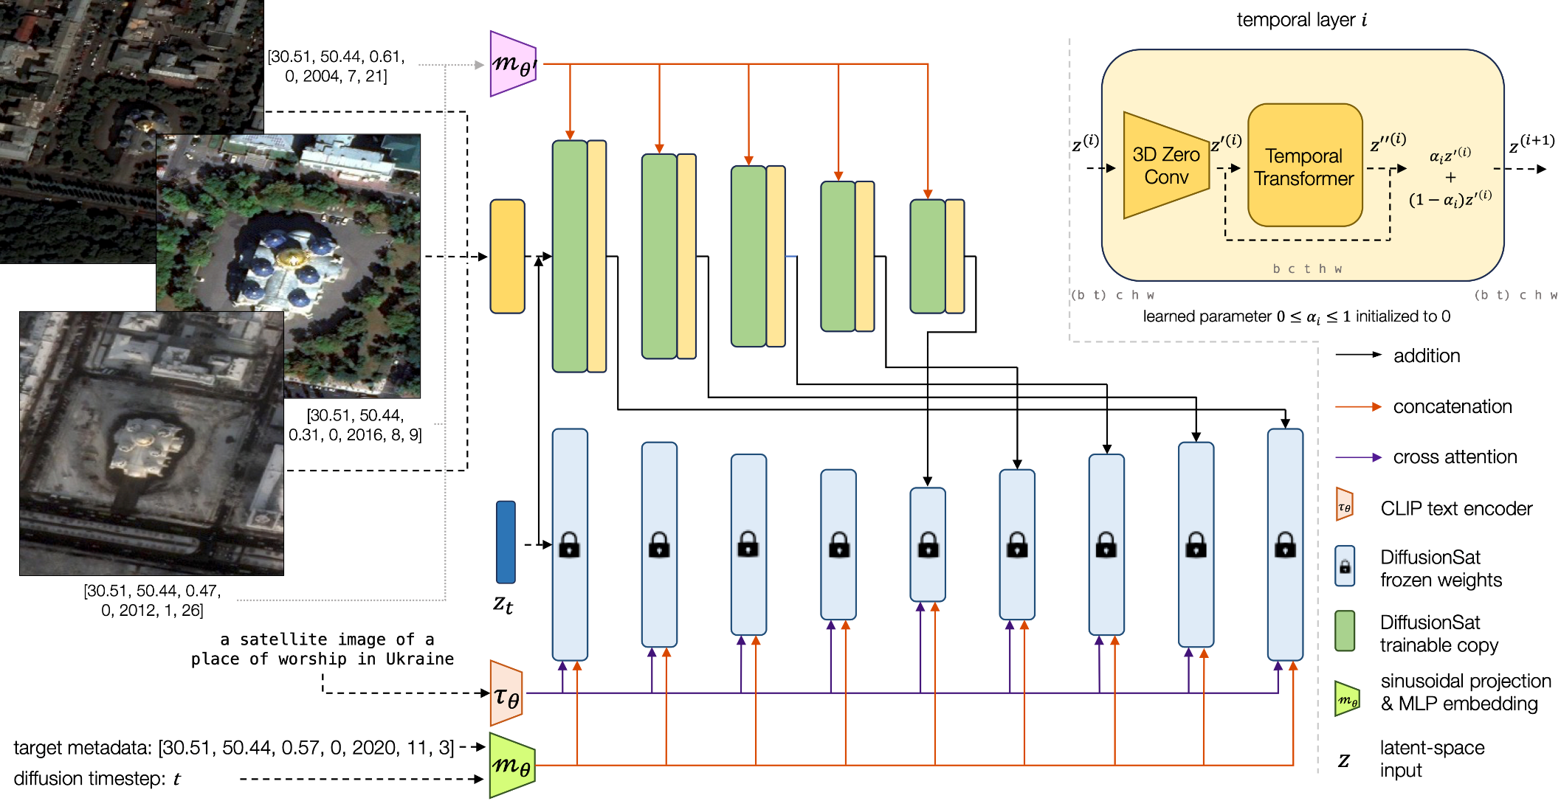
空间约束（二）：SD+3DControlNet (Temporal) → DiffusionSat
DiffusionSat使用同个地点的时序数据进行ControlNet的训练，使模型获得序列图像生成的能力
如此，参考图（如灾前图像）作为输入条件控制，可以极大程度的保持原有图像的信息 [3]
[3] S. Khanna et al., ‘DiffusionSat: A Generative Foundation Model for Satellite Imagery’, presented at the The Twelfth International Conference on Learning Representations, Oct. 2023.

