Slide 1
第34课时 分式的乘除法

Slide 2
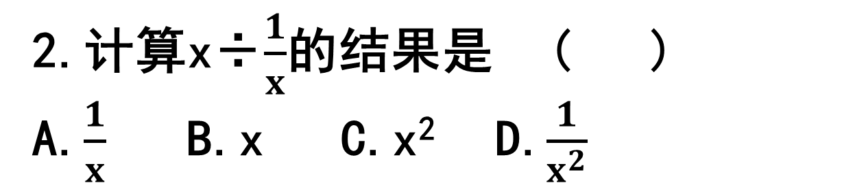
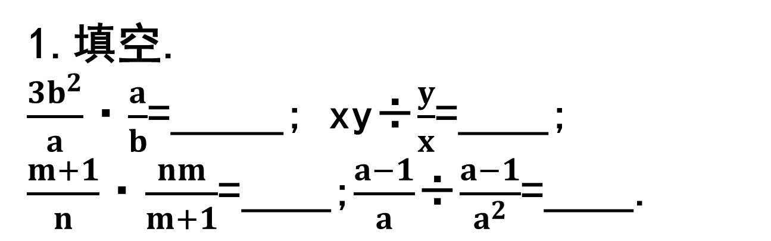
1.填空.
$\frac{3b^{2}}{a}$·$\frac{a}{b}$=_____; xy÷$\frac{y}{x}$=____;
$\frac{m+1}{n}$·$\frac{nm}{m+1}$=____;$\frac{a−1}{a}$÷$\frac{a−1}{a^{2}}$=____.
3b
x²
m
a
2.计算x÷$\frac{1}{x}$的结果是 ( )
A.$\frac{1}{x}$ B.x C.x² D.$\frac{1}{x^{2}}$
C

Slide 3
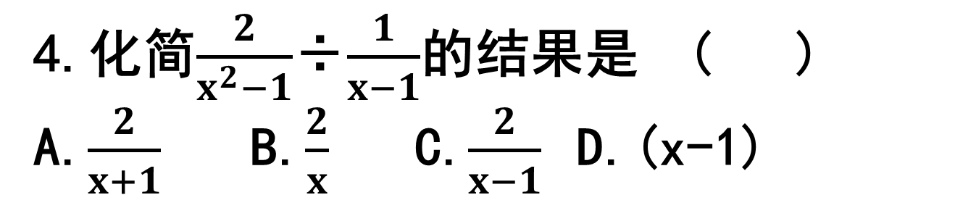
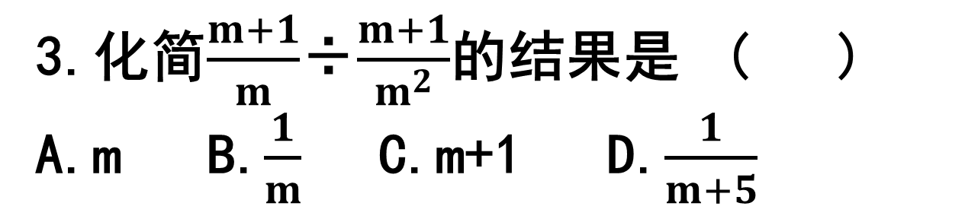
3.化简$\frac{m+1}{m}$÷$\frac{m+1}{m^{2}}$的结果是 ( )
A.m B.$\frac{1}{m}$ C.m+1 D.$\frac{1}{m+5}$
A
4.化简$\frac{2}{x^{2}−1}$÷$\frac{1}{x−1}$的结果是 ( )
A.$\frac{2}{x+1}$ B.$\frac{2}{x}$ C.$\frac{2}{x−1}$ D.(x-1)
A

Slide 4
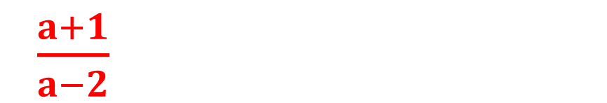
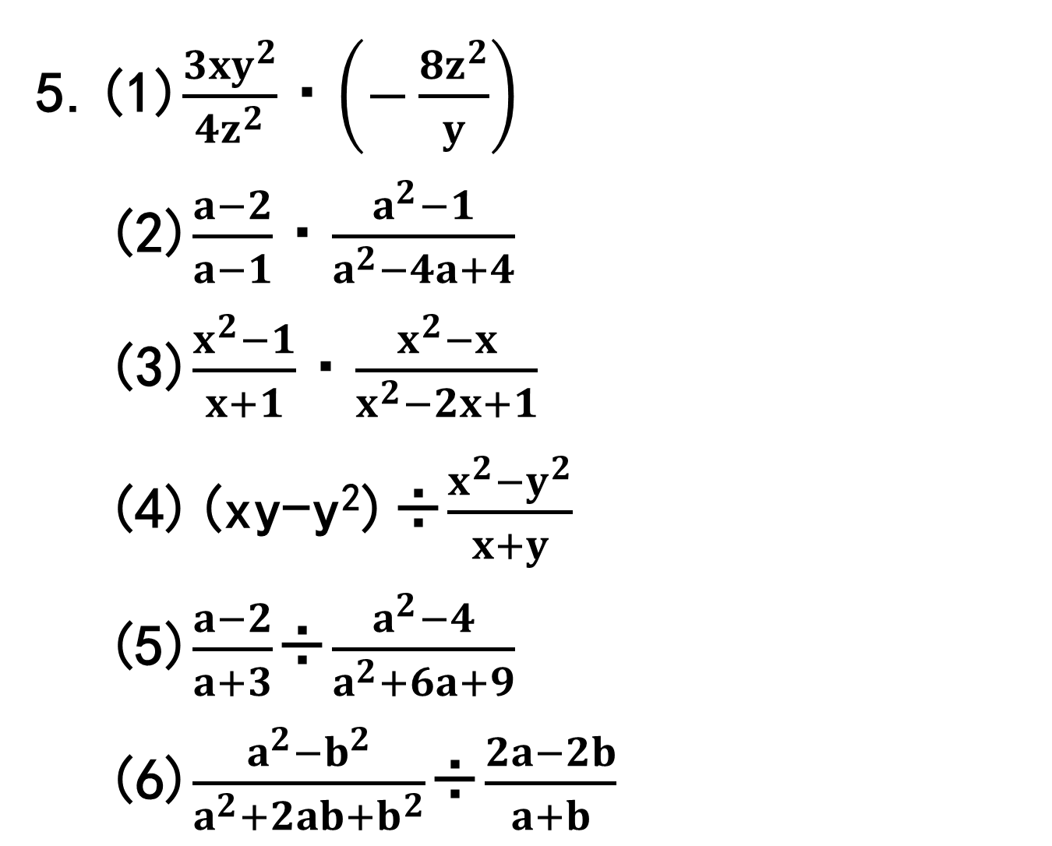
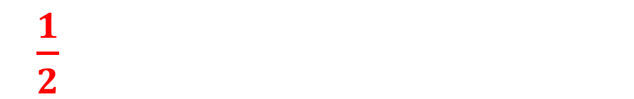

5.(1)$\frac{3xy^{2}}{4z^{2}}$·$\left(−\frac{8z^{2}}{y}\right)$
(2)$\frac{a−2}{a−1}$·$\frac{a^{2}−1}{a^{2}−4a+4}$
(3)$\frac{x^{2}−1}{x+1}$·$\frac{x^{2}−x}{x^{2}−2x+1}$
(4)(xy-y²)÷$\frac{x^{2}−y^{2}}{x+y}$
(5)$\frac{a−2}{a+3}$÷$\frac{a^{2}−4}{a^{2}+6a+9}$
(6)$\frac{a^{2}−b^{2}}{a^{2}+2ab+b^{2}}$÷$\frac{2a−2b}{a+b}$
-6xy
$\frac{a+1}{a−2}$
x
y
$\frac{a+3}{a+2}$
$\frac{1}{2}$

Slide 5
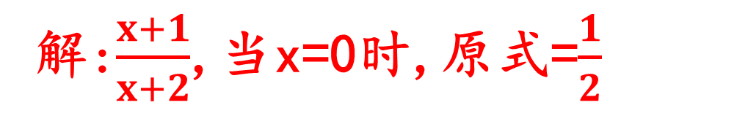
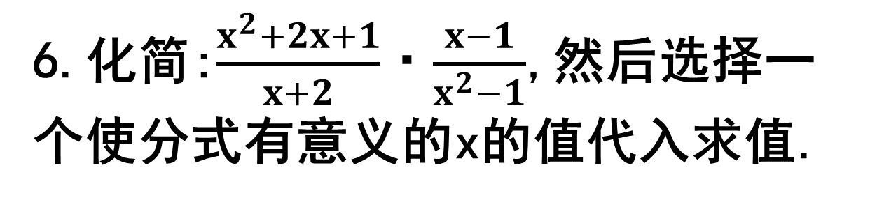
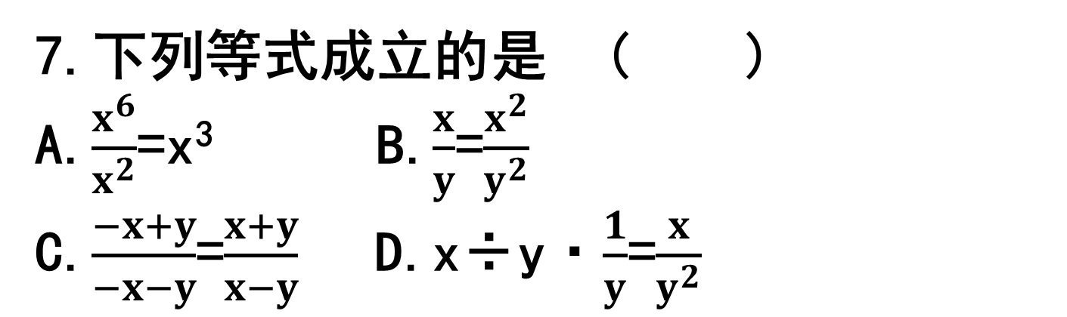
6.化简:$\frac{x^{2}+2x+1}{x+2}$·$\frac{x−1}{x^{2}−1}$,然后选择一个使分式有意义的x的值代入求值.
解:$\frac{x+1}{x+2}$,当x=0时,原式=$\frac{1}{2}$
7.下列等式成立的是 ( )
A.$\frac{x^{6}}{x^{2}}$=x³ B.$\frac{x}{y}$=$\frac{x^{2}}{y^{2}}$
C.$\frac{−x+y}{−x−y}$=$\frac{x+y}{x−y}$ D.x÷y·$\frac{1}{y}$=$\frac{x}{y^{2}}$
D

Slide 6
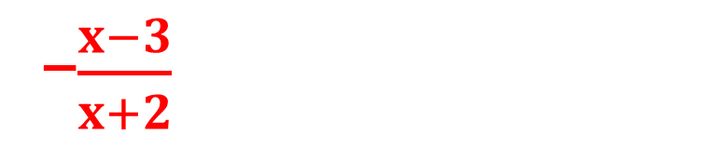
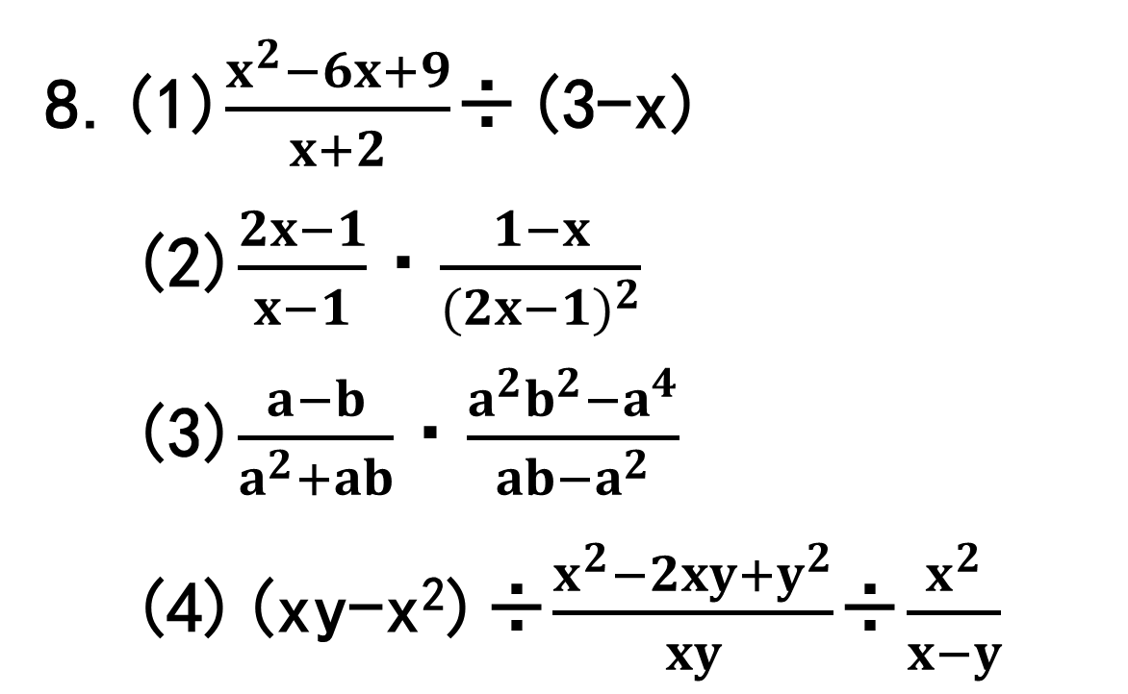

8.(1)$\frac{x^{2}−6x+9}{x+2}$÷(3-x)
(2)$\frac{2x−1}{x−1}$·$\frac{1−x}{{(2x−1)}^{2}}$
(3)$\frac{a−b}{a^{2}+ab}$·$\frac{a^{2}b^{2}−a^{4}}{ab−a^{2}}$
(4)(xy-x²)÷$\frac{x^{2}−2xy+y^{2}}{xy}$÷$\frac{x^{2}}{x−y}$
-$\frac{x−3}{x+2}$
$\frac{1}{1−2x}$
a-b
-y

Slide 7
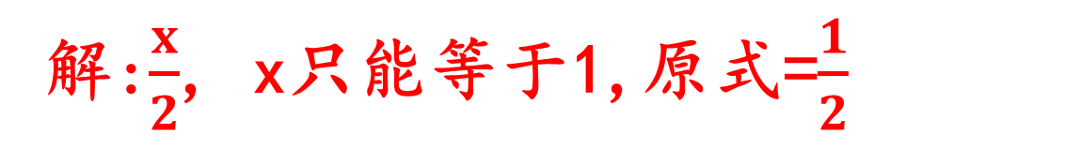
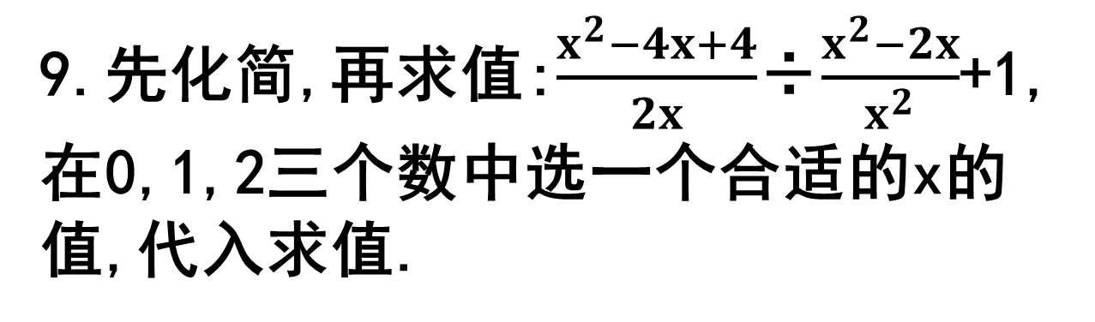
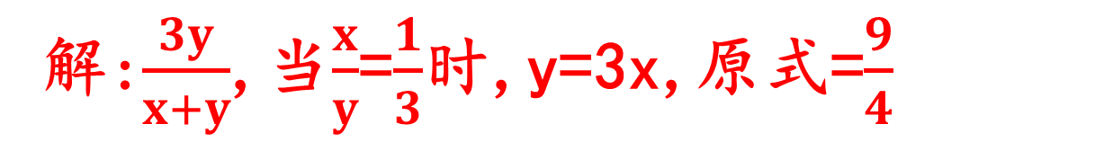
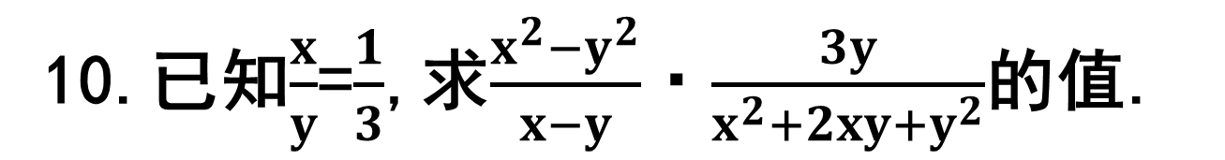
9.先化简,再求值:$\frac{x^{2}−4x+4}{2x}$÷$\frac{x^{2}−2x}{x^{2}}$+1,在0,1,2三个数中选一个合适的x的值,代入求值.
解:$\frac{x}{2}$, x只能等于1,原式=$\frac{1}{2}$
10.已知$\frac{x}{y}$=$\frac{1}{3}$,求$\frac{x^{2}−y^{2}}{x−y}$·$\frac{3y}{x^{2}+2xy+y^{2}}$的值.
解:$\frac{3y}{x+y}$,当$\frac{x}{y}$=$\frac{1}{3}$时,y=3x,原式=$\frac{9}{4}$

Slide 8
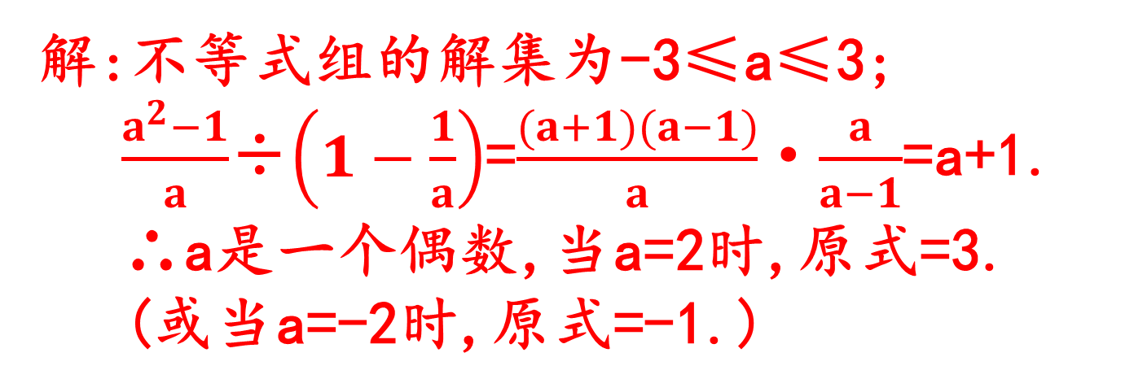
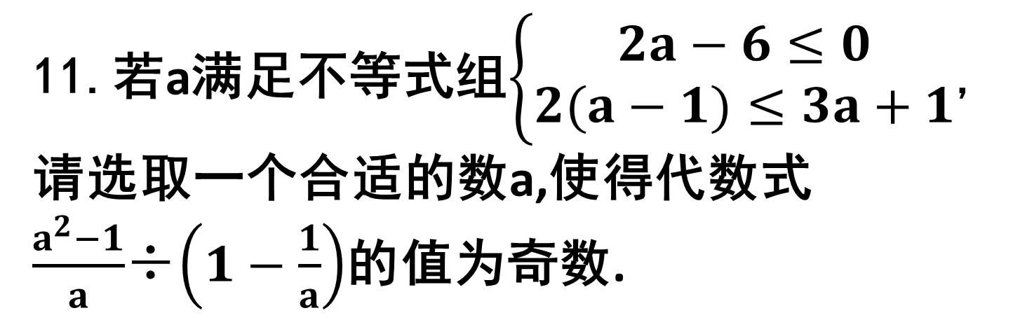
11.若a满足不等式组$\left\{\begin{matrix}2a−6≤0 \\ 2(a−1)≤3a+1\end{matrix}\right.$,请选取一个合适的数a,使得代数式$\frac{a^{2}−1}{a}$÷$\left(1−\frac{1}{a}\right)$的值为奇数.
解:不等式组的解集为-3≤a≤3;
$\frac{a^{2}−1}{a}$÷$\left(1−\frac{1}{a}\right)$=$\frac{(a+1)(a−1)}{a}$·$\frac{a}{a−1}$=a+1.
∴a是一个偶数,当a=2时,原式=3.
(或当a=-2时,原式=-1.)

