Slide 1
第36课时 分式的加减法(2) ——异分母相加减

Slide 2
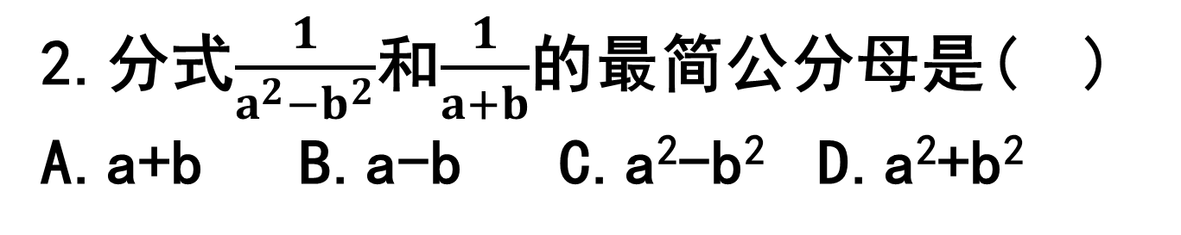
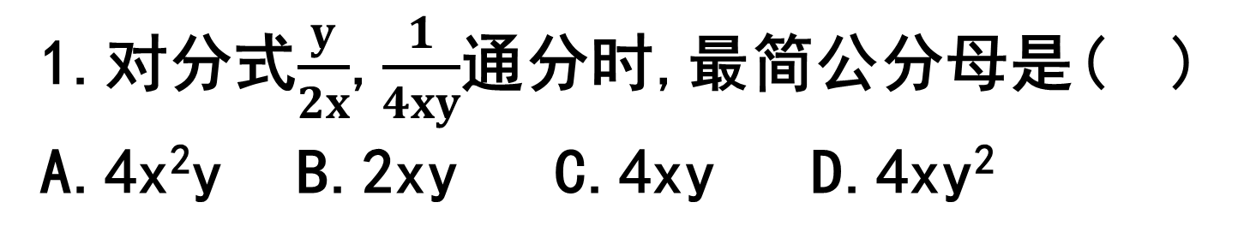
1.对分式$\frac{y}{2x}$,$\frac{1}{4xy}$通分时,最简公分母是( )
A.4x²y B.2xy C.4xy D.4xy²
C
2.分式$\frac{1}{a^{2}−b^{2}}$和$\frac{1}{a+b}$的最简公分母是( )
A.a+b B.a-b C.a²-b² D.a²+b²
C

Slide 3
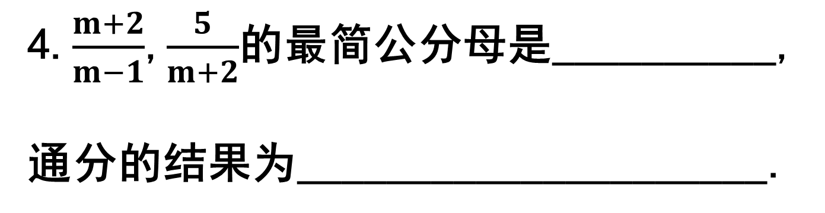

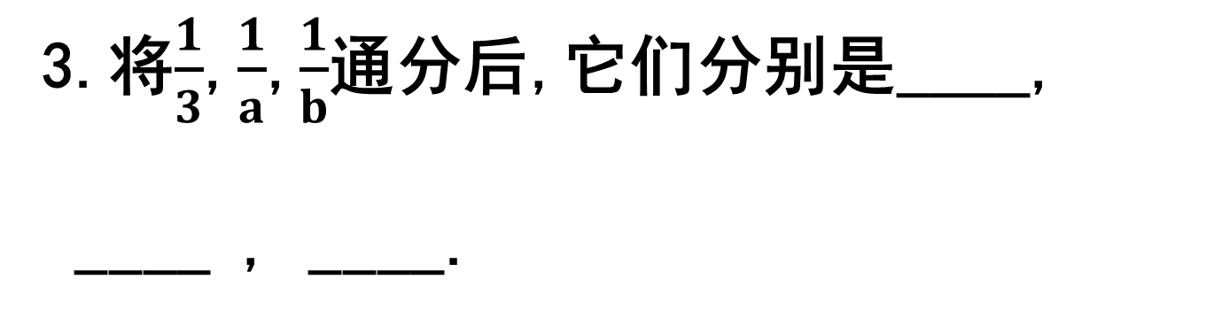

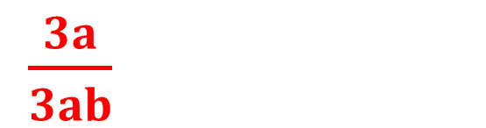
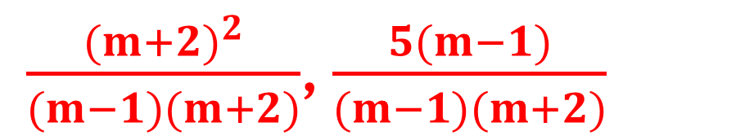
$\frac{ab}{3ab}$
3.将$\frac{1}{3}$,$\frac{1}{a}$,$\frac{1}{b}$通分后,它们分别是____,
____ , ____.
$$\frac{3b}{3ab}$$
$\frac{3a}{3ab}$
(m-1)(m+2)
4.$\frac{m+2}{m−1}$,$\frac{5}{m+2}$的最简公分母是__________,
通分的结果为_____________________.
$\frac{{(m+2)}^{2}}{(m−1)(m+2)}$,$\frac{5(m−1)}{(m−1)(m+2)}$

Slide 4
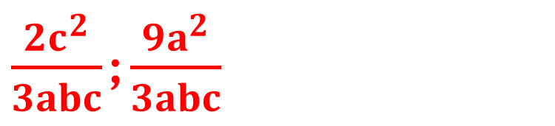

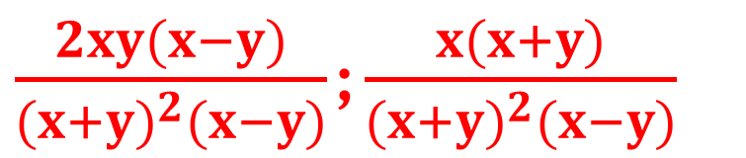
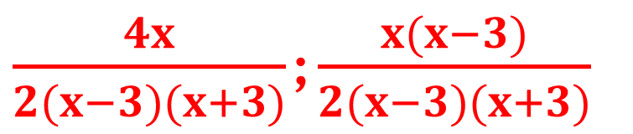
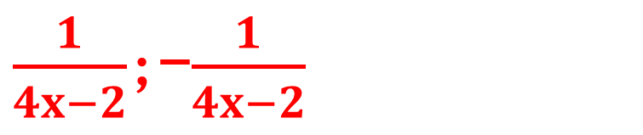
5.通分:
(1)$\frac{2c}{3ab}$, $\frac{3a}{bc}$
(2)$\frac{1}{4x−2}$, $\frac{1}{2−4x}$
(3)$\frac{2x}{x^{2}−9}$, $\frac{x}{2x+6}$
(4)$\frac{2xy}{{(x+y)}^{2}}$, $\frac{x}{x^{2}−y^{2}}$
$\frac{2c^{2}}{3abc}$;$\frac{9a^{2}}{3abc}$
$\frac{1}{4x−2}$;-$\frac{1}{4x−2}$
$\frac{4x}{2(x−3)(x+3)}$;$\frac{x(x−3)}{2(x−3)(x+3)}$
$\frac{2xy(x−y)}{{(x+y)}^{2}(x−y)}$;$\frac{x(x+y)}{{(x+y)}^{2}(x−y)}$

Slide 5




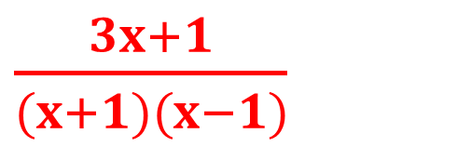

6.计算:
(1)$\frac{1}{a}$+$\frac{1}{b}$-$\frac{2a+b}{2ab}$
(2)$\frac{6}{x^{2}−9}$+$\frac{1}{x+3}$
(3)$\frac{x^{2}−1}{x^{2}−2x+1}$-$\frac{2}{x−1}$
(4)$\frac{x+1}{x−1}$-$\frac{x}{x+1}$
(5)$\frac{a^{2}−2a+1}{a^{2}−1}$-$\frac{a}{a−1}$ (6)$\frac{4}{a^{2}−4}$+$\frac{2}{a+2}$-$\frac{1}{a−2}$
$$\frac{1}{2a}$$
$\frac{1}{x−3}$
1
$\frac{3x+1}{(x+1)(x−1)}$
$\frac{1−3a}{a^{2}−1}$
$$\frac{1}{a+2}$$

Slide 6
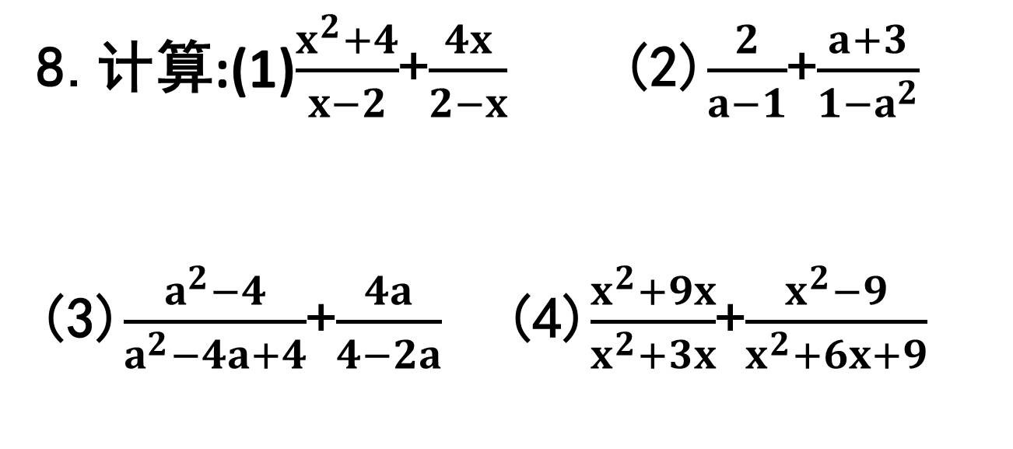
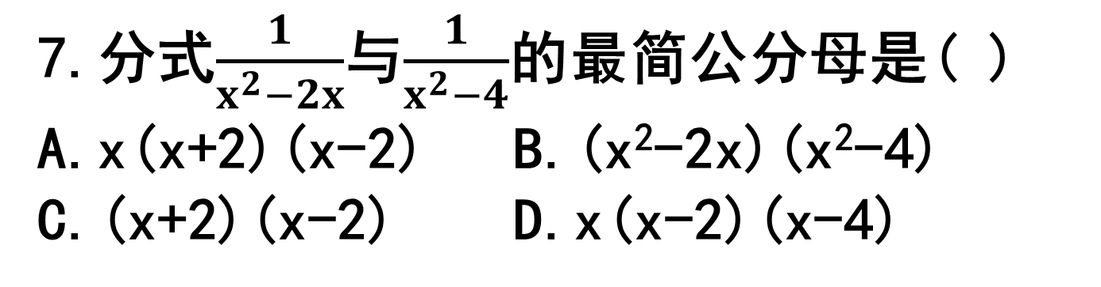

7.分式$\frac{1}{x^{2}−2x}$与$\frac{1}{x^{2}−4}$的最简公分母是( )
A.x(x+2)(x-2) B.(x²-2x)(x²-4)
C.(x+2)(x-2) D.x(x-2)(x-4)
A
8.计算:(1)$\frac{x^{2}+4}{x−2}$+$\frac{4x}{2−x}$ (2)$\frac{2}{a−1}$+$\frac{a+3}{1−a^{2}}$
(3)$\frac{a^{2}−4}{a^{2}−4a+4}$+$\frac{4a}{4−2a}$ (4)$\frac{x^{2}+9x}{x^{2}+3x}$+$\frac{x^{2}−9}{x^{2}+6x+9}$
$$\frac{1}{a+1}$$
x-2
-1
2

Slide 7
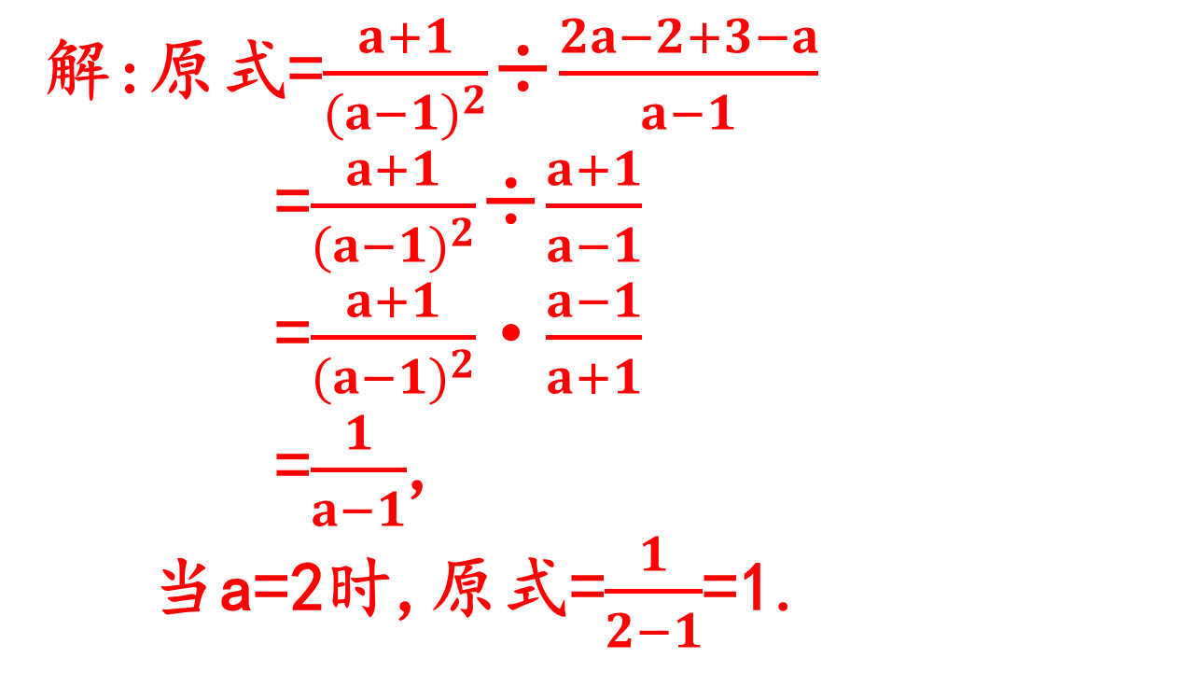
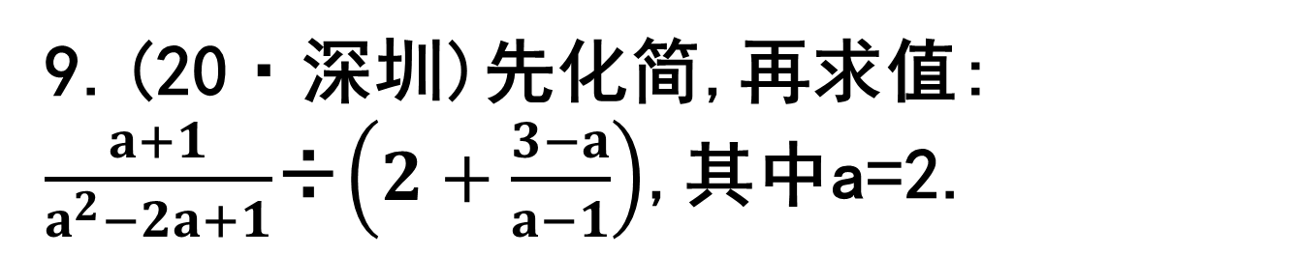
9.(20·深圳)先化简,再求值:
$\frac{a+1}{a^{2}−2a+1}$÷$\left(2+\frac{3−a}{a−1}\right)$,其中a=2.
解:原式=$\frac{a+1}{{(a−1)}^{2}}$÷$\frac{2a−2+3−a}{a−1}$
=$\frac{a+1}{{(a−1)}^{2}}$÷$\frac{a+1}{a−1}$
=$\frac{a+1}{{(a−1)}^{2}}$·$\frac{a−1}{a+1}$
=$\frac{1}{a−1}$,
当a=2时,原式=$\frac{1}{2−1}$=1.

Slide 8

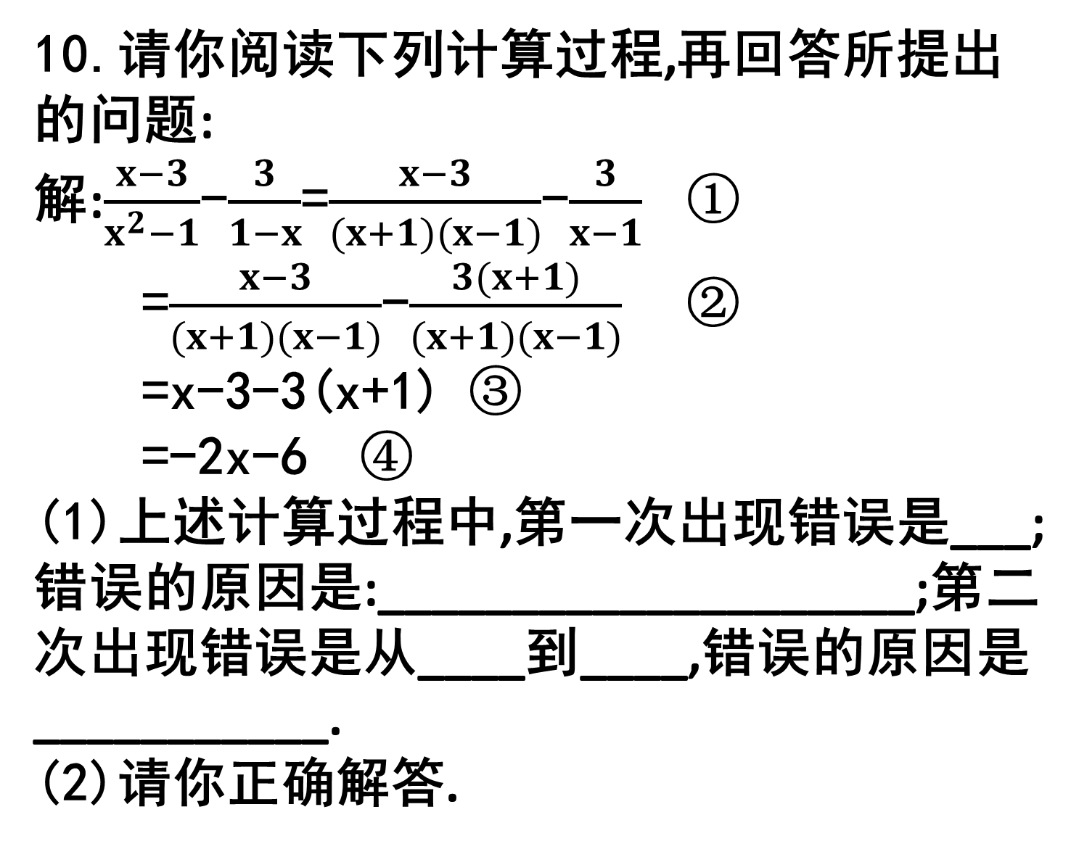
10.请你阅读下列计算过程,再回答所提出的问题:
解:$\frac{x−3}{x^{2}−1}$-$\frac{3}{1−x}$=$\frac{x−3}{(x+1)(x−1)}$-$\frac{3}{x−1}$ ①
=$\frac{x−3}{(x+1)(x−1)}$-$\frac{3(x+1)}{(x+1)(x−1)}$ ②
=x-3-3(x+1) ③
=-2x-6 ④
(1)上述计算过程中,第一次出现错误是___;错误的原因是:____________________;第二次出现错误是从____到____,错误的原因是___________.
(2)请你正确解答.
①
-x转换成x-1时添负号
②
③
不能去分母
(2)$\frac{4x}{x^{2}−1}$

