Slide 1
第25课时 分解因式

Slide 2
1. 分解因式.
(1)a³-a (2)4xy-x³y
(3)-3x³y+27xy (4)2x²-8x+8
(5)a³+9ab²-6a²b (6)-a³b+2a²b²-ab³
(7)(2a+1)²-a² (8)b²-(2a+b)²
a(a+1)(a-1)
xy(2+x)(2-x)
-3xy(x+3)(x-3)
2(x-2)²
a(a-3b)²
-ab(a-b)²
(3a+1)(a+1)
-4a(a+b)

Slide 3
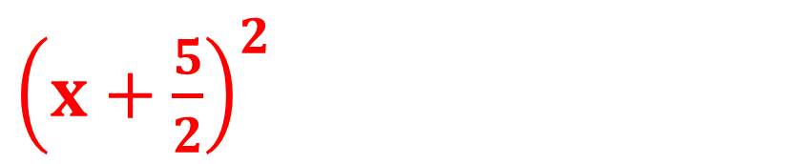
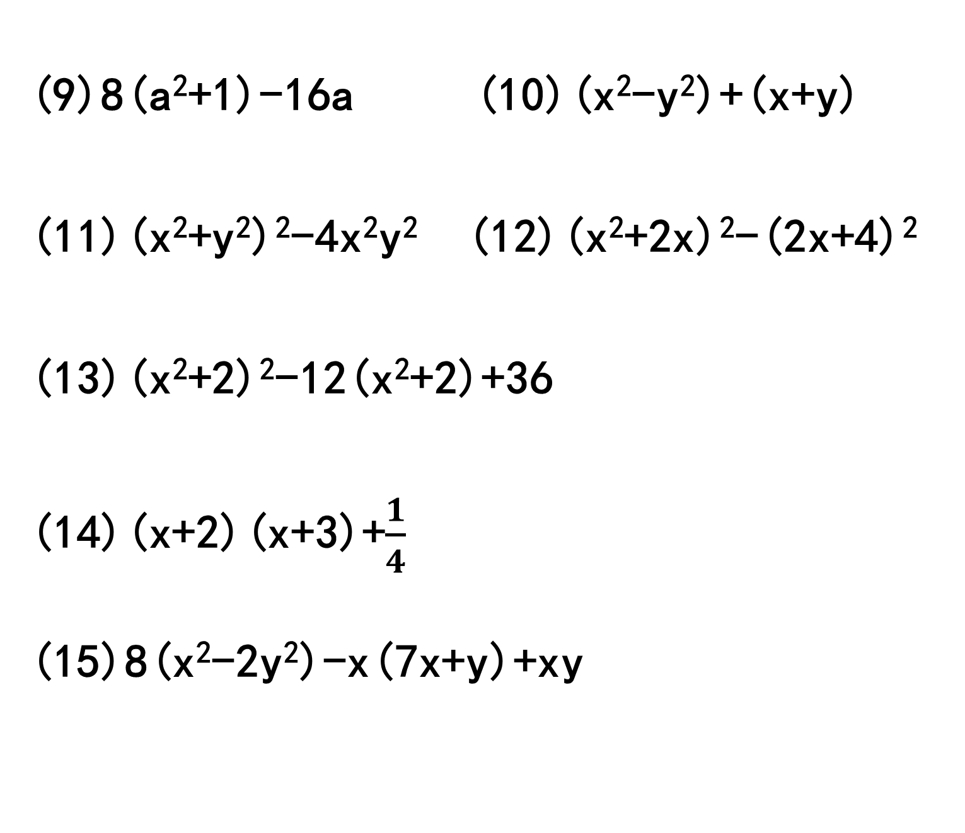
(9)8(a²+1)-16a (10)(x²-y²)+(x+y) (11)(x²+y²)²-4x²y² (12)(x²+2x)²-(2x+4)²
(13)(x²+2)²-12(x²+2)+36
(14)(x+2)(x+3)+$\frac{1}{4}$ (15)8(x²-2y²)-x(7x+y)+xy
8(a-1)²
(x+y)(x-y+1)
(x-y)²(x+y)²
(x+2)³(x-2)
(x+2)²(x-2)²
${\left(x+\frac{5}{2}\right)}^{2}$
(x+4y)(x-4y)

Slide 4
2. 用十字相乘分解因式(选做).
(1)x²-x-2 (2)x²-2x-8
(3)x²-3x-4 (4)x²-4x-12
(5)x²-5x-14 (6)x²-4x-780
(7)3x²-5x-2 (8)6x²+7x-5
(x-2)(x+1)
(x-4)(x+2)
(x+1)(x-4)
(x-6)(x+2)
(x+2)(x-7)
(x+26)(x-30)
(3x+1)(x-2)
(2x-1)(3x+5)

Slide 5
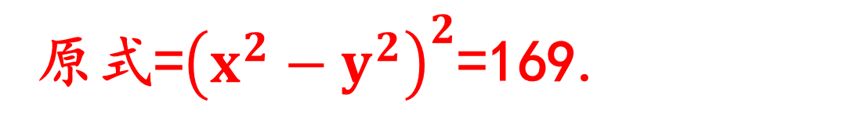
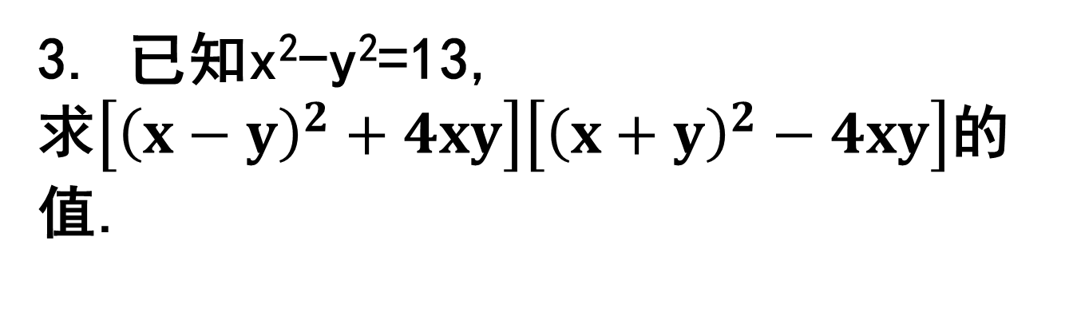
3. 已知x²-y²=13,
求$\left[{\left(x−y\right)}^{2}+4xy\right]\left[{\left(x+y\right)}^{2}−4xy\right]$的值.
原式=${\left(x^{2}−y^{2}\right)}^{2}$=169.
4. 已知x-y=3,x²+y²=13,求x³y-8x²y²+xy³的值.
由(x-y)² =9,得xy=2.
x³y-8x²y²+xy³=xy(x²-8xy+y²)=-6.

Slide 6
5. 已知x²+xy=54,y²+xy=27,求x-y的值.
由x²+xy=54,y²+xy=27,
得x²-y²=27,(x+y)²=81,∴x+y=±9,
由(x-y)(x+y)=27,
得x-y=27÷(±9)=±3.

