Slide 1

数
学
一
本
通
八年级下册
重点复习7
因式分解

Slide 2
1.因式分解:
(1)m²-9m (2)3m²-27
(3)-x³+4x (4)9a²-30a+25
(5)a³b-2a²b²+ab³ (6)-4a²b+4a³+ab²
m(m-9)
3(m+3)(m-3)
-x(x+2)(x-2)
(3a-5)²
ab(a-b)²
a(2a-b)²

Slide 3



(7)-3x²+2x-$\frac{1}{3}$ (8)16x⁴-1
(9)16x⁴-8x²y²+y⁴ (10)a³-4a(a-1)
(11)(x-y)²+4xy (12)(x+1)(x+2)+$\frac{1}{4}$
-$\frac{1}{3}$(3x-1)²
(4x²+1)(2x+1)(2x-1)
(2x-y)²(2x+y)²
a(a-2)²
${\left(x+\frac{3}{2}\right)}^{2}$
(x+y)²

Slide 4
(13)(x-y)²+2y(x-y) (14)x²-(x-y)²
(15)(x²+4)²-16x² (16)(x²-5)²+8(x²-5)+16
(17)x²(y²-1)+2x(y²-1)+(y²-1)
(x-y)(x+y)
y(2x-y)
(x+2)²(x-2)²
(x+1)²(x-1)²
(y+1)(y-1)(x+1)²

Slide 5
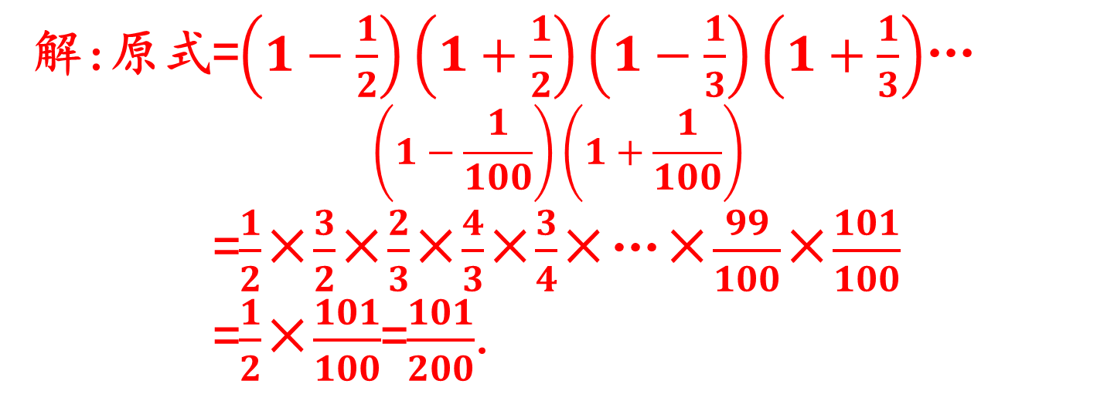
2.计算:$\left(1−\frac{1}{2^{2}}\right)\left(1−\frac{1}{3^{2}}\right)\left(1−\frac{1}{4^{2}}\right)$…$\left(1−\frac{1}{{100}^{2}}\right)$.
解:原式=$\left(1−\frac{1}{2}\right)\left(1+\frac{1}{2}\right)\left(1−\frac{1}{3}\right)\left(1+\frac{1}{3}\right)$…
$$\left(1−\frac{1}{100}\right)\left(1+\frac{1}{100}\right)$$
=$\frac{1}{2}$×$\frac{3}{2}$×$\frac{2}{3}$×$\frac{4}{3}$×$\frac{3}{4}$×…×$\frac{99}{100}$×$\frac{101}{100}$
=$\frac{1}{2}$×$\frac{101}{100}$=$\frac{101}{200}$.
3.已知x-y=3,x²+y²=13,求x³y-8x²y²+xy³的值.
解:∵(x-y)²=x²-2xy+y²=9,当x²+y²=13时,
13-2xy=9,得:xy=2.
原式=x³y-8x²y²+xy³
=xy(x²-8xy+y²)=2×(13-8×2)=-6.

Slide 6
4.已知:x+y=2,求(x²-y²)²-8(x²+y²)的值.
解:由x+y=2,得y=2-x,
原式=[x²-(2-x)²]²-8[x²+(2-x)²]
=(4x-4)²-8(2x²-4x+4)
=16x²-32x+16-16x²+32x-32=-16.

