Slide 1
SOBEL FILTER
Software, Hardware Implementation & Optimizations
Karamellios Sotirios 2237
Biliouri Victoria 2138

Slide 2
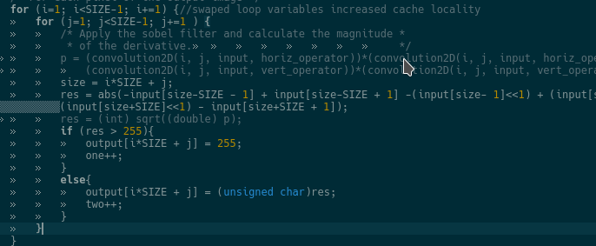
Software Optimizations
Loop Swap
Swapping loop variables (j,i) to increase cache locality.

Slide 3
Software Optimizations
Temporary Variables
  Replacing repetitive multiplications with a temp. variable
    - for instance variables we use to access the arrays in Convolution2D function
O3
  Using maximum compiler optimizations

Slide 4
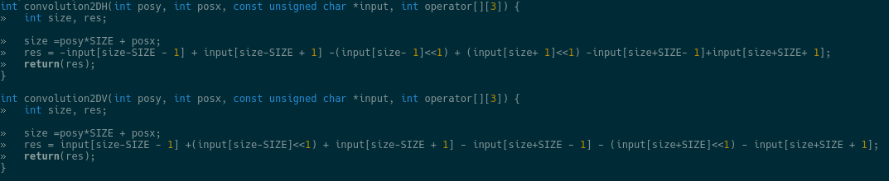
Software Optimizations
Convolution2D Unroll
Unrolling the for loops of Convolution2D function, removing unnecessary calculations

Slide 5
Software Optimizations
Convolution2D Inline
Inlining convolution2D and applying Manhattan Distance formula instead of Pythagorian formula.

Slide 6
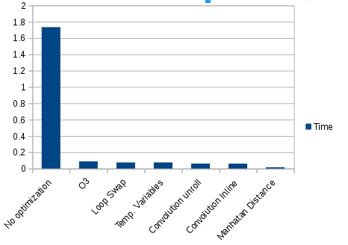
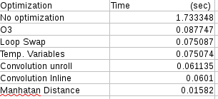
Software Optimizations
Results

Slide 7
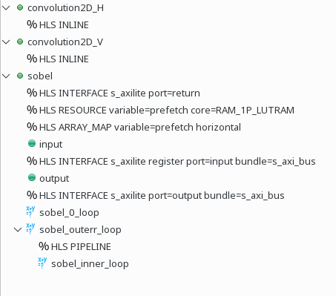
Hardware Optimizations
Directives
  Inlining Convolution2D function
  Pipelining external for loop of
  sobel function

Slide 8
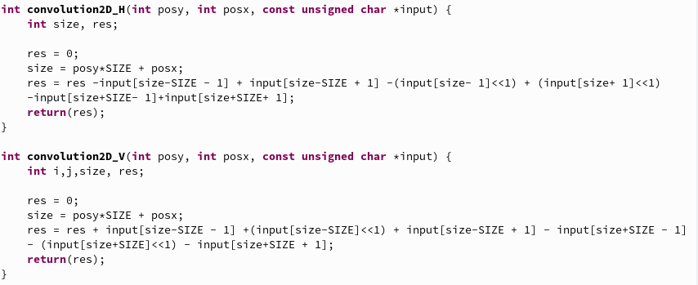
Hardware Optimizations
Convolution2D Unroll
Unrolling the for loops of Convolution2D function, removing unnecessary calculations

Slide 9
Hardware Optimizations
Manhattan Distance
Applying Manhattan Distance formula instead of Pythagorian

Slide 10
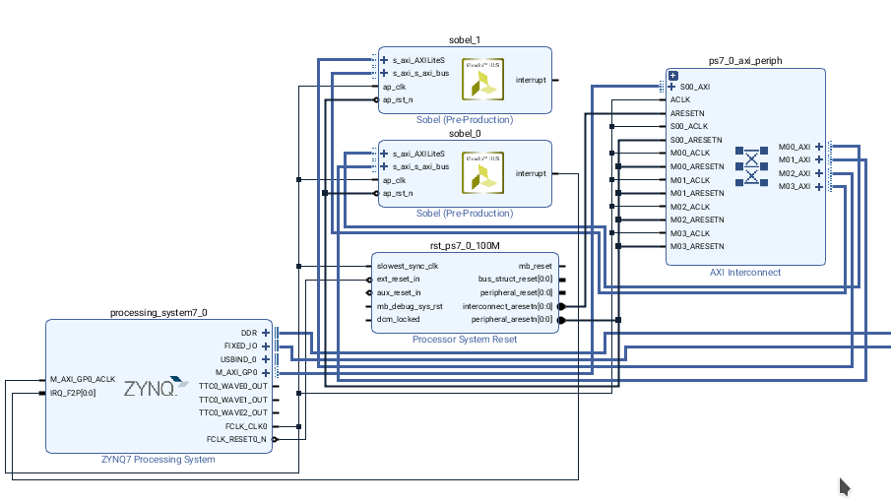
Hardware Optimizations
Two parallel sobel filters

Slide 11
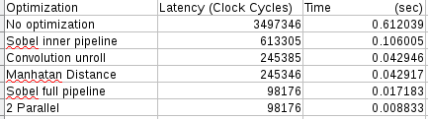
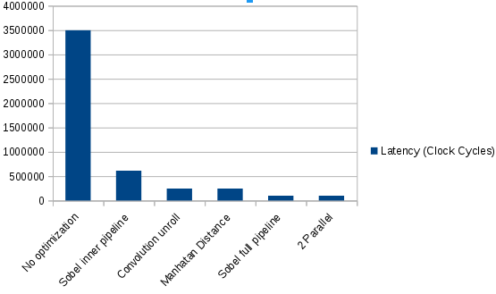
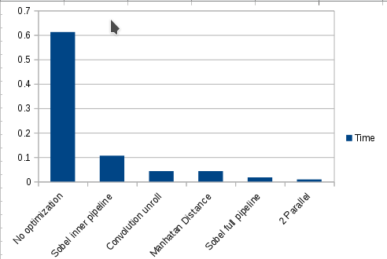
Hardware Optimizations
Time Results

Slide 12
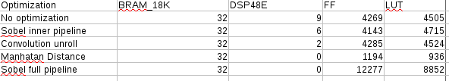
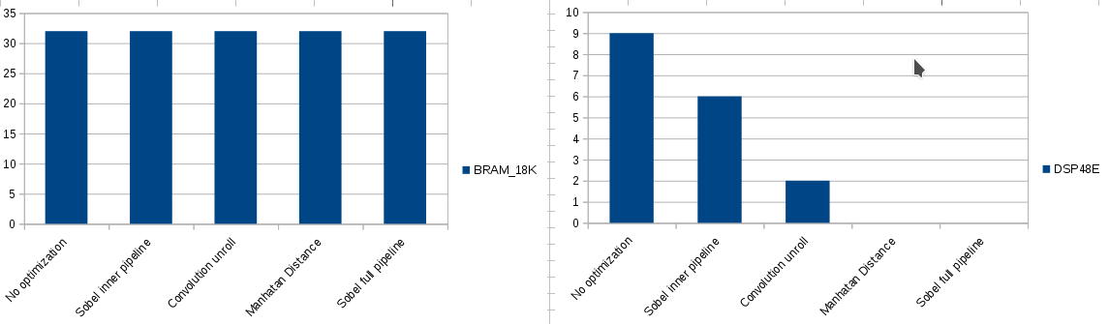
Hardware Optimizations
Area Results

Slide 13
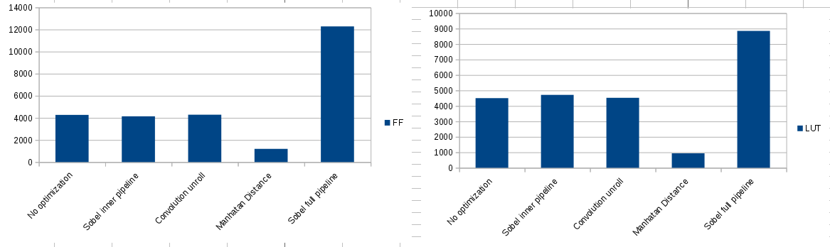
Hardware Optimizations
Area Results

Slide 14
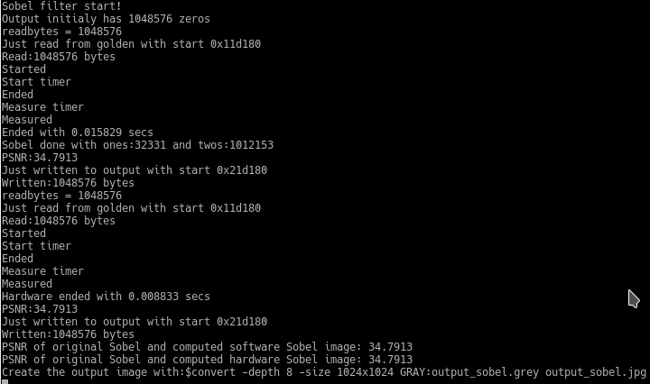
Final Report

