Slide 1
Calorimeter for High Efficiency converters
Design and Modeling
Internship(July 01 – August 31 2026)

Slide 2
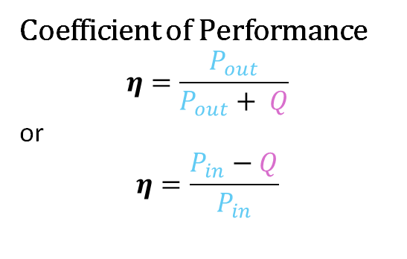
Double Jacket Chamber
T_{out}
T_{in}
Power Loss calculation
Q = m x c_{p} x ΔT
m = coolant mass flow rate
c_{p} = coolant heat capacity
ΔT = T_{out} - T_{in}
P_{fan}
T_{i}
DUT
P_{heater}
Coefficient of Performance
$$η=\frac{P_{out}}{P_{out}+ Q}$$
or
$$η=\frac{P_{in}−Q}{P_{in}}$$
P_{leak}
T_{e}
P_{heater}
P_{fan}
T_{a}
P_{out}
P_{in}
T_{i} = T_{e}
T_{i} > T_{a}
P_{leak}

Slide 3
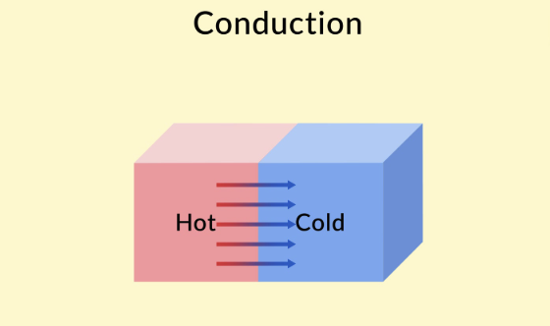
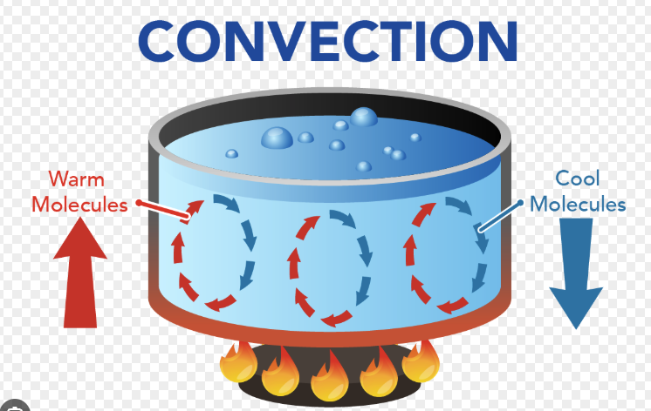
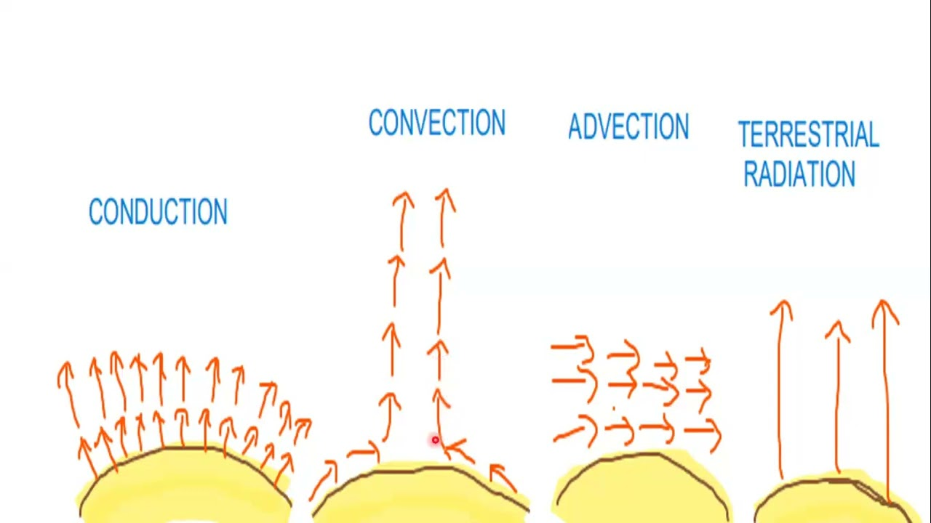
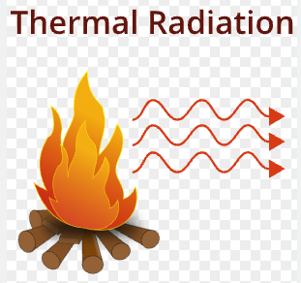
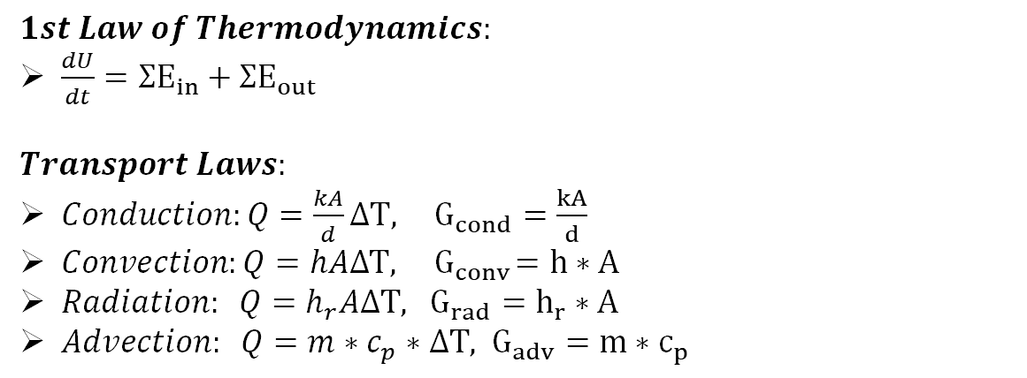
Thermodynamics Laws
$$1st Law of Thermodynamics:$$
$\frac{dU}{dt}=ΣE_{in}+ΣE_{out}$
$$Transport Laws:$$
$Conduction:Q=\frac{kA}{d}ΔT, G_{cond}=\frac{kA}{d}$
$Convection:Q=hAΔT, { G}_{conv}=h∗A$
$Radiation: Q=h_{r}AΔT, G_{rad}=h_{r}∗A$
$Advection: Q=m∗c_{p}∗ΔT, G_{adv}=m∗c_{p}$

Slide 4

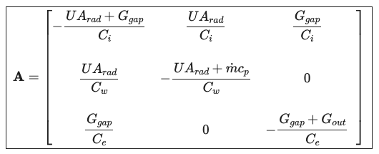
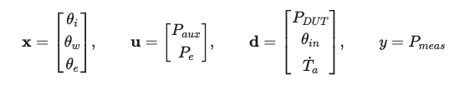
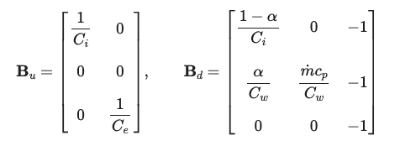
Equations & Space State
$C_{i}θ_{i}=\left(1−a\right)P_{DUT}+P_{aux}−UA_{rad}\left(θ_{i}−θ_{w}\right)−G_{gap}\left(θ_{i}−θ_{e}\right)−C_{i}T_{a}^{′}$ (air)
$C_{w}θ_{w}^{′}=aP_{DUT}+UA_{rad}\left(θ_{i}−θ_{w}\right)−m^{′}c_{p}\left(θ_{w}−θ_{in}\right)−C_{w}T_{a}^{′}$ (block + water)
$C_{e}θ_{e}^{′}=P_{e}+G_{gap}\left(θ_{i}−θ_{e}\right)−G_{out}θ_{e}−C_{e}T_{a}^{′}$ (Guard gap)
$P_{meas}=m^{′}c_{p}\left(θ_{w}−θ_{in}\right)−P_aux$ (the meter)

Slide 5
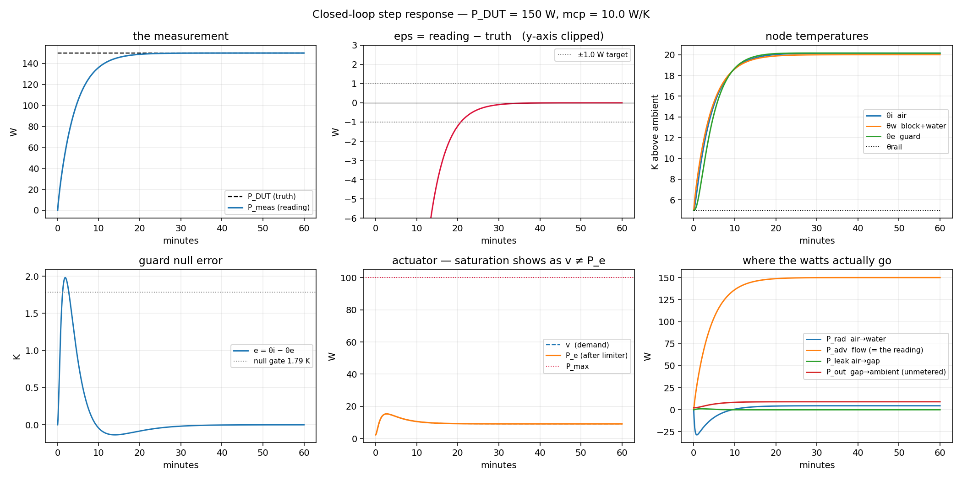

Slide 6
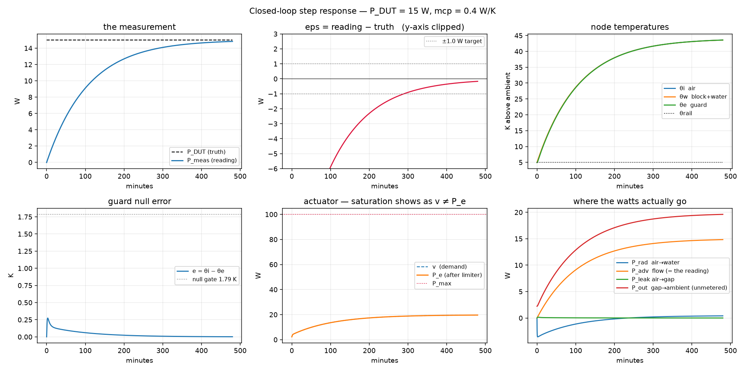

Slide 7
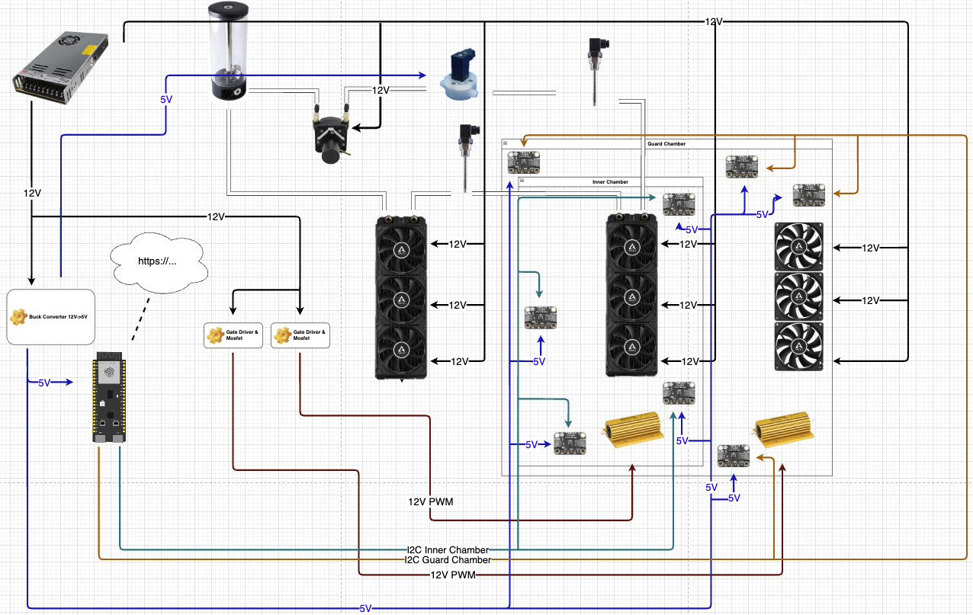

Slide 8

Safety Measurements
Hardware:
Input mosfet as input diode
Current sense
Avoid wiring boot strap pins
ESD arrays
Firmware:
Zephyr RTOS
Scheduler
Safety Threads

Slide 9
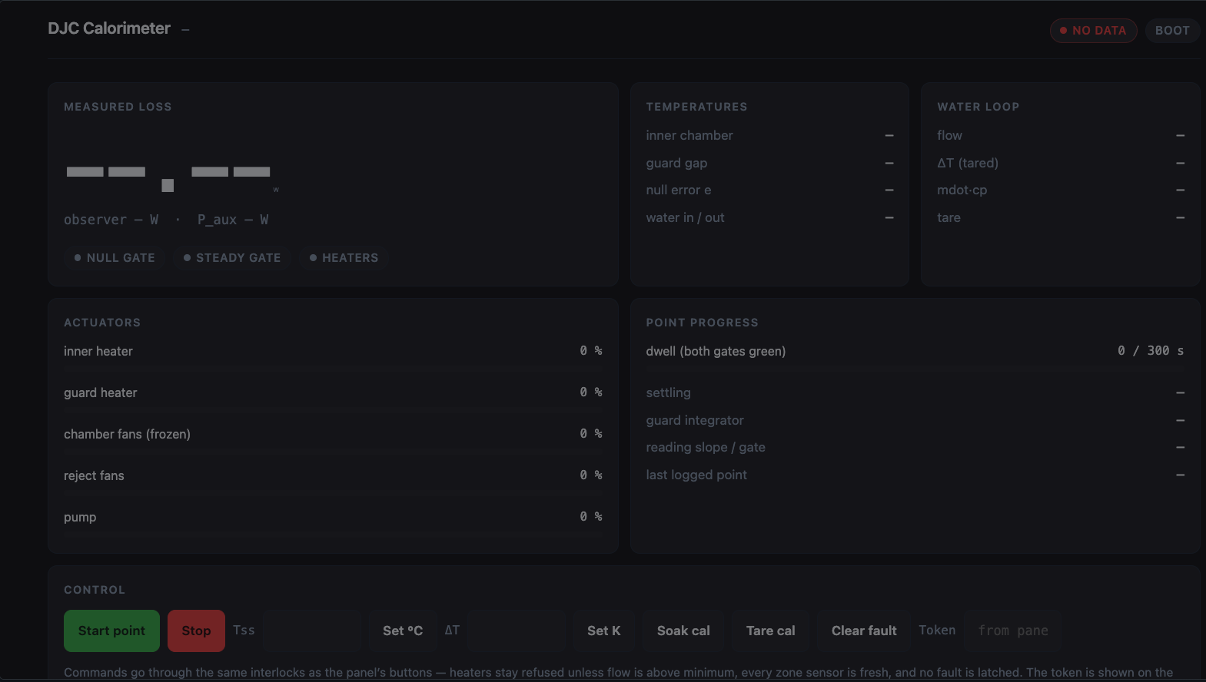

Slide 10
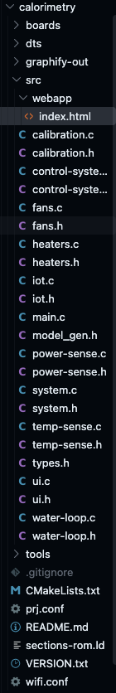

Zephy Directory and File structure

Slide 11
Thank you for your time

