Slide 2
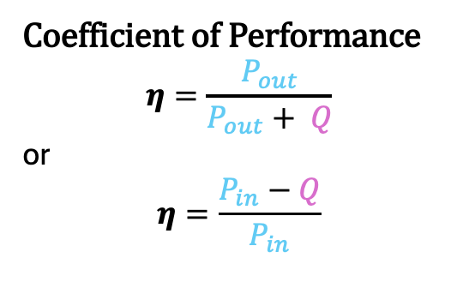
Double Jacket Chamber
T_{out}
T_{in}
Power Loss calculation
Q = m x c_{p} x ΔT
m = coolant mass flow rate
c_{p} = coolant heat capacity
ΔT = T_{out} - T_{in}
P_{fan}
T_{i}
DUT
P_{heater}
Coefficient of Performance
$$η=\frac{P_{out}}{P_{out}+ Q}$$
or
$$η=\frac{P_{in}−Q}{P_{in}}$$
P_{leak}
T_{e}
P_{heater}
P_{fan}
T_{a}
T_{i} > T_{a}
P_{out}
P_{in}
T_{i} = T_{e}
P_{leak}

Slide 3
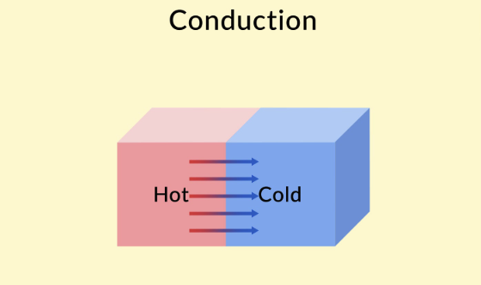
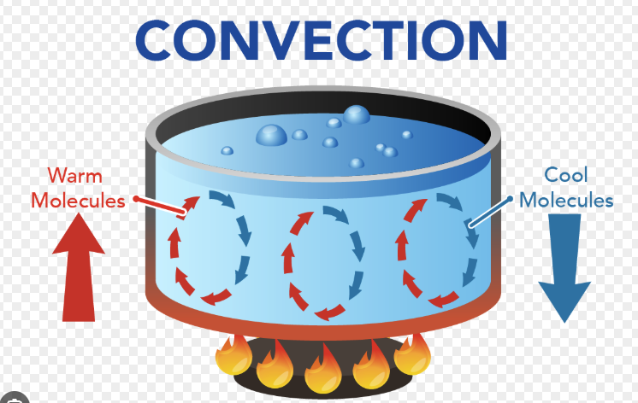
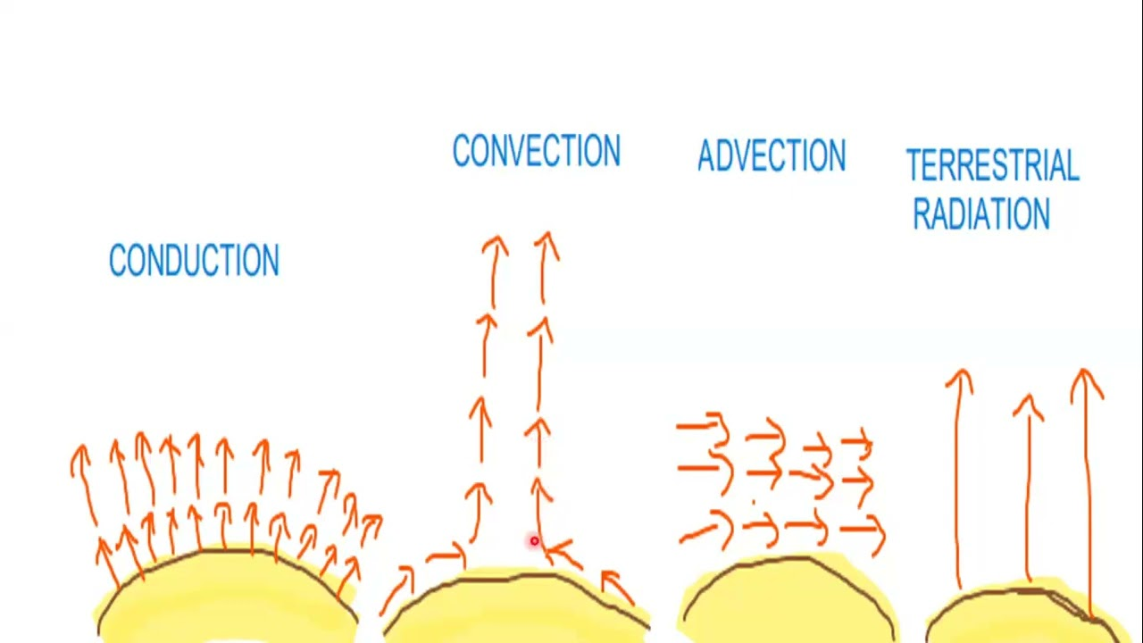
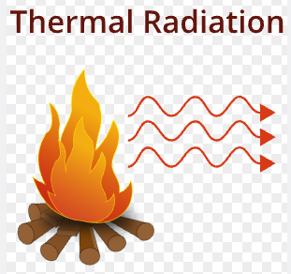

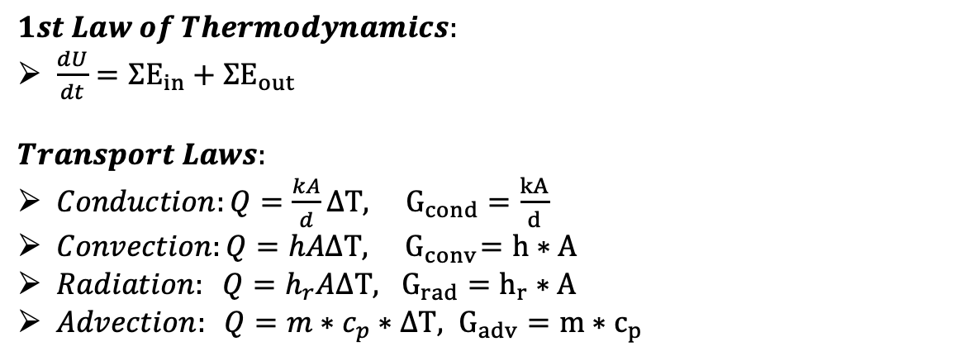
Thermodynamics Laws
$$1st Law of Thermodynamics:$$
$\frac{dU}{dt}=ΣE_{in}+ΣE_{out}$
$$Transport Laws:$$
$Conduction:Q=\frac{kA}{d}ΔT, G_{cond}=\frac{kA}{d}$
$Convection:Q=hAΔT, { G}_{conv}=h∗A$
$Radiation: Q=h_{r}AΔT, G_{rad}=h_{r}∗A$
$Advection: Q=m∗c_{p}∗ΔT, G_{adv}=m∗c_{p}$
$$Q=G_{thermal}∗ΔT \sim I=G_{electrical}∗ΔV$$

Slide 4
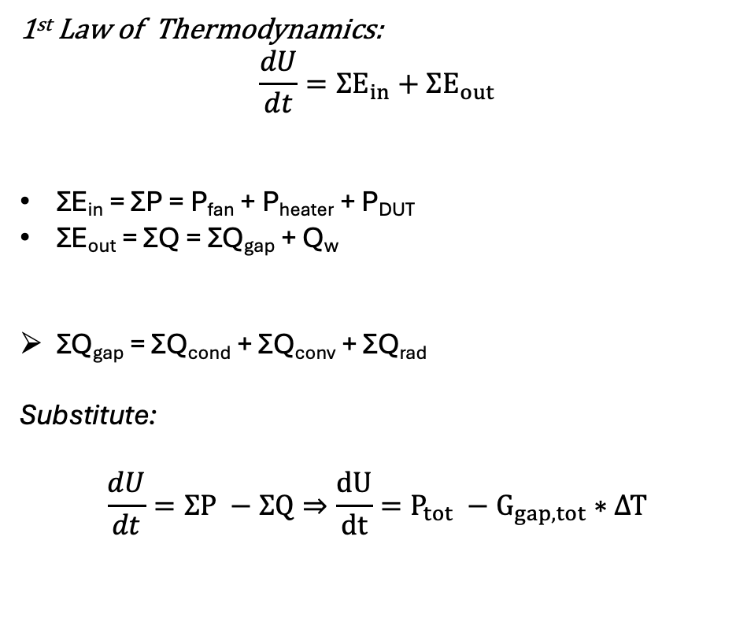
Inner Chamber modeling
T_{out}
T_{in}
1st Law of Thermodynamics:
$$\frac{dU}{dt}=ΣE_{in}+ΣE_{out}$$
ΣE_{in} = ΣP = P_{fan} + P_{heater} + P_{DUT}
ΣE_{out} = ΣQ = ΣQ_{gap} + Q_{w}
ΣQ_{gap} = ΣQ_{cond} + ΣQ_{conv} + ΣQ_{rad}
Substitute:
$$\frac{dU}{dt}=ΣP −ΣQ⇒\frac{dU}{dt}=P_{tot} −G_{gap,tot}∗ΔΤ$$
P_{fan}
T_{i}
DUT
P_{heater}
T_{e}
P_{out}
P_{in}

Slide 5
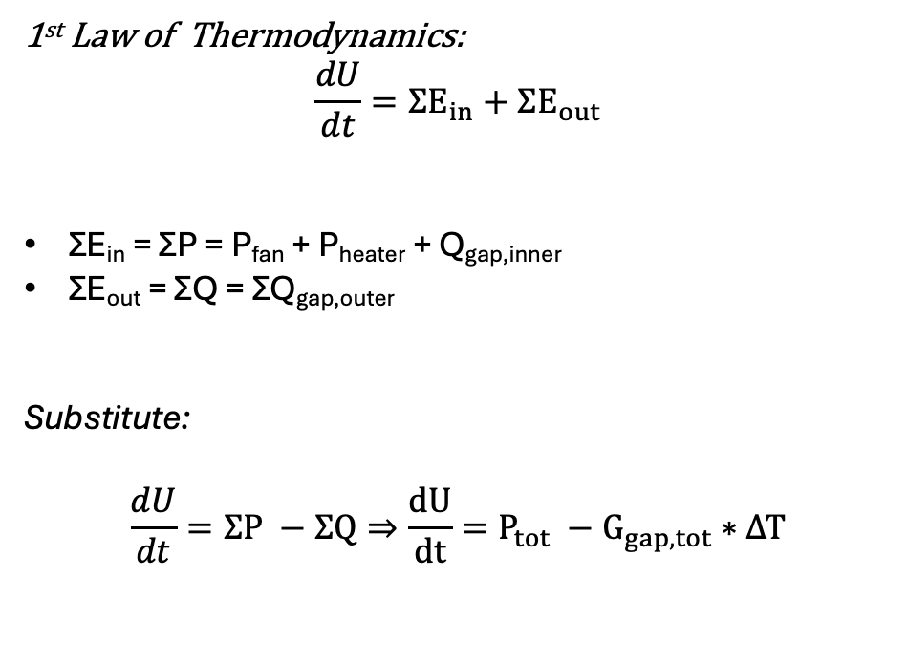
Outer Chamber Modeling
1st Law of Thermodynamics:
$$\frac{dU}{dt}=ΣE_{in}+ΣE_{out}$$
ΣE_{in} = ΣP = P_{fan} + P_{heater} + Q_{gap,inner}
ΣE_{out} = ΣQ = ΣQ_{gap,outer}
Substitute:
$$\frac{dU}{dt}=ΣP −ΣQ⇒\frac{dU}{dt}=P_{tot} −G_{gap,tot}∗ΔΤ$$
T_{i}
T_{e}
P_{heater}
P_{fan}
T_{a}

Slide 6
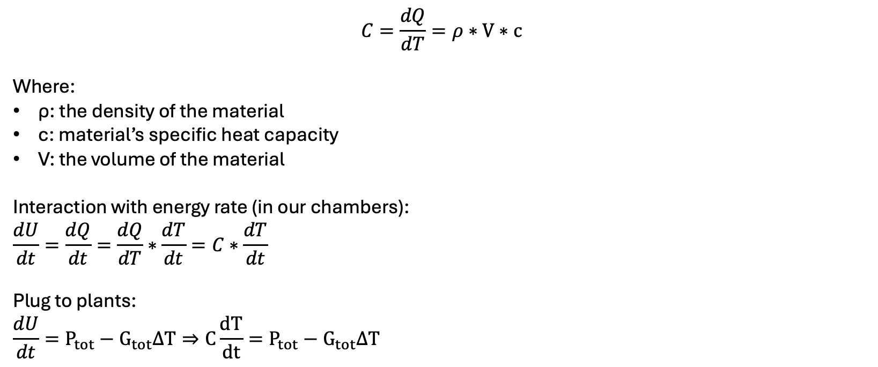
Thermal Capacitance
$$C=\frac{dQ}{dT}=ρ∗V∗c$$
Where:
ρ: the density of the material
c: material’s specific heat capacity
V: the volume of the material
Interaction with energy rate (in our chambers):
$$\frac{dU}{dt}=\frac{dQ}{dt}=\frac{dQ}{dT}∗\frac{dT}{dt}=C∗\frac{dT}{dt}$$
Plug to plants:
$$\frac{dU}{dt}=P_{tot}−G_{tot}ΔT⇒C\frac{dT}{dt}=P_{tot}−G_{tot}ΔT$$

Slide 7
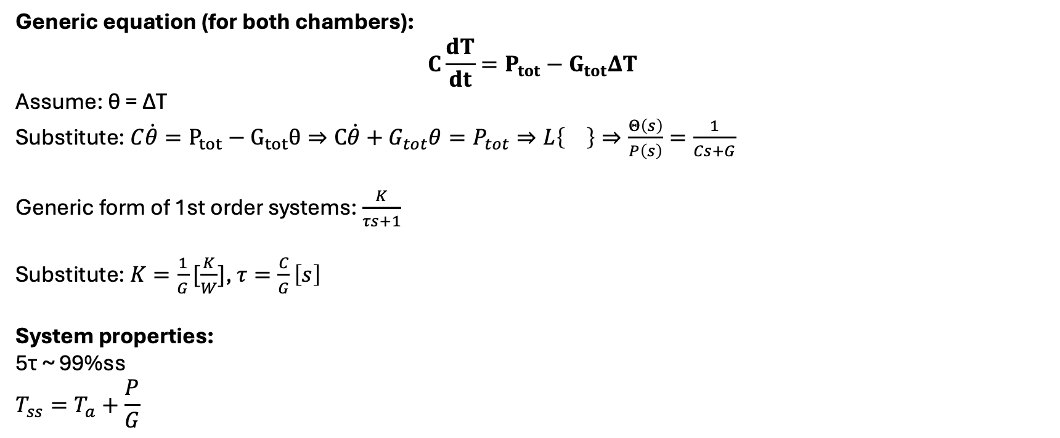
Equations & S-domain
Generic equation (for both chambers):
$$C\frac{dT}{dt}=P_{tot}−G_{tot}ΔT$$
Assume: θ = ΔT
Substitute: $C\dot{θ}=P_{tot}−G_{tot}θ⇒C\dot{θ}+G_{tot}θ=P_{tot}⇒L\left\{\right\}⇒\frac{Θ\left(s\right)}{P\left(s\right)}=\frac{1}{Cs+G}$
Generic form of 1st order systems: $\frac{K}{τs+1}$
Substitute: $K=\frac{1}{G}[\frac{K}{W}]$, $τ=\frac{C}{G}\left[s\right]$
System properties:
5τ ~ 99%ss
$$T_{ss}=T_{a}+\frac{P}{G}$$

Slide 8
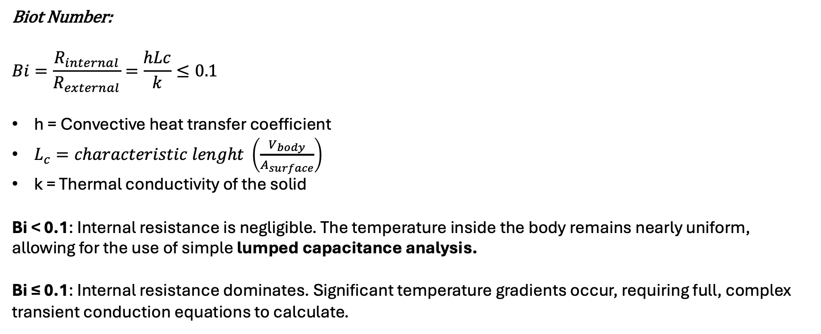
Lump assumption and Copper cooling block (1/2)
Biot Number:
$$Bi=\frac{R_{internal}}{R_{external}}=\frac{hLc}{k}≤0.1$$
h = Convective heat transfer coefficient
$L_{c}=characteristic lenght \left(\frac{V_{body}}{A_{surface}}\right)$
k = Thermal conductivity of the solid
Bi < 0.1: Internal resistance is negligible. The temperature inside the body remains nearly uniform, allowing for the use of simple lumped capacitance analysis.
Bi ≤ 0.1: Internal resistance dominates. Significant temperature gradients occur, requiring full, complex transient conduction equations to calculate.

Slide 9
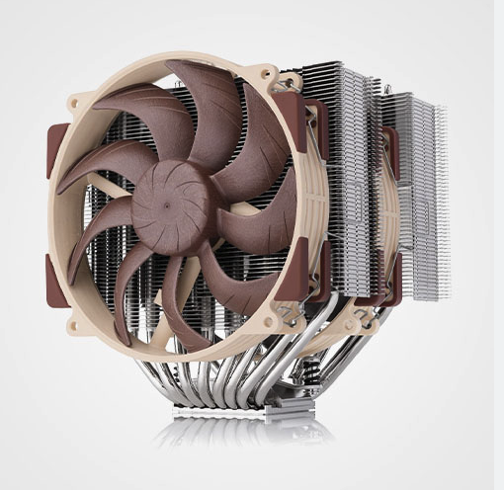
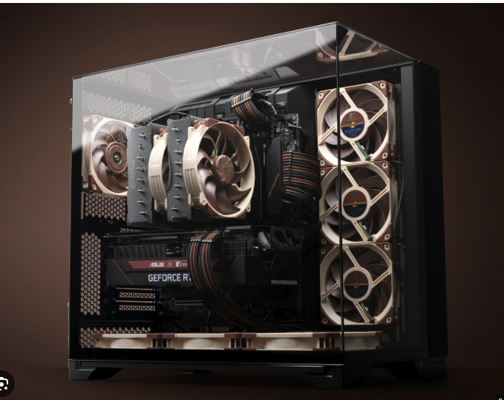
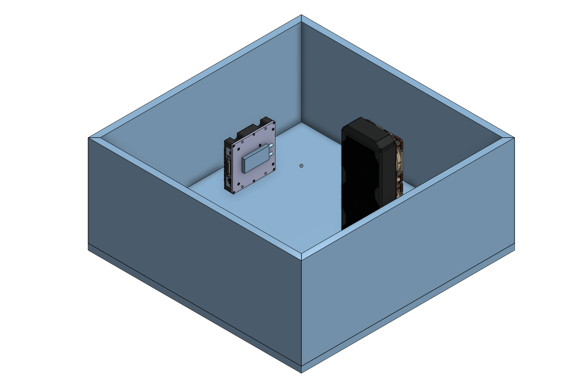
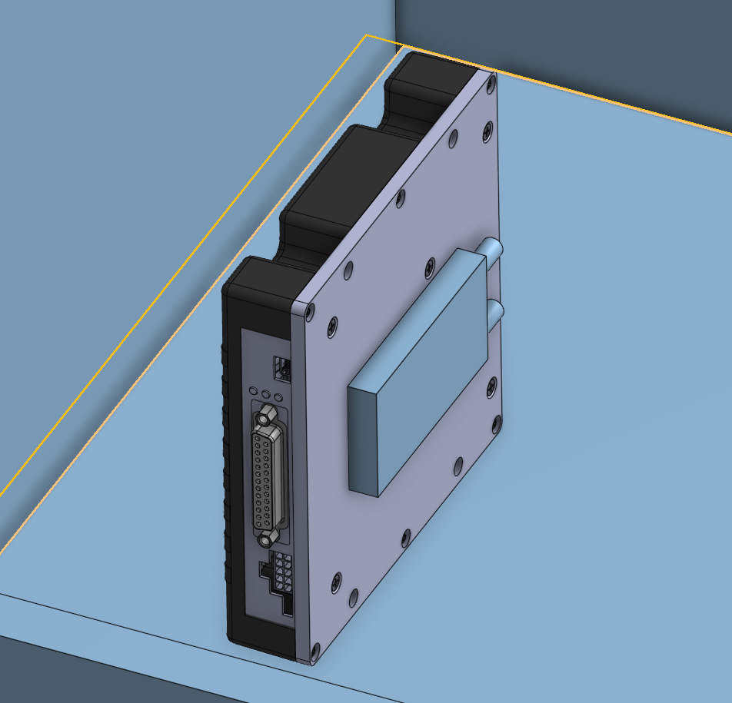
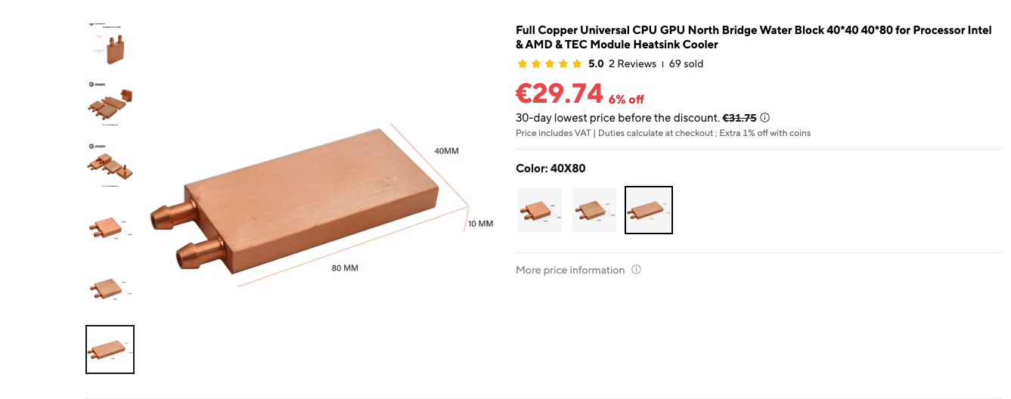
Lump assumption and Copper cooling block (1/2)
~200TDP

Slide 10
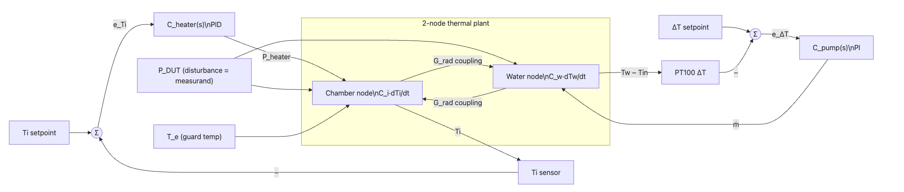
2 Node draft block diagram

Slide 11


Next Steps – Wall Thermal modeling
Thermal Modeling: Inner Walls
$$τ_{system}≠τ_{total}$$
T_{i}
T_{wall}
T_{e}

