Slide 1
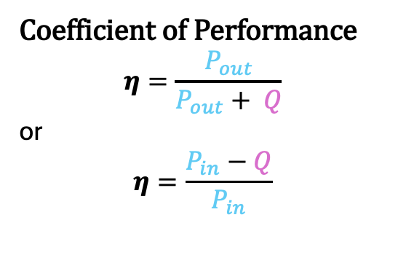
Double Jacket Chamber
T_{out}
T_{in}
Power Loss calculation
Q = m x c_{p} x ΔT
m = coolant mass flow rate
c_{p} = coolant heat capacity
ΔT = T_{out} - T_{in}
P_{fan}
T_{i}
DUT
P_{heater}
Coefficient of Performance
$$η=\frac{P_{out}}{P_{out}+ Q}$$
or
$$η=\frac{P_{in}−Q}{P_{in}}$$
P_{leak}
T_{e}
P_{heater}
P_{fan}
T_{a}
P_{out}
P_{in}
T_{i} = T_{e}
T_{i} > T_{a}
P_{leak}

Slide 2
Topology Differences

