Slide 1
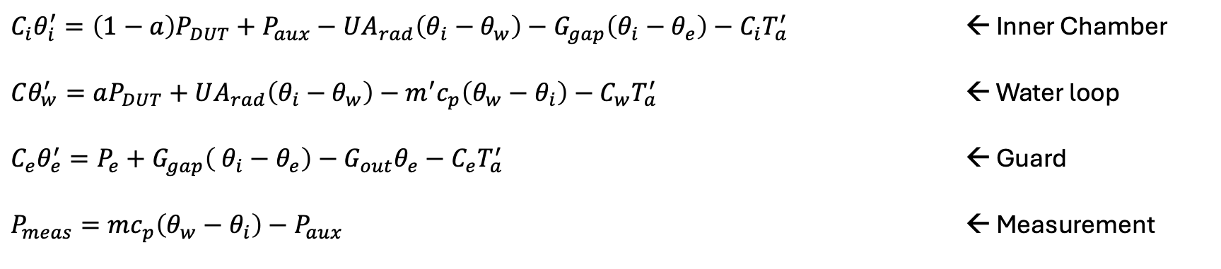
Equations
$C_{i}θ_{i}^{′}=\left(1−a\right)P_{DUT}+P_{aux}−UA_{rad}\left(θ_{i}−θ_{w}\right)−G_{gap}\left(θ_{i}−θ_{e}\right)−C_{i}T_{a}^{′}$ ← Inner Chamber
$Cθ_{w}^{′}=aP_{DUT}+UA_{rad}\left(θ_{i}−θ_{w}\right)−m^{′}c_{p}\left(θ_{w}−θ_{i}\right)−C_{w}T_{a}^{′}$ ← Water loop
$C_{e}θ_{e}^{′}=P_{e}+G_{gap}\left( θ_{i}−θ_{e}\right)−G_{out}θ_{e}−C_{e}T_{a}^{′}$ ← Guard
$P_{meas}=mc_{p}\left(θ_{w}−θ_{i}\right)−P_{aux}$ ← Measurement

Slide 2

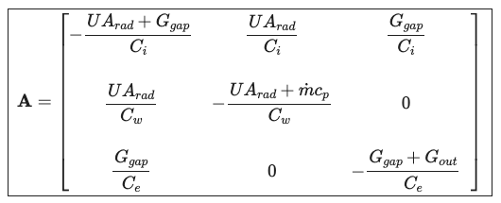
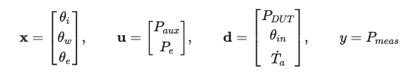
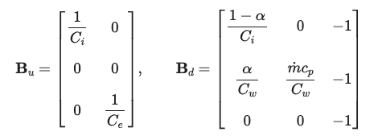
Space State Matrices

Slide 3
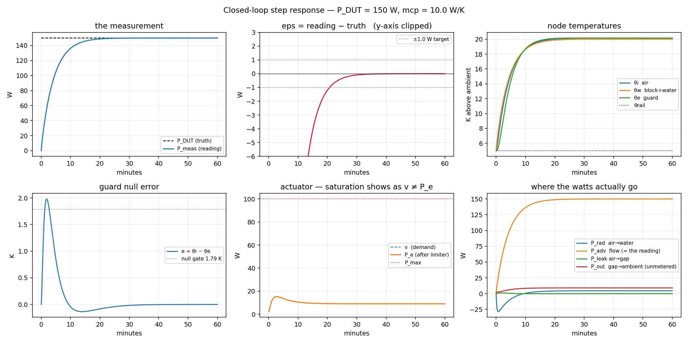
System response @ 150W DUT

Slide 4
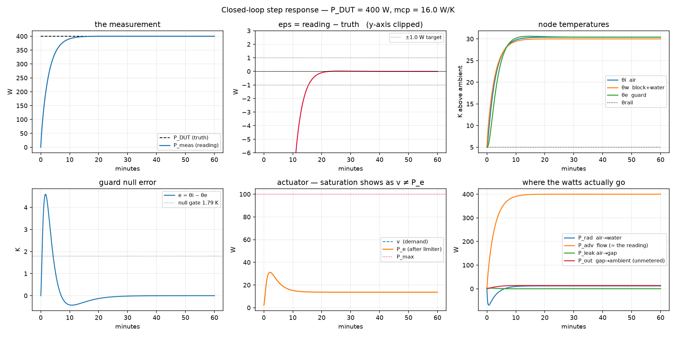
System response @ 400W DUT

