Slide 1
Predicting Machine Maintenance
Bill Murphy
3/10/2019

Slide 2
The Problem Summary:
Using data captured over a one year period, across a fleet of production machines, develop a model that will predict which machines will fail within the next 24 hours.
Model should be extensible to predict maintenance costs and develop a proactive strategy to minimize costs
Results: A random Forest model was created that was 97% effective in identifying machines due to fail. It would allow an efficient strategy to be developed, and significant savings (49%) to be achieved.

Slide 3
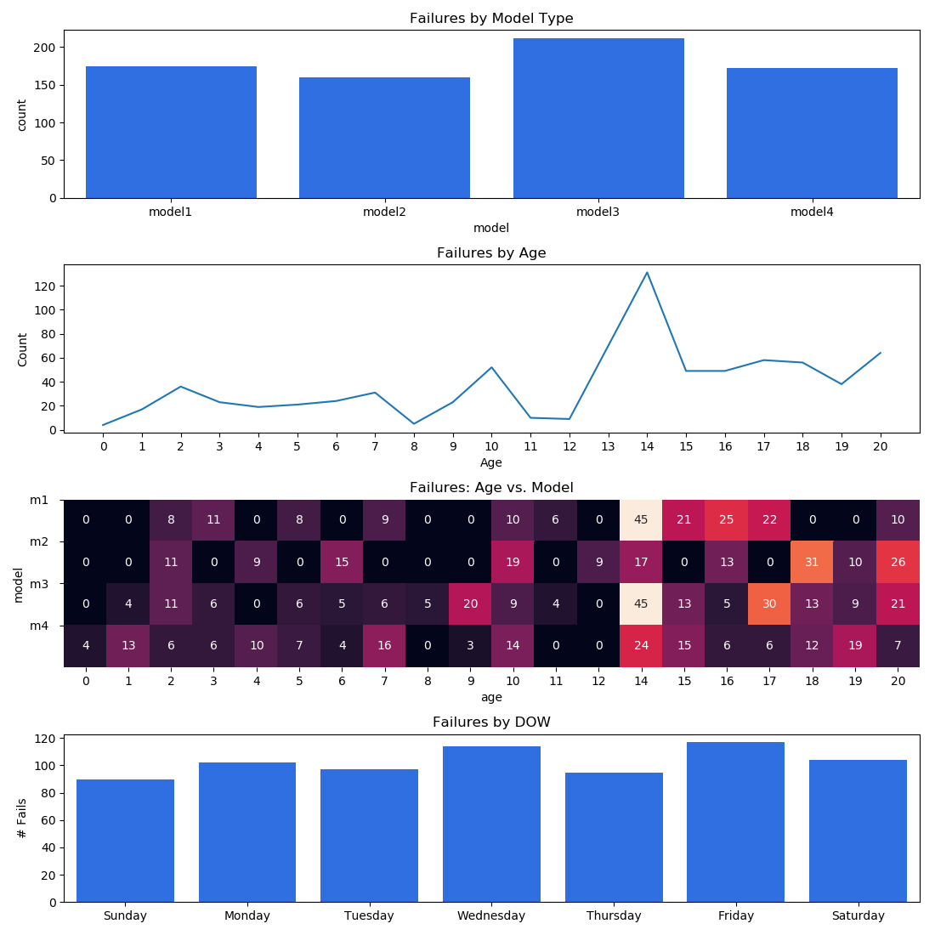
The Data
Dataset contains:
100 Machines
4 Models
Ages 0-20 years
Differing failure profiles
Hourly Sensor Data:
Vibration, Rotation, Pressure, Voltage
5 Different Error Codes
Daily Failure Data

Slide 4
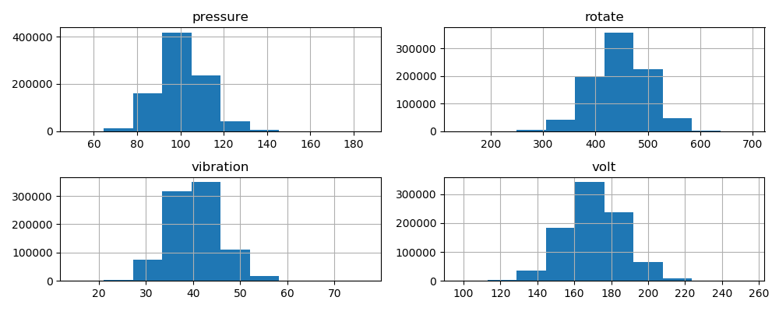
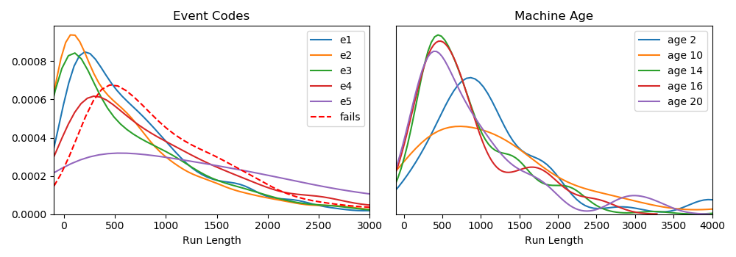
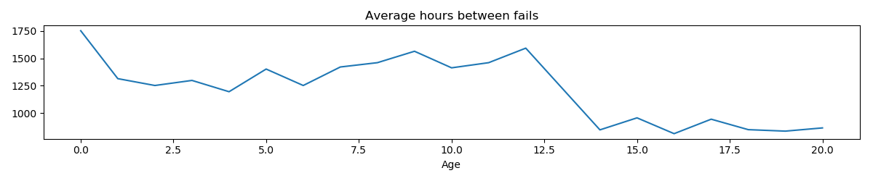
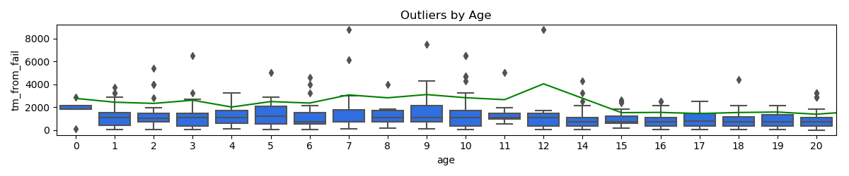
The Data (contd)
Sensor data has predominantly normal distributions
Error Codes map to varying run length
Machine age Matters:
Age maps to different run lengths, with a visible change at 12 years
“Outliers” (machines that have long TBF) are more prevalent in the younger machines

Slide 5
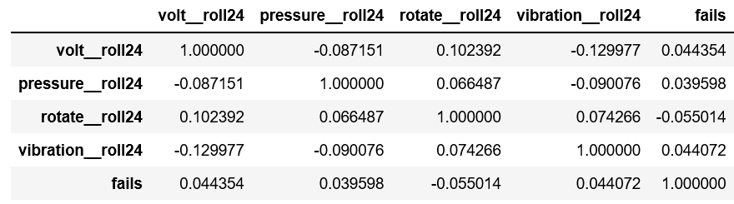
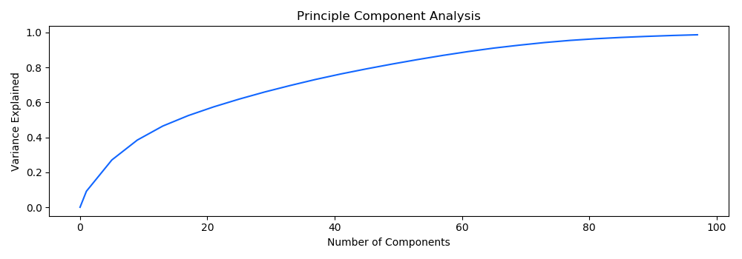
The Data (contd)
Lag features:
3 and 24 hour periods created
Surprisingly low correlation to “fails’. Makes sense given multiple failures modes likely have different physical profiles.
PCA:
Many features required to absorb variance.
No clear ‘knee’ supports low correlation of sensors to fails

Slide 6
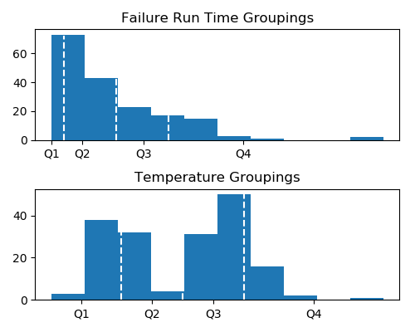
The Model Features: 8 given, 168 derived, 176 total
Type | Source | Derived | Groups
Time Series Run Length | Sensor, Error Codes, Model | max, min, std, roll3, roll24, Q1-4 | Age, Model Type,
Time Series | Time from fail | delta | MachineID
Run Number | Error Codes Fails | Delta | MachineID
Categorical | DOW, Model | One hot encode

Slide 7
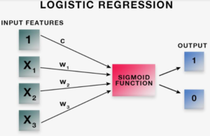
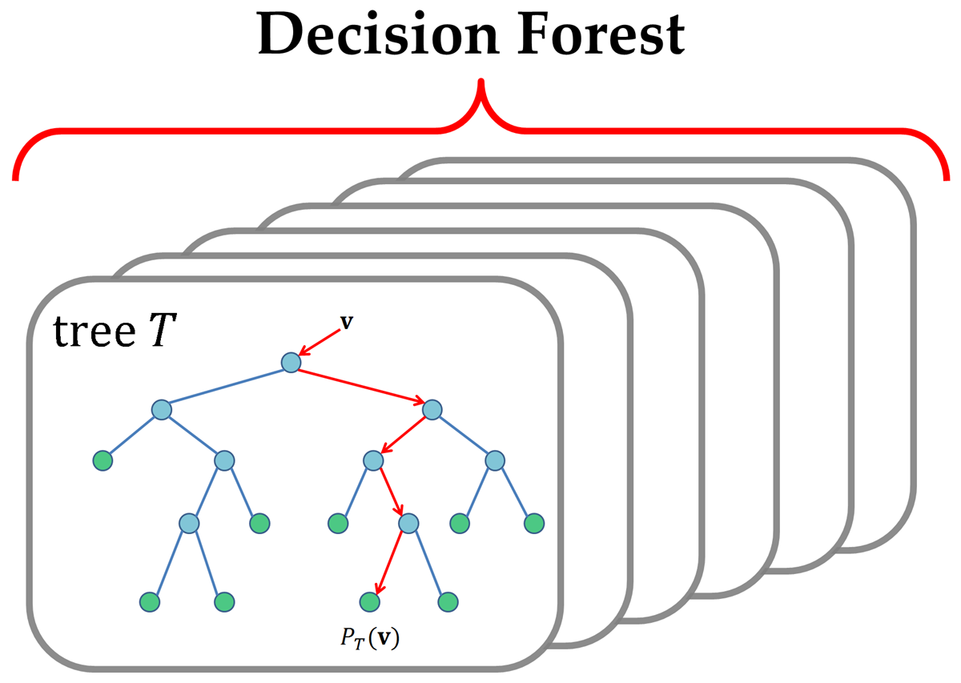
The Model
Considerations / Decisions
Single Daily Fail Point / Develop “Fail w/in 24hr” target class –Binary Classification
Unbalanced Data / Keep All Fail24 Class, Subsample Normal Class
PCA indicates need for high # features / Keep all features, try both logistic regression and Random forest as a first pass

Slide 8
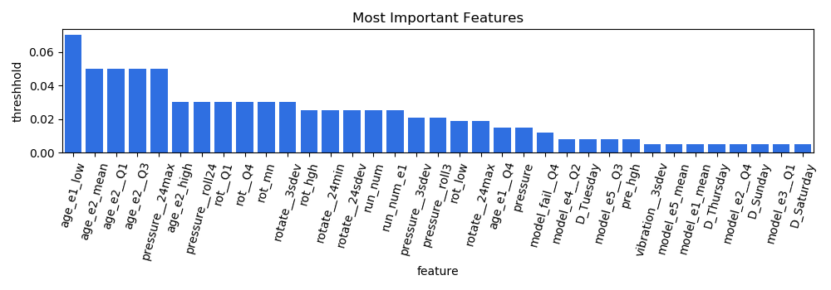
Feature Importance (rf model)
Machine age interacting with error code# and runtime
Max Pressure over past 24 hours
Rotation Performance

Slide 9
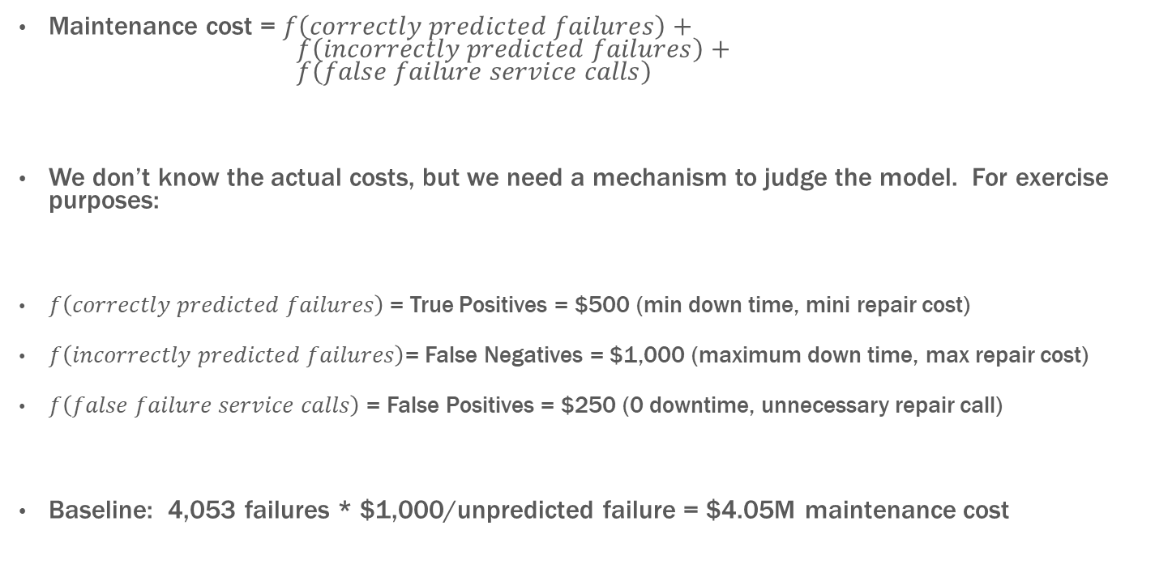
Judging Criteria:
Maintenance cost = $f\left(correctly predicted failures\right)+ f\left(incorrectly predicted failures\right)+$ $f\left(false failure service calls\right)$
We don’t know the actual costs, but we need a mechanism to judge the model. For exercise purposes:
$f\left(correctly predicted failures\right)$ = True Positives = $500 (min down time, mini repair cost)
$f\left(incorrectly predicted failures\right)$= False Negatives = $1,000 (maximum down time, max repair cost)
$f\left(false failure service calls\right)$ = False Positives = $250 (0 downtime, unnecessary repair call)
Baseline: 4,053 failures * $1,000/unpredicted failure = $4.05M maintenance cost

Slide 10
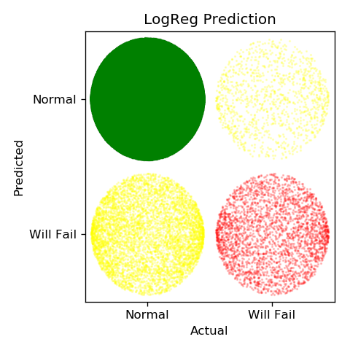
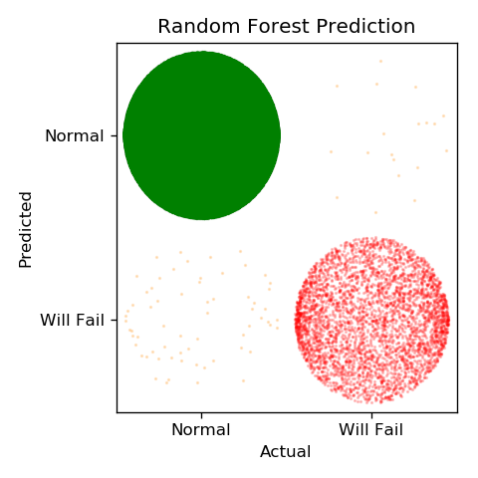
Model Results
Logistic Regression
True Failures = 2,875 $1,437,500
Unpredicted Failures = 1,178 $1,178,000
Falsely Predicted Failures = 5,481 $1,370,250
--------------
Baseline $4,053,000 $3,990,525
Savings: $ 62,475
1.5% Savings
Random Forest
True Failures = 4,034 $2,017,000
Unpredicted Failures = 19 $ 38,000
Falsely Predicted Failures = 65 $ 16,250
--------------
$2,071,250
Savings: $ 1,981,750
49% Savings

Slide 11
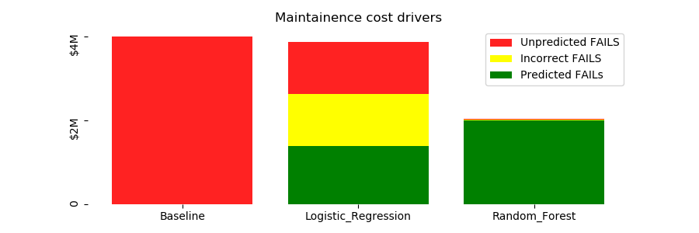
The Model (results)
The Logistic Regression Model:
Some predictive value
The economic penalties of the incorrect predictions make that model almost worthless.
The Random Forest Model:
97% accuracy in predictions
Economic Impact Clear
From a pragmatic standpoint it is not worth expending any additional effort on the LR model.

Slide 12
Summary
Across a dataset with 100 machines, all with different failure profiles, basic sensor, errorcode and failure rates were analyzed.
A model was developed that is 97% accurate in terms of predicting machines that will fail within 24 hours
Key indicators: error codes run times in model and age contexts (5/top 11)
Pressure and Rotation Sensor outputs over past 24 hours (6/top 11)
Using reasonable assumptions, the best model was able to save nearly 50% of the maintenance cost. A poor model saved only 1.5%

