Slide 1
Blockchain Suitability Evaluation
COMP6452 Software Architecture for Blockchain Applications
Xiwei (Sherry) Xu
| Senior Research Scientist @ AAP team, CSIRO Data61
| Xiwei.Xu@data61.csiro.au
Notes:
The topic of this lecture is blockchain suitability evaluation

Slide 2

Outline
Blockchain Suitability Evaluation Framework
4 Use Cases
First Guest Lecture: A Platform Architecture for Multi-Tenant Blockchain-Based Systems
Notes:
This is the outline of this lecture.
We will first learn an evaluation framework to assess suitability of using blockchain
Then we will look at 4 use cases that apply the suitability evaluation framework.
We will then have our first guest lecture, which describe a concrete software system using blockchain in the context of food supply chain.

Slide 3
Design Process
This Lecture
Last
lecture
Every step is a procedure to decide between alternative options
Taxonomy
Systematic comparison of different design options
Notes:
This is the design process for blockchain-base application that we learnt in the last lecture.
To complete the process, we will learn the first step within the process, that is suitability evaluation.

Slide 4
Use Blockchain Where It Makes Sense
Trustworthy and efficient ways to work together
Focus on spaces between individuals, organisations
Data integrity for information sharing
Neutral ground for coordination
Logically centralises information
Administratively decentralises control
Don’t use blockchain where it doesn’t make sense
Does using blockchain make a system possible?
Or does it offer big benefits?
4 |
Notes:
The main aim of this suitability evaluation is to make sure only use blockchain where it makes sense.
Blockchain, as a infrastructure, provides a trustworthy and efficient way to work together. Using blockchain can achieve data integrity for information sharing, and also provides a neutral ground for coordination.
Blockchain provides logically centralized information with a administratively decentralized control.
As we learn earlier, blockchain provide fundamental properties with some technical limitations. Thus, blockchain cannot be used for all the use cases.
When we assess the suitability of blockchain, we need to consider whether using blockchain makes a system possible? Or does blockchain offer big benefits?

Slide 5
Evaluation Framework
Notes:
The evaluation framework is essentially a flow with 6 main questions to be answered according to the characteristics of the use case. They are shown as white diamonds
Some of the questions have follow-up question as shown in grey diamonds.
We will discuss these questions one by one in detail.

Slide 6
Is Multi-party Required? 1/2
Blockchain is NOT SUITABLE for systems that only serve individual isolated users
Conventional database is simpler and more efficient
Different legally distinct parties
Supply chain
Complex, dynamic, multi-party arrangements with regulatory and logistical constraints spanning jurisdictional boundaries
Manufacturers, shipping companies, transport infrastructure organizations, financial service firms, or regulators
Information exchange can be as important and difficult as the physical exchange of goods
Inter-bank payments and reconciliation
Two different banks, account holders (organizations or individuals)
Notes:
The first question to ask is does the system need to serve multiple different parties?
Blockchain is NOT SUITABLE for systems that only serve individual isolated users. In this case, conventional database is simpler and more efficient
The multi-parties are different legally distinct parties
For example, in supply chain scenarios, there are complex, dynamic, multi-party arrangements with regulatory and logistical constraints spanning jurisdictional boundaries
The stakeholders involved in a supply chain scenario include manufacturers, shipping companies, transport infrastructure organizations, financial service firms, or regulators
Information exchange can be as important and difficult as the physical exchange of goods, thus a logically centralized data platform, like blockchain, could offer big benefits here.
Another example is inter-bank payments and reconciliation.
Here the multiple parties are at least two different banks, but may also include the account holders performing payment transfers between the banks. So, parties might be organizations or individuals.

Slide 7
Is Multi-party Required? 2/2
Large enterprise or government
Different functional or geographic divisions or departments
Informational or administrative “silos” as multiple parties
Blockchain can be SUITABLE for supporting multi-party systems
Physically distributed
Logically centralized
Infrastructure providing a single view of truth across those parties
Notes:
In large enterprise or government.
Different functional or geographic divisions or departments maybe informational or administrative “silos” which need to be served as multiple parties.
Blockchain can be suitable for supporting multi-party systems. As mentioned learner, blockchain is s physically distributed and logically centralized infrastructure that can provide a single view of truth across those parties

Slide 8
Is Trusted Authority Required? 1/2
An entity that is relied upon to perform a function (Operating a system)
Blockchain is NOT SUITABLE if a single party can or must be relied upon as a trusted authority
Trusted authority implements a traditional centralized solution with conventional technologies
Scope of the system is important in deciding the question
Bank is a trusted authority for bank accounts
Central bank is a trusted authority for inter-bank payments
Trusted authority is a single point of failure
Technical single points of failure can be mitigated by using redundancy
Single points of organizational or business failure remain present
Business failures, service interruptions, data loss or fraud.
Notes:
The second question to ask is that if trusted authority is required in this scenario
A trusted authority is an entity that is relied upon to perform a function (Operating a system)
Most current complex systems are controlled by a trusted authority. Examples of these authorities include banks and government departments.
Blockchain is NOT SUITABLE if a single party can or must be relied upon as a trusted authority
Trusted authority implements a traditional centralized solution with conventional technologies
Scope of the system is important in deciding the question
For example, bank is a trusted authority for bank accounts
For inter-bank payments, each participating bank will not be a trusted authority;
instead the conventional approach is for banks to collectively rely upon separate authorities to facilitate inter-bank payments.
within a country that trusted authority might be a central bank.
Trusted authority is a single point of failure from architecture perpective.
When a trusted authority experiences a problem, users accessing its services are affected.
Technical single points of failure can be mitigated by using redundancy in conventional distributed systems architectures.
Those solutions do not address single points of organisational or business failure that remain present when relying on a trusted authority.

Slide 9
Is Trusted Authority Required? 2/2
Trusted authority is a monopoly or oligopoly service provider
“rent-seeking” behavior
Increase one’s share of existing wealth without creating new wealth
A natural trusted authority might be difficult for everyone to accept reliance on that party
Centralization of services can be perceived as a loss of control or power
Blockchain is SUITABLE for system with no single party that is acceptable for operating the system
Operated jointly by a collective of nodes
Not remove trust
Users are exposed to risk in use of blockchain technology
What is trusted is the software, the incentive mechanism, and “oracles”
Distributed Trust
Remove the need to trust a single third-party to maintain a ledger.
Notes:
For situations where the trusted authority is a monopoly or oligopoly service provider, there is also the possibility of what economists call “rent-seeking” behaviour
An example of rent-seeking is when a company lobbies the government for loan subsidies, grants or tariff protection. These activities do not create any benefit for society but only redistribute resources from the taxpayers to the company.
Some time a natural trusted authority might in principle be available, in practice it might be difficult for everyone to accept reliance on that party.
Large enterprises or government could in principle define a central agency to provide services for coordinated operations across their whole organization.
Centralisation of services can be perceived as a loss of control or power, and so in practice it may be difficult to achieve this kind of administrative centralization.
Using a blockchain does not remove trust, because users are still exposed to risk in their use of blockchain technology.
In a blockchain, what is trusted (i.e., relied upon) is the blockchain software, the incentive or contractual mechanisms driving the behaviour of processing nodes that operate the blockchain system, and the trusted third-parties that act as ‘oracles’ which record information about the external world on the blockchain.
Blockchain removes the need to trust a single third-party to maintain a ledger.

Slide 10



Student Task
Consider the case of exam registration, as before
Take half a minute to think about trusted authority in this context
10 |

Slide 11
Is operation centralized?
System with multiple parties, but no party is suitable as a trusted authority for administering the system
Conventional, Group of parties form a joint venture to operate a conventional centralized system
Credit card associations, like Visa and MasterCard
Joint venture between banks
Centralized operation of the system lead to the administering party becoming a trusted authority
Unacceptable to the parties within the system
Forming a new entity like a joint venture is too costly
Centralized administration may cause single point of business failure
Blockchain-based systems do not need a single system operator
Better system reliability and availability
Notes:
The third question to ask: Is operation centralized?
Given that a system supports multiple parties, and given no party is suitable as a trusted authority for administering the system, might centralised operation of the system still be possible?
In this case, conventional, Group of parties form a joint venture to operate a conventional centralized system
Credit card associations, like Visa and MasterCard, which is Joint venture between banks
However in some cases, it is not possible or desirable to centralise operation of the system.
Centralized operation of the system lead to the administering party becoming a trusted authority, which might not be unacceptable to the parties within the system,, besides, forming a new entity like a joint venture is too costly. And such a centralized administration may cause single point of business failure
A benefit of blockchain-based systems is that there does not have to be a single authority or system operator. Eliminating single points of failure can increase system reliability or availability.

Slide 12
Student Task
Consider the case of exam registration, as before
Take half a minute to think about centralized operation in this context
12 |

Slide 13
Is Immutability Required? 1/3
Data immutability means data con not be changed or altered after its creation
Immutability supports non-repudiation
Assurance that a party cannot deny the authenticity of their signature
Conventional technologies naturally support mutable data
Blockchain naturally support data immutability in the ledger
Linking of blocks in a chain of cryptographic hashes supports immutability
Data continually replicated across many locations and organization
Attempts to change it in one location will be interpreted as an attack on integrity
Strong evidence that the transactions were performed by someone with control over those cryptographic keys.
Transaction history is immutable, the latest view of the current state can change
Notes:
The fourth question Is data immutability required and acceptable?
Data immutability means data connot be changed or altered after its creation
Immutability supports non-repudiation. Assurance that a party cannot deny the authenticity of their signature
Conventional technologies naturally support mutable data
Blockchain naturally support data immutability in the ledger, where data continually replicated across many locations and organization. The attempts to change it in one location will be interpreted as an attack on integrity by other participants, and will be rejected.
the immutability of historical transactions which are cryptographically signed means that there is always strong evidence that those transactions were performed by someone with control over those cryptographic keys.
Although the blockchain transaction history is immutable, the latest view of the current state in a blockchain can change.
A transaction may need to update the owner of an asset. What is recorded to the ledger in this case is the new owner for the asset, and so all that changes is our view of the latest owner.

Slide 14
Is Immutability Required? 2/3
Impossible to change the transaction history in most blockchains
Cause problems if blockchain contains illegal content
Court orders content to be removed from the blockchain
Other issues
Disputed transactions
Incorrect addresses
Exposure or loss of private keys
Data-entry errors
Unexpected changes to assets tokenized on blockchain
Other cheaper mechanisms available to prove the originality of data
Hashing technology
Cryptographically signed data
Time-stamped, distributed / federated data stores
Notes:
This is normally a good thing in supporting data integrity.
it can cause problems if blockchain contains illegal content, or if a court orders content to be removed from the blockchain. It will be easier to support these requirements using conventional technologies.
in blockchain systems, problems may arise such as disputed transactions, incorrect addresses, exposure or loss of private keys, data-entry errors, or unexpected changes to assets tokenized on blockchain.
The immutability of blockchain ledgers may make them less adaptable than conventional technologies controlled by trusted third-party organizations that support rollback.
Using blockchain to achieve immutability and non-repudiation may be relatively expensive compared to other persistence mechanisms, like hashing technology, cryptographically signed data, time-stamped, distributed / federated data stores.

Slide 15
Is Immutability Required? 3/3
Immutability of Nakamoto-based blockchain is a long-run probabilistic durability property
Conventional database supports ACID (Atomicity, Consistency, Isolation and Durability)
A transaction initially thought by a participant to be committed may later turn out to have been on a shorter chain
A transaction is in practice be immutable if it has been committed to a blockchain for a sufficiently long time (number of confirmation blocks)
Blockchain using other consensus mechanism can offer stronger, more conventional immutability
E.g. Practical Byzantine Fault Tolerance (PBFT)
Small number of known nodes participating in the operation
Notes:
Immutability of Nakamoto-based blockchain is a long-run probabilistic durability property,
A transaction initially thought by a participant to be committed may later turn out to have been on a shorter chain
A transaction is in practice be immutable if it has been committed to a blockchain for a sufficiently long time (number of confirmation blocks)
Blockchain using other consensus mechanism can offer stronger, more conventional immutability, Practical Byzantine Fault Tolerance (PBFT), Small number of known nodes participating in the operation

Slide 16
Student Task
Consider the case of exam registration, as before
Take half a minute to think about immutability, and whether it is acceptable / advantageous / problematic in this context
16 |

Slide 17
Is High Performance Required? 1/2
Blockchain is NOT SUITABLE if the system need to support high performance
Extremely short response time (Latency)
Process very large amounts of data (Throughput)
Bitcoin and Ethereum cannot currently match the maximum throughput of conventional transaction processing system
Visa payments network
New mechanisms to improve performance (Taxonomy)
Sharding
State channels
Reduced inter-block time
Consortium and private blockchains with careful design and performance tuning have much better performance
Notes:
The fifth question: Does the system need to support extremely short response times or process very large amounts of data?
If so, conventional technologies may be more suitable than blockchain technology.
Performance is a known and current limitation of public blockchain, like Bitcoin or Ethereum, but is being addressed by the development of new mechanisms such as sharding, state channels, and reduced inter-block time.
Consortium and private blockchains with careful design and performance tuning have much better performance
While blockchains are currently not highly scalable, this is not necessarily an inherent limitation, and may be overcome in the future.

Slide 18
Is High Performance Required? 2/2
Read latency can be much faster than with conventional technologies
Response time for accessing historical data from a blockchain client
Clients keep a full local copy of the database
No network delays
Write latency is probabilistic with several sources of uncertainty
Network delays
Sending transactions to the network
Confirmation blocks on Nakamoto consensus-based blockchain increases write latency
Blockchain is NOT SUITABLE for storing Big Data
Large volumes or high velocity
Massive redundancy
Notes:
When data has previously been written to the blockchain, read latency is the response time for accessing historical data from a blockchain client, there is no network delays. Thus Read latency can be much faster than with conventional technologies
Write latency is probabilistic with several sources of uncertainty, including network delays and number of confirmation blocks.
Node should not be highly confident that the most recent block it saw will ultimately be included in the main chain.
So, to increase the confidence that data has successfully been committed to the blockchain, we can wait for a number of confirmation blocks. Waiting for more confirmation blocks will increase write latency.
Blockchain is not suitable for storing big data.
This is because on a blockchain there is massive redundancy in the large number of processing nodes holding a full copy of the distributed ledger.
Big Data is hard to physically move in a distributed system, and the large numbers of replicas make it infeasible to store it on a blockchain.

Slide 19
Is Transparency Required? 1/4
Data transparency means data is available and accessible to by other parties
Facebook public newsfeed posts
Twitter public tweets
Facebook/Twitter support confidentiality
Choose what users publish to the public or to specific audience
Blockchain provides a neutral platform where all participants can see and audit the published data
Validation of cryptocurrency transfers
From addresses with enough cryptocurrency
Signed with an authorized private key
Record of correct smart contract execution is stored on the blockchain and validated
Notes:
The last question in the evaluation framework is whether data transparency required or acceptable in the system?
Data transparency means data is available and accessible to by other parties, Facebook public newsfeed post, or Twitter public tweets
Facebook/Twitter support confidentiality: users can choose what they publish to the public or to specific audience
Blockchain provides a neutral platform where all participants can see and audit the published data
This is important to achieve data integrity through validation by all processing nodes.
Nodes validate that cryptocurrency transfers are from addresses that have enough cryptocurrency and signed with an authorized private key. For smart contracts, nodes validate that the effects of the smart contract program execution are correctly recorded on the blockchain.

Slide 20
Is Transparency Required? 2/4
Blockchain MAY BE SUITABLE if data transparency is required or acceptable
Confidentiality is harder to establish in blockchain-based systems
By default, information is visible to all participants
Volume / frequency of interactions and links between parties can be a confidentiality concern
Very often customer relationships, pricing, or aggregate transaction volume are commercially-sensitive information
Volume might be inferred from transactions, even if content is encoded or encrypted
Create a new address for each transaction
Flow of assets may be used to infer relationships between addresses
Use pseudonym
Contents of a transaction are publicly visible
Reidentification
Reuse of addresses and their connection via transfers of cryptocurrency
Notes:
Blockchain MAY BE SUITABLE if data transparency is required or acceptable
Because Confidentiality is harder to establish in blockchain-based systems. By default, information is visible to all participants
However, Volume / frequency of interactions and links between parties can be a confidentiality concerns
Very often customer relationships, pricing, or aggregate transaction volume are commercially-sensitive information: Volume might be inferred from transactions, even if content is encoded or encrypted
Create a new address for each transaction: Flow of assets may be used to infer relationships between addresses
Although blockchain is pseudonymous, Use pseudonym, the Contents of a transaction are publicly visible
Reidentification is possible in case of reuse of addresses and their connection via transfers of cryptocurrency

Slide 21
Is Transparency Required? 3/4
Public blockchain MAY BE SUITABLE in some settings, e.g.:
Public advertising
Fully open government registries
Secure software package management
IoT device configuration updates
Blockchain can be used to share encrypted data
Asymmetrical with a party’s public key
Symmetrical with a shared secret key
Requires a secure means of exchanging the secret key
Increase confidentiality, but reduce performance
Encrypted data makes it difficult to use smart contracts with the data
Embedding keys within a smart contract would reveal the keys
Notes:
This limitation does not matter for all use cases.
For example, public blockchains may be suitable as infrastructure for public advertising or fully open government registries, secure software package management, or IoT device configuration updates.
Data Integrity in theses use cases may be required, but rather than privacy or confidentiality, publicity is important.
Public blockchains can provide integrity and publicity.
Sometimes, although raw data cannot be shared, it may be acceptable to share encrypted forms of that data, and in such cases a blockchain could be used.
Encrypting data will make it difficult or impossible to use smart contracts with that data.
If information needs to be processed by smart contracts, the information typically has to be decrypted.
This is because smart contract code runs on all nodes of the network, and thus any of them needs to be able to process the input data.
This is required to achieve consensus on the outcomes of smart contract execution.
Embedding keys within a smart contract would reveal the keys to all participants of the blockchain network.

Slide 22
Is Transparency Required? 4/4
Sometime encryption is not acceptable
Concerns about successful encryption key management
Future technological developments in decryption (e.g. quantum computing)
Reveal information as meta-data
Consortium and private blockchains provide read access controls
Not commercial confidentiality between competitors
Trade-off is between the benefits of sharing data within the group of collaborators and retaining confidentiality towards competitors where needed
More controlled data sharing can be enabled by distributed ledger technology platforms
E.g. Corda or Hyperledger Fabric
Small ledgers shared between parties of interest to each transaction
Notes:
Sometime encryption is not acceptable with Concerns about successful encryption key management, Future technological developments in decryption (e.g. quantum computing), or Reveal information as meta-data
In this case, consortium and private blockchains can provide read access controls, the trade off is between the benefits of sharing data within the group of collaborators and retainining confidentiality
In situations where full data transparency between all participants may not be acceptable, and where encrypting data is not acceptable or workable,
more-controlled data sharing can be enabled by distributed ledger technology platform, like corda or hyperledger fabric
These platforms may be suitable where greater control is required over confidentiality

Slide 23
Student Task
Consider the case of exam registration, as before
Take half a minute to think about transparency and encryption in this context
23 |

Slide 24
Evaluation Framework
Notes:
Back to the overview decision flow
If multi-party is not required, use conventional database
If trusted authority is required, and cannot be decentralized, use conventional database
If operation is centralized, use conventional database
If immutability is not required, use conventional database
If high performance is required and the big volume of data can be stored off-chain, use conventional database
If transparency is not required and the data cannot be shared even after being encrypted, use DLTs.

Slide 25
Example Use Cases for Suitability Evaluation
Four example use cases in the book:
Electronic health records
Identity
Stock market
Supply chain
Notes:
Now let’s look at four example use cases: electronic health records, identify and stock market, and supply chain.

Slide 26
Use Case 1: Electronic Health Records 1/3
Collections of patient medical records
Blood type, vital signs, past medical records, medication, and radiology report
Maintained by specific healthcare providers in siloed systems
Multiple parties from different medical jurisdictions are involved
Patients, professionals and organizations
Healthcare service providers are decentralized trusted authorities
Each has access to patient data and authority to make changes
Operation is distributed across healthcare service providers
Data transparency is the main issue
Patient privacy
Shared with patient consent, except emergency situations
Access to anonymised data for approved medical research
Health records cannot be inappropriately created or updated
Notes:
Electronic health records are collection of patient medical record, including blood type, vital signs, past medical records, medication, and radiology report.
Such information is maintained by specific healthcare providers in siloed systems.
In this use case, there are multiple parties including patients, professionals and organizations from different medical jurisdictions and are involved in data exchange to allow more efficient health care and research.
Operation is distributed across healthcare service providers
Patient privacy is critical, and normally information should only be shared with patient consent.
Sometimes exceptions are made, for example to access medical records in emergency situations, or to allow access to anonymised data for approved medical research.
Accesses made to EHRs are often required to be logged for audit purposes.
In addition to tight controls on read access, it is also important that health records cannot be inappropriately created or updated.

Slide 27
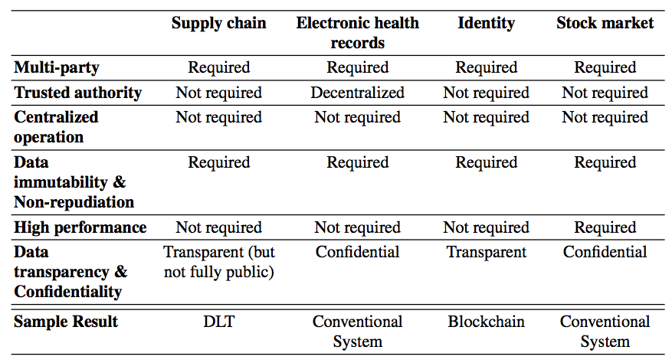
Use Case 1: Electronic Health Records 2/3
No low latency updates
Most records do not change often
Large diagnostic image needs to be managed
Due to privacy constraints, blockchain can not used to store patient records, even in encrypted form
Conventional systems are used
Blockchain provides auxiliary service
Keep audit logs of accesses made to HER
Notes:
EHRs do not typically need very low latency updates, and most patients’ records do not change often
Sometimes large diagnostic image information needs to be managed for an EHR.
Due to the privacy constraint, blockchain can not used to store patient records, even in encrypted form
Instead, conventional systems can be used, while blockchain can provide auxiliary service.
One example is the use of blockchains to keep audit logs of accesses made to EHRs. Records in these audit logs are typically encrypted or hashed to maintain patient privacy.

Slide 28

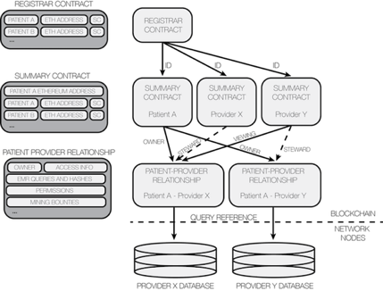
Use Case 1: Electronic Health Records 3/3
Initiative to explore on blockchain architecture in contributing to secure and interoperable EHRs system
MedRec 2.0: Improve scalability
Bypass the blockchain for patient notification
Restrict blockchain storage to creation and modification of identities and relationships
Notes:
https://medrec.media.mit.edu/technical/
MedRec: Initiative to explore on blockchain architecture in contributing to secure and interoperable EHRs system
stores a pointer to patients’ data in the blockchain and allow patients to choose when and with whom to share their data.
Three contracts: registrar contract, summary contract and patient provider relationship
Registrar maps participant’s ID (patient, provider or insurer) to their Ethereum address identity
Summary contract stores a list of relationships between a specific participant and others.
Patient provider relationship contract link two nodes in the system, one node stores and manages medical records for the other.
Smart contracts are used to provide pointers: the database queries return the records are handled off-chain.
The second version MedRc 2.0 improves the scalability. The design of MedRec bypasses the blockchain for patient notification, and restricts blockchain storage to creation and mortification of identifities and relationships.

Slide 29
Use Case 2: Identity Management 1/2
Individuals, organizations, devices and assets can be identified by many schemes
Passport, wedding certificates, serial number, registration certificate
Conventionally, the operations are centralized
Managed by a trusted authority
Set permissions and role for users to ensure they only access parts of the system relevant to them
Integrity is critical
Complicated authorization
Requirement for delegated authorization
Requirement for dynamic revocation of authorizations
Logs of system accesses are required to be able to audit
Read accesses can be frequent, updates to information are less frequent
Some delay in propagating updates is acceptable
Notes:
The second use case is identity management
Individuals, organizations, devices and assets can be identified by many schemes, including passport, wedding certificates, serial number, registration certificate
Identity management underlies most business and social interactions.
Identity Management system (IDM) manages user identities within an enterprise system.
Conventionally, the operations of such a system are centralized and managed by a trusted authority that set permissions and role for users to ensure they only access parts of the system relevant to them.
Integrity is critical for IDM, to allow only authorised updates to users and their authorisations.
Authorisatiosn can be complicated by requirements for delegated authorisation, and by requirements to enable dynamic revocation of authorisations.
Read accesses to an IDM can be frequent, to confirm authorised access, but updates to information in an IDM are normally much less frequent.
It is often acceptable for there to be some delay in propagating updates to information about user identities and their authorisations.
Despite the fact that most current blockchains’ performance does not match that of existing systems,
It can still be viable to implement IDMs on blockchain because most operations require read accesses, which can have low latency for blockchains.

Slide 30



Use Case 2: Identity Management 2/2
Blockchain allows the roles, permission and privilege of users to be verified by the distributed peers
Remove the centralized administrator
Remove the centralized database
Ensure integrity of user identities, roles, and authorization
Privacy is critical
Plaintext identity information is kept off-chain or encrypted on-chain
Notes:
Blockchain allows the roles, permission and privilege of users to be verified by the distributed peers
This removes the need for a centralized administrator and centralized database. Data on blockchain is transparent to everyone on the network by default.
IDMs on a blockchain ensure that user identities, roles and authorization will not be altered improperly.
Privacy is a critical requirement for IDMs, and so plaint ext identity information for users is not normally stored directly on a blockchain.
Instead, that is either kept off-chain, or perhaps encrypted on-chain.
For any solution, a significant privacy concern for system designers must be the possibility of reidentification attacks that may allow identities to be inferred from meta-data or relationships stored on the blockchain.

Slide 31
Use Case 3: Stock Market 1/2
A place where stocks, bonds and securities are traded
Inherently involves multiple entities to issue and trade stocks
Conventionally implemented by a centrally-controlled and maintained register
Regulatory approval is required for the operation of stock market
Regulatory approval may be required for the trading of specific stocks
Stock market is a natural trusted authority
Integrity, immutability and non-repudiation is critical
Ensure high-value trades cannot be undone by either party
Transaction history is important in providing evidence for trades and current stock holdings
Typically have a high-volume, extremely low-latency price-setting mechanism
Settlement can have high throughput but does not have extreme latency
Notes:
The third use case is stock market, which is a place where stocks, bonds and securities are trades.
Stock Market inherently involves multiple entities to issue and trade stocks.
Conventionally stock market is implemented by a centrally-controlled and maintained register
In most jurisdictions, regulatory approval is required for the operation of stock market infrastructure,
and regulatory approval may be required for the trading of specific stocks.
In those contexts, the stock market is a natural trusted authority.
Integrity, immutability and non-repudiation is critical to ensure high-value trades cannot be undone by either party
Transaction history is important in providing evidence for trades and current stock holdings
Stock markets typically have a high-volume, extremely low-latency price-setting mechanism to match buyers and sellers.
However, stock markets typically settle trades (i.e. exchange the stocks and payment) at a later time.

Slide 32
Use Case 3: Stock Market 2/2
Blockchain allows settlement using peer confirmation
Remove the centralized operation and authority
Data transparency is an issue
All investors and market participants are exposed to blockchain participants
Data immutability is crucial
Ensures no successful transaction can be tampered with by anyone
Blockchain is not highly suitable for the operation of conventional regulated stock markets
Scalability issue
NASDAQ offers Linq ledger for registration and settlement or private securities
Notes:
Blockchain allows settlement using peer confirmation, Remove the centralized operation and authority
Data immutability is crucial to Ensures no successful transaction can be tampered with by anyone
Data transparency is an issue, All investors and market participants are exposed to blockchain participants
Even in a consortium blockchain between brokers this create a disadvantage to the investor and may be prohibited by a regulator.
Looking at the scalability of existing stock exchange, blockchain technology might not be suitable for this use case until the performance of blockchain can match up with current conventional technologies. Overall, blockchain is not highly suitable for the operation of conventional regulated stock markets.
Some blockchain solutions are being explored in this context. NASDAQ offers its Linq blockchain ledger for registration and settlement of private securities

Slide 33
Use Case 4: Supply Chain 1/3
A collection of processes involved in creating and distributing goods, from raw materials to completed products, through to consumers
Highly complex multi-party system
Farmers, factories, transport providers, and retailers
Operations are distributed and loosely coupled
Data transparency is desired by participants
Support logistics planning, and to identify and respond to problems
Controlled confidentiality is required
Related-party ledgers
Conventional information exchange + hashed information on blockchain
Transaction history and data immutability are desired to enable traceability back to the origin of goods
Control fraud and substitution
Notes:
The fourth use case is supply chain, which is a collection of processes involved in creating and distributing goods, from raw materials to completed products, through to consumers
Supply chains are normally highly complex multi-party systems, including Farmers, factories, transport providers, and retailers
The operations in a supply chain is typically distributed and loosely coupled.
Data transparency is desired by participants to support logistics planning, and to identify and respond to problems
Controlled confidentiality is required for open supply chain infrastructure,
and this could be supported by the use of related-party ledgers in distributed ledger systems,
combining conventional information exchange technologies with hashed information on blockchains to ensure integrity and authorisation.
Transaction history and data immutability are desired to enable traceability back to the origin of goods, which can be used to control fraud and substitution

Slide 34
Use Case 4: Supply Chain 2/3
The time taken in a supply chain is dominated by physical transportation and storage, which moderates demand for performance
Reasonably short latency is required at key points of hand-over of goods
Dynamic structure of business relationship and operation can be accommodated by blockchain network
Logically-centralized view of information supports demands for transparency
Notes:
The time taken in a supply chain is dominated by physical transportation and storage, which moderates demand for performance
Reasonably short latency is required at key points of hand-over of goods, but there is no requirement for extreme throughput or latency.
The complex, dynamic structure of business relationships and operations in a supply chain can be accommodated by the flexible structure of blockchain networks,
logically-centralised view of information provided by a blockchain supports many of the demands for transparency in a supply chain.

Slide 35
Use Case 4: Supply Chain 3/3
Example: First Guest Lecture
Notes:
The first guest lecture is an example of using blockchain in a food supply chain scenario.

Slide 36
Summary
Blockchain Suitability Evaluation Framework
4 Use Cases
Electronic health records
Identity
Stock market
Supply chain
Notes:
We will first learn an evaluation framework to assess suitability of using blockchain
The main aim of this suitability evaluation is to make sure only use blockchain where it makes sense.
As we learn earlier, blockchain provide fundamental properties with some technical limitations. Thus, blockchain cannot be used for all the use cases.
The suitability evaluation framework is essentially a flow with 6 main questions the developer or software architect needs to answer in order to decide whether or not to use blockchain according to the characteristics of the use case in hand.
Then we looked at 4 use cases that apply the suitability evaluation framework.

Slide 37
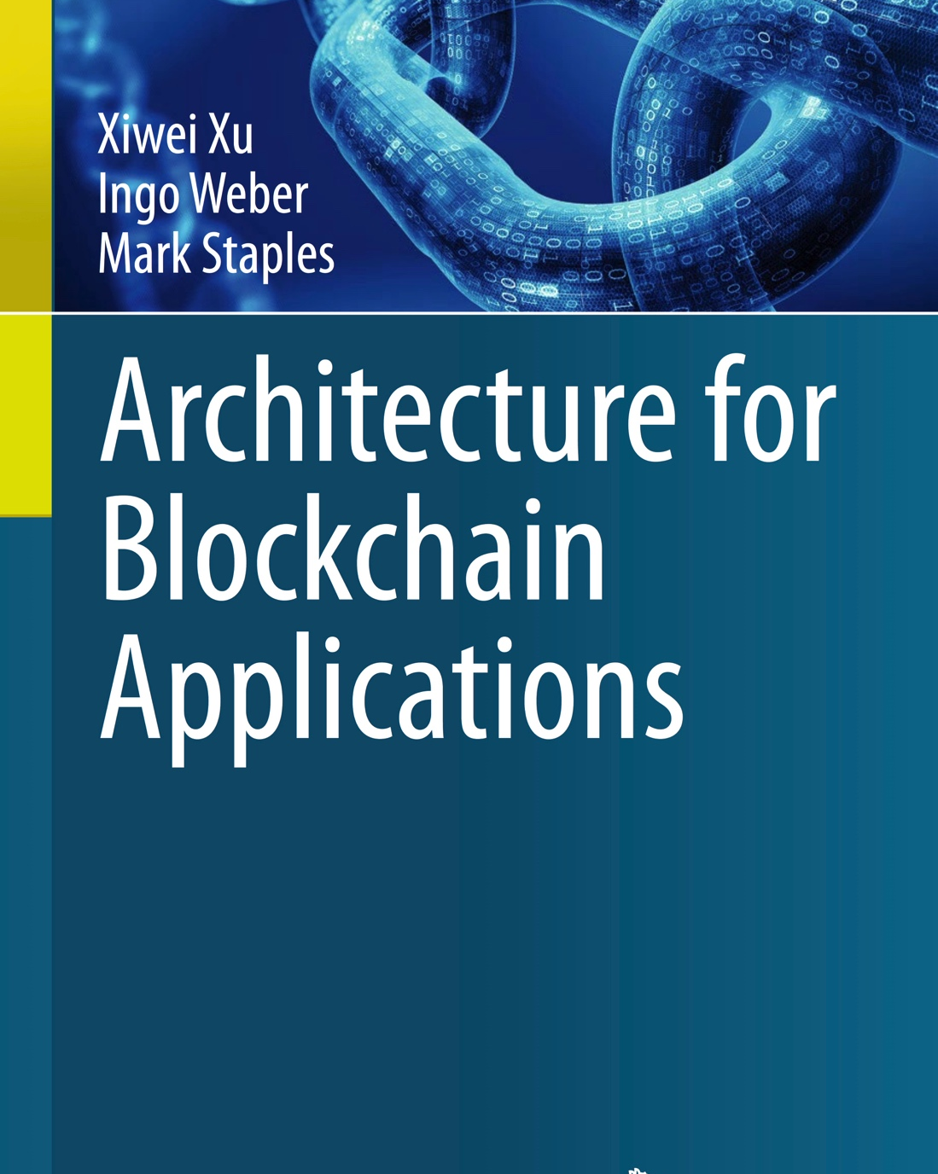
Thank You
Xiwei Xu | Senior Research Scientist
Architecture & Analytics Platforms (AAP) team
T +61 2 9490 5664
E xiwei.xu@data61.csiro.au
W www.data61.csiro.au/

