Slide 1
Smart Contract Testing
COMP6452 Software Architecture for Blockchain Applications
Dilum Bandara
| Research Scientist
| Architecture & Analytics Platforms (AAP) team
| Dilum.Bandara@data61.csiro.au
Notes:
In this class, we’ll discuss several SC testing techniques

Slide 2

Outline
Importance of testing
Types of testing
Common vulnerabilities & solutions
Tools & techniques

Slide 3
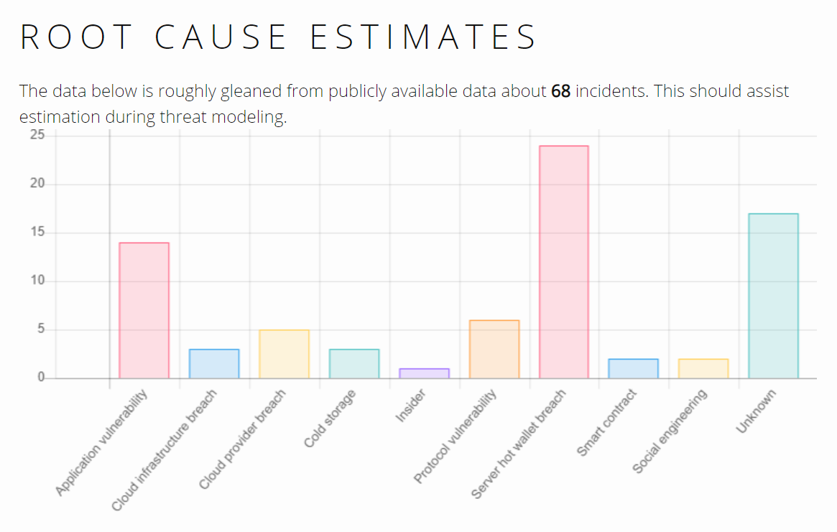
Failures in Blockchains are Catastrophic
Source: https://magoo.github.io/Blockchain-Graveyard/
Notes:
Failures in Blockchains are Permanent & Catastrophic
Here’s some statistics from a web site called Blockchain graveyard
We can see application vulnerabilities & how you manage keys are key sources of attacks
More frighteningly, we don’t even know what took place. Those are under “unknowns”
There are also issues around system-level vulnerabilities
To guard against these issues
First we need to be build secure software and infrastructure
Then we should test them

Slide 4
Test Scope of Blockchain-Based Applications
DApp architecture
Smart contract
Integration with external systems
Data management
Cryptography & Key management
Access control & KYC
Scalability & Performance
Infrastructure – especially for private & consortium chains
Blockchain platform
Smart contract language & Execution-environment
Privacy
Business continuity & Disaster recovery
Governance & compliance
Notes:
Therefore, to make sure a Blockchain-Based Application is secure we need a conduct a large set of tests
What specific tests and depth of testing can depend on the important of the application
Typically, final phase of testing is done by a 3rd party
Anyway, in this class we’ll focus mostly on smart contract testing
KYC – Know Your Customer

Slide 5
Types of Software Testing
Software Testing
Static
Byte code
Dynamic
White box
Black box
Source code
Notes:
There are several classifications of software testing. Here’s one way, that I would consider more relevant to SCs
Another form of classification is the functional & non-functional testing
Static testing - class of methods that examine the source code or bytecode of a contract without executing it
Source code – use code as it is. Typically IDEs (e.g., Remix) give various hints as you write code. Or evaluated at the time of compilation
Byte code – Use the compiled code, e.g., when multiple high-level languages can generate the same byte code
Dynamic testing - observe a contract while executing it in a test or production environment
White box testing – You know code or international functionality
Black box testing – Only ABI is available so you know the functions and parameters
Unit testing and integration testing are forms of dynamic testing as we execute the code

Slide 6
SC Testing Solution Space
Source: Di Angelo, M., & Salzer, G. (2019, April). A survey of tools for analyzing Ethereum smart contracts. In 2019 IEEE Int. Conf. on Decentralized Applications and Infrastructures (DAPPCON).
Notes:
Here’s a table from a survey of testing tools for Ethereum SCs
Each row is a tool
Columns are group based on their purpose of testing (or objective) whether the test is performed based on bytecode or source code.
Also, here we are most tests are based on static testing and dynamic testing tools are less
These 2 sets of columns capture the technique used by the tool
Some tools will translate or convert either byte or source code to another intermediate language that is easier to analyse using formal techniques
The paper is on Moodle. I would encourage your to have a look as it’s not very difficult to read

Slide 7
SC Security Testing Solutions
Source: Di Angelo, M., & Salzer, G. (2019, April).
Notes:
Here’s another table from the same survey paper, which focus specifically on SC security testing
It also split the testing based on the target, for e.g., whether it’s testing the BC platform, EVM, or the source code. Source code testing may actually happen at bytecode
You can see that Remix-IDE has a good coverage of tests.
However, this doesn’t mean that you are covered against all possible vulnerabilities or even more complex cases of these vulnerabilities. Hence, more detailed and wide-spread testing is needed

Slide 8
Common Vulnerabilities & Solutions
Notes:
Let’s focus a bit on some of the common vulnerabilities and hoe we can overcome them
We have already discussed a couple of these issues do different extent through the course

Slide 9
Known Issues/Vulnerabilities in SCs
Race conditions
Reentrancy
Cross-function race conditions
Deadlocks
Denial of Service (DoS)
Unexpected throw
Gas limit
SC calls & block
Arithmetic overflow/underflow
TX order dependence (front running)
Timestamp & block no dependence
Random no
Access control
Ability to call selfdestruct()
Bad error handling
Language-specific behaviour
In solidity SC owner is set at time of initialization
Depreciated functions
Short address attack in EVM
Call stack depth
Notes:
These are some of the well-know issues in SCs
A race condition occurs when more than one piece of code try to concurrently update a state. For e.g., we have seen re-entrancy attack
Today, we’ll also see how this occur across multiple functions. If you mess-up you may ended up with a deadlock too
Denial of Service is possible when you don’t properly handle errors or due to the block gas limit. We’ll talk about a few examples
Arithmetic overflow and underflow of variables in another problem
There can be unintended behaviour when your SC is sensitive to TX order. One such example is front running
We already talked about some issues around use of time
There can also be SC language specific issues, e.g., if you forget to set the owner of a SC. Also, use of depreciated functions is another problem, which can go unnoticed depending on the solidity compiler version you use
Also, there were specific issues related to how EVM handle certain addresses and limits on function depth
Now that you know these, you should definitely try to check for these. There can also be many others that are specific to a given SC. Hence, you need to check for those are well
Usually 3rd parties are used to perform last phase of testing

Slide 10
Single Function Reentrancy
mapping (address => uint) private userBalances;
function withdrawBalance() public {
uint amountToWithdraw = userBalances[msg.sender];
(bool success, ) = msg.sender.call.value(amountToWithdraw)("");
require(success);
userBalances[msg.sender] = 0;
}
Source: https://github.com/ConsenSys/smart-contract-best-practices/blob/master/docs/known_attacks.md
Notes:
This is an example of re-entrancy within a single function. We have already seen similar examples
We need to move userBalance set to zero before call.value
Also, we can use a withdraw function to get the receiver to pull the crypto

Slide 11
Cross Function Reentrancy
mapping (address => uint) private userBalances;
function transfer(address to, uint amount) {
if (userBalances[msg.sender] >= amount) {
userBalances[to] += amount;
userBalances[msg.sender] -= amount;
}
}
function withdrawBalance() public {
uint amountToWithdraw = userBalances[msg.sender];
(bool success, ) = msg.sender.call.value(amountToWithdraw)("");
require(success);
userBalances[msg.sender] = 0;
}
Source: https://github.com/ConsenSys/smart-contract-best-practices/blob/master/docs/known_attacks.md
Notes:
Here’s an example with 2 functions
In this example, re-entrancy can be used either to call transfer or withdraw functions
Same bug can occur across multiple contracts, if those contracts share state

Slide 12
Cross Function Reentrancy – Failure Case
mapping (address => uint) private userBalances;
mapping (address => bool) private claimedBonus;
mapping (address => uint) private rewardsForA;
function withdrawReward(address recipient) public {
uint amountToWithdraw = rewardsForA[recipient];
rewardsForA[recipient] = 0;
(bool success, ) = recipient.call.value(amountToWithdraw)("");
require(success);
}
function getFirstWithdrawalBonus(address recipient) public {
require(!claimedBonus[recipient]);
rewardsForA[recipient] += 100;
withdrawReward(recipient);
claimedBonus[recipient] = true;
}
Source: https://github.com/ConsenSys/smart-contract-best-practices/blob/master/docs/known_attacks.md
Notes:
Here’s another example where just setting balance won’t work
The withdrawReward function is fixed to overcome re-entrancy issue
However, it can be called within getFirstWithdrawalBonus function, where for the 1st withdrawal you get a bonus
While call.value is pending you can call getFirstWithdrawalBonus function
In this case, becalling withdraw function claimedBonus need to be set to True
Potential solutions
Use a mutex
Use withdraw function

Slide 13
Front-Running
All TXs are visible while they wait in TX pool (aka., mempool)
Waiting time vary from seconds to hours
An adversary can issue a TX with much higher gas price
Displacement – Bidding, crypto exchanges, registering a domain name
Insertion – Seeing a buy order, buy first & sell immediately at a higher price
Suppression – Slowing others down
Solutions
Restructure SC such that order or time is a not a factor that determines outcome
Commit & reveal, e.g., hashlock
Zero-knowledge protocols
Notes:
This issue occur as all TXs are visible to anyone while they await in the TX pool
Waiting time could vary from a few seconds to many hours. In the mean time, others can see what your TX is planning to do & adapt their TXs
An adversary has a good chance of getting his/her TX included before your TX, if they offer to pay a higher gas price than you
There are several scenarios here
In displace the adversary replace your TX with his/her TX by out bidding you. This can be a problem in bidding, crypt exchanges (particular distributed ones), and registering for resources like Domain names
In insertion, adversary inset one or more TXs before your TXs. For e.g., knowing that you are interested in buying something they can buy that first and immediately sell it to you at a profit
In suppression, adversary’s objective is to slow you down. They can do by submitting large & high fee paying TXs
Potential solutions include
Modifying your SC such that it doesn’t depend on order or time of TXs. This is not always possible
In such cases you can use solutions like commit and reversal or even zero-knowledge proofs. Idea is to hide sensitive information until desired result is achived. For e.g., you may commit to buy something at a set price. Based on this you send a hash value. Later revealing actual price such that SC can check with previous hash

Slide 14
Arithmetic Overflow/Underflow
mapping (address => uint256) public balanceOf;
function transfer(address _to, uint256 _value) {
require(balanceOf[msg.sender] >= _value);
balanceOf[msg.sender] -= _value;
balanceOf[_to] += _value;
}
Another solution is to use SafeMath.sol library
function transfer(address _to, uint256 _value) {
require(balanceOf[msg.sender] >= _value &&
balanceOf[_to] + _value >= balanceOf[_to]);
balanceOf[msg.sender] -= _value;
balanceOf[_to] += _value;
}
Source: https://github.com/ConsenSys/smart-contract-best-practices/blob/master/docs/known_attacks.md
Notes:
This is usual cases of over or under flowing a variable.
Also be aware this can happen with ++, --, *, /, and bit shift operations
Be careful with the smaller data-types like uint8, uint16, uint24...etc: they can even more easily hit their maximum value.
Solution is to check if sender has balance and for overflows
Another solution is to rely on a library like SafeMath that perform these checks for you

Slide 15
Timestamp Dependence
Miner can manipulate block timestamp to some extent
Inter-block time can substantially vary
Should not use block.timestamp or block.number x 14 sec
Solutions
Design SC to not rely on time
Even block.number isn’t future proof
Use oracle as a time source
Notes:
It is unsafe to decide the execution of your SC based on time as miner can manipulate block timestamp to some extent
If the reword of manipulating time is high miners may even put additional computing power to set timestamp to a value favourable to the miner
Also, estimating time based on inter-block time is risky
Hence, it’s not a good ides to use either block.timestamp or even block.number x 14 (14 is ave of 13 & 15)
Best solution is not to rely on time
Even block.number is not very future safe to guard against significant change in mining difficulty or inter-block time. For e.g., say Ethereum suddenly decide to reduce inter-block time to 5 sec
Another option is to rely on an externa time source via an Oracle. This way we can rely on physical time. Of course we are trusting the oracle

Slide 16
Denial of Service (DoS)
contract Auction {
address currentLeader;
uint highestBid;
function bid() payable {
require(msg.value > highestBid);
require(currentLeader.send(highestBid));
currentLeader = msg.sender;
highestBid = msg.value;
}
}
Source: https://github.com/ConsenSys/smart-contract-best-practices/blob/master/docs/known_attacks.md
Notes:
Your SC can get stuck due to a bug in code or some odd sequence of fun calls that you didn’t anticipate
Here’s a bidding SC that reflect previous highest bidder as soon a better bid arrives
Refund the old leader, if it fails then revert
Fallback function on old leader can be set to revert any payments
A malicious bidder can become the leader while making sure that any refunds to their address will always fail → That bidder will always be the highest bidder

Slide 17
DoS (Cont.)
address[] private refundAddresses;
mapping (address => uint) public refunds;
function refundAll() public {
for(uint x; x < refundAddresses.length; x++) {
require(refundAddresses[x].send(refunds[refundAddresses[x]]))
}
}
Solutions
Pull refund than push
Limit no of accounts
Break the loop into multiple TXs
Source: https://github.com/ConsenSys/smart-contract-best-practices/blob/master/docs/known_attacks.md
Notes:
Here’s another example that can go wrong in 2 ways
Because of the require statement, if one participant reject/fail, rest of the participants can’t get payout
Also, if payee list is too large, refundAll may not fit into block gas limit
Attacker cold also deposit small amounts from large number of accounts
Potential solutions include the use of withdraw function with pull
Also, we can prevent the use of large number of accounts by setting a limit of minimum amount or even limiting the no of accounts
We can also break the loop into multiple TXs, e.g., rather than refunding to 100 accounts, we can get someone to issue 10 TXs such that each TX refund to 10 accounts

Slide 18
Random Number Generation
Typical rand() won’t generate same random no across all blockchain nodes
Use of block.timestamp, block.number, block.difficulty, block.hash as random seed is predictable
Solutions
Use an oracle to provide random value
Using commitment scheme, e.g. RANDAO
Notes:
Random numbers are useful in many contracts, e.g., lottery and gambling contracts
We can’t use typical rand() functions as different nodes will generate different random values → TX fail to validate
While values like block.timestamp, block.number, block.difficulty, block.hash could be use to set the see for random no generation, they are predictable for an adversary
Even block.hash is known to some extend based on difficulty. So if stakes are high miners can look to benefit from this
One potential solution is to rely on an Oracle
Another is to use some external commit. For e.g., DAO has developed a scheme called RANDAO

Slide 19
Best Practices
Avoid external calls
Finish all internal work before making external calls
Favour pull over push – Let users withdraw funds
Use send() over call.value() – send() has a fixed gas limit of 2,300
Exception handling – Be aware of different function behaviour
Use libraries/languages that prevent overflow & underflow
Reuse well-tested code
Avoid multi-party contracts – One party may disappear
Explicitly set visibility of functions & variables
Keep fallback function simple
Upgradable contracts – No hardcoding of contract addresses
Rate limiting – No of calls & crypto
Notes:
Here are some of the best practices, some of which we have already seen as patterns
For e.g., upgradable contracts can be developed through proxy or SC registry
We also talked about speed bumps, rate limits, and balance limit as various from of limiting TXs

Slide 20
Question
Mark True or False for each the following statements
 | True | False
Blackbox testing use source code
Only way to guarantee no reentrancy is to use a mutex
Front running (i.e., TX order dependence) can be avoided by using an Oracle to provide the timestamp
One way to overcome DoS while performing multiple refunds is to get recipients to withdraw funds. This is same as breaking the refund loop to a size of one
✓
✓
✓
✓

Slide 21
Tools & Techniques

Slide 22
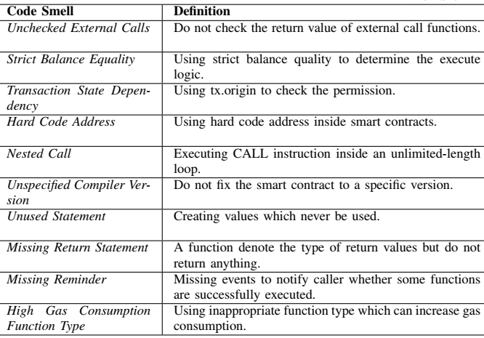
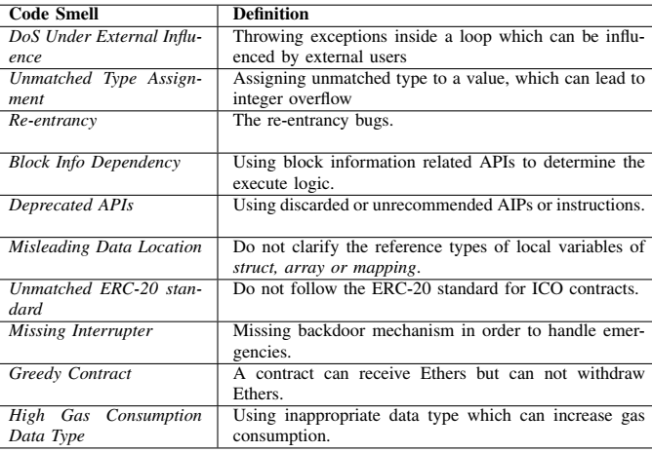
Code Smells^{[1]}
[1] Chen, Jiachi, Xin Xia, David Lo, John Grundy, Daniel Xiapu Luo, and Ting Chen. "Domain Specific Code Smells in Smart Contracts." arXiv preprint arXiv:1905.01467 (2019).
Notes:
Code smells are symptoms in source code that possibly indicate deeper problems
By detecting code smells we can try avoid potential bugs & improve the design of our code
For e.g., 1st one check whether we are validating return value for an external call. We have already seen this can become a problem when you try to send Ether to some account using a SC
Other e.g., include use of hard corded addresses, call in loops, high gas consuming functions, and reentrancy
Authors manually analysed SC-related posts from Stack Exchange & identified these 20 kinds of code smells
Those can be categorized as related to security, architecture, and usability problems
Authors then manually identified defined code smells in 587 contract accounts to validate the code smells
You should make sure your SC doesn’t have these issues

Slide 23
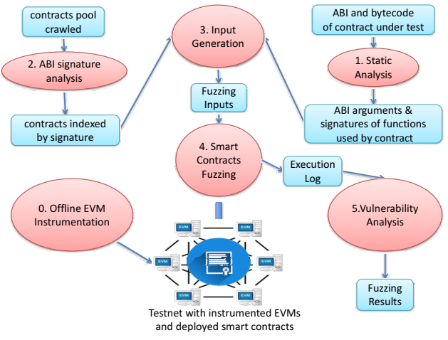
ContractFuzzer – Fuzzing SCs for Vulnerability Detection^{[2]}
Fuzz testing – Automated testing by providing invalid, unexpected, or random data as inputs
Set of test oracles
Gasless send
Exception disorder
Reentrancy
Timestamp dependency
Block no dependency
Dangerous delegate calls
Freezing Ether
[2] Jiang, Bo, Ye Liu, and W. K. Chan. "Contractfuzzer: Fuzzing smart contracts for vulnerability detection." In Proc. 33rd ACM/IEEE Intl. Conf. on Automated Software Engineering, pp. 259-269. ACM, 2018.
Notes:
Fuzzing or fuzz testing is an automated testing technique that gives invalid or random inputs to a program, and then monitor for exceptions such as crashes, failed assertions, or other potential issues.
Groups of such inputs are called test oracles.
ContractFuzzer generates fuzzing inputs based on the ABI specifications of a SC to detect security vulnerabilities
For e.g., in gasless send address.send() is called with value = 0
In exception disorder we check whether an exception is propagated through a chain of calls
Freezing Ether check for cases like calling selfdestruct without returning Ether
It also use EVM to log SC runtime behavior, and analyzes these logs to identify security vulnerabilities

Slide 24
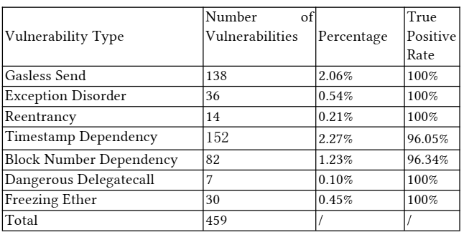
ContractFuzzer (Cont.)
Testing
With 6,991 smart contracts
Better performance than Oyente
Critique
+ Dynamic testing
- High rate of false negatives
- Depends on quality of test oracles
- Offline EVM
Notes:
Authors tested the tool using real SCs
Oyente is a popular & one of the oldest tools for SC testing
We can see that gasless send & timestamp dependence are not uncommon
This is a dynamic testing technique as the code is executed with fuzz inputs
Some of the negative aspects include high false negatives, which mean you can’t detect a vulnerability when it really exist
Also, effectiveness depends on quality of test oracles & you need a modified EVM

Slide 25
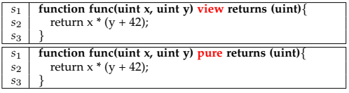
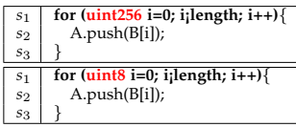
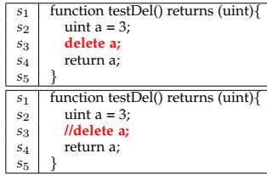
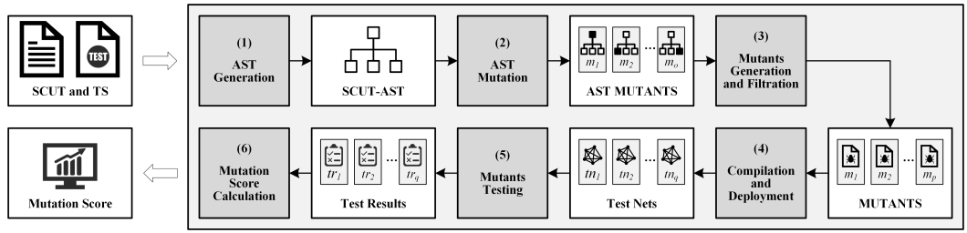
Mutation Testing for Ethereum^{[3]}
Mutation testing – Fault-based software testing technique
Used to evaluate the adequacy of test cases
[3] Wu, Haoran et al., "Mutation testing for Ethereum smart contract." arXiv preprint arXiv:1908.03707 (2019).
Notes:
Mutation testing is another software testing technique that try to introduce faults into code.
This can be used to evaluate the adequacy of test cases
For e.g., we replace keyword view with pure, which makes the function even more restrictive. This is called a mutant
Here we change uint256 to uint8. Also, delete is commented
Give a source code, authors generate an abstract syntax tree (AST) - AST is a tree representation of the abstract syntactic structure of source code. Then these types of mutations are introduced.
Based on that a different versions of the source code of SC are generated and then compiled
Each version is run on a test network and results are compared
If muted code does not fail & product the same result or original code, then there is a problem.

Slide 26
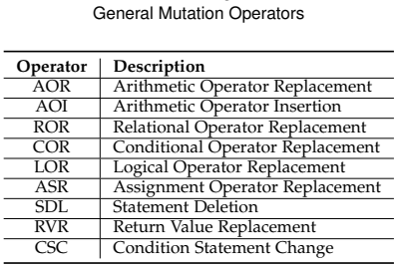
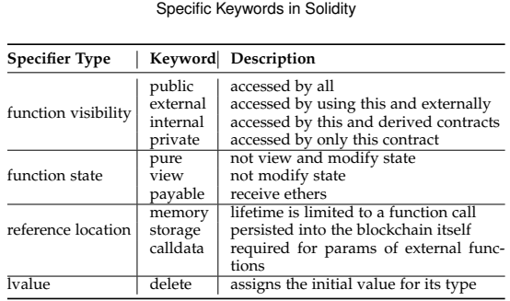
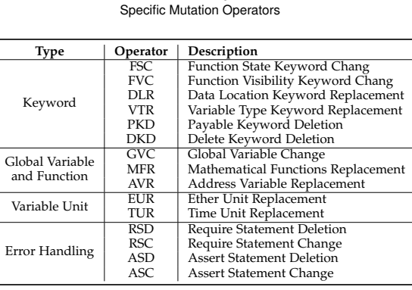
Mutation Testing (Cont.)
10 general mutation operations
15 SC-specific mutation operations
Mutation Score (MS) → Goodness of test coverage
Notes:
Authors proposed 15 mutation operators for Ethereum SCs in addition to 10 taken from typical software testing

Slide 27
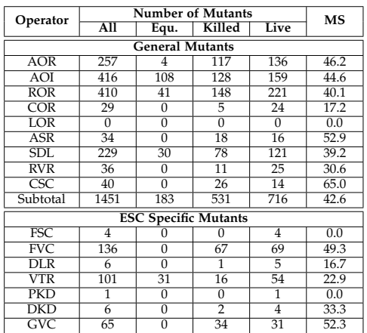
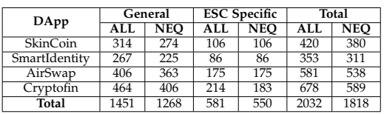
Mutation Testing (Cont.)
Critique
+ Works on SCs as they are small
+ Dynamic testing
- Too many false positives
- Too many cases to test
- Depends on mutation operators
Notes:
Approach was testing using 4 Ethereum DApps
They used both general & Ethereum specific mutations
2nd table depicts the numbers of all, equivalent, killed & live mutants. The last column depicts mutation score. Higher the score better
Overall result show that test coverage is not very good

Slide 28
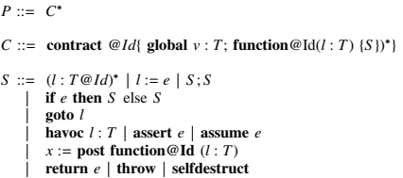
ZEUS – Analysing Safety of Smart Contracts^{[4]}
Automatic formal verification of SCs using abstract interpretation & symbolic model checking
Focuses on
Correctness – Safe programming practices
Fairness – Follow business logic
Technique
Policy builder
Abstract language to model smart contract behaviour
Source code translator
Solidity to LLVM bytecode
Add policy conditions as assert statements
Verifier
Check assertion violations
[4] Kalra, Sukrit et al., "ZEUS: Analyzing Safety of Smart Contracts." In Network and Distributed Systems Security (NDSS) Symposium, Feb. 2018.
Notes:
ZEUS is a tool by IBM that focus on automatic formal verification
ZEUS compare source code against its abstract representation
It focus on safe programming practices (correctness) and correctness of business logic implementation (fairness)
First you have to define the logic using policy build, which provide an abstract langue to model SC behaviour
Then translate the source code to an intermediate language called LLVM
Then compare policy conditions as violations of assert conditions in LLVM code

Slide 29
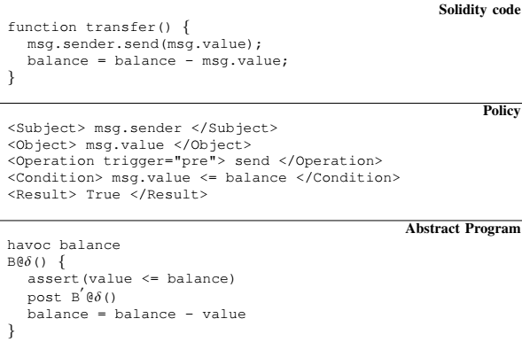
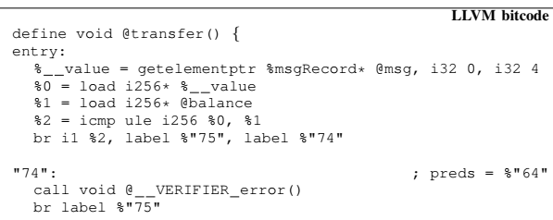
ZEUS (Cont.)
Performance
Tested with 1,524 unique contracts
Found 94.6% of them to be vulnerable
Test within seconds
No false negatives & few false positives
Critique
+ Static testing
- User needs to provide policy document
- Can check only for pre-coded issues
- CPU & memory expensive
- No multi-function/contract testing
Notes:
Found most SCs have known issues
Main issues is that a user needs to provide policy document

Slide 30
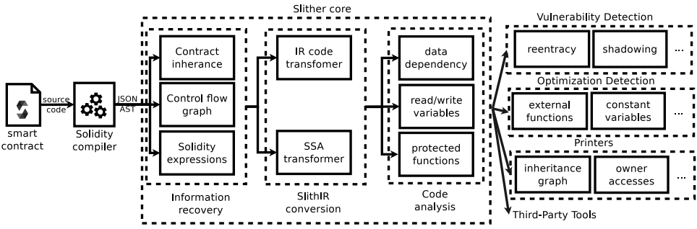
Slither – A Static Analysis Framework for SCs^{[5]}
Use an intermediate representation called Slither
Supports security testing, code optimization, review, & user understanding
[5] Feist, Josselin, Gustavo Grieco, and Alex Groce. "Slither: a static analysis framework for smart contracts." In 2019 IEEE/ACM 2nd Intl. Workshop on Emerging Trends in Software Engineering for Blockchain (WETSEB), pp. 8-15. IEEE, 2019.
Notes:
Slither is another static analysis tool
Given a complied SC, it transform the code and then perform various analysis on the transformed code
Based on this analysis, Slither can support security testing, code optimization, review, & user understanding
For e.g., it can check for re-entrancy, code optimizations, and provide various visualizations to understand code

Slide 31
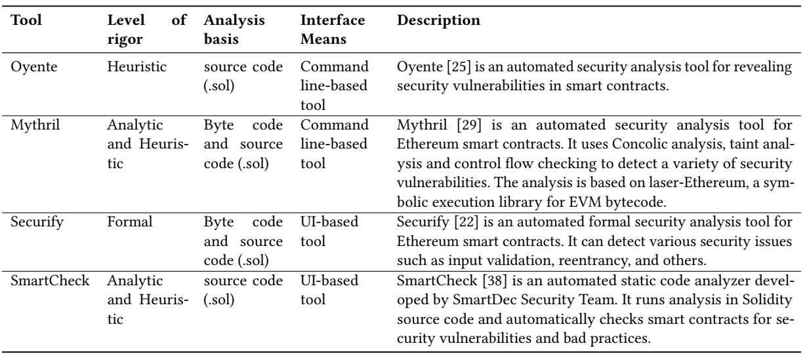
Other Tools^{[6]}
[6] Parizi, Reza M. et al., "Empirical vulnerability analysis of automated smart contracts security testing on blockchains." In Proc. 28th Annual Intl. Conf. on Computer Science and Software Engineering, pp. 103-113. IBM Corp., 2018.
Notes:
There are several other tools and Oyente and Myrhril are popular
All these are static analysis tools

Slide 32
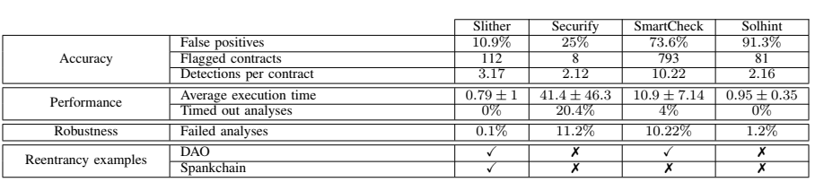
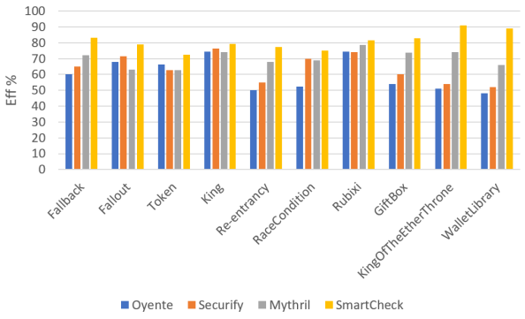
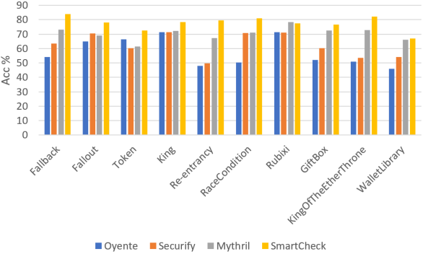
Other Tools – Effectiveness & Accuracy
Notes:
Here’s a comparison of 4 tools. We can see that false positives are generally high. Execution time is not bad Robustness is a measure of different SCs you can analyse
So tool that you chose also need to depend on your SC & type of analysis you want to perform
Here we look at 4 tools from previous slide in terms of their detection efficiency (ability to detect all vulnerabilities) and accuracy (are those actual vulnerabilities).
Oyente is one of the 1st tools and new tools are better

Slide 33
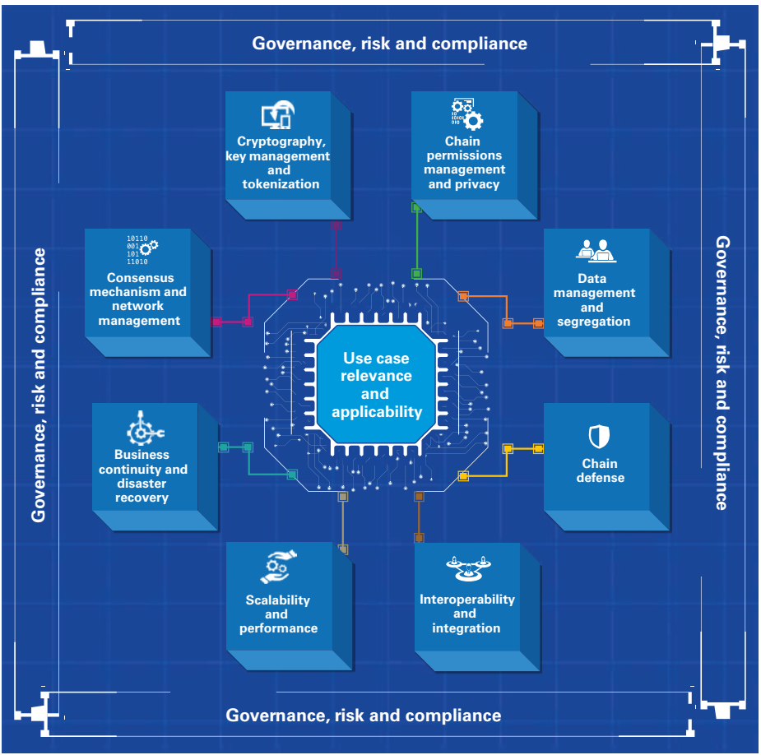
KPMG BC Risk Assessment Framework^{[7]}
Consensus & network management
Security & incentives
Cryptography & Key management
Generation, distribution, use, & revocation
Access control & privacy
Use case relevancy
Data management
On-chain vs. off-chain
Chain defence
Integration
Scalability & performance
Business continuity & DR
Certificate Authority (CA) & wallets
Governance & compliance
[7] KPMG International, Realizing Blockchains Potential, 2018
Notes:
KPMG BC risk assessment framework focus on an entire BC-based application
This is useful from both the design and testing

Slide 34
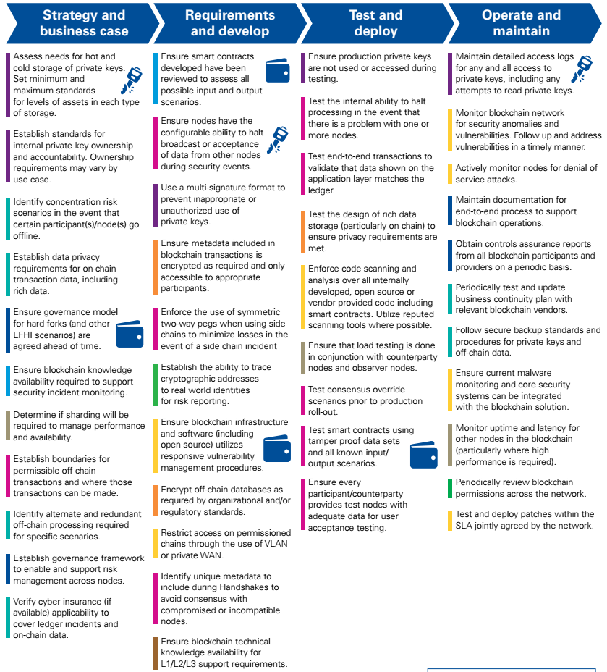
Applying KPMG Framework
[7] KPMG International, Realizing Blockchains Potential, 2018
Notes:
Here we see thing we need to consider from business case development to operation of a BC-based application
Most of these steps are common to any enterprise application. There’s are some specific steps related to BCs

Slide 35
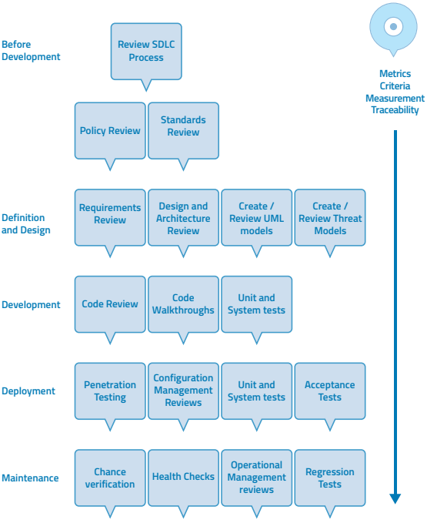
OWASP Testing Framework^{[8]}
Testing throughout SDLC
Manual inspection, threat modelling, code review, penetration testing
Identification of functional & non-functional security requirements
Details are more focused on penetration testing
Extensive set of test cases
Web-application specific
ISO/IEC 27034 cover some of the other aspects
[8] OWASP Testing Guide v4.0, 2014
Notes:
OWASP stands for Open Web Application Security Project
They provide a testing framework, as well as publish top 10 vulnerabilities in web applications, mobile apps, and IOT
OWASP is perhaps the most well-known and used testing framework
The testing framework applies throughout the SDLC (Software Development Life Cycle) and even how you conduct SDLC
These are set of actions or tests that you can perform along the SDLC
There’s some discussion on BC-specific OWASP, so maybe we’ll see something soon

Slide 36
Question
Which of the following statement(s) is True?
Code Smells is a form of automated testing that use invalid, unexpected, or random data as inputs
Mutation testing can detect vulnerabilities in our source code
We can certify a smart contract as secure if at least 2 testing tools didn't find any vulnerabilities
All tools contain false positives; hence, you need to manually verify whether a vulnerability really exist
X
X
X
✓
Notes:
Code smell are for programmers to avoid common pitfalls. Providing invalid, unexpected, or random data as inputs is fuzz testing
Mutation testing provide an idea of adequacy of test cases. It can’t detect actual issues
There can be false negatives. Also, no single tool can check for all possible vulnerabilities. More tools are better, but we can’t say 100% secure
Any tool will contain false positives. So we need to check whether the problem really exist

Slide 37
Summary
Many static analysis tools are available
Support for dynamic analysis is limited
Other limitations
Mainly support Solidity/Ethereum
Support for real-time debugging
https://www.trufflesuite.com/tutorials/debugging-a-smart-contract
Low effectiveness, accuracy, & vulnerability coverage
Multi-contract & multi-TX analysis
SC profiling & optimization
Test frameworks & test methodologies need to cover BC-specific aspects
Coverage of other test areas – platform, SCs
BC-specific threat modelling
Notes:
Many static analysis tools are available. However, there’s lost of opportunity to make them more useable and increase the types of issues they test against
Support for dynamic analysis is limited. Quite a lot of work can be done in this space including SC optimization to reduce gas consumption
Following are several other limitations
Tools mainly support Solidity/Ethereum. There is a need to extend them to enterprise blockchains such as Hyperledger
Support for real-time debugging is also limited. If you are into Ethereum https://www.trufflesuite.com/tutorials/debugging-a-smart-contract is a decent solution
Low effectiveness, accuracy, & vulnerability coverage need to addressed too
There’s little support for multiple SCs and multiple TXs working together
Another are of use is SC profiling & optimization, for e.g., in business process compliance management and optimization
Test frameworks & test methodologies need to cover BC-specific aspects. More work is needed in this area to cover other areas like BC platforms & SC specific aspects
BC-specific threat modelling which should be conducted even at architecture design stage

Slide 38
Course Outline – Next 2 Weeks
Week | Date | Lecturer | Lecture Topic | Relevant Book Chapters | Notes
7 | July 15 & 16 | Dilum | Security & Reliability | 11. Dependability and Security | Quiz 2
8 | July 22 & 23 | Helen | Model driven engineering Privacy Data Governance Data Management | 8. Model-driven Engineering for Applications on Blockchains (model-driven basics, UML)

