Slide 1
Prediction of Thermodynamic Properties of Superheated Steam
Bill Yan
Levi Cameron

Slide 2
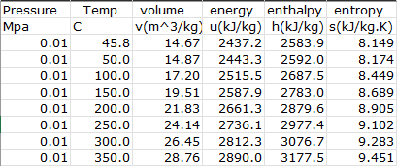
Problem description
Thermodynamic properties (TP) are state functions of a substance. Ex. pressure, temperature, enthalpy, entropy
Design of chemical processes requires accurate information on TP at operating conditions (temperature, pressure)
Traditional approach to obtain TP is to measure TP at a wide range of conditions, and linearly interpolate to get TP at desire conditions
First-principle approaches have been investigated based on equation of state (EOS), but the accuracies are far from being practical
An artificial neural network offers the possibility of cutting down storage without hurting accuracy

Slide 3
Method
Obtained dataset from NIST, with 1600 samples in total. 20% is held for testing
Normalized dataset before training to improve convergence
Coded linear interpolation method and Van der Waals EOS method for baseline comparison
Trained an MLPNN with (25, 10, 4) structure, and a tree regressor ensemble with 2 estimators each of depth 4.

Slide 4
Result

