Slide 1
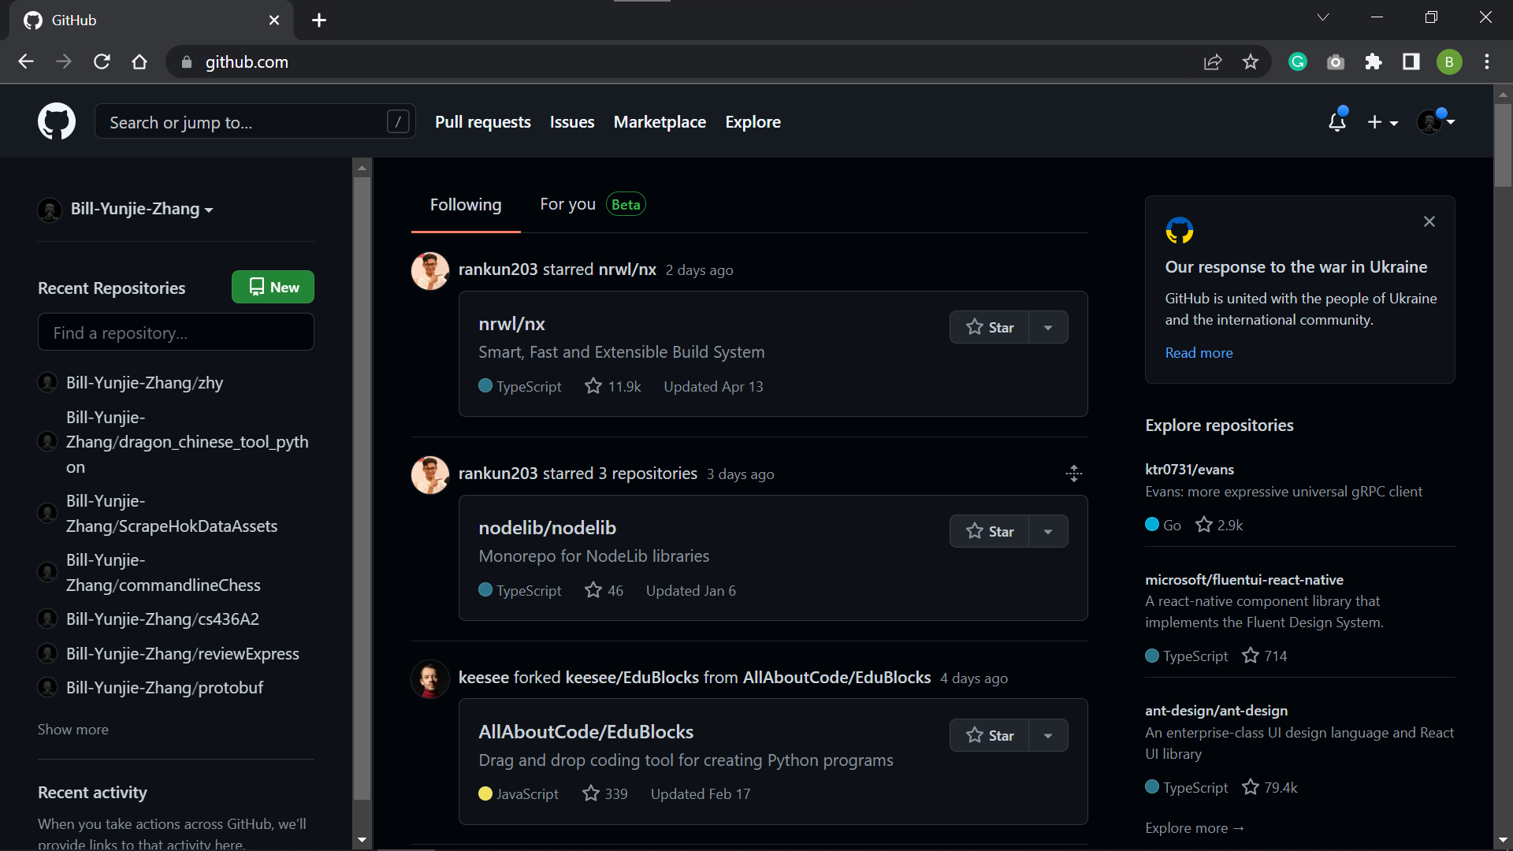
(1)
First, we go to github.com and get logged in.
(2)
Here are all your past repositories.
(3)
Click here to create a new repository
Click here to create a new repository

Slide 2
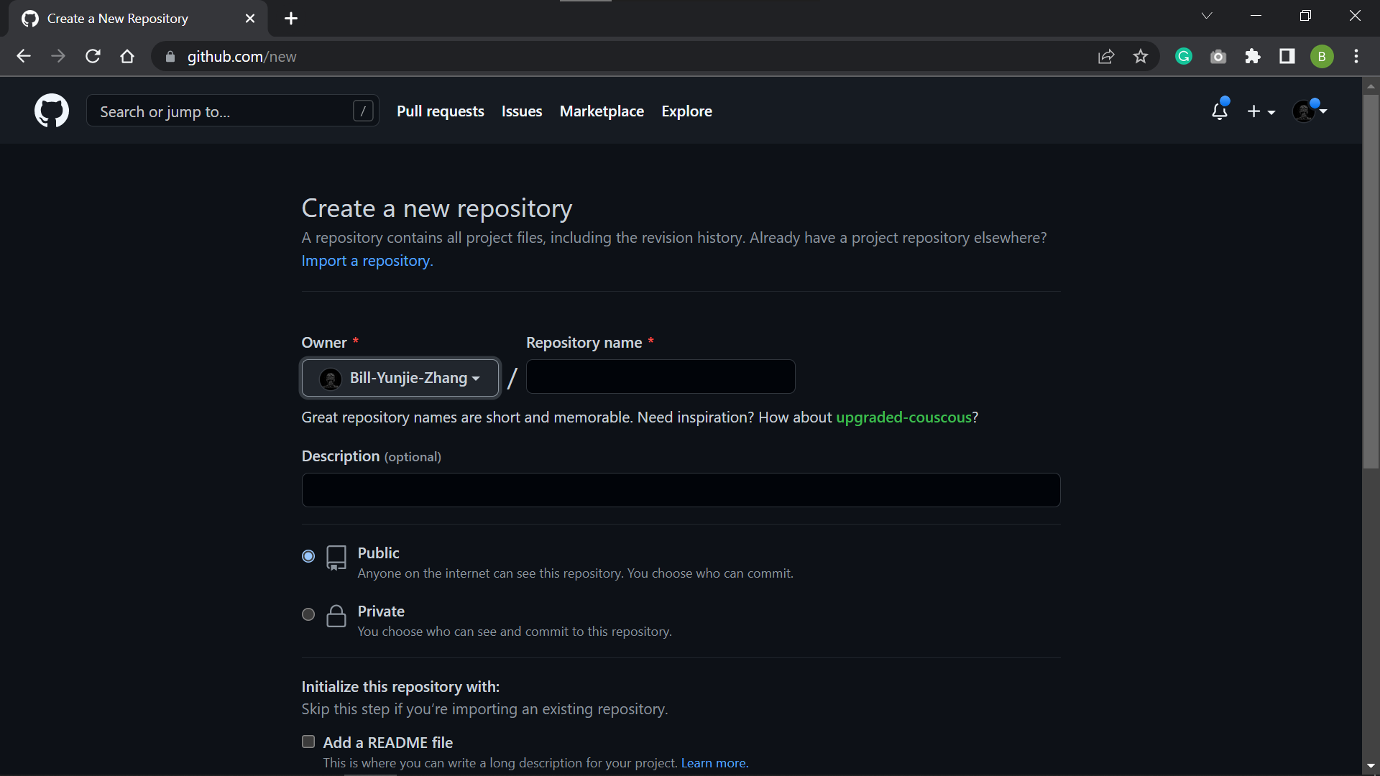
(1)
After you clicked new, you are going arrive at this page

Slide 3
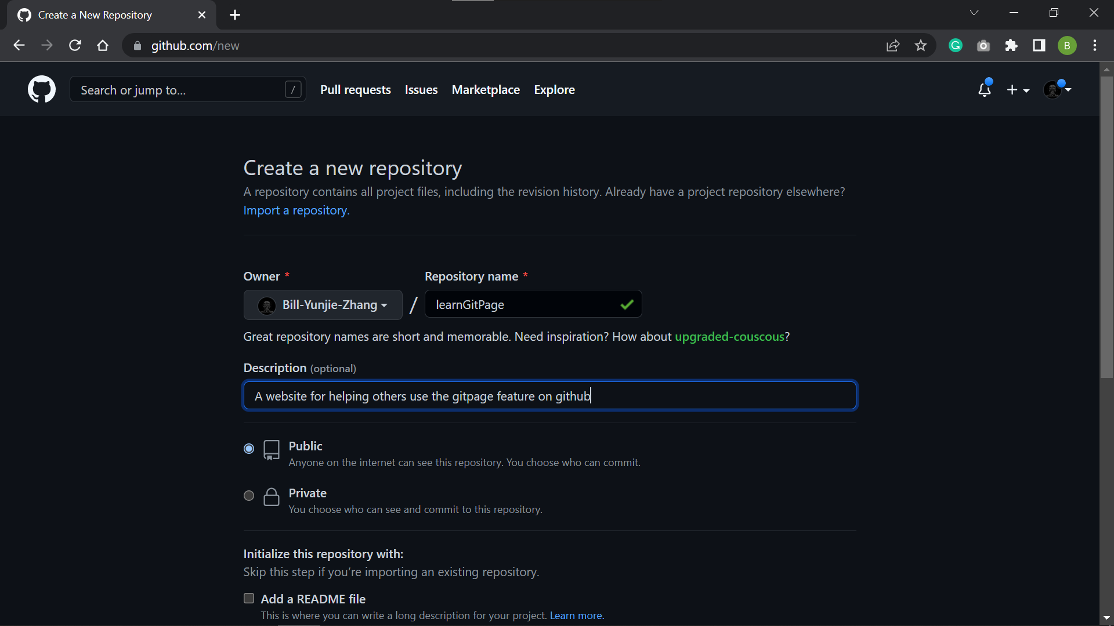
(1)
(2)
Name your repository whatever you like, but for the sake of demonstration, I’m going to name my repository “learnGitPage”.
You can provide some description about your repository here.

Slide 4
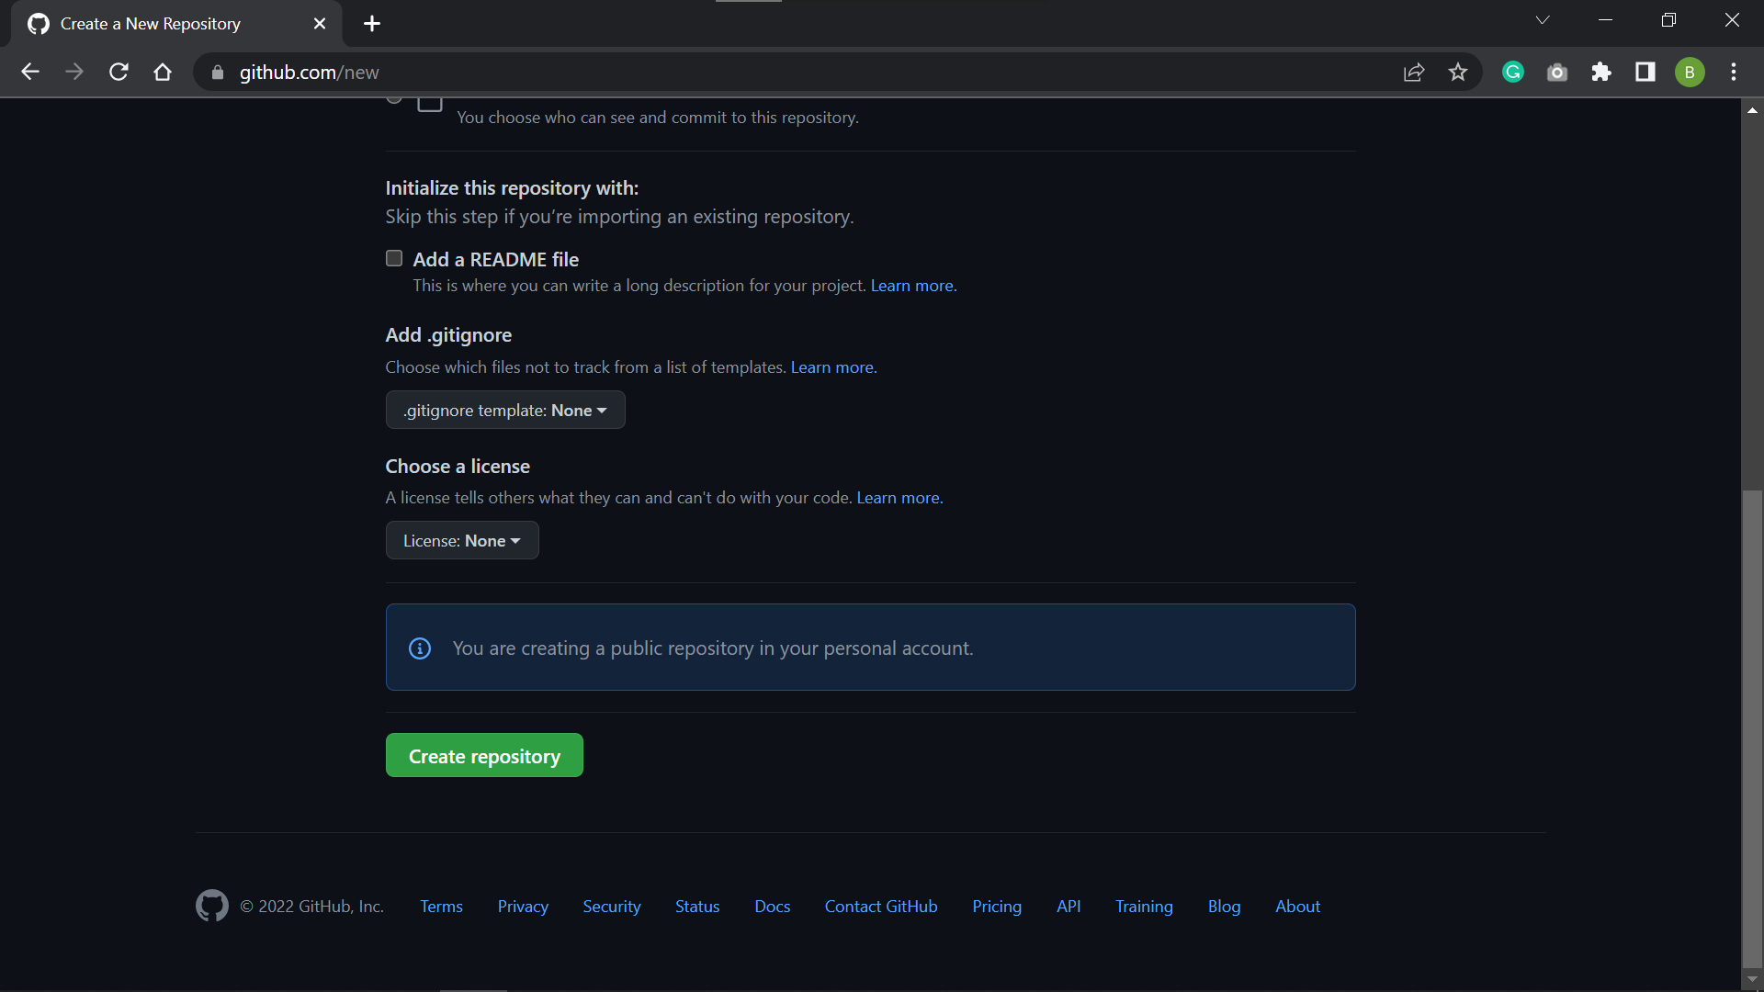
(1)
After you scroll down on the same page, click here to create the new repository!

Slide 5
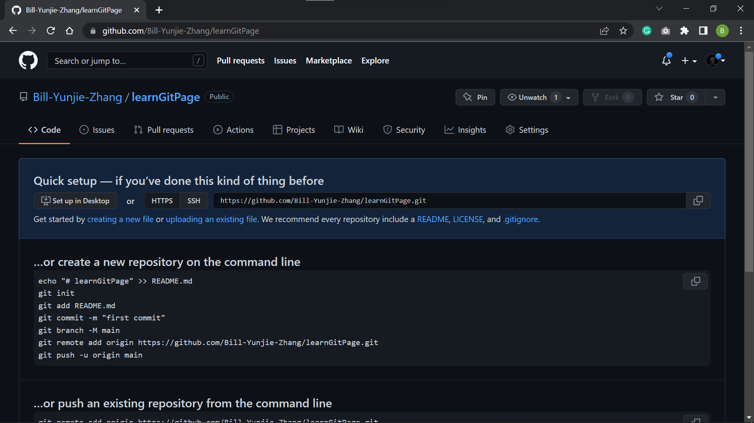
(1)
After you click the create repository button, you are going to arrive at this page.

Slide 6
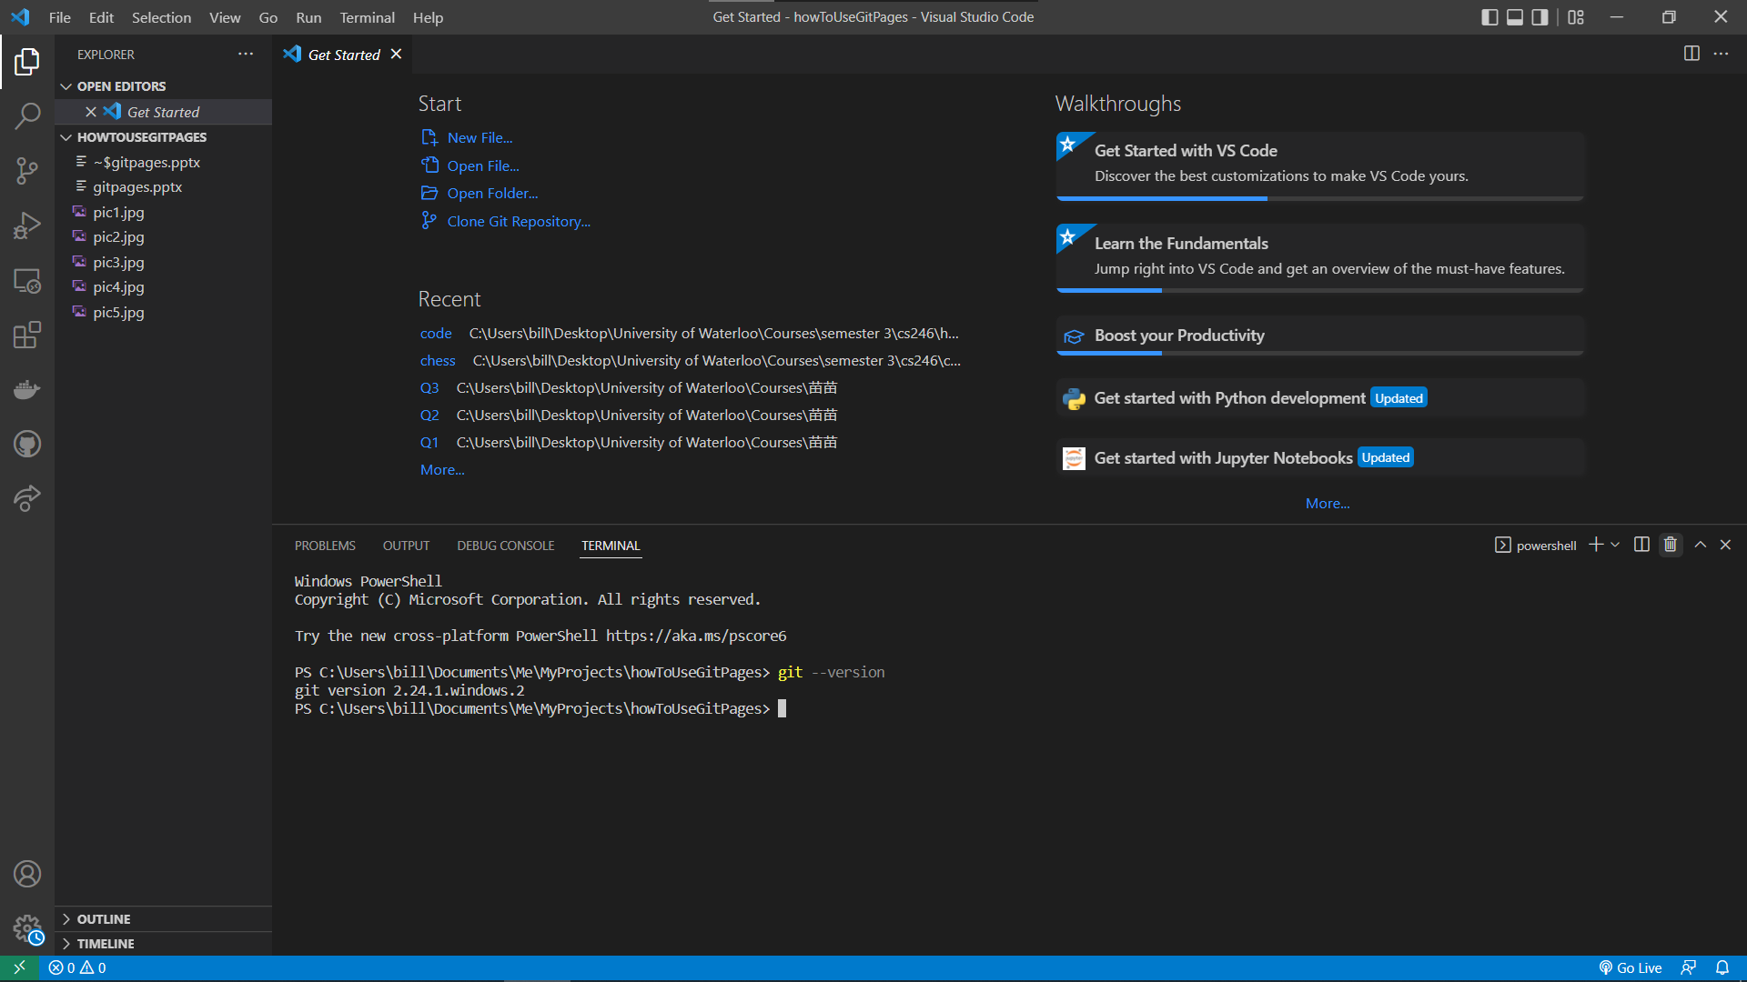
(1)
Now let’s make sure you have git installed using git –version.
(2)
If you do not have git pre-installed, go to this link:
https://git-scm.com/downloads.

Slide 7
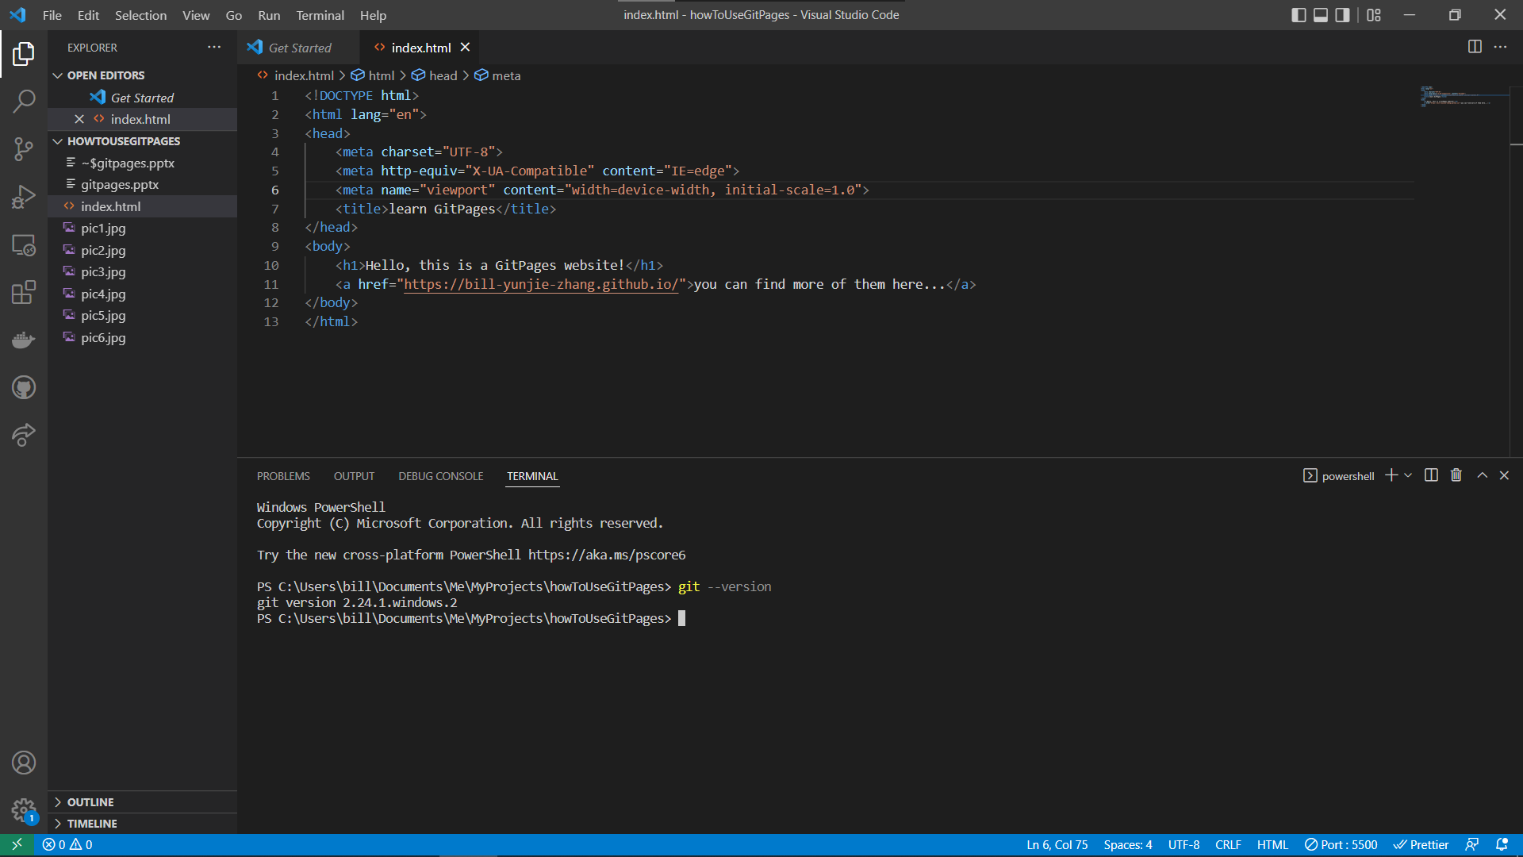
(1)
Create an html file for your website.

Slide 8
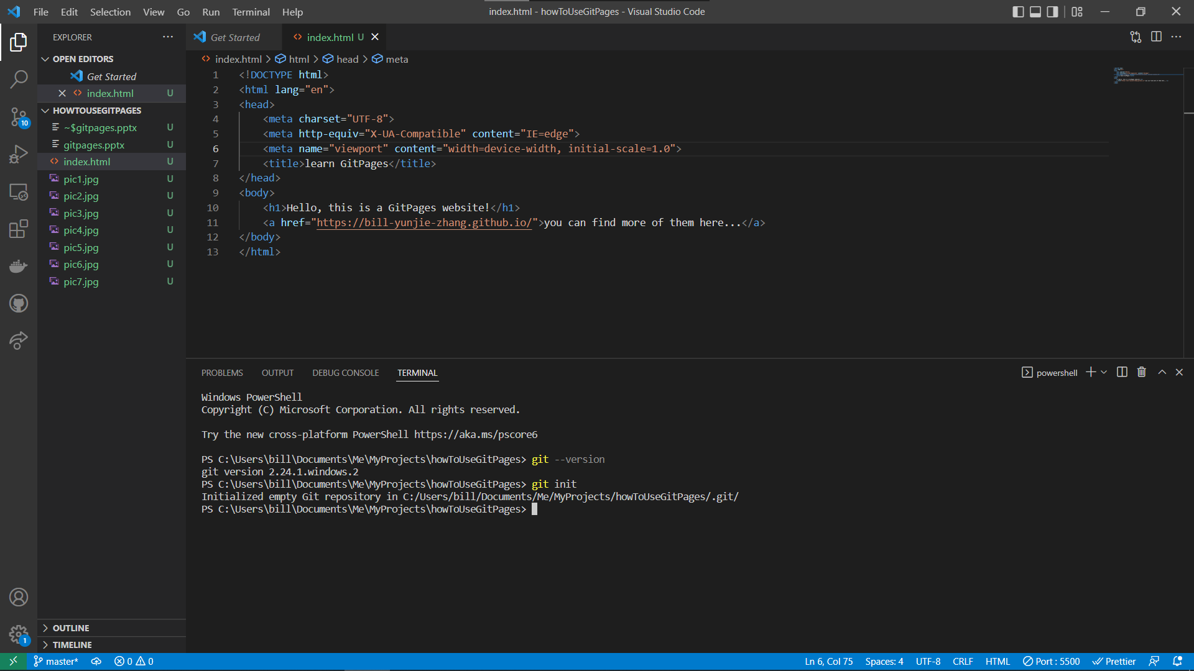
(2)
You are going to notice that all the files turned to green, and there’s a “10” here.
(1)
“git init” your directory
(3)
Green files means they have been changed.
The 10 in the blue circles indicates the total number of files changed.

Slide 9
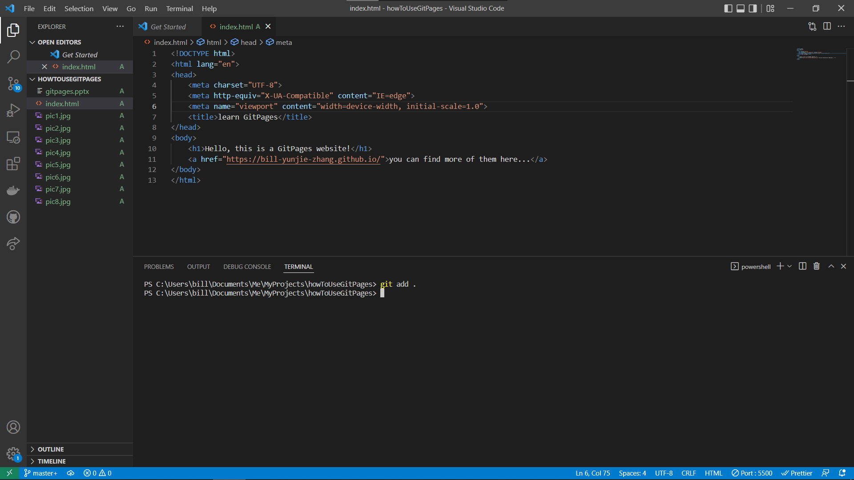
(1)
“git add .” adds all the files changed in the current directory.

Slide 10
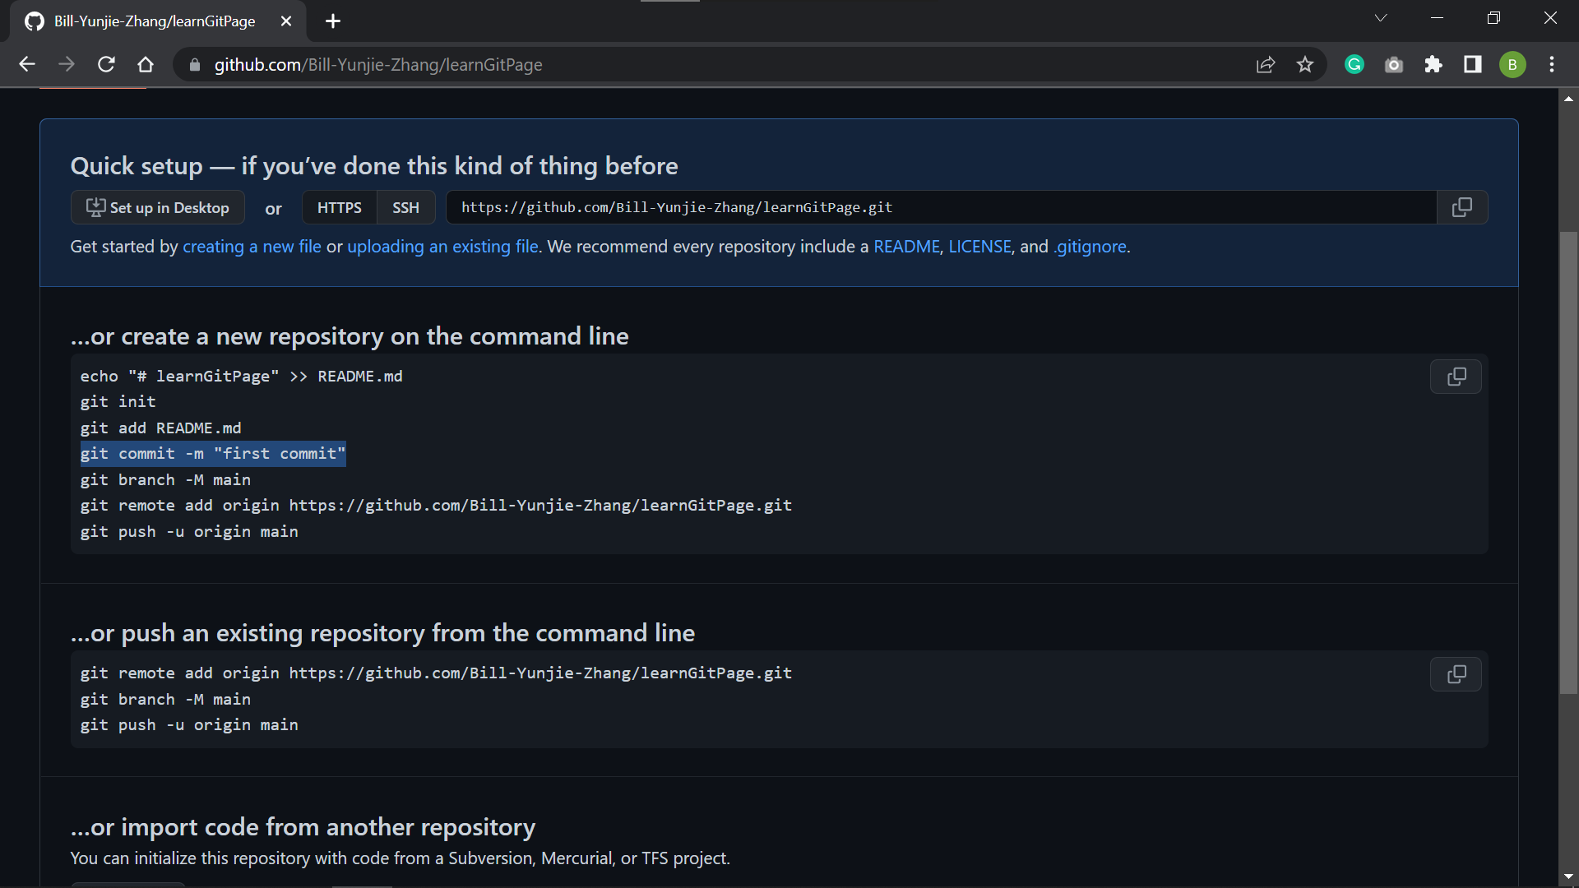
(1)
Let’s go back to our repository page on Github.
(2)
Copy this line

Slide 11
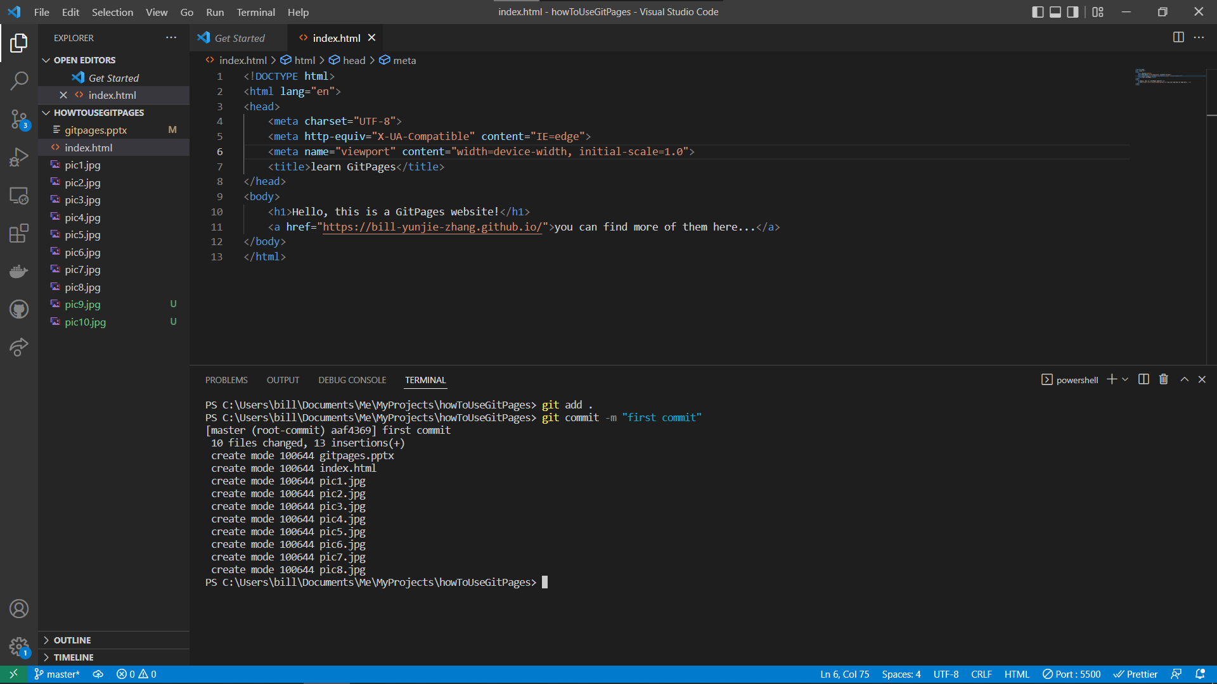
(1)
Paste it in your command-line and enter.
(2)
This commits all your files to local repository.

Slide 12
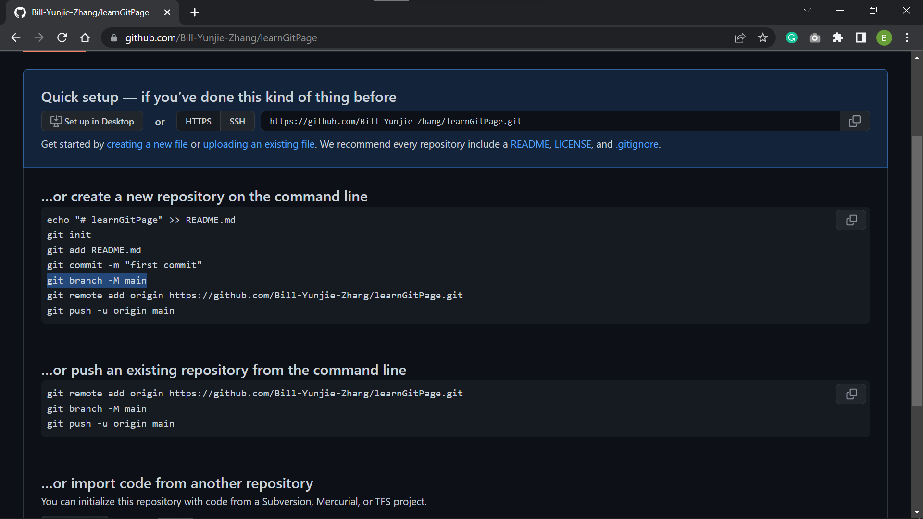
(2)
Copy this line

Slide 13
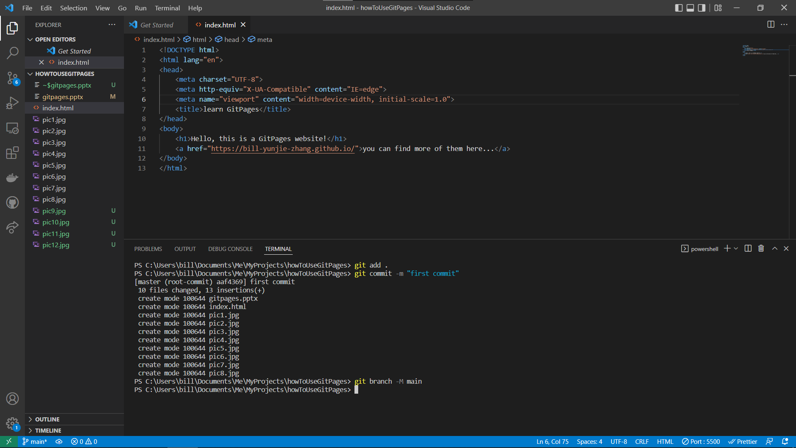
(1)
Paste it in your command-line and enter.
(2)
This indicate which branch your code is on.

Slide 14
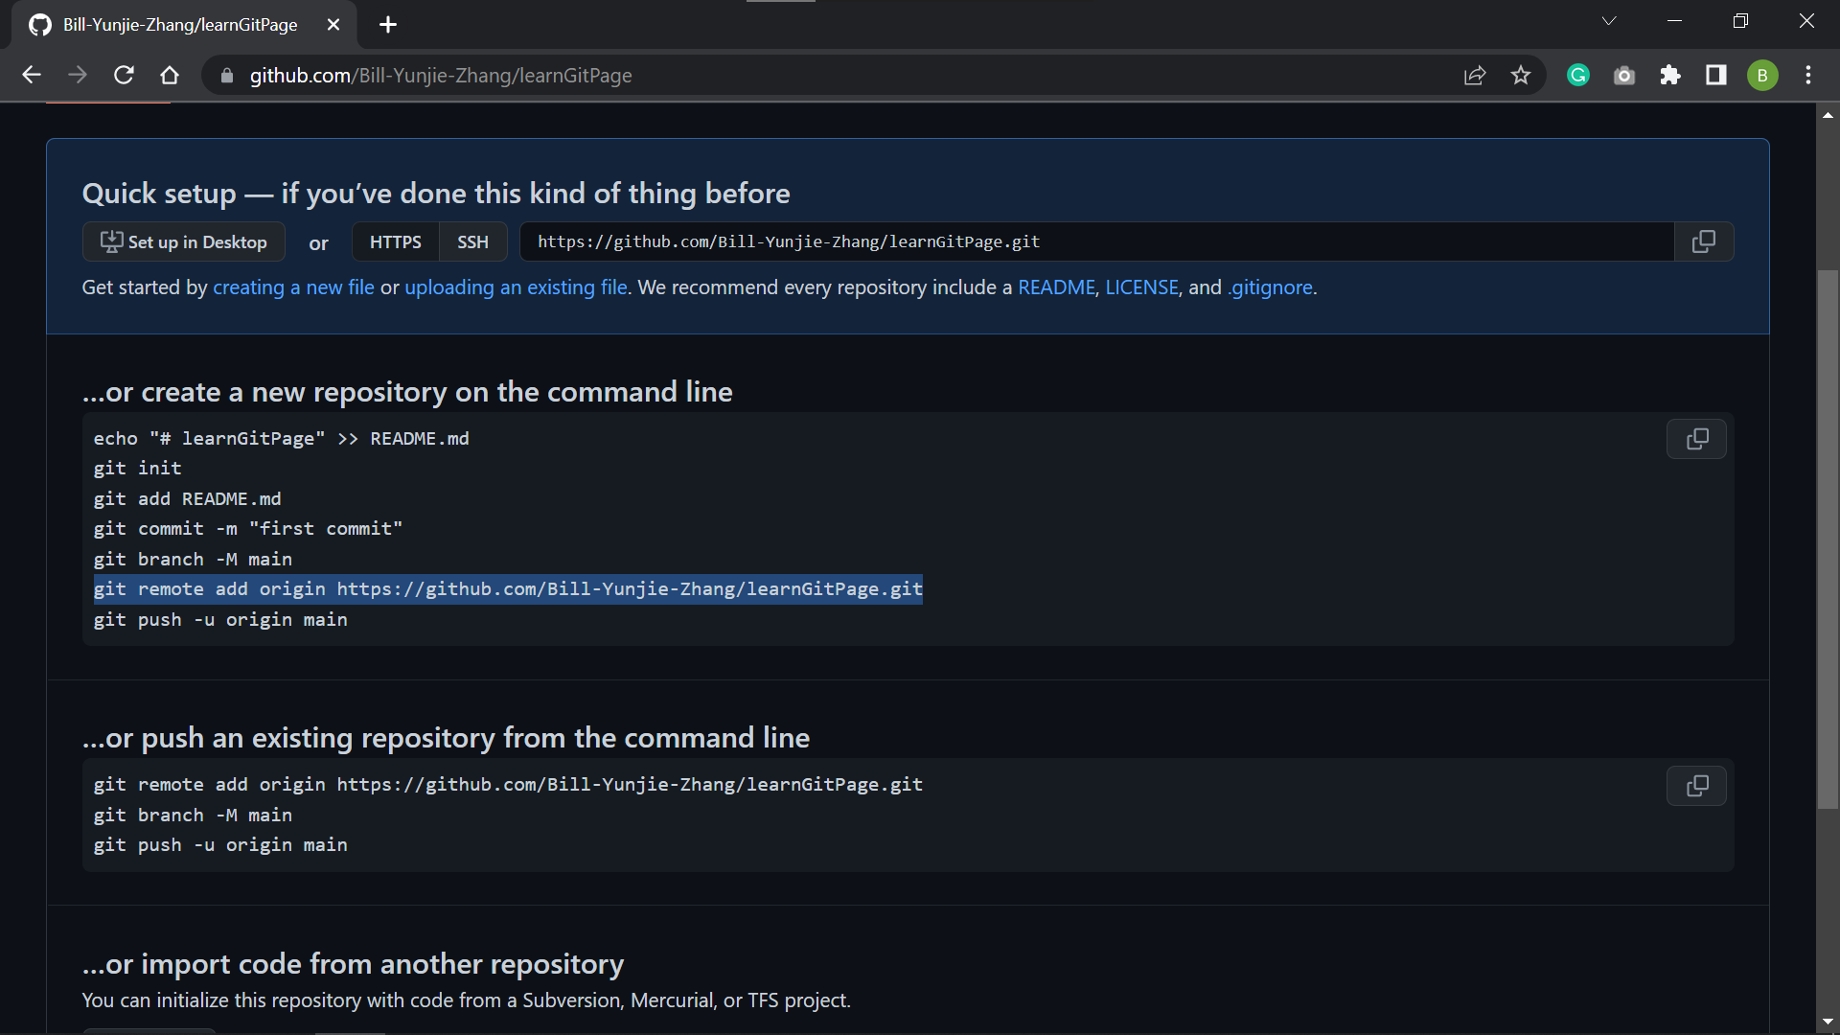
(2)
Copy this line

Slide 15
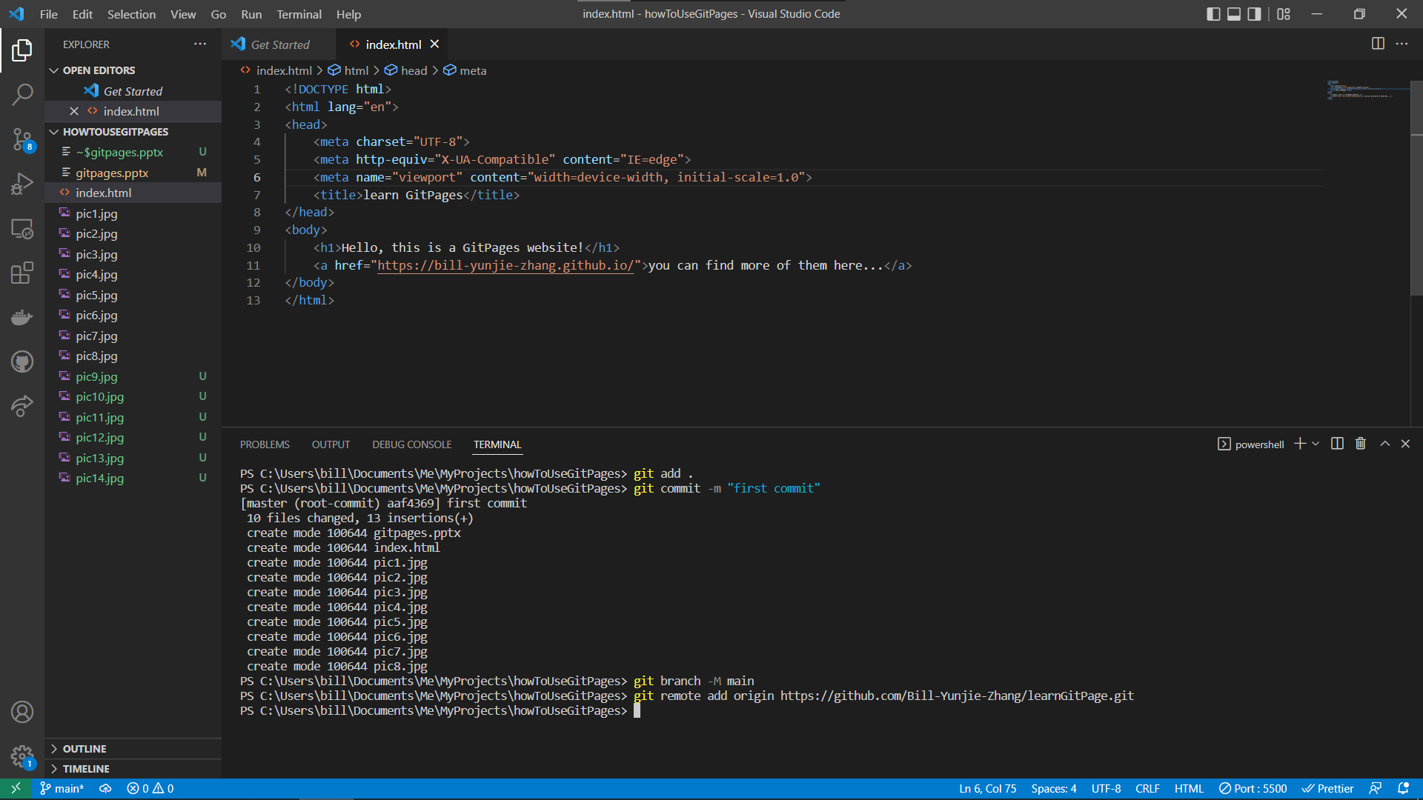
(1)
Paste it in your command-line and enter.
(2)
This links your local repository to Github repository.

Slide 16
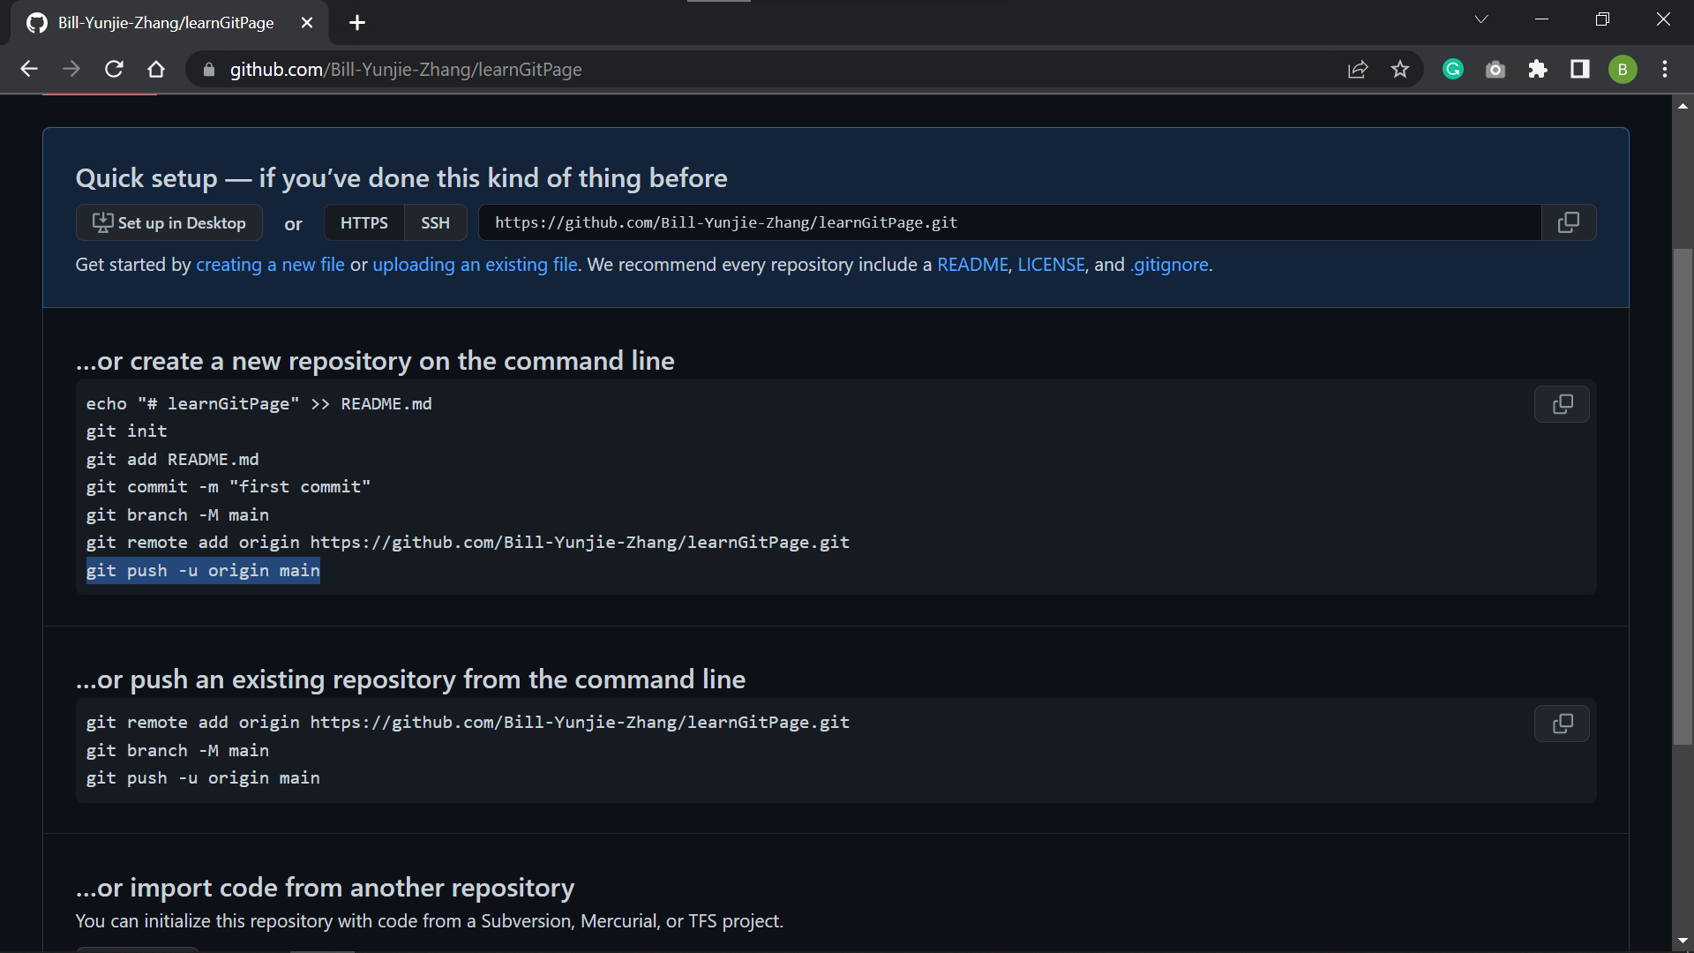
(2)
Copy this line

Slide 17
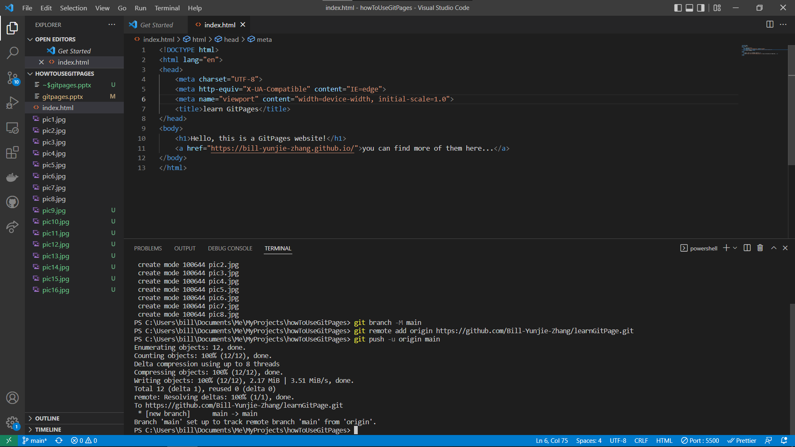
(1)
Paste it in your command-line and enter.
(2)
This pushes your local git repository to the one on Github.

Slide 18
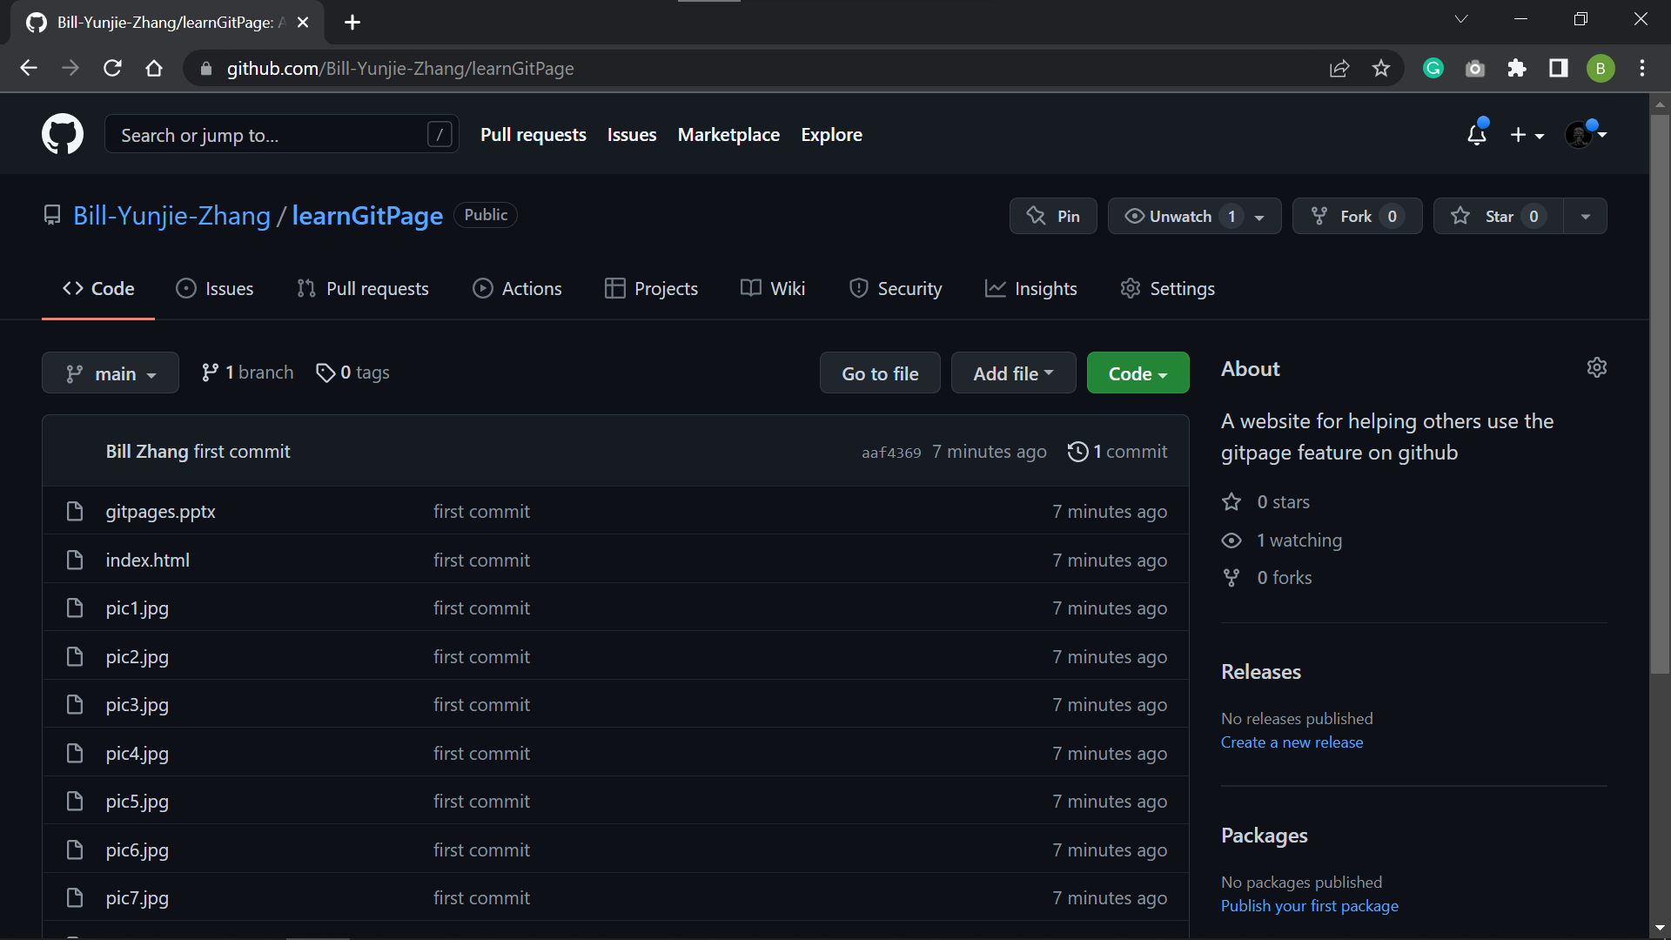
(1)
After you refreshed your repository page, you well be able to see all your local code and files have been uploaded.
(1)
Now click the Settings here.

Slide 19
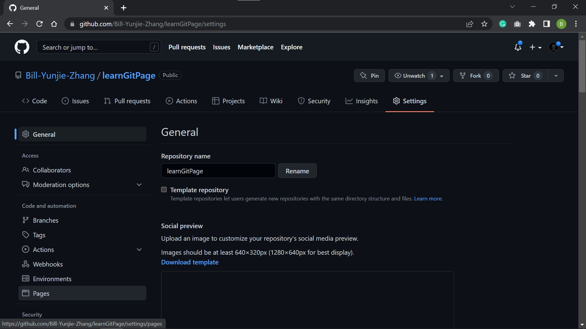
(1)
Now click here to the “Pages” section.

Slide 20
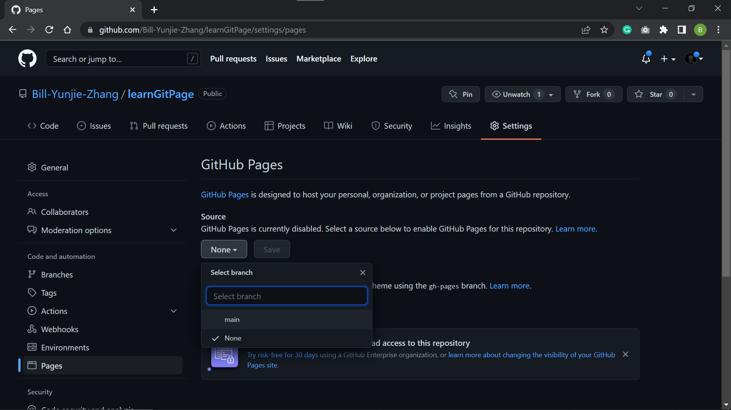
(1)
Now click here to select which branch of the repository to put on Gitpages.
(1)
Choose main branch as your Gitpages branch

Slide 21
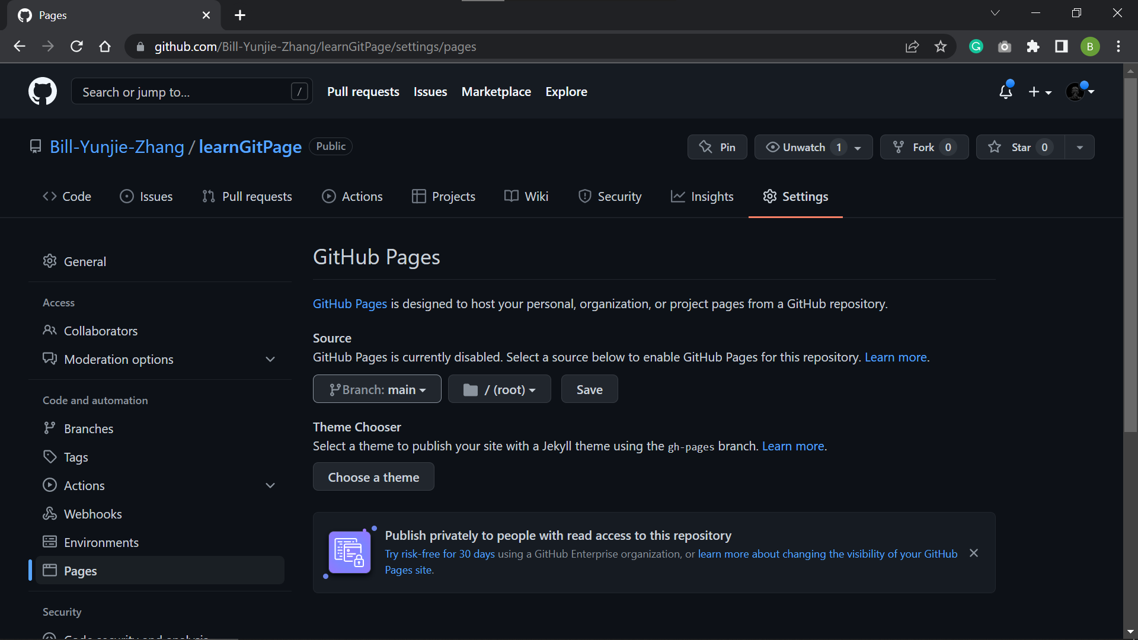
(1)
After you have selected your “main” branch, your page is going to look like this.

Slide 22
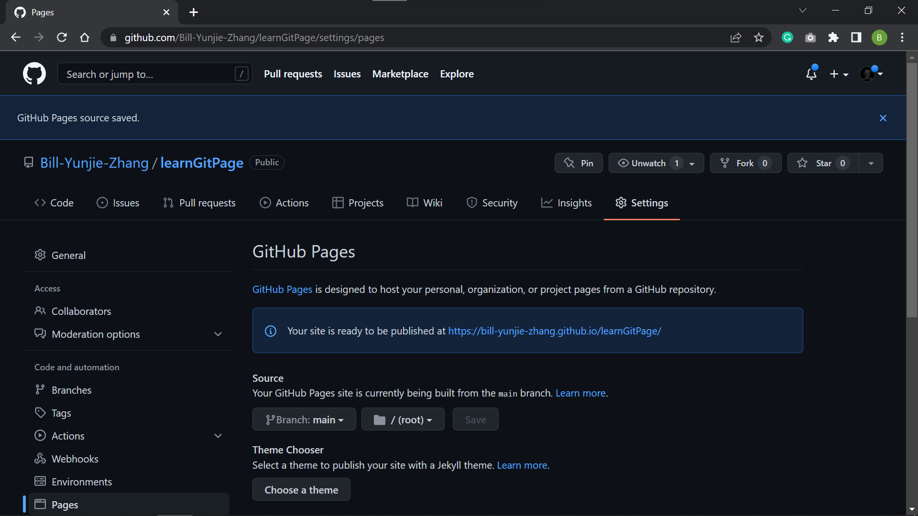
(1)
Your website is posted at this link!
Wait several minute for it to be ready, then click into the link!

Slide 23
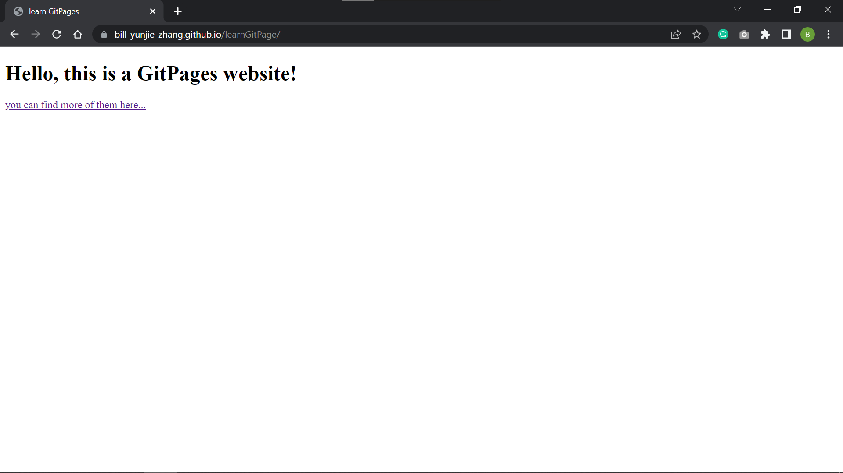

Slide 24
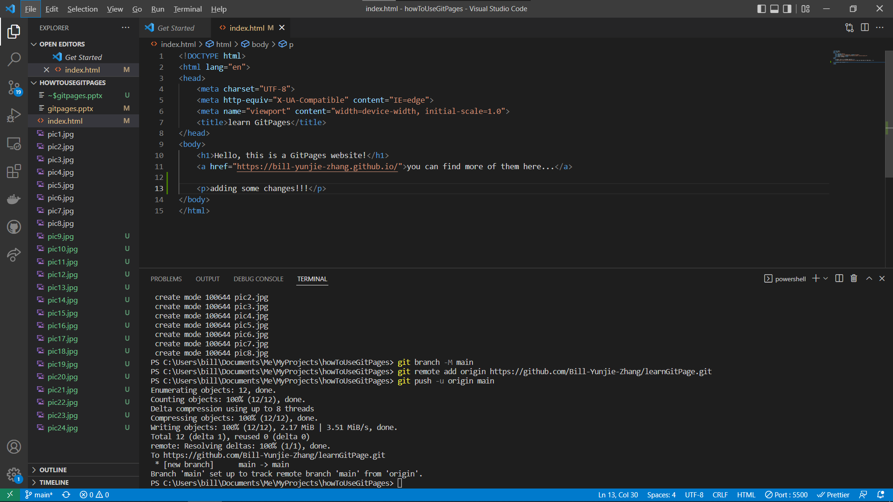
(1)
Now let’s go back to your code editor. Find that we and do some modification to it!

Slide 25
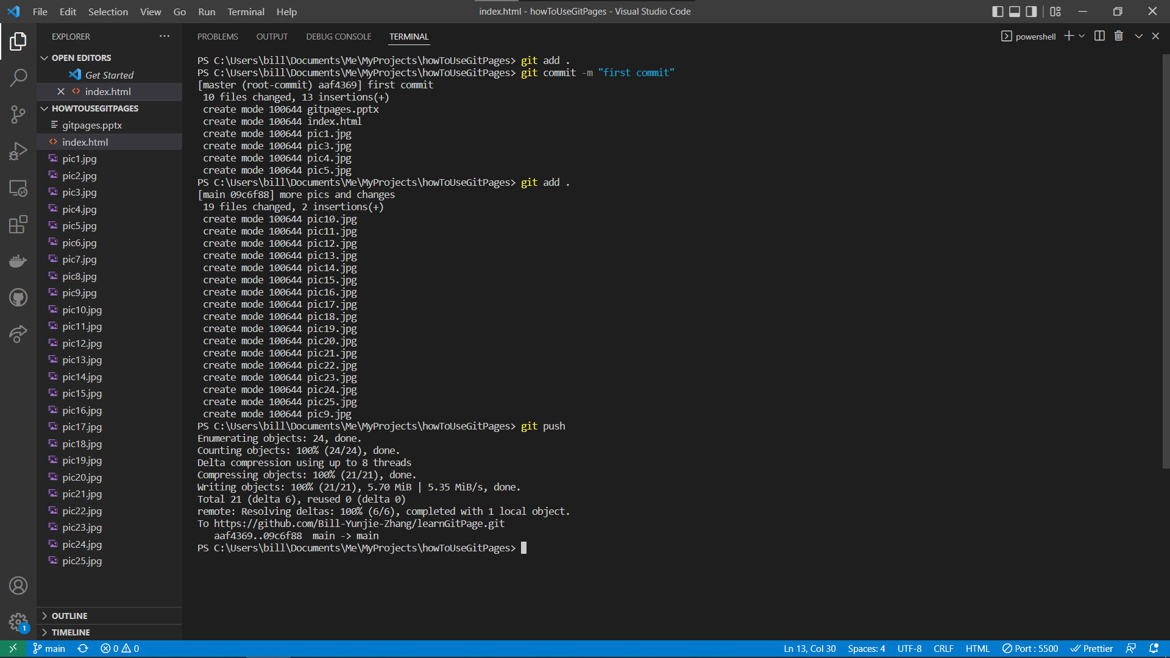
(1)
Follow the same steps to add, commit, and push.

Slide 26
