Slide 1



Xây dựng framework tạo dựng mô hình AI cho các ứng dụng theo dõi chuyển động của con người
GVHD: Dr. Le Trong Nhan
Học viên: Nguyễn Trương Minh Hoàng - 2270757

Slide 2

Nội dung
Introduction
Literature Review
Experimental Setup and Results
Problem Analysis
Methodology

Slide 3
Background: Motion Tracking & AI Integration
Introduction
Motion Tracking: Capturing and analyzing movement across industries like healthcare, sports, gaming (VR/AR), and robotics.
Healthcare: Physical rehab, fall detection, patient monitoring.
Sports: Performance tracking, injury prevention.
Gaming & VR/AR: Immersive user experiences.
Robotics: Navigation and precise control.
AI's Role: Enhances accuracy, efficiency, and flexibility.
Enables gesture recognition, activity classification, and predictive modeling.
Challenges:
Complex steps: data collection, preprocessing, feature extraction, model training.
Steep learning curve for developers without AI expertise.
Solution:
Emergence of simplified frameworks to make motion tracking and AI more accessible.
Democratizing technology and fostering innovation by reducing barriers for developers and researchers.

Slide 4
Problem Statement
Introduction
Challenge:
AI model creation for motion tracking remains complex, requiring extensive technical knowledge and resources.
Current tools often have steep learning curves and limited functionality, hindering customization and scalability for diverse use cases.
Issues:
Existing solutions are application-specific, lacking flexibility to adapt to new or evolving motion tracking needs.
This stifles innovation and limits adoption in transformative areas like healthcare, sports, and robotics.
Need:
A flexible, intuitive, user-friendly framework for simplifying AI model creation in motion tracking.
Designed for both experts and non-experts, empowering a wider range of users to leverage motion tracking technologies effectively.

Slide 5
Research Goals
Introduction
Study Goals:
Investigate challenges in designing AI models for motion tracking.
Analyze existing tools (e.g., Google’s Teachable Machine) to identify gaps.
Propose a conceptual design for a more adaptable framework.
Explore the benefits of simplified, accessible model development.
Scope:
Review of current motion tracking methodologies, technologies, and tools.
Evaluation of sensor-based data collection and pre-processing for quality assurance.
Design opportunities for a general-purpose AI model generator tailored for motion tracking.
Exploration of technical design elements and user interfaces for broad adoption.
Limitations:
Focus on high-level design and conceptual aspects, not detailed implementation or coding.
Does not include in-depth analysis of domain-specific applications (e.g., medical or sports).
Limited by hardware and computational constraints, affecting real-world testing and validation.

Slide 6
Motion Tracking Applications
Literature Review
Table 2.1: Applications of Motion Tracking Across Domains
Application Domain | Examples | Key Benefits
Healthcare | Gait analysis, fall detection | Accurate monitoring, personalized treatment plans
Sports | Performance tracking, injury prevention | Optimized training, reduced injury risks
Gaming/VR/AR | Immersive VR/AR experiences | Enhanced user interaction, lifelike simulations
Robotics | Path planning, human-robot interaction | Autonomous navigation, precise task execution
Figure 2.1: Motion Detection Process General

Slide 7
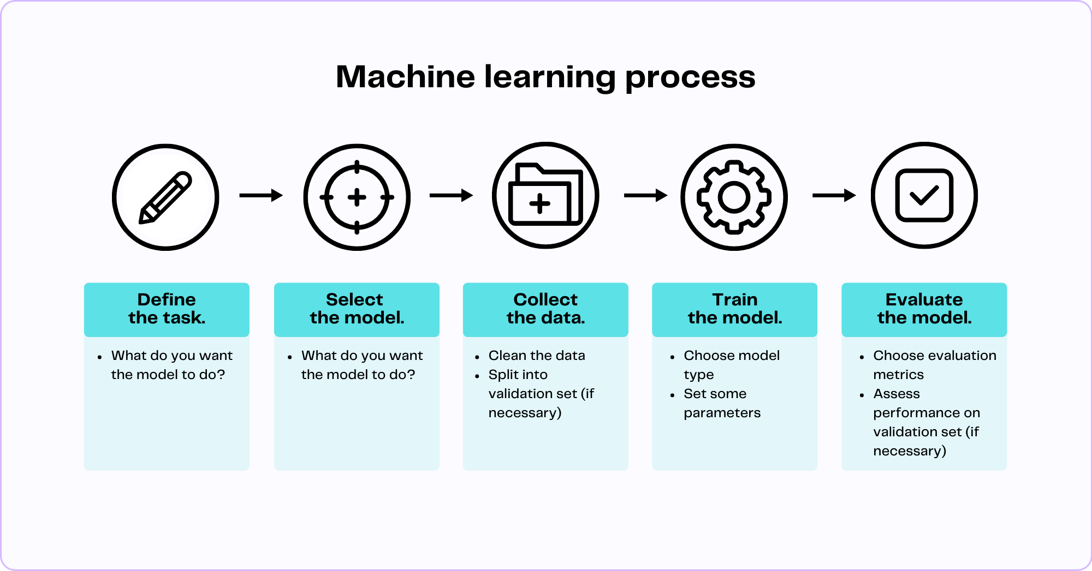
AI Models Generation Techniques
Literature Review
Figure 2.2: Machine learning process

Slide 8
AI Models Generation Techniques
Literature Review
Traditional Machine Learning:
Approach: Handcrafted features (mean, variance, frequency-domain) used with classifiers (SVM, Decision Trees, kNN).
Challenges: Requires domain expertise and may struggle with generalization.
Deep Learning:
Approaches:
CNNs: Process spatial data like images or time-series.
RNNs/LSTMs: Handle sequential, temporal data.
Transformers: Used for activity recognition and sequence modeling.
Benefits: Automates feature extraction, higher accuracy, but requires large datasets and resources.
Hybrid Approaches:
Combines traditional feature extraction with neural networks for improved interpretability and efficiency.

Slide 9
AI Models Generation Techniques
Literature Review
Data Requirements & Preprocessing
Key Steps:
Noise Reduction: Filter out sensor drift and artifacts.
Normalization: Ensure consistent scaling.
Segmentation & Labeling: Divide data into meaningful segments for supervised learning.
Table 2.2: Tools and Frameworks for Model Generation
Framework | Key Features | Best Suited For
Edge Impulse | AutoML, TinyML optimization | Resource-constrained devices
Google MediaPipe | Real-time tracking, multimodal pipelines | VR/AR, interactive applications
TensorFlow/PyTorch | Extensive libraries, flexibility | Custom AI model development

Slide 10
Benefits of Motion Tracking AI Models
Literature Review
Improved Accuracy
High precision in detecting and classifying motion, crucial for healthcare diagnostics and sports performance analysis.
Real-Time Feedback
Instant feedback for applications like rehabilitation, sports training, and interactive VR/AR.
Scalability
Deployment across various platforms (mobile, robots) for a wide range of use cases.
Personalization
Tailored motion tracking for individual users (e.g., fitness tracking, rehabilitation).
Cost-Effectiveness
Automation reduces reliance on manual intervention, saving costs in manufacturing and elder care.
Wider Accessibility
Lightweight models for edge devices enable motion tracking in resource-constrained environments.
Data-Driven Insights
AI-powered analytics support decision-making in sports, healthcare, and industrial operations.

Slide 11
Challenges in Motion Tracking AI Models
Literature Review
Data Collection and Quality
Sensor Noise: Environmental and hardware factors impact data quality.
Dataset Diversity: Limited variety in datasets affects generalization.
Labeling Complexity: Requires time and expertise for accurate labeling.
Computational Constraints
Edge Deployment: Limited resources on edge devices require optimization.
Real-Time Processing: Balancing speed and model complexity for low-latency applications.
Generalizability and Adaptability
Domain-Specific Customization: Models need to adapt across diverse use cases (e.g., healthcare vs. gaming).
Cross-Device Consistency: Variations in sensors and devices affect consistency.
Data Privacy and Security
Sensitive Data: Ensuring privacy for personal movement data.
Federated Learning: Local model training to protect privacy, but with potential performance trade-offs.
Integration Challenges
Hardware-Software Compatibility: Seamless integration needed for optimal performance.
Scalability: Difficulties in scaling across diverse ecosystems and applications.

Slide 12
Challenges in Motion Tracking & AI Integration
Literature Review
Challenge | Description | Impact | Potential Solutions
Hardware Constraints | - Low-power devices with limited processing and storage capabilities. | - AI models need to be optimized for efficiency on edge devices. | - Model optimization for edge devices (e.g., pruning, quantization).
 | - Deep learning models may not run effectively on microcontrollers. | - Trade-offs between model accuracy and computational efficiency. | - Use of lightweight AI models.
Data Quality & Variability | - Sensor data can be noisy or inconsistent, influenced by environmental factors (e.g., temperature). | - Requires robust preprocessing and models capable of handling noisy data. | - Advanced preprocessing techniques to reduce noise and artifacts.
 | - Variability in data can lead to poor model performance. | - Inaccurate data may affect motion tracking systems, such as in wearables. | - Enhanced data collection and filtering methods.
Scalability of AI Models | - Large-scale models require extensive resources and large datasets. | - Limits access for smaller organizations or independent researchers. | - Pre-trained models, transfer learning, and model compression.
Latency in Real-Time Apps | - Real-time applications (e.g., VR/AR, robotics, gaming) require low-latency processing. | - Can lead to lag or poor user experience. | - Optimization techniques like model pruning, quantization, and distillation.
Ethical & Privacy Concerns | - Collecting motion data raises privacy issues (e.g., sensitive health data or identifiable movement). | - User trust concerns and regulatory challenges regarding data security. | - Federated learning and on-device processing to preserve privacy.

Slide 13
Current Trends in Motion Tracking and AI Integration
Literature Review
Trend | Description | Examples and Impact
Wearable Motion Tracking | Wearable devices equipped with IMUs, GPS, and sensors for real-time analysis and actionable insights. | - Smart fitness bands (e.g., Fitbit, Apple Watch) use AI for accurate fall detection, step counting, heart rate, and sleep. - Impact: Improved accessibility and affordability in consumer tech.
AI-Driven Real-Time Tracking | Real-time motion tracking powered by AI for fast, accurate motion prediction with low-latency requirements. | - Google MediaPipe for hand tracking - Applications in VR/AR, gaming, and robotics. - Impact: Enhanced user experiences with immersive environments and autonomous systems.
Multimodal Sensor Fusion | Combining multiple sensor data sources (IMUs, cameras, LiDAR) for enhanced motion tracking accuracy and robustness. | - Autonomous vehicles use sensor fusion for precise navigation. - Impact: Improved accuracy and adaptability in dynamic environments.
Edge AI & Federated Learning | AI models deployed on devices (Edge AI) for real-time processing and federated learning for privacy-preserving training. | - Smart glasses for gesture recognition powered by Edge AI. - Smartphones using federated learning for activity recognition. - Impact: Reduced latency, improved privacy, and scalability.
Emerging Domains and Applications | Motion tracking with AI expanding into new and innovative domains. | - Smart cities monitoring traffic and pedestrian movements. - Healthcare innovations using motion data for predictive diagnostics. - AI-assisted motion capture in cinema and gaming.

Slide 14
Hardware Configuration
Experimental Setup and Results
Seeed XIAO nRF52840 Sense
Features:
Wireless Capabilities: Bluetooth 5.0 with onboard antenna
Powerful Processor: Nordic nRF52840, ARM® Cortex®-M4 32-bit processor with Floating Point Unit (FPU), running at 64 MHz
Ultra-Low Power Consumption: Standby power consumption under 5μA
Battery Charging Support: Lithium battery charge and discharge management
Storage: Onboard 2 MB flash memory
Onboard Sensors:
Microphone: PDM microphone for audio input (only in XIAO nRF52840 Sense version)
IMU: 6-axis LSM6DS3TR-C Inertial Measurement Unit (IMU) for motion tracking (only in XIAO nRF52840 Sense version)
Compact Size: 21 x 17.8 mm, suitable for wearable devices
Rich Interfaces:
1x UART, 1x I2C, 1x SPI, 1x NFC, 1x SWD, 11x GPIO (PWM), 6x ADC
Component Design: Single-sided, surface-mounting components for a sleek, space-efficient design.
Notes:
The Seeed Studio XIAO nRF52840 Sense is a compact yet powerful development board designed specifically for IoT applications and sensor-based projects. It integrates a range of advanced capabilities such as Bluetooth Low Energy (BLE), environmental sensors, and an ultra-small form factor, making it an ideal choice for wearable devices and remote sensing systems.

Slide 15
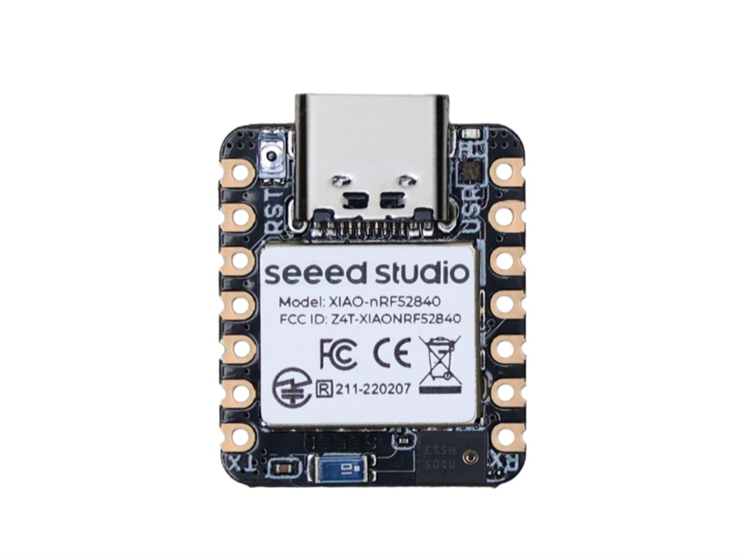
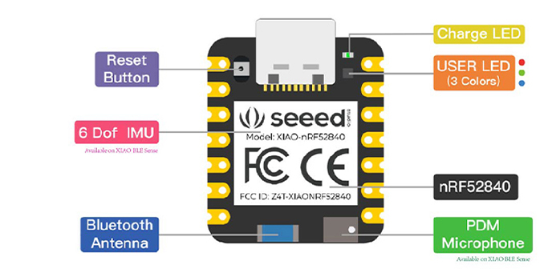
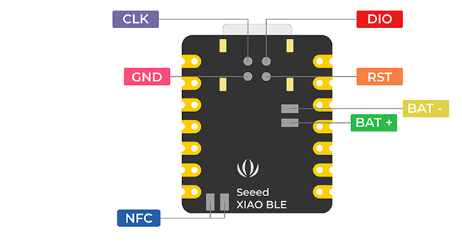
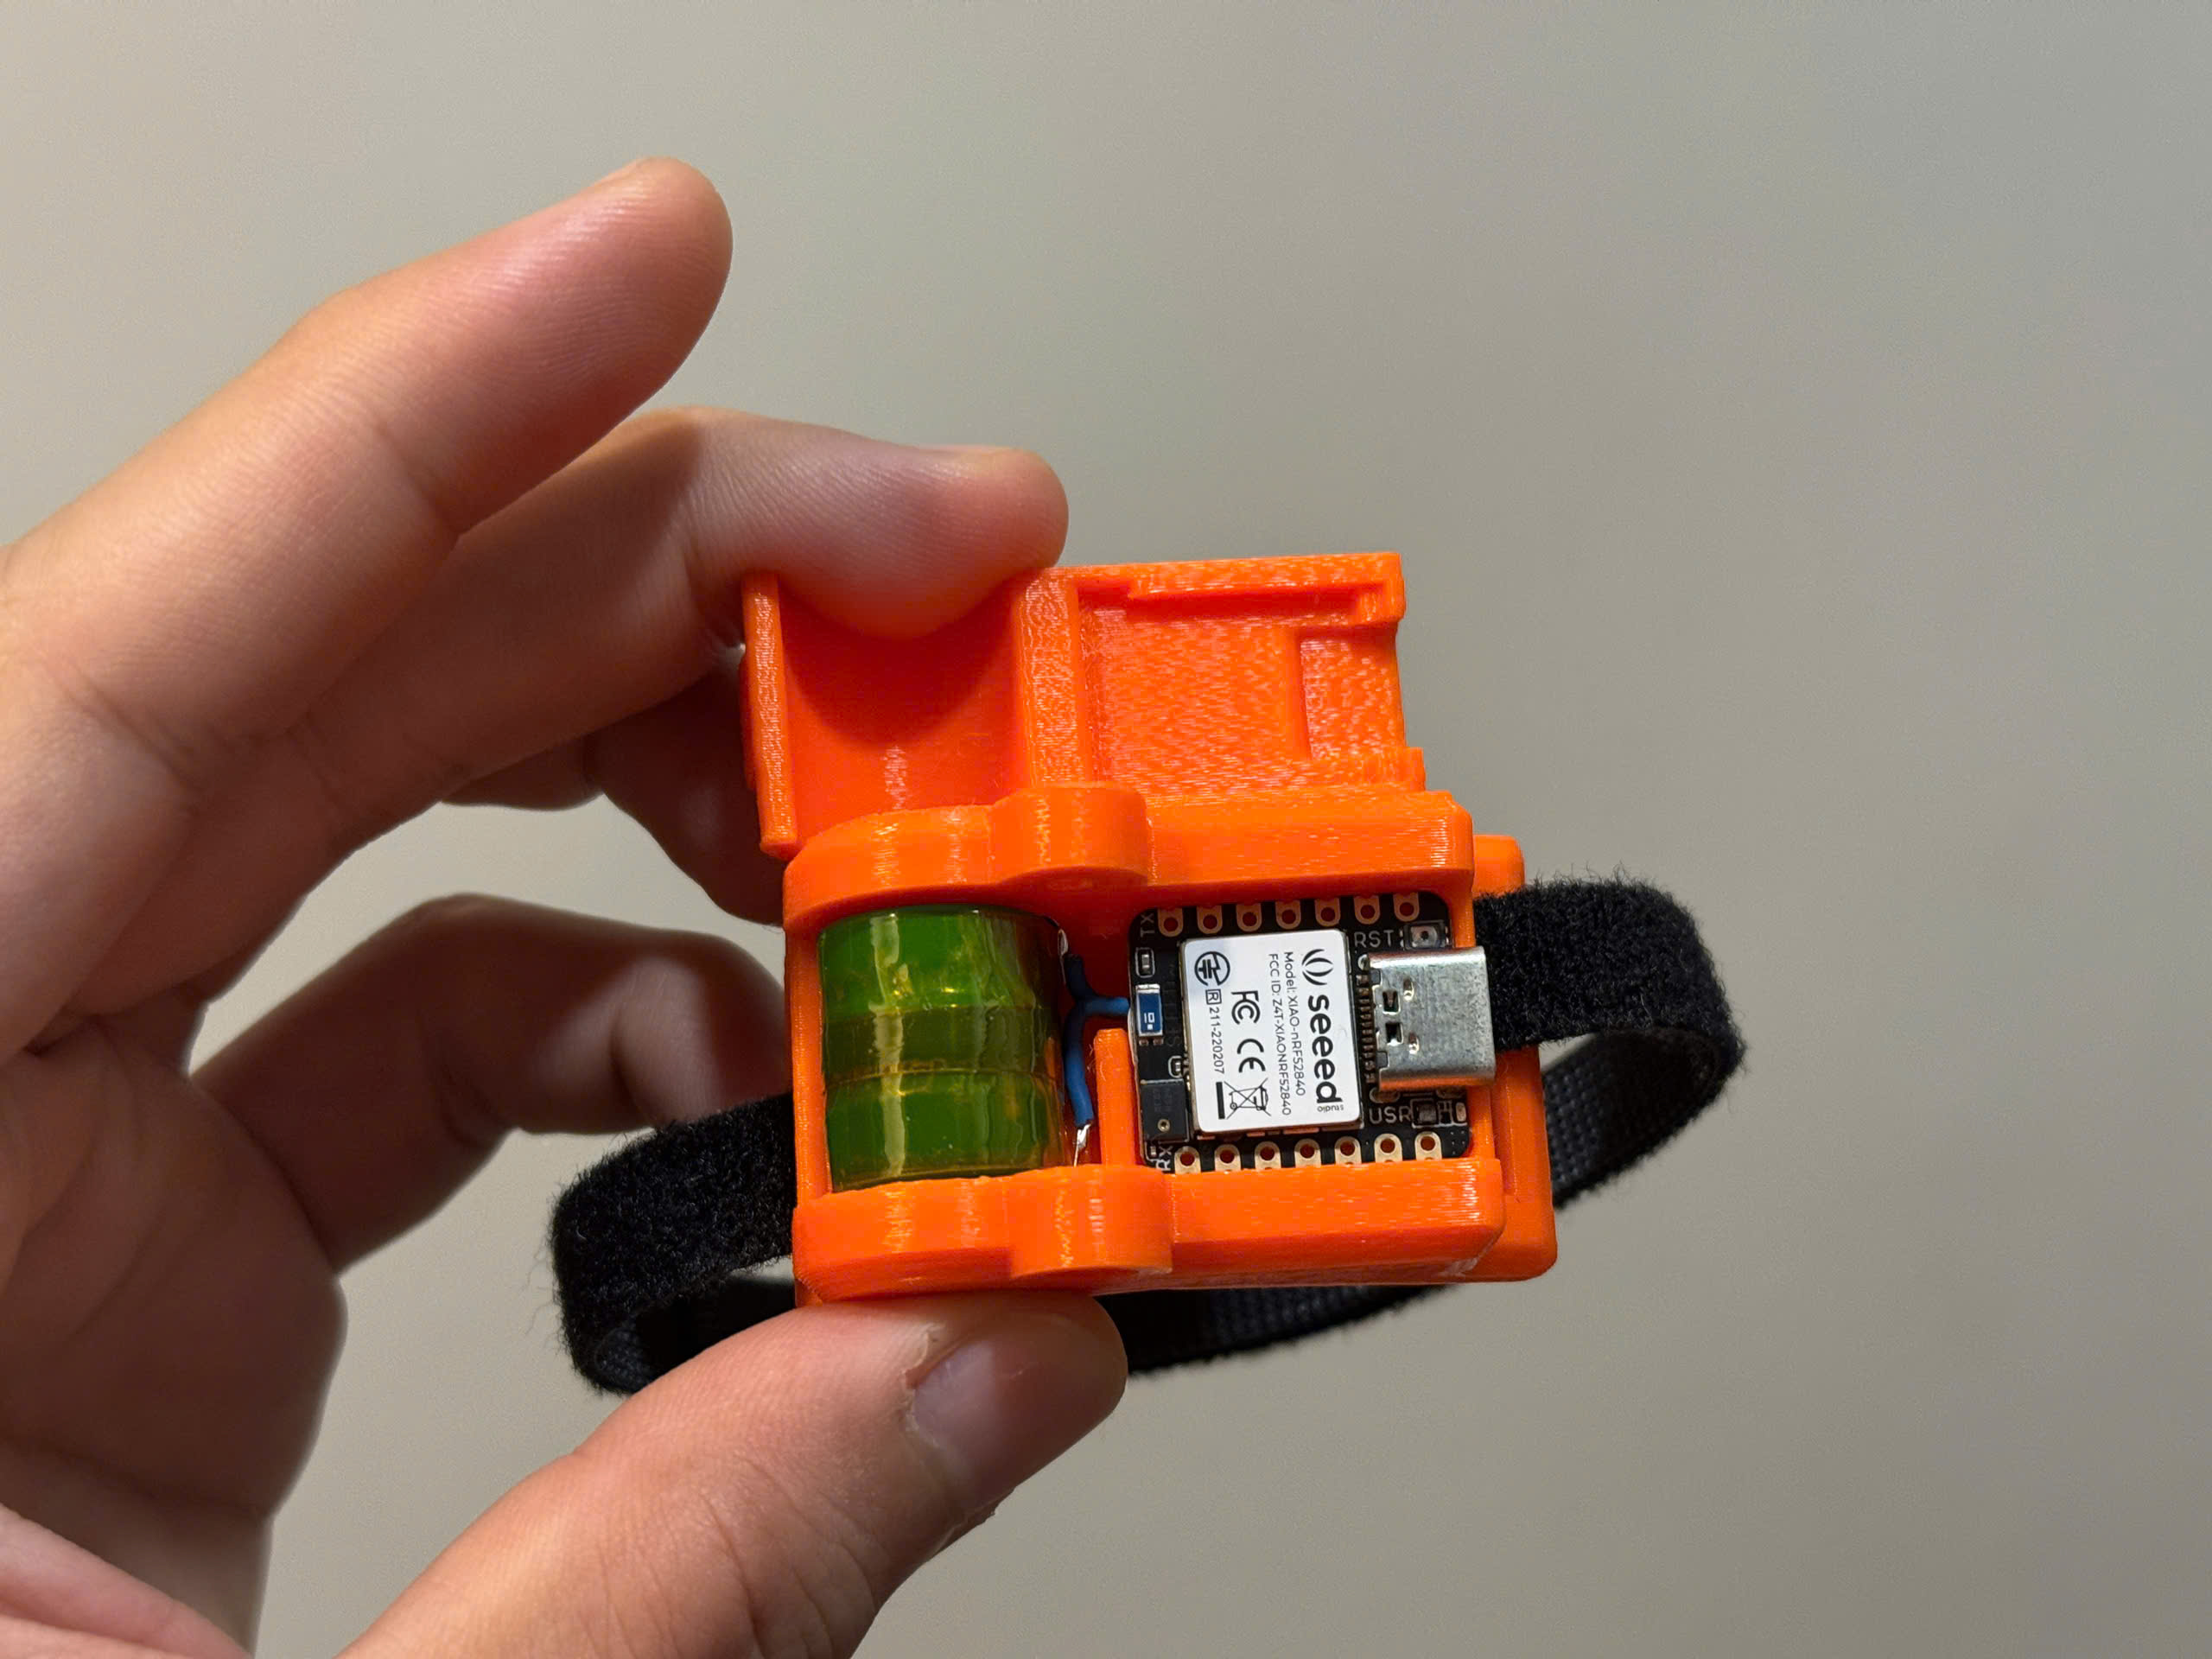
Hardware Configuration
Experimental Setup and Results
Notes:
The Seeed Studio XIAO nRF52840 Sense is a compact yet powerful development board designed specifically for IoT applications and sensor-based projects. It integrates a range of advanced capabilities such as Bluetooth Low Energy (BLE), environmental sensors, and an ultra-small form factor, making it an ideal choice for wearable devices and remote sensing systems.

Slide 16
Hardware Configuration
Experimental Setup and Results
Setting Up the Hardware
To set up the Seeed XIAO nRF52840 Sense for motion tracking applications, the following components are required:
1 x Seeed XIAO nRF52840 Sense
1 x 3.3V 80mAh Battery
1 x Device Housing with Strap (for wearable form factor)
1 x Computer (for software and code deployment)
1 x USB Type-C Cable
Setup Process:
Connect the Seeed XIAO nRF52840 Sense to your computer using a USB Type-C cable.
Attach the Battery: Ensure that the battery is securely connected to the XIAO nRF52840 Sense for portable operation.
Notes:
The Seeed Studio XIAO nRF52840 Sense is a compact yet powerful development board designed specifically for IoT applications and sensor-based projects. It integrates a range of advanced capabilities such as Bluetooth Low Energy (BLE), environmental sensors, and an ultra-small form factor, making it an ideal choice for wearable devices and remote sensing systems.

Slide 17
Software Configuration
Experimental Setup and Results
Edge Impulse Studio is used for collecting IMU data, performing signal processing, training machine learning models, and deploying them to the Seeed XIAO nRF52840 Sense. Despite some challenges with direct IMU integration, UART communication is used for data capture.
Arduino IDE enables firmware programming to handle sensor data streaming over BLE and integrate machine learning models for real-time inference. The setup process includes installing the appropriate board packages and libraries, ensuring smooth communication between the XIAO nRF52840 Sense and Edge Impulse Studio.
Notes:
Edge Impulse Studio is a powerful platform used to create and deploy machine learning models for embedded devices like the Seeed XIAO nRF52840 Sense. This platform facilitates the entire AI workflow, from data collection to deployment, enabling you to easily integrate AI-based motion tracking models.

Slide 18
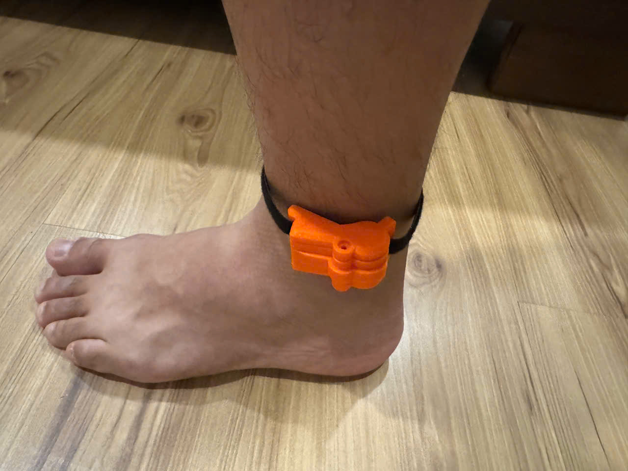
Data Acquisition
Experimental Setup and Results
Sensor Placement: Device affixed to the ankle using a strap for stability and consistent positioning.
Recording: Each activity was recorded for around 30 seconds using Arduino sketch to capture serial data. The sampling frequency using is 100Hz.
Labeling: Manual labeling during data acquisition to map samples to their respective activities

Slide 19
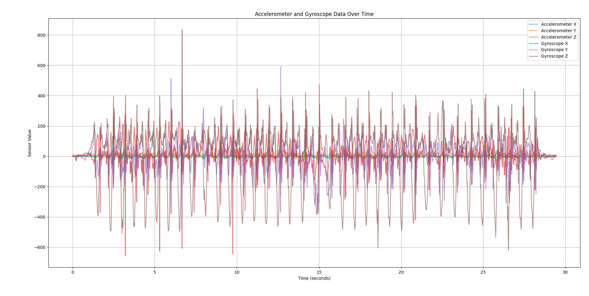
Data Acquisition
Experimental Setup and Results
Figure 3.5: Running 100Hz raw

Slide 20
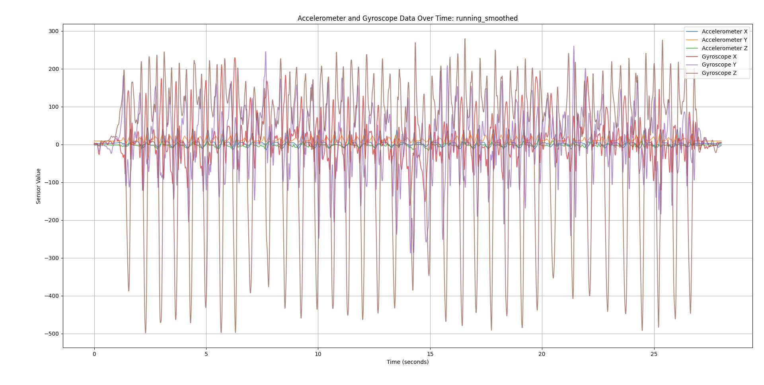
Data Acquisition
Experimental Setup and Results
Figure 3.6: Running 100Hz preprocessed

Slide 21
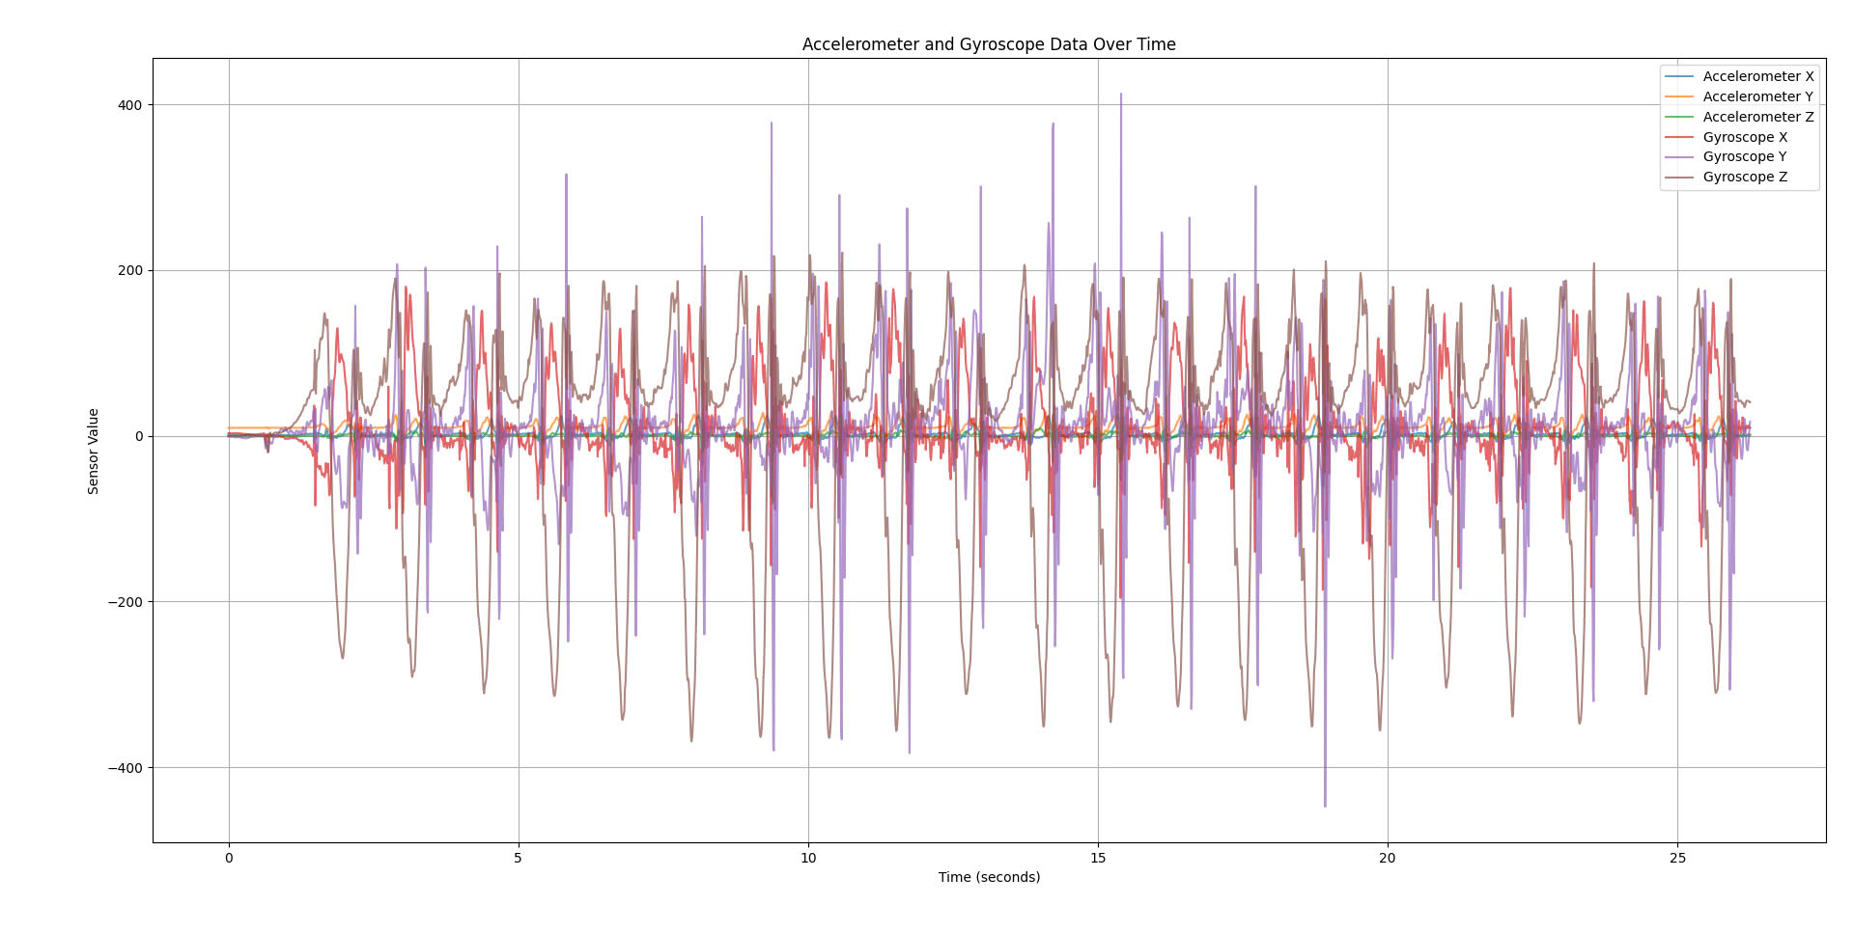
Data Acquisition
Experimental Setup and Results
Figure 3.7: Walking 100Hz raw

Slide 22
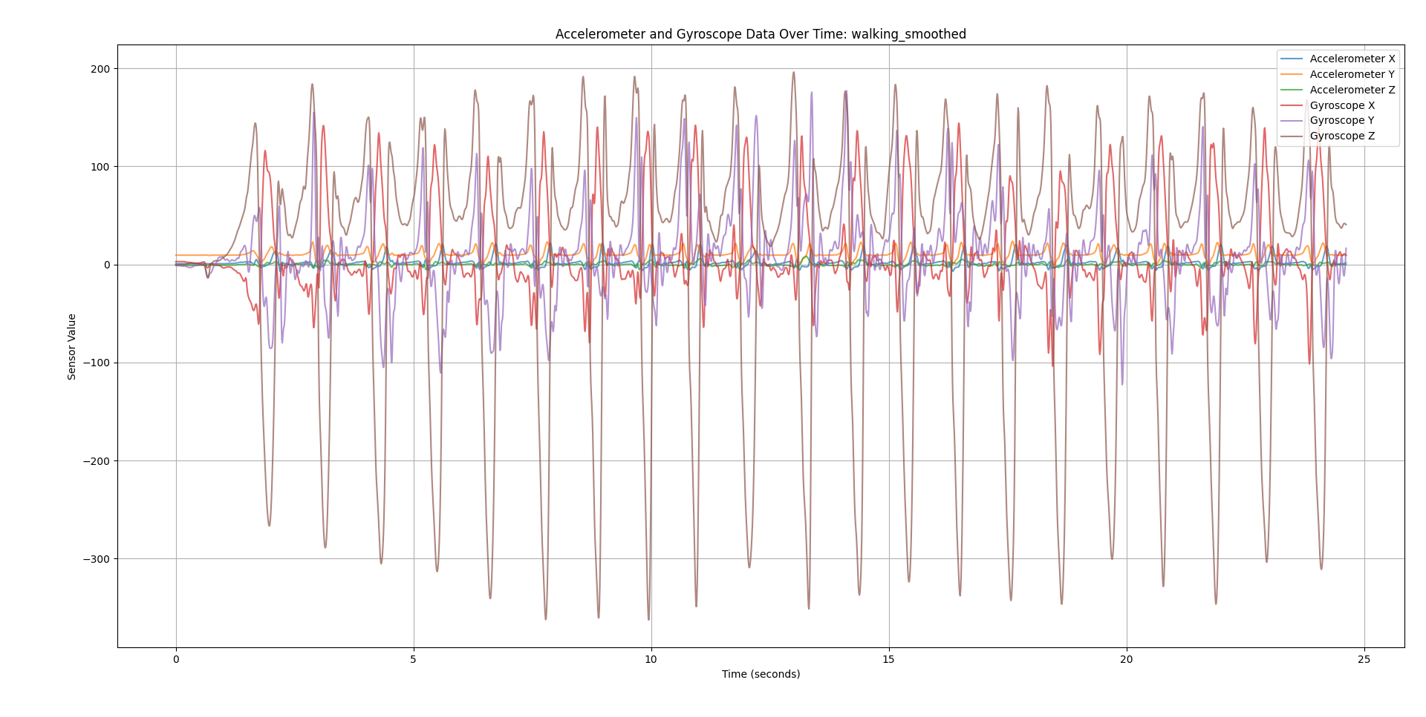
Data Acquisition
Experimental Setup and Results
Figure 3.8: Walking 100Hz preprocessed

Slide 23
References
[1] Markus Miezal Gabriele Bleser-Emanuele Ruffaldi Alessandro Filippeschi, Nor bert Schmitz and Didier Stricker. Survey of motion tracking methods based on inertial sensors: A focus on upper limb human motion. Advances in Body Sensor Networks: Sensors, Systems, and Applications, 2017.
[2] Kaustubh Utturwar Tejas Shelked Anuj Patil, Darshan Rao and Ekta Sarda. Body posture detection and motion tracking using ai for medical exercises and recom mendation system. ITM Web Conf. Volume 44, 2022 International Conference on Automation, Computing and Communication 2022 (ICACC-2022), 2022, May 05.
[3] Google. Litert overview, internet: https://ai.google.dev/edge/litert, Dec 12, 2024.
[4] Google. Mediapipe solutions guide, internet: https://ai.google.dev/edge/mediapipe/solutions/guide, Dec 12, 2024.
[5] Google. Teachable machine, internet: https://teachablemachine.withgoogle.com/, Dec 12, 2024.
[6] Edge Impulse. Edge impulse, internet: https://studio.edgeimpulse.com/, Dec 12, 2024.
[7] Marcelo Rovai Lei Feng. XIAO: Big Power, Small Board Mastering Arduino and TinyML. Seeed Studio, 2024, January 10.

Slide 24
References
[8] Tommaso Marangoni Mariolino De Cecco Marco Tarabini Manuela Galli Mat teo Zago, Matteo Luzzago. 3d tracking of human motion using visual skeletoniza tion and stereoscopic vision. Machine Learning Approaches to Human Movement Analysis, 2020, March 05.
[9] Man Luo Nian-hua Zhu Peng-zhan Chen, Jie Li. Real-time human motion capture driven by a wireless sensor network. International Journal of Computer Games Techonology, 2015.
[10] Seeed Studio. Xiao nrf52840 series, internet: https://wiki.seeedstudio.com/xiao_ble/, Dec 12, 2024.
[11] Benaissa Bellach Rachid Oulad Haj Thami Hamid Tairi Wafae Mrabti, Kaoutar Baibai. Human motion tracking: A comparative study. Second Interna tional Conference on Intelligent Computing in Data Sciences (ICDS 2018), 2018.
[12] Huiyu Zhou and Huosheng Hu. Human motion tracking for rehabilitation—a survey. Biomedical Signal Processing and Control, 3:1–18, 01 2008.

Slide 25
Thank You For Listening Q&A

