Slide 1
K-Time_Modifiable_and_Epoch-Based_Redactable_Blockchain

Slide 2
Block chain Introduction
Widely used in digital currency, supply chain, insurance, agency…
immutable appendonly ledger
Relies on a hash chain that links multiple blocks together (Usually)
Allow forks (most blockchain system)
immutability property : 區塊鏈發展障礙
Notes:
区块链是一个不可改变的、仅有附加功能的账本，其状态是通过在对等节点之间运行的去中心化的共识 协议在对等节点之间运行
区块链的结构 区块链的结构依赖于将多个区块连接在一起的哈希链 联系在一起。
每个区块包含多个交易紀錄(monetary information or any other auxiliary(輔助) information)
任何交易的修改都会影响到相应的 区块和所有后续区块。區塊上交易修改 : 與原區塊不一致，不被下一區塊認可
多數允许分叉，以保持不可更改性
分岔 :
https://medium.com/@crypto.peng/%E4%BB%80%E9%BA%BC%E6%98%AF%E5%8D%80%E5%A1%8A%E9%8F%88%E5%88%86%E5%8F%89-%E4%BB%80%E9%BA%BC%E5%8F%88%E6%98%AF%E7%A1%AC%E5%88%86%E5%8F%89-%E8%BB%9F%E5%88%86%E5%8F%89-2246d1d28d84
https://earning.tw/what-is-hard-fork/
https://zh.wikipedia.org/wiki/%E5%88%86%E5%8F%89
依靠启发式方法，即一个区块由若干个后续区块确认。如比特币的6次确认（大约1小时）和 Ethereum 的30次确认（约6分钟） 。

Slide 3
Blockchain 不可更改性
被濫用於散播不恰當內容 (e.g., child pornography and material that infringes on intellectual rights)
The Right to be Forgotten (個人隱私資訊 : 歐盟2006 GDPR)
Solution ?
Notes:
儿童色情制品和侵犯知识产权的材料
鏈上參與者可能無意間協助散播這些不適合內容 因為他們沒有能力去辨識這是違法或者不適當內容
造成鏈上參與者不願下載跟參與鏈
the right to remove personal private information from Internet searches and other directories under several circumstances
違反GDPR : 4% of a company’s annual revenue or EU 20 million

Slide 4
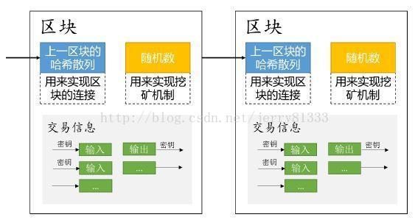
Related Work
μ chain by Puddu (DPSS) [22]
Novel data erasing approach by Florian [23]
the concept of redactable blockchain was first introduced by Ateniese [24]
Notes:
Puddu et al. [22] introduced a novel structure called μ chain that is a voting-like approach via dynamic proactive (动态主动) secret
Sharing [DPSS] dealing with secret shared keys in permissionless blockchain.
DPSS : https://web.cs.ucla.edu/~rafail/PUBLIC/188.pdf
μ chain 問題 : large overheads and multiple interactions among the chain’sparticipants
Florian : 允许链上的参与者在本地消除掉每笔交易中的任意内容，但原始交易是不可改变的 (所有节点都保留所有的原始區塊)
Ateniese : 在一个许可的环境中 需要一个中央权威机构（CA）通过密匙授予改写权限
It offers a block-level rewriting controlled at a coarse-grained level via an enhanced collision-resistance chameleon hash (CH) [27] and public key infrastructure (PKI) technologies
Chameleon hash : https://blog.csdn.net/jerry81333/article/details/76141596
PKI : https://zh.wikipedia.org/wiki/%E5%85%AC%E9%96%8B%E9%87%91%E9%91%B0%E5%9F%BA%E7%A4%8E%E5%BB%BA%E8%A8%AD

Slide 5
Related Work
CHET and ABE by Derler [25]
To eliminate the trusted CA :
Deuber et al. [26] proposed a block-level redactable blockchain
Dishonest and rational miners may not check the candidate block pool for more opportunities to be a new block finder
Vulnerable to denial-of-service attacks if the cost of applying for an amendment is not high enough
Notes:
Derler et al. [25] proposed a redactable blockchain in a permissioned setting with transaction-level rewriting controlled at a fine-grained level via
chameleon hashes with ephemeral trapdoors (CHET) [28] and attribute-based encryption (ABE)
ABE : https://en.wikipedia.org/wiki/Attribute-based_encryption
CHET : https://eprint.iacr.org/2017/011.pdf
To eliminate the trusted CA, Deuber et al. [26] proposed a block-level redactable blockchain in a permissionless setting via consensus-based voting.
Dishonest and rational miners may not check the candidate block pool for more opportunities to be a new block finder.
Moreover, every chain participant is allowed to make rewriting proposals, which is vulnerable to denial-of-service attacks if the cost of applying for an amendment(修改) is not high enough
the trapdoor is used for finding a hash collision without modifying the hash result
ABE incurs large overheads such that the space complexity of each ciphertext is linear to the associated policy and the computational cost of revealing
the trapdoor is linear to the attributes specified in each secret key
Dishonest and rational miners may pursue a higher efficiency by skipping or random voting without verifying the candidate block is reasonable or not to gain more mining opportunities
the modification privilege can be compromised due to a variety of reasons, such as no-paid leave, retirement, and even selling
the secret key to gain monetary profits.
the attribute-based redactable blockchain solution [25] faces collusion attacks.

Slide 6
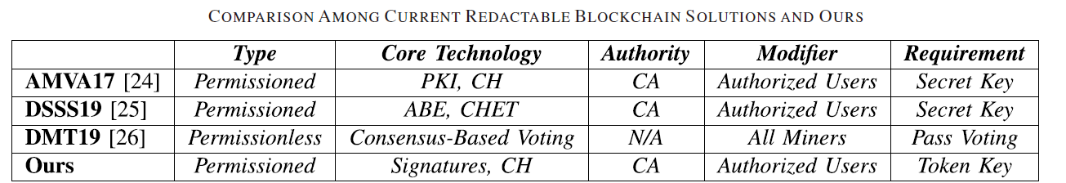
Contributions
k-time modifiable and epoch-based redactable blockchain (KERB)
K-time modification
Epoch-based redaction
Strong security model
Notes:
the rewriting privilege is limited at most k times defined by CA, where the secret signing key can be extracted when more than k-time transaction rewriting operations happen.
为减少恶意行为，修改权限被CA定义为最多限制k次，若发生超过k次的交易修改时，CA处理罚款
each modifier is required to make a time-locked deposit in the chain. This deposit can be spent before the expiration date t with the signatures signed by CA and the modifier. After the expiration date t, the deposit can be drawn by the modifier individually. The modifier has rewriting privileges before the expiration date t.
为惩罚恶意行为，每个修改者需定时存保证金。在授权期限内，若发生恶意行为，CA可以使用自身密钥和修改者的密钥提取存款
Strong security model : by allowing the collusion between transaction owners and modifiers (without specifying attributes to satisfy the policy associated with redactable transaction). In contrast, the previous solution in [25] cannot prevent such a collusion attack.
允许交易所有者和修改者之间的勾结来改进Ateniese和Derler中引入的安全模型。本文使用更通用的变色龙哈希，而不是增强变色龙哈希和CHET。没有陷门正确性检查的需求，数字签名来支持重写特权，而不是加密机制，以获得最佳性能，适用于大型环境，成本小。

Slide 7
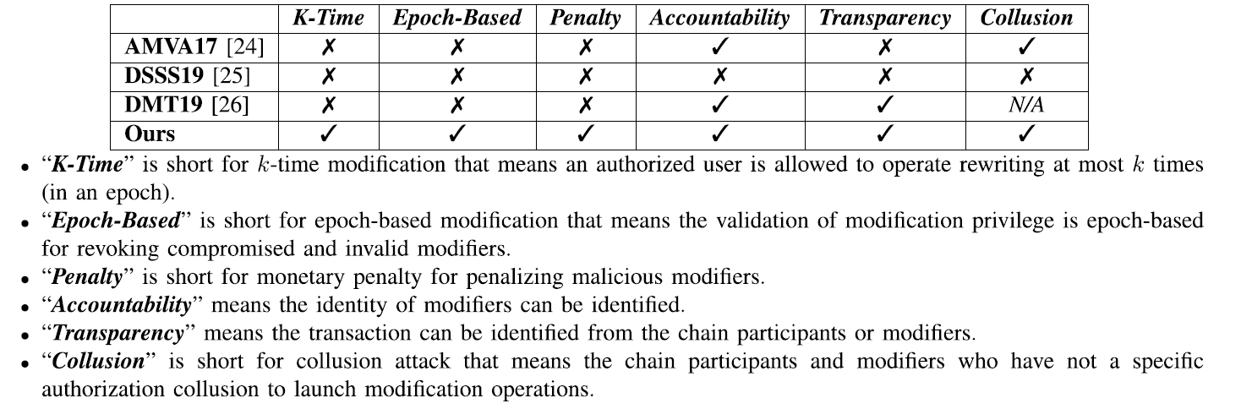
Contributions

Slide 8
Advantage
more generic chameleon hashes rather than enhanced collision-resistance [24], and even CHET [25].
no trapdoor correctness checking requirement
We apply digital signatures to endorse rewriting privileges rather than encryption mechanisms for optimal performance
suitable for a large-scale setting
Notes:
• We apply more generic chameleon hashes, where it only
requires the basic adaption property rather than enhanced
collision-resistance [24], and even CHET [25].
• Our solution has no trapdoor correctness checking
requirement, while the previous solutions [24], [25] may
require trapdoor correctness checking since malicious
chain participants may seal the incorrect trapdoor.
• We apply digital signatures to endorse rewriting privileges
rather than encryption mechanisms for optimal performance.
Digital signatures have no costly key encapsulation
mechanism. Moreover, no expensive secret channel
is needed to distribute secret keys in the blockchain
environment.
• Our solution is suitable for a large-scale setting. The
increment of attributes and redaction times has far less
influence on the cost of our solution, as shown in
Section V.

Slide 9
Challenges
Functionality
K-time modification is helpful to reduce the loss when key leakage or faulty operation happens
Epoch-based modification limits the validation period of rewriting privileges ( Quite challenging : ABE(RABE)? )
ABE
semi-trusted third party ?
Costly to synchronize
Easy to find historical information
Security
CHET
Two trapdoors ( by CA and by transaction owner )
Notes:
epoch-based modification is quite challenging in current redactable blockchains. One possible solution is to use revocable ABE (RABE) [31], [32] to replace the ABE component in [25].
RABE requires a semi-trusted third party (e.g., cloud) to update the ciphertext in each epoch so that the revoked
user cannot reveal the ciphertext which the revoked user can access before they are revoked. In a blockchain environment, it is 不可行 to find a semi-trusted third party to process ciphertext updates
2) The auxiliary information (e.g., updated ciphertext) is changed in each epoch. It is costly to synchronize them in all the distributed ledgers each time.
3) The content in the blockchain is public. The revoked users are easy to find historical information that contains the ciphertexts generated before they are revoked. These ciphertexts can be decrypted by the revoked users.
CHET includes two trapdoors: a long-term trapdoor is specified by CA, and an
ephemeral trapdoor is generated by the transaction owner
The secret key of ABE is used to reveal the ephemeral trapdoor sealed by the transaction owner.
Hence, it has a security threat, where modifiers have the long-term trapdoor and the transaction owner has the ephemeral trapdoor.
The collusion of unauthorized modifiers (who have a long-term trapdoor but an invalid ABE secret key) and transaction owners
to launch transaction rewriting to be possible

Slide 10
Technical Overview
To eliminate the costly encryption mechanism, we apply digital signatures to release the trapdoor of chameleon hashes.
only the rewriting from the authorized modifier can pass the verification
Double-authentication-preventing signatures
Messages consist of an address and a payload component, and a signer is penalized if two messages with the same addresses but different payloads are signed
Schnorr signature
improve efficiency
rather than costly zero-knowledge proof Systems
Notes:
https://icode.best/i/87147544305930
insecure to directly release the trapdoor of chameleon hashes
valid redactable transaction must have a valid hash value, a valid signature signed by a modifier, and a credential of this modifier issued by CA.
allows anyone to operate transaction rewriting, but only the rewriting from the authorized modifier can pass the verification
Inspired by double-authentication-preventing signatures [33]–[35] and Schnorr signature
Double-authentication-preventing signatures are a variety of digital signatures equipped with a self-enforcement mechanism.
Messages consist of an address and a payload component, and a signer is penalized if two messages with the same addresses but different payloads are signed

Slide 11
Technical Overview
reduce the computational cost
1-degree polynomial to realize secret sharing
“{Admin, Finance}” : “Admin AND Finance”
cannot rewrite the transaction specified by a policy “Admin AND Healthcare”
CA issues the rewriting privileges by signing the attribute set of the modifier (and the public key of this modifier). If a transaction associated access policy complies with the attribute set, the modifier can rewrite this transaction
Notes:
we use 1-degree polynomial to realize secret sharing.
Specifically, we apply 1-degree polynomial with k instantiations rather than k-degree polynomial to prevent more than k times transaction rewriting
Inspired by revocable proxy signatures [37], we apply digital signatures rather than encryption mechanisms to privilege
delegation for epoch-based modification. In proxy signatures, the original signer delegates signing privilege to proxy signers.
In our solution, we follow this concept, CA delegates rewriting privilege to modifiers.
the modifier associated attributes “{Admin, Finance}” can rewrite the transaction protected by a policy “Admin AND Finance” but
cannot rewrite the transaction specified by a policy “Admin AND Healthcare”
each modifier has a unique identifier such as {user1, user2, . . .}, transaction protected by a policy “user1 OR user2” can be rewritten by the modifiers
with identifier either user1 or user2.
CA issues the rewriting privileges by signing the attribute set of the modifier (and the public key of this modifier). If a transaction associated access
policy complies with the attribute set, the modifier can rewrite this transaction

Slide 12

Digital Signatures
A digital signature DS with a message space M consists of four algorithms { Setup, KeyGen, Sign, Verify }

Slide 13
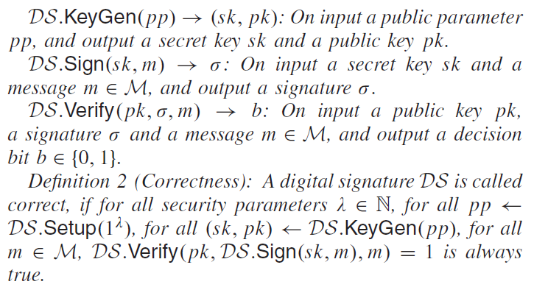
Digital Signatures
Notes:
A cannot (except with negligible probability) come up with a signature for a message m∗ for
which the adversary never see before.
In the following, we give the security model called existential unforgeability under a chosen message attack (EUF-CMA security) to specify the
security requirement for the digital signature in multi-user settings.

Slide 14
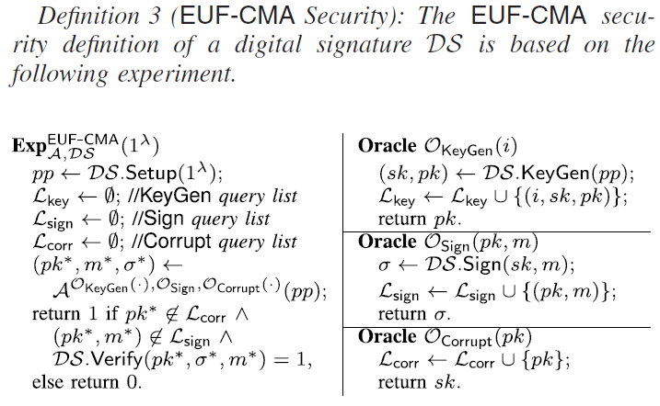
Digital Signatures

Slide 15

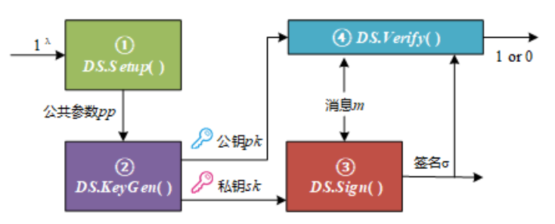
Digital Signatures

Slide 16
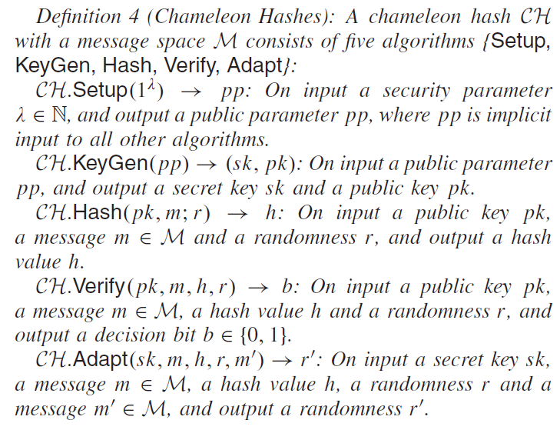
Chameleon Hashes

Slide 17
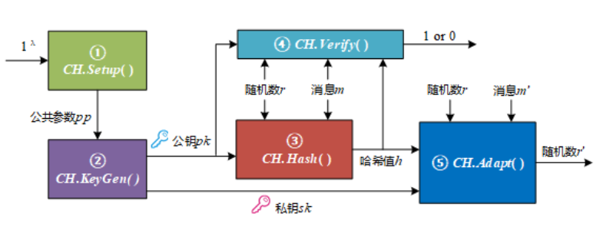
Chameleon Hashes

Slide 18
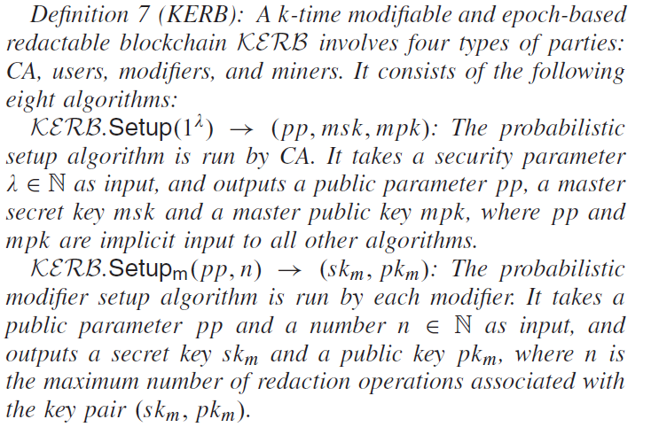
K-TIME MODIFIABLE AND EPOCH-BASED REDACTABLE BLOCKCHAIN

Slide 19
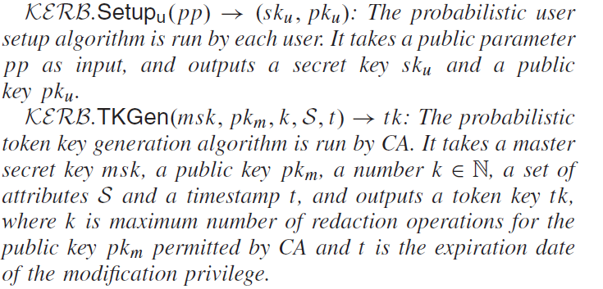
K-TIME MODIFIABLE AND EPOCH-BASED REDACTABLE BLOCKCHAIN

Slide 20
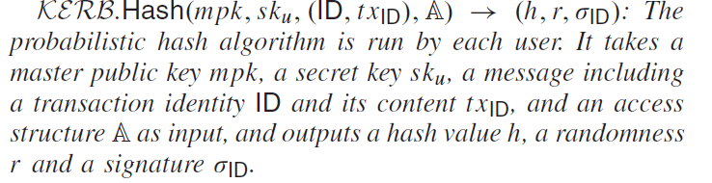

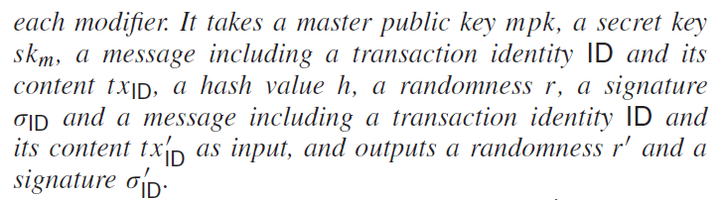
K-TIME MODIFIABLE AND EPOCH-BASED REDACTABLE BLOCKCHAIN

Slide 21
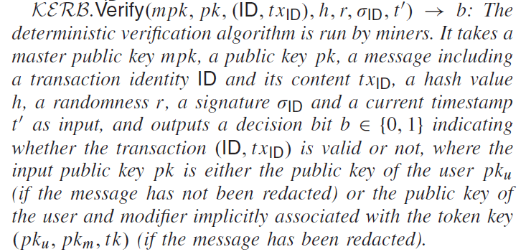
K-TIME MODIFIABLE AND EPOCH-BASED REDACTABLE BLOCKCHAIN

Slide 22
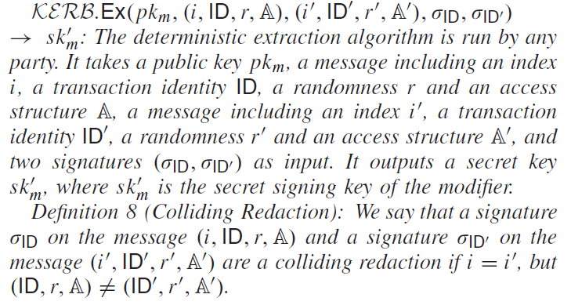
K-TIME MODIFIABLE AND EPOCH-BASED REDACTABLE BLOCKCHAIN

Slide 23
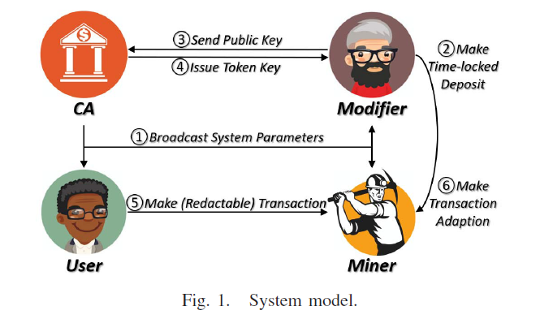
K-TIME MODIFIABLE AND EPOCH-BASED REDACTABLE BLOCKCHAIN
Notes:
CA represents a blockchain administrator who has three
responsibilities:
1) CA needs to initialize the KEBR system and broadcasts system parameters to other parties (see 1).
2) After receiving a key issuing request from a modifier(from 3), CA checks the validation of this modifier’s time-locked deposit (see 2) and issues k-time
rewriting privileges, where the number of redaction operations k and the expiration date of the issued rewriting privileges depend on the deposit (see 1).
3) If any modifier violates the k-time rewriting privileges, CA can reveal the secret key of that modifier and draw the time-locked deposit before the expiration date.
• Users are chain participants who are allowed to make two types of transactions (see 5). One is immutable transactions
that cannot be rewritten. Another is redactable transactions that allow the specified modifier to rewrite.
• Modifiers are chain participants who make the timelocked deposit (see 2) and have rewriting privileges issued by CA (see 4). After the expiration date, modifiers can draw(提取) the time-locked deposit. However, if any misbehavior is found, modifiers will lose the deposit.
• Miners are chain participants who verify and add transactions (see 2, 5 and 6) to global public ledger of past transactions.

Slide 24
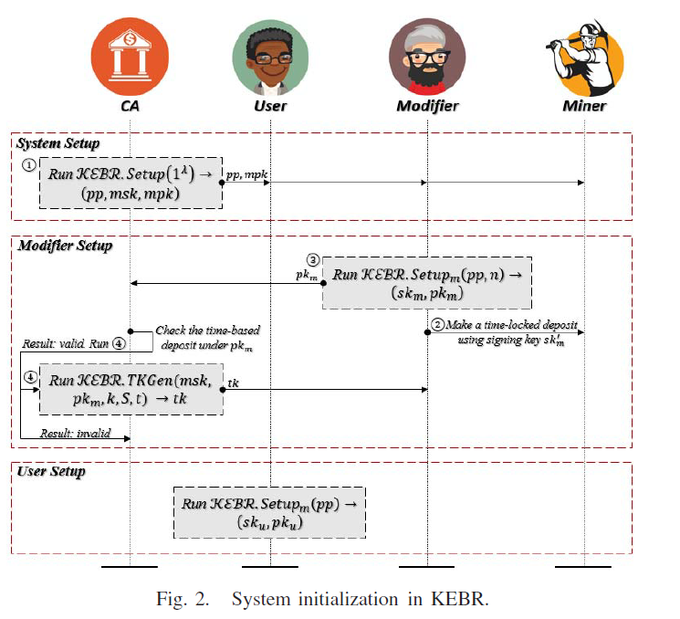
KEBR System Initialization
Notes:
The workflow of KEBR includes four phases: system initialization, transaction making, transaction verification, and malicious punishment.
System Initialization:
• System setup : CA generates a public parameter pp, a master secret key msk and a master public key mpk by running the setup algorithm KERB.Setup( 1^λ). Then, CA broadcasts the public parameter pp and the master public key mpk to other parties (see 1).
• Modifier setup: After receiving the public parameter pp and the master public key mpk from CA, each modifier runs the modifier setup algorithm KERB.Setupm(pp, n) to generate a secret key skm and a public key pkm. Then, the modifier makes a time-locked deposit in which the
deposit can be spent with the signatures signed by CA and the modifier before the expiration date t (see 2). Next,
the modifier sends the public key pkm to CA (see 3).
CA specifies the number of rewriting operations k and
the attribute set S of the modifier, and runs the token key generation algorithm KERB.TKGen(msk, pkm, k, S, t) to generate a token key tk, then sends tk to the modifier (see 4). After the expiration date, modifiers can renew their rewriting privileges by making a time-locked deposit
with new expiration date. Hence, modification privileges are issued periodically.
• User setup: After receiving the public parameter pp and the master public key mpk from CA, each user runs the user setup algorithm KERB.Setupu(pp) to generate a secret key sku and a public key pku.

Slide 25
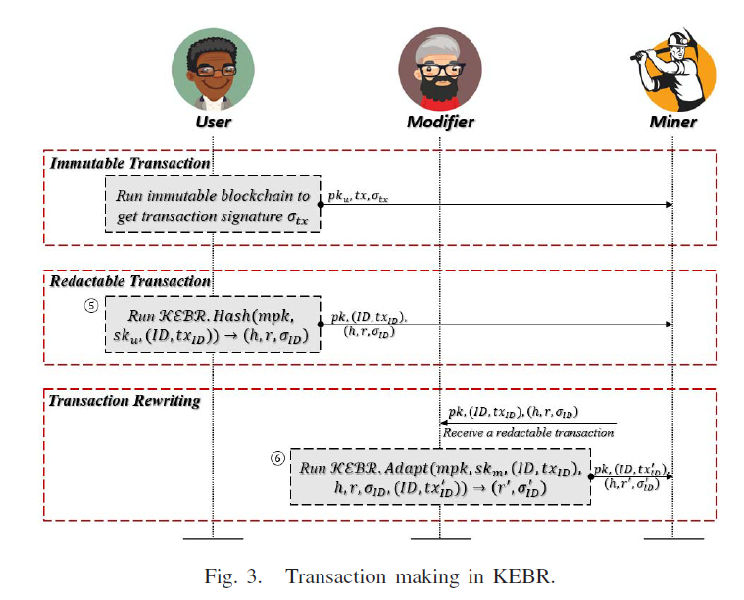
KEBR Transaction Making
Notes:
2) Transaction Making:
• Immutable transaction making: Each user is allowed to make the immutable transaction as in the traditional immutable blockchain. The user uses her/his secret key sku with traditional hash function to generate a transaction tx and its signature σ(t x) . Then, the user propagates the public key pkm, the transaction tx and the signature σ(t x) to the blockchain ecosystem.
• Redactable transaction making: Each user is allowed to make the redactable transaction by running the hash algorithm KERB.Hash( mpk, sku, ( ID, tx ID),A ) with a specified access structure A to generate a hash value h, a randomness r and a signature σID. The user propagates the public key pkm, the transaction (ID, txID) and the signature (h, r, σID) to the blockchain ecosystem (See 5).
•Transaction rewriting: The modifier with the attribute set S with S |= A is allowed to make transaction rewriting. The modifier runs the adaption algorithm KERB.Adapt(mpk, skm, (ID, txID), h, r, σID, (ID, txID)) to generate a randomness r and a signature σID.
The modifier then broadcasts the transaction with the public key pk = (pku, pkm, tk), the transaction
(ID, txID) and the signature (h, r , σID) to blockchain ecosystem (See 6).

Slide 26
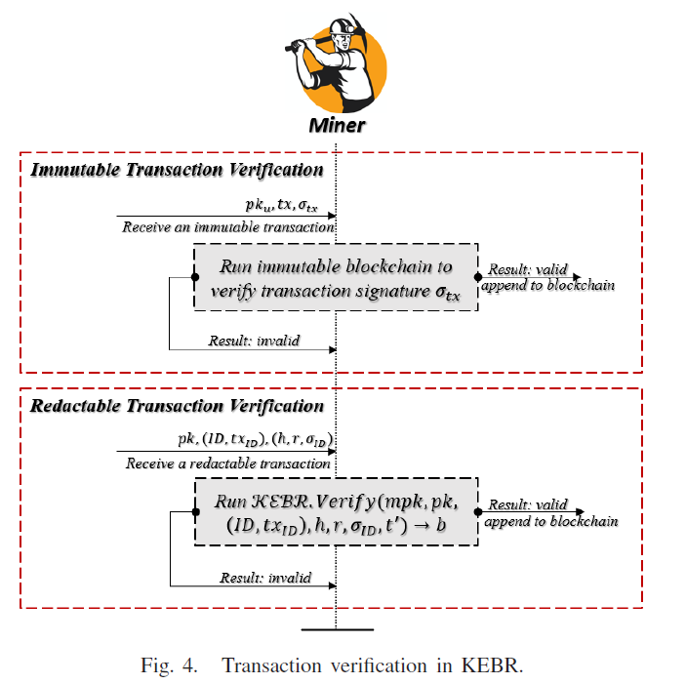
KEBR Transaction Verification

Slide 27
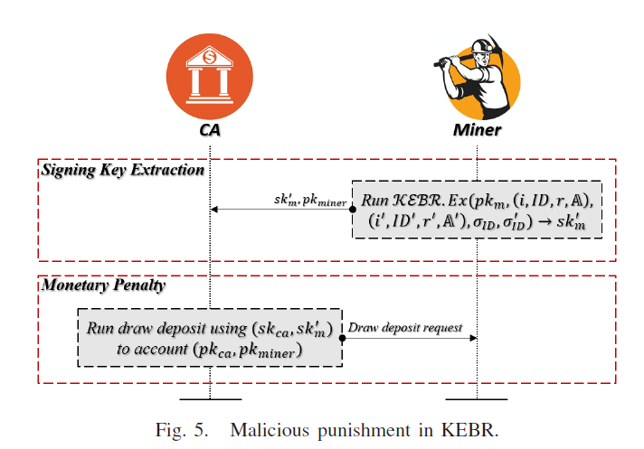
KEBR Malicious Punishment

Slide 28
Threat Model
Assumption
CA is fully trusted.
Miners are majority trusted as the normal blockchain ecosystem.
Users and modifiers are untrusted and they can get together to launch collusion attacks.
Notes:
The malicious modifier can gain the ephemeral trapdoor from users to operate transaction rewriting without a valid secret key,
Our system is secure if the secret signing key of CA remains secret

Slide 29
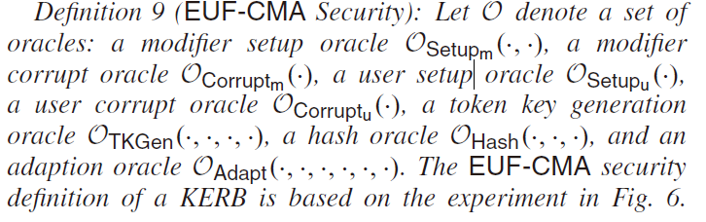
Security Model

Slide 30
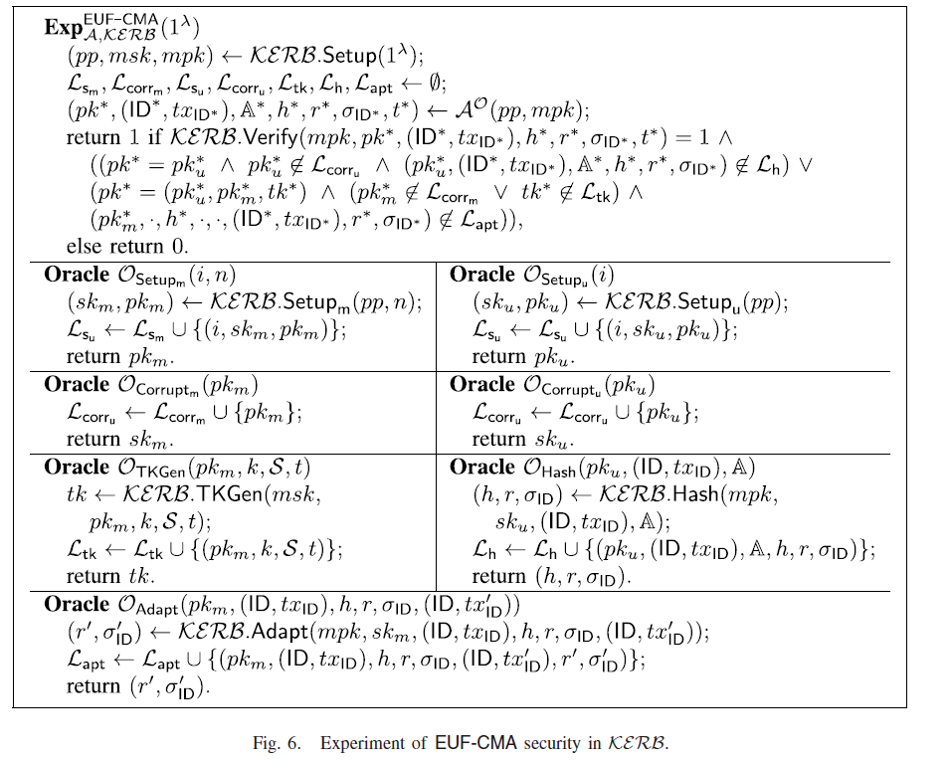
Security Model

Slide 31
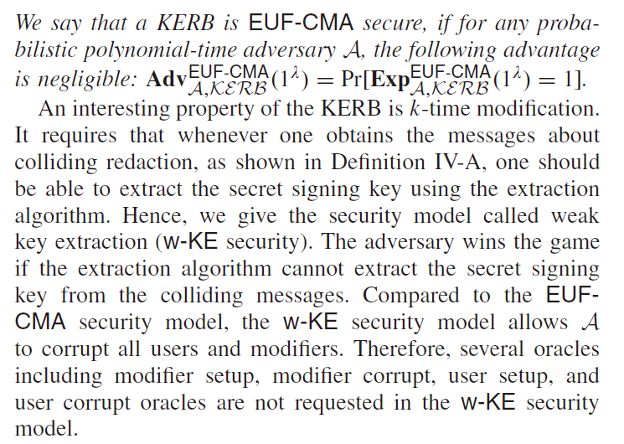
Security Model

Slide 32
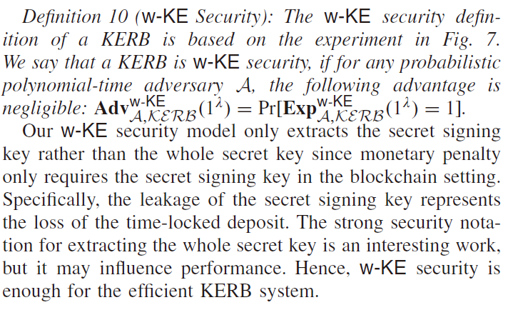
Security Model

Slide 33
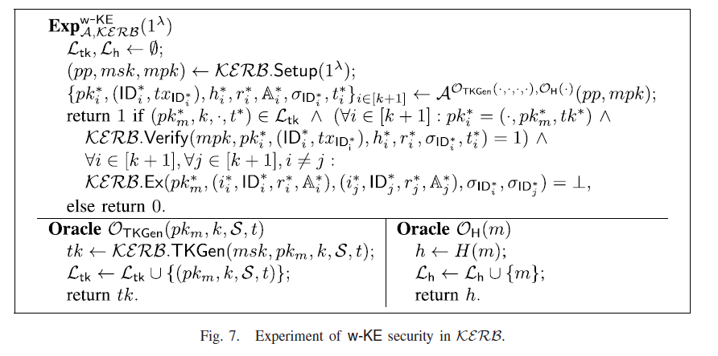
Security Model

Slide 34
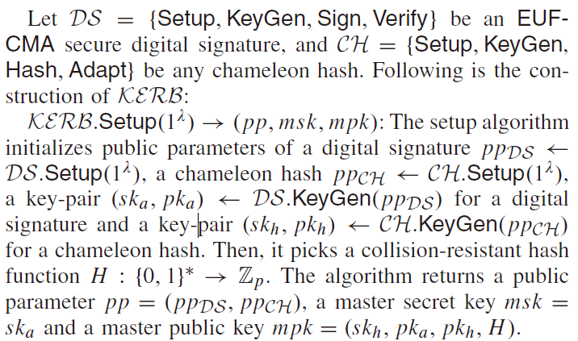
Proposed Scheme

Slide 35
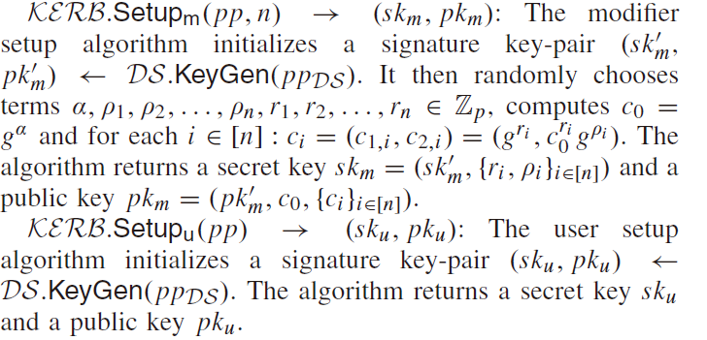
Proposed Scheme

Slide 36
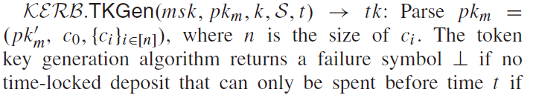
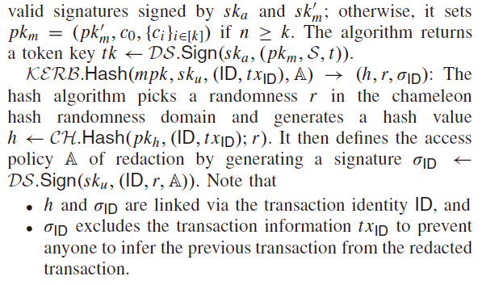
Proposed Scheme

Slide 37
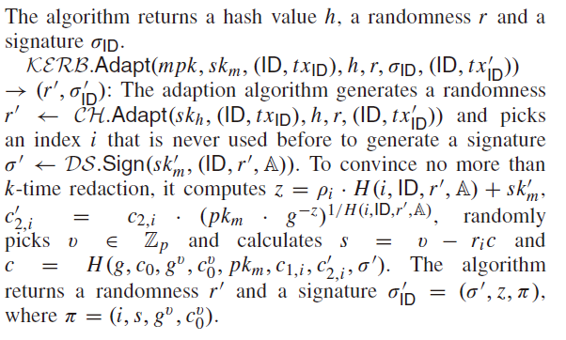
Proposed Scheme

Slide 38
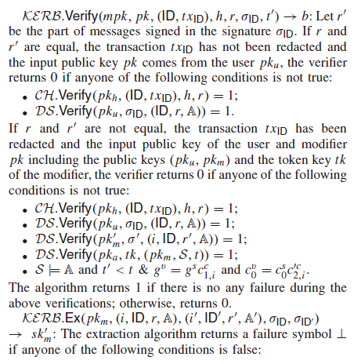
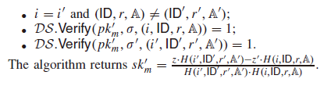
Proposed Scheme

Slide 39
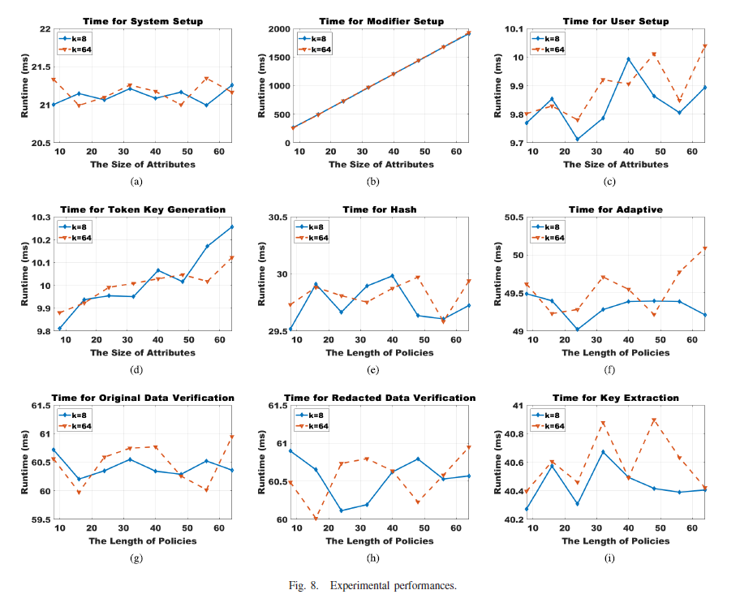
Proposed Scheme

Slide 40
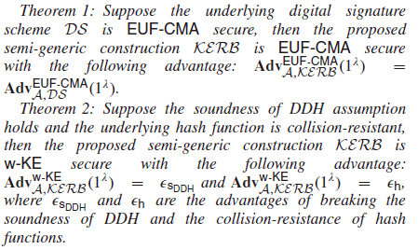
Security Proof

Slide 41
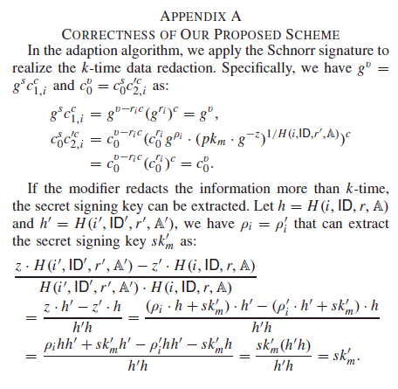
Security Proof
Notes:
P10

