Slide 1

Overview Technology
Confidential Proposal to UMass Boston for a Urinary Collagen Aptamer Diagnostic
(Phase I – understanding existing aptamer suitability in urine)
May 29, 2026

Slide 2
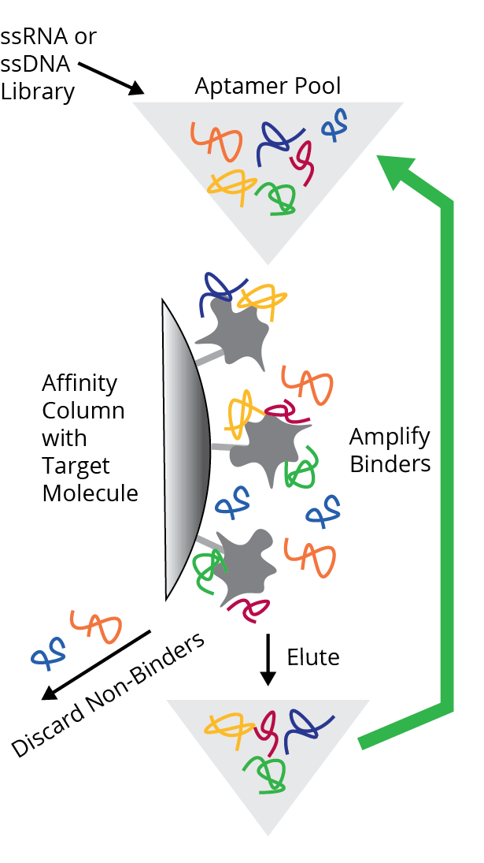
Technology Overview
Aptamers are nucleic acids selected in vitro from a library to bind to a particular target or targets.
Aptamer” is a term coined by Andy Ellington: “Aptus” = “to fit” + “meros” = “part”.
Like enzymes and antibodies, target recognition and binding involves three dimensional shape-dependent interactions, as well as charge interactions, hydrophobic interactions, base-stacking, intercalation, etc. Aptamers bind because they “fit” their targets.
MULTIPLEXING TECHNOLOGY
Conventional SELEX allows development of aptamers for only one target at a time. Base Pair’s patented multiplexing method allows us to screen our libraries against up to 30 targets simultaneously.
Shorter times to results AND the capability to identify binders under identical conditions in the same samples
U.S. Patent No. 8,314,052: a barcoding strategy that uses next generation sequencing to map aptamers binding to specific targets to their cognate sequences, even in complex mixtures.
Also issued in Japan, Canada, and EU (validated in Germany, France, Great Britain, and Italy)
VENN MULTIPLEX SELEX™
Proprietary bioinformatics algorithms combined with multiplex SELEX allow Base Pair to distinguish aptamers that bind single targets or multiple targets, and that do not bind unwanted molecules.
Systematic Evolution of Ligands by Exponential Enrichment (SELEX)
III. PROPRIETARY LIBRARIES
Base Pair has very large aptamer candidate libraries consisting of ~10¹⁵ unique molecules (for comparison, the best phage display antibody libraries have ~10⁹)
Standard libraries - 32-base random-sequence, synthetic native DNA or RNA, flanked by amplification primers
Specialized libraries - modifications that increase overall hydrophobicity, are tailored to bind specific targets (e.g. chelators), and/or other modifications that increase the diversity of secondary and tertiary structural conformations
Highly customized libraries - sensor-specific sequences and conformational changing structures designed upon request (including ribozymes/riboswitches)
Affinity maturation - Once initial selection is complete, aptamers can be “matured” by generating highly-focused, aptamer-specific libraries containing smaller randomized regions, truncations, nuclease-blocking technology, or conformational locking.
Advantages of Aptamers
Low cost: chemical synthesis based manufacture
No organisms involved: straightforward regulatory path
Versatile: non-immunogenic and toxic targets can be used; selection can take place under final assay conditions, including various sample types, binding inhibitors, etc.
Customizable: Easily conjugated to haptens, fluorophores, chromophores, enzymes, beads; readily modified to adjust affinity/avidity, stability, solubility, etc.
Small: can penetrate tissues, cells and other matrices, minimal steric hindrance, more moles/gram than antibodies
Stable: no cold chain required, highly soluble, denaturing is readily reversible

Slide 3
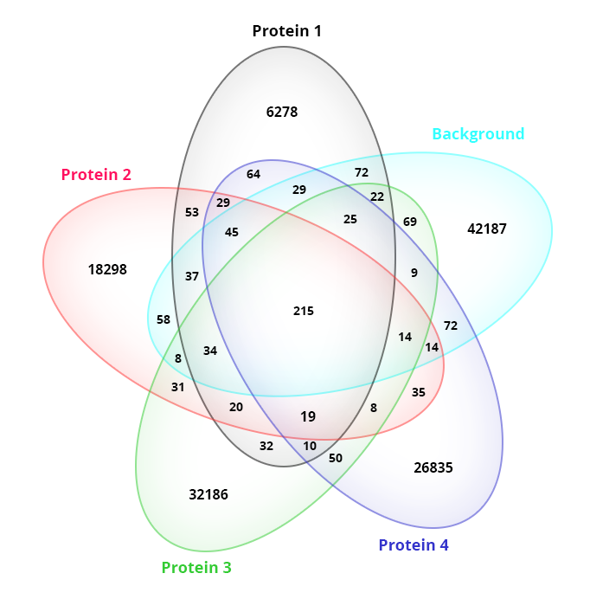
VennPlex SELEX (Patented by BasePair)
Venn Multiplex SELEX™
Proprietary bioinformatics algorithms and a patented barcoding strategy allow us to find aptamers that bind single targets or multiple targets, and that do not bind to unwanted molecules
Identifies binders up to 30 targets under identical conditions in the same samples
Same time our competitors require for a single target.
Reduces cost by grouping together targets/projects, providing pricing advantage
In the example at right, a client had four related proteins and wanted aptamers that were unique for each protein as well as aptamers that could recognize all four proteins
VennPlex SELEXTM identified 19 “pan binders” out of 100,000 aptamer candidates that bound all four related proteins while ignoring unwanted background, and also identified unique binders to each individual protein.
Unique binders
Pan binders (19)

Slide 4
Value Proposition vs. Competitors
Base Pair’s value proposition versus its competitors has the following key components:
Collaboration. Base Pair has a highly collaborative project design process, in which its scientists work closely with customers to tailor experimental designs to have the highest likelihood of success in meeting customer needs.
Flexibility. Base Pair, unlike its competitors, is very flexible in the choice of libraries, choice of DNA versus RNA, designing for expression in vivo versus in vitro use, project complexity, project design, immobilization surface (beads, arrays, gels, etc.), matrix/sample type for binding and elution, amount of validation, etc.
Multiplexing. Base Pair, unlike its competition, uses its patented method to perform SELEX in a true multiplex mode, including undesired targets along with desired targets in the immobilized as well as elution phase; de-convoluting data through bar-coding and next generation sequencing, facilitating lower per-aptamer pricing.
Accuracy. Unlike its competitors, Base Pair has validated several unique approaches to affinity measurements, which provide more accurate results than surface plasmon resonance. Surface plasmon resonance requires that one of the targets is immobilized, which perturbs the binding interaction. Additionally, in the case of a large molecule binding to a small molecule, the method is inaccurate and unreliable.

Slide 5
Project Challenge & Overall Strategy
Challenge: Dr. Macoska’s lab has shown that fibrillar collagen – the hallmark of tissue fibrosis – accumulates in the urine of men with lower urinary tract dysfunction, while controls show almost none. No non-invasive test for urinary tract fibrosis exists today, and the dye-based assay used to date (Sircol / Sirius Red) cannot be licensed for clinical use. UMass Boston seeks a point-of-care reagent to quantify fibrillar collagen in urine.
Strategy: Base Pair already holds an aptamer raised against the Gly-X-Y tripeptide repeat common to the fibrillar collagens (originally selected against a purified collagen reagent). Because aptamer binding can be matrix-dependent, the first objective is to confirm that this existing aptamer recognizes fibrillar collagen in urine and to determine its binding affinity (K_{D}) in that matrix. Collagen will be spiked into collagen-free / synthetic urine to establish a quantitative dose-response. If the existing aptamer binds with suitable affinity, Base Pair will advance it toward a quantitative point-of-care assay (e.g., electrochemical or lateral-flow format). If binding in urine is inadequate, Base Pair will perform a new SELEX campaign conducted directly in a urine matrix to generate aptamers optimized for the urinary sample type, with counter-selection against off-targets defined with UMass Boston.

Slide 6
Workflow overview
Obtain the existing anti-collagen aptamer, a purified fibrillar-collagen reagent, and collagen-free / synthetic urine
Phase 1 – Test the existing aptamer for binding to fibrillar collagen in urine and determine its binding affinity (K_{D}) using collagen spiked into urine
Establish a quantitative dose-response across spiked collagen concentrations
Confirm specificity against urine background and assess assay window vs. clinical collagen levels
Phase 2 (if needed) – Perform a new SELEX campaign directly in a urine matrix to generate aptamers optimized for urine, with counter-selection against off-targets
Screen and rank candidates by NGS; complete K_{D} determination of best candidates via MicroScale Thermophoresis (MST) or another appropriate method
Synthesize sample aptamer materials for point-of-care assay development by UMass Boston (electrochemical or lateral-flow format)*
* Phase 2 SELEX and any large-scale synthesis are scoped and quoted separately.

Slide 7
Timeline and Milestones – Phase 1 Feasibility
Timeline: ~6–9 weeks from receipt of materials
Obtain materials
~1 week
Binding test in urine
~1–2 weeks
K_{D} & dose-response
~2–3 weeks
Sample synthesis
~1–2 weeks
Milestone | Pricing (USD) | Payment Terms
Project Initiation & Materials | $2,500 | Due upon execution of the Aptamer Development Agreement.
Aptamer Binding Test in Urine (yes/no ranging expt) | $1,500 | Due within 30 days of Base Pair reporting binding results.
K_{D} Determination & Dose-Response in Urine | $4,500 | Due within 30 days of delivery of the Binding / K_{D} report.
Sample Aptamer Synthesis for Assay Development | $1,400 | Due within 30 days of shipment of sample materials.
TOTAL | $9,900*
* Final pricing provided in a formal quote. Phase 2 SELEX in urine is scoped separately if needed.

