Slide 1
Risk Board Game
John Owen Zeming Chen
Chengcheng Ding Zachary Prince

Slide 2
Risk Rules
Setup
Players take turns claiming territories until each one is claimed
Once every territory is claimed, players have a certain number of armies that they can place on their territories
On Each Player’s turn:
The player gets a certain number of armies, determined by the territories they own, to place on their current territories
With these armies they can attack and defend territories.
Once they are done attacking, they can move as many units to adjacent territories that they own as they like.
First player to control all territories wins the game.

Slide 3
User Stories ( As a player I want to be able to:)
See the status of each territory (number of armies, continent/territory name).
Move troops to adjacent territories.
Attack and defend territories.
See how many territories each player controls.
Be able to end the turn, passing it to the next player.
See who’s turn it currently is.
Know the state of the current turn.

Slide 4
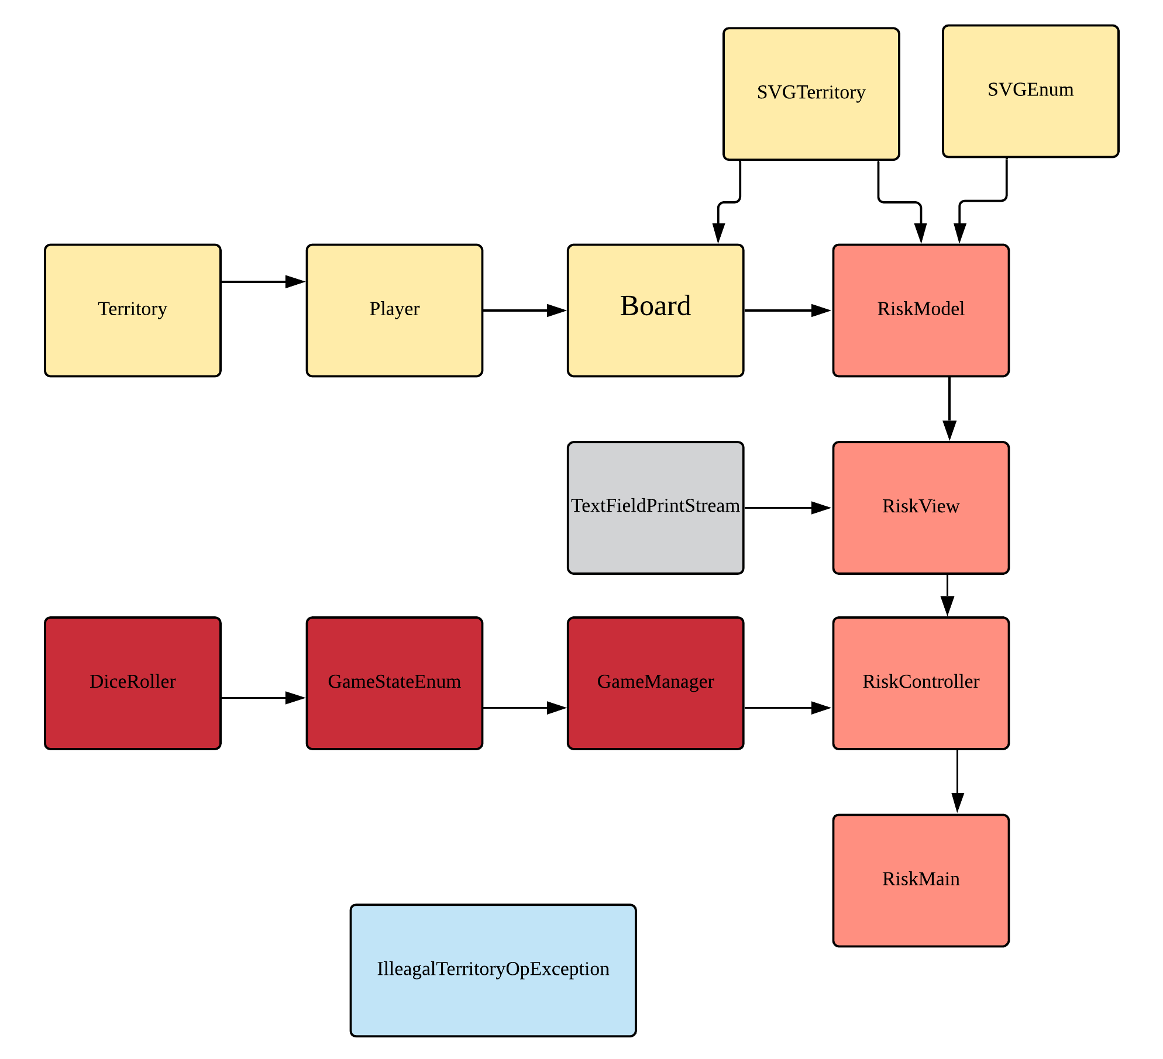
Basic UML

Slide 5
User Interface

Slide 6
Demo!

Slide 7
Scrum experience
Switching between roles between sprints
flexible to everyone’s schedule
experience for all
Problems with clear user stories due to the nature of the game

Slide 8
Strengths
Clear goal on minimum and maximum
We know what are the things that we will be able to accomplish at least, and the stuff we could given the time
Good division between works
Utilizing personal strengths
Dedication to work and assignments

Slide 9
Weakness & Challenges
Git Hell
Several high coupling classes that was hard to get around with
Individual pulls

Slide 10
Conclusion & Risk 2.0
What we’ve learned -- first time collaborating on a project
SVG and CSS for GUI design
For Risk 2.0
Networking between players
Better looking GUI
AI Opponents

