Slide 1
Image Classification and Unsupervised Image Object Removal in the Street View House Numbers Dataset
Group 7 Final Project
Bill Grieser -- Darshan Kasat -- Shivam Thassu

Slide 2
The Project
Use the Street View House Numbers dataset to classify images from the Street View House Numbers dataset
Explore using PyTorch and the by-products of an image classification network to remove digits from the test data used in 1)

Slide 3
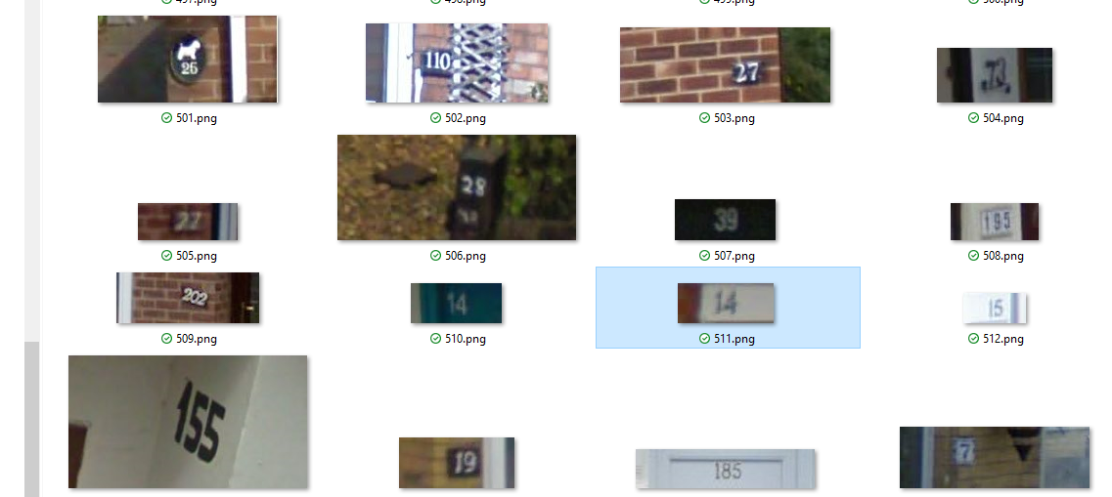
The Data
Images from Google Street View that contain digits

Slide 4
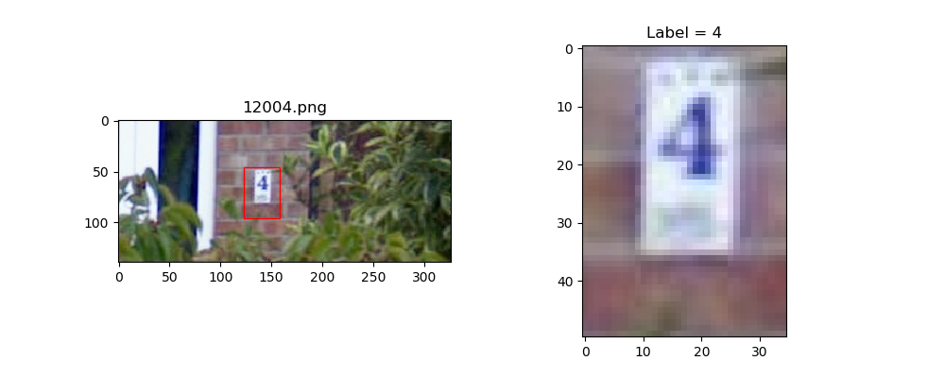
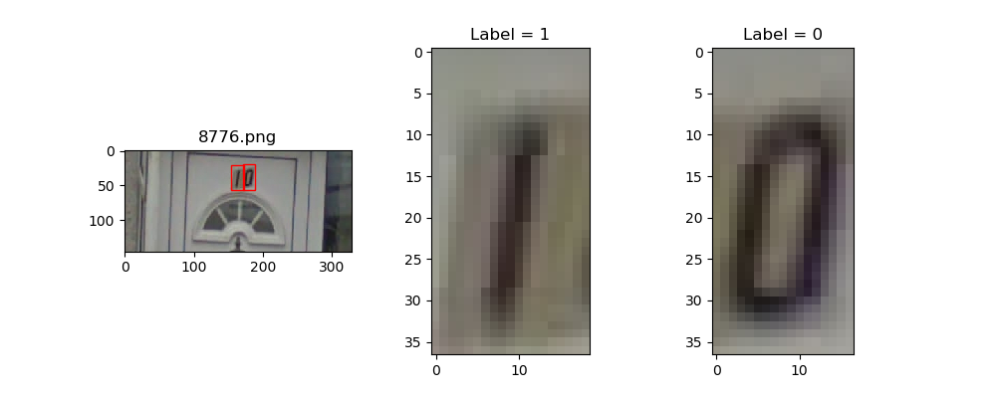
Data Components
PNG file per parent image
Bounding Box co-ordinates to identify digits in parent image
Label (0..9)
Available in two different formats:
Format 1: Original images with bounding box available for each character (may contain multiple characters in same images).
Format 2: MNIST like 32x32 cropped images having single character in each image.

Slide 5
Tasks
Classify digit from image
TensorFlow
Caffe
PyTorch
Remove digit from image (experimental)
PyTorch

Slide 6


Slide 7
About TensorFlow
TensorFlow is an open source software library for numerical computation using dataflow graphs. Nodes in the graph represents mathematical operations, while graph edges represent multi-dimensional data arrays (aka tensors) communicated between them.
TensorFlow as nothing but numpy with a twist. A major difference between numpy and TensorFlow is that TensorFlow follows a lazy programming paradigm. The advantages of using TensorFlow are:
It has an intuitive construct, because as the name suggests it has “flow of tensors”. You can easily visualize each part of the graph.
Easily train on CPU/GPU for distributed computing
Platform flexibility. You can run the models wherever you want, whether it is on mobile, server or PC.

Slide 8
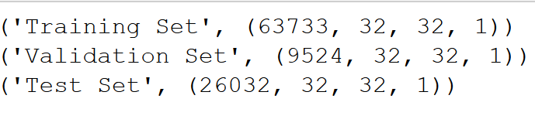
PREPROCESSING
In this dataset all digits have been resized to a fixed resolution of 32-by-32 pixels.
Initial Exploratory Analysis
Created a Balanced (Startified) 13% of data in Validation Set.
Splitting to 13% in Val Set as it gives around 9500 data having minimum of 800 instances of each class.
Converting the Label 10's to 0’s
So, we got a target label of [0 1 2 3 4 5 6 7 8 9]
RGB to Grayscale
Since we are not concerned about the color of the image. Increase the computation
Normalization & Storing to Disk
Used h5py package to store the numerical data, so that it can be easily manipulated using NumPy.

Slide 9
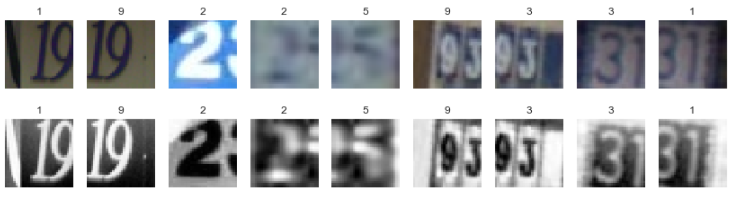
IMAGE SAMPLE

Slide 10
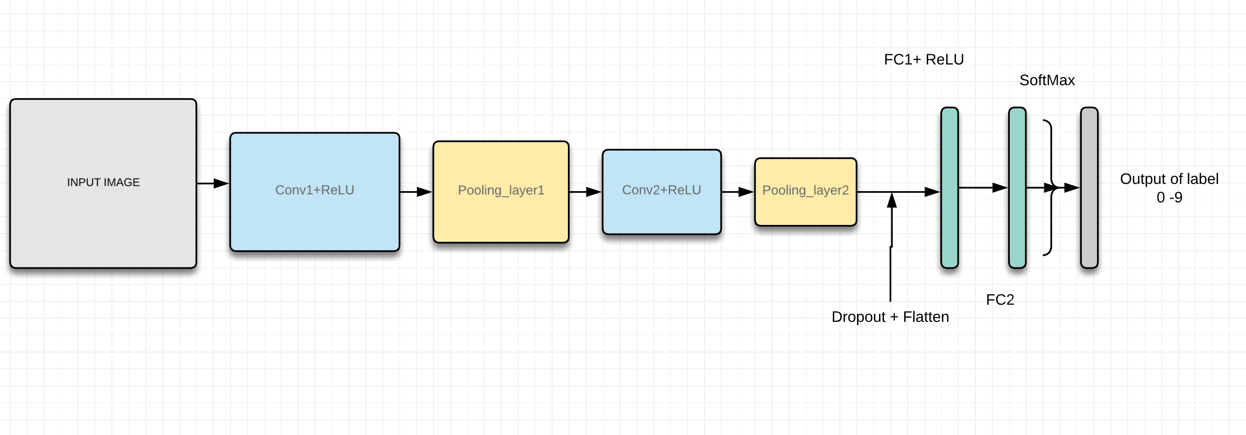
MODEL ARCHITECTURE

Slide 11
Bit Info…
Softmax
The second fully-connected layer estimates how likely it is that the input image belongs to each of the 10 classes. However, these estimates are a bit rough and difficult to interpret because the numbers may be very small or large, so we want to normalize them so that each element is limited between zero and one and the 10 elements sum to one. This is calculated using the so-called softmax function and the result is stored in y_pred.
Calculate Cross-entropy
To make the model better at classifying the input images, we must somehow change the variables for all the network layers. Comparing the predicted output of the model y_pred to the desired output y_true.
Optimization Method: Adam
Through experimentation we found out Adam outperformed other optimizers for this problem in terms of convergence speed.

Slide 12
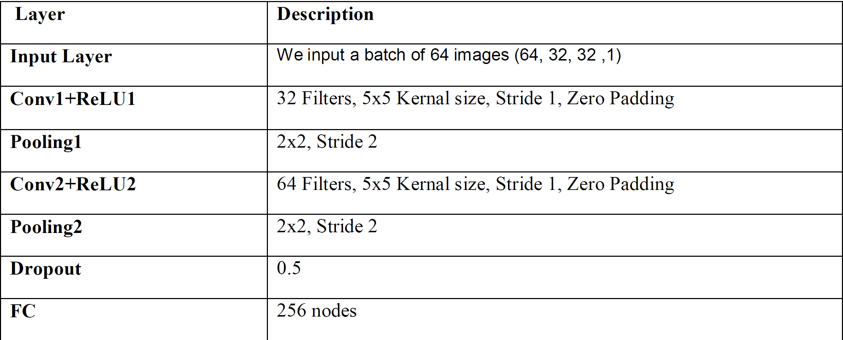
Parameters

Slide 13
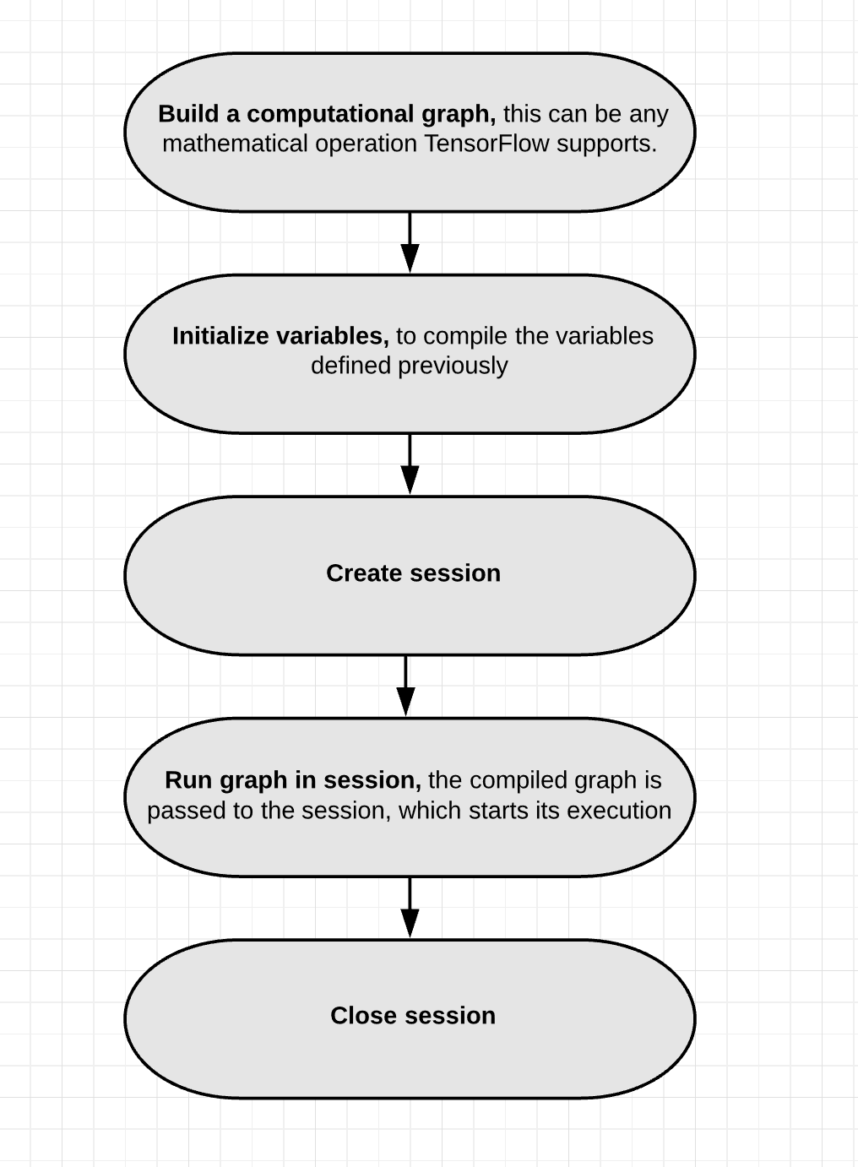
FRAMEWORK WORKFLOW
write functions for creating new TF variables
define Placeholder Variables. They serve as the input to the graph
that we may change each time we execute the graph
In order to save the variables of the neural network created saver object
which is used for storing and retrieving all the variables of the
TensorFlow graph. The saved files are often called checkpoints

Slide 14
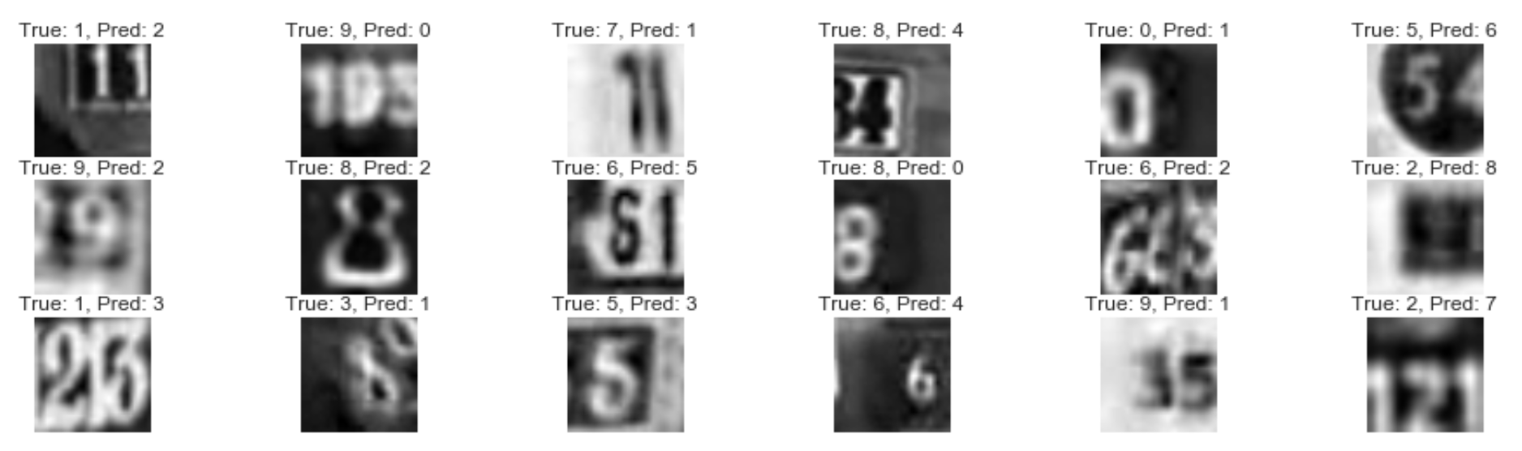
RESULTS
With the mentioned Architecture I got Test accuracy of 92.96 % at 50000 iterations.
I had some of the misclassified images which I found so I dig in deeper to see how good the model works

Slide 15
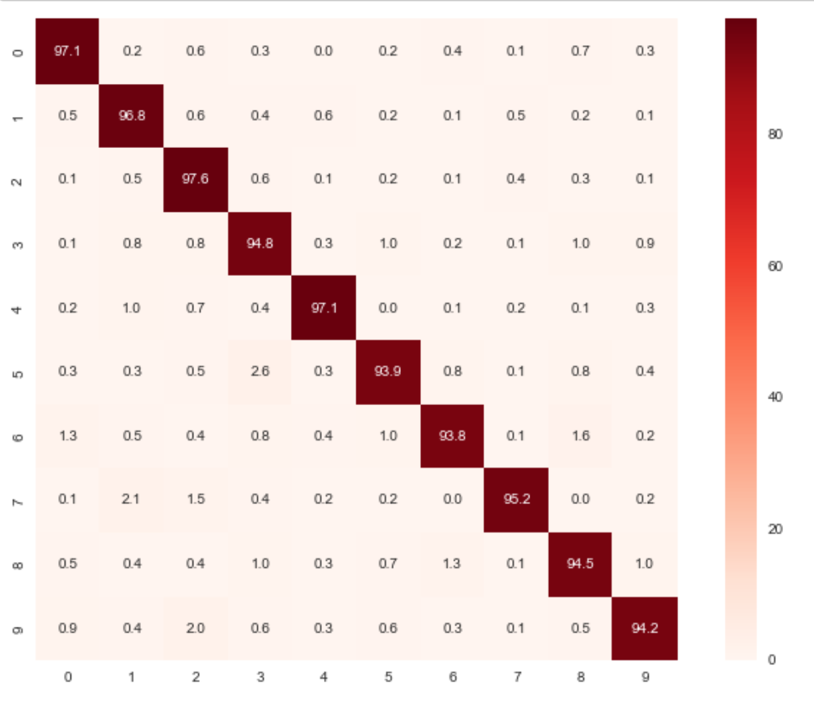
CONFUSION MATRIX
All digits have accuracy > 90%
Can say the model does good Classification.

Slide 16


Slide 17

Data Preprocessing
Caffe works on Lightning Memory-Mapped Database in the back end.
Data was available in .mat file.
I used scipy to read the data from mat file
Data in the form of 4D array:
(Width, Height, Channels, Total_Number)
(Total_Number, Channels, Width, Height)

Slide 18
Data Preprocessing
Digit "0" was labeled as "10"
Normalization
Generates mean.binaryproto file
Goes under transform_param in the data layer.

Slide 19
CNN Architecture
The architecture comprises of two conv-relu-pooling-BN layers. The third layer is conv-relu-pooling. It is further connected to a fully connected layer with dropout.
Network parameters:
The architecture is a 32-32-64 architecture.
Kernel size: 5
Batch_size: 48
Dropout: 0.5
Optimizer: Adam

Slide 20
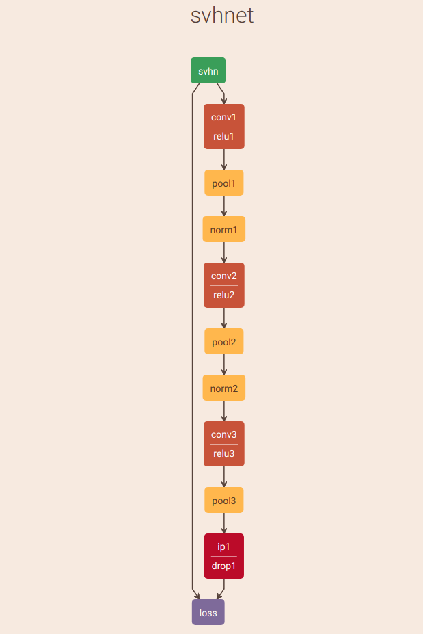
CNN Architecture

Slide 21
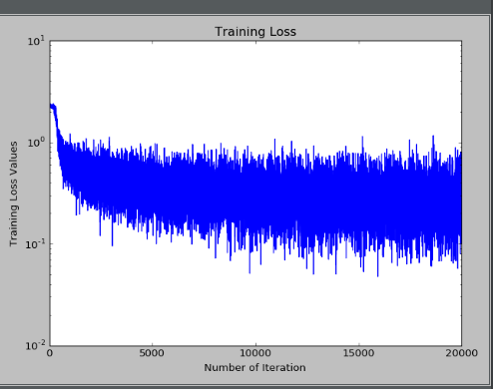
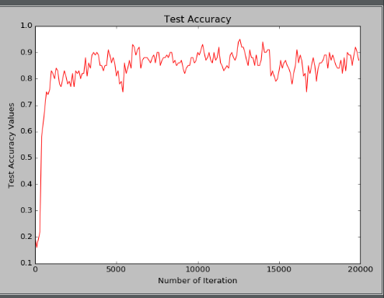
Results
The model achieved the accuracy of 91%.

Slide 22
Image Classification with PyTorch
Preprocessing:
Resize to 40 x 40
Grayscale
Algorithm:
Convolutional Neural Network with 3 Convolution-BatchNorm-Relu-Maxpool, layers, Dropout, and Fully Connected Layer
Kernel size 3x3
Number of kernels: 48 – 64 – 32
Dropout p=0.50
Optimizer: SGD
Batch Size: 32
Learning rate: 0.005

Slide 23
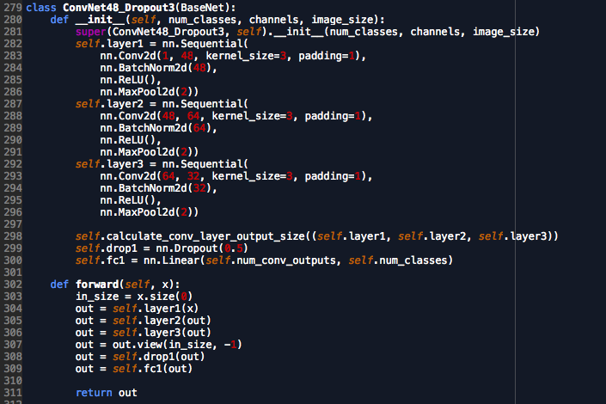
The PyTorch Model

Slide 24
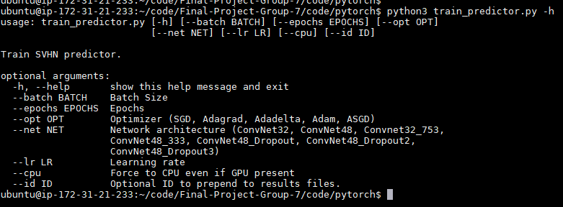
Experimental Approach
Main python code accepted command line arguments to select different network architectures and hyper-parameters
Each run results run written file
Bash scripts to kick off runs in the background
Used cloud GPU – way too slow on a CPU-only machine
Performance measures collected each epoch:
Loss
Val Accuracy
Weights saved for later visualization

Slide 25
Overfitting Countermeasures
Used dropout at 50%
Monitored performance metrics over epochs to look for tell-tale loss decreasing while validation accuracy increasing
Batch Size
Used a small batch size of 32 to get frequent weight updates
Performed as well as 16
Larger batch sizes ran faster, did not perform as well

Slide 26
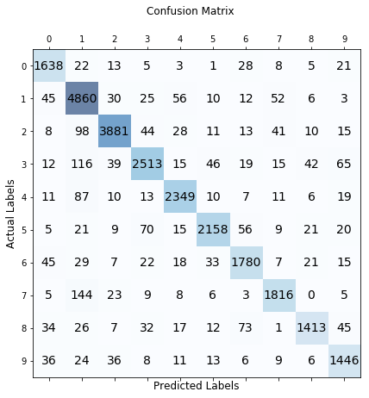
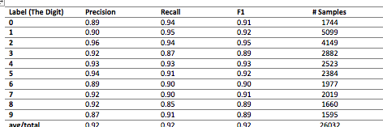
Results
Accuracy is the performance metric (target .90)
Achieved 91.6% on the test data
(Need to try 5x5 kernels w/ Dropout)

Slide 27
Monitored Metrics
“Winning” network did not show overfitting signs but runner-up did

Slide 28
Unsupervised Digit Removal from Images
Not supervised: No labeled training data
Approach:
Train a model in PyTorch to classify digit images
Use by-products of the model to identify key pixels for an image
Key Pixel: represents the background without the digit
Create a Generalized Regression NN, trained with the key pixels, to generate an image
Goal is when the generated image is returned to the parent, a photorealistic image without the digit results

Slide 29
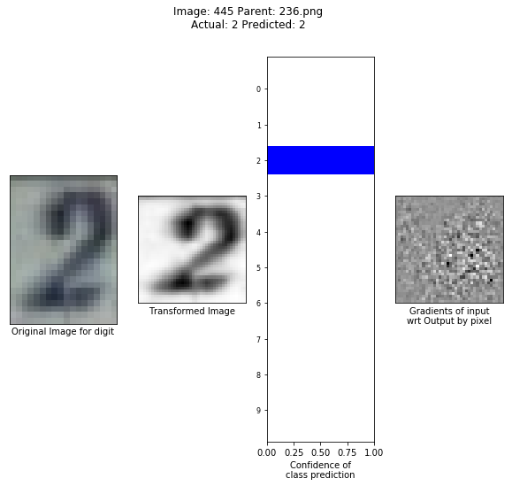
Identifying Key Pixels
First thought, gradients
Very noisy
Promising, perhaps better suited to a supervised approach

Slide 30
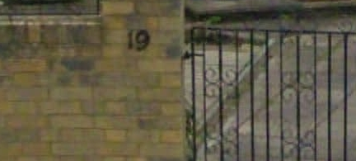
Next Try: Feature Maps from first Conv Layer
First layer set up with stride, padding to have same Feature Map size as the image
48 Feature Maps from the first layer, reduced using mean() and std() across the pixel dimension – results in a tensor dimensioned the same as the image

Slide 31
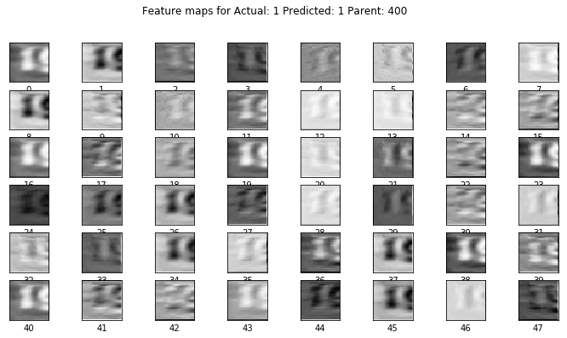
Feature Map for the first digit . . .

Slide 32
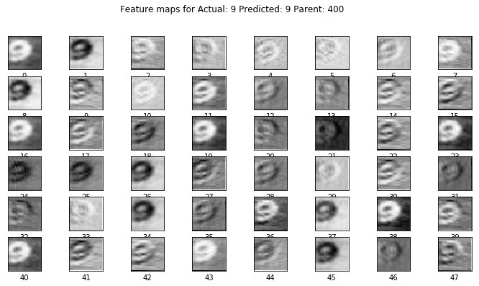
. . .And the second

Slide 33
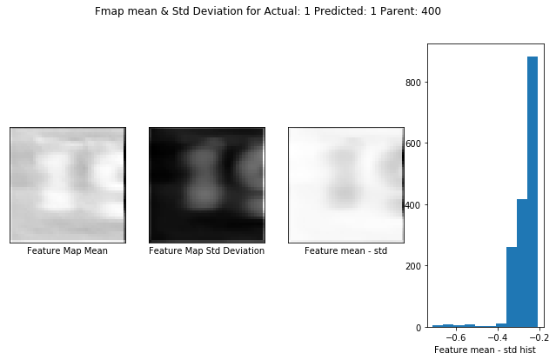
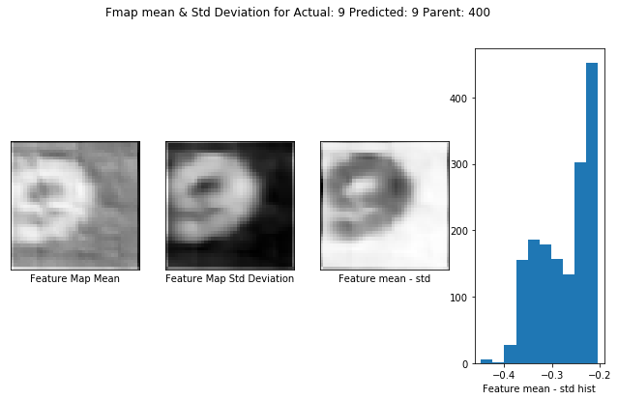
Feature Map Reductions

Slide 34
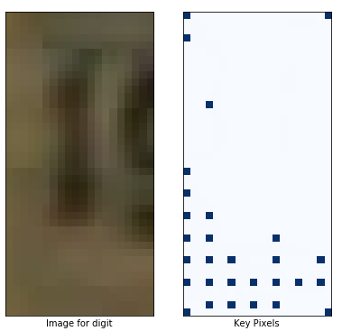
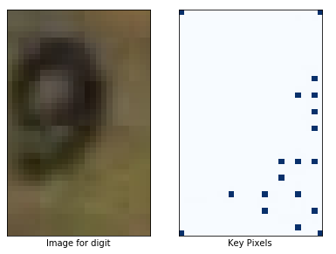
Key Pixel Identification

Slide 35
Network to Generate an Image
Based on a paper about image infill after removing overlays:
Alilou, V., & Yaghmaee, F. (2015). Application of GRNN neural network in non-texture image inpainting and restoration. Pattern Recognition Letters, 24-31.

Slide 36
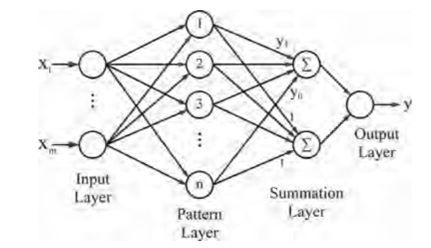
Architecture
Input: x,y co-ordinate
Output: Pixel value ( range[0..1])
Pattern layer outputs distance from input X to every node to itself
Weights between pattern layer nodes and top summation layer are learned
Weights to bottom note in summation layer always 1
Output layer transfer function is a radial basis function

Slide 37
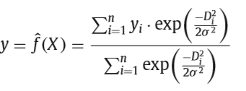
Radial Basis Function for summation and output layers
Gaussain: Nearby pattern nodes have greater influence than distant one on predicted X
Sigma – “spread” or “bias: determines how quickly the influence of a pattern node diminishes with distance

Slide 38
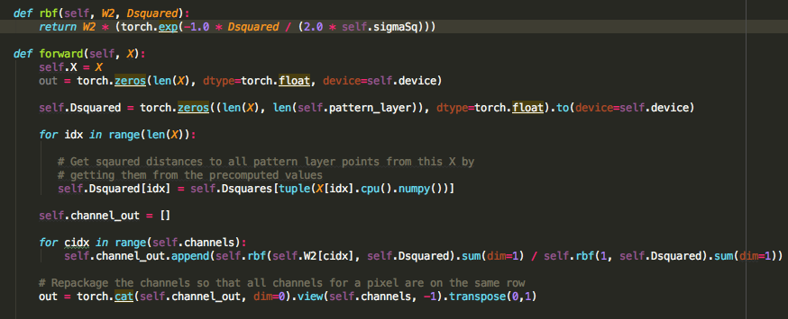
PyTorch Module (excerpt)

Slide 39
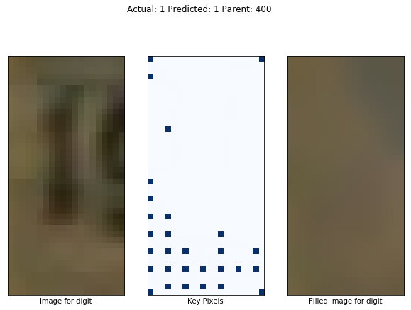
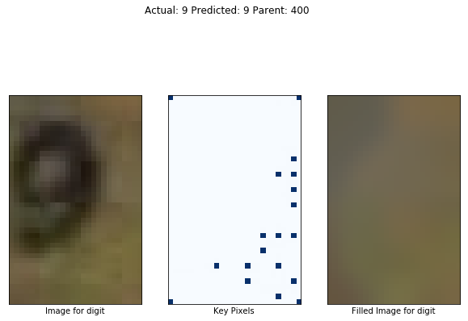
Results

Slide 40
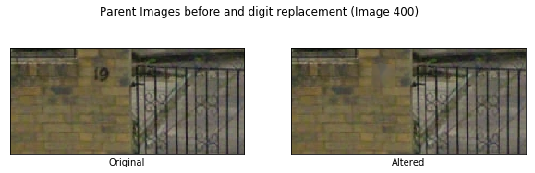
Final Results

Slide 41
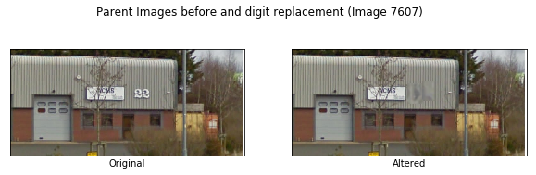
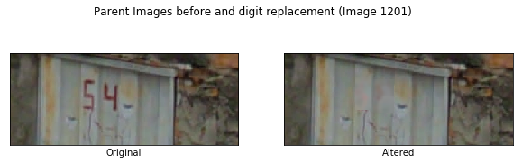
Hits and Misses

Slide 42
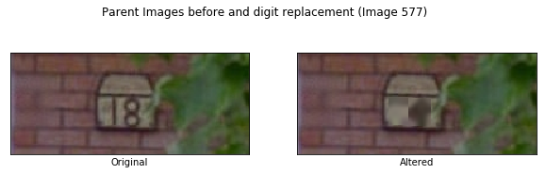
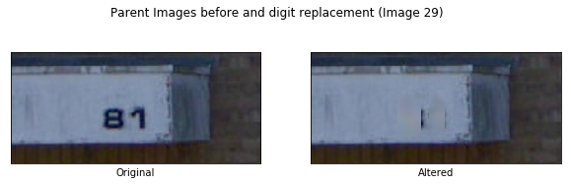
Hits and Misses (cont’d)

