Slide 1


Slide 2

Data Preprocessing
Caffe works on Lightning Memory-Mapped Database in the back end.
Data was available in .mat file.
I used scipy to read the data from mat file
Data in the form of 4D array:
(Width, Height, Channels, Total_Number)
(Total_Number, Channels, Width, Height)

Slide 3
Data Preprocessing
Digit "0" was labeled as "10"
Normalization
Generates mean.binaryproto file
Goes under transform_param in the data layer.

Slide 4
CNN Architecture
The architecture comprises of two conv-relu-pooling-BN layers. The third layer is conv-relu-pooling. It is further connected to a fully connected layer with dropout.
Network parameters:
The architecture is a 32-32-64 architecture.
Kernel size: 5
Batch_size: 48
Dropout: 0.5
Optimizer: Adam

Slide 5
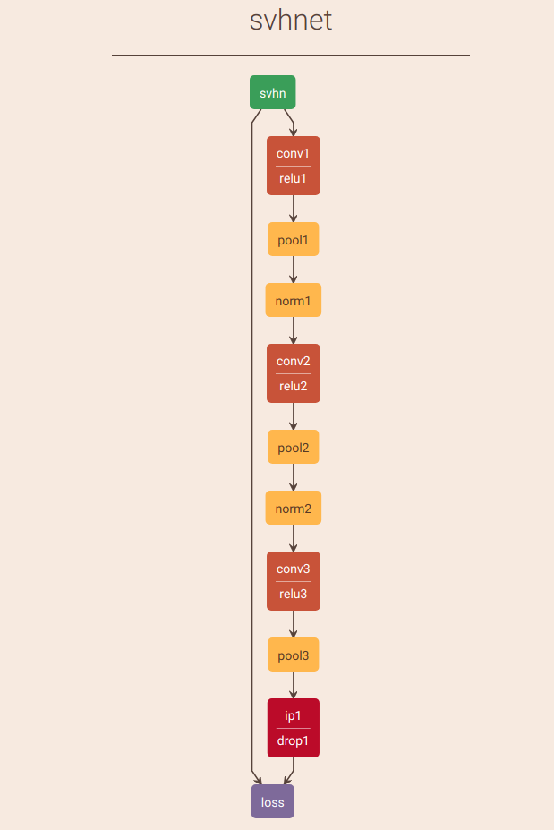
CNN Architecture

Slide 6
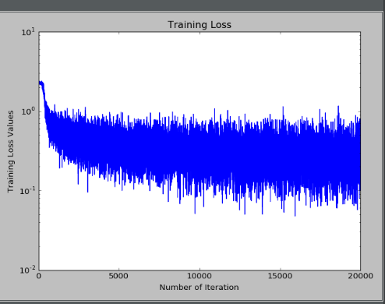
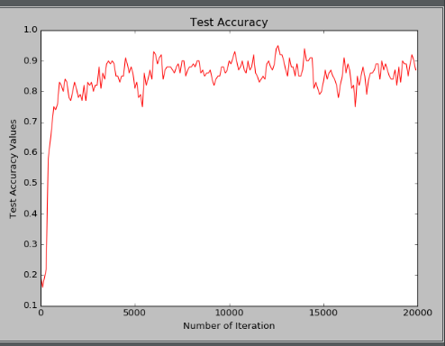
Results
The model achieved the accuracy of 91%.

