Slide 1
MACHINE LEARNING 2
FINAL PROJECT PRESENTATION
Bill Grieser
Darshan Kasat
Shivam Thassu

Slide 2


Slide 3
DATA SET
Google Street View House Number(SVHN) Dataset
Souce: http://ufldl.stanford.edu/housenumbers/
SVHN is a real-world image dataset for developing machine learning and object recognition algorithms with minimal requirement on data preprocessing and formatting. It is similar in flavor to MNIST (e.g., the images are of small cropped digits), but incorporates an order of magnitude more labeled data (over 600,000-digit images)
Total 10 Classes, 1 for each digits i.e Label '9' for digit 9 and '10' for digit 0.
73,257 digits for training, 26,032 digits for testing
Available in two different formats:
Format 1: Original images with bounding box available for each character (may contain multiple characters in same images).
Format 2: MNIST like 32x32 cropped images having single character in each image.
I worked on Format 2 dataset in this project using CNN Architecture on TensorFlow framework.

Slide 4
About TensorFlow
TensorFlow is an open source software library for numerical computation using dataflow graphs. Nodes in the graph represents mathematical operations, while graph edges represent multi-dimensional data arrays (aka tensors) communicated between them.
TensorFlow as nothing but numpy with a twist. A major difference between numpy and TensorFlow is that TensorFlow follows a lazy programming paradigm. The advantages of using TensorFlow are:
It has an intuitive construct, because as the name suggests it has “flow of tensors”. You can easily visualize each part of the graph.
Easily train on CPU/GPU for distributed computing
Platform flexibility. You can run the models wherever you want, whether it is on mobile, server or PC.

Slide 5
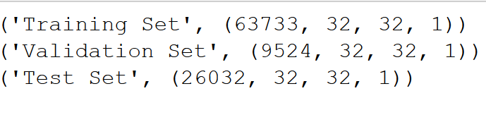
PREPROCESSING
In this dataset all digits have been resized to a fixed resolution of 32-by-32 pixels.
Initial Exploratory Analysis
Created a Balanced (Startified) 13% of data in Validation Set.
Splitting to 13% in Val Set as it gives around 9500 data having minimum of 800 instances of each class.
Converting the Label 10's to 0’s
So, we got a target label of [0 1 2 3 4 5 6 7 8 9]
RGB to Grayscale
Since we are not concerned about the color of the image. Increase the computation
Normalization & Storing to Disk
Used h5py package to store the numerical data, so that it can be easily manipulated using NumPy.

Slide 6
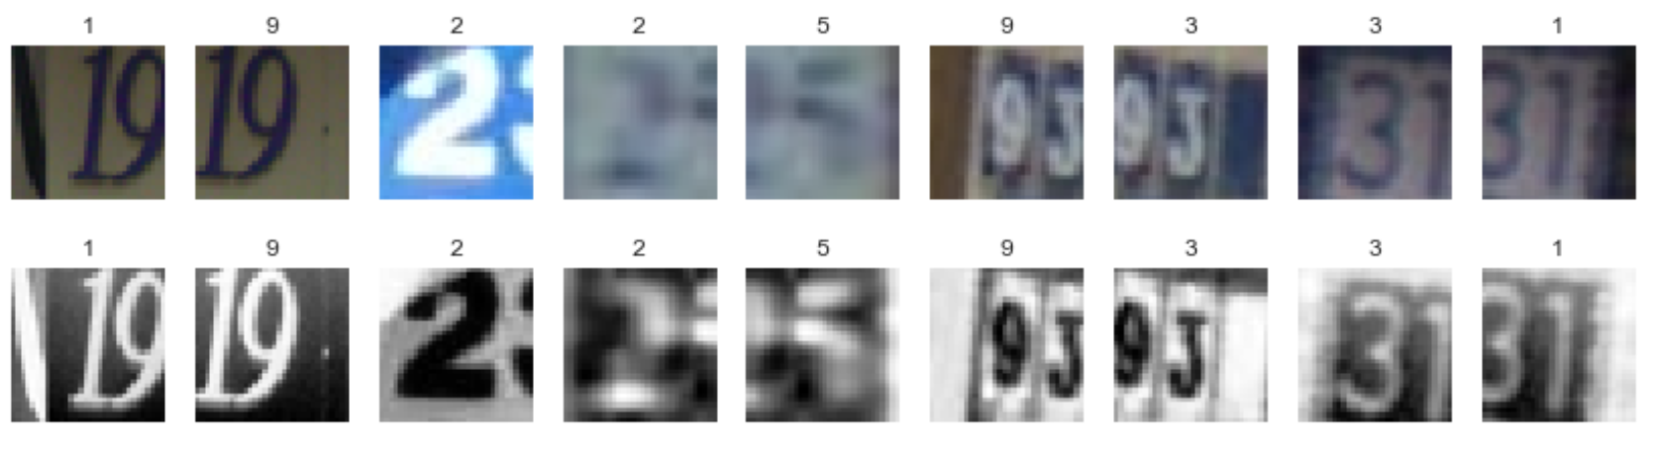
IMAGE SAMPLE

Slide 7
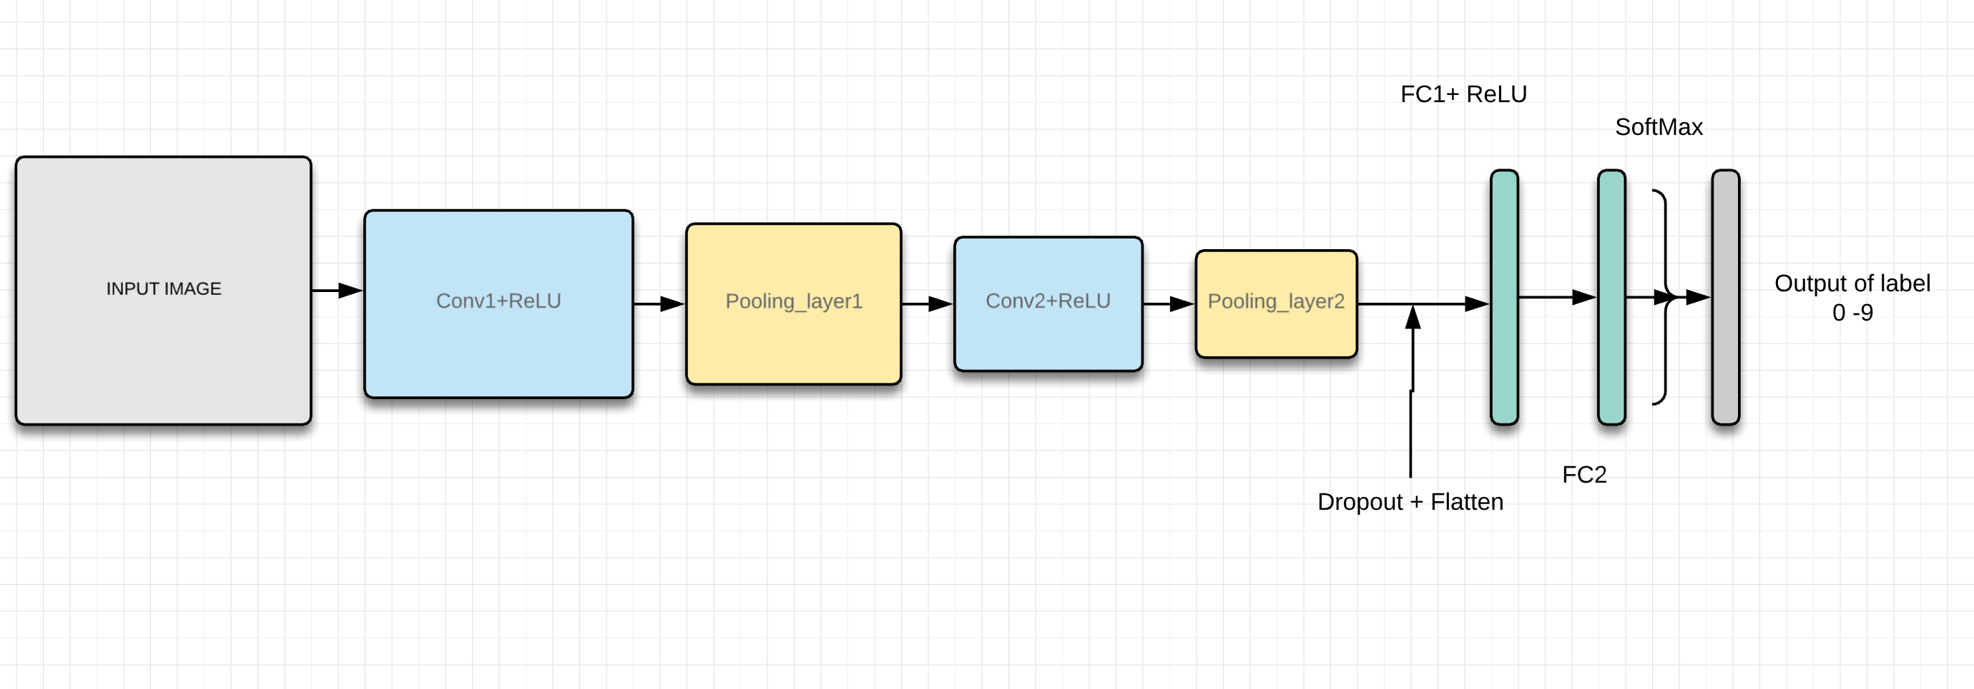
MODEL ARCHITECTURE

Slide 8
Bit Info…
Softmax
The second fully-connected layer estimates how likely it is that the input image belongs to each of the 10 classes. However, these estimates are a bit rough and difficult to interpret because the numbers may be very small or large, so we want to normalize them so that each element is limited between zero and one and the 10 elements sum to one. This is calculated using the so-called softmax function and the result is stored in y_pred.
Calculate Cross-entropy
To make the model better at classifying the input images, we must somehow change the variables for all the network layers. Comparing the predicted output of the model y_pred to the desired output y_true.
Optimization Method: Adam
Through experimentation we found out Adam outperformed other optimizers for this problem in terms of convergence speed.

Slide 9
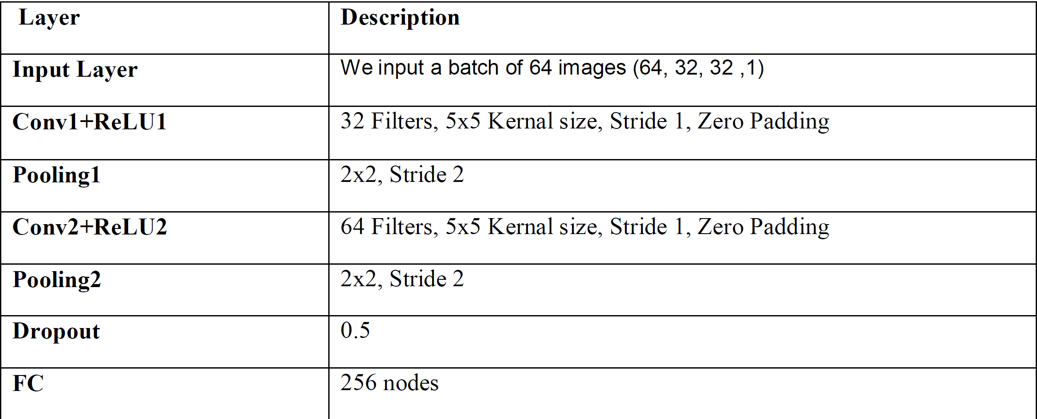
Parameters

Slide 10
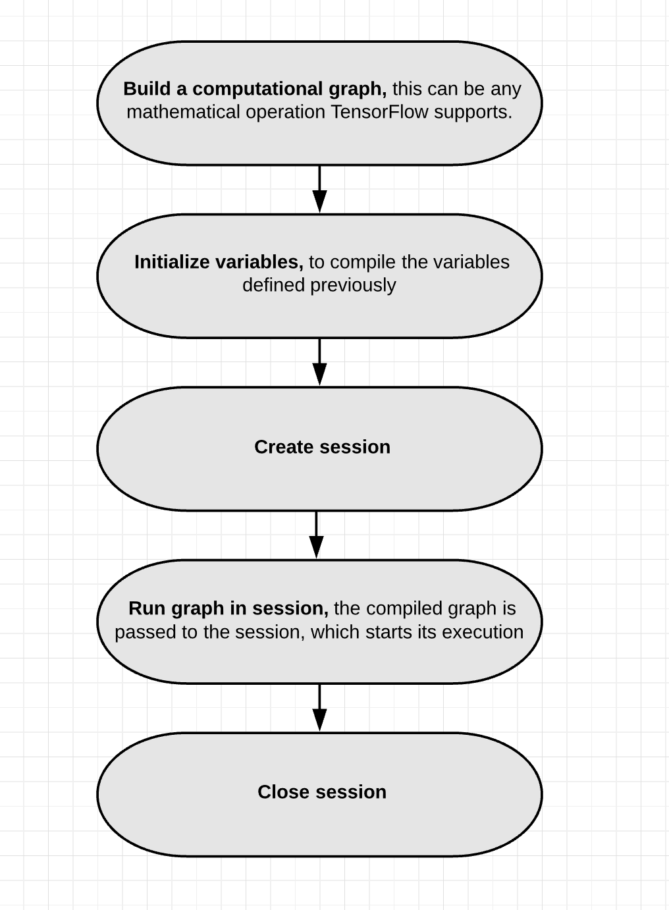
FRAMEWORK WORKFLOW
write functions for creating new TF variables
define Placeholder Variables. They serve as the input to the graph
that we may change each time we execute the graph
In order to save the variables of the neural network created saver object
which is used for storing and retrieving all the variables of the
TensorFlow graph. The saved files are often called checkpoints

Slide 11
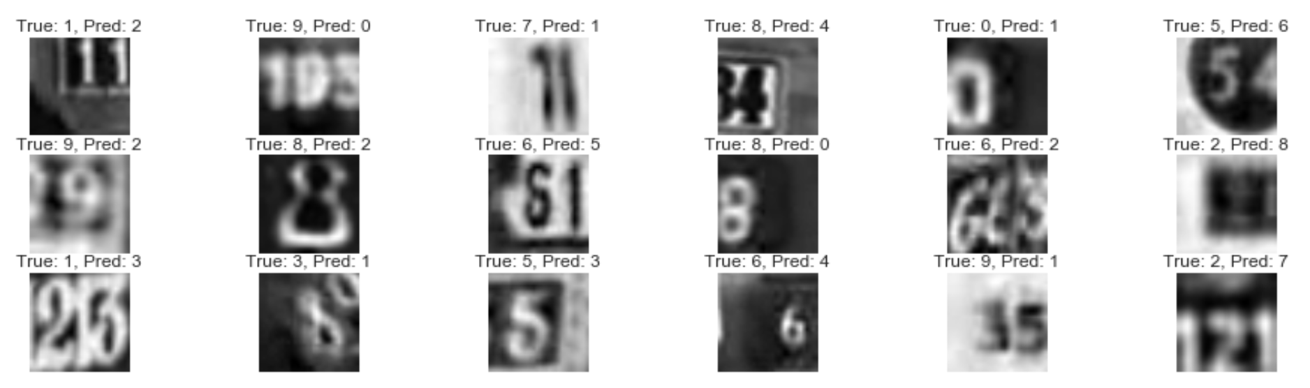
RESULTS
With the mentioned Architecture I got Test accuracy of 92.96 % at 50000 iterations.
I had some of the misclassified images which I found so I dig in deeper to see how good the model works

Slide 12
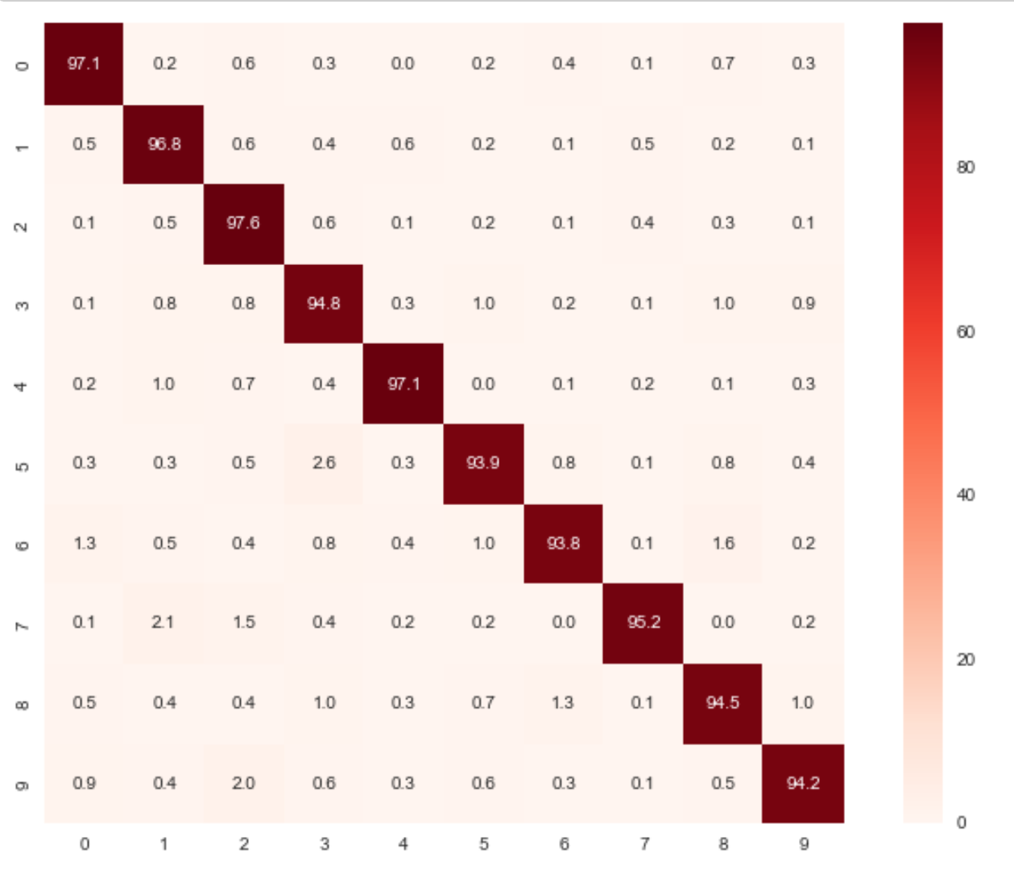
CONFUSION MATRIX
All digits have accuracy > 90%
Can say the model does good Classification.

