Slide 1
Image Classification and Unsupervised Image Object Removal in the Street View House Numbers Dataset
Group 7 Final Project
Bill Grieser -- Darshan Kasat -- Shivam Thassu

Slide 2
The Project
Use the Street View House Numbers dataset to classify images from the Street View House Numbers dataset
Explore using PyTorch and the by-products of an image classification network to remove digits from the test data used in 1)

Slide 3
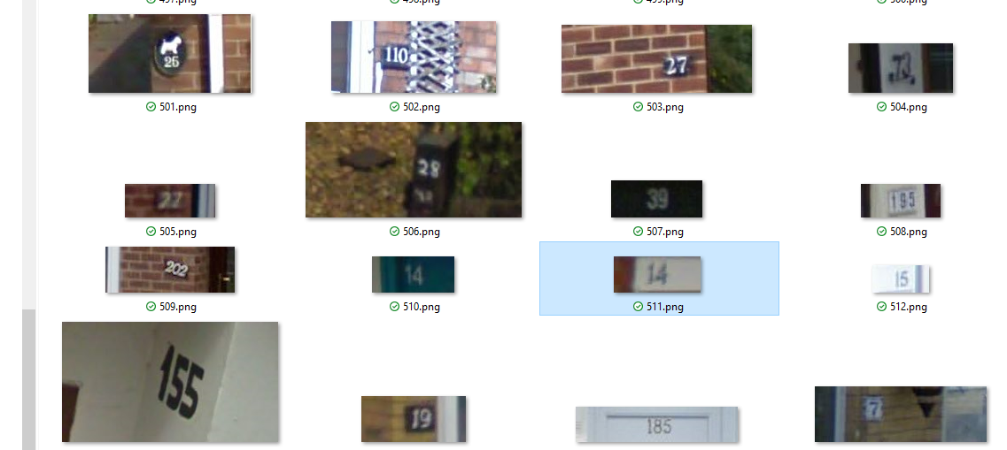
The Data
Images from Google Street View that contain digits

Slide 4
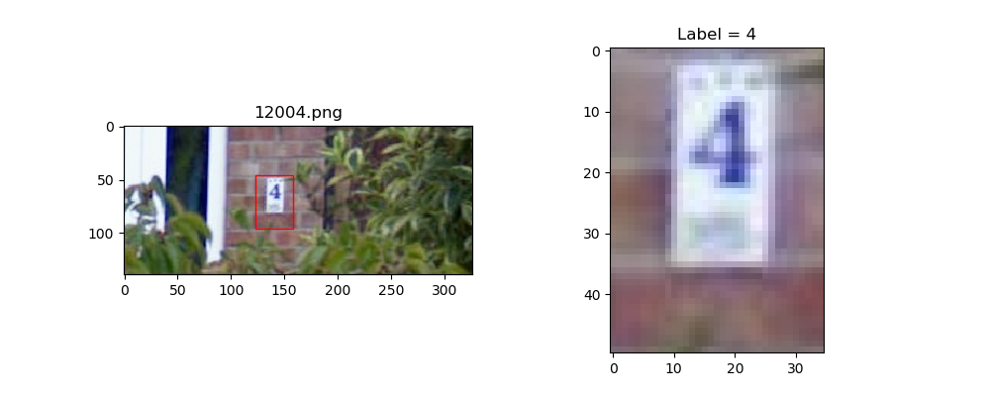
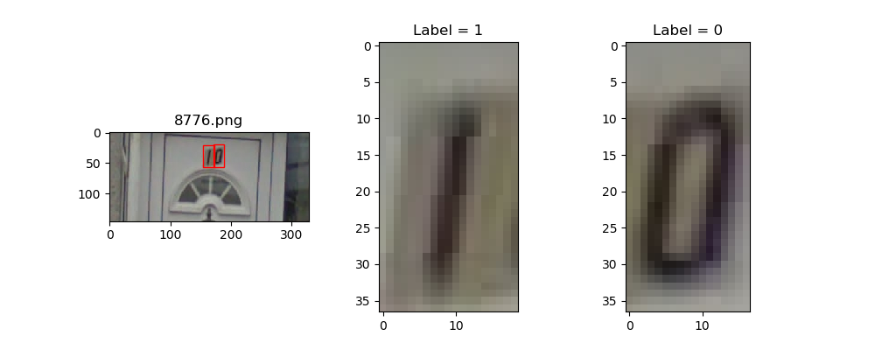
Data Components
PNG file per parent image
Bounding Box co-ordinates to identify digits in parent image
Label (0..9)

Slide 5
Tasks
Classify digit from image
TensorFlow
Caffe
PyTorch
Remove digit from image (experimental)
PyTorch

Slide 6
Image Classification with TensorFlow

Slide 7
Image Classification with Caffe

Slide 8
Image Classification with PyTorch
Algorithm:
Convolutional Neural Network with 3 Convolution-BatchNorm-Relu-Maxpool, layers, Dropout, and Fully Connected Layer
Kernel size 3x3
Number of kernels: 48 – 64 – 32
Dropout p=0.50
Optimizer: SGD
Batch Size: 32
Learning rate: 0.005

Slide 9
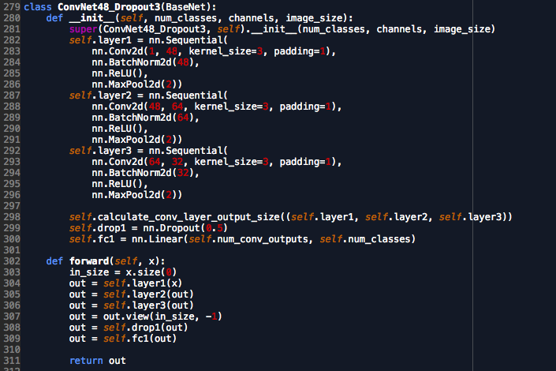
The PyTorch Model

Slide 10
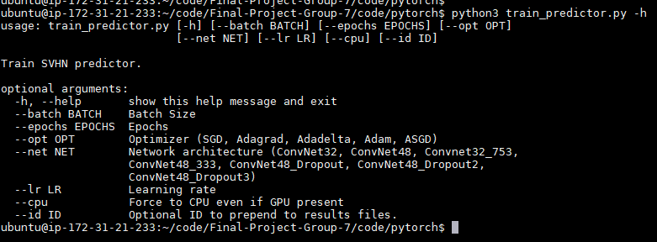
Experimental Approach
Main python code accepted command line arguments to select different network architectures and hyper-parameters
Each run results run written file
Bash scripts to kick off runs in the background
Used cloud GPU – way too slow on a CPU-only machine
Performance measures collected each epoch:
Loss
Val Accuracy
Weights saved for later visualization

