Slide 1
Image Classification and Unsupervised Image Object Removal in the Street View House Numbers Dataset
Group 7 Final Project
Bill Grieser -- Darshan Kasat -- Shivam Thassu

Slide 2
The Project
Use the Street View House Numbers dataset to classify images from the Street View House Numbers dataset
Explore using PyTorch and the by-products of an image classification network to remove digits from the test data used in 1)

Slide 3
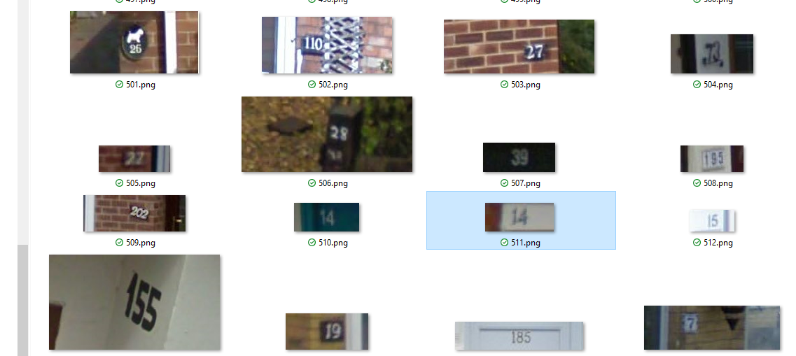
The Data
Images from Google Street View that contain digits

Slide 4
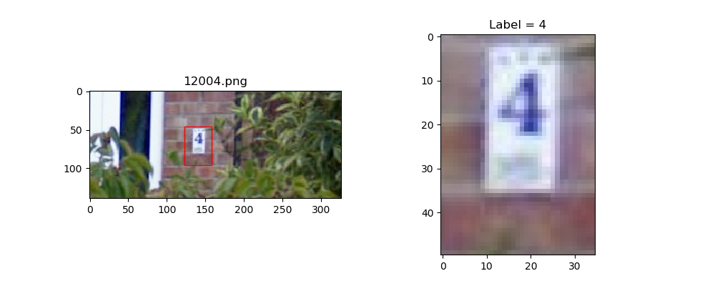
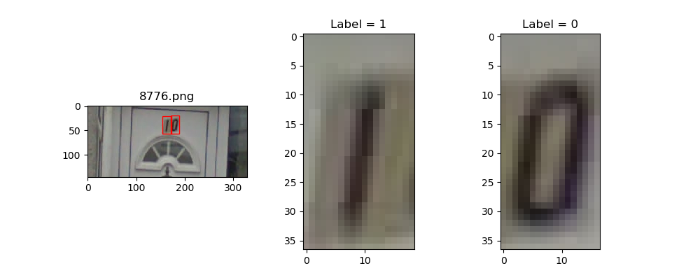
Data Components
PNG file per parent image
Bounding Box co-ordinates to identify digits in parent image
Label (0..9)

Slide 5
Tasks
Classify digit from image
TensorFlow
Caffe
PyTorch
Remove digit from image (experimental)
PyTorch

Slide 6
Image Classification with TensorFlow

Slide 7
Image Classification with Caffe

Slide 8
Image Classification with PyTorch
Preprocessing:
Resize to 40 x 40
Grayscale
Algorithm:
Convolutional Neural Network with 3 Convolution-BatchNorm-Relu-Maxpool, layers, Dropout, and Fully Connected Layer
Kernel size 3x3
Number of kernels: 48 – 64 – 32
Dropout p=0.50
Optimizer: SGD
Batch Size: 32
Learning rate: 0.005

Slide 9
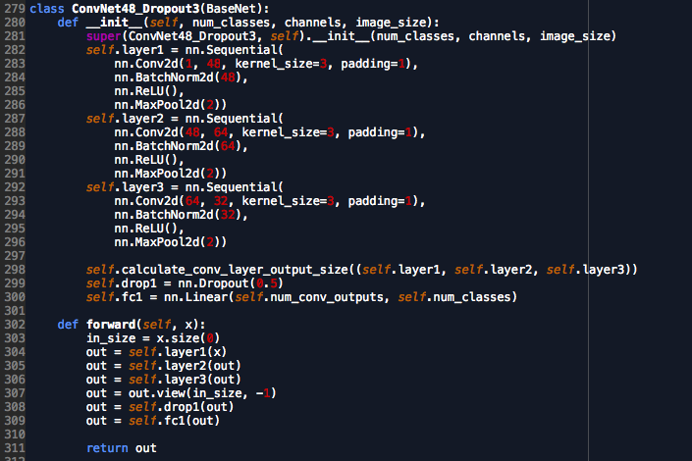
The PyTorch Model

Slide 10
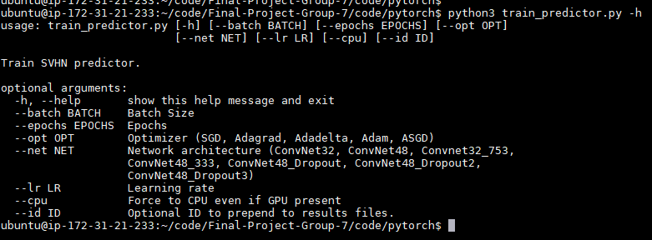
Experimental Approach
Main python code accepted command line arguments to select different network architectures and hyper-parameters
Each run results run written file
Bash scripts to kick off runs in the background
Used cloud GPU – way too slow on a CPU-only machine
Performance measures collected each epoch:
Loss
Val Accuracy
Weights saved for later visualization

Slide 11
Overfitting Countermeasures
Used dropout at 50%
Monitored performance metrics over epochs to look for tell-tale loss decreasing while validation accuracy increasing
Batch Size
Used a small batch size of 32 to get frequent weight updates
Performed as well as 16
Larger batch sizes ran faster, did not perform as well

Slide 12
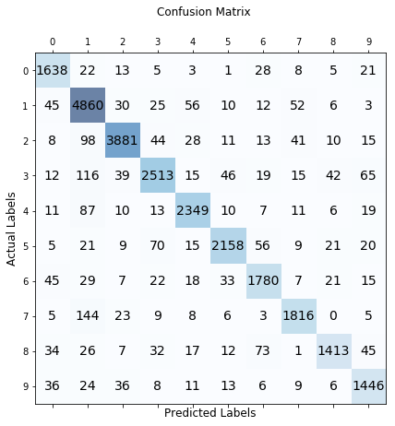
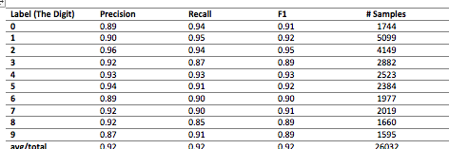
Results
Accuracy is the performance metric (target .90)
Achieved 91.6% on the test data
(Need to try 5x5 kernels w/ Dropout)

Slide 13
Monitored Metrics
“Winning” network did not show overfitting signs but runner-up did

Slide 14
Unsupervised Digit Removal from Images
Not supervised: No labeled training data
Approach:
Train a model in PyTorch to classify digit images
Use by-products of the model to identify key pixels for an image
Key Pixel: represents the background without the digit
Create a Generalized Regression NN, trained with the key pixels, to generate an image
Goal is when the generated image is returned to the parent, a photorealistic image without the digit results

Slide 15
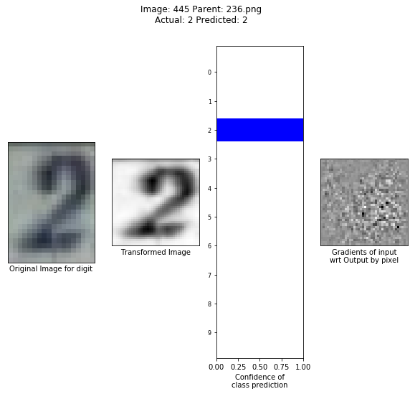
Identifying Key Pixels
First thought, gradients
Very noisy
Promising, perhaps better suited to a supervised approach

Slide 16
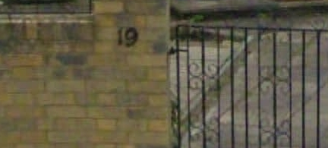
Next Try: Feature Maps from first Conv Layer
First layer set up with stride, padding to have same Feature Map size as the image
48 Feature Maps from the first layer, reduced using mean() and std() across the pixel dimension – results in a tensor dimensioned the same as the image

Slide 17
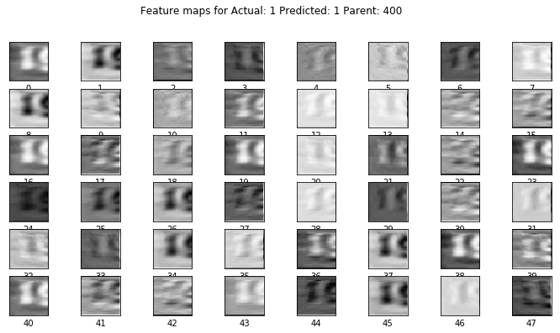
Feature Map for the first digit . . .

Slide 18
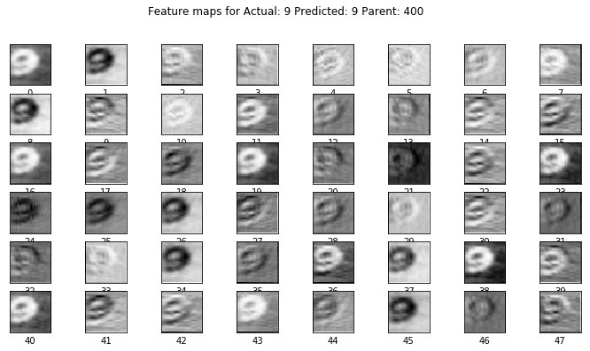
. . .And the second

Slide 19
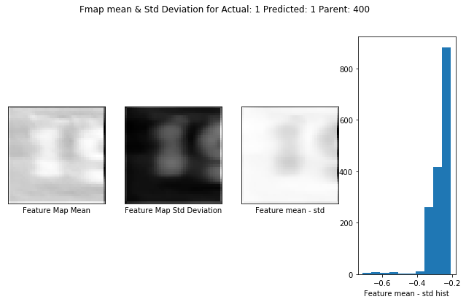
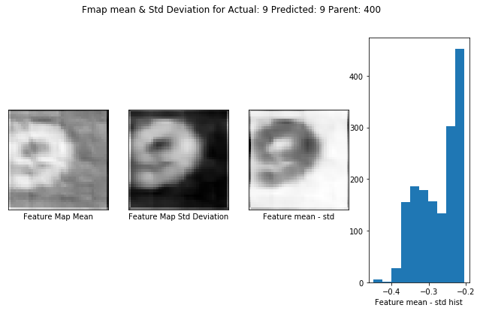
Feature Map Reductions

Slide 20
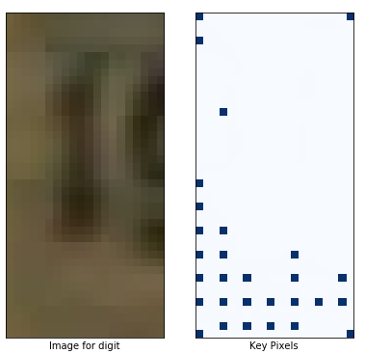
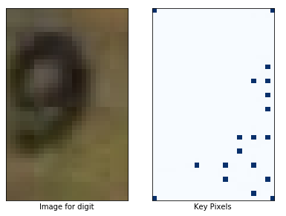
Key Pixel Identification

Slide 21
Network to Generate an Image
Based on a paper about image infill after removing overlays:
Alilou, V., & Yaghmaee, F. (2015). Application of GRNN neural network in non-texture image inpainting and restoration. Pattern Recognition Letters, 24-31.

Slide 22
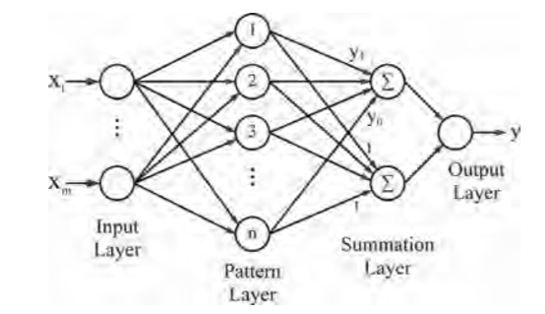
Architecture
Input: x,y co-ordinate
Output: Pixel value ( range[0..1])
Pattern layer outputs distance from input X to every node to itself
Weights between pattern layer nodes and top summation layer are learned
Weights to bottom note in summation layer always 1
Output layer transfer function is a radial basis function

Slide 23
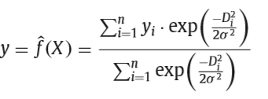
Radial Basis Function for summation and output layers
Gaussain: Nearby pattern nodes have greater influence than distant one on predicted X
Sigma – “spread” or “bias: determines how quickly the influence of a pattern node diminishes with distance

Slide 24
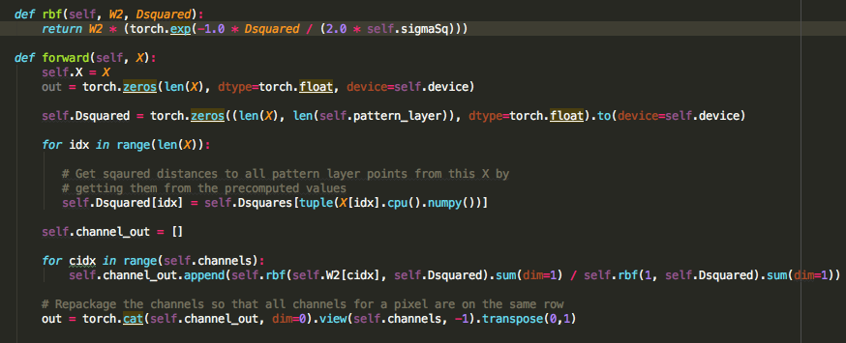
PyTorch Module (excerpt)

Slide 25
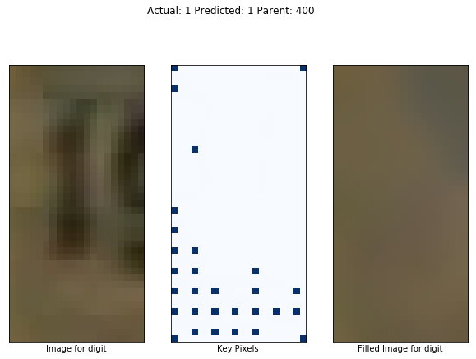
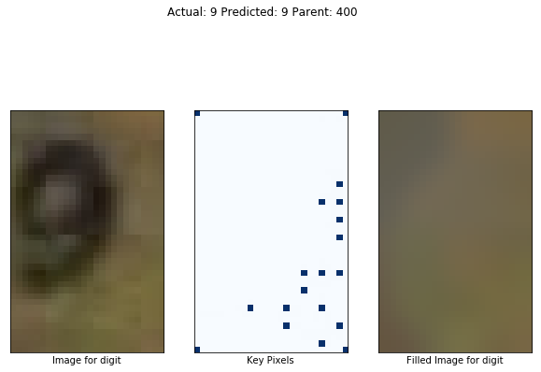
Results

Slide 26
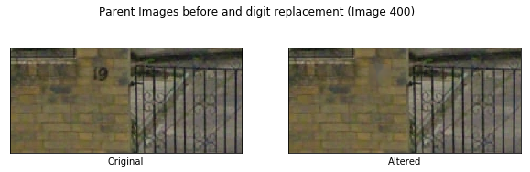
Final Results

Slide 27
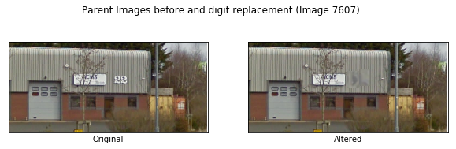
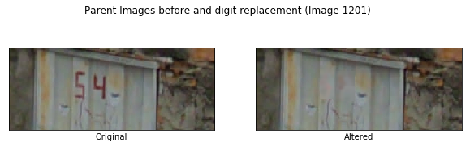
Hits and Misses

Slide 28
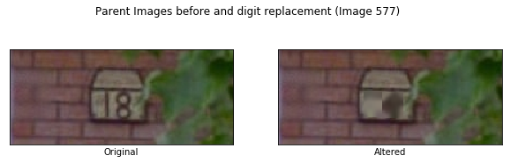
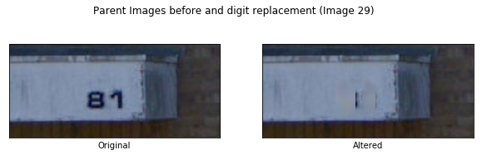
Hits and Misses (cont’d)

