Slide 1
Software Architecture
Front-End, Microservices, and Backend
William M. Mongan

Slide 2
Microservices and Service-Oriented Architectures
Service Oriented Computing (SOC) is a movement towards an implementation-independent architecture for distributed computing.
Rather than an object-based design and functionality, Service Oriented Architecture (SOA) raises the level of abstraction towards higher level business logic.

Slide 3
A Typical Scenario
A small company is currently using separate in-house proprietary systems to process orders, charge credit cards, check inventory and ship products.
  Data is exchanged from one department to the other via hand-written e-mails, though the inventory and shipping departments were recently integrated and sharing messages using a proprietary format over TCP.

Slide 4
Why SOA
In this example, departments only expose the highest level of business logic that each needs to share.
For example, the shipping department need only know that the credit card transaction was approved and the shipping address provided by the customer.

Slide 5
Bottom Up vs. Top Down Design
Although SOA allows for a bottom-up design amicable to the integration of legacy systems, the real benefit is realized from a top-down, implementation-independent approach.

Slide 6
Bottom Up vs. Top Down Design
By using schemas to define abstract data types and to define business-logic operations in terms of these abstract types, a complete interface is derived for a system that naturally hides implementation details and business secrets.
The design hides the implementation: Services only provide their public interfaces to one another.

Slide 7
So What?
Imagine services as a pipeline, or assembly line, through which business logic is realized.
If a service (i.e. the shipping department) was outsourced to a third party, only the service contract and the surrounding clients that invoke it need to be changed.
The new shipping company does not want to disclose private information such as its sub-contractors and charges.
Only the invocation requirements, message format, and data parameters are exposed by the contract.

Slide 8
Advantages to SOA
Services are discoverable and dynamically bound;
Services are self-contained and modular;
Services stress interoperability;
Services are loosely coupled;
Services have a network-addressable interface;
Services have coarse-grained interfaces;
Services are location transparent;
Services are composable;
Service-oriented architecture supports self-healing.

Slide 9
Service Composition
Because services are a primitive unit in SOA, they can be composed just as objects are in the OO paradigm to create new applications according to business processes.
Unlike objects, services are also registered with a name service that can be searched.
In this way, services can be dynamically found, bound, and consumed at runtime.
  An interesting and open problem is to dynamically bind to services based on a semantic query.

Slide 10
Service Flexibility
This flexibility facilitates a heterogeneous and asynchronous service environment.
Of course, one requirement is that the decision must be made and agreed upon by the service and caller.

Slide 11
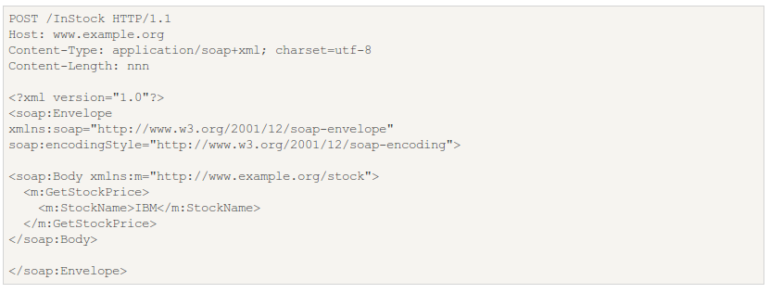
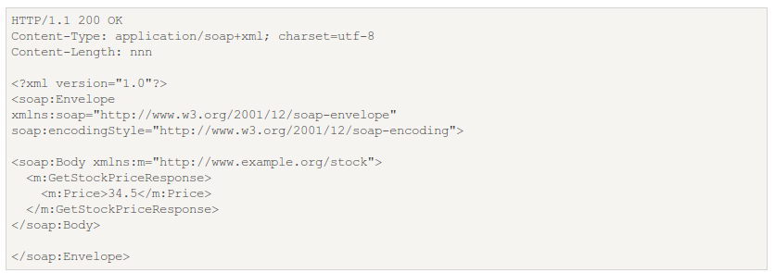
Example SOAP Request and Response

Slide 12
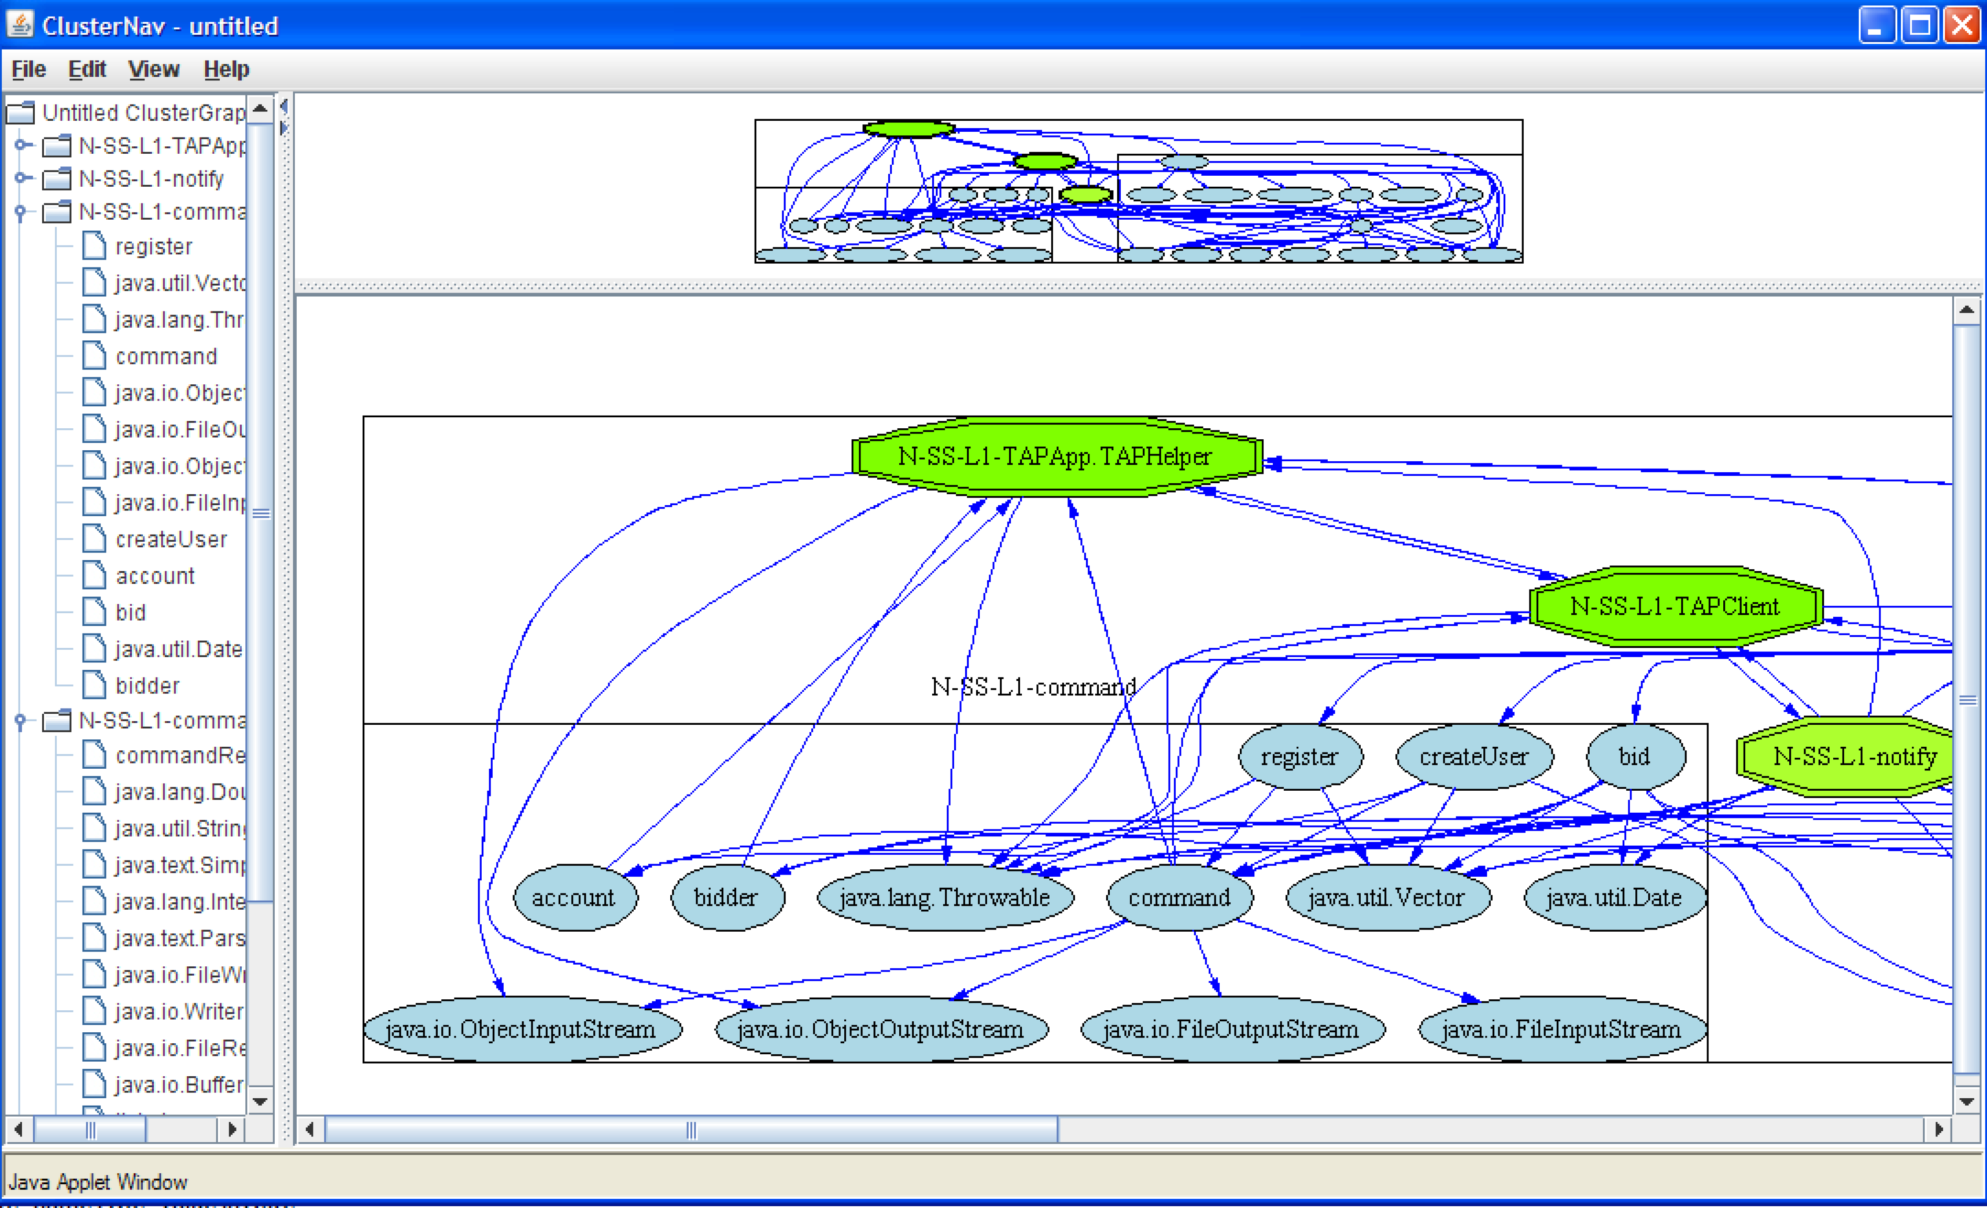
CASE STUDY: REPORTAL

Slide 13
Case Study: REportal
REportal is a service-based reverse engineering portal.
Users may upload code to REportal and perform RE analysis, without needing to install, configure and run individual tools.

Slide 14
Brief History
REportal 1.0 was based on Java Servlets, but the presentation layer was tightly coupled to the tools.
The tools quickly became obsolete, and others simply didn’t work, hindering the functionality.
Browser wars were a big problem during this time as well.

Slide 15
REportal 2.0
REportal 2.0 is based on web services. This was chosen because the architecture decouples the interface from the tools.
Relationships between tools are based on data via message passing in XML.
This makes it easy to
  Maintain existing tools.
  Add new (legacy) tools by simply turning them into a service.
  Take advantage of SOA security, automatic binding, distributed computing, and other features.

Slide 16
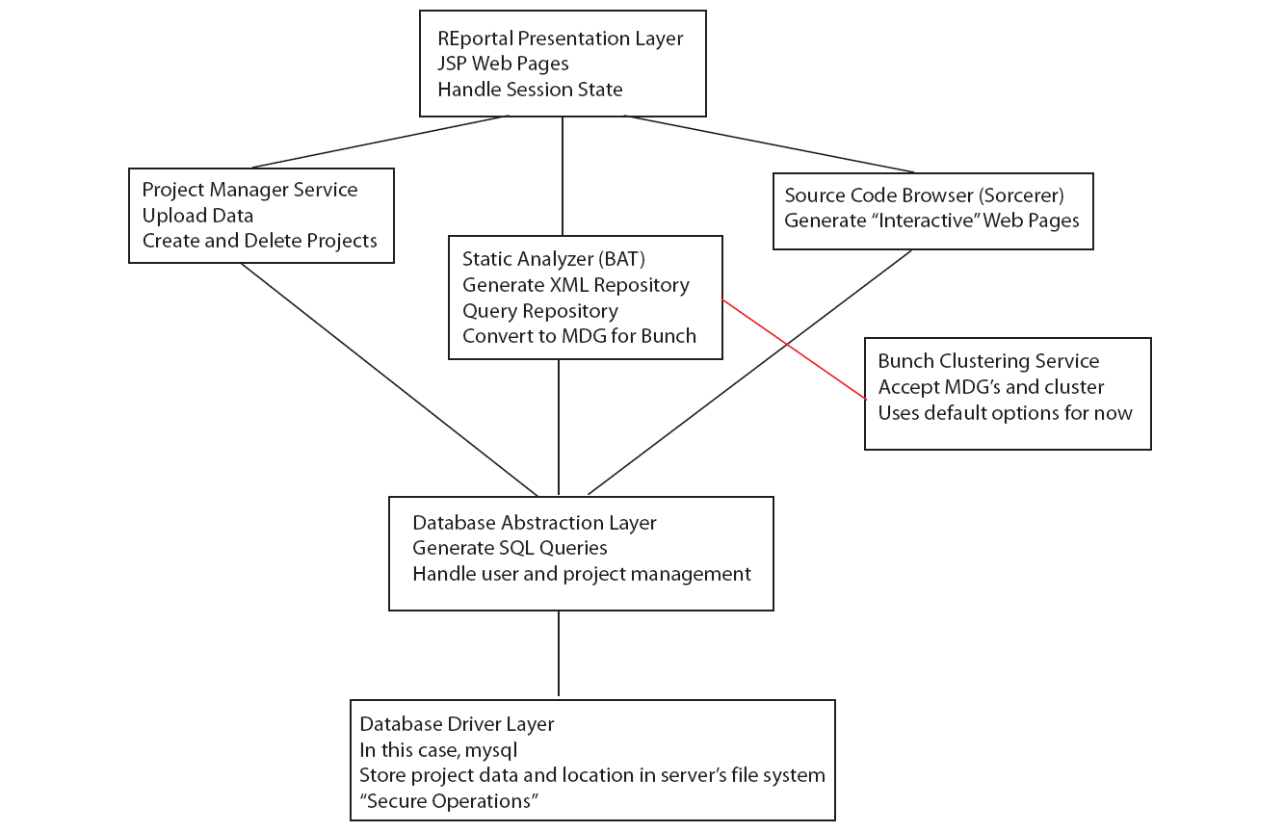

Slide 17
The Tools (Services)
REportal Application Layer
Bunch Wrapper
Static Analyzer
Source Code Browser
Text Search
Aspect Instrumentation
Project Manager
Database Layer

Slide 18
The Tools
REportal Application Layer
  This is the presentation layer, where JSP pages reside. The JSP pages invoke services to render functionality.
Bunch Wrapper
  This is used by several services, whenever graphical data or an MDG is produced. Bunch Wrapper clusters the graph and returns a new graph.

Slide 19
The Tools
Static Analyzer
  This is based on the BAT Static Analyzer for Java 1.5.
  Given Java class file(s), BAT creates an XML repository with source code relationships that exist between the entities.
    This needs to be improved to a database model for scalability.
    REportal queries the repository via XQuery and XSLT.

Slide 20
The Tools
Source Code Browser
  This is based on the Sorcerer source code browser tool. It provides a cross-referenced source index.
  Currently, REportal downloads a zip file of web pages to the user.
    Ultimately, using Ajax, we will display this content on the fly, rendering a seamless user interface!
Text Search
  Grep

Slide 21
The Tools
Aspect Instrumentation
  Using aspects, it is possible to instrument code to trace function calls.
  Doing this, we yield an MDG graph that can be viewed or clustered to show runtime slices.
Project Manager and Database Layer
  Using a database, tracks user logins and projects, including their location on the file system.
  They don’t have to reside on the same machine, but the database provides absolute file paths on the Project Manager service’s file system.

Slide 22
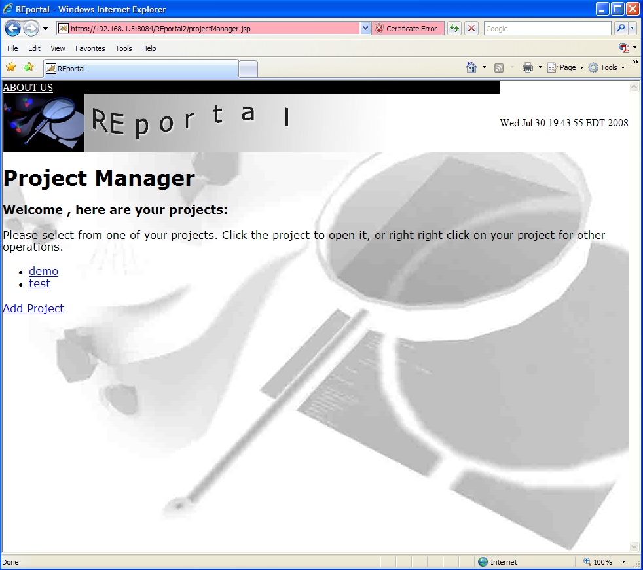
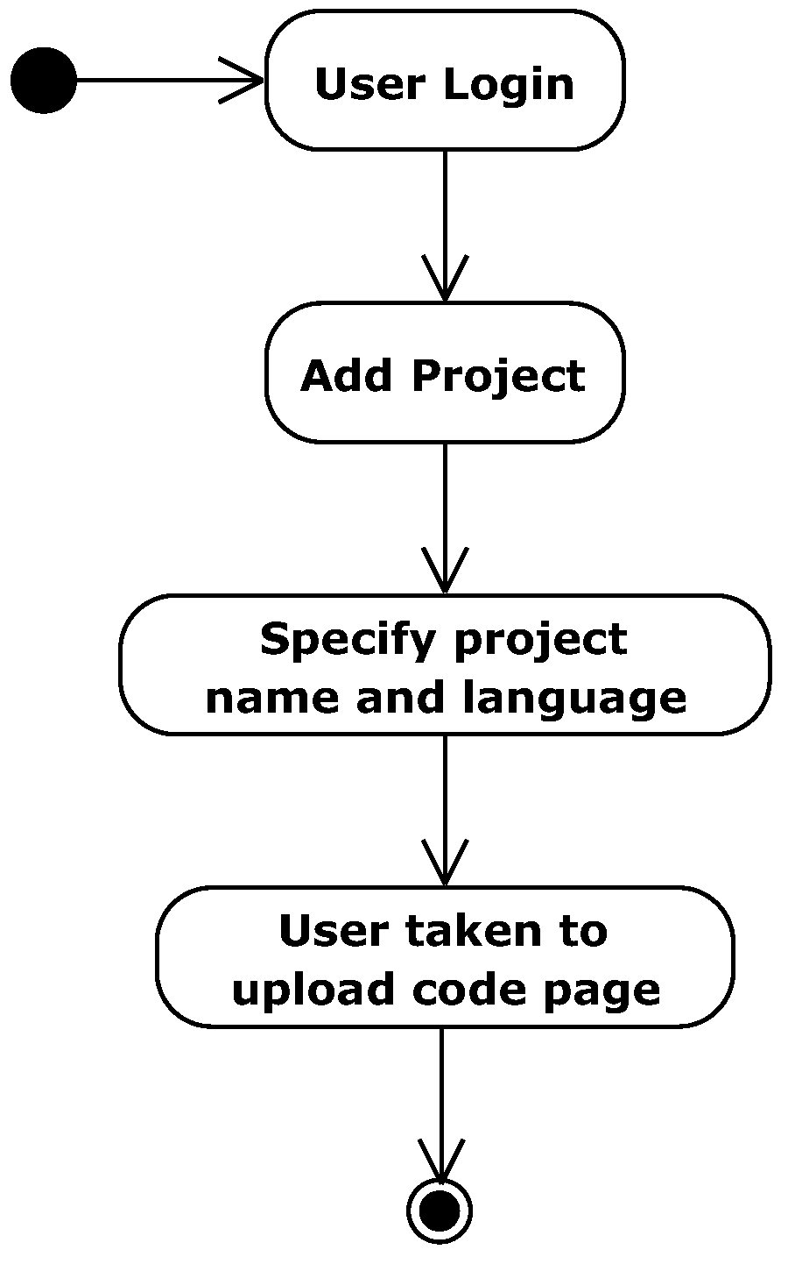
Sample Use Case: Adding a Project

Slide 23
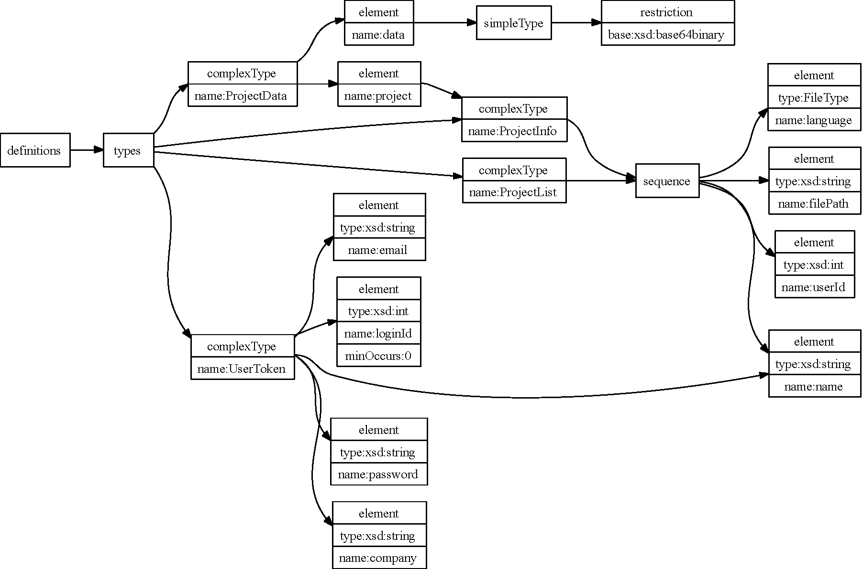
Sample Service Definition: Adding a Project

Slide 24
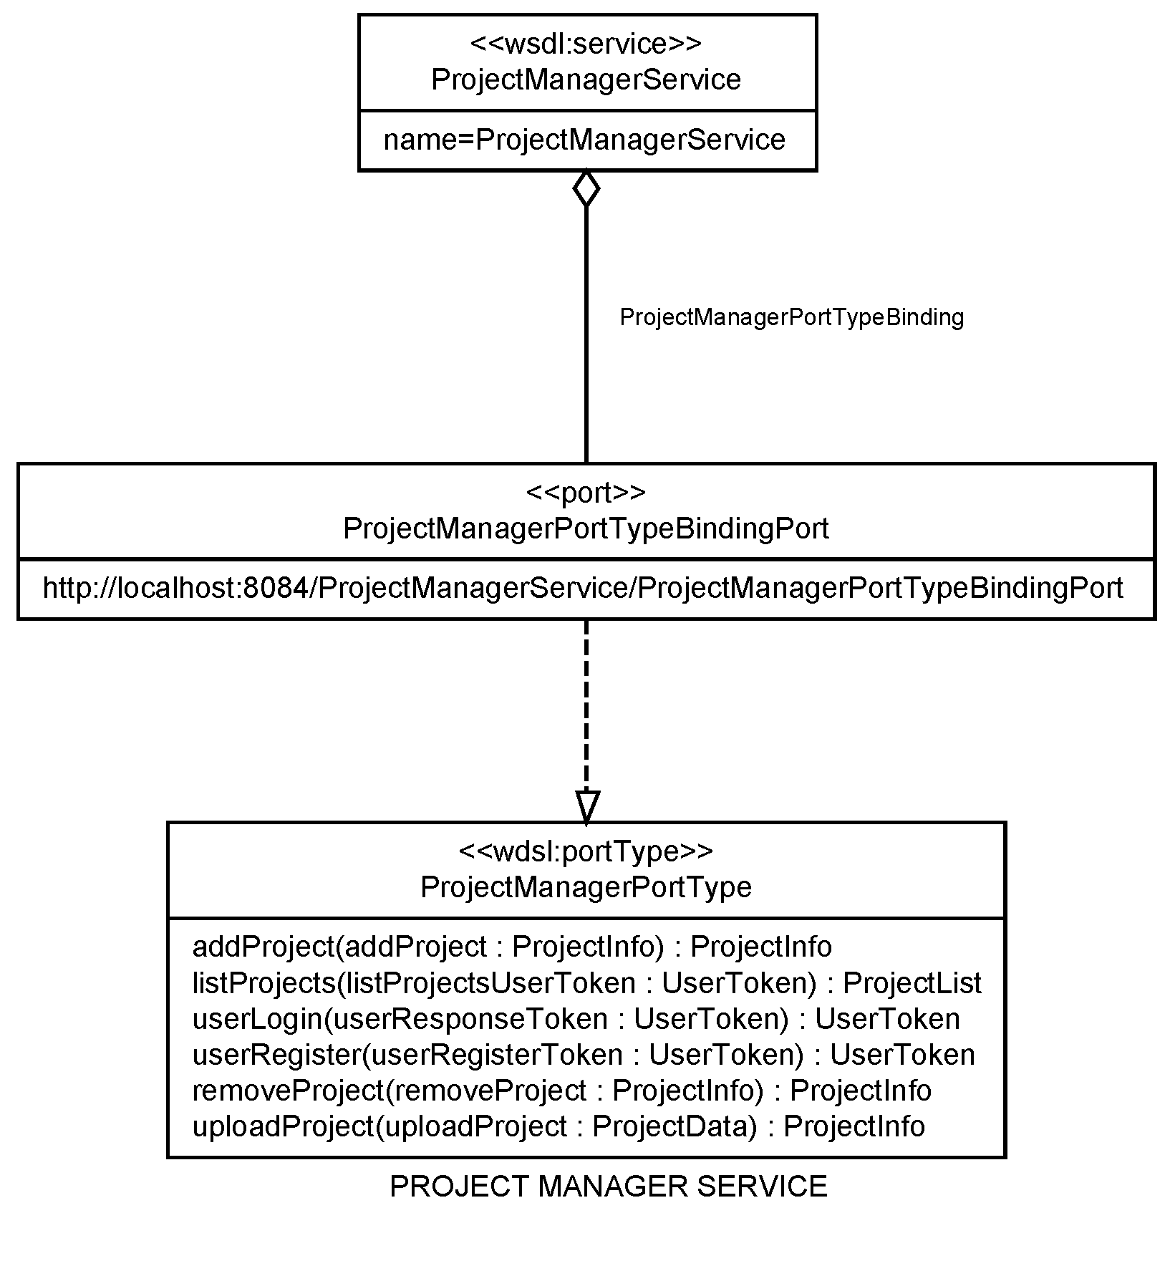
Sample Service Interface: Adding a Project

Slide 25
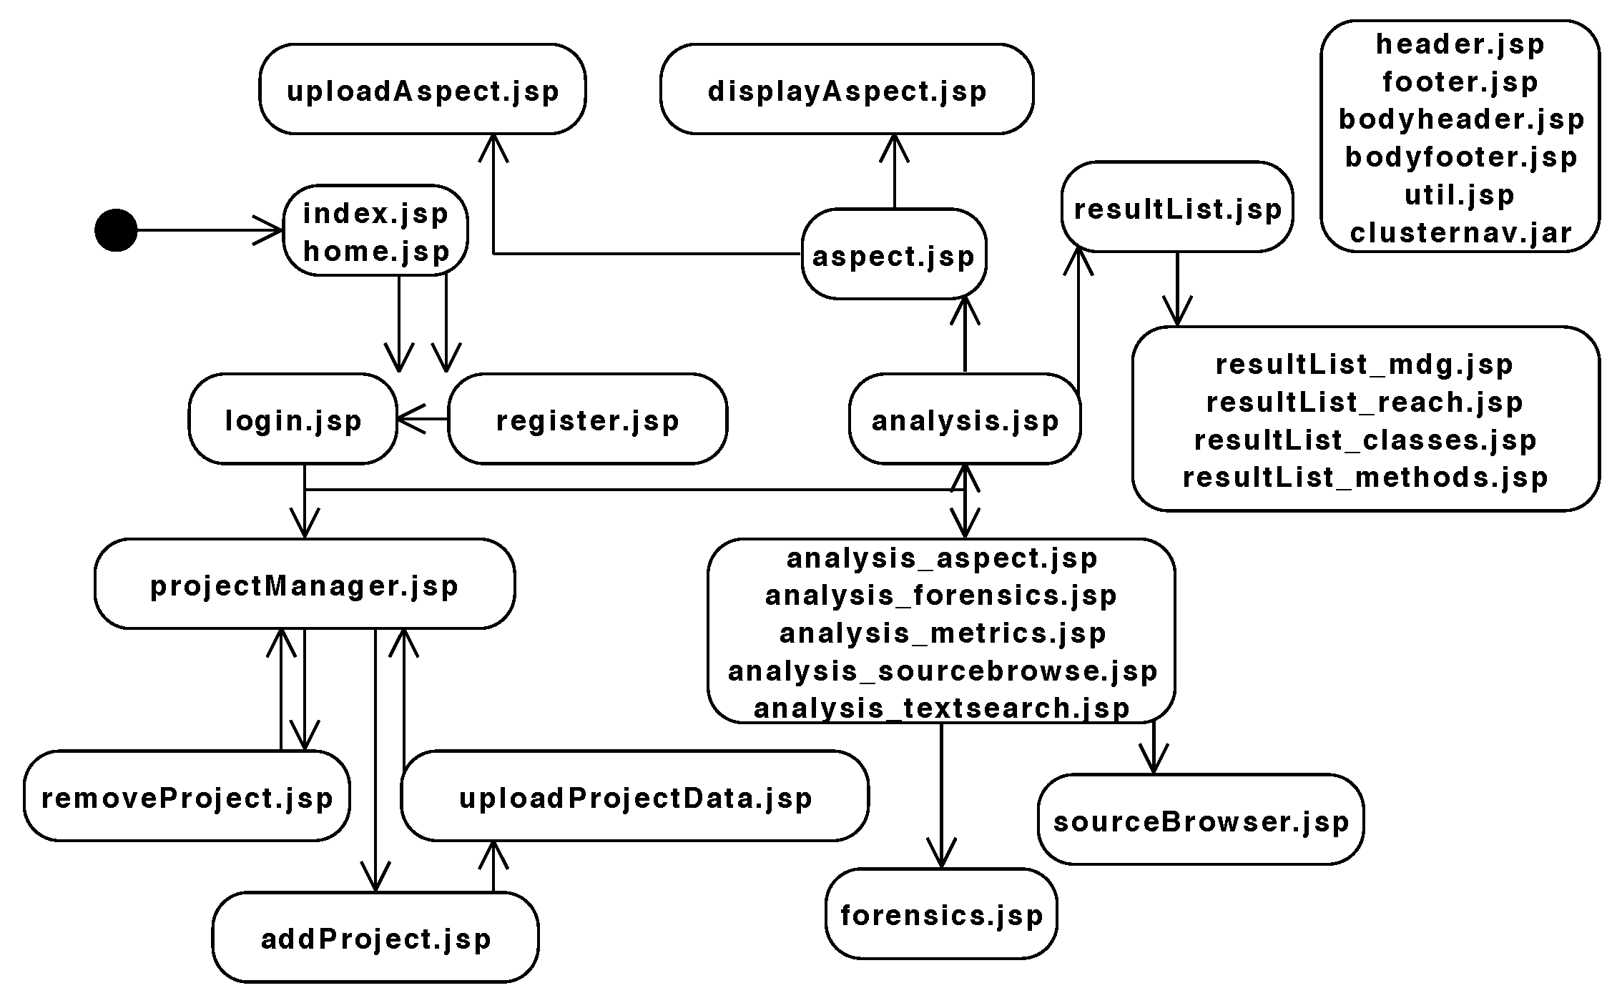
Front-End Design and Presentation

Slide 26
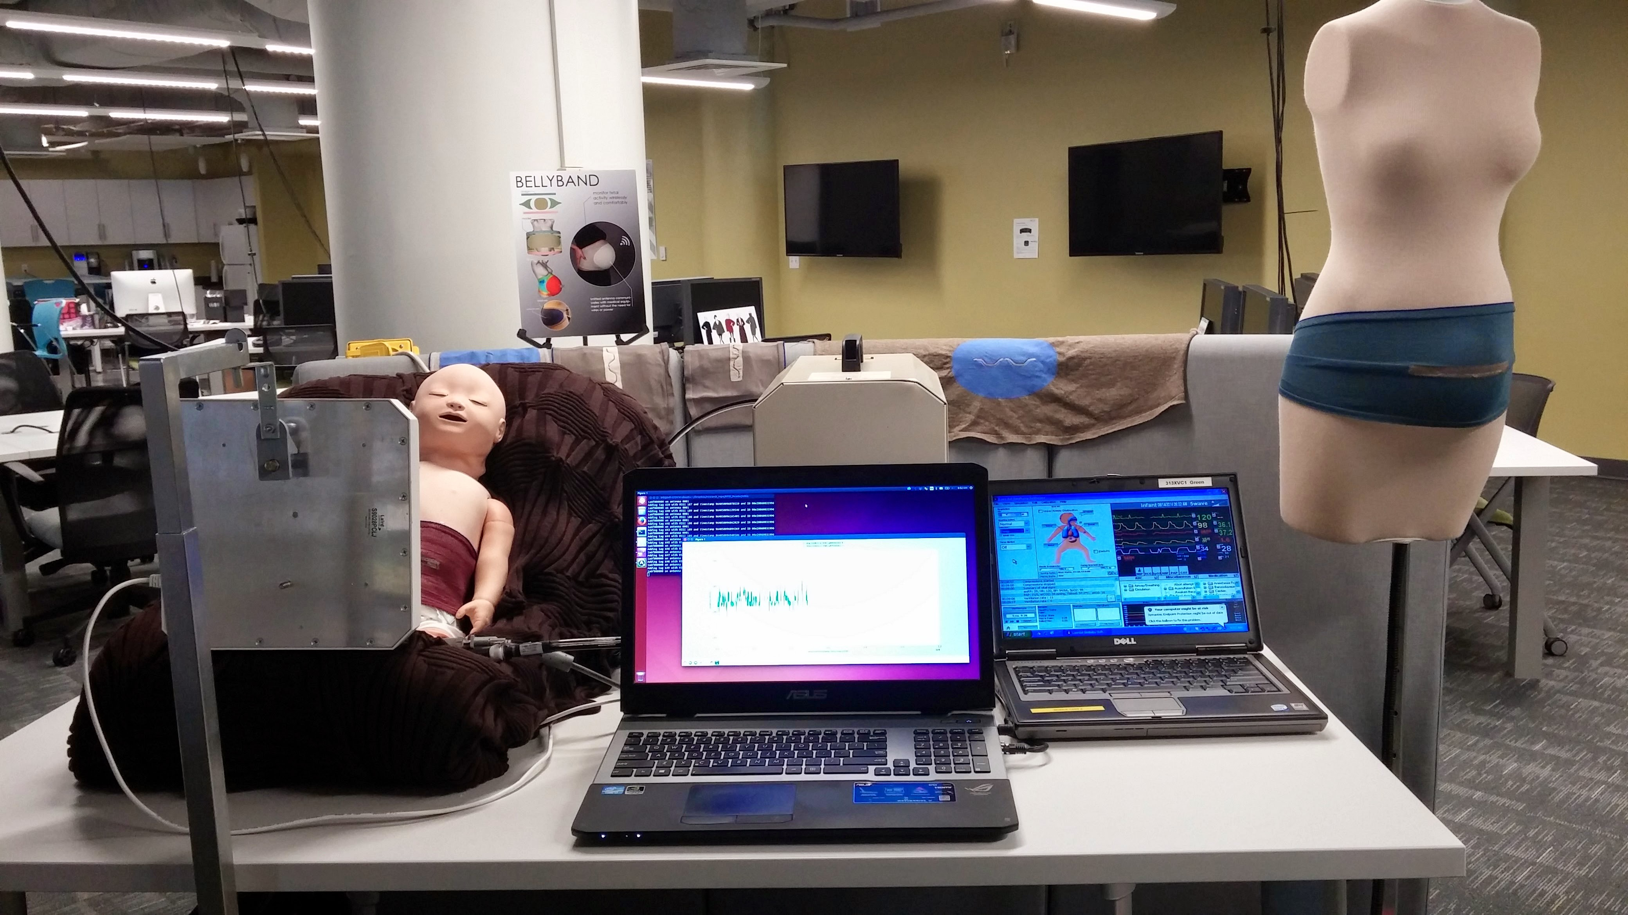
CASE STUDY: THE IOT SENSOR FRAMEWORK

Slide 27
Case Study: IoT Sensor Framework
This software suite contains scripts to collect and store IoT sensor data, such as RFID tag information using an Impinj Speedway RFID reader.
The collection framework interfaces with a heterogeneous suite of devices in real-time, and stores the data in a database or streaming service as defined by the driver configuration.
A corresponding processing suite visualizes the real-time or archived data collected by the collection framework, enabling rapid experimentation and testing of machine learning algorithms on existing and new datasets.
Sensor fusion, ground truth, and data perturbation modules allow for automated and controlled manipulation of the data sets and comparison to ground truth.
It is modular and generalizable to a variety of sensor systems and processing needs.

Slide 28
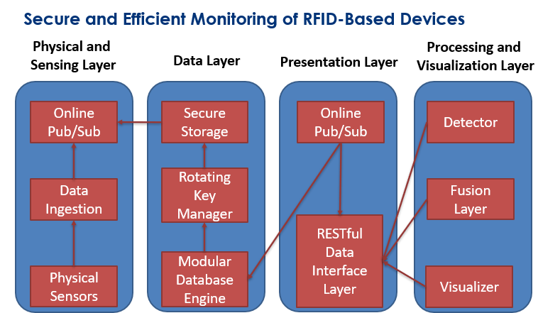
Layered Approach

Slide 29
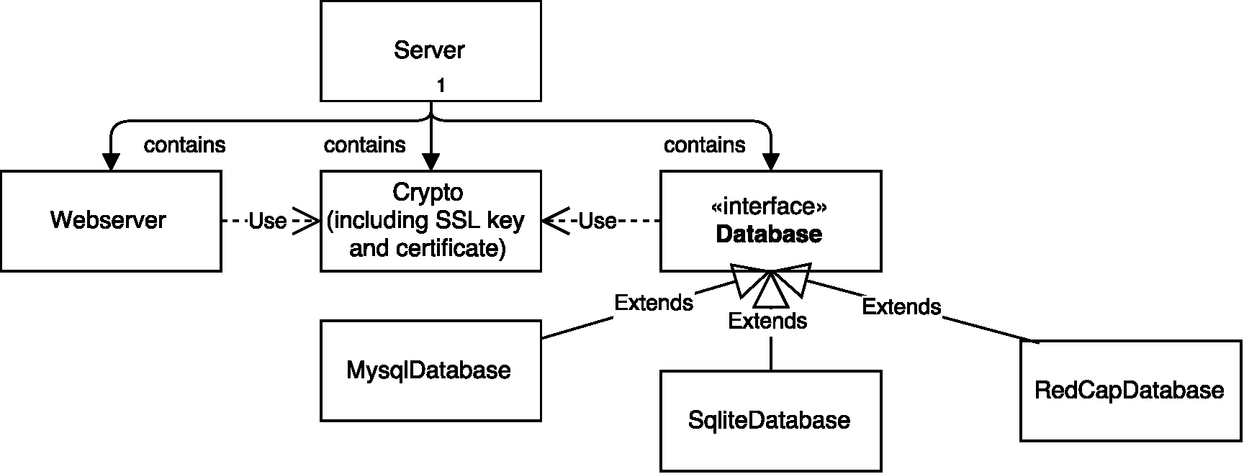
Front-End, Microservices, Back-End

Slide 30
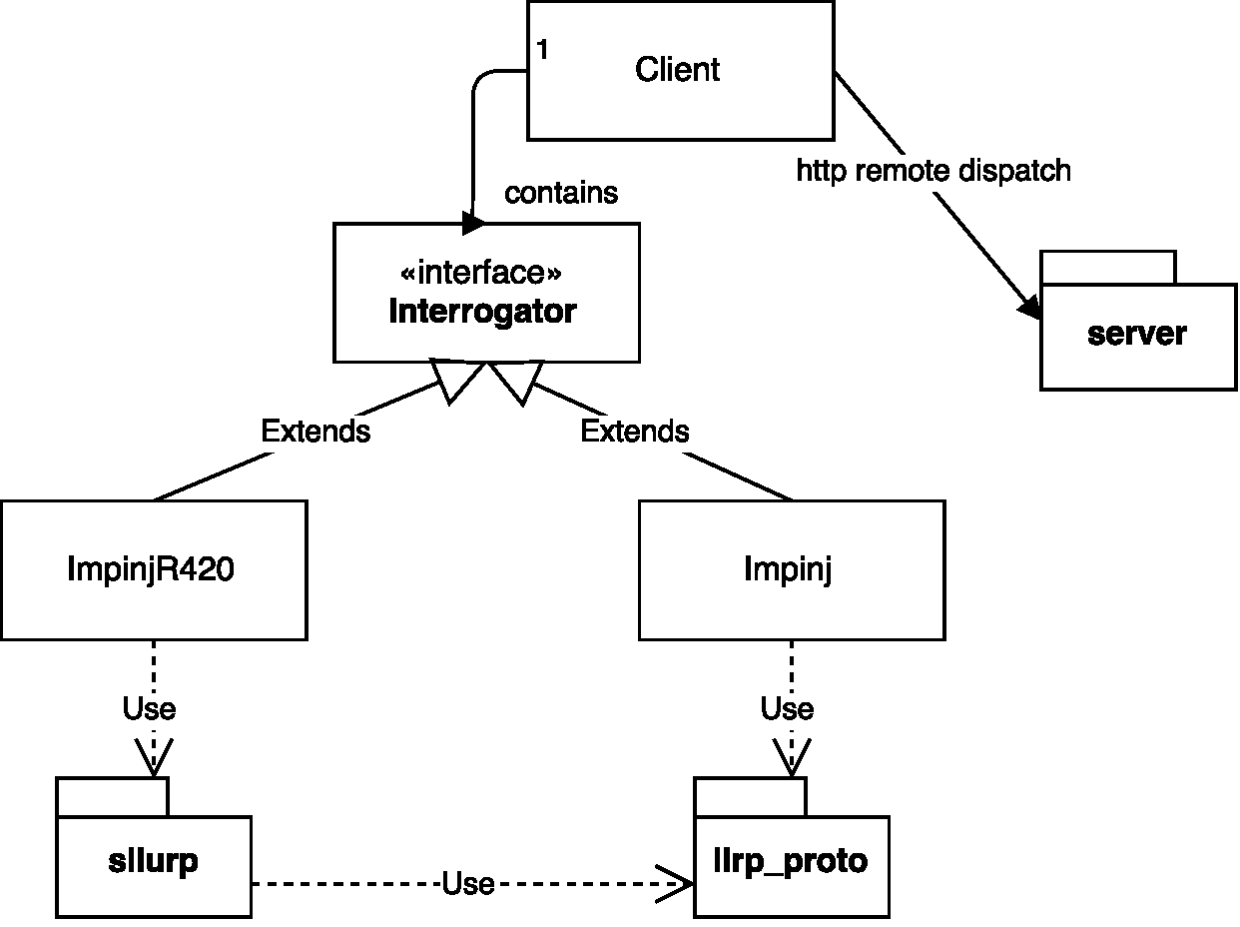
Microservice Implementation: Drivers

Slide 31

Microservice Implementation: Database

Slide 32
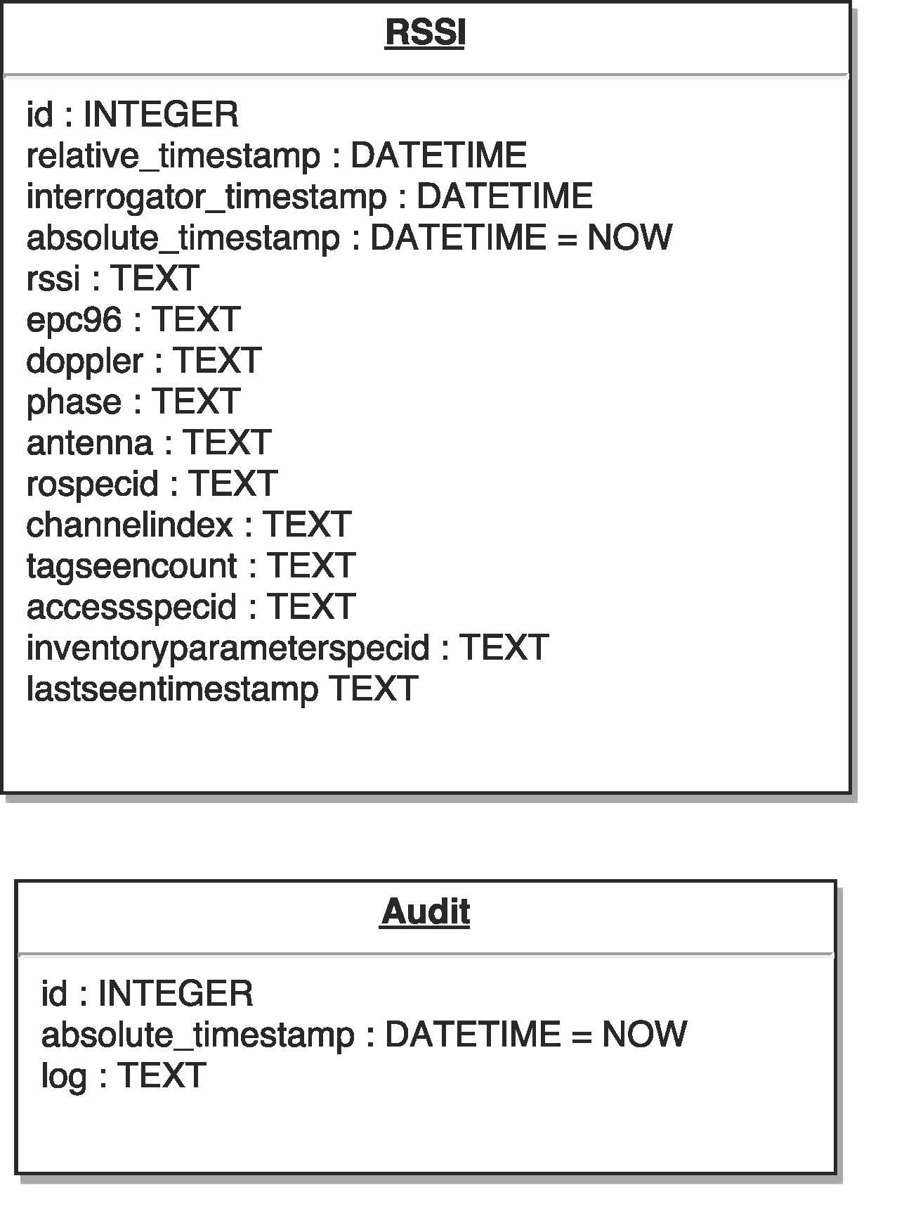
Database Schema

Slide 33
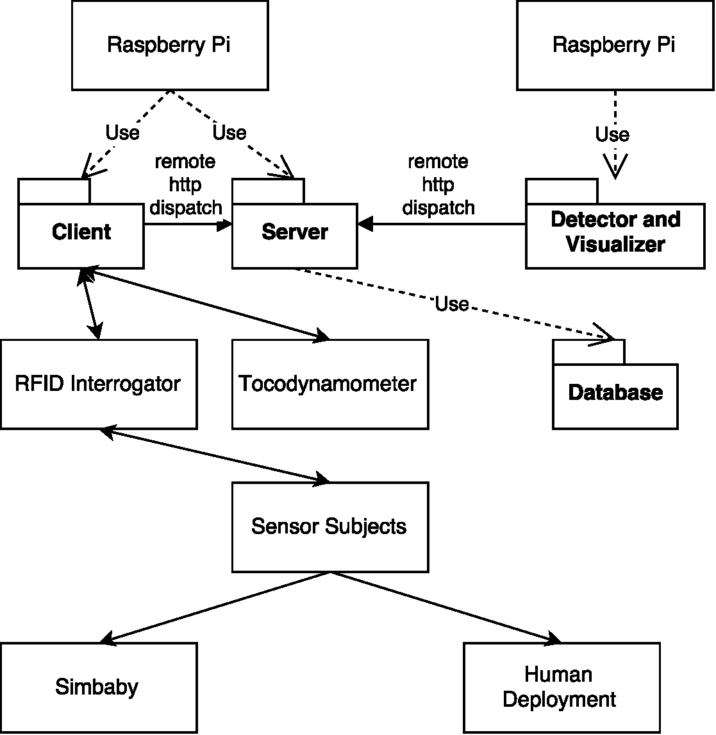
Microservice Composition

Slide 34
Case Study: IoT Sensor Framework
This software is available as an open source package for others to use, modify (by forking the repository and issuing pull requests), and contribute back.
https://zenodo.org/record/3786933
https://zenodo.org/record/3825126

Slide 35
Example: Reading RESTful Data
def retrieve_data(start, end):
global timescale
global db_password
global server
resp, content = sendhttp(server + '/api/iot/' + str(start * timescale) + '/' + str(end * timescale), headerdict={'Content-Type': 'application/json'}, bodydict={'data': {'db_password': db_password}}, method='POST')
return resp, content

Slide 36
References
Mongan, W., Shevertalov, M., Mancoridis, S., “Re-engineering a Reverse Engineering Portal to a Distributed SOA.” IEEE Proceedings of the 16th International Conference on Program Comprehension (ICPC), 2008.
Mongan, W. “A Service-Based Web Portal for Integrated Reverse Engineering and Program Comprehension.”
William M. Mongan, Ilhaan Rasheed, Enioluwa Segun, Henry Dang, Victor S. Cushman, Charlie Rose Chiccarine, Kapil R. Dandekar, & Adam K. Fontecchio. (2020). drexelwireless/iot-sensor-framework: Public Release 1.0 (v1.0). Zenodo. https://doi.org/10.5281/zenodo.3786933
http://www.codeproject.com/Articles/28704/Programming-With-Exchange-Server-2007-EWS-Part-1
http://www.w3schools.com/webservices/ws_soap_example.asp

