Slide 1

Process Scheduling
Maxim Sheverlatov Jay Kothari William M. Mongan From Operating Systems Concepts by Bryant and O’Hallaron

Slide 2
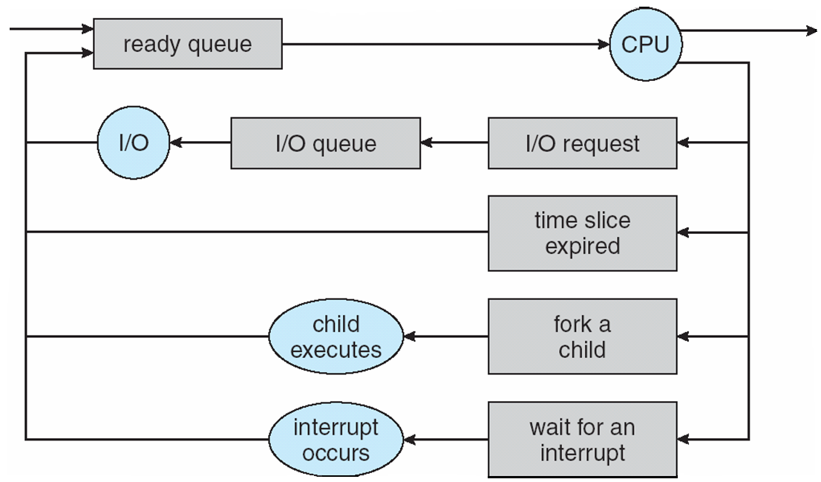
CPU Scheduling
How is the OS to decide which of several tasks to take off a queue?
Scheduling: deciding which threads are given access to resources from moment to moment.

Slide 3
Assumptions about Scheduling
CPU scheduling big area of research in early ‘70s
Many implicit assumptions for CPU scheduling:
One program per user
One thread per program
Programs are independent
These are unrealistic but simplify the problem
Does “fair” mean fairness among users or programs?
If I run one compilation job and you run five, do you get five times as much CPU?
Often times, yes!
Goal: dole out CPU time to optimize some desired parameters of the system.
What parameters?

Slide 4
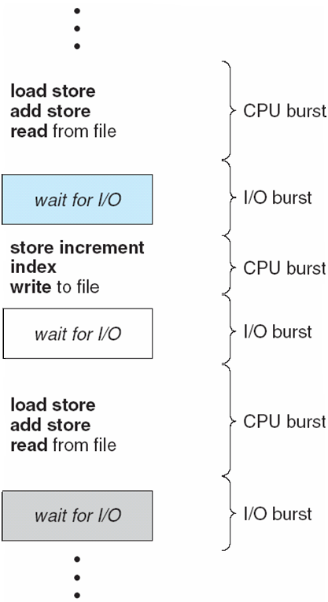
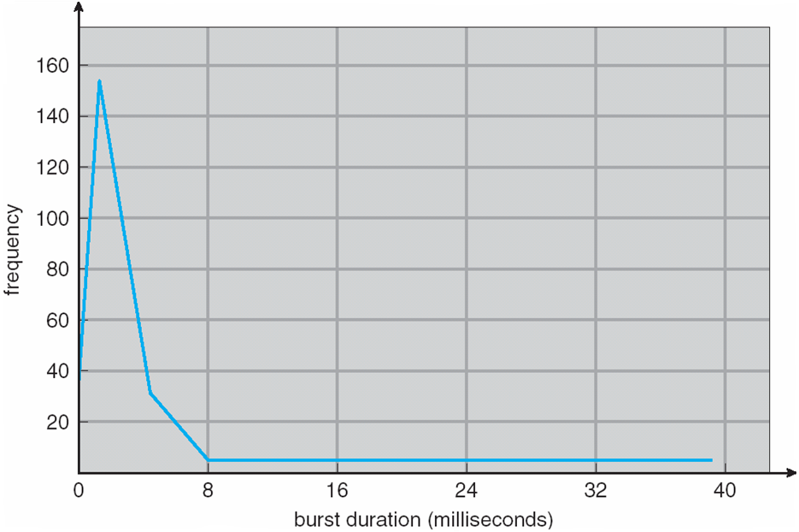
Assumption: CPU Bursts

Slide 5
Assumption: CPU Bursts
Execution model: programs alternate between bursts of CPU and I/O
Program typically uses the CPU for some period of time, then does I/O, then uses CPU again
Each scheduling decision is about which job to give to the CPU for use by its next CPU burst
With timeslicing, thread may be forced to give up CPU before finishing current CPU burst.

Slide 6

What is Important in a Scheduling Algorithm?

Slide 7
What is Important in a Scheduling Algorithm?
Minimize Response Time
Elapsed time to do an operation (job)
Response time is what the user sees
Time to echo keystroke in editor
Time to compile a program
Real-time Tasks: Must meet deadlines imposed by World
Maximize Throughput
Jobs per second
Throughput related to response time, but not identical
Minimizing response time will lead to more context switching than if you maximized only throughput
Minimize overhead (context switch time) as well as efficient use of resources (CPU, disk, memory, etc.)
Fairness
Share CPU among users in some equitable way
Not just minimizing average response time

Slide 8
Scheduling Algorithms: First-Come, First-Served (FCFS)
“Run until Done:” FIFO algorithm
In the beginning, this meant one program runs non-preemtively until it is finished (including any blocking for I/O operations)
Now, FCFS means that a process keeps the CPU until one or more threads block
Example: Three processes arrive in order P1, P2, P3.
P1 burst time: 24
P2 burst time: 3
P3 burst time: 3
Draw the Gantt Chart and compute Average Waiting Time and Average Completion Time.

Slide 9
Scheduling Algorithms: First-Come, First-Served (FCFS)
Example: Three processes arrive in order P1, P2, P3.
P1 burst time: 24
P2 burst time: 3
P3 burst time: 3
Waiting Time
P1: 0
P2: 24
P3: 27
Completion Time:
P1: 24
P2: 27
P3: 30
Average Waiting Time: (0+24+27)/3 = 17
Average Completion Time: (24+27+30)/3 = 27
P1
P2
P3
0
24
27
30

Slide 10
Scheduling Algorithms: First-Come, First-Served (FCFS)
What if their order had been P2, P3, P1?
P1 burst time: 24
P2 burst time: 3
P3 burst time: 3

Slide 11
Scheduling Algorithms: First-Come, First-Served (FCFS)
What if their order had been P2, P3, P1?
P1 burst time: 24
P2 burst time: 3
P3 burst time: 3
Waiting Time
P1: 0
P2: 3
P3: 6
Completion Time:
P1: 3
P2: 6
P3: 30
Average Waiting Time: (0+3+6)/3 = 3 (compared to 17)
Average Completion Time: (3+6+30)/3 = 13 (compared to 27)
P2
P3
P1
0
3
6
30

Slide 12
Scheduling Algorithms: First-Come, First-Served (FCFS)
Average Waiting Time: (0+3+6)/3 = 3 (compared to 17)
Average Completion Time: (3+6+30)/3 = 13 (compared to 27)
FIFO Pros and Cons:
Simple (+)
Short jobs get stuck behind long ones (-)
If all you’re buying is milk, doesn’t it always seem like you are stuck behind a cart full of many items
Performance is highly dependent on the order in which jobs arrive (-)

Slide 13
How Can We Improve on This?

Slide 14
Round Robin (RR) Scheduling
FCFS Scheme: Potentially bad for short jobs!
Depends on submit order
If you are first in line at the supermarket with milk, you don’t care who is behind you; on the other hand…
Round Robin Scheme
Each process gets a small unit of CPU time (time quantum)
Usually 10-100 ms
After quantum expires, the process is preempted and added to the end of the ready queue
Suppose N processes in ready queue and time quantum is Q ms:
Each process gets 1/N of the CPU time
In chunks of at most Q ms
What is the maximum wait time for each process?

Slide 15
Round Robin (RR) Scheduling
FCFS Scheme: Potentially bad for short jobs!
Depends on submit order
If you are first in line at the supermarket with milk, you don’t care who is behind you; on the other hand…
Round Robin Scheme
Each process gets a small unit of CPU time (time quantum)
Usually 10-100 ms
After quantum expires, the process is preempted and added to the end of the ready queue
Suppose N processes in ready queue and time quantum is Q ms:
Each process gets 1/N of the CPU time
In chunks of at most Q ms
What is the maximum wait time for each process?
No process waits more than (n-1)q time units

Slide 16

Round Robin (RR) Scheduling
Round Robin Scheme
Each process gets a small unit of CPU time (time quantum)
Usually 10-100 ms
After quantum expires, the process is preempted and added to the end of the ready queue
Suppose N processes in ready queue and time quantum is Q ms:
Each process gets 1/N of the CPU time
In chunks of at most Q ms
What is the maximum wait time for each process?
No process waits more than (n-1)q time units
Performance Depends on Size of Q
Small Q => interleaved
Large Q is like…
Q must be large with respect to context switch time, otherwise overhead is too high (spending most of your time context switching!)

Slide 17
Round Robin (RR) Scheduling
Round Robin Scheme
Each process gets a small unit of CPU time (time quantum)
Usually 10-100 ms
After quantum expires, the process is preempted and added to the end of the ready queue
Suppose N processes in ready queue and time quantum is Q ms:
Each process gets 1/N of the CPU time
In chunks of at most Q ms
What is the maximum wait time for each process?
No process waits more than (n-1)q time units
Performance Depends on Size of Q
Small Q => interleaved
Large Q is like FCFS
Q must be large with respect to context switch time, otherwise overhead is too high (spending most of your time context switching!)

Slide 18
Example of RR with Time Quantum = 4
Process Burst Time
P₁ 24
P₂ 3
P₃ 3
The Gantt chart is:
P₁
P₂
P₃
P₁
P₁
P₁
P₁
P₁
0
4
7
10
14
18
22
26
30

Slide 19
Example of RR with Time Quantum = 4
P₁
P₂
P₃
P₁
P₁
P₁
P₁
P₁
Process Burst Time
P₁ 24
P₂ 3
P₃ 3
Waiting Time:
P1: (10-4) = 6
P2: (4-0) = 4
P3: (7-0) = 7
Completion Time:
P1: 30
P2: 7
P3: 10
Average Waiting Time: (6 + 4 + 7)/3= 5.67
Average Completion Time: (30+7+10)/3=15.67
0
4
7
10
14
18
22
26
30

Slide 20
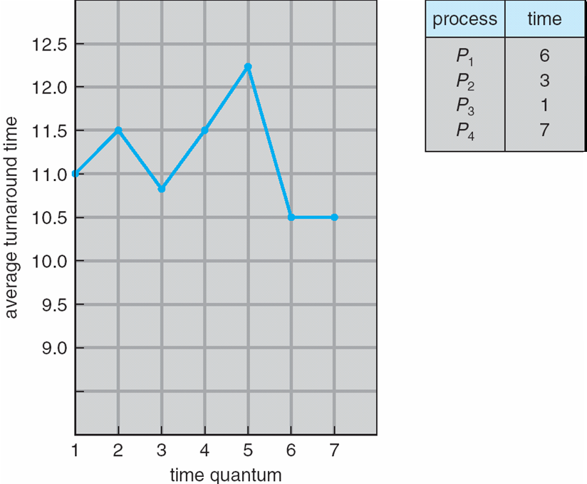
Turnaround Time Varies With The Time Quantum

Slide 21
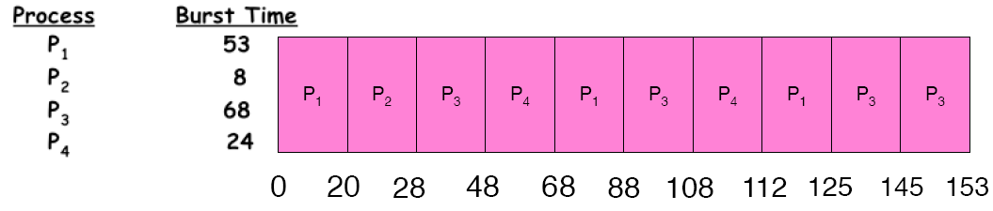
Example of RR with Time Quantum = 20
Waiting Time:
P1: (68-20)+(112-88) = 72
P2: (20-0) = 20
P3: (28-0)+(88-48)+(125-108) = 85
P4: (48-0)+(108-68) = 88
Completion Time:
P1: 125
P2: 28
P3: 153
P4: 112
Average Waiting Time: (72+20+85+88)/4 = 66.25
Average Completion Time: (125+28+153+112)/4 = 104.5
A process can finish before the time quantum expires, and release the CPU.

Slide 22

RR Summary
Pros and Cons:
Better for short jobs (+)
Fair (+)
Context-switching time adds up for long jobs (-)
The previous examples assumed no additional time was needed for context switching – in reality, this would add to wait and completion time without actually progressing a process towards completion.
Remember: the OS consumes resources, too!
If the chosen quantum is
too large, response time suffers
infinite, performance is the same as FIFO
too small, throughput suffers and percentage overhead grows
Actual choices of timeslice:
UNIX: initially 1 second:
Worked when only 1-2 users
If there were 3 compilations going on, it took 3 seconds to echo each keystroke!
In practice, need to balance short-job performance and long-job throughput:
Typical timeslice 10ms-100ms
Typical context-switch overhead 0.1ms – 1ms (about 1%)

Slide 23
Comparing FCFS and RR
Assuming zero-cost context switching time, is RR always better than FCFS?
Assume 10 jobs, all start at the same time, and each require 100 seconds of CPU time
RR scheduler quantum of 1 second
Completion Times (CT)
Both FCFS and RR finish at the same time
But average response time is much worse under RR!
Bad when all jobs are same length
Also: cache state must be shared between all jobs with RR but can be devoted to each job with FIFO
Total time for RR longer even for zero-cost context switch!
Job # | FCFS CT | RR CT
1 | 100 | 991
2 | 200 | 992
… | … | …
9 | 900 | 999
10 | 1000 | 1000

Slide 24

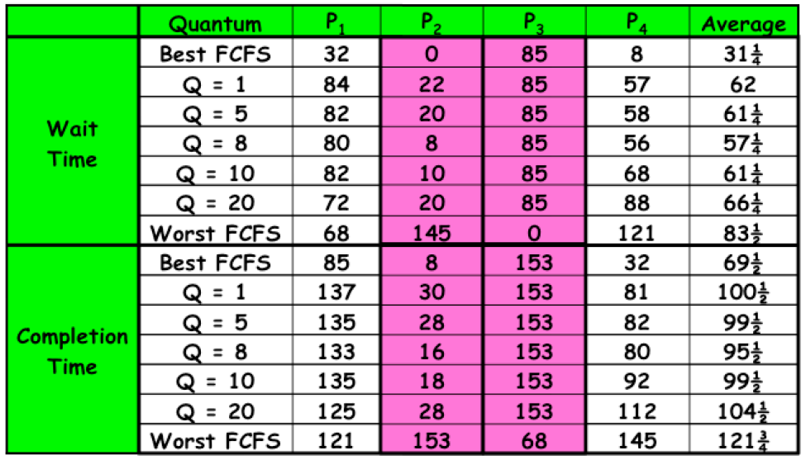
Comparing FCFS and RR

Slide 25
Scheduling
The performance we get is somewhat dependent on what “kind” of jobs we are running (short jobs, long jobs, etc.)
If we could “see the future,” we could mirror best FCFS
Shortest Job First (SJF) a.k.a. Shortest Time to Completion First (STCF):
Run whatever job has the least amount of computation to do
Shortest Remaining Time First (SRTF) a.k.a. Shortest Remaining Time to Completion First (SRTCF):
Preemptive version of SJF: if a job arrives and has a shorter time to completion than the remaining time on the current job, immediately preempt CPU
These can be applied either to a whole program or the current CPU burst of each program
Idea: get short jobs out of the system
Big effect on short jobs, only small effect on long ones
Result: better average response time

Slide 26
Scheduling
But, this is hard to estimate
We could get feedback from the program or the user, but they have incentive to lie!
SJF/SRTF are the best you can do at minimizing average response time
Provably optimal (SJF among non-preemptive, SRTF among preemptive)
Since SRTF is always at least as good as SJF, focus on SRTF
Comparison of SRTF with FCFS and RR
What if all jobs are the same length?
What if all jobs have varying length?

Slide 27
Scheduling
But, this is hard to estimate
We could get feedback from the program or the user, but they have incentive to lie!
SJF/SRTF are the best you can do at minimizing average response time
Provably optimal (SJF among non-preemptive, SRTF among preemptive)
Since SRTF is always at least as good as SJF, focus on SRTF
Comparison of SRTF with FCFS and RR
What if all jobs are the same length?
SRTF becomes the same as FCFS (i.e. FCFS is the best we can do)
What if all jobs have varying length?
SRTF (and RR): short jobs are not stuck behind long ones

Slide 28
Example: SRTF
A or B
C
C I/O
A,B: both CPU bound, run for a week
C: I/O bound, loop 1ms CPU, 9ms disk I/O
If only one at a time, C uses 90% of the disk, A or B could use 100% of the CPU
With FIFO: Once A and B get in, the CPU is held for two weeks
What about RR or SRTF?
Easier to see with a timeline

Slide 29
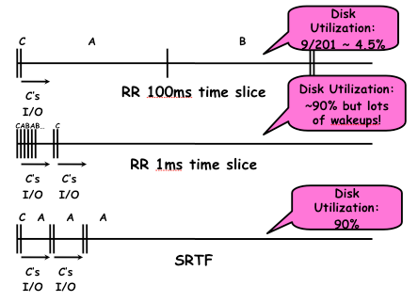
Example: SRTF
A or B
C
C I/O
A,B: both CPU bound, run for a week
C: I/O bound, loop 1ms CPU, 9ms disk I/O

Slide 30
Last Word on SRTF
Starvation
SRTF can lead to starvation if many small jobs!
Large jobs never get to run
Somehow need to predict future
How can we do this?
Some systems ask the user
When you submit a job, you have to say how long it will take
To stop cheating, system kills job if it takes too long
But even non-malicious users have trouble predicting runtime of their jobs
Bottom line, can’t really tell how long job will take
However, can use SRTF as a yardstick for measuring other policies, since it is optimal
SRTF Pros and Cons
Optimal (average response time) (+)
Hard to predict future (-)
Unfair, even though we minimized average response time! (-)

Slide 31
Predicting the Future
Back to predicting the future… perhaps we can predict the next CPU burst length?
Iff programs are generally repetitive, then they may be predictable
Create an adaptive policy that changes based on past behavior
CPU scheduling, virtual memory, file systems, etc.
If program was I/O bound in the past, likely in the future
Example: SRTF with estimated burst length
Use an estimator function on previous bursts
Let T(n-1), T(n-2), T(n-3), …, be previous burst lengths. Estimate next burst T(n) = f(T(n-1), T(n-2), T(n-3),…)
Function f can be one of many different time series estimation schemes (Kalman filters, etc.)

Slide 32
Determining Length of Next CPU Burst
Can only estimate the length
Can be done by using the length of previous CPU bursts, using exponential averaging

Slide 33
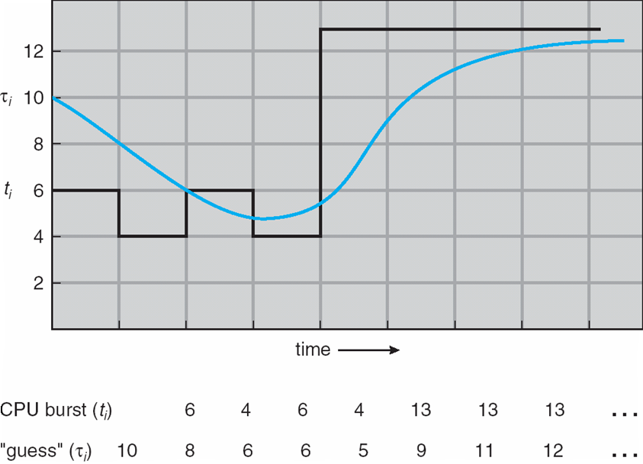
Predicting the Future

Slide 34
Examples of Exponential Averaging
α =0
τ_{n+1} = τ_{n}
Recent history does not count
α =1
τ_{n+1} = α t_{n}
Only the actual last CPU burst counts
If we expand the formula, we get:
τ_{n+1} = α t_{n}+(1 - α)α t_{n} -1 + …
+(1 - α )^{j} α t_{n} _{-j} + …
+(1 - α )^{n +1} τ₀
Since both α and (1 - α) are less than or equal to 1, each successive term has less weight than its predecessor

Slide 35
Priority Scheduling
A priority number (integer) is associated with each process
The CPU is allocated to the process with the highest priority (smallest integer ≡ highest priority)
Preemptive (if a higher priority process enters, it receives the CPU immediately)
Nonpreemptive (higher priority processes must wait until the current process finishes; then, the highest priority ready process is selected)
SJF is a priority scheduling where priority is the predicted next CPU burst time
Problem ≡ Starvation – low priority processes may never execute
Solution ≡ Aging – as time progresses increase the priority of the process

Slide 36
Priority Inversion
Consider a scenario in which there are three processes, one with high priority (H), one with medium priority (M), and one with low priority (L).
Process L is running and successfully acquires a resource, such as a lock or semaphore.
Process H begins; since we are using a preemptive priority scheduler, process L is preempted for process H.
Process H tries to acquire L’s resource, and blocks (because it is held by L).
Process M begins running, and, since it has a higher priority than L, it is the highest priority ready process. It preempts L and runs, thus starving high priority process H.
This is known as priority inversion.
What can we do?

Slide 37
Priority Inversion
Process L should, in fact, be temporarily of “higher priority” than process M, on behalf of process H.
Process H can donate its priority to process L, which, in this case, would make it higher priority than process M.
This enables process L to preempt process M and run.
When process L is finished, process H becomes unblocked.
Process H, now being the highest priority ready process, runs, and process M must wait until it is finished.
Note that if process M’s priority is actually higher than process H, priority donation won’t be sufficient to increase process L’s priority above process M. This is expected behavior (after all, process M would be “more important” in this case than process H).

Slide 38
Multi-level Feedback Scheduling
Another method for exploiting past behavior
Multiple queues, each with different priority
Higher priority queues often considered “foreground” tasks
Each queue has its own scheduling algorithm
E.g. foreground → RR, background → FCFS
Sometimes multiple RR priorities with quantum increasing exponentially (highest queue: 1ms, next: 2ms, next: 4ms, etc.)
Adjust each job’s priority as follows (details vary)
Job starts in highest priority queue
If entire CPU time quantum expires, drop one level
If CPU is yielded during the quantum, push up one level (or to top)

Slide 39
Scheduling Details
Result approximates SRTF
CPU bound jobs drop rapidly to lower queues
Short-running I/O bound jobs stay near the top
Scheduling must be done between the queues
Fixed priority scheduling: serve all from the highest priority, then the next priority, etc.
Time slice: each queue gets a certain amount of CPU time (e.g., 70% to the highest, 20% next, 10% lowest)
Countermeasure: user action that can foil intent of the OS designer
For multilevel feedback, put in a bunch of meaningless I/O to keep job’s priority high
But if everyone does this, it won’t work!
Consider an Othello program, playing against a competitor. Key was to compute at a higher priority than the competitors.
Put in printf’s, run much faster!

Slide 40
Scheduling Details
It is apparent that scheduling is facilitated by having a “good mix” of I/O bound and CPU bound programs, so that there are long and short CPU bursts to prioritize around.
There is typically a long-term and a short-term scheduler in the OS.
We have been discussing the design of the short-term scheduler.
The long-term scheduler decides what processes should be put into the ready queue in the first place for the short-term scheduler, so that the short-term scheduler can make fast decisions on a good mix of a subset of ready processes.
The rest are held in memory or disk
Why else is this helpful?

Slide 41
Scheduling Details
It is apparent that scheduling is facilitated by having a “good mix” of I/O bound and CPU bound programs, so that there are long and short CPU bursts to prioritize around.
There is typically a long-term and a short-term scheduler in the OS.
We have been discussing the design of the short-term scheduler.
The long-term scheduler decides what processes should be put into the ready queue in the first place for the short-term scheduler, so that the short-term scheduler can make fast decisions on a good mix of a subset of ready processes.
The rest are held in memory or disk
This also provides more free memory for the subset of ready processes given to the short-term scheduler.

Slide 42
Fairness
What about fairness?
Strict fixed-policy scheduling between queues is unfair (run highest, then next, etc.)
Long running jobs may never get the CPU
In Multics, admins shut down the machine and found a 10-year-old job
Must give long-running jobs a fraction of the CPU even when there are shorter jobs to run
Tradeoff: fairness gained by hurting average response time!
How to implement fairness?
Could give each queue some fraction of the CPU
i.e., for one long-running job and 100 short-running ones?
Like express lanes in a supermarket – sometimes express lanes get so long, one gets better service by going into one of the regular lines
Could increase priority of jobs that don’t get service (as seen in the multilevel feedback example)
This was done in UNIX
Ad hoc – with what rate should priorities be increased?
As system gets overloaded, no job gets CPU time, so everyone increases in priority
Interactive processes suffer

Slide 43
Lottery Scheduling
Yet another alternative: Lottery Scheduling
Give each job some number of lottery tickets
On each time slice, randomly pick a winning ticket
On average, CPU time is proportional to number of tickets given to each job over time
How to assign tickets?
To approximate SRTF, short-running jobs get more, long running jobs get fewer
To avoid starvation, every job gets at least one ticket (everyone makes progress)
Advantage over strict priority scheduling: behaves gracefully as load changes
Adding or deleting a job affects all jobs proportionally, independent of how many tickets each job possesses

Slide 44
Example: Lottery Scheduling
Assume short jobs get 10 tickets, long jobs get 1 ticket
What percentage of time does each long job get? Each short job?
What if there are too many short jobs to give reasonable response time
In UNIX, if load average is 100%, it’s hard to make progress
Log a user out or swap a process out of the ready queue (long term scheduler)

Slide 45
Example: Lottery Scheduling
Assume short jobs get 10 tickets, long jobs get 1 ticket
What if there are too many short jobs to give reasonable response time
In UNIX, if load average is 100%, it’s hard to make progress
Log a user out or swap a process out of the ready queue (long term scheduler)
# short jobs / # long jobs | % of CPU each short job gets | % of CPU each long job gets
1/1 | 91% | 9%
0/2 | N/A | 50%
2/0 | 50% | N/A
10/1 | 9.9% | 0.99%
1/10 | 50% | 5%

Slide 46
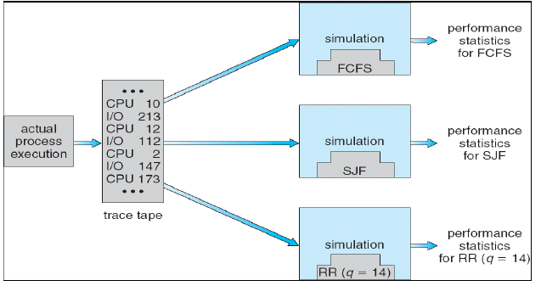
Scheduling Algorithm Evaluation
Deterministic Modeling
Takes a predetermined workload and compute the performance of each algorithm for that workload
Queuing Models
Mathematical Approach for handling stochastic workloads
Implementation / Simulation
Build system which allows actual algorithms to be run against actual data. Most flexible / general.

Slide 47
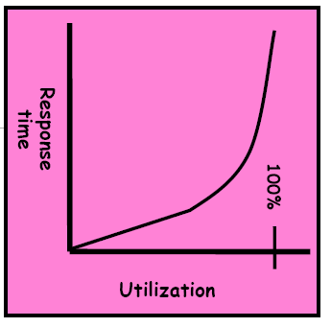
Conclusion
Scheduling: selecting a waiting process from the ready queue and allocating the CPU to it
When do the details of the scheduling policy and fairness really matter?
When there aren’t enough resources to go around
When should you simply buy a faster computer?
Or network link, expanded highway, etc.
One approach: buy it when it will pay for itself in improved response time
Assuming you’re paying for worse response in reduced productivity, customer angst, etc.
Might think that you should buy a faster X when X is utilized 100%, but usually, response time goes to infinite as utilization goes to 100%
Most scheduling algorithms work fine in the “linear” portion of the load curve, and fail otherwise
Argues for buying a faster X when utilization is at the “knee” of the curve

Slide 48
Summary
FCFS scheduling, FIFO Run Until Done:
Simple, but short jobs get stuck behind long ones
RR scheduling:
Give each thread a small amount of CPU time when it executes, and cycle between all ready threads
Better for short jobs, but poor when jobs are the same length
SJF/SRTF:
Run whatever job has the least amount of computation to do / least amount of remaining computation to do
Optimal (average response time), but unfair; hard to predict the future
Multi-Level Feedback Scheduling:
Multiple queues of different priorities
Automatic promotion/demotion of process priority to approximate SJF/SRTF
Lottery Scheduling:
Give each thread a number of tickets (short tasks get more)
Every thread gets tickets to ensure forward progress / fairness
Priority Scheduing:
Preemptive or Nonpreemptive
Priority Inversion

