Slide 1

I/O and Disk Scheduling
Maxim Sheverlatov Jay Kothari William M. Mongan From Operating Systems Concepts by Bryant and O’Hallaron

Slide 2
Review: Scheduling Policy Goals/Criteria
Minimize Response Time
Minimize elapsed time to do an operation (or job)
Response time is what the user sees:
Time to echo a keystroke in editor
Time to compile a program
Real-time Tasks: Must meet deadlines imposed by World
Maximize Throughput
Maximize operations (or jobs) per second
Throughput related to response time, but not identical:
Minimizing response time will lead to more context switching than if you only maximized throughput
Two parts to maximizing throughput
Minimize overhead (for example, context-switching)
Efficient use of resources (CPU, disk, memory, etc)
Fairness
Share CPU among users in some equitable way
Fairness is not minimizing average response time:
Better average response time by making system less fair

Slide 3
Recap: Scheduling (1)
Scheduling: selecting a waiting process from the ready queue and allocating the CPU to it
FCFS Scheduling
Round-Robin Scheduling
Shortest Job First (SJF)/Shortest Remaining Time First (SRTF)
Multi-Level Feedback Scheduling
Lottery Scheduling

Slide 4
Disk Performance
Response Time = Queue time + Service Time
Service Time = Controller + Seek + Rotation + Transfer
Latency factors
Software paths, Hardware controller, Disk media
Queueing
Latency goes up as disk utilization approaches 100%
Achieve highest bandwidth when transferring a large group of blocks sequentially from one track

Slide 5
Mass-Storage Systems and I/O
Overview of Mass Storage Structure
Disk Structure
Disk Attachment
Disk Scheduling
Disk Management
Swap-Space Management
RAID Structure
Disk Attachment
Tertiary Storage Devices
Operating System Support
Performance Issues
I/O Architecture
Notes:
5

Slide 6
Objectives
Describe the physical structure of secondary and tertiary storage devices and the resulting effects on the uses of the devices
Explain the performance characteristics of mass-storage devices
Discuss operating-system services provided for mass storage, including RAID and HSM
Notes:
6

Slide 7
Thread Queues
When thread is not running, its TCB is in a scheduler queue
Separate queues for each device/signal/condition
Each queue can have different scheduling policy
Ready
Head
TCB
TCB
TCB
Tail
Disc
NULL
Head
Tail
NULL
Ether
Head
TCB
Tail

Slide 8

Filesystem
What do we want?

Slide 9
Filesystem
OS Layer that presents blocks of data stored on a drive as files, directories
File systems:
Manage translation from User view to System view
Provide security, durability, reliability
Naming interface
System view (sys call)
Collection of bytes/sectors
No idea how the data is stored on disk
System view (Kernel)
Collection of blocks
Block size is greater than sector size: UNIX => 4KB block
Files are collections of blocks

Slide 10
Access Patterns
Need to optimize for most common accesses

Slide 11
Access Patterns
Need to optimize for most common accesses
Sequential Access: (majority)
read in order
Random Access: (an important minority)
read from middle of file
Content-based Access:
Search based access
Important for database applications

Slide 12
Usage Patterns
Need to optimize for common file types

Slide 13
Usage Patterns
Need to optimize for common file types
Small files: (majority)
Large files: (minority)
Use up most of the disk space
Is this still true?
Is it changing?

Slide 14
Overview of Mass Storage Structure
Magnetic disks provide bulk of secondary storage of modern computers
Drives rotate at 60 to 200 times per second
Transfer rate is rate at which data flow between drive and computer
Positioning time (random-access time) is time to move disk arm to desired cylinder (seek time) and time for desired sector to rotate under the disk head (rotational latency)
Head crash results from disk head making contact with the disk surface
That’s bad
Disks can be removable
Drive attached to computer via I/O bus
Busses vary, including EIDE, ATA, SATA, USB, Fibre Channel, SCSI
Host controller in computer uses bus to talk to disk controller built into drive or storage array
Notes:
14

Slide 15
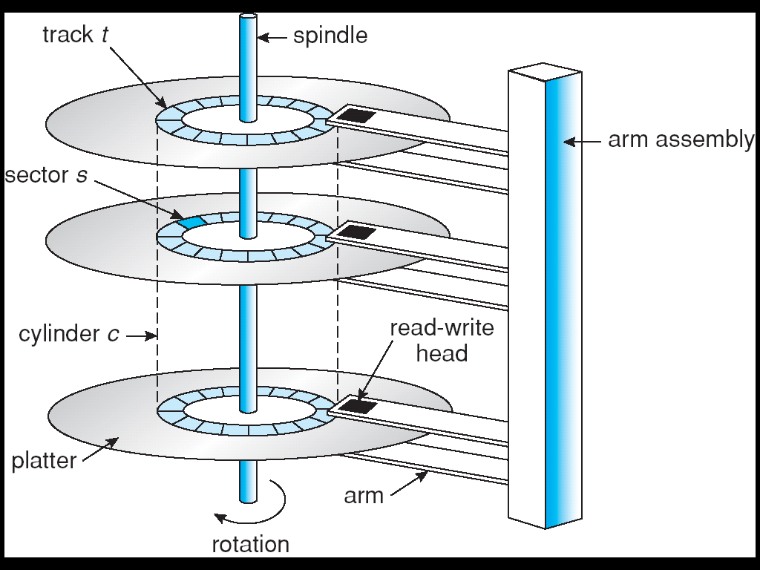
Moving-head Disk Mechanism
Notes:
15

Slide 16
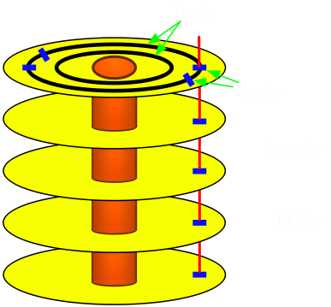
Hard Drives
Sector: Smallest element
OS transfers groups of sectors called blocks
Can access any block directly (Random Access)
Can access files randomly or sequentially
More sectors on outer tracks
Speed varies with track location
What is our goal?
What are the problems?

Slide 17
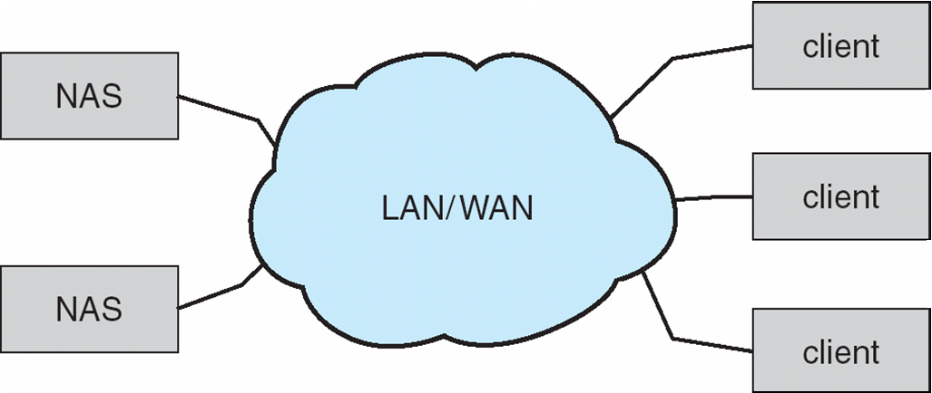
Network-Attached Storage
Network-attached storage (NAS) is storage made available over a network rather than over a local connection (such as a bus)
NFS and CIFS are common protocols
Implemented via remote procedure calls (RPCs) between host and storage
New iSCSI protocol uses IP network to carry the SCSI protocol
Notes:
17

Slide 18
Disk Performance
Response Time =

Slide 19
Disk Performance
Response Time = Queue time + Service Time
Latency factors
Software paths
Hardware controller
Disk media
Queueing
Latency goes up as disk utilization approaches 100%
What contributes to Service Time

Slide 20
Service Time
Service Time = Controller + Seek + Rotation + Transfer
Controller: Process the request
Seek: Position the head/arm over the proper cylinder
Rotation: Wait for the requested sector to rotate under the head
Transfer: Transfer a block of bits from the drive to the system
Achieve highest bandwidth when transferring a large group of blocks sequentially from one track

Slide 21
Queue Delay (Scheduling)
a, b, c, d, e, f, g, h, i, j, k
H
a
b
k
c
j
d
f
h
g
e
i

Slide 22
Disk Scheduling
The operating system is responsible for using hardware efficiently — for the disk drives, this means having a fast access time and disk bandwidth
Access time has two major components
Seek time is the time for the disk are to move the heads to the cylinder containing the desired sector
Rotational latency is the additional time waiting for the disk to rotate the desired sector to the disk head
Minimize seek time
Seek time ≈ seek distance
Disk bandwidth is the total number of bytes transferred, divided by the total time between the first request for service and the completion of the last transfer
Notes:
22

Slide 23
Disk Scheduling (Cont)
Several algorithms exist to schedule the servicing of disk I/O requests
We illustrate them with a request queue (0-199)
98, 183, 37, 122, 14, 124, 65, 67
Head pointer 53
Notes:
23

Slide 24
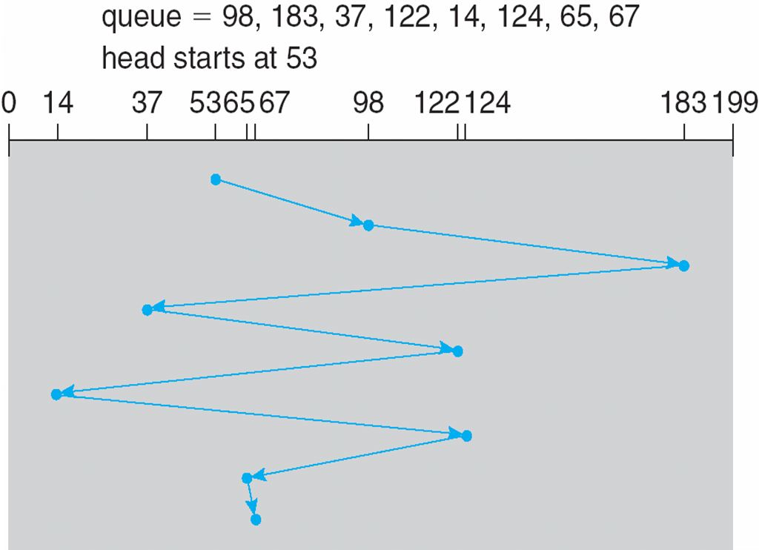
FCFS
Illustration shows total head movement of 640 cylinders
Notes:
24

Slide 25
SSTF
Selects the request with the minimum seek time from the current head position
SSTF scheduling is a form of SJF scheduling; may cause starvation of some requests
Illustration shows total head movement of 236 cylinders
Notes:
25

Slide 26
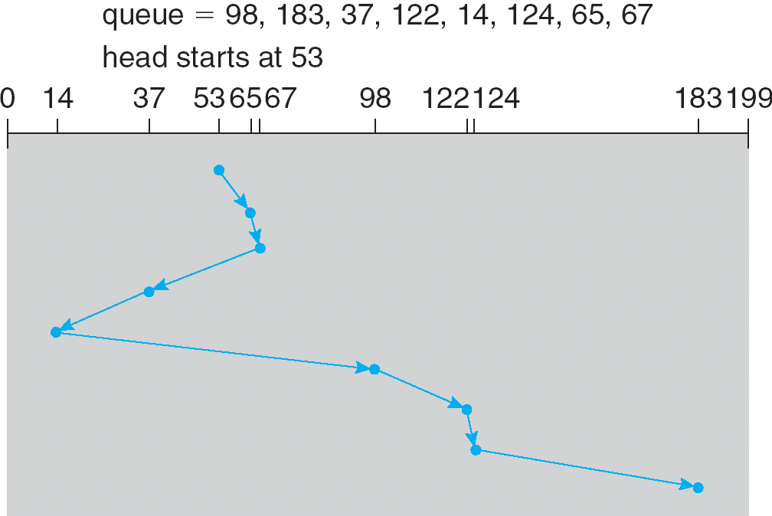
SSTF (Cont)
Notes:
26

Slide 27
SCAN
The disk arm starts at one end of the disk, and moves toward the other end, servicing requests until it gets to the other end of the disk, where the head movement is reversed and servicing continues.
SCAN algorithm Sometimes called the elevator algorithm
Illustration shows total head movement of 208 cylinders
Notes:
27

Slide 28
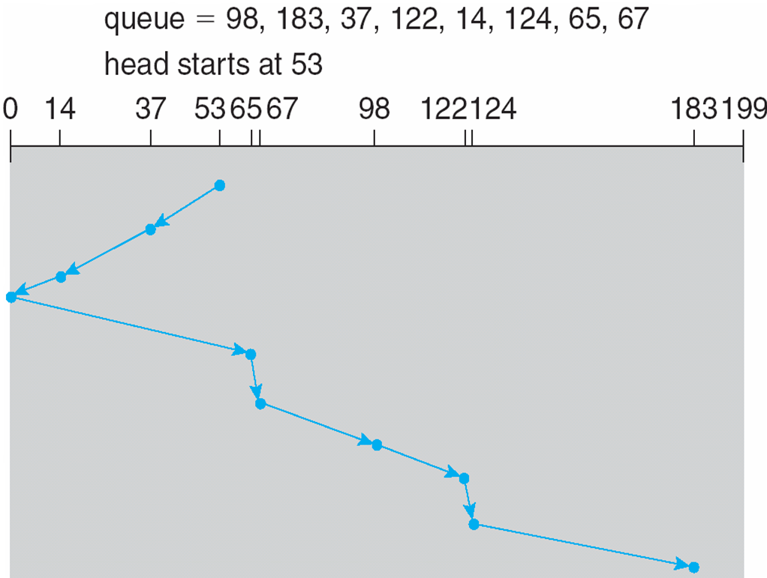
SCAN (Cont.)
Notes:
28

Slide 29
C-SCAN
Provides a more uniform wait time than SCAN
The head moves from one end of the disk to the other, servicing requests as it goes
When it reaches the other end, however, it immediately returns to the beginning of the disk, without servicing any requests on the return trip
Treats the cylinders as a circular list that wraps around from the last cylinder to the first one
Notes:
29

Slide 30
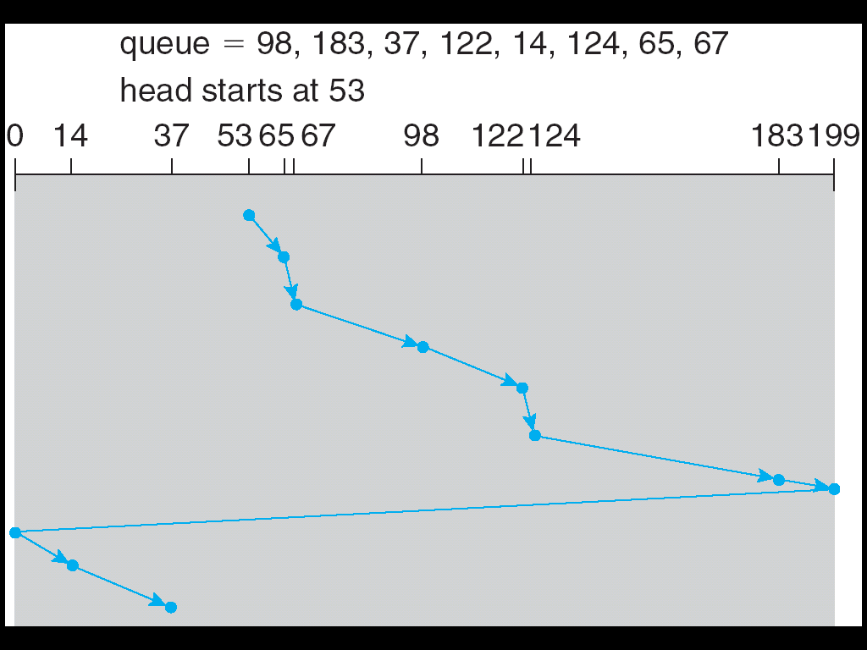
C-SCAN (Cont)
Notes:
30

Slide 31
C-LOOK
Version of C-SCAN
Arm only goes as far as the last request in each direction, then reverses direction immediately, without first going all the way to the end of the disk
Notes:
31

Slide 32
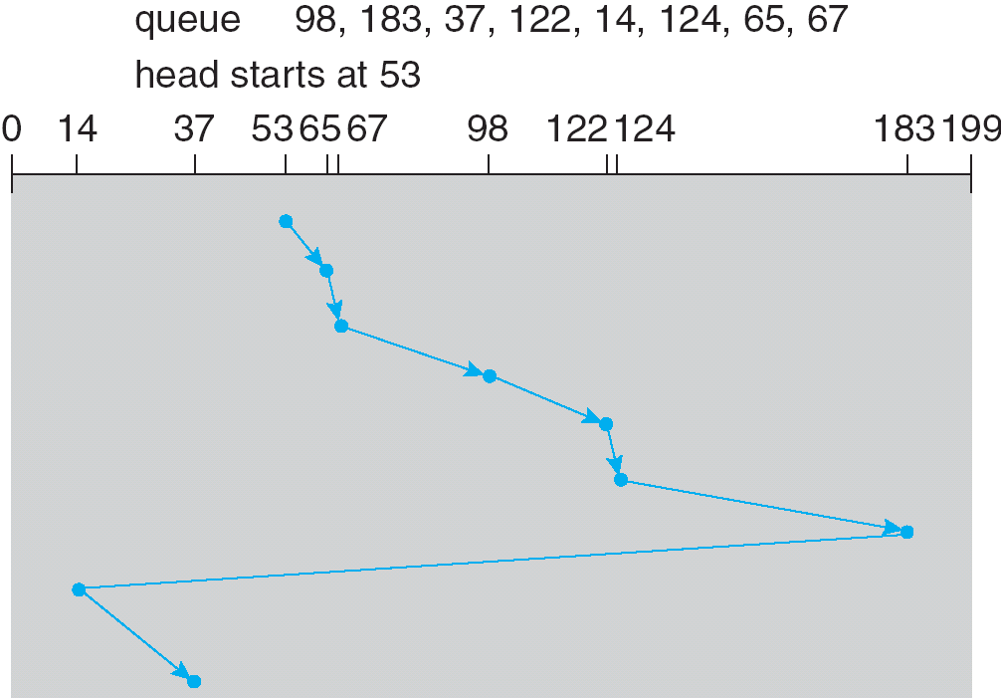
C-LOOK (Cont)
Notes:
32

Slide 33
Selecting a Disk-Scheduling Algorithm
SSTF is common and has a natural appeal
SCAN and C-SCAN perform better for systems that place a heavy load on the disk
Performance depends on the number and types of requests
Requests for disk service can be influenced by the file-allocation method
The disk-scheduling algorithm should be written as a separate module of the operating system, allowing it to be replaced with a different algorithm if necessary
Either SSTF or LOOK is a reasonable choice for the default algorithm
Notes:
33

Slide 34
Linux Scheduling Algorithms
The Linus Elevator
Deadline Scheduling
Anticipatory Scheduling
Completely Fair Queuing (CFQ)
Noop Scheduler

Slide 35
Linux Scheduling Algorithms
Noop Scheduler
Basic FCFS scheduler – all it does is keep the requests sorted by sector number
Good for random-access block devices
Completely Fair Queuing (CFQ)
Sort by sector number, but maintain process-level fairness by keeping a separate sorted queue for each process
Service those queues round robin, with a quantum (ensures that each process will be served I/O every so often, i.e. for buffering purposes)
The Linus Elevator
Sort by sector number, but check to see if some requests are getting starved (aging)
If so, queue the request at the end, not in sorted order

Slide 36
Linux Scheduling Algorithms
Deadline Scheduling
Reads block processes, as opposed to writes (typically), so mandate that reads be served within 500 ms, and writes within 5 seconds
If something expires, start serving those requests in sorted order
Otherwise, keep 3 queues: reads, writes, sorted order
Anticipatory Scheduling
Same as above, but wait ~6ms for new requests to maintain the sort
Risky (could lose that time if no new requests), but we hedge our bets by playing the numbers (due to locality)

Slide 37
Disk Management
Low-level formatting, or physical formatting — Dividing a disk into sectors that the disk controller can read and write
To use a disk to hold files, the operating system still needs to record its own data structures on the disk
Partition the disk into one or more groups of cylinders
Logical formatting or “making a file system”
To increase efficiency most file systems group blocks into clusters
Disk I/O done in blocks
File I/O done in clusters
Boot block initializes system
The bootstrap is stored in ROM
Bootstrap loader program
Methods such as sector sparing used to handle bad blocks
Notes:
37

Slide 38
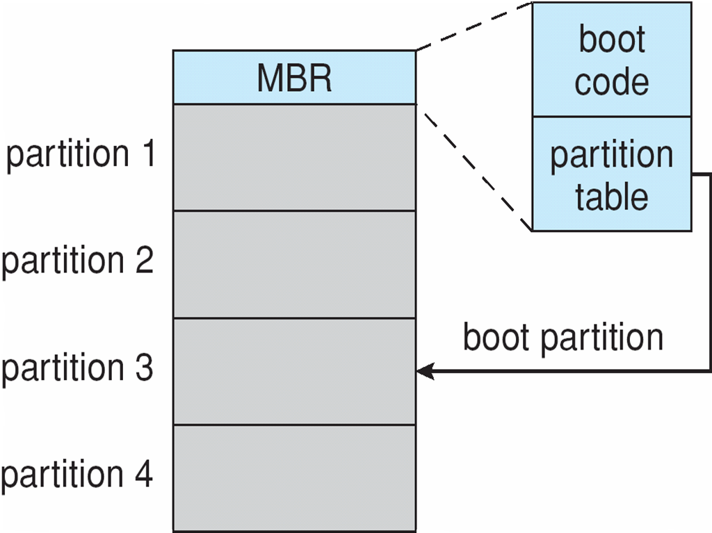
Booting from a Disk in Windows 2000
Notes:
38

Slide 39
Swap-Space Management
Swap-space — Virtual memory uses disk space as an extension of main memory
Swap-space can be carved out of the normal file system, or, more commonly, it can be in a separate disk partition
Swap-space management
4.3BSD allocates swap space when process starts; holds text segment (the program) and data segment
Kernel uses swap maps to track swap-space use
Solaris 2 allocates swap space only when a page is forced out of physical memory, not when the virtual memory page is first created
Notes:
39

Slide 40
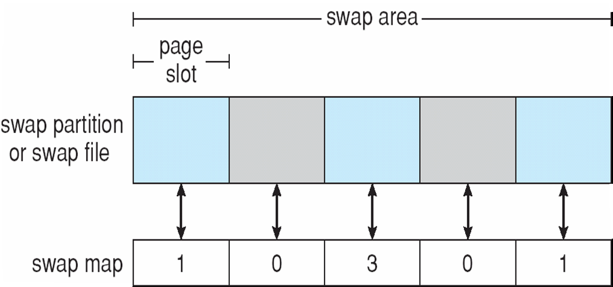
Data Structures for Swapping on Linux Systems
Notes:
40

Slide 41
RAID Structure
RAID – multiple disk drives provides reliability via redundancy
Increases the mean time to failure
Frequently combined with NVRAM to improve write performance
RAID is arranged into six different levels
Notes:
41

Slide 42
RAID (Cont)
Several improvements in disk-use techniques involve the use of multiple disks working cooperatively
Disk striping uses a group of disks as one storage unit
RAID schemes improve performance and improve the reliability of the storage system by storing redundant data
Mirroring or shadowing (RAID 1) keeps duplicate of each disk
Striped mirrors (RAID 1+0) or mirrored stripes (RAID 0+1) provides high performance and high reliability
Block interleaved parity (RAID 4, 5, 6) uses much less redundancy
RAID within a storage array can still fail if the array fails, so automatic replication of the data between arrays is common
Frequently, a small number of hot-spare disks are left unallocated, automatically replacing a failed disk and having data rebuilt onto them
Notes:
42

Slide 43
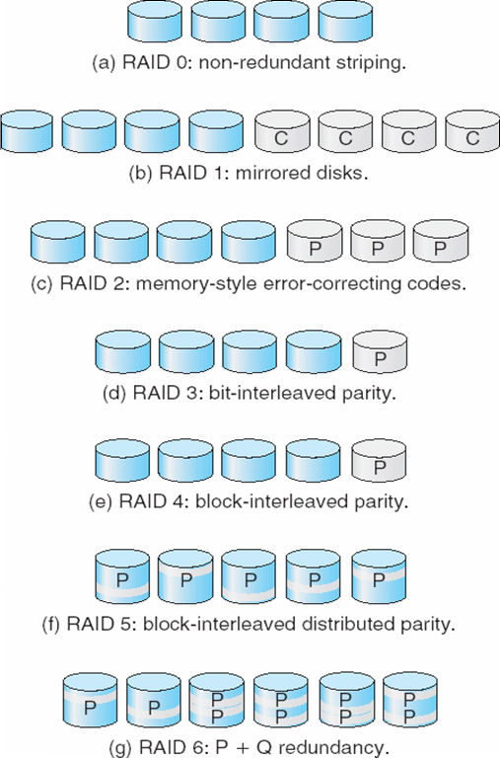
RAID Levels
Notes:
43

Slide 44
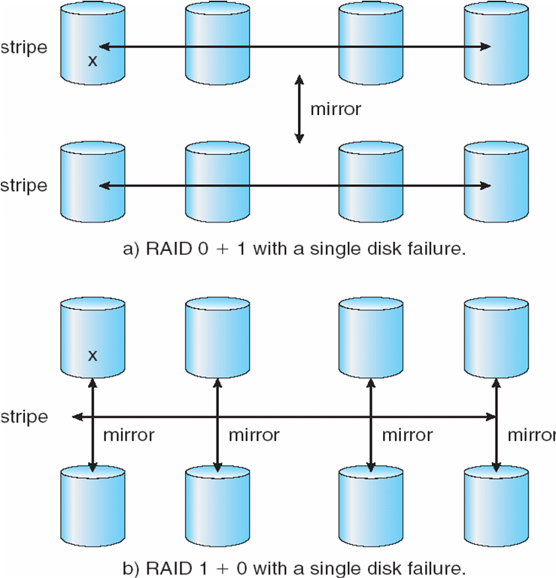
RAID (0 + 1) and (1 + 0)
Notes:
44

Slide 45
Removable Disks
A magneto-optic disk records data on a rigid platter coated with magnetic material
Laser heat is used to amplify a large, weak magnetic field to record a bit
Laser light is also used to read data (Kerr effect)
The magneto-optic head flies much farther from the disk surface than a magnetic disk head, and the magnetic material is covered with a protective layer of plastic or glass; resistant to head crashes
Optical disks do not use magnetism; they employ special materials that are altered by laser light
Notes:
45

Slide 46
Operating System Support
Major OS jobs are to manage physical devices and to present a virtual machine abstraction to applications
For hard disks, the OS provides two abstraction:
Raw device – an array of data blocks
File system – the OS queues and schedules the interleaved requests from several applications
Notes:
46

Slide 47
Speed
Two aspects of speed in tertiary storage are bandwidth and latency
Bandwidth is measured in bytes per second
Sustained bandwidth – average data rate during a large transfer; # of bytes/transfer time Data rate when the data stream is actually flowing
Effective bandwidth – average over the entire I/O time, including seek() or locate(), and cartridge switching Drive’s overall data rate
Notes:
47

Slide 48
Speed (Cont)
Access latency – amount of time needed to locate data
Access time for a disk – move the arm to the selected cylinder and wait for the rotational latency; < 35 milliseconds
Access on tape requires winding the tape reels until the selected block reaches the tape head; tens or hundreds of seconds
Generally say that random access within a tape cartridge is about a thousand times slower than random access on disk
The low cost of tertiary storage is a result of having many cheap cartridges share a few expensive drives
A removable library is best devoted to the storage of infrequently used data, because the library can only satisfy a relatively small number of I/O requests per hour
Notes:
48

Slide 49
Reliability
A fixed disk drive is likely to be more reliable than a removable disk or tape drive
An optical cartridge is likely to be more reliable than a magnetic disk or tape
A head crash in a fixed hard disk generally destroys the data, whereas the failure of a tape drive or optical disk drive often leaves the data cartridge unharmed
Notes:
49

Slide 50
Cost
Main memory is much more expensive than disk storage
The cost per megabyte of hard disk storage is competitive with magnetic tape if only one tape is used per drive
The cheapest tape drives and the cheapest disk drives have had about the same storage capacity over the years
Tertiary storage gives a cost savings only when the number of cartridges is considerably larger than the number of drives
Notes:
50

Slide 51
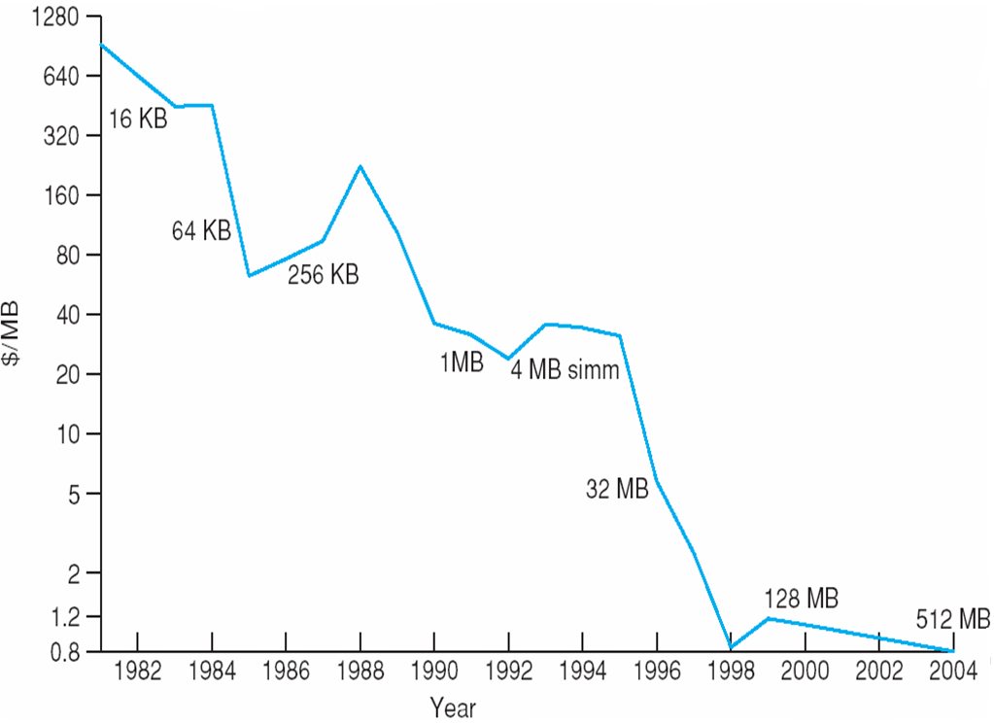
Price per Megabyte of DRAM, From 1981 to 2004
Notes:
51

Slide 52
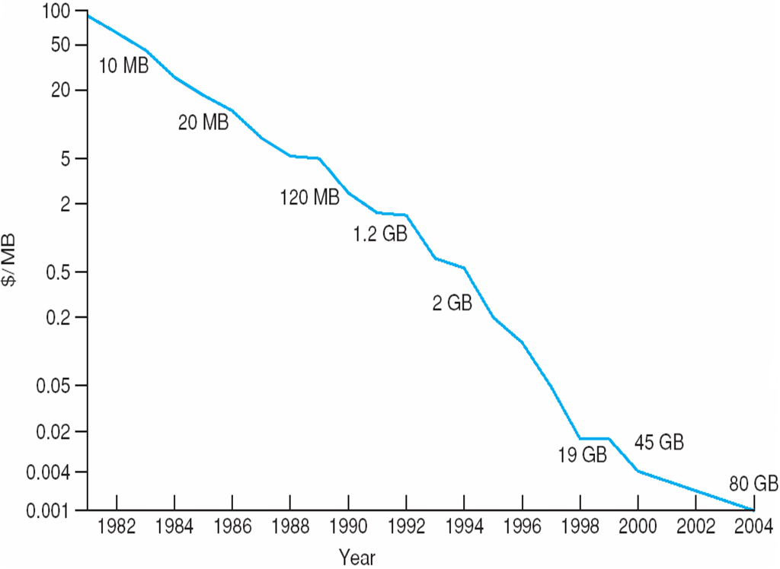
Price per Megabyte of Magnetic Hard Disk, From 1981 to 2004
Notes:
52

Slide 53
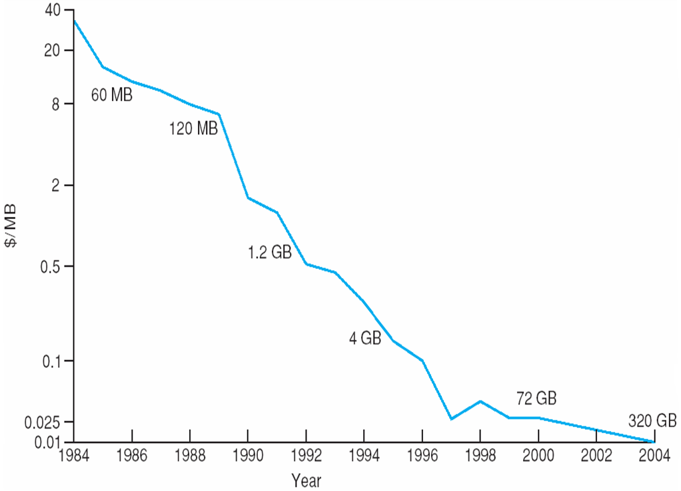
Price per Megabyte of a Tape Drive, From 1984-2000
Notes:
53

Slide 54
I/O Hardware
Incredible variety of I/O devices
Common concepts
Port
Bus (daisy chain or shared direct access)
Controller (host adapter)
I/O instructions control devices
Devices have addresses, used by
Direct I/O instructions
Memory-mapped I/O
Notes:
54

Slide 55
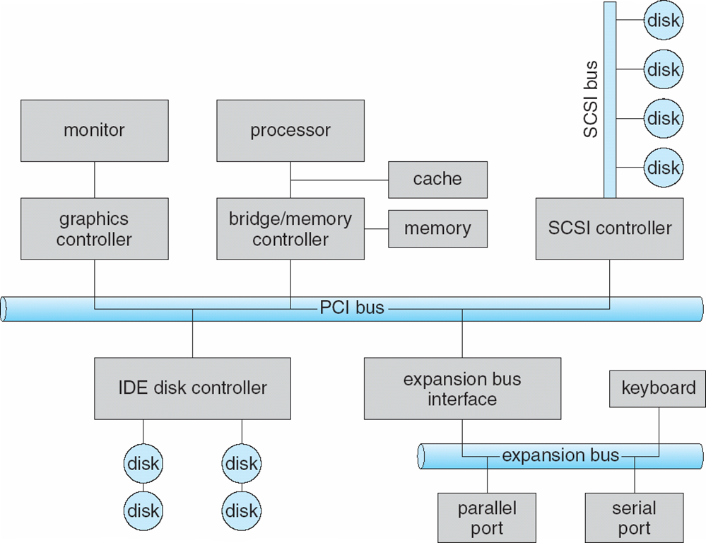
A Typical PC Bus Structure
Notes:
55

Slide 56
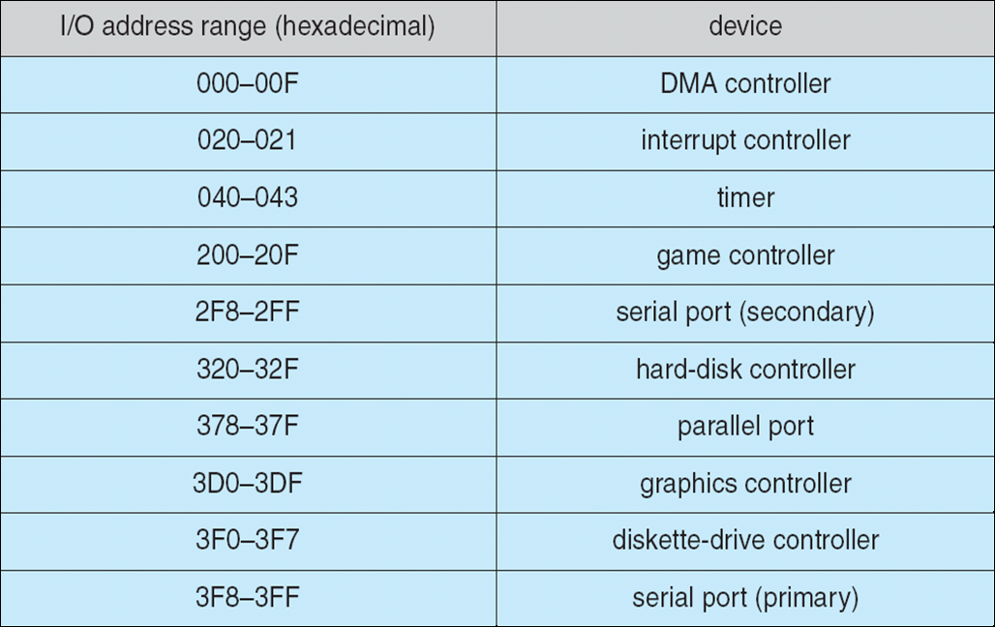
Device I/O Port Locations on PCs (partial)
Notes:
56

Slide 57
Polling
Determines state of device
command-ready
busy
Error
Busy-wait cycle to wait for I/O from device
Notes:
57

Slide 58
Interrupts
CPU Interrupt-request line triggered by I/O device
Interrupt handler receives interrupts
Maskable to ignore or delay some interrupts
Interrupt vector to dispatch interrupt to correct handler
Based on priority
Some nonmaskable
Interrupt mechanism also used for exceptions
Notes:
58

Slide 59
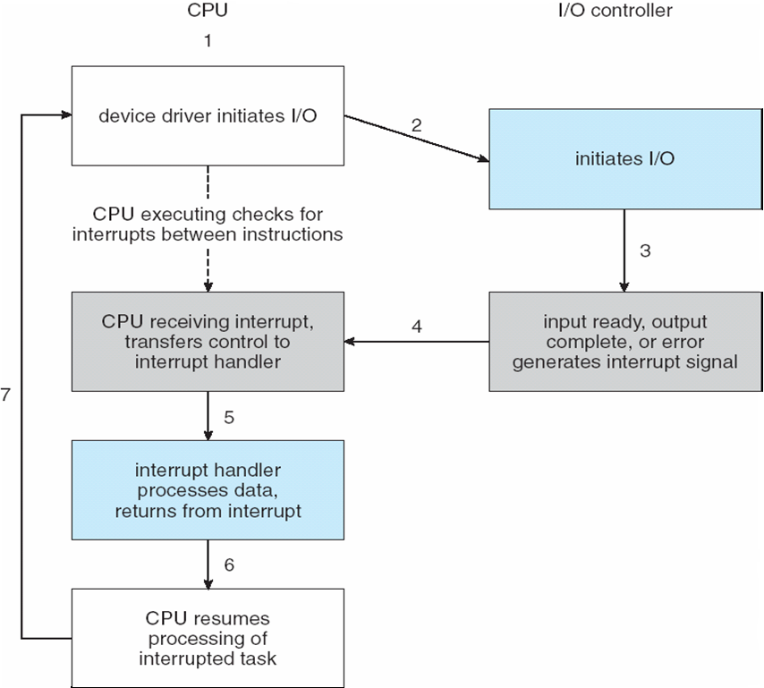
Interrupt-Driven I/O Cycle
Notes:
59

Slide 60
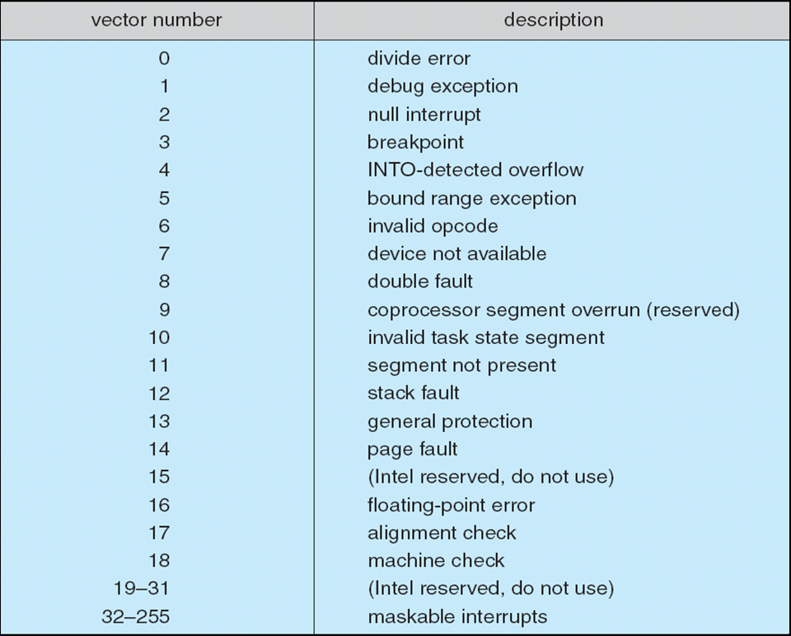
Intel Pentium Processor Event-Vector Table
Notes:
60

Slide 61
Direct Memory Access
Used to avoid programmed I/O for large data movement
Requires DMA controller
Bypasses CPU to transfer data directly between I/O device and memory
What’s a challenge with this scheme as it relates to other subsystems like memory management?
Notes:
61

Slide 62
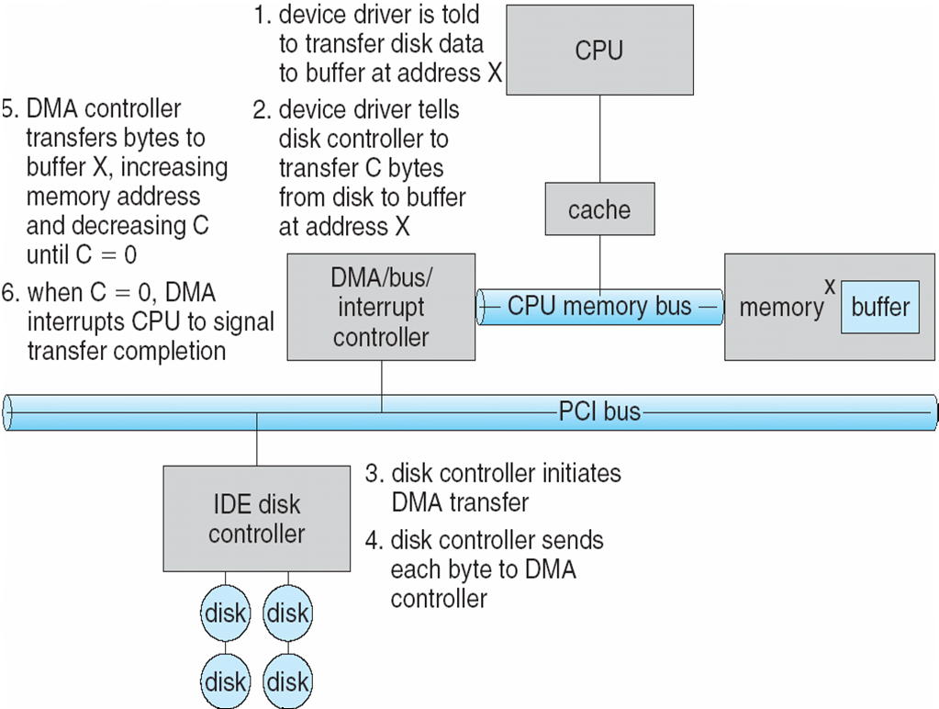
Six Step Process to Perform DMA Transfer
Notes:
62

Slide 63
RAID: Redundant Arrays of Inexpensive DIsks
RAID 1: Full mirroring/Shadowing
Most Expensive
Bandwidth sacrifice: 1 write = 2
To recover simply swap out a disk, can be hot swappable
RAID 5+: High I/O Rate Parity
Stripped across multiple disks
Disk 1
Disk 2
Disk 3
Disk 4
Disk 5
D0
D1
D2
D3
P0
D4
D5
D6
P1
D7
D8
D9
P2
D10
D11
D12
P3
D13
D14
D15
P4
D16
D17
D18
D19
D20
D21
D22
D23
P5
P0
=
D0
⊗
D1
⊗
D2
⊗
D3

