Slide 1


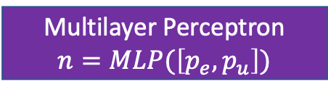

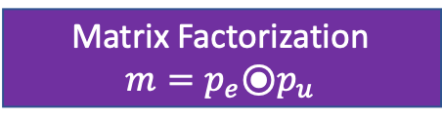




$$output$$
Multilayer Perceptron
$$output=MLP([m, n, φ_{t}, φ_{e}, φ_{u}])$$
$$φ_{t}, φ_{e}, φ_{u}$$
Matrix Factorization
$m=p_{e}$⦿$p_{u}$
Multilayer Perceptron
$$n=MLP(\left[p_{e}, p_{u}\right])$$
User Embedding $p_{e}$
Action Embedding $p_{u}$
0 | 0 | 0 | 1 | 0 | …
0 | 0 | 0 | 1 | 0 | …
$$α_{e}$$
$$α_{u}$$

Slide 2



Inference
Training
Replay Buffer
Output
Active Index
$$o_{1}$$ | $$o_{2}$$ | … | $$o_{M}$$
$$o_{1}$$ | $$o_{2}$$ | … | $$o_{M}$$
$$l_{1}$$ | $$l_{2}$$ | … | $$l_{M}$$
Loss
NCF₁
NCF₂
NCF₃
…
NCF_{M}
Minimization

Slide 3








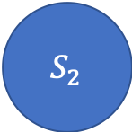

$$a_{1}$$
$$a_{1}$$
$${ S}_{0}$$
$$a_{2}$$
$${ S}_{1}$$
$$a_{2}$$
$${ S}_{2}$$
$$a_{2}$$
$$a_{2}$$
$${ S}_{N}$$
$$a_{1}$$
…

