Slide 1
Responsible AI
Opportunities and Challenges for Testers
Bill Matthews

Slide 2
AI Risks and Harms
2023 survey of 800 businesses and IT decision makers found that
85%
36%
73%
Expect AI to increase revenue growth in the next 18-24 months
Were confident their organization has sufficient checks and balances in place to mitigate potential risks and harms of AI
Agreed that Safe AI and Responsible AI are a priority for their organization over the next 18-24 months
Source https://www.avanade.com/-/media/asset/thinking/avanade-trendlines-exec-summary-pdf.pdf

Slide 3
What is Responsible AI
Responsible AI Seeks to…
Responsible AI Is NOT…
Provide a set common themes that aim to promote AI that is Useful and Beneficial to Society.
Mitigate risks and harms of AI
Foster a more humanistic approach to building AI systems
Build Trust in AI Systems
Supports Regulatory Compliance
Solely about meeting regulatory and governance requirements
Solely about Ethics
A collection of best practices for companies to adopt
It is multi-disciplinary, context-driven, risk focused and people centric

Slide 4
Common Themes in Responsible AI
Fairness
Built for Everyone
Transparency and Explainability
Ensuring AI Decisions can be Explained and Understood
Accountability
Clear responsibility for AI Actions and Decisions
Avoid creating or reinforcing Bias and Discrimination
Fairness of outcomes
People are accountable not algorithms
Ensuring how the AI System is used is understood.
Privacy and Security
Respects user data and confidentiality
Robustness and Reliability
Robust to malicious users
Reliable outcomes
Safe outcomes
Avoids data leakage

Slide 5

The Importance of Responsible AI
Why it matters
Real World Consequences
Impacts on individuals and society
https://www.theguardian.com/technology/article/2024/jul/01/british-female-politicians-targeted-by-fake-pornography

Slide 6

The Importance of Responsible AI
Why it matters
Real World Consequences
Impacts on individuals and society
Business Reputation
https://www.wired.com/story/air-canada-chatbot-refund-policy/

Slide 7
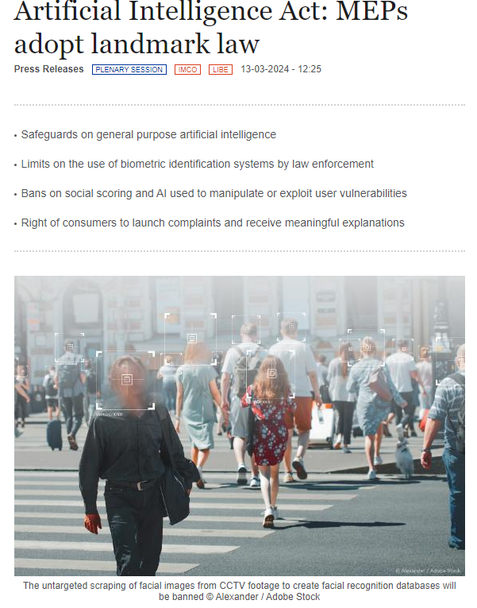
The Importance of Responsible AI
Why it matters
Real World Consequences
Impacts on individuals and society
Business Reputation
Regulatory Compliance

Slide 8
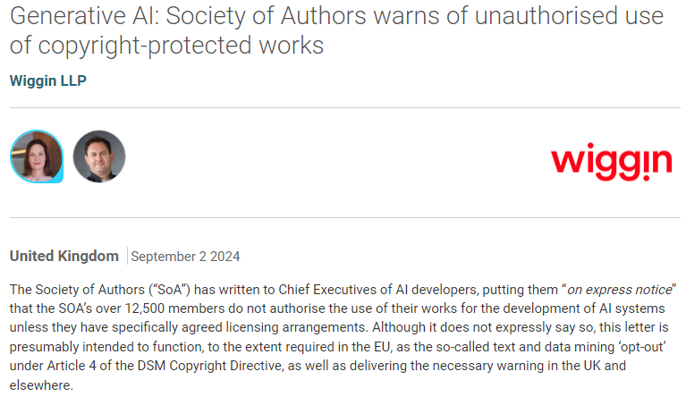
The Importance of Responsible AI
Why it matters
Real World Consequences
Impacts on individuals and society
Business Reputation
Regulatory Compliance
Legal Challenges
https://www.lexology.com/library/detail.aspx?g=65ce4bc7-bea2-4706-a6fd-f589776b6265

Slide 9
What does this have to with Testing?
Developing Responsible AI requires an understanding of the
possible issues,
limitations,
and unintended consequences
of the AI System
Sounds a lot like testing to me

Slide 10
The role of Testing in Responsible AI
Where (should) testing occur to Support Responsible AI?
A
B
C
D
E
Data Collection
Model Building
Integration
Deployment
Monitoring
Collecting data for training models
Transforming the data
Data Storage
Construct Data Pipelines
Model Training
Model Chaining
Building Re/Training Pipelines
Building Inference Pipelines
Packaging Models
Integrate Model(s) with applications
Building Deployment Pipelines
Deployment to inference infrastructure
Monitor Data
Monitor Models
Monitor Infrastructure
Monitor KPIs
Event Triggers
Data Quality Checks
Data Transformation Tests
Data Bias Tests
Model Fairness
Model Correctness
Edge Cases
Adversarial Testing
Model Interpretation
Model Integration
Testing Feedback Loops
Testing Externalities
Model Performance
Model Reliability
Testing Metrics Capture

Slide 11
Where (might) Testers Fit into Responsible AI?
Model Testing
System Testing
Model Fairness and Bias
Model Correctness
Model Reliability
Adversarial Testing
Edge Case Testing
Privacy and Security Tests
Positive Feedback Loops
Negative Feedback Loops
Data Flows

Slide 12
Challenges for Testers
Knowledge
Mindset
Tooling
Foundational AI/ML
Responsible AI Themes
AI/ML specific Technical Risks and manifestations
AI/ML specific testing techniques
Data Analysis and manipulation
Notions of Correctness
Testing distributions not data points
Hypothesis Testing
Tooling tends to be Code-First tools
Some No/Low Code tools are emerging
Tool space is fast evolving

Slide 13
Testing for Fairness And Bias
Ensuring equitable outcomes for different groups
General Approach
Identify the different groups that are important in your context
Understand how membership of those groups manifest in your input data
Understand the ways that Bias and Un-Fairness can manifest in your model output (threats to Fairness)
Understand potential harms for specific groups and how that might manifest in your models
Choose how you will assess fairness and bias
Common Approaches to Fairness and Bias Testing
Group Fairness - ensuring the model’s performance is consistent across different demographic groups.
Demographic Parity: Measures whether different groups receive positive outcomes at equal rates
Equal Opportunity: Evaluates whether a model’s true positive rate (sensitivity) is the same for all groups.
Equalized Odds: Extends equal opportunity by ensuring that both the true positive rate and false positive rate are equal across groups.
Individual Fairness - focuses on treating similar individuals similarly
Counterfactual Fairness: Measures whether a model’s decision would remain the same if an individual’s group membership were changed while keeping all other attributes constant
Similarity Metrics: Assess whether similar individuals (based on specific feature similarities) receive similar outcomes
Causal Fairness - examines the causal relationships between inputs to ensure that protected attributes do not unjustly influence outcomes.
Total Effect: Measures the total influence of a protected attribute on the model’s prediction
Direct and Indirect Effects: Decomposes the influence of a protected attribute into direct and indirect effects to identify and mitigate unfair causal pathways

Slide 14
Testing for Correctness
Ensuring the Reliability of the model
General Approach
Determine the properties of correctness in your context
Determine how correctness will be measured
Determine how the inputs will be generated
Determine how the inputs and outputs could be segmented into useful segments
Understand what are the expectations based on domain knowledge
Accuracy/Precision/Recall – Assess how well the model performs against the data (often evaluated as part of model training)
Segmentation Analysis – Assess how well the model performs against different segments of inputs/outputs.
Error Analysis – Investigating the cases where the model produced incorrect or unsatisfactory outputs.
Expectation Testing – Does the model hold true with respect to the identified business expectations.

Slide 15
Testing for Model Robustness
Building Trust in the Model
Adversarial Testing - intentionally exposing the model to adversarial inputs—slightly modified examples designed to deceive the model or to control the outcome.
Attack Success Rate: Measures the effectiveness of adversarial attacks against the model.
Robust Accuracy: Assesses model performance on adversarial perturbed inputs compared to normal inputs
Noise Injection/Perturbation/Augmentation Testing – intentionally injecting small changes/noise into inputs to understand how they impact the outcomes
Performance Degradation: Measures the drop in accuracy, precision, or other performance metrics when noise is added to the inputs
Noise Sensitivity: Quantifies how much input noise affects the model’s predictions
Out-Of-Distribution (OOD) Testing – Assess the model’s performance using data that is outside the norms of the training distribution.
OOD Detection Rate: Measures the model’s ability to correctly identify when an input is out-of-distribution.
Confidence Calibration: Evaluates whether the model’s confidence in its predictions appropriately reflects its uncertainty on OOD inputs.

Slide 16
Testing for Edge Cases
Testing the Boundaries
General Approach
Identify the edge cases (that matter) for your context
Understand how these are represented in the input data
Understand the potential impact of failures
Edge Case Testing – Assess the model’s performance using data that is outside the norms of the training distribution.
Edge Case Detection Rate: Measures the model’s ability to correctly handle an Edge Case.
Confidence Calibration: Evaluates whether the model’s confidence in its prediction of an Edge Case is comparable to typical cases.

Slide 17
Testing for Feedback Loops
Ensuring model Stability over time
General Approach
Identify the feedback loops within interactions
Identify the positive feedback loops and recognising how these can be detected in the output
Identify the negative feedback loops and recognising how these can be detected in the output
Feedback Loop Testing - simulating feedback loops to understand how model outputs can affect future inputs. Sensitivity analysis examines how variations in input can lead to changes in model performance
Sensitivity Metrics: Measures how sensitive model outputs are to changes in inputs, particularly those generated by the model itself.
Error Propagation Analysis: Evaluates how errors can accumulate through feedback loops, affecting long-term model quality.
Counterfactual Testing- involves altering specific inputs to observe how these changes affect model outputs, particularly focusing on inputs that are influenced by the model itself in feedback scenarios.
Counterfactual Impact Score: Measures the influence of altered inputs on model predictions.
Bias Amplification Metrics: Evaluates whether feedback loops cause biases to grow over time.

Slide 18
Testing for Data Flows
Ensuring longevity of Models
General Approach
Understand where and how data is collected for training future versions of models
Common Approaches to testing ML Data Flows
Data Poisoning- Simulate new data arriving from source that aims to artificially change the distribution of the data (such as using outliers, toxic inputs etc.)
Population Stability Index (PSI): Measures the stability of feature distributions over time.
Kullback-Leibler Divergence: Quantifies the difference between the probability distributions of the training data and the current data.
Population Bias – Simulate biased (but within the current distribution) data arriving from source that aims to artificially change the distribution of the data
Population Stability Index (PSI): Measures the stability of feature distributions over time.
Kullback-Leibler Divergence: Quantifies the difference between the probability distributions of the training data and the current data.

Slide 19
Charting your Roadmap into Responsible AI
AI/ML Knowledge
Has foundational knowledge of AI/ML.
Understands the engineering practices used to build and deploy AI/ML Models
The Responsible AI Tester
Understanding the RAI themes
How they apply to products
How they apply to testing practices
Responsible AI
Understands the Technical risks related to using AI in products.
Understands the ways AI systems can fail (manifestation of technical risks)
Technical Risks
Some skills in Data Analysis, Uncertainty, Hypothesis Testing
Familiarity with using common AI Testing tools
Familiarity with AI Testing Techniques
Technical Skills

Slide 20
Thank you!
Ask Questions now or later via:
During TestBash (I’m very approachable!)
Ministry of Testing Slack
LinkedIn: linkedin.com/in/billmatthews
Threads: @BillMatthews

