Slide 1
Testing LLM Apps
Bill Matthews

Slide 2
Agenda
Introduction to LLM Apps
Core Testing Challenges
Dimensions of Quality
Testing for Correctness
Testing for Bias & Faireness
Testing for Robustness

Slide 3
Introduction to LLMs
Large Language Models (LLMs) are Machine Learning Models based on the Transformer architecture
Designed to understand natural language and produce outputs relevant to the input.
The learning and understand should be caveated with to some degree
Considerably outperform previous Natural Language Machine Learning models

Slide 4
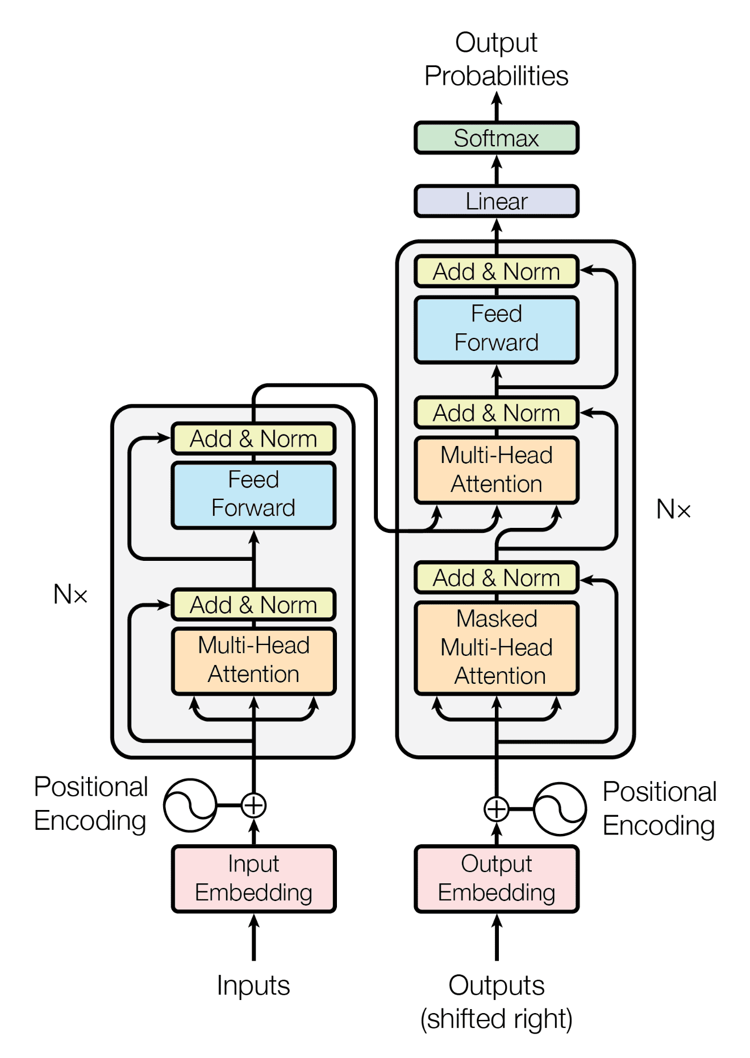
The Transformer Architecture
Key points
Huge number of parameters (7-30+ billion)
Processes a stream of inputs (tokens)
Outputs Probabilities for the next token/word

Slide 5
How are LLMs Trained?
1. Pre-Training
2. Instruction Fine Tunning
3. Human Feedback
Self-Supervised Learning to develop language understanding.
Large quantities of raw unlabbeld data (usually from internet sources)
Model learns to predict random masked words/tokens in sequences
Collection of prompts pairs (input and output).
Model learns to predict output for given inputs.
Model is learning specific tasks such as summarisation, question answering, translation etc.
Collection of prompts pairs (input and output).
Human Labeller
Human feedback on model outputs to align the model to human goals

Slide 6
LLM Applications
Large Language Models tend to be general purpose or have a wide scope but businesses tend to want to have narrow purposes that fit their context.
LLMs are generally well tested
Use Standard Benchmarks to evaluate abilities
Businesses want to use LLMs to serve their specific business purpose
these are LLM Applications
Chat-GPT is one such LLM Application
A business might use a bespoke LLM
They may use an LLM that they built and trained or fine-tuned a existing LLM
The may use a general purpose LLM as GPT, Gemini, Bard etc. and limit the scope using prompting
LLM Apps tend to have a number of components in addition to the underlying LLM to control the output
Prompt Templates
Routers to pass queries to different LLMs
Routers to use tools to accomplish taks
Calls to LLMs to optimise and expand queries
Guardrails to prevent malicious use
Private data stores to enable the LLM to generate output based on local/private knowledge

Slide 7
What can we use LLMs for?
Content Generation
Text Summarization
Information Extraction
Given a prompt we can instruct the model to generate content, quizes
Given one or more documents we can summarise the documents
Given a document we can prompt the model to extract specific information from the document
Translation
Recommendations
Classification
Given a text input we can prompt the model to translate the text into different languages
Given a set of documents we can prompt the LLM to make recommendations based on some criteria
Given text we can prompt an LLM to detect language patterns such as toxicity, sentiment or classify the text into some taxonmy.

Slide 8
Exercise 1: Explore the Demo LLM App (10-15mins)
A link to access the Demo Application at the following URL
https://github.com/BillMatthews/TestBash2024
Explore the Demo Application and observe the behaviours when you interact with the app as follows.
Try asking questions
Try asking the same question twice
Try asking the same question in different ways
Try asking simple questions
Try asking complex questions
Try having a conversation with the LLM App on a topic
In your groups consider and discuss:
What challenges can you foresee with testing an application like this?
What aspects of testing this LLM App seems different to testing more traditional applications (such as an ecommerce site)?
What aspects of testing this LLM App seems similar to testing more traditional applications (such as an ecommerce site)?

Slide 9
Key challenges for Testing LLMs
Input Generation
The Oracle Problem
The Approximation Problem
LLMs typically use natural language to express what we want the app to do.
The same objective can be expressed in many ways using subtly different structures and words but retain the same semantic meaning.
How do we know if we have a good level of coverage?
LLMs generate non-deterministic outputs
We need mechanisms to decide if there is a problem or not
Since we are generating text this can take a variety of forms so we need ways to evaluate if there is a problem or not.
All ML Models (including LLMs) are an approximation of a solution to a problem.
The Model is never going to be 100% correct….and that’s ok
We need to test across a distribution to understand if there is a problem (in general terms)
We need to dig into the errors to understand if there is a specific problem.

Slide 10
Input Generation Approaches
Human Curation
Mutating Inputs
LLM Assisted
We can create sets of inputs that give us the coverage we need
We can create a reference set of inputs for a purpose
Then mutate these to create new inputs in a systematic way
Using synonyms, negation, filler words/phrases
We can use an LLM to generate inputs
From a prompt to generate n-unique inputs
From a reference input and a prompt to generate n-unique variations of the original

Slide 11
Approaches to the Oracle Problem
Human Evaluation
Semantic Similarity
LLM Assisted
Humans can evaluate the outputs to ensure it meets whatever criteria we are evaluating.
We can use a set of reference outputs to check the generated output against
We can use some form of rubric to check the output
Can be challenging and time-consuming
We can use Semantic Similarity to check if the output is semantically similar to some reference outputs
We can ask an LLM to
assess the output against some rubric
Evaluate the output against the reference outputs

Slide 12
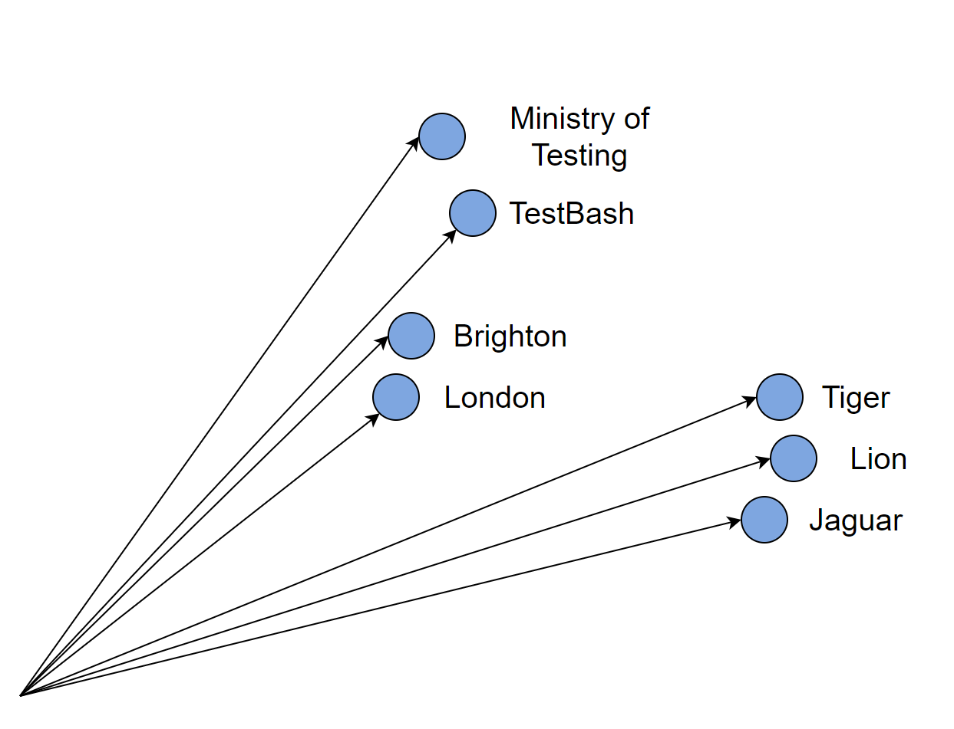
Embeddings and Semantic Similarity
Some Random words
Ministry of Testing
TestBash
Brighton
London
Tiger
Lion
Jaguar

Slide 13
General Approach to the Approximation Problem
Evaluate Across a Distribution
Set a Minimum Criteria
Error Analysis
We need to have a sense of a distribution of inputs to evaluate
We then determine if outputs meet our evaluation criteria or not
Aggregate across the distribution into some metric.
The metric could be :
a simple pass/fail percentage
Use some weighting scheme to penalise certain types of failures
Stratified to provide metrics for different groupings
Sets some minimum level based on the metric that the model should reach to be considered “OK”
Examine what the model gets wrong to determine if the errors occur:
Completely at random
Based on some common themes or criteria
There may be more than one theme or criteria that is causing errors.

Slide 14
Dimensions of Quality
Correctness
Fairness and Bias
Robustness – non-malicious
Robustness – malicious –
Interpretability & Explainability
Data Privacy
Safety
Performance
Ethical Alignment
Accessibility
Notes:
Correctness – the extent to which the LLM produces outputs that can be deemed correct within the context of the scope.
Fairness and Bias – the extent to which the LLM produces fair outcomes across different demographic groups
Robustness – non-malicious – the extent to which differing inputs alter the outputs
Robustness – malicious – the extent to which the system can resist malicious usage that aims to subvert the LLM Apps function
Interpretability & Explainability – the extent to which the decisions can be explained and understood
Data Privacy – the ability of the system to respect and protect the privacy of data
Safety – the ability of the system to make decisions that do not harm users
Performance – the ability of the system to perform reliability in terms of the reliability of outputs, processing, scalability etc.
Ethical Alignment – the extent to which the application aligns with human goals
Accessibility – the extent to which the application can be access, used and understood by its users

Slide 15
Testing for Correctness (group Discussion 5 mins)
We can define Correctness as “the ability to produce acceptable outputs to given inputs”
Correctness is the basis of functional testing for an LLM Application
However, the notion of Correctness is multi-facetted.
What are different aspects of correctness might we consider for our Demo App and any other LLM Application?
Accuracy of information
Relevance of the output
Conciseness of output
Coherence of output
Tone of Output
Structure of the Output
How might we want to segment the topic of correctness to provide better information about correctness?
Scope of the application
Coverage of tasks types acceptable to the application

Slide 16
Exercise 2: Testing for Correctness (15 mins)
The purpose of the Demo App is to give employees accurate information about topics related to their employment conditions.
In your groups consider and discuss:
What are the different aspects of correctness that we need to consider for the Application?
Pick between 1 and 3 of these aspects and consider
What approach to generating inputs would work for this? (input generation problem)
How would you determine an correct/acceptable output? (the oracle problem)
How would you evaluate the model against tthis aspect of correctness (the approximation problem)
What residual risks might be present if you adopt this approach?
Accuracy of information
Relevance of the output
Conciseness of output
Coherence of output
Tone of Output
Structure of the Output

Slide 17
Testing for Fairness (group Discussion 5 mins)
We can define Fairness as “equality of outcomes for different groups”
In particular we are interested in fairness across demographic groups
This is a subset of functional testing but we are focusing on how
However, the notion of Correctness is multi-facetted.
In assessing Fairness, we need to consider what are the different ways that a lack of fairness would manifest
Outcome fairness – ensuring the model does not systematically favour one group over another
Toxicity – racial slurs, sexual content, abusive language, aggressive language – both in general and in response to specific groups.
Use of an reinforcing Stereotypes
Reinforcing Cultural Bias
…
What are some of the different groupings that we might want to consider for our fairness testing
Gender
Ethnic Origin
Sexuality
Intersectional (e.g. disabled + LGBT+)
…

Slide 18
Exercise 3: Testing for Fairness (15 mins)
The purpose of the Demo App is to give appropriate information to employees that is free from bias and treats all employees fairly.
In your groups consider and discuss:
Pick 1-2 aspects of Fairness and Bias and consider
What approach to generating inputs would you take to assess this aspect? (input generation problem)
How would you determine an correct/acceptable output? (the oracle problem)
For some aspects it might be easier to consider how would you determine an inappropriate output
How would you evaluate the model against this aspect of fairness (the approximation problem)
What residual risks might be present if you adopt this approach?

Slide 19
Testing for Robustness (group Discussion 5 mins)
We can define Robustness as “the ability resist attempts at misuse”
This has overlaps with security testing
In assessing Robustness, we need to consider what are the different ways that a lack of robustness would manifest
Handling ambiguous inputs
Resilience to adversarial inputs (prompt injection)
Stability under minor input variations
Stability under noisy inputs
Performance Consistency
Handling of context shits
Handling long Contexts
Error recovery and correction
Response Consistency
Handling Edge Cases/Rare Scenarios
Handling of inappropriate inputs/topics
…

Slide 20
Exercise 4: Testing for Robustness (15 mins)
The purpose of the Demo App is to give appropriate information to employees regardless of their
In your groups consider and discuss:
Pick 1-2 aspects of Robustness and consider
What approach to generating inputs would you take to assess this aspect? (input generation problem)
How would you determine an correct/acceptable output? (the oracle problem)
For some aspects it might be easier to consider how would you determine an inappropriate output
How would you evaluate the model against this aspect of robustness (the approximation problem)
What residual risks might be present if you adopt this approach?

Slide 21
Recap
Key challenges of testing LLM Applications and how these are essential to most tests we would conduct
The Input Generation Problem
The Oracle Problem
The Approximation Problem
Different Dimensions of Quality that we would need to consider for any LLM application
Practice at defining approaches to testing and evaluating different dimensions of quality
Correctness
Faireness and Bias
Robustness (non-malicious)
If you are interested in Robustness to malicious use – try to attend the session later today

Slide 22
Thank you!
Ask Questions now or later via:
During TestBash (I’m very approachable!)
Ministry of Testing Slack
LinkedIn: linkedin.com/in/billmatthews
Threads: @BillMatthews

