Slide 1

Testing LLM-Based Applications
Building trust in tomorrow’s technology today
Strategies, Risk and Evaluations
Bill Matthews

Slide 2
Introduction to Generative AI
Generative AI produces new content—text, images, code—by learning patterns from data.
It shifts software from rule-based logic to probabilistic and adaptive systems
Foundation Models are large-scale models trained on broad data that serve many downstream tasks.
Large Language Models (LLMs) (e.g., GPT, LLaMA) specialize in understanding and generating human language.
Other foundation models work across **modalities**—vision, audio, or multi-modal (e.g., image + text).
The learning and understanding should be caveated with to some degree
These models require new approaches to testing and evaluation, beyond traditional QA methods.

Slide 3
What can go wrong?
Functional Risks
Ethics and Social Risks
Security and Abuse Risks
Hallucinations
Inconsistent responses
Misunderstand intent
Forget or misrepresent earlier parts of the conversation
Exceed remit
Generation of Toxic and Offensive content
Biased or unfair outputs and decisions
Reinforce stereotypes
Contribute to disinformation
Leakage Sensitive Data
Impersonation/Deep Fakes
Prompt injection
Data Poisoning
Regulatory Risks
Operational Risks
Human AI Interaction Risks
Privacy Violations
Lack of Explainability
IP Infringement
Content Moderation gaps
Runaway model/token costs
Drift and versioning of external models
Overreliance/Automation bias
False sense of understanding
Cognitive offloading
Inadequate feedback loops

Slide 4
The Testing Challenge
The Oracle Problem
Spectrum of Results
The Approximation Problem
LLMs generate non-deterministic outputs.
We need mechanisms to decide if there is a problem or not
Since we are generating text, this can take a variety of forms so we need ways to evaluate if there is a problem or not.
Binary thinking about outputs (Pass/Fail) are rarely appropriate when evaluating LLMs.
We need to think about the quality of the output as a spectrum. Such as: Binary Thinking:
Is the response relevant to the query?
Spectrum Thinking
How relevant is the response to the query?
All ML Models (including LLMs) are an approximation of a solution to a problem.
The Model is never going to be 100% correct….and that’s ok
We need to test across a distribution to understand if there is a problem (in general terms)
We need to dig into the errors to understand if there is a specific problem.

Slide 5
Mind shift for testing
Define what “good” looks like to you across multiple dimensions
This is contextual but there are some common dimensions to consider
Develop methods to measure performance along those dimensions
Many dimensions are subjective qualities
Set acceptable thresholds that align with business objectives
Helps guide development and testing
Balance automated evaluation with human judgement
Allows us to scale and make best use of skilled testers and domain experts

Slide 6
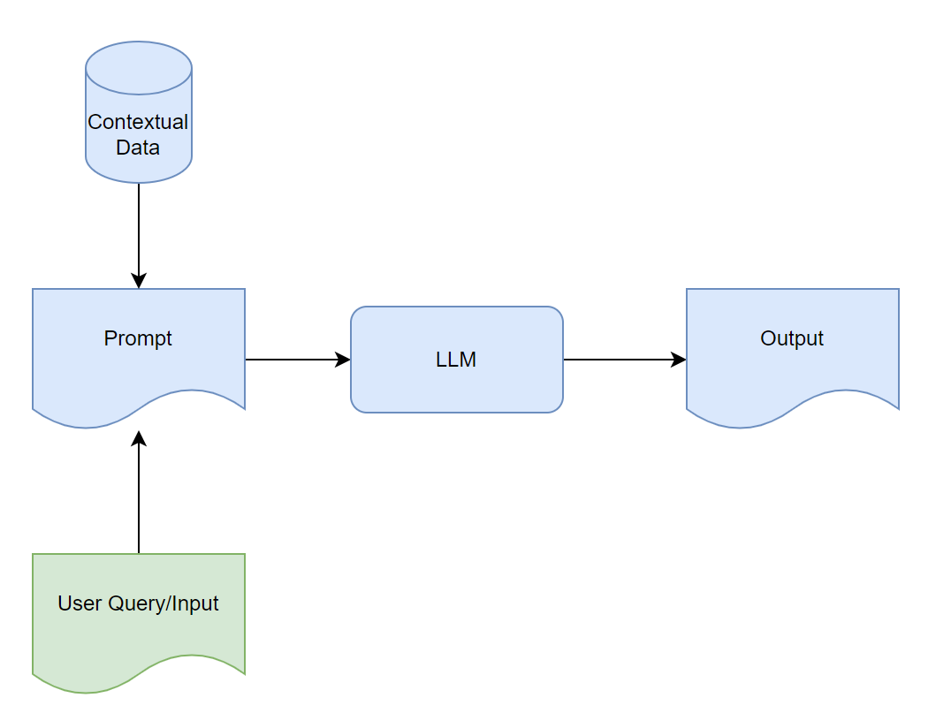
What is an Evaluation?
General Flow without Evaluations

Slide 7
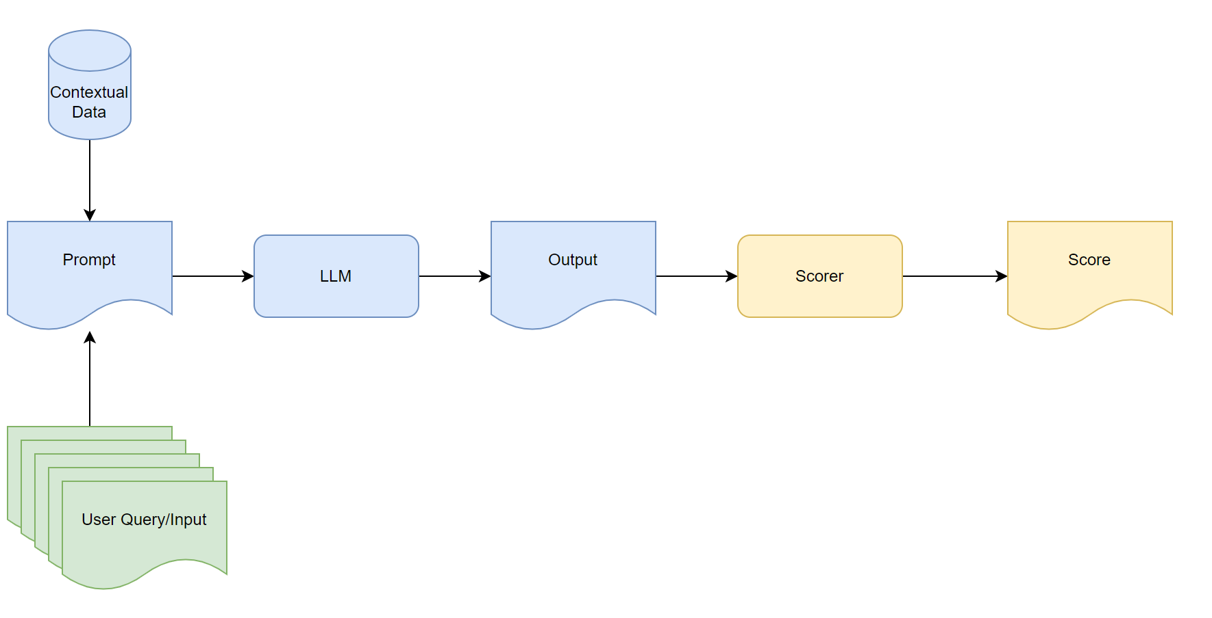
What is an Evaluation?
General Flow With Evaluations for a Single Dimension

Slide 8
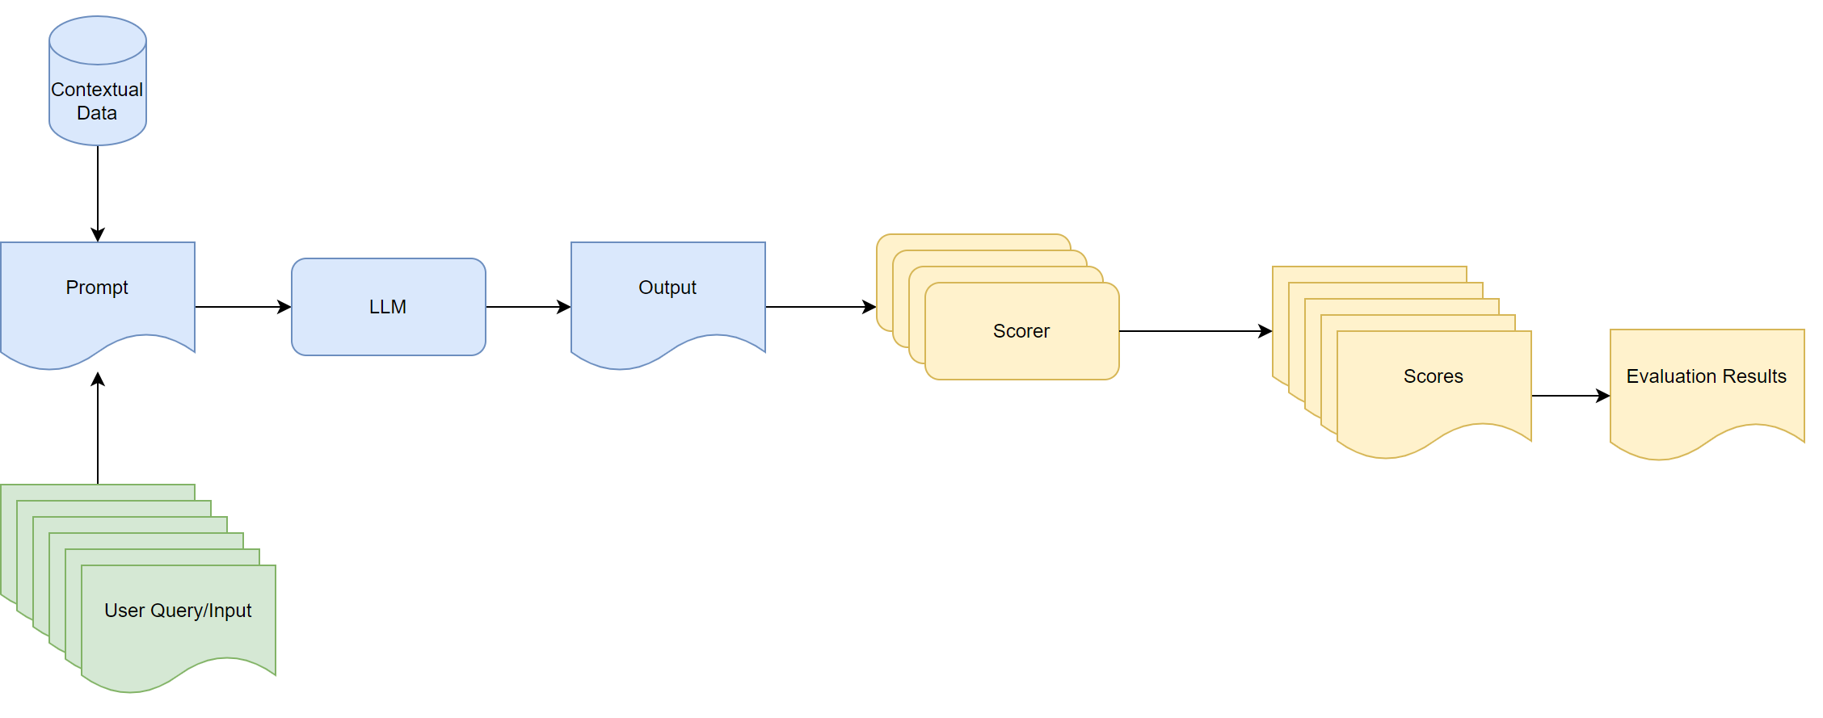
What is an Evaluation?
General Flow With Evaluations across Dimensions

Slide 9
Establishing an Effective Evaluations Framework
System Analysis
Evaluation Guidelines
Evaluation Methods
What are the components of the system?
What are the tasks/use cases for the system?
What is the flow of interactions like?
What is important for us to evaluate in this context.
How do these relate to business objectives
Input Generation
Human Evaluation Automated Evaluations
Meta Evaluation
Execution
Error Analysis
How do we know if our inputs are diverse enough?
How do we know we are doing enough to evaluate accurately?
Automated
Human Evaluations
Understanding what the system is getting wrong.
Uncovering patterns that lead to failures.

Slide 10
System Analysis
What’s on our plate
To design an effective evaluation, we need to better understand:
What is the purpose of the system?
What the system is expected to do
What are the typical use cases for the system? What are the edge cases?
What the system is not expected to do?
What would be catastrophic if it happened?
How will the system be used?
How will the output of the system be used?
What are the components of the system and how do they interact with each other
Modern Gen AI systems are no longer a UI and a LLM, instead they are a complex mix of components for data retrieval, tool usage, LLMs, ML Models, Guardrails and controls.
Understanding these and how they work together lets gives us more flexibility in what and where we run our evaluations
How does this system align to business objectives
Often-overlooked but crucial link

Slide 11
Establish Evaluation Guidelines
What’s important to us and why
Probably one of the most challenging elements
We need to establish what is important to us in our context
The dimensions that might be important are often subjective
Link dimensions to Business Objectives
Ensures testing has real value
Define the dimension for your team to give a common vocabulary
Defining a scoring rubric for the scoring with examples
For example, if Relevance is important to use, how score Relevance? A 5 point scale?
Are there any outcomes that would automatically disqualify?
An Evaluation guideline should:
Provide a clear definition of the dimension
Establish a rating scale (typically 1-5 or 1-7)
Include examples of responses at different rating levels
Specify any automatic disqualifiers
Evaluation guidelines can be through of as living documents that will change as the produce mature.

Slide 12
Establish Evaluation Guidelines
Example Evaluation Guideline
Dimension: Helpfulness
Definition: The degree to which the response provides actionable information that addresses the user's need or question.
Rating Scale:
1: Completely unhelpful, ignores the question or provides irrelevant information
2: Minimally helpful, acknowledges the question but offers vague or indirect guidance
3: Moderately helpful, provides general information addressing the question but lacks specificity
4: Very helpful, provides specific, actionable information that mostly addresses the user's need
5: Exceptionally helpful, provides comprehensive information tailored to the specific question with clear next steps if applicable
Examples:
Query: "How do I return a damaged product?"
Rating 1 response: "We have many products available in our store.“
Rating 3 response: "You can return products through our return system. Check the website for more details.“
Rating 5 response: "I'm sorry about the damaged product. You can return it by: 1) Filling out the return form at example.com/returns, 2) Using the prepaid shipping label we'll email you, 3) Dropping it at any postal service location. You should receive your refund within 5-7 business days."
Automatic disqualifier: Any response that forces the customer to repeat information already provided.

Slide 13
Dimensions to Evaluate
Common dimensions
Core Quality Dimensions
Relevance: The degree to which the response directly addresses the user's query or need
Factual Correctness: The accuracy of information provided in the response
Completeness: The comprehensiveness of the response relative to what would satisfy the user's need
Grounded-ness: The extent to which claims are explicitly tied to provided context or reliable knowledge
Hallucination Avoidance: The absence of fabricated, incorrect, or misleading information
Usability Dimensions
Clarity: How easily understandable the response is for the intended audience
Conciseness: The efficiency of communication without unnecessary verbosity
Helpfulness: The degree to which the response enables the user to accomplish their goal
Consistency: Maintains reliable behaviour across interactions and sessions
Tone Appropriateness: Uses communication style suitable for the context and brand voice
Creativity: Generates novel, valuable ideas when appropriate

Slide 14
Dimensions to Evaluate
Common dimensions
Domain Adaptation Dimensions
Personalisation: Tailors responses to the user's specific situation, knowledge level, or preferences
Adaptability: Ability to adjust responses based on feedback or clarification
Regulatory Compliance: Adheres to relevant regulations and professional standards
Domain Knowledge: Demonstrates appropriate knowledge depth in specialized fields and terminology
Cultural Sensitivity: Demonstrates awareness and respect for cultural differences
Safety and Ethics Dimensions
Safety: Avoids generating harmful, unethical, or inappropriate content or decisions
Bias Mitigation: Avoids perpetuating harmful stereotypes or unfair treatment
Transparency: Clearly communicates system capabilities, limitations, and confidence
Technical Dimensions
Reasoning Quality: Demonstrates sound logical processes and critical thinking
Format Adherence: Follows requested or appropriate output formats

Slide 15
Define Evaluation Methods
How do we best evaluate each dimension ?
In general, we have 2 options:
Human Evaluation: use Humans to evaluate and score the outputs
Automated Evaluation: use code to evaluate and score the outputs
For most production systems, I recommend a hybrid approach:
Use human evaluation to establish gold standards and evaluate critical dimensions
Deploy automated metrics for continuous monitoring and regression testing
Apply model-based evaluation for dimensions that correlate well with human judgment
Your data selection is equally important as your method. Consider:
Representative sampling from actual user interactions
Challenge sets specifically designed to test particular capabilities
Contrastive examples where small input changes should/shouldn't change outputs
Adversarial examples deliberately designed to cause system failures

Slide 16
Define Evaluation Methods
Human Evaluations
Considered the Gold Standard for assessing many aspects of GenAI output but
Can be costly
Scales poorly
Expert reviewer score outputs against your evaluation guidelines.
May be a tester for some dimensions
May require a subject matter expert for other dimensions
Great for high-risk and nuanced assessments.

Slide 17
Define Evaluation Methods
Automated Evaluations
Exact/Fuzzy Checking
Look for specific words/phrases that you expect to be in the response
Looking for specific words/phrases that you don’t expect to be in the response
Score based on presence/absence of terms
Lexical Overlap Metrics
Standardised metrics like ROUGE and BLEU measure the overlap in words/word-groupings to produce an evaluation score.
Semantic Similarity
Uses Embeddings (an AI Model)
Model Based Evaluation
For some dimensions, such as toxicity we can leverage specialise ML models to evaluate the output
These are narrowly trained models
LLM-As-A-Judge
Using an LLM to evaluate the quality of the output with respect to some criteria.
Works surprisingly well but requires some skill to craft the evaluation prompt to avoid bias and weak results.

Slide 18
Generating Evaluation Inputs
Garbage in….Garbage out
Human Generated Inputs
Subject Matter Expert Creation
Crowdsourced Generation
Participatory Testing Sessions – watching real users interact with the system in a controlled setting
Annotated Live Inputs
Random (stratified) sampling
Failure mining
Diversity Sampling (if appropriate)
Synthetic Input Generation
Template Based Generation
Adversarial Input Generation
LLM Based Input Generation
Perturbation based Generation

Slide 19
Meta Evaluation
How do we know we are doing enough of the right things?
Dimension Coverage: Do we have evaluations for all dimensions we care about?
Task Coverage: Do we have evaluations for each of the tasks we care about?
Statistical Significance: when evaluating probabilistic systems, the sample size matters
As a rule of thumb – you probably want 100-200 examples per task you are evaluating
More for critical or nuanced tasks/behaviours
Input Diversity: The raw number is not the only consideration
User Persona variety: are different types of system users covered (equally) in the input data? Does the language and tone used reflect those personalities
Edge case Coverage: do we have sufficient examples to find potential misuse, harmful and unexpected inputs?

Slide 20
Meta Evaluation
How do we know we are doing enough of the right things?
A well balanced set of inputs for a task might include
Representative sampling from actual user interactions
Challenge sets specifically designed to test particular capabilities
Contrastive examples where small input changes should/shouldn't change outputs
Adversarial examples deliberately designed to cause system failures

Slide 21
Execution
Let’s run some tests
Not that much different to how you run tests now
Depends on how you can interact with the system or component within the system
Workflow is typically :
Submit the input to the system/component
Observe the generated response
Evaluate using the define evaluation guidelines and methods
Collate the results across to provide scores across the dimensions of interest
Possibly sub-categorised by input partitions of interest (e.g. complex inputs, diversity inputs etc.)
Testing GenAI applications has a cost associated with using the LLM
The cost needs to be managed and balanced against the risks
Doubly so if you use LLM-As-A-Judge
When and what evaluations you run is an important consideration
Small changes can have large impacts when it comes to GenAI

Slide 22
Error Analysis
What is the system getting wrong and does it matter?
Transforms evaluations from simple scoring to a strategic improvement tool
An often-neglected step
Allows for a more comprehensive report on the system evaluation
Guides Exploratory Testing
Guides System development and improvements
How do we do this?
Define a Taxonomy of Failures for each of the dimensions you care about
After running evaluations, review cases where the model failed or performed poorly and categorise based on the taxonomy
Grade the severity of the failure
Input Pattern Analysis - Are there common patterns in the inputs that result in failures
Input length, Input complexity, Use of specific terms, types of questions, Levels of ambiguity etc.
Is it Random or Structural error

Slide 23
Key Takeaways
Testing Gen AI is challenging
Mindset Shift
Establish an evaluation framework
The Oracle Problem: The quality of outputs is often subjective
The Approximation Problem: Some outputs will be wrong and that might be ok
The Output Problem: output are on a spectrum
Different dimensions for evaluations
Evaluating on a spectrum
Evaluation over a distribution of inputs
System Analysis
Establish Evaluation Guidelines
Define Evaluation Methods and Data
Meta Evaluation
Execution
Error Analysis
It’s an iterative process

Slide 24
Thank you!
Ask Questions now or later via:
During this or other events (I’m very approachable!)
Ministry of Testing Slack
LinkedIn: linkedin.com/in/billmatthews

