Slide 1
Rolling a Pair: Optimizing the Chances of a Double Play Ball
Bill Petti
Saber Seminar
August 6, 2017
@BillPetti | billpetti.github.io

Slide 2
Motivation for the study
1
Double plays can have a large impact on the expected runs of an inning and are of strategic value to teams (both inducing and avoiding them)
On average, double plays drop the run expectancy of an inning from 1.59 to 0.12 with 0 outs; wipes out 1.02 runs on average when there is 1 out

Slide 3
Motivation for the study
1
Double plays can have a large impact on the expected runs of an inning and are of strategic value to teams (both inducing and avoiding them)
2
Double plays are relatively rare events based on balls in play. Understanding how to even marginally increase their odds should be valuable
Only 3.2% of all batted balls turn into two outs
Only 5% of batted balls that result in outs generate more than 1 out
Only 15.2% of double play opportunities are converted

Slide 4
Data and Methodology Details
All balls pitches that resulted in balls in play from 2015 through 2016
Data courtesy of FanGraphs and BaseballSavant
DATA
We are interested in traditional double play opportunities where teams might logically want to induce a double play
These are defined as having the following features:
Less than 2 outs
Runners on first base, first and second, first and third, or bases load
DEFINITIONS

Slide 5
Phases and Analytical Plan
Classifying batted balls that are likely to result in double plays
Given how a ball is struck—velocity, vertical angle, horizontal or spray angle—what is the likelihood that it results in a double play?
Classification model then applied to all batted balls to provide likelihood scores for “double play balls”
PHASE 1
Modeling the situational characteristics that increase the likelihood of inducing batted balls that lead to double plays
Given specific batters and pitchers, what type of pitch will increase the likelihood of inducing a double play ball?
Velocity, Spin Rate, Vertical and Horizontal Location, Release Point, etc.
PHASE 2
Developing a tool to XXXXX
XXXXX
PHASE 3

Slide 6
Classifying double play batted balls
PHASE 1

Slide 7
Distribution of Ground Ball Double Plays by Batter Handedness: Exit Velocity

Slide 8
Distribution of Ground Ball Double Plays by Batter Handedness: Launch Angle

Slide 9
Regardless of handedness, the combination of launch angle and exit velocity look similar by handedness
Highest frequency between 0 & -10 degrees and 95-100 mph

Slide 10
Distribution of Ground Ball Double Plays by Batter Handedness: Spray Angle

Slide 11
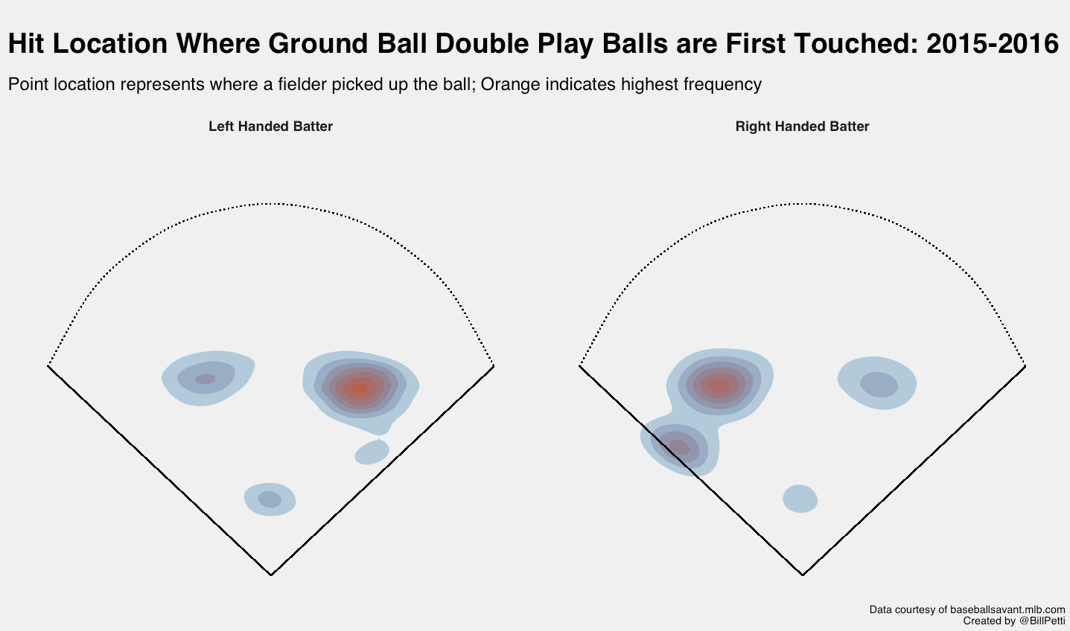

Slide 12
Classification Modeling Notes
successful_double_play ~ hit_angle + hit_speed + spray_angle + stand
The features are on different scales, so feature engineering makes sense here
The imbalanced nature of the data needs to be accounted for
Could guess against a double play every time and technically have 83.7% accuracy; that doesn’t exactly help us
Approaches to deal with imbalance: resampling, down-sampling, tree-based models that handle imbalance better, quality measures other than Accuracy (e.g. ROC) to select best model
6 different types of models were tested (Logistic Regression, Bayesian GLM, LDA, CART, Gradient Boosting Machines, and Random Forest)
Each model was fit using all hitters with imbalance intact, splitting by handedness with imbalance, and all hitters with down-sampling

Slide 13
Classification Results
Tree-based and ensemble models performed the best
Random Forest (RF) and Stochastic Gradient Boosting (GBM) models performed very similar across a number of metrics
Down-sampling (ds_) improved all models, including RF and GBM
RF and GBM superior when taking into account multiple measures that balance different aspects of accuracy (i.e. F1, AUC, Balanced Accuracy)

Slide 14
Predicting the inducement of a ground ball double play
PHASE 2

Slide 15
Predictive Modeling Notes
The down-sampled GBM was chosen as the initial model to use for assigning probabilities or class of double play contact
Applied to all batted balls, 2015-2016 (n = 216,866)
Initial list of features to use to predict double play contact based off a pitch:
Vertical location (pz)
Horizontal location (px)
Velocity (start_speed)
Release Spin rate (release_spin_rate)
Batter ID (batter)
Pitcher ID (pitcher)
Batter handedness (stand)
Pitcher handedness (p_throws)

Slide 16
Predictive Modeling Notes

