Slide 1
Hadoop Stored Procedures, Procedural Language, Visualization, Oh My!
Bill Preachuk, Solutions Engineer, Hortonworks
Scott Shaw, Sr. Solutions Engineer, Hortonworks

Slide 2
Please silence cell phones

Slide 3












Explore Everything PASS Has to Offer
FREE ONLINE WEBINAR EVENTS
FREE 1-DAY LOCAL TRAINING EVENTS
VOLUNTEERING OPPORTUNITIES
LOCAL USER GROUPS AROUND THE WORLD
ONLINE SPECIAL INTEREST USER GROUPS
PASS COMMUNITY NEWSLETTER
FREE ONLINE RESOURCES
BUSINESS ANALYTICS TRAINING
BA INSIGHTS NEWSLETTER

Slide 4

Bill Preachuk Solutions Engineer, Hortonworks
Bill Preachuk is a SQL Server MCTS with plenty of years spent in the SQL Server DBA/Developer/DW trenches.
Bill has been in IT since 1991 and has presented at PASS Summit, multiple SQL Saturdays, and PASS/Hadoop/ Analytics user group meetings in the Twin Cities, Wisconsin, Iowa, Winnipeg, and Ukraine. He also served 2 years on the Board of PASSMN - The Minnesota SQL Server User Group.
/billpreachuk
@billpreachuk
Bill.preachuk

Slide 5
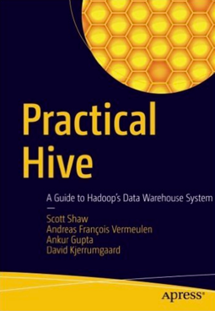

Scott Shaw Sr. Solutions Engineer, Hortonworks
Scott Shaw has over a decade of experience in data management. He is a frequent speaker at local and national community events with experience in ETL design, data warehouse modeling, and Hadoop architecture. He has co-authored two books on T-SQL and just completed a third book titled "Practical Hive” (published by Apress). He lives in Saint Louis and is a Senior Solutions Engineer for Hortonworks.
/scottpshaw
@shawsql
scottshaw

Slide 6
Agenda
HPL/SQL
Stored Procedures in Hive
Hive Roadmap
LLAP
Visualization with PowerBI

Slide 7
Apache Hive History
Initially Hive provided SQL on Hadoop
Provided a table view instead of file view of data
Translated SQL to MapReduce
Mostly used for ETL (Extract Transform Load)
Big, batch, high start up time
Around 2012 it became clear users wanted to do all data warehousing on Hadoop, not just ETL
Hive has shifted over time to focus on traditional data warehousing problems
Still does large ETL well
Now also can be used for analytics, reporting
Work being done to better support BI (Business Intelligence) tools
Not OLTP, very focused on backend analytics

Slide 8
Apache Hive: Fast Facts
Most Queries Per Hour
100,000 Queries Per Hour
(Yahoo Japan)
Analytics Performance
100 Million rows/s Per Node
(with Hive LLAP)
Largest Hive Warehouse
300+ PB Raw Storage
(Facebook)
Largest Cluster
4,500+ Nodes
(Yahoo)

Slide 9
HPL/SQL Stored Procedures in Hive

Slide 10
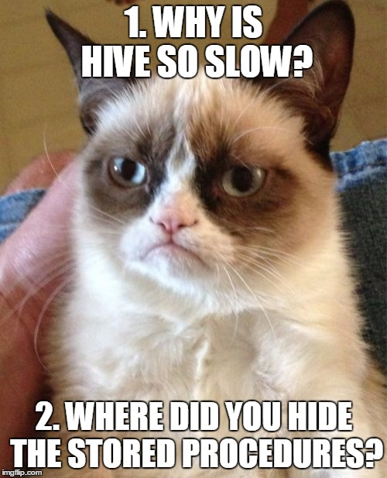
Common Objections to Hive

Slide 11
Common Objections to Hive
Addressed by
Stinger
and LLAP
Addressed by
HPL/SQL

Slide 12
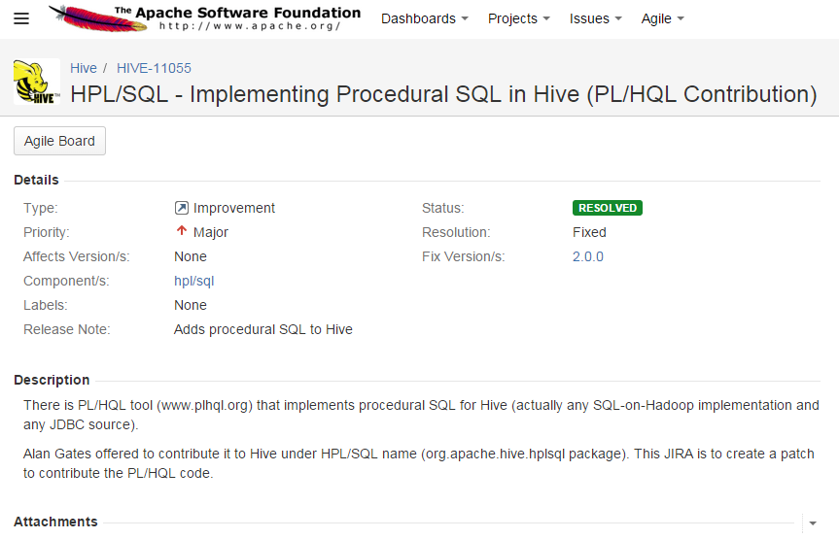
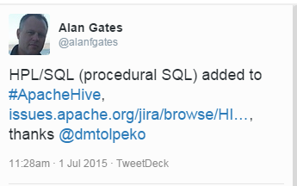
HPL/SQL History
Originally called PL/HQL
HPL/SQL 0.1 – Feb. 27, 2015
Initial release
Included in Hive 2.0/HDP 2.5

Slide 13
So what is HPL/SQL?
Implements Procedural SQL Language for Hive (and others)
GREATLY eases Migration of RDBMS SQL into Hive
Variables & Expressions
Flow Control and Iterations
Error Handling
Stored Procedures & Functions
On-the-fly SQL conversion to HiveQL
Single scripting environment (instead of Python, Shell scripts, etc.)
Multi-RDBMS code (MySQL, Oracle, SQL Server, DB2) in same script

Slide 14
Installation
HDP 2.5: Included!
HDP 2.4 and older: Straightforward
http://www.hplsql.org/start
hplsql file
Change HADOOP_CLASSPATH text
/usr/lib/ to /usr/hdp/2.x.x.x-xxxx/ ( /usr/hdp/2.3.0.0-2557/ )
hplsql-site.xml
Change connection info
Update Hive parms (queue name, default DB, execution engine, etc.)
Notes:
Dunce Alert: Ensure Hive service is started! ;-)

Slide 15
Command Line & Configuration
Just like Hive
hplsql -f "query3.hpl"
hplsql -e "declare ZP char(10); select ZP = min(zipPostal) from customer; print 'Smallest Zip Code is: ' || ZP; "
Hiveconf & Hivevar variables can be specified
Ability to use ‘dual’ table functionality (like Oracle)
Can create its’ own temporary Tables (outside of Hive)
Smallest Zip Code is: 00131
Notes:
CREATE TABLE `dual`(`dummy` varchar(1))
insert into dual select 'A' from customer limit 1 ;

Slide 16


Testbed – SQL Server & Hive
Customer
(2,000 records)
Product
(300 records)
Customer
(2,000 records)
Product
(300 records)
Sqoop
SalesLineItem
(50,000 records)
SalesLineItem
(50,000 records)
(using default Sqoop
variable type assignment)
available
on
github

Slide 17
Code Differences #1 – Dates & Local Variables
SQL Server
declare @date_value date;
set @date_value = '2011-05-01' ;
print 'The date is: ' +
cast(@date_value as char);
select count(*) from saleslineitem
where transactiondate < @date_value;
select count(*) from saleslineitem
where transactiondate >= @date_value;
HPL/SQL
declare @date_value string;
set @date_value = '2011-05-01' ;
print 'The date is: ' ||
@date_value;
select count(*) from saleslineitem
where transactiondate < @date_value;
select count(*) from saleslineitem
where transactiondate >= @date_value;

Slide 18
Code Differences #1 – Results
SQL Server
The date is: 2011-05-01
-----------
23471
(1 row(s) affected)
-----------
26561
(1 row(s) affected)
HPL/SQL
The date is: 2011-05-01
15/11/18 03:57:53 INFO jdbc.Utils: Supplied authorities: localhost:10000
15/11/18 03:57:53 INFO jdbc.Utils: Resolved authority: localhost:10000
15/11/18 03:57:53 INFO jdbc.HiveConnection: Will try to open client transport with JDBC Uri: jdbc:hive2://localhost:10000
Open connection: jdbc:hive2://localhost:10000 (236 ms)
Starting query
Query executed successfully (1.49 sec)
23471
Starting query
Query executed successfully (2.55 sec)
26561
This code will not be displayed in future slides

Slide 19
Code Differences #2 – Results-Based Execution
SQL Server
declare @date_value datetime;
select @date_value = min(transactiondate)
from saleslineitem;
print 'The date is: ' +
cast(@date_value as char);
select count(*) from saleslineitem
where transactiondate = @date_value;
select min(transactiondate) as MinNextDate
from saleslineitem
where transactiondate > @date_value;
HPL/SQL
declare @date_value string;
select @date_value = min(transactiondate)
from saleslineitem;
print 'The date is: ' || @date_value ;
select count(*) from saleslineitem
where transactiondate = @date_value;
select min(transactiondate) as MinNextDate
from saleslineitem
where transactiondate > @date_value;

Slide 20
Code Differences #2 – Results-Based Execution
SQL Server
declare @date_value datetime;
select @date_value = min(transactiondate)
from saleslineitem;
print 'The date is: ' +
cast(@date_value as char);
select count(*) from saleslineitem
where transactiondate = @date_value;
select min(transactiondate) as MinNextDate
from saleslineitem
where transactiondate > @date_value;
HPL/SQL
declare @date_value string;
select @date_value = min(transactiondate)
from saleslineitem;
print 'The date is: ' || @date_value ;
select count(*) from saleslineitem
where transactiondate = @date_value;
select min(transactiondate) as MinNextDate
from saleslineitem
where transactiondate > @date_value;
[root@sandbox hplsql_queries]# hplsql -f "query2.hpl"
Starting query
Query executed successfully (1.85 sec)
The date is: 2011-01-01 00:11:34.19
Starting query
Query executed successfully (2.97 sec)
1
Starting query
Query executed successfully (1.70 sec)
2011-01-01 00:18:02.99

Slide 21
Code Sample #3 – Flow Control & Multi-RDBMS code
---------------------------------------------
-- SQL Server and Oracle/DB2 Syntax mixed up
---------------------------------------------
declare @MNCustomerCount int;
declare ILCustomerCount int default 0;
select @MNCustomerCount = count(*)
from Customer
where State = 'MN';
set ILCustomerCount =
(select count(*) from Customer
where State = 'IL');
print ' MN Count: ' || @MNCustomerCount ||
' IL Count: ' || ILCustomerCount;
/* ------------------------------------
If statement - Oracle/DB2 Syntax *
--------------------------------------- */
IF (@MNCustomerCount > ILCustomerCount) THEN
print 'MN has the most customers';
END IF;
-------------------------------------
-- If Statement - SQL Server syntax
-------------------------------------
IF ILCustomerCount > @MNCustomerCount
BEGIN
print 'IL has the most customers';
END
ELSE
print 'We checked twice. MN Still has the most
customers. It''s time to give up...';

Slide 22
Code Sample #3 – Flow Control & Multi-RDBMS code
---------------------------------------------
-- SQL Server and Oracle/DB2 Syntax mixed up
---------------------------------------------
declare @MNCustomerCount int;
declare ILCustomerCount int default 0;
select @MNCustomerCount = count(*)
from Customer
where State = 'MN';
set ILCustomerCount =
(select count(*) from Customer
where State = 'IL');
print ' MN Count: ' || @MNCustomerCount ||
' IL Count: ' || ILCustomerCount;
/* ------------------------------------
If statement - Oracle/DB2 Syntax *
--------------------------------------- */
IF (@MNCustomerCount > ILCustomerCount) THEN
print 'MN has the most customers';
END IF;
-------------------------------------
-- If Statement - SQL Server syntax
-------------------------------------
IF ILCustomerCount > @MNCustomerCount
BEGIN
print 'IL has the most customers';
END
ELSE
print 'We checked twice. MN Still has the most
customers. It''s time to give up...';
[root@sandbox ~]# hplsql -f "query3.hpl"
…
Starting query
Query executed successfully (1.67 sec)
Starting query
Query executed successfully (1.17 sec)
MN Count: 37 IL Count: 36
MN has the most customers
We checked twice. MN Still has the most customers.
It's time to give up...
[root@sandbox ~]#

Slide 23
Code Sample #4 – Stored Procs & Error Handling
create procedure spLoadSalesFact (LoadMonth char(10))
BEGIN
SET plhql.onerror = seterror;
print 'Beginning execution...';
print '*' || LoadMonth || '*';
/* Fail if invalid Input Parameter
if (LoadMonth not in ('LAST', 'CURRENT'))
BEGIN
print 'Bad Input Parameter';
RETURN -1;
END
/* Load Prior Month */
IF (LoadMonth = 'LAST')
BEGIN
print 'Inserting Last Month''s Data...';
insert into table saleslineitem
select * from saleslineitem
where TransactionDate >= '2011-06-01'
and transactionDate < '2011-07-01';
if SQLCODE <> 0
RETURN -2;
END
/* Load Current Month */
ELSE IF (LoadMonth = 'CURRENT')
BEGIN
print 'Inserting Current month''s data...';
insert into table saleslineitem
select * from saleslineitem
where TransactionDate >= '2011-07-01'
and transactionDate < '2011-08-01';
if SQLCODE <> 0
RETURN -3;
END
PRINT 'Execution Completed...';
END
/* Stored Proc invocation */
-- CALL spLoadSalesFact ('GARBAGE');
-- CALL spLoadSalesFact ('LAST');
CALL spLoadSalesFact ('CURRENT');

Slide 24
Code Sample #4 – Stored Procs & Error Handling
create procedure spLoadSalesFact (LoadMonth char(10))
BEGIN
SET plhql.onerror = seterror;
print 'Beginning execution...';
print '*' || LoadMonth || '*';
/* Fail if invalid Input Parameter
if (LoadMonth not in ('LAST', 'CURRENT'))
BEGIN
print 'Bad Input Paramter';
RETURN -1;
END
/* Load Prior Month */
IF (LoadMonth = 'LAST')
BEGIN
print 'Inserting Last Month''s Data...';
insert into table saleslineitem
select * from saleslineitem
where TransactionDate >= '2011-06-01'
and transactionDate < '2011-07-01';
if SQLCODE <> 0
RETURN -2;
END
/* Load Current Month */
ELSE IF (LoadMonth = 'CURRENT')
BEGIN
print 'Inserting Current month''s data...';
insert into table saleslineitem
select * from saleslineitem
where TransactionDate >= '2011-07-01'
and transactionDate < '2011-08-01';
if SQLCODE <> 0
RETURN -3;
END
PRINT 'Execution Completed...';
END
/* Stored Proc invocation */
-- CALL spLoadSalesFact ('GARBAGE');
-- CALL spLoadSalesFact ('LAST');
CALL spLoadSalesFact ('CURRENT');
[root@sandbox hplsql_queries]# hplsql -f "query4.hpl"
Beginning execution...
*CURRENT*
Inserting Current month's data...
Starting SQL statement
SQL statement executed successfully (228 ms)
Execution Completed...

Slide 25
Executing Stored Procedures
1. Inline (prior slide)
2. By using INCLUDE statement in your script
INCLUDE "spLoadSalesFact.hpl"
…
CALL spLoadSalesFact ('CURRENT');
3. Add stored proc to .hplsqlrc file
Once added to the file, Stored procs can be executed from hplsql command line, files, or SPs
hplsql -e "CALL spLoadSalesFact ('CURRENT')"
Notes:
Dunce Alert: Ensure Hive service is started! ;-)
CREATE TABLE `dual`(`dummy` varchar(1))
insert into dual select 'A' from customer limit 1 ;

Slide 26
Hive Today and Tomorrow

Slide 27

What Is Apache Hive?
Apache Hive is a SQL data warehouse infrastructure that delivers fast, scalable SQL processing on Hadoop and in the Cloud.
Features:
Extensive SQL:2011 Support
ACID Transactions
In-Memory Caching
Cost-Based Optimizer
User-Based Dynamic Security
Replication and Disaster Recovery
JDBC and ODBC Support
Compatible with every major BI Tool
Proven at 300+ PB Scale

Slide 28
Apache Hive Timeline
Apache Hive becomes a Top-Level Project
Apache Tez enters incubation
Hive ACID introduced
2010
2011
2012
2013
2014
2015
2016
HiveServer2 adds ODBC/JDBC
SQL breadth expands with windowing and more
Hive 0.13 marks delivery of the Stinger Initiative with Tez, Vectorized Query and ORCFile support
Hive 2.0 introduces LLAP and intelligent in-memory caching

Slide 29
HDP 2.5 is a Major Milestone for Hive
At a High Level:
2000+ features, improvements and bug fixes in Hive since HDP 2.4.
600+ of these from outside of Hortonworks.
Major Improvements:
Preview: Hive LLAP: Persistent query servers with intelligent in-memory caching.
ACID GA: Hardened and proven at scale.
Expanded SQL Compliance: More capable integration with BI tools.
Performance: Interactive query, 2x faster ETL.
Security: Row / Column security extending to views, Column level security for Spark.
Operations: LLAP integration in Ambari, new Grafana dashboards.
Hive 2 Improvements
+
Interactive Query with Hive LLAP
+
SQL ACID Fully Supported
+
2x Faster ETL
Notes:
Substanial milestone for Hive
ACID GA
LLAP
HPL\SQL
MR deprecated HDP 3.0

Slide 30
Hive: Scalable Modern Data Warehousing with HDP
Applications
ETL
Reporting
Data Mining
Deep Analytics
Reporting
BI Tools: Tableau, Microstrategy, Cognos
Ad-Hoc
Drill-Down
BI Tools: Tableau, Excel
Continuous Ingestion from Operational DBMS
Slowly Changing Dimensions
Multidimensional Analytics
MDX Tools
Excel
Capabilities
Batch SQL
Interactive SQL
Sub-Second SQL
ACID / MERGE
OLAP / Cube
Core Hive
Comprehensive
SQL:2011 Coverage
Legend
Petabyte Scale Processing
Advanced Cost-Based Optimizer
JDBC / ODBC
Existing
Scale-Out Storage
Apache Tez: Scalable Distributed Processing
Advanced Security
Development
Platform
Core SQL Engine
Connectivity
Future
Notes:
Multi-year roadmap
Focused on data warehouse. EDW holds 3 months of data, HDP can hold 3 years but certain capabilities hold back adoption.

Slide 31
Apache Hive: Journey to SQL:2011 Analytics
Data Types |  | SQL Features |  | File Formats |  | Futures
Numeric |  | Core SQL Features |  | Columnar |  | Procedural Extensions (PL/SQL)
FLOAT/DOUBLE |  | Date, Time and Arithmetical Functions |  | ORCFile |  | Primary Key / Foreign Key
DECIMAL |  | INNER, OUTER, CROSS and SEMI Joins |  | Parquet |  | Non-Equijoin
INT/TINYINT/SMALLINT/BIGINT |  | Derived Table Subqueries |  | Text |  | Scalable Cross Product
BOOLEAN |  | Correlated + Uncorrelated Subqueries |  | CSV |  | Enhanced OLAP
String |  | UNION ALL |  | Logfile
CHAR / VARCHAR |  | UDFs, UDAFs, UDTFs |  | Nested / Complex |  | ACID MERGE
STRING |  | Common Table Expressions |  | Avro |  | Multi Subquery
BINARY |  | UNION DISTINCT |  | JSON |  | Comparison to sub-select
Date, Time |  | Advanced Analytics |  | XML |  | INTERSECT and EXCEPT
DATE |  | OLAP and Windowing Functions |  | Custom Formats
TIMESTAMP |  | CUBE and Grouping Sets |  | Other Features
Interval Types |  | Nested Data Analytics |  | XPath Analytics
Complex Types |  | Nested Data Traversal
ARRAY |  | Lateral Views
MAP |  | ACID Transactions
STRUCT |  | INSERT / UPDATE / DELETE
UNION
Legend
Existing
Projected: HDP 2.5
Projected: HDP 3.0
Track Hive SQL Complete: HIVE-13554

Slide 32
Complete Picture
Other ETL Tools
Ambari Hive View
BI Tools
Ingest and Store
ETL, Data Mining,
Advanced Analytics
Interactive SQL,
Reporting, OLAP
Hive
ACID
Reporting Tools
Kafka
HDFS
Spark
HPL / SQL
Druid (Future)
Hive LLAP
Atlas
Governance and Lineage
Ranger
Advanced Security
Zeppelin

Slide 33

LLAP (Long Live and Process)

Slide 34
Hive 2 with LLAP Enable Interactive Query In Seconds
NEW
Developer Productivity: Interactive query in seconds
Ease of Use and Adoption : 100% compatible with Hive SQL
Enterprise Readiness: Linear scaling at Terabytes volume of data
Streamlined Operations: LLAP integration with Ambari with automated dashboards
Notes:
Hive 2 with LLAP Advantages:
Optimized in-memory caching of the hottest data.
Persistent servers to instantly execute SQL queries.
Fine-grained preemption.
Overcomes latency of traditional SQL-on-Hadoop.
Simplified operational setup via Ambari & reduces tuning complexity.
SQL Compatibility:
100% Compatible with Hive SQL.
Compatible with existing tools (BI, ETL, etc.)
Security:
Security via HiveServer2.
Integrates with Apache Ranger.

Slide 35
Why LLAP?
People like Hive
Disk->Mem is getting further away
Cloud Storage isn’t co-located
Disks are connected to the CPU via network
Security landscape is changing
Cells & Columns are the new security boundary, not files
Safely masking columns needs a process boundary
Concurrency, Performance & Scale are at conflict
Concurrency at 100k queries/hour
Latencies at 2-5 seconds/query
Petabyte scale warehouses (with terabytes of “hot” data)
Node
Query Fragment
Query Fragment
LLAP Process
Cache
HDFS

Slide 36
What is LLAP?
Hybrid model combining daemons and containers for fast, concurrent execution of analytical workloads (e.g. Hive SQL queries)
Concurrent queries without specialized YARN queue setup
Multi-threaded execution of vectorized operator pipelines
Asynchronous IO and efficient in-memory caching
Relational view of the data available thru the API
High performance scans, execution code pushdown
Centralized data security
Node
Query Fragment
Query Fragment
LLAP Process
Cache
HDFS

Slide 37

Hive 2 with LLAP: Architecture Overview
YARN Cluster
Query
Coordinators
ODBC /
JDBC
LLAP Daemon
LLAP Daemon
LLAP Daemon
LLAP Daemon
SQL
Queries
Coord-inator
Query
Executors
Query
Executors
Query
Executors
Query
Executors
HiveServer2 (Query Endpoint)
Coord-inator
In-Memory Cache
In-Memory Cache
In-Memory Cache
In-Memory Cache
Coord-inator
Deep Storage
HDFS
S3 + Other HDFS Compatible Filesystems
Notes:
Combines intelligent in-memory caching and persistent query execution
Keeps in-memory at the columnar level and compressed.
Query executors run for a long time.
LLAP runs in YARN and you can configure how much resources to dedicate to LLAP. Allow for dynamic resource allocation – flex capacity based on time.

Slide 38
Power BI and Hive
Demo

Slide 39
Session Evaluations
ways to access
3
Your feedback is important and valuable.
Submit by 5pm
Friday November 6th to WIN prizes
Go to passSummit.com
Download the GuideBook App and search: PASS Summit 2016
Follow the QR code link displayed on session signage throughout the conference venue and in the program guide

Slide 40
Thank You
Learn more from Bill Preachuk and Scott Shaw bpreachuk@hortonworks.com or follow @billpreachuk
sshaw@hortonworks.com or follow @shawsql

