Slide 1
CS 3700 Networks and Distributed Systems
Bridging
(From Hub to Switch by Way of Tree)
Revised 8/19/15

Slide 2
Just Above the Data Link Layer
Bridging
How do we connect LANs?
Function:
Route packets between LANs
Key challenges:
Plug-and-play, self configuration
How to resolve loops
Application
Presentation
Session
Transport
Network
Data Link
Physical

Slide 3
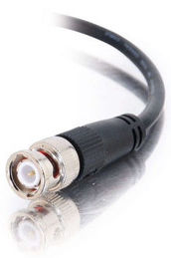

Recap
Originally, Ethernet was a broadcast technology
Terminator
Repeater
Tee Connector
Pros: Simplicity
Hardware is stupid and cheap
Cons: No scalability
More hosts = more collisions = pandemonium
Hub

Slide 5
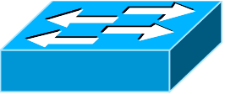
The Case for Bridging
Need a device that can bridge different LANs
Only forward packets to intended recipients
Much less broadcasting!
Send Packet
B → C
A
Send Packet
B → C
A
Bridge
B
Hub
B
C
C

Slide 6
Bridging the LANs
Hub
Hub
Bridging limits the size of collision domains
Vastly improves scalability
Question: could the whole Internet be one bridging domain?
Tradeoff: bridges are more complex than hubs
Physical layer device vs. data link layer device
Need memory buffers, packet processing hardware, routing tables

Slide 7
Bridge Internals
Bridge
Hub
Inputs
Outputs
Switch Fabric
Memory buffer
Makes routing decisions
Bridges have memory buffers to queue packets
Bridge is intelligent, only forwards packets to the correct output
Bridges are high performance, full N * line rate is possible

Slide 8
Bridges
Forwarding of frames
Learning of (MAC) Addresses
Spanning Tree Algorithm (to handle loops)
Original form of Ethernet switch
Connect multiple IEEE 802 LANs at layer 2
Goals
Reduce the collision domain
Complete transparency
“Plug-and-play,” self-configuring
No hardware of software changes on hosts/hubs
Should not impact existing LAN operations
Hub

Slide 9
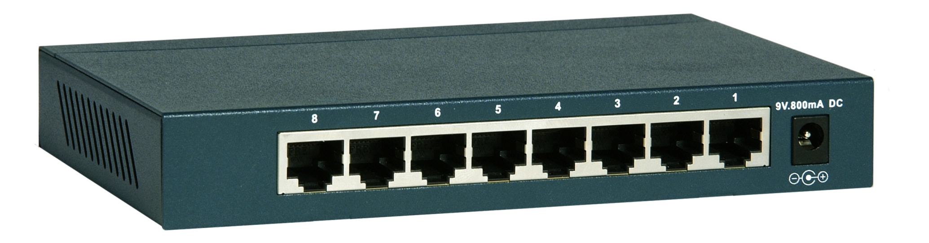
Frame Forwarding Tables
Each bridge maintains a forwarding table
MAC Address | Port | Age
00:00:00:00:00:AA | 1 | 1 minute
00:00:00:00:00:BB | 2 | 7 minutes
00:00:00:00:00:CC | 3 | 2 seconds
00:00:00:00:00:DD | 1 | 3 minutes

Slide 10
Frame Forwarding in Action
Port 1
Port 4
Port 2
Port 3
Assume a frame arrives on port 1
If the destination MAC address is in the forwarding table, send the frame on the correct output port
If the destination MAC isn’t in the forwarding table, broadcast the frame on all ports except 1

Slide 11
Learning Addresses
Manual configuration is possible, but…
Time consuming
Error Prone
Not adaptable (hosts may get added or removed)
Instead, learn addresses using a simple heuristic
Look at the source of frames that arrive on each port
Delete old entries after a timeout
MAC Address | Port | Age
00:00:00:00:00:AA | 1 | 0 minutes
00:00:00:00:00:BB | 2 | 0 minutes
00:00:00:00:00:AA
Port 1
Port 2
Hub
00:00:00:00:00:BB

Slide 12
Complicated Learning Example
<Src=AA, Dest=FF>
<Src=CC, Dest=AA>
<Src=EE, Dest=CC>
Bridge 1
Bridge 2
AA | 1
AA | 1
CC | 2
CC | 1
EE | 2
EE | 2
Port 1
Port 2
Port 1
Port 2
Hub
Hub
Hub
AA
BB
CC
DD
EE
FF

Slide 13
The Danger of Loops
<Src=AA, Dest=DD>
This continues to infinity
How do we stop this?
Remove loops from the topology
Without physically unplugging cables
802.1 uses an algorithm to build and maintain a spanning tree for routing
CC
DD
Hub
Port 2
Port 2
AA | 1
AA | 2
AA | 1
AA | 1
AA | 2
AA | 1
Port 1
Port 1
Hub
AA
BB

Slide 14
Spanning Tree Definition
A subset of edges in a graph that:
Span all nodes
Do not create any cycles
This structure is a tree
5
1
1
2
2
3
3
4
6
2
5
3
5
4
1
4
6
7
6
7
7

Slide 15

Spanning Tree Poem
Algorhyme
I think that I shall never see
a graph more lovely than a tree.
A tree whose crucial property
is loop-free connectivity.
A tree that must be sure to span
so packet can reach every LAN.
First, the root must be selected.
By ID, it is elected.
Least-cost paths from root are traced.
In the tree, these paths are placed.
A mesh is made by folks like me,
then bridges find a spanning tree.
- Radia Perlman

Slide 16
802.1 Spanning Tree Approach
Elect a bridge to be the root of the tree
Every bridge finds shortest path to the root
Union of these paths becomes the spanning tree
Bridges exchange Configuration Bridge Protocol Data Units (BPDUs) to build the tree
Used to elect the root bridge
Locate the next hop closest to the root, and its port
Select ports to be included in the spanning trees

Slide 17
Definitions
Bridge ID (BID) = <Random Number>
Root Bridge: bridge with the lowest BID in the tree
Path Cost: cost (in hops) from a transmitting bridge to the root
Each port on a bridge has a unique Port ID
Root Port: port that forwards to the root on each bridge
Designated Bridge: the bridge on a LAN that provides the minimal cost path to the root
The designated bridge on each LAN is unique

Slide 18
Determining the Root
Initially, all hosts assume they are the root
Bridges broadcast BPDUs:
Based on received BPDUs, each switch chooses:
A new root (smallest known Root ID)
A new root port (what interface goes towards the root)
A new designated bridge (who is the next hop to root)
Root ID
Path Cost to Root
Bridge ID

Slide 19
Comparing BPDUs
BPDU1
BPDU2
R1
Cost1
B1
R2
Cost2
B2
if R1 < R2: use BPDU1
else if R1 == R2 and Cost1 < Cost2: use BPDU1
else if R1 == R2 and Cost1 == Cost 2 and B1 < B2: use BPDU1
else: use BPDU2

Slide 20
Spanning Tree Construction
Legend
Bridge ID: Root Bridge ID / Cost to Root
3: 0/2
0: 0/0
12: 0/1
3: 3/0
12: 12/0
41: 3/1
27: 0/1
41: 0/2
27: 27/0
41: 41/0
68: 3/2
68: 9/1
9: 3/2
68: 0/3
9: 0/3
68: 68/0
9: 9/0

Slide 21
Designated Bridges
Ultimately, each bridge must decide to enable or disable each port
Reasons to keep a port enabled:
The port is a root port
You need to be able to forward packets to the root of the spanning tree
You are the designated bridge for that LAN
Your BPDU was the best BPDU you heard on that LAN
?
On, 2
On, 2
?
On, 2
?
0
?
On, 1
9
27
On, 1
?
?
On, 2
Off
?

Slide 22
More Designated Bridges
On, 2
Ultimately, each bridge must decide to enable or disable each port
Reasons to keep a port enabled:
The port is a root port
You need to be able to forward packets to the root of the spanning tree
You are the designated bridge for that LAN
Your BPDU was the best BPDU you heard on that LAN
?
On, 2
?
0
?
On, 1
9
27
On, 1
?
On, 2
?
?
On, 2
?
?
On, 1
Off
3

Slide 23
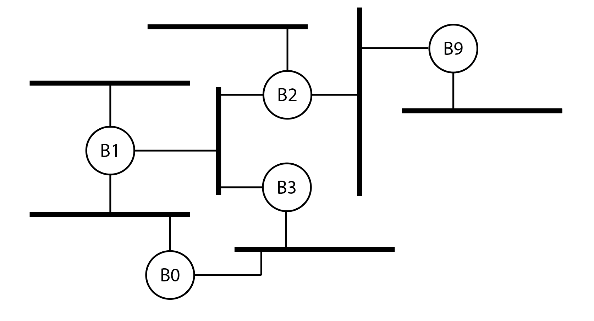
Exercise (easier)

Slide 24
Exercise (harder)

Slide 25
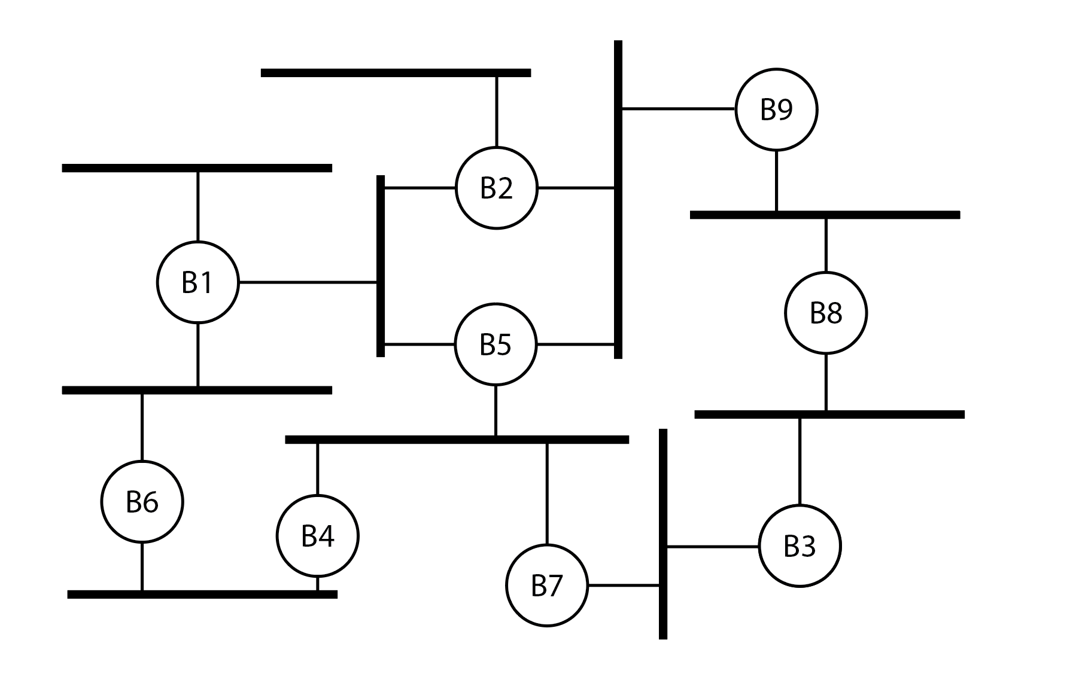
Exercise (again)

Slide 26
Bridges vs. Switches
Bridges make it possible to increase LAN capacity
Reduces the amount of broadcast packets
No loops
Switch is a special case of a bridge
Each port is connected to a single host
Either a client machine
Or another switch
Thus, there are no collision domains
No need for CSMA/CD! Simplifies hardware.
Can have different speeds on each port
2 hosts on 1 port
Bridge
Bridge
Not a legal network with switches
Switch
Switch
1 host per port

Slide 27
Switching the Internet
Capabilities of switches:
Network-wide routing based on MAC addresses
Learn routes to new hosts automatically
Resolve loops
Could the whole Internet be one switching domain?
NO

Slide 28
Limitations of MAC Routing
Inefficient
Flooding packets to locate unknown hosts
Poor Performance
Spanning tree does not balance load
Spanning tree != minimum spanning tree
Hot spots
Extremely Poor Scalability
Every switch needs every MAC address on the Internet in its routing table!
IP addresses these problems (next lecture…)

