Slide 1
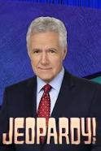
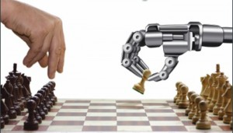
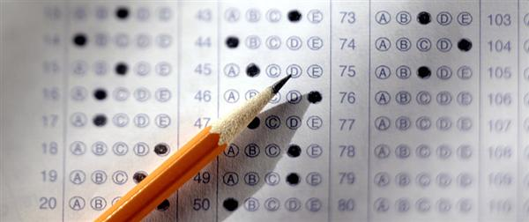
Vander Parser: Solving LSAT Logic Puzzles

Slide 2
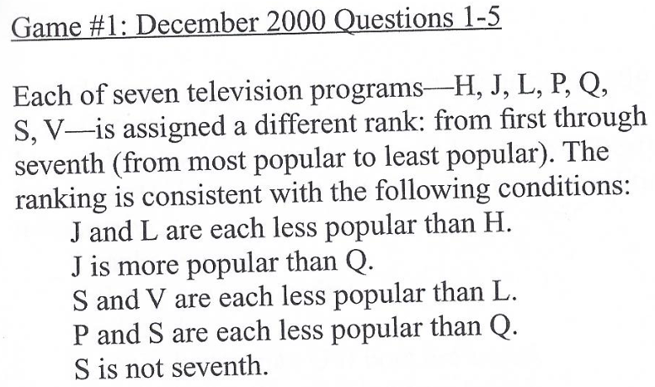
LSAT Logic Puzzle ©LSAC

Slide 3
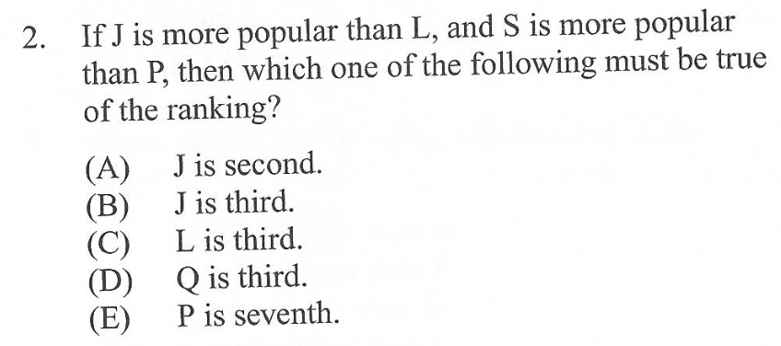
LSAT Logic Puzzle ©LSAC

Slide 4

7 Steps to LSAT Success
Classify the Puzzle
Set Up the Puzzle
Parse the Rules →
Apply the Rules
Parse the Question
Parse the Answers
Pick the Correct Answer

Slide 5
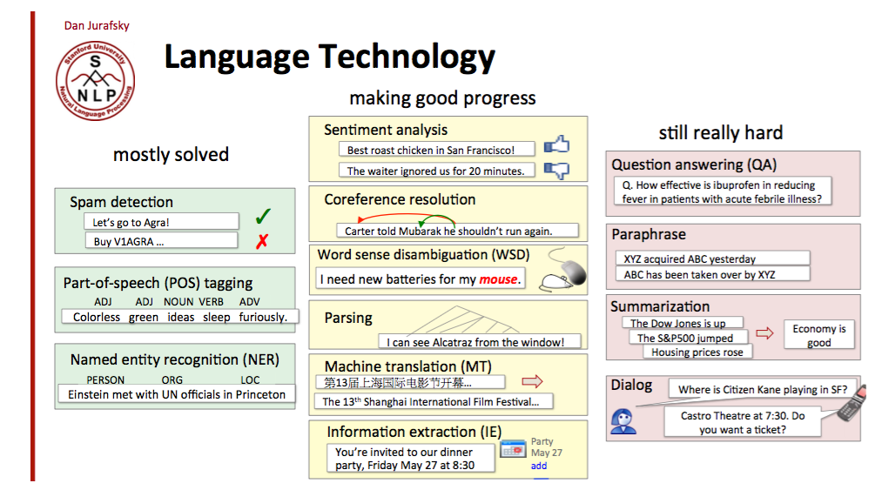
Unsolved Problems in NLP: Reading = Semantic Parsing

Slide 6
Stanford Parser & Google’s
Parsey McParseface
Vander Parser
Syntactic Parsers
POS Tagger
Context-Free Grammar
Semantic Parser
POS Tagger (SpaCy)
Context-Free Grammar

Slide 7
LSAT’s Context-Free Grammar
Rule → Boolean (True/False)
Rule → If Boolean: Boolean
Boolean → Set Comparative Set
Boolean→ Boolean Conjunction Boolean
Set → Variable
Set → Set Conjunction Set
Conjunction → and, or, xor
Comparative → >, <, =, -
Comparative → not (Comparative)

Slide 8
Parsing: from English to Python
If Q is more expensive than R,
then neither T nor V is more expensive than S.
SpaCy POS tagger
If Q is more than R, then neither T nor V more than S. S.
Context-Free Grammar
If (Q > R): ((not (T and V) > S))
IN NNP VBZ RBR JJ IN NN,
RB CC NNP CC NNP VBZ RBR JJ IN NNP.
Remove Stopwords

Slide 9
Fred Jelinek’s advice: forget linguistics “Every time I fire a linguist, performance goes up.”
Build on What’s Already Known about the Text’s Grammar & Parts of Speech
Deep Learning
Parser
POS Tagger (SpaCy)
Context-Free Grammar
Parser

Slide 10
Puzzle Classification Model (2 Classes)
Rules Alone Accuracy = 88.2%
DATA SET:
25 of Class 1
25 of Class 2
10-fold Cross-Validation
Random Forest
Text from Prompt
Text from Rules
POS Tags from Rules
p
p
p
Prompt Alone Accuracy
= 92.4%
POS Alone Accuracy
= 76.8%
Combined Accuracy = 94.6%

