Slide 1
Developer Productivity: What’s New in C# 6
Bill Wagner
Author / Consultant
Anthony D. Green
Managed Languages Program Manager

Slide 2
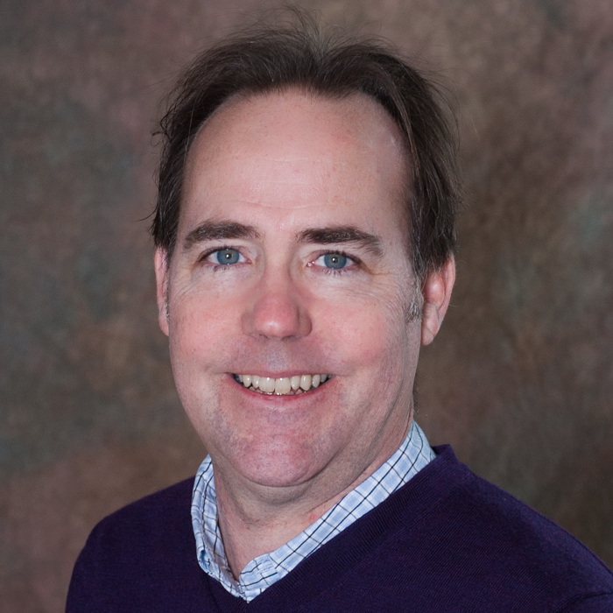
Meet Bill Wagner | @billwagner
Author
Effective C#
More Effective C#
Passion for informing and inspiring software developers to write better code be more productive
www.thebillwagner.com
www.github.com/BillWagner
Notes:
I left these slides in, just to say hello again.

Slide 3
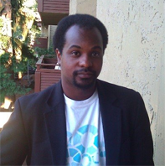
Meet Anthony D. Green |
Microsoft Program Manager
Managed Languages Team
Focus on Language APIs
Syntactic and semantic analysis tools
Diagnostics and Refactorings

Slide 4
M5: Adoption Strategies
Notes:
In this last module, we’ll discuss putting some of these features in practice. Null Conditionals, in particular, can be used with many different idioms. We’ll discuss some of the idioms that make null conditionals amazingly useful.
We’ll also explore how some of these features interrelate with each other or existing features, and we’ll discuss some improvements to the betterness definition for method overloading.

Slide 5
What’s new in C# 6 Agenda
Day 1 | HTML, CSS and JavaScript
Module 1: C# features add productivity and conciseness
Module 2: Data Transfer Object Enhancements
Module 3: Handling Strings More Easily
MEAL BREAK
Module 4: Exceptions and Error Handling Improvements
Module 5: Adopting C# 6
Notes:
Here’s the second module. It’s Data Transfer Enhancement.

Slide 6
Adoption Strategies
Please leave this area blank to allow for picture in picture recording
Key | Your existing code won’t break
Key | No reason to bulk replace
Key | Improve Readability with Adoption as you add features
Key | Diagnostics and CodeFixes can automate the process
Notes:
The keys for this session are to understand the new language features and how that will change error handling, and make it easier to write async code that is robust in the face of error conditions

Slide 7
Additional Resources
Please leave this area blank to allow for picture in picture recording
For Corp courses, this slide must list 1 MOC, 1 Book ,and 1 Exam Related to this topic as part of the Connected Content Strategy

Slide 8
Thoughtful Adoption
Please leave this area blank to allow for picture in picture recording
Any New Code Leverages the features that we’ve discussed
Look for Diagnostics and Code Fixes
Automate the process
Only update when modifying the class
Notes:
Again, new language features will not break existing programs.
Decision points come when you are maintaining code, and extending or modifying the code.

Slide 9
Please leave this area blank to allow for picture in picture recording
demo
tdb.github.com
Expression Bodied Members, Static Usings, and Elvis
Notes:
Script goes here.
Build it, and talk about it.

Slide 10
Feature Review
Please leave this area blank to allow for picture in picture recording
Expression Bodied Members
Static Usings
Null Conditionals
Readonly Properties and Initializers
Dictionary Initializers
Notes:
Again, new language features will not break existing programs.
Decision points come when you are maintaining code, and extending or modifying the code.

Slide 11
Feature Review
Please leave this area blank to allow for picture in picture recording
nameof
Dictionary Initializers
Exception Filters
Await in Catch and Finally
Notes:
Again, new language features will not break existing programs.
Decision points come when you are maintaining code, and extending or modifying the code.

