Slide 1
Into the Matrix
Using the Roslyn APIs to fix code…
By Writing More code

Slide 2













Boston Code Camp 24 - Thanks to our Sponsors!
In-Kind Donations
Gold
Silver
Bronze

Slide 3

Bill Wagner
C# MVP
Microsoft Regional Director
C# ECMA Standardization Committee
.NET Foundation Advisory Board
Author, Trainer, Consultant

Slide 4
Today’s Mission
Build an Analyzer and Code Fix
Guide Developers to a better practice

Slide 5
Guidance Review
Declare only Non-Virtual Events
More Effective C#
Item 24
Backing event field gets hidden
Leads to Subtle Bugs
Remove Virtual Keyword
Implement Virtual Method
That raises the non-virtual event

Slide 6
Tour of Roslyn APIs
File: New Project
Guidelines on APIs and Models

Slide 7
Step 1: File New Project
Install Extensibility Tools
File: New Project
Tour the Code
Test Project
Run and Build

Slide 8
Find Virtual Events
Build First Tests
Implement Diagnostic

Slide 9
Step 2: Update Test Code
Create Tests for our expected results
Find Event Field declarations
Find Event Property Declarations
Assert Diagnostics are raised

Slide 10
Step 3: Find Diagnostics
Use Syntax Visualizer
Determine What to Find
Analyze Code

Slide 11
Step 3: Report Diagnostic
Update Resources
Update IDs
Report Diagnostic

Slide 12
Diagnostic Keys
Diagnostics are called as User Types Code
Diagnostics must be performant
Minimize syntax nodes checked
Exit Quickly
Remember Immutable Trees
Diagnostics called when new Tree Nodes are Created

Slide 13
Remove Virtual Keyword
Modify Code
Fix the bad practice

Slide 14
Step 4: Remove Virtual Keyword
Two different paths here
Find the Field Based Event Declaration
Find the modifiers
Remove Virtual Node
Find the Property Based Event Declaration
Find the modifiers
Remove the Virtual Node

Slide 15
CodeFix Keys, part 1
Code Fixes are called for preview.
Must not modify main source document
Code Fixes are called when the user Accepts Changes
Must create a new document
Asynchronous generation of new document
Or Project
Or Solution

Slide 16
Implement Virtual Method
New Tests
New Functionality

Slide 17
Step 5: Create New Tests
Diagnostic is the same
Code Fix has two options
Field event method is easy
Property event method has extra complications

Slide 18
Step 6: Roslyn Quoter
http://roslynquoter.azurewebsites.net/
Type C# code
See Roslyn APIs to Generate
Caveats:
Not all Convenience Methods are here
Not all APIs are shown

Slide 19
Step 7: Implement for Fields
Remove the Virtual Keyword
Create a node for the method
Make sure to raise the correct event name
Set the function name to match the event being raised
Note that you must find the declaration after first edit
Bonus points: Use C# 7 ?.Invoke() syntax

Slide 20
CodeFix Keys, part 2
Writing Code with Code is hard
Consider Syntax.Parse*()
ParseToken()
ParseStatement()
.With*() extension methods
Trivia is really annoying

Slide 21
Step 8: Implement for Properties
Must Find the private event field for this property
Must Raise the correct event
Implement the correct Raise method
Reuse much of the code for creating the method

Slide 22
CodeFix Keys, part 3
Find Symbols to create correct code.
Must find the right event field for this property
Look at accessors, find the assignment

Slide 23
Summing Up
What have we built?
What’s the big picture

Slide 24
Diagnostic and Code Fix
As-you-type Guidance for Developers
Errors, Warnings, Messages
By Developer or By Project
Delivered as VSIX (developer) or NuGet package (project)
Test, Test, Test
What we built today misses many permutations
Not using EventHandler<T>
Not using (sender, args) convention

Slide 25
Call to Action
More Effective C#, Second Edition
Diagnostics?

Slide 26
Would you use or recommend?
More Effective C# Analyzer?
For fee?
Associated with book purchase?
Reach out and tell me your thoughts: bill@thebillwagner.com

Slide 27
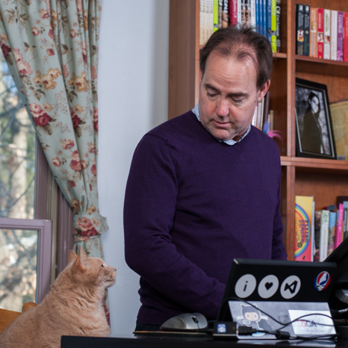
Bill Wagner
bill@thebillwagner.com
@billwagner
http://thebillwagner.com
http://github.com/BillWagner/NonVirtualEventAnalyzer/
Architecture
Software Engineering Practices
Developer Mentor and Teacher

