Slide 1

DEMO
Puzzles!!

Slide 2


Slide 3
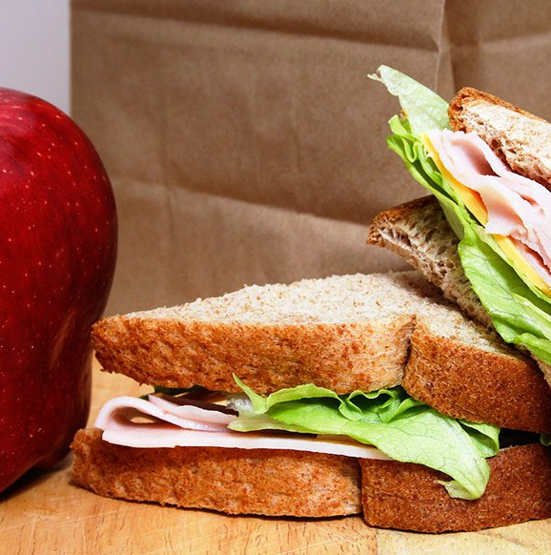
Lunch

