Slide 1
Memory Management
Intro to Garbage Collection
When to use heap and stack

Slide 2
What Does the Type System Provide?
Storage
Type of storage (direct/via pointers aka value/reference)
Memory safety - things can’t change/overwrite other things in unplanned ways
Features
Miscellaneous like maximum and minimum values
Members (methods, fields, events, operations and so on)
Base types
Rules for type casting and conversions
Manages memory so you don’t have to
Allocates space
Reclaims space

Slide 3
Two fundamental kinds – direct access and indirect access via pointers

Slide 4
Memory Management
Stack
Heap
Value types
Pointers to instances
Instances of reference types

Slide 5
Two fundamental kinds – direct access and indirect access via pointers
Depending on platform design, it is either expensive to create or it is expensive to destroy objects on the heap

Slide 6
A few kinds of memory management
Ref counted (VB6)
None (C++)
Traced GC (C#/VB.NET)
.NET

Slide 7
Tracing Garbage Collection
$$☺$$
$$☺$$
$$☺$$
$$☺$$
$$☺$$
$$☺$$
$$☺$$
Roots
Stack
Static data

Slide 8
Tracing Garbage Collection
$$☺$$
$$☺$$
$$☺$$
$$☺$$
$$☺$$
$$☹$$
$$☺$$
$$☺$$

Slide 9
Two fundamental kinds – direct access and indirect access via pointers
Depending on platform design, it is either expensive to create or it is expensive to destroy objects accessed via pointers
In .NET, cheap to create, not so cheap to destroy
So, they hang around until reclaiming memory is required or convenient

Slide 11
Heap
How do objects wind up on the heap?
new()
Boxing
ref type
value type
Notes:
Prior to .NET 4.5, LOH had compaction issues
Objects wind up on the heap via “new” and boxing

Slide 12
Heap
Large
Small

Slide 13
Heaps
Large
Small

Slide 14
Heaps
Small
Large
Threshold: 85K
Large GC is different
NOTE:
Prior to .NET 4.5, the large object heap had compaction issues
Large
Large
small
Large
small
small
Notes:
.NET Core Large is 85K

Slide 15

Large Object Heap

Slide 16
Large Object Heap

Slide 17
Large Object Heap

Slide 18
Large Object Heap

Slide 19
Small Object Heap

Slide 20
Small object heap
Notes:
Prior to .NET 4.5, LOH had compaction issues
Objects wind up on the heap via “new” and boxing

Slide 21
Pointers Removed as App Runs
Notes:
Prior to .NET 4.5, LOH had compaction issues
Objects wind up on the heap via “new” and boxing

Slide 22
Pointers Removed as App Runs
Notes:
Prior to .NET 4.5, LOH had compaction issues
Objects wind up on the heap via “new” and boxing

Slide 23
Garbage Collection Starts

Slide 24
Small
Gen 0
Gen 1
Gen 2
Notes:
Which might possibly affect performance?
Which happen in background? (it depends)

Slide 25
Small
Gen 0
Gen 1
Gen 2
Notes:
Which might possibly affect performance?
Which happen in background? (it depends)

Slide 26
Small
Gen 0
Gen 1
Gen 2
Notes:
Which might possibly affect performance?
Which happen in background? (it depends)

Slide 27
Gen 0 GC
Small
Gen 0
Gen 1
Gen 2
Notes:
Which might possibly affect performance?
Which happen in background? (it depends)

Slide 28
Gen 0 GC
Small
Gen 0
Gen 0
Gen 1
Gen 2
Notes:
Which might possibly affect performance?
Which happen in background? (it depends)

Slide 29
Small
Gen 0
Gen 1
Gen 2
Notes:
Which might possibly affect performance?
Which happen in background? (it depends)

Slide 30
Small
Gen 0
Gen 1
Gen 2
Notes:
Which might possibly affect performance?
Which happen in background? (it depends)

Slide 31
Gen 1 GC
Small
Gen 0
Gen 1
Gen 2
Notes:
Which might possibly affect performance?
Which happen in background? (it depends)

Slide 32
Gen 1 GC
Small
Gen 0
Gen 1
Gen 1
Gen 2
Notes:
Which might possibly affect performance?
Which happen in background? (it depends)

Slide 33
Gen 2 GC
Small
Gen 0
Gen 1
Gen 2
Notes:
Which might possibly affect performance?
Which happen in background? (it depends)

Slide 34
Small
Recent
Not recent
Gen 0
Gen 1
Gen 2
Notes:
Which might possibly affect performance?
Which happen in background? (it depends)

Slide 36
Gen 0 & Gen 1 Collection

Slide 37
Gen 0 & Gen 1 Collection

Slide 38
Gen 0 & Gen 1 Collection

Slide 39
Gen 2 Collection

Slide 40
Gen 2 Collection

Slide 41
Gen 2 Collection

Slide 42
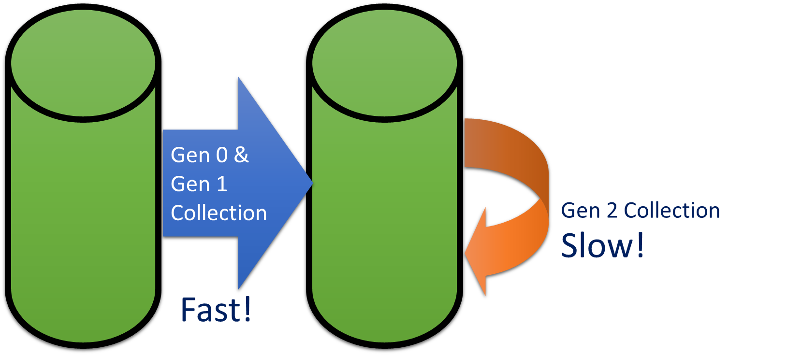
What’s the point?

Slide 43
Gen 0 & Gen 1 Collection
Gen 2 Collection
Slow!
Fast!

Slide 44
Why Three Generations
Gen 0
Objects must have
lived at least
The time length
of Gen 1
Gen 0
Gen 1
Gen 2
Gen 2

Slide 45
Allocations
$$☺$$
$$☺$$
$$☺$$
$$☺$$
$$☺$$
$$☺$$
$$☺$$
Roots
Stack
Static data

Slide 46
Design so objects are discarded quickly or live forever

Slide 47
GC Settings may be out of date, follow @maoni0 Defaults for app type generally right
Workstation or Server (config)
Server: maximize throughput
Small and large object heap, and GC thread for each working thread
Workstation: minimize latency
Concurrent or non-concurrent (config)
Concurrent/background default is good
gcTrimCommitOnLowMemory (config)
Only for web hosting of several small web sites
LowLatency and SustainedLowLatency (GCSettings)
Almost never use

Slide 48


Ways You Effect GC
Allocations
Well, this is sort of the point of memory ☺
You don’t have a GC problem, you might have an allocation problem
Design objects to live forever (if they are needed) or be discarded quickly
Avoid boxing
GC settings
Explicitly calling Collect

